Slide 1
ME 251
Anupam Saxena
Professor
Mechanical Engineering
Compliant and Robotic Systems Lab
Indian Institute of Technology Kanpur

Slide 2
ME 251 ENGINEERING DESIGN AND GRAPHICS
Prerequisite: N/A
Credits: 5
Schedule Lecture: WED (L19) 12:00-13:00
Tutorial: N/A
Practical: FRI 14:00-16:00
Tutors: P. Venkatinarayan and Ashish Dutta
Instructor: Anupam Saxena

Slide 3
ME 251 ENGINEERING DESIGN AND GRAPHICS
Grading Policy:
Lab work: 50%
Mid sem: 20%
End sem: 30%
Extra credit/Projects: +___%
(as announced)
Teaching Assistants:
Vitthal Kartik Manohar, Ishu Agrawal, ---, ---
Lectures, Lab assignments and solutions:
home.iitk.ac.in/~anupams (Lecture notes and Lab manual)
PLEASE PRINT THE LAB MANUAL AND BRING IT TO CLASS
ALTERNATIVELY, WE WOULD MAKE IT AVAILABLE AT COPY POINT

Slide 4
ME 251 ENGINEERING DESIGN AND GRAPHICS
OVERVIEW
LECTURES 1ST AUGUST 8TH AUGUST 22ND AUGUST 29TH AUGUST 5TH SEPTEMBER 12TH SEPTEMBER 19TH SEPTEMBER 26TH SEPTEMBER 3RD OCTOBER 10TH OCTOBER 17TH OCTOBER 24TH OCTOBER 31ST OCTOBER 7TH NOVEMBER 14TH NOVEMBER 19TH NOVEMBER | TOPIC INTRODUCTION BELT ROLLER ASSEMBLY NON RETURN VALVE FEED CHECK VALVE FASTENERS AND SCREW JACK ASSEMBLY COUPLINGS MID SEM EXAM FUEL INJECTOR ASSEMBLY GEARS BEARINGS MIDSEM RECESS FITS AND TOLERANCES FITS AND TOLERANCES DESIGN PRINCIPLES DESIGN PRINCIPLES END SEM EXAM | LABS 3RD AUGUST 10TH AUGUST 24TH AUGUST 31TH AUGUST 7TH SEPTEMBER 14TH SEPTEMBER 21TH SEPTEMBER 28TH SEPTEMBER 5TH OCTOBER 12TH OCTOBER 19TH OCTOBER 26TH OCTOBER 2ND NOVEMBER 9TH NOVEMBER PROJECT ! | ---
We shall choose examples, solve them and learn in the process ---

Slide 5
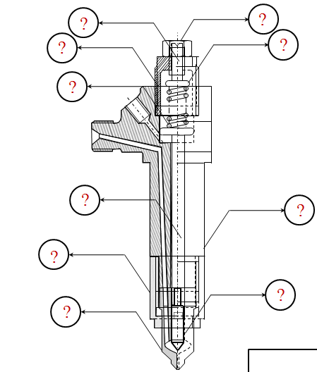
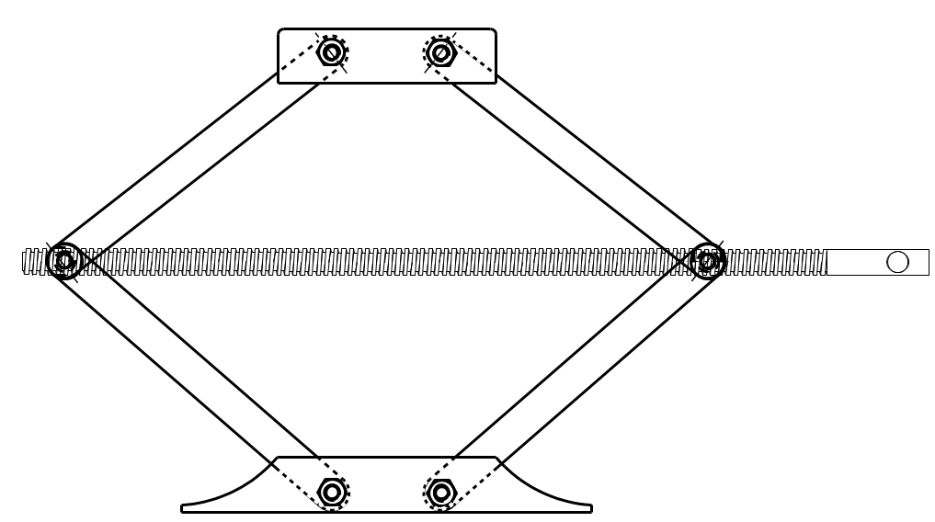
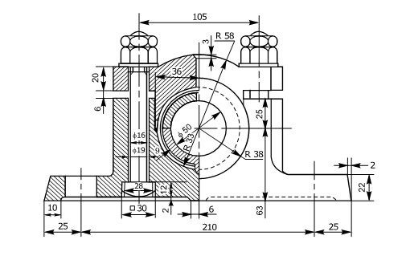
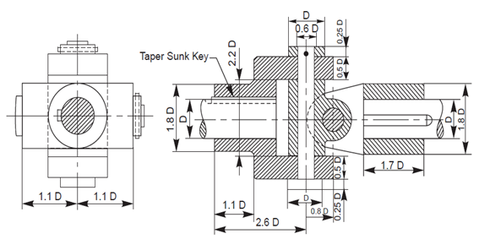
ME 251 ENGINEERING DESIGN AND GRAPHICS
OVERVIEW
We shall choose examples, solve them and learn in the process ---

Slide 6
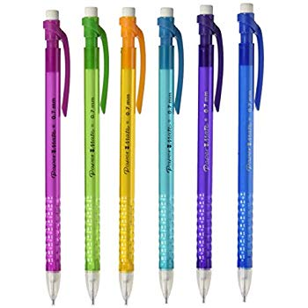
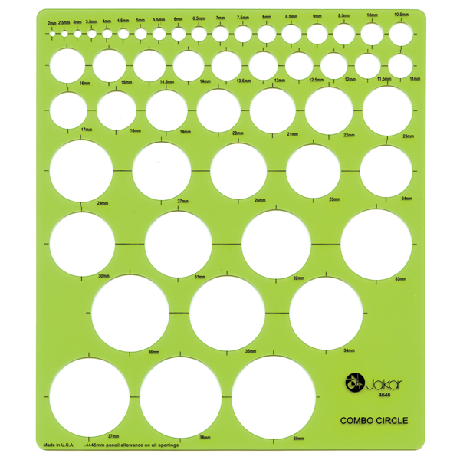
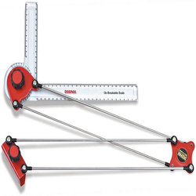
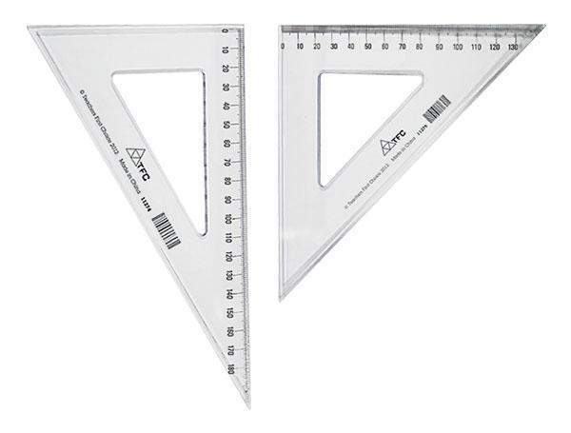
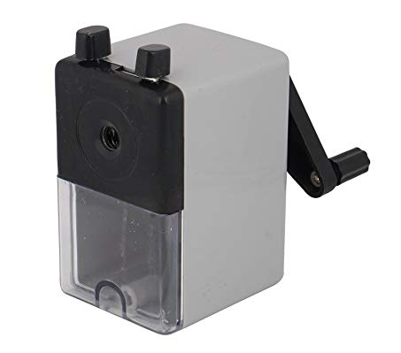
ME 251 ENGINEERING DESIGN AND GRAPHICS
WHAT WOULD YOU NEED?
H and 2H leads

Slide 7
ME 251 ENGINEERING DESIGN AND GRAPHICS
MILD WARNING ---
LABORATORY EXERCISES WILL BE VERY LENGTHY ---
PLEASE COME WELL PREPARED IF YOU INTEND TO FINISH THEM ON TIME!
H and 2H leads

Slide 8
ME 251 ENGINEERING DESIGN AND GRAPHICS
Why do we do what we do ?
Mechanical Engineering is ALL about
TRANSMISSION
SMOOTH
H and 2H leads

Slide 9
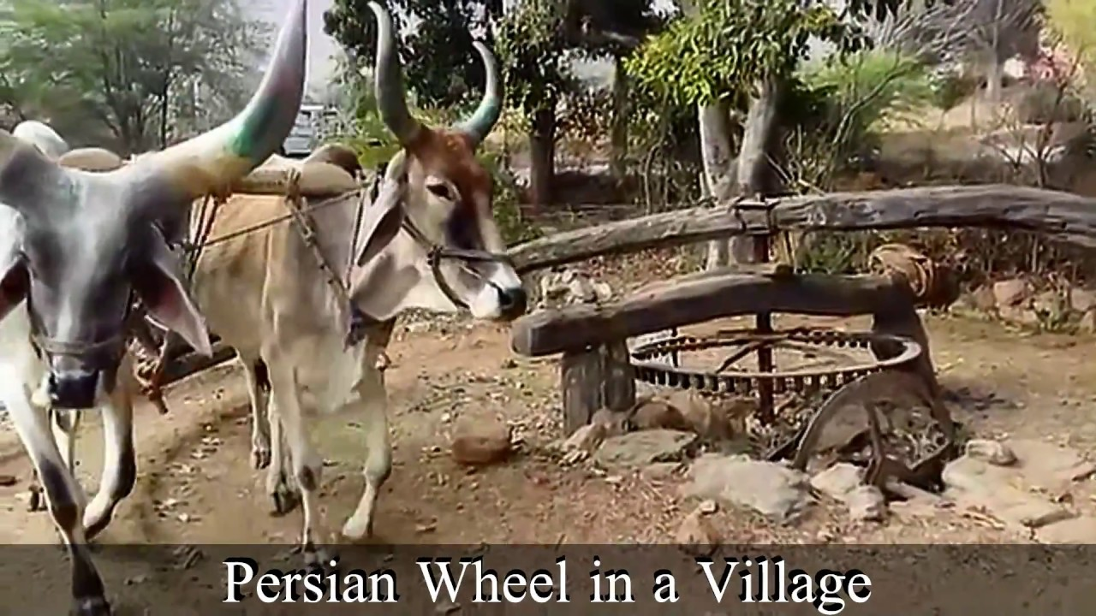
ME 251 ENGINEERING DESIGN AND GRAPHICS
Why do we do what we do ?
https://www.youtube.com/watch?v=Wlb_zdBjI5I

Slide 10
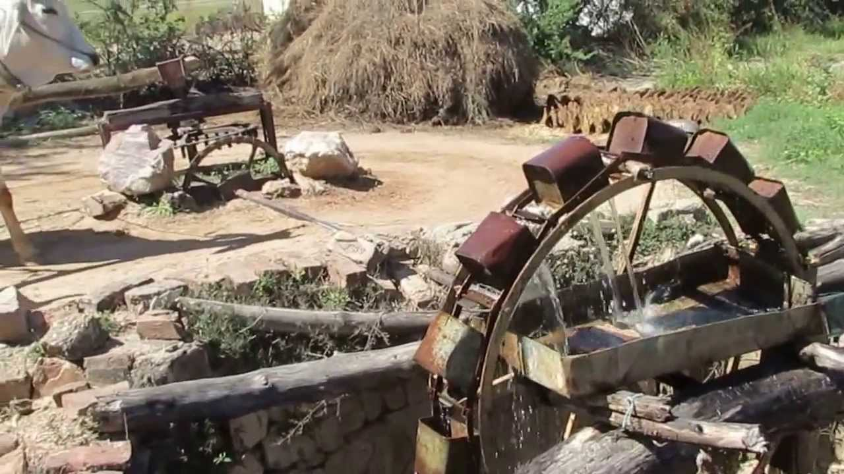
ME 251 ENGINEERING DESIGN AND GRAPHICS
Why do we do what we do ?
https://www.youtube.com/watch?v=Wlb_zdBjI5I

Slide 11
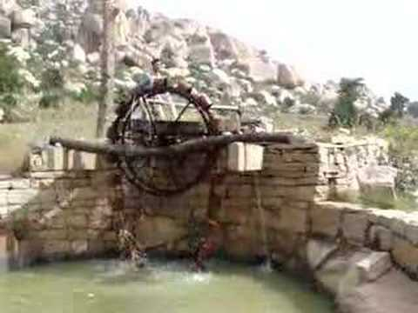
ME 251 ENGINEERING DESIGN AND GRAPHICS
Why do we do what we do ?
https://www.youtube.com/watch?v=Wlb_zdBjI5I

Slide 12
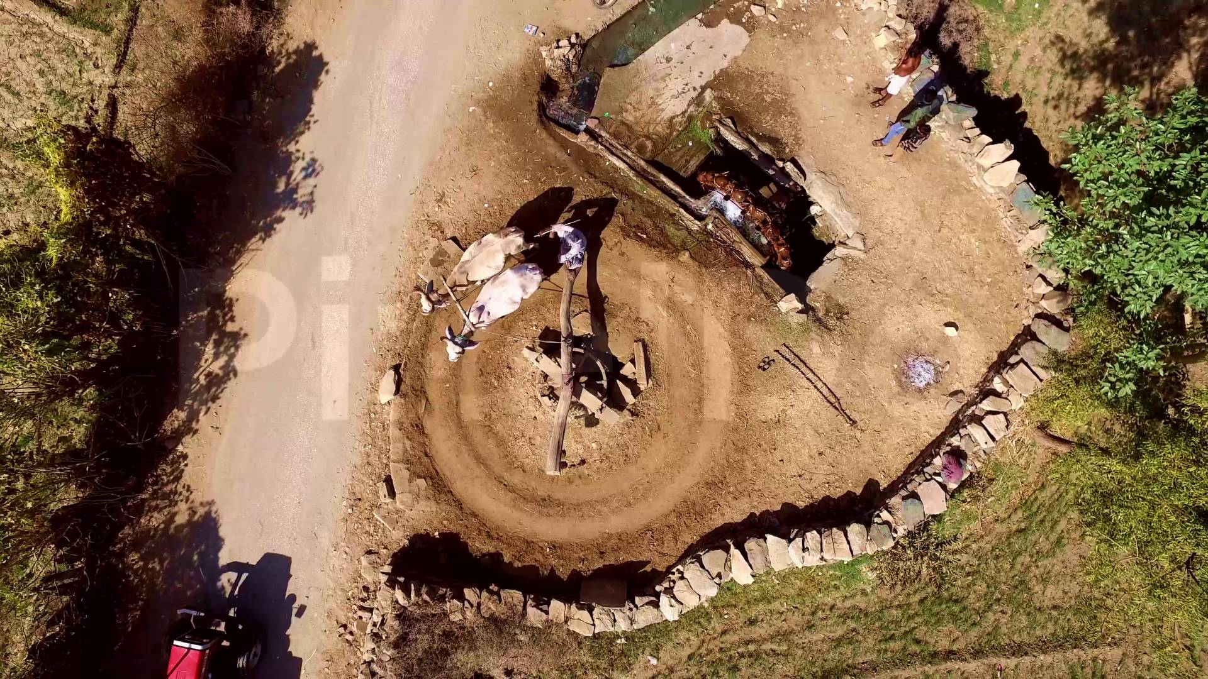
ME 251 ENGINEERING DESIGN AND GRAPHICS
Why do we do what we do ?
https://www.youtube.com/watch?v=Wlb_zdBjI5I

Slide 13
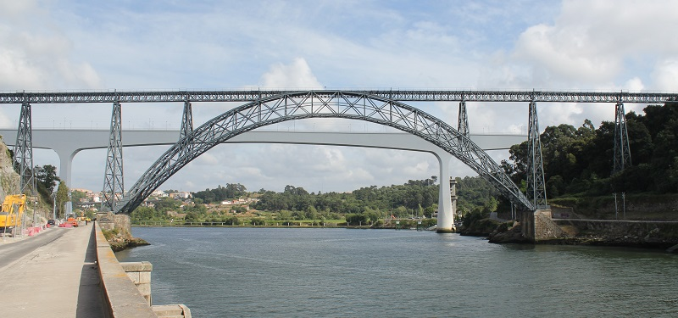
ME 251 ENGINEERING DESIGN AND GRAPHICS
Why do we do what we do ?
https://www.gracesguide.co.uk/Maria_Pia_Bridge

Slide 14
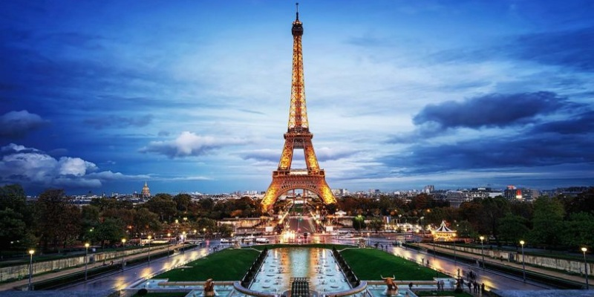
ME 251 ENGINEERING DESIGN AND GRAPHICS
Why do we do what we do ?
https://www.discoverwalks.com/blog/things-to-do-around-the-eiffel-tower/

Slide 15
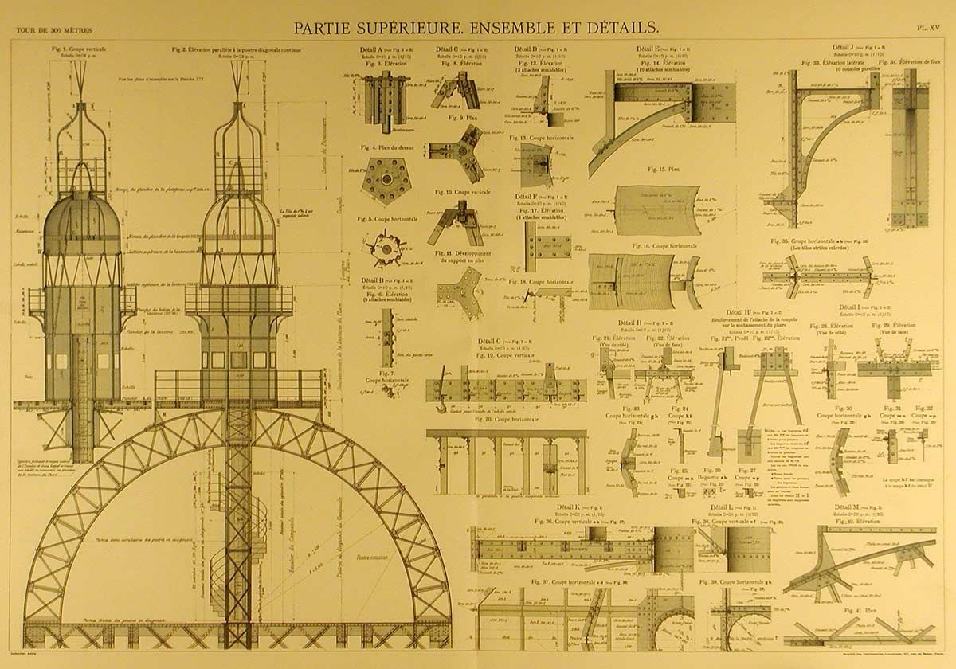
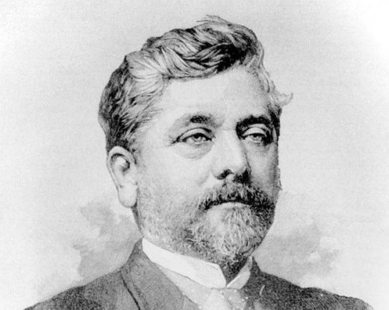
ME 251 ENGINEERING DESIGN AND GRAPHICS
Why do we do what we do ?
https://www.pinterest.ca/pin/204350901819707300/

Slide 16
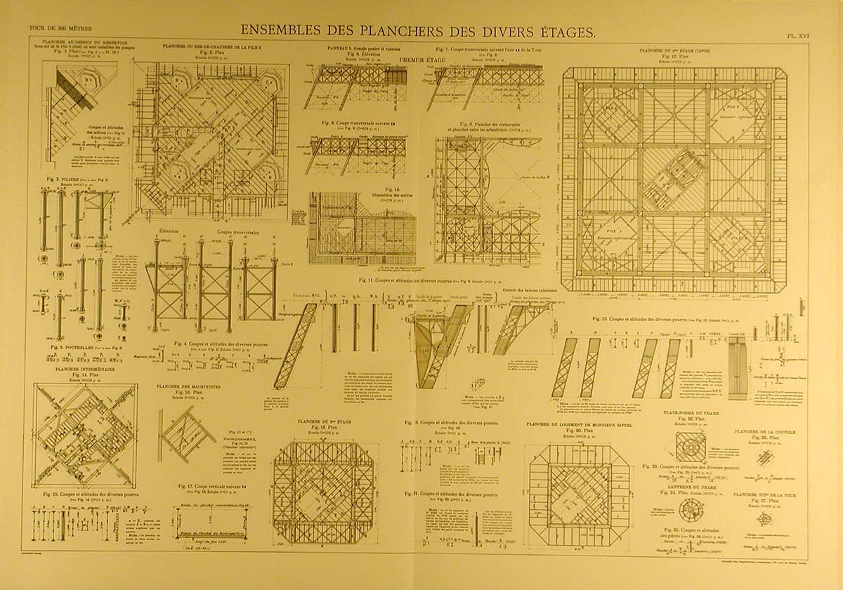
ME 251 ENGINEERING DESIGN AND GRAPHICS
Why do we do what we do ?
https://www.pinterest.ca/pin/204350901819707300/

Slide 17
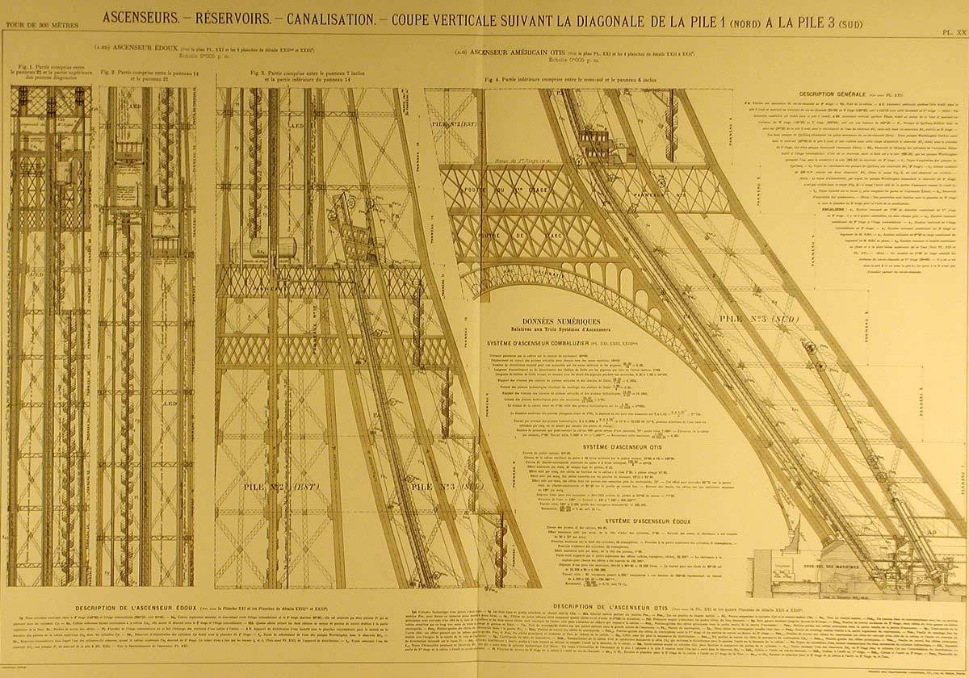
ME 251 ENGINEERING DESIGN AND GRAPHICS
Why do we do what we do ?
https://www.pinterest.ca/pin/204350901819707300/

Slide 18
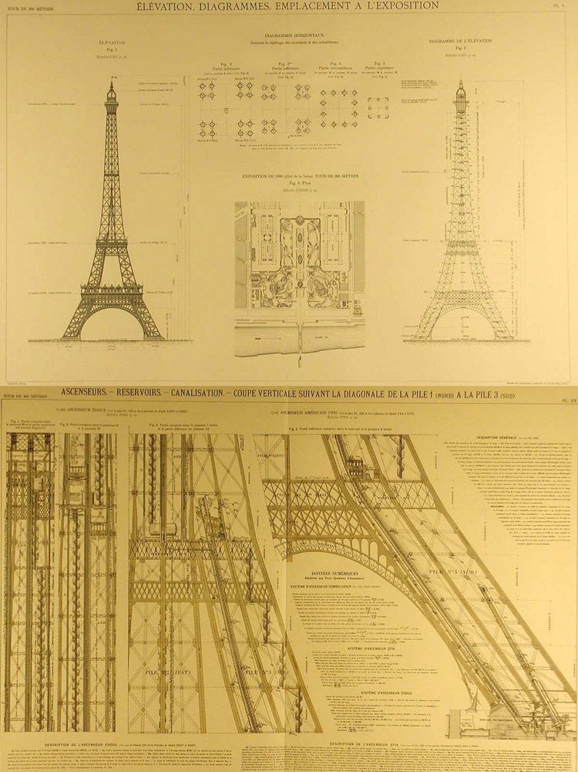
ME 251 ENGINEERING DESIGN AND GRAPHICS
Why do we do what we do ?
https://www.pinterest.ca/pin/204350901819707300/

Slide 19
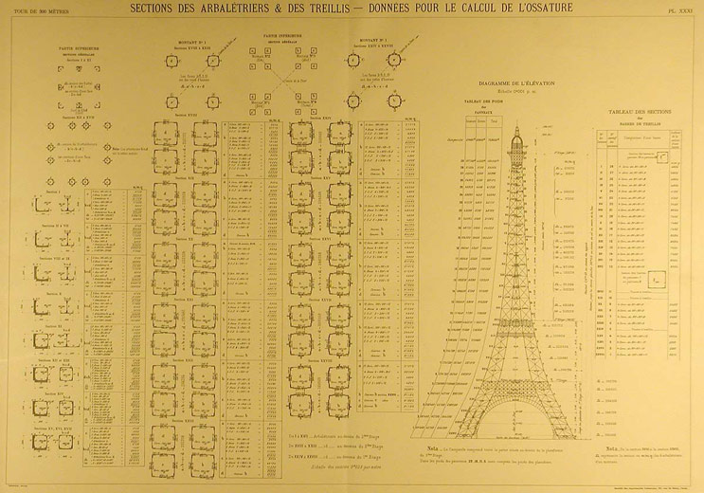
ME 251 ENGINEERING DESIGN AND GRAPHICS
Why do we do what we do ?
https://www.pinterest.ca/pin/204350901819707300/

Slide 20
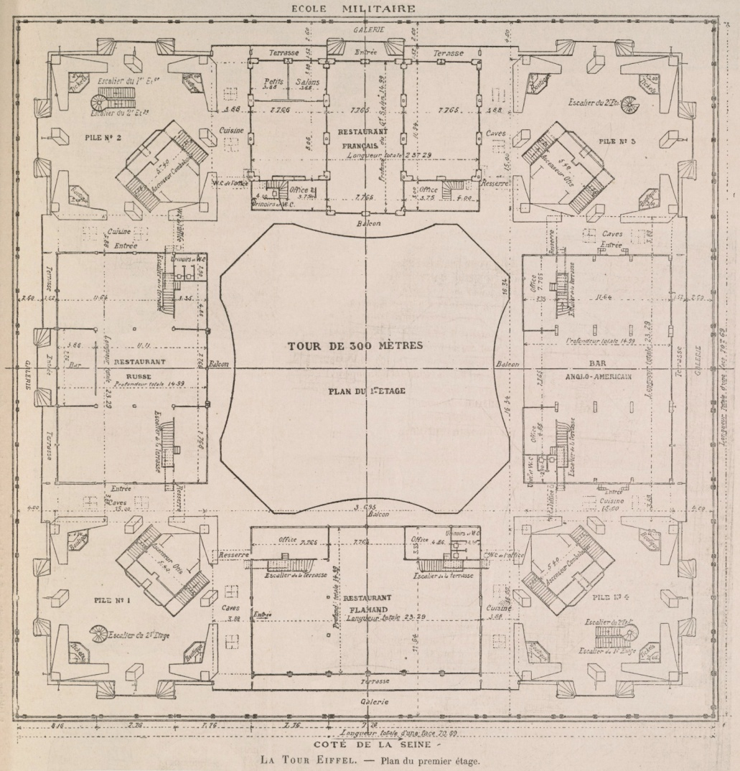
ME 251 ENGINEERING DESIGN AND GRAPHICS
Why do we do what we do ?
https://www.pinterest.ca/pin/204350901819707300/

Slide 21
ME 251 ENGINEERING DESIGN AND GRAPHICS
Why do we do what we do ?
https://www.tajmahal.gov.in/

Slide 22
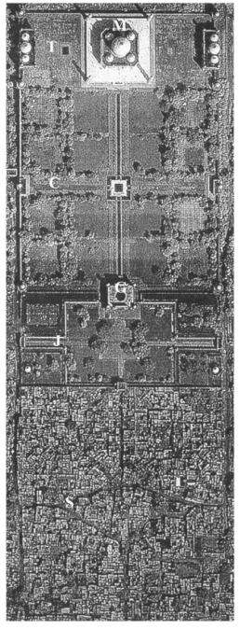
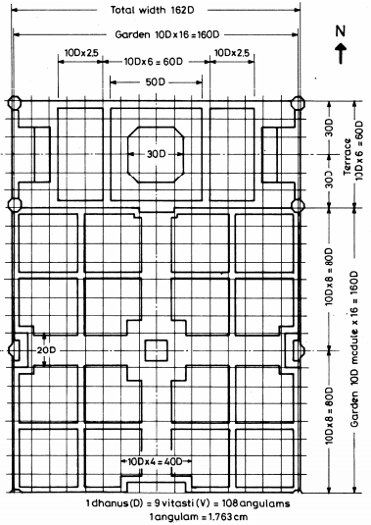
ME 251 ENGINEERING DESIGN AND GRAPHICS
Why do we do what we do ?
New insights on the modular planning of the Taj Mahal
R. Balasubramaniam, CURRENT SCIENCE, VOL. 97, NO. 1, 10 JULY 2009

Slide 23
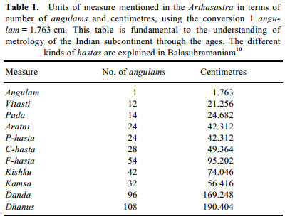
ME 251 ENGINEERING DESIGN AND GRAPHICS
Why do we do what we do ?
New insights on the modular planning of the Taj Mahal
R. Balasubramaniam, CURRENT SCIENCE, VOL. 97, NO. 1, 10 JULY 2009

Slide 24
ME 251 ENGINEERING DESIGN AND GRAPHICS
Why do we do what we do ?
New insights on the modular planning of the Taj Mahal
R. Balasubramaniam, CURRENT SCIENCE, VOL. 97, NO. 1, 10 JULY 2009

Slide 25
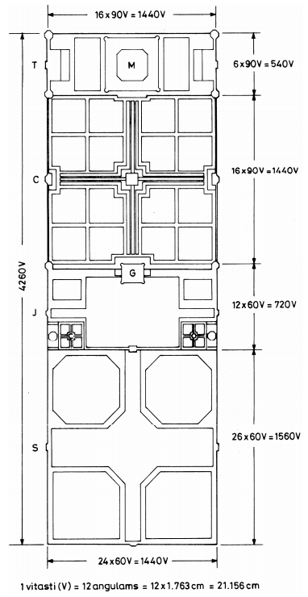
ME 251 ENGINEERING DESIGN AND GRAPHICS
Why do we do what we do ?
New insights on the modular planning of the Taj Mahal
R. Balasubramaniam, CURRENT SCIENCE, VOL. 97, NO. 1, 10 JULY 2009

Slide 26
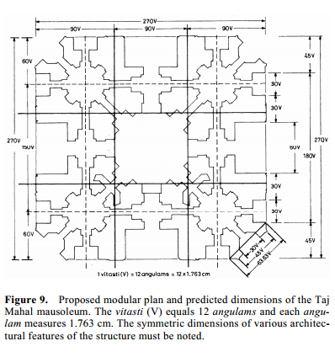
ME 251 ENGINEERING DESIGN AND GRAPHICS
Why do we do what we do ?
New insights on the modular planning of the Taj Mahal
R. Balasubramaniam, CURRENT SCIENCE, VOL. 97, NO. 1, 10 JULY 2009

Slide 27
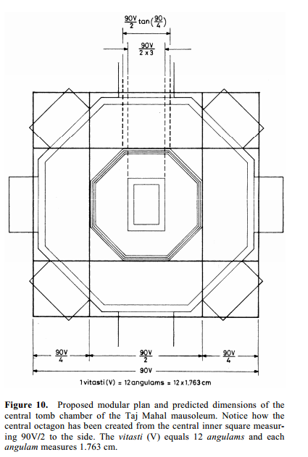
ME 251 ENGINEERING DESIGN AND GRAPHICS
Why do we do what we do ?
New insights on the modular planning of the Taj Mahal
R. Balasubramaniam, CURRENT SCIENCE, VOL. 97, NO. 1, 10 JULY 2009

Slide 28
ME 251 ENGINEERING DESIGN AND GRAPHICS
Why do we do what we do ?
Summary:
The modular planning of the Taj Mahal complex at Agra has been understood in a novel approach in terms of the traditional units of measure mentioned in the Arthasastra using a constant angulam of 1.763 cm and, in particular, the vitasti measuring 12 angulams. The riverfront terrace and garden sections of the complex were planned using square grids of 90 vitasti to the side, while the forecourt and caravanserai section using square grids of 60 vitasti to the side. The logical numbers that result for the
dimensions have been analysed to show the ease of
division of these numbers into symmetric elements,
including decimal divisions. A novel method by which
the architectural structures of the subcontinent can be
understood is confirmed by the low percentage of errors
between the predicted and actual measurements of the
Taj Mahal complex.
Traditional design principles and civil engineering skills of the Indian subcontinent were utilized in the construction of the Taj Mahal.
New insights on the modular planning of the Taj Mahal
R. Balasubramaniam, CURRENT SCIENCE, VOL. 97, NO. 1, 10 JULY 2009

Slide 29
ME 251 ENGINEERING DESIGN AND GRAPHICS
Why do we do what we do ?
Chariot in Bahubali

Slide 30
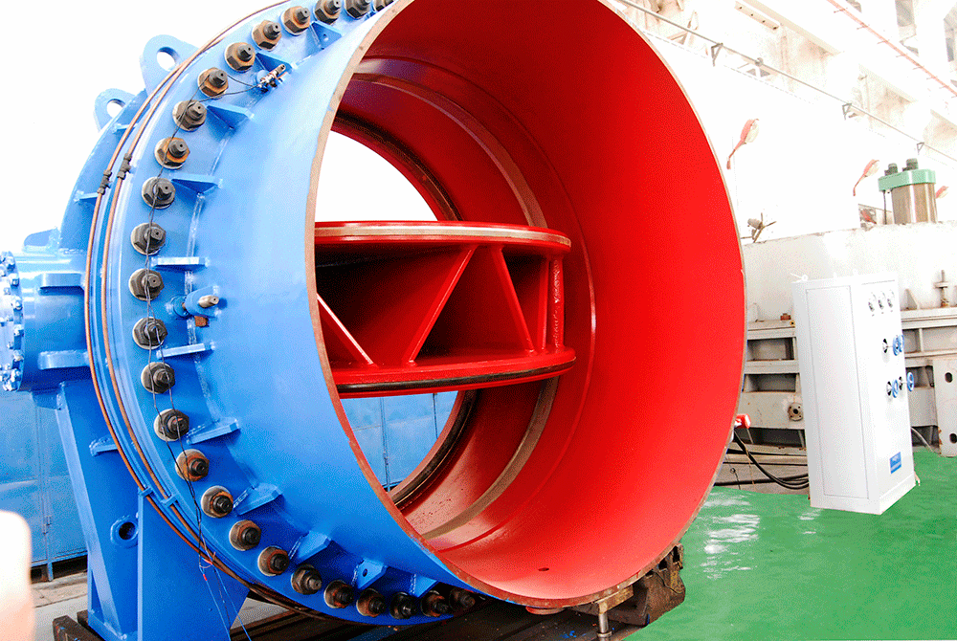
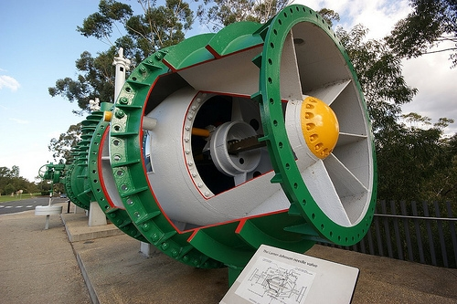
ME 251 ENGINEERING DESIGN AND GRAPHICS
Why do we do what we do ?
Butterfly Valve, MAT HYDRO INT.
Butterfly valves are typically used in high flow
rate dams and power plant projects
The Larner-Johnson needle valve, Warragamba Dam

Slide 31
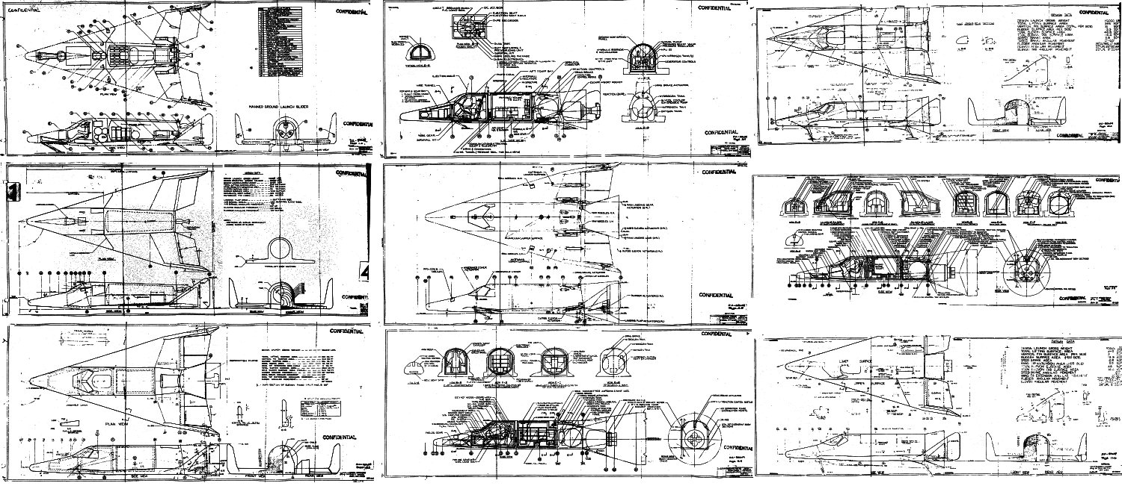
ME 251 ENGINEERING DESIGN AND GRAPHICS
Why do we do what we do ?
http://www.drawingskill.com/wp-content/uploads/1/Airplane-Engineering-Best-Art.jpg

Slide 32
ME 251 ENGINEERING DESIGN AND GRAPHICS
Types of Drawings:
Machine drawing: Provides details of a machine part or component
Orthographic/section views (top, front, profile etc.
Production or working drawing: Machine drawings + additional details (tolerances, surface finish, processes etc.
Assembly drawing: Various parts of a machine at (relatively) correct working locations ---
If the machine is too complex having large number of parts, then
sub-assembly drawings are made for each sub-assembly
Bill of Material (List of parts) provided
Exploded Drawings: Pictorial views of each component arranged in the same sequence they are to be assembled.
Patent drawings: Self-explanatory pictorial drawings explaining an invention
Part drawing: Detailed drawing of each part of a system
Installation drawing: Location and dimensions of few important parts and overall dimensions of assembled system are given

Slide 33
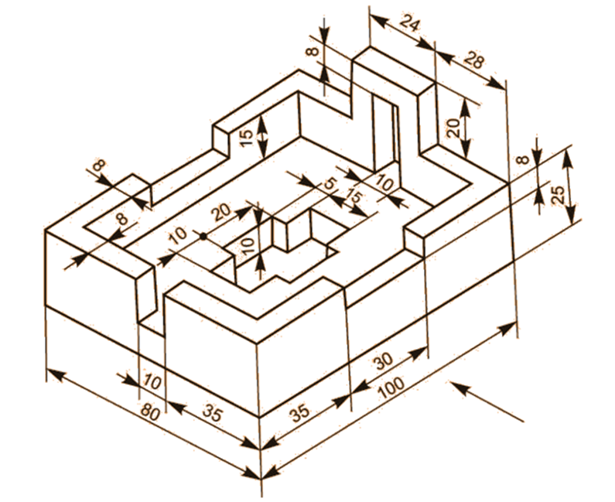
ME 251 ENGINEERING DESIGN AND GRAPHICS
Lab I (Warm up):
Draw the full-section front view and half-section side view of the object

