Slide 1
ME 251
Anupam Saxena
Professor
Mechanical Engineering
Compliant and Robotic Systems Lab
Indian Institute of Technology Kanpur

Slide 2

TOLERANCES
FITS AND CLEARANCES

Slide 3
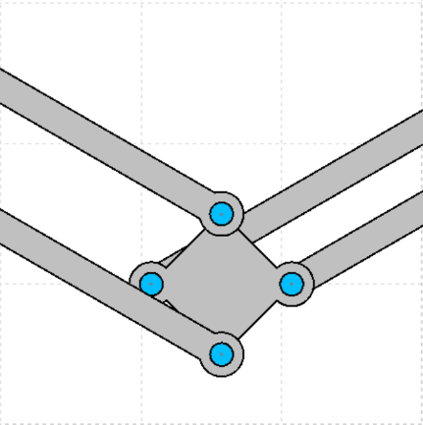
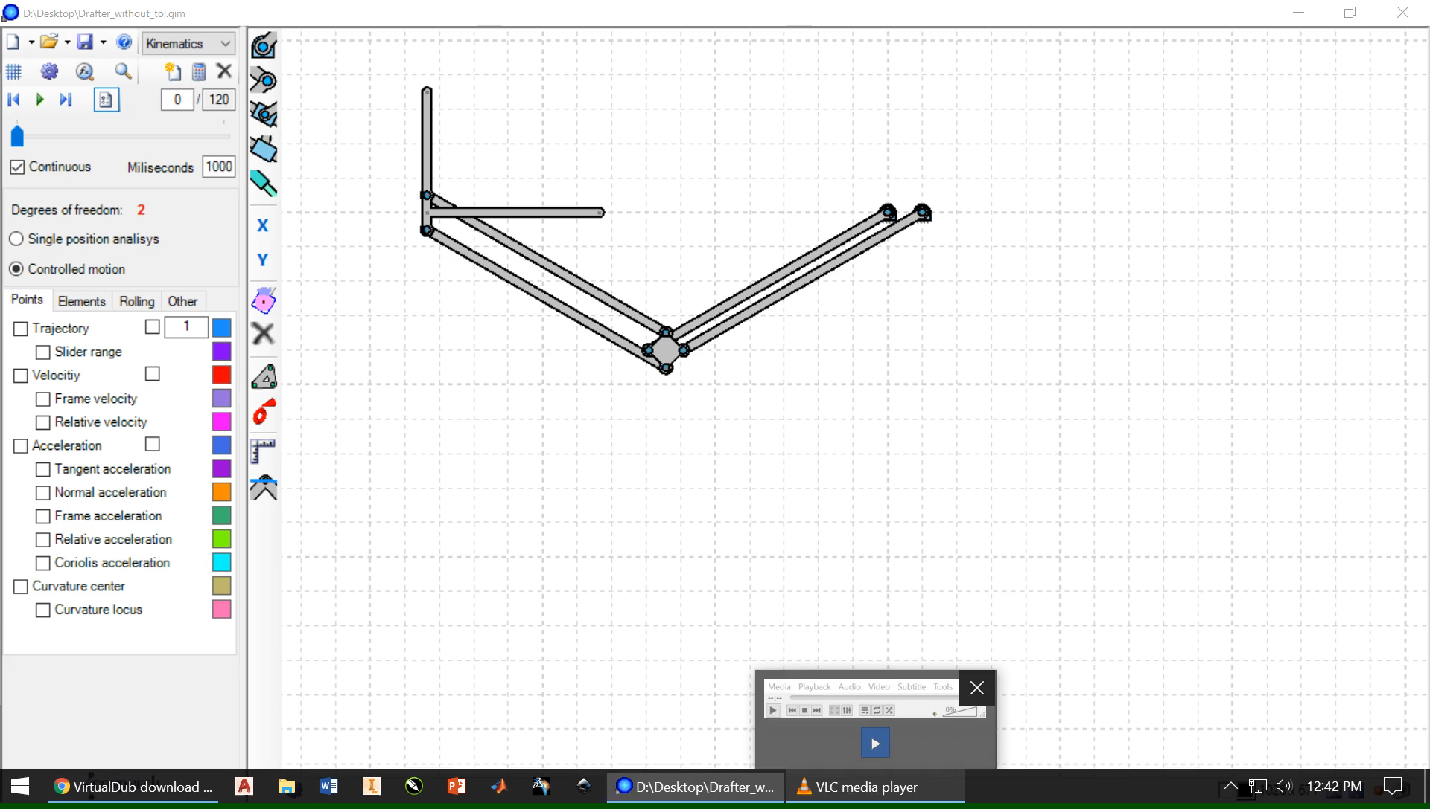

Slide 4
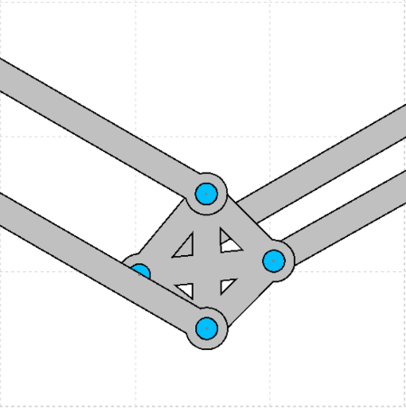
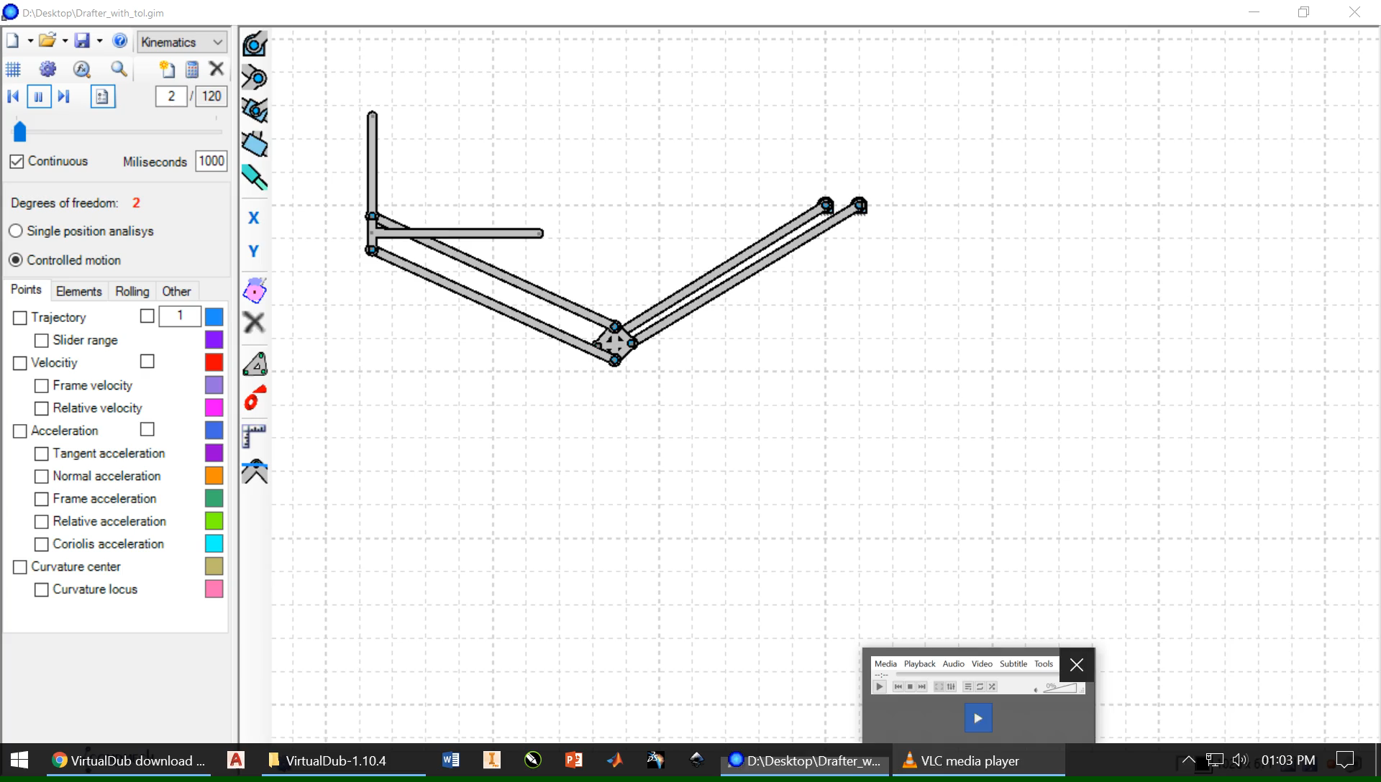

Slide 5
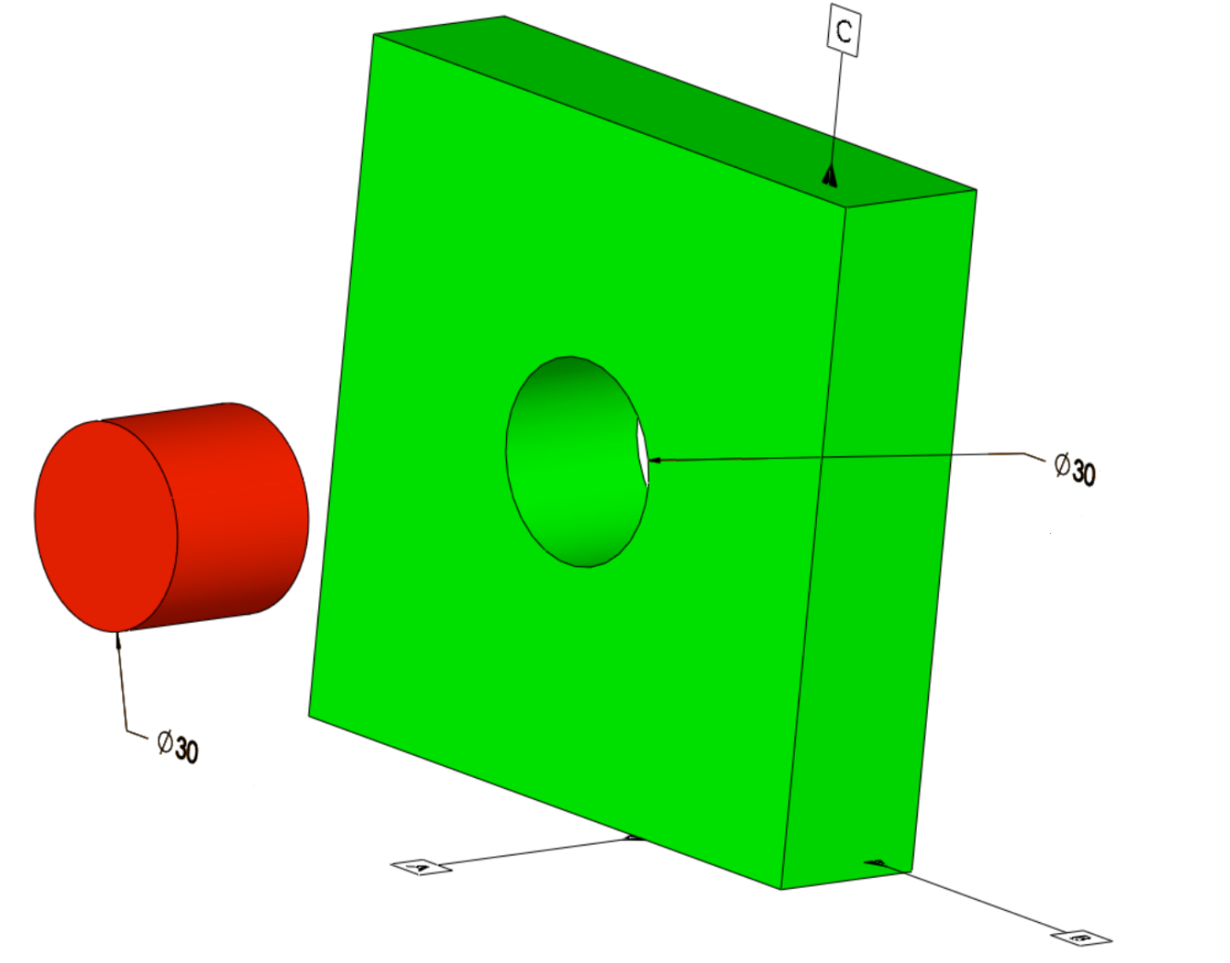

Do you think that these objects are always made to their exact size?
http://www.builditsoftware.com/2016/02/relationships-material-modifiers-fits-mmc-lmc-rfs-modifiers-fit-tolerances/

Slide 6

Why it is not possible to manufacture an object to its exact size ?
Very accurate control of size leads to huge increase in manufacturing cost.
In case of complex product, compatibility of different parts with each other may become difficult.
Machine settings and human errors also contributes to the same.
Very tight control of dimensions leads to increase in inspection cost, rejection of parts.
May require special methods for simple task like six sigma.

Slide 7
What is the solution to this problem ?
Answer
By providing TOLERANCE
TOLERANCE
Permissible variation in size.
Difference between the maximum and minimum permissible limits of the given size.

Slide 8
Why it is necessary ?
It is practically impossible to manufacture a part or component to exact size or geometry.
Since variation from the drawing is inevitable, acceptable variation must be sought.
Large variations may affect the functionality of part like inducing vibrations.
Small variations may make the component less economic.

Slide 9
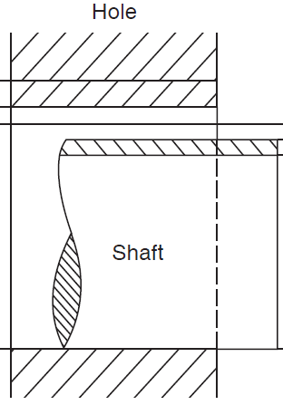
Terminology
Actual Size – Actual measured dimension of the part.
Basic Size – The size with reference to which the limits of size are fixed.
Zero Line – It is the straight line corresponding to basic size. Deviations are measured from this line.
Tolerance
Zero line
Min. Diameter
Basic size
Max. Diameter

Slide 10
Limit of Size – The two extreme permissible sizes of a part between which the actual size should lie.
Maximum Limit of Size – The greater of the two limit of size.
Minimum Limit of Size – The smaller of the two limit of size.
Tolerance zone – Difference between the minimum and maximum limit size.
Upper Deviation – It is the algebraic difference between the maximum size and the basic size.
Lower Deviation - It is the algebraic difference between the minimum size and the basic size.
Lower deviation
Upper deviation
Upper deviation
Tolerance
Lower deviation
Tolerance
Zero line
Max. Diameter
Min. Diameter
Basic size

Slide 11
Specification of Tolerances
Dimensional
Geometrical
Dimensional Tolerance – Amount by which a specified dimension is allowed to vary.
Geometrical Tolerance – These are applied to features.

Slide 12
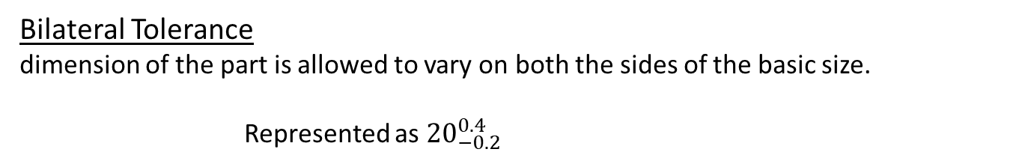

Specification of Dimensional Tolerances
Unilateral Tolerance
Bilateral Tolerance
Unilateral Tolerance
dimension of a part is allowed to vary only on one side of the basic size,
Represented as ${20}_{0}^{0.4}$
Bilateral Tolerance
dimension of the part is allowed to vary on both the sides of the basic size.
Represented as ${20}_{−0.2}^{0.4}$

Slide 13
Designation of Tolerance
IT Tolerance grade of hole
IT Tolerance grade of shaft
25 H 7 f 6
Basic size of hole and shaft
Fundamental deviation of hole
Fundamental deviation of shaft

Slide 14

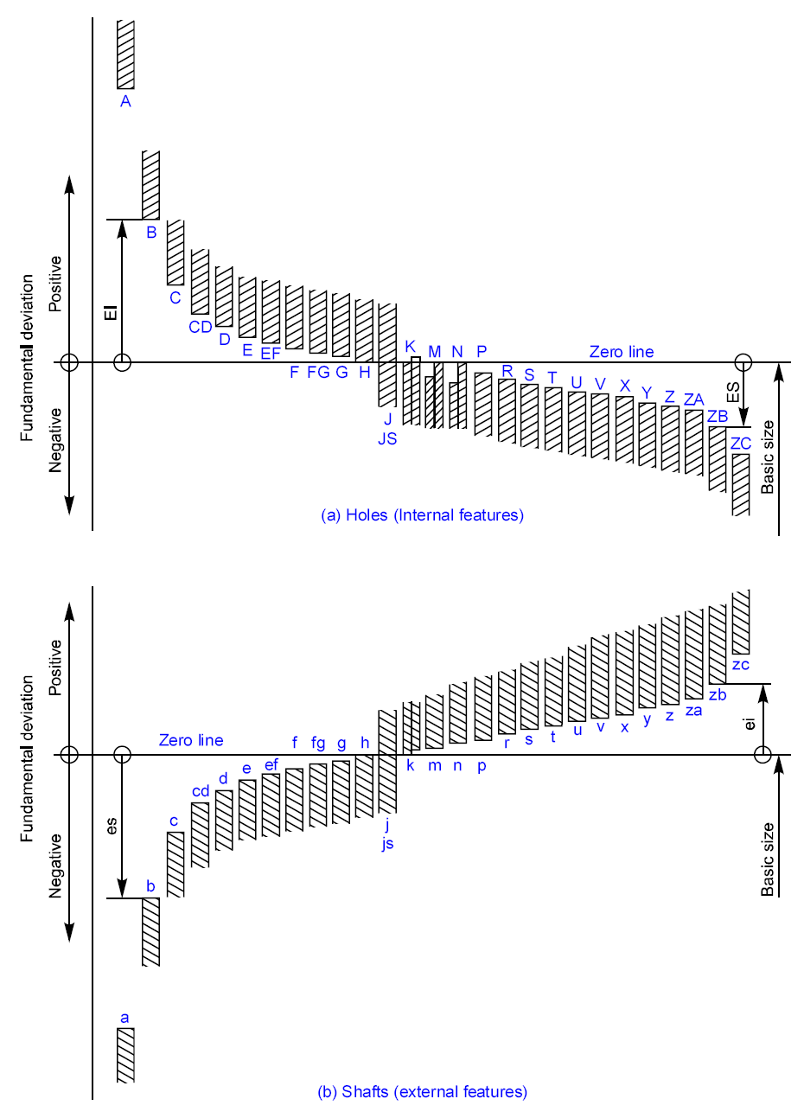
Fundamental Deviations
IT – Tolerance Grade
Holes, EI = ES – IT
Shafts, ei = es – IT
EI: Lower deviation for hole
ES: Upper deviation for hole
IT: Tolerance
Clearances
Transition
Interference
SYMMETRIC ?

Slide 15

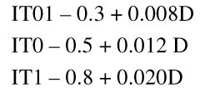
International Tolerance Grade (IT Grade)
Group of tolerances which has the same relative level of accuracy
IT 01 is the most precise and IT 16 is most coarse
Tolerance value depends on basic size
Measuring Instruments/Guages
General Engineering/Industry
And Precision Fits
Semi finished products
D – geometric mean*
Grade | IT5 | IT6 | IT7 | IT8 | IT9 | IT10 | IT11 | IT12 | IT13 | IT14 | IT15 | IT16
Tol. | 7i | 10i | 16i | 25i | 40i | 64i | 100i | 160i | 250i | 400i | 640i | 1000i
These relations must have been arrived at after a lot of tests and experience
Slide Adapted from Prof. P. Venkitanarayanan

Slide 16
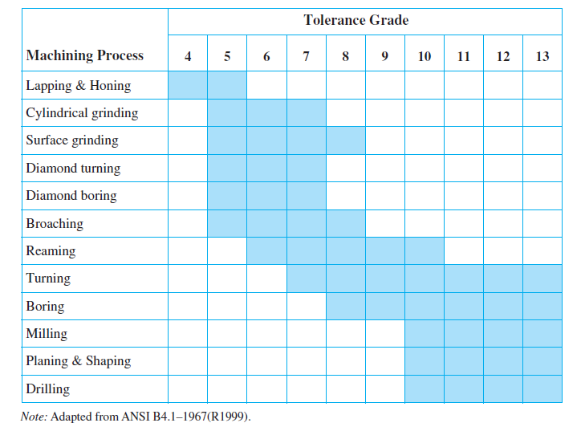
Tolerance grades for different machining processes
Precision and Costs decrease

Slide 17
Machine drawing by K L Narayana, P kannaiah and V reddy

Slide 18
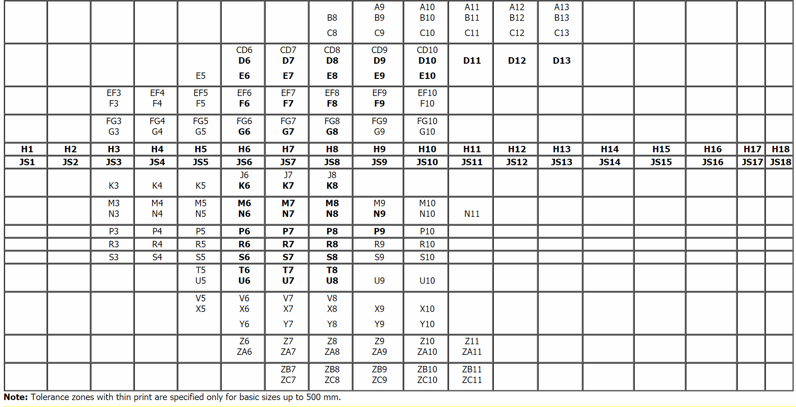
Are Fundamental deviations and Tolerance grades related?
HOLES
Entries in BOLD recommended
Tolerance Grade
Fundamental Deviation

Slide 19
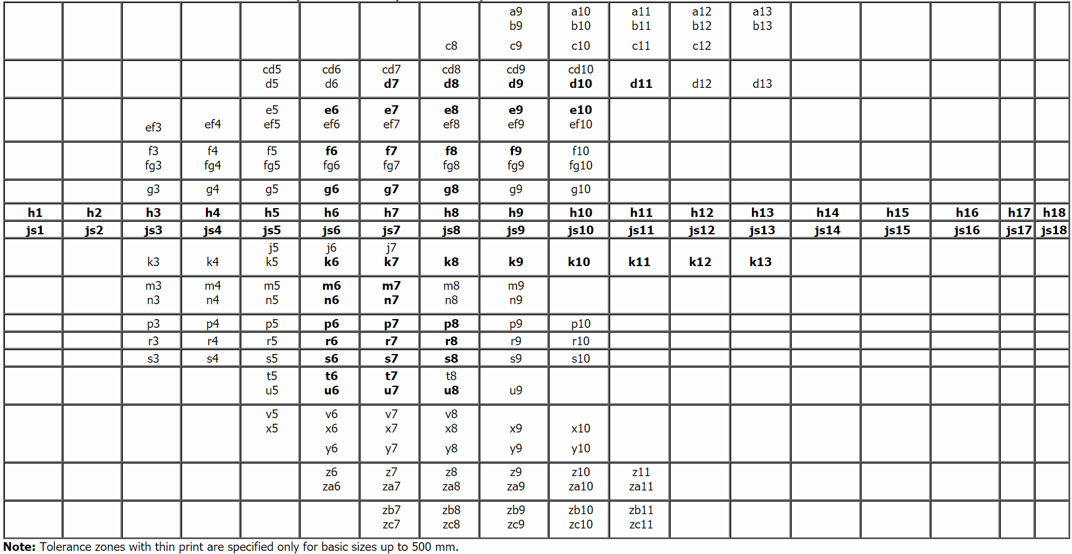
Are Fundamental deviations and Tolerance grades related?
SHAFT
Entries in BOLD recommended
Tolerance Grade
Fundamental Deviation

Slide 20
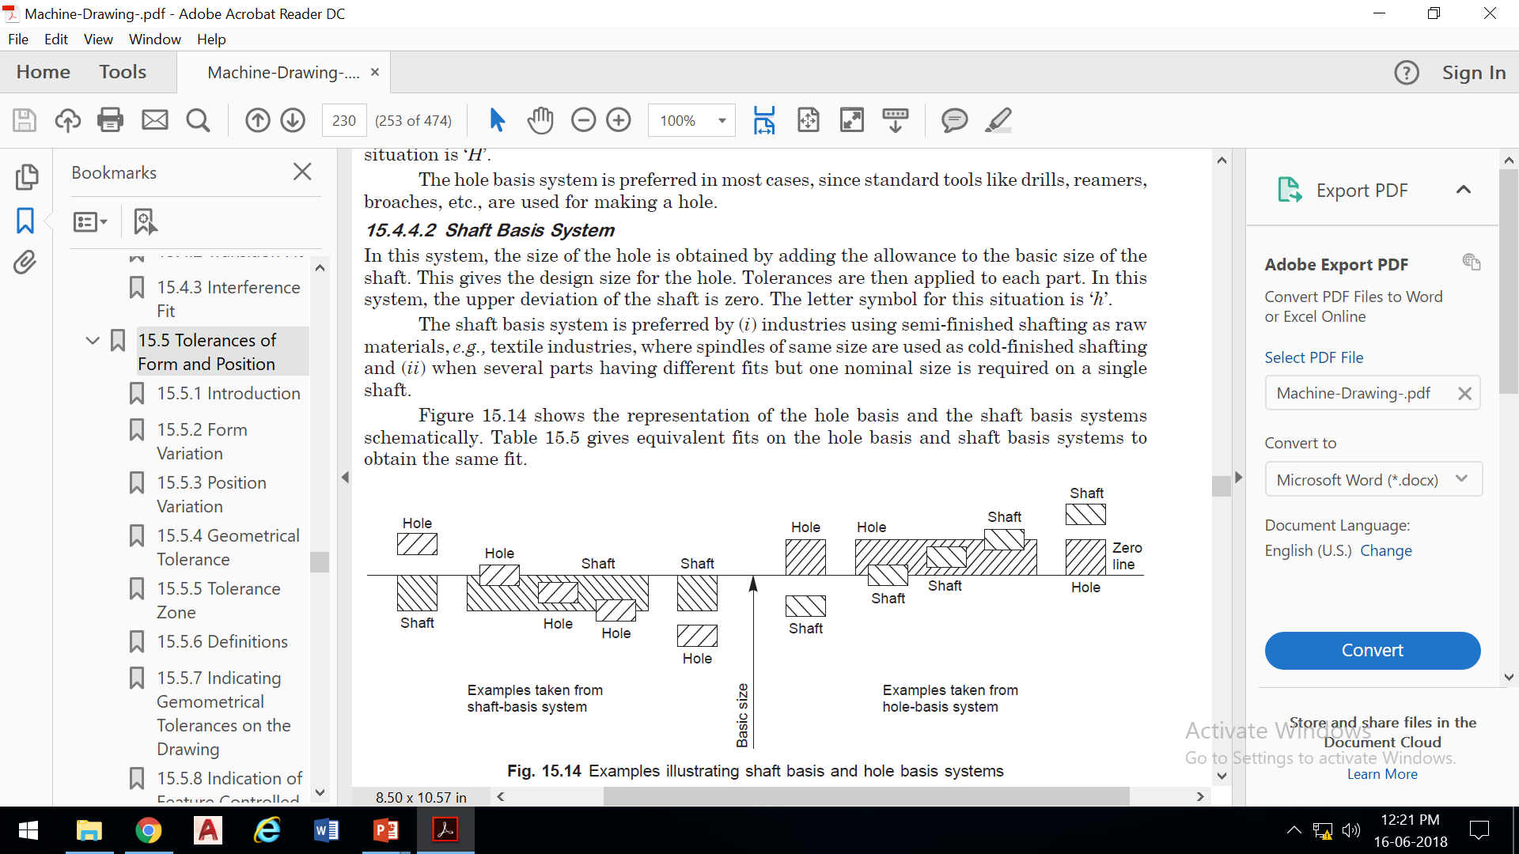
Hole Basis System
The lower deviation (Fundamental deviation) of the hole is zero.
Letter symbol is ‘H’.
Tools like drills, reamers, etc are used for manufacturing the hole.
Most preferred method because machining of hole is much costlier than shaft.
Clearances
Transition
Interference
Clearances
Transition
Interference
Shaft Basis System
The upper deviation (Fundamental deviation) of the shaft is zero.
Letter symbol is ‘h’.
preferred by industries using semi-finished shafting as raw materials, e.g., textile industries

Slide 21
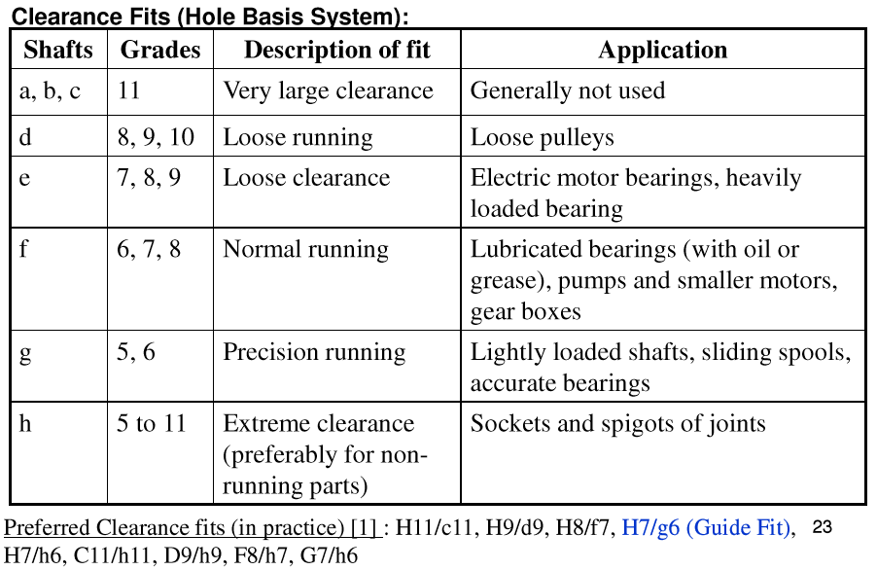
GUIDELINES --- CLEARANCE FITS

Slide 22
GUIDELINES --- CLEARANCE FITS
Combinations recommended in BOLD
Hole-Shaft Combination | Description | Uses
H11/a11, H11/c11, H11/c9, H11/d11, A11/h11, C11/h11, D11/h11 | Fits with great clearances with parts having great tolerances. | Pivots, latches, fits of parts exposed to corrosive effects, contamination with dust and thermal or mechanical deformations
H9/C9, H9/d10, H9/d9, H8/d9, H8/d8, D10/h9, D9/h9, D9/h8 | Running fits with greater clearances without any special requirements for accuracy of guiding shafts. | Multiple fits of shafts of production and piston machines, parts rotating very rarely or only swinging.
H9/e9, H8/e8, H7/e7, E9/h9, E8/h8, E8/h7 | Running fits with greater clearances without any special requirements for fit accuracy | Main fits of machine tools. General fits of shafts, regulator bearings, machine tool spindles, sliding rods.
H9/f8, H8/f8, H8/f7, H7/f7, F8/h7, F8/h6 | Running fits with smaller clearances with general requirements for fit accuracy | Main fits of machine tools. General fits of shafts, regulator bearings, machine tool spindles, sliding rods.
H8/g7, H7/g6, G7/h6 | Running fits with very small clearances for accurate guiding of shafts. Without any noticeable clearance after assembly. | Parts of machine tools, sliding gears and clutch disks, crankshaft journals, pistons of hydraulic machines, rods sliding in bearings, grinding machine spindles.
H11/h11, H11/h9 | Slipping fits of parts with great tolerances. The parts can easily be slid one into the other and turn | Easily demountable parts, distance rings, parts of machines fixed to shafts using pins, bolts, rivets or welds.
H8/h9, H8/h8, H8/h7, H7/h6 | Sliding fits with very small clearances for precise guiding and centring of parts. Mounting by sliding on without use of any great force, after lubrication the parts can be turned and slid by hand. | Sliding fits with very small clearances for precise guiding and centring of parts. Mounting by sliding on without use of any great force, after lubrication the parts can be turned and slid by hand.

Slide 23
GUIDELINES --- TRANSITION FITS
Combinations recommended in BOLD
Hole-Shaft Combination | Description | Uses
H8/j7, H7/js6, H7/j6, J7/h6 | Tight fits with small clearances or negligible interference. The parts can be assembled or disassembled manually. | Easily dismountable fits of hubs of gears, pulleys and bushings, retaining rings, frequently removed bearing bushings.
H8/k7, H7/k6, K8/h7, K7/h6 | Similar fits with small clearances or small interferences. The parts can be assembled or disassembled without great force using a rubber mallet. | Demountable fits of hubs of gears and pulleys, manual wheels, clutches, brake disks.
H8/p7, H8/m7, H8/n7, H7/m6, H7/n6, M8/h6, N8/h7, N7/h6 | Fixed fits with negligible clearances or small interferences. Mounting of fits using pressing and light force. | Fixed plugs, driven bushings, armatures of electric motors on shafts, gear rims, flushed bolts.

Slide 24
GUIDELINES --- INTERFERENCE FITS
Combinations recommended in BOLD
Hole-Shaft Combination | Description | Uses
H8/r7, H7/p6, H7/r6, P7/h6, R7/h6 | Pressed fits with guaranteed interference. Assembly of the parts can be carried out using cold pressing. | Hubs of clutch disks, bearing bushings.
H8/s7, H8/t7, H7/s6, H7/t6, S7/h6, T7/h6 | Pressed fits with medium interference. Assembly of parts using hot pressing. Assembly using cold pressing only with use of large forces. | Permanent coupling of gears with shafts, bearing bushings.
H8/u8, H8/u7, H8/x8, H7/u6, U8/h7, U7/h6 | Pressed fits with big interferences. Assembly using pressing and great forces under different temperatures of the parts. | permanent couplings of gears with shafts, flanges.

Slide 25
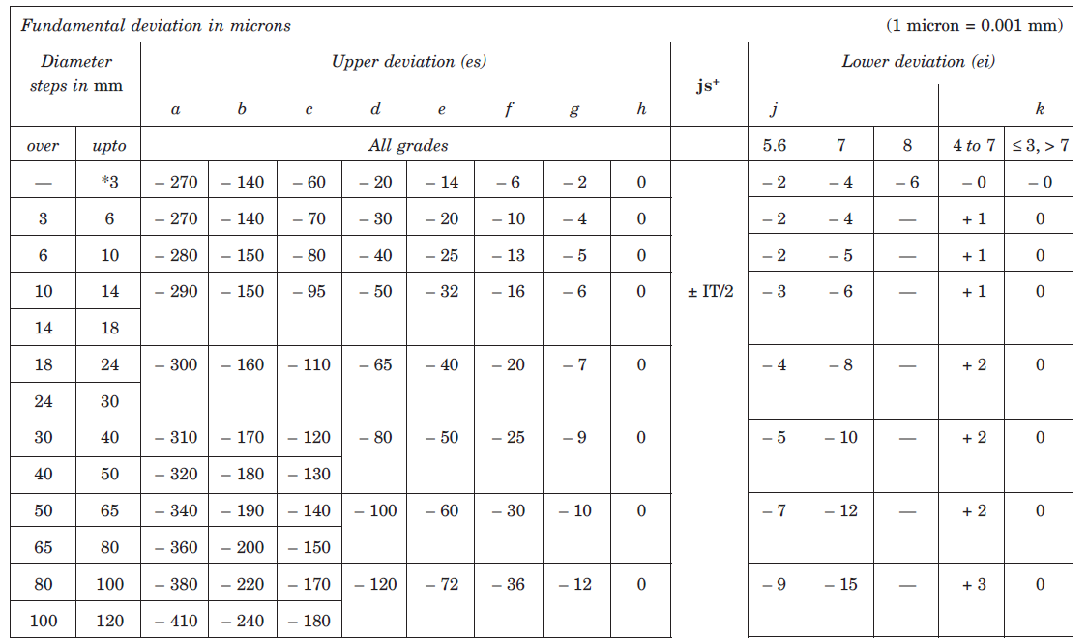
HOLE BASIS
NOTE: CHANGE SIGNS AND CHANGE LETTER CASE
fundamental deviations are SYMMETRIC

Slide 26

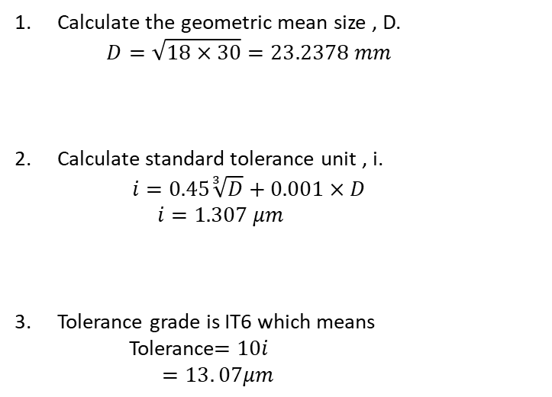
25 H 7 f 6
Tolerance Grade
What is
Basic Size
Fundamental Deviation of shaft
Calculation Procedure for IT6 (SHAFT)
Calculate the geometric mean size , D.
  $$D=\sqrt{18×30}=23.2378 mm$$
Calculate standard tolerance unit , i.
  $$i=0.45\sqrt[3]{D}+0.001×D$$
    $$i=1.307 μm$$
Tolerance grade is IT6 which means
    Tolerance$=10i$
    $$=13. 07μm$$

Slide 27
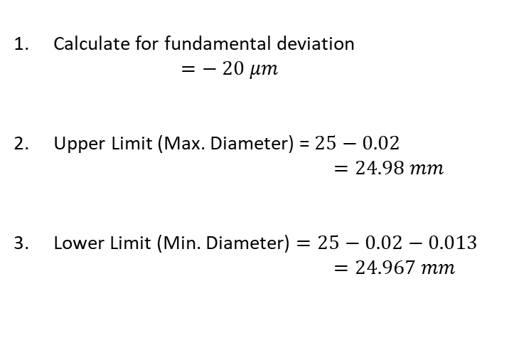
25 H 7 f 6
Tolerance Grade
What is
Basic Size
Fundamental Deviation of shaft
Calculation Procedure for Fundamental Deviation (SHAFT)
Calculate for fundamental deviation
  $$=− 20 μm$$
Upper Limit (Max. Diameter) = $25−0.02$
            $$=24.98 mm$$
Lower Limit (Min. Diameter) $=25−0.02−0.013$
            $$=24.967 mm$$
− 0.020
Dimensional representation
φ 25
− 0.033

Slide 28
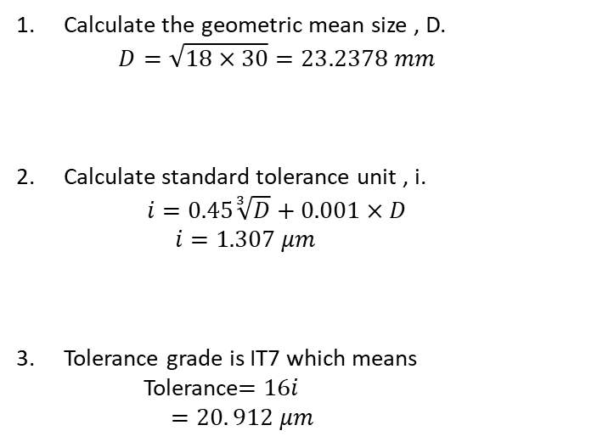
Tolerance Grade
25 H 7 f 6
What is
Basic Size
Fundamental Deviation of Hole
Calculation Procedure for IT7 (HOLE)
Calculate the geometric mean size , D.
  $$D=\sqrt{18×30}=23.2378 mm$$
Calculate standard tolerance unit , i.
  $$i=0.45\sqrt[3]{D}+0.001×D$$
    $$i=1.307 μm$$
Tolerance grade is IT7 which means
    Tolerance$=16i$
    $$=20. 912 μm$$

Slide 29
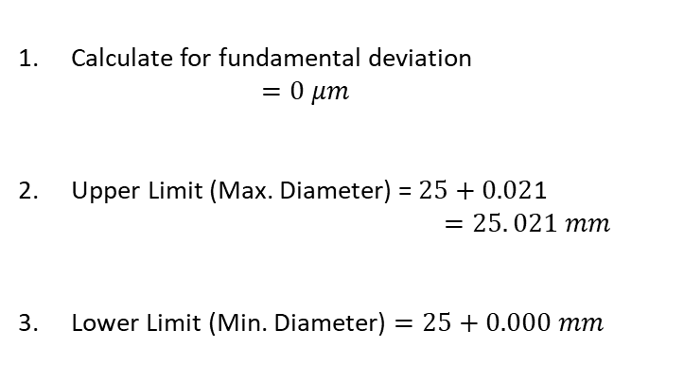
Tolerance Grade
25 H 7 f 6
What is
Basic Size
Fundamental Deviation of Hole
Calculation Procedure for Fundamental Deviation (HOLE)
A B C D E F G H
Calculate for fundamental deviation
  $$=0 μm$$
Upper Limit (Max. Diameter) = $25+0.02$1
            $$=25. 021 mm$$
Lower Limit (Min. Diameter) $=25+0.000 mm$
NOTE: CHANGE SIGNS AND CHANGE LETTER CASE
fundamental deviations are SYMMETRIC
Dimensional representation
0.021
φ 25
0.000

Slide 30
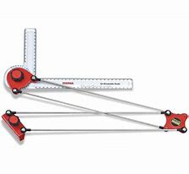
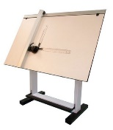
What do you have to say about the tolerances
at pin joints?
Better design ?

