Slide 1
ME 251
Anupam Saxena
Professor
Mechanical Engineering
Compliant and Robotic Systems Lab
Indian Institute of Technology Kanpur

Slide 2
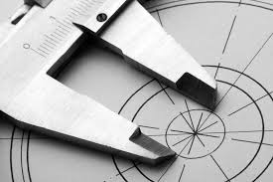
FITS AND CLEARANCES

Slide 3
RECAP
Designation of Tolerance
IT Tolerance grade of hole
IT Tolerance grade of shaft
25 H 7 f 6
Basic size of hole and shaft
Fundamental deviation of hole
Fundamental deviation of shaft

Slide 4

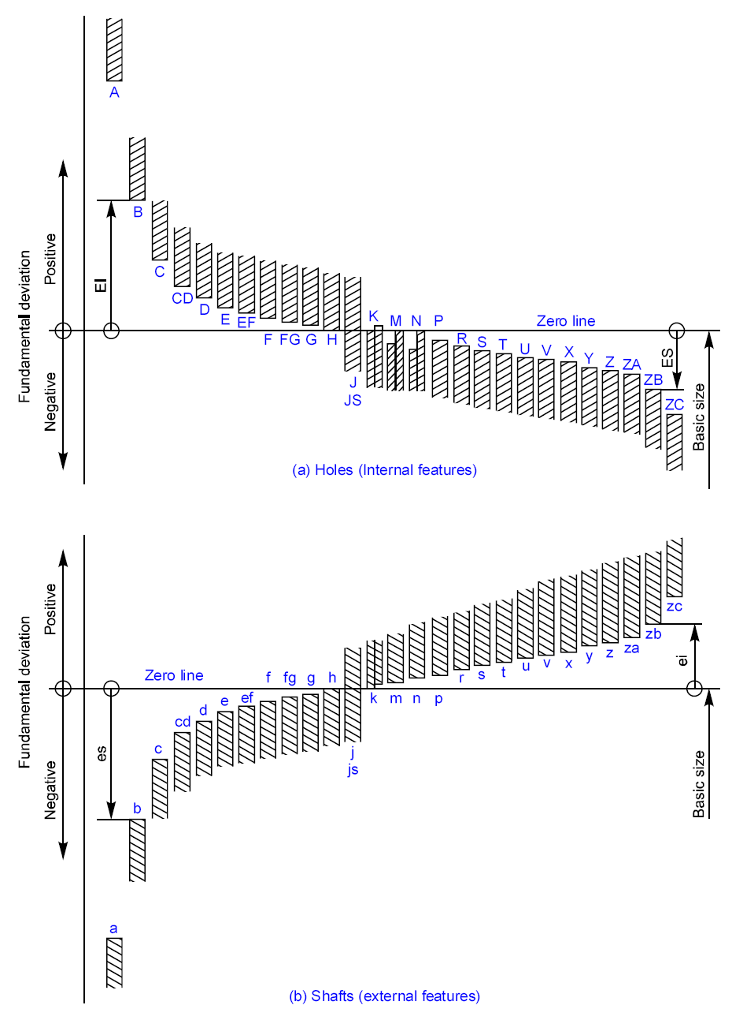
Fundamental Deviations
RECAP
IT – Tolerance Grade
SYMMETRIC ?
Clearances
ALMOST !
Transition
Interference

Slide 5

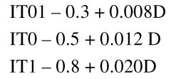
International Tolerance Grade (IT Grade)
RECAP
Group of tolerances which has the same relative level of accuracy
IT 01 is the most precise and IT 16 is most coarse
Tolerance value depends on basic size
Measuring Instruments/Guages
General Engineering/Industry
And Precision Fits
Semi finished products
D – geometric mean*
Grade | IT5 | IT6 | IT7 | IT8 | IT9 | IT10 | IT11 | IT12 | IT13 | IT14 | IT15 | IT16
Tol. | 7i | 10i | 16i | 25i | 40i | 64i | 100i | 160i | 250i | 400i | 640i | 1000i
These relations must have been arrived at after a lot of tests and experience
Slide Adapted from Prof. P. Venkitanarayanan

Slide 6
RECAP
Machine drawing by K L Narayana, P kannaiah and V reddy

Slide 7
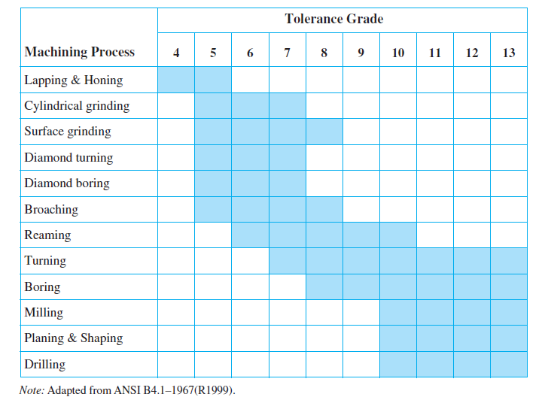
Tolerance grades for different machining processes
RECAP
Precision and Costs decrease

Slide 8
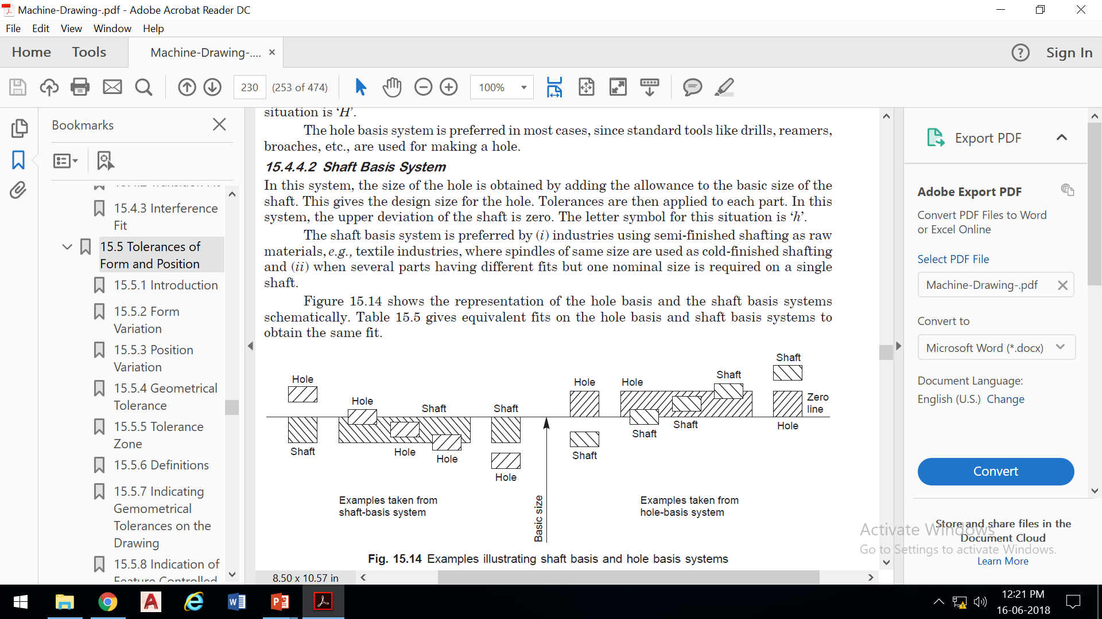
RECAP
Hole Basis System
The lower deviation (Fundamental deviation) of the hole is zero.
Letter symbol is ‘H’.
Tools like drills, reamers, etc are used for manufacturing the hole.
Most preferred method because machining of hole is much costlier than shaft.
Clearances
Transition
Interference
Clearances
Transition
Interference
Shaft Basis System
The upper deviation (Fundamental deviation) of the shaft is zero.
Letter symbol is ‘h’.
preferred by industries using semi-finished shafting as raw materials, e.g., textile industries

Slide 9
RECAP
GUIDELINES --- CLEARANCE FITS
Combinations recommended in BOLD
Hole-Shaft Combination | Description | Uses
H11/a11, H11/c11, H11/c9, H11/d11, A11/h11, C11/h11, D11/h11 | Fits with great clearances with parts having great tolerances. | Pivots, latches, fits of parts exposed to corrosive effects, contamination with dust and thermal or mechanical deformations
H9/C9, H9/d10, H9/d9, H8/d9, H8/d8, D10/h9, D9/h9, D9/h8 | Running fits with greater clearances without any special requirements for accuracy of guiding shafts. | Multiple fits of shafts of production and piston machines, parts rotating very rarely or only swinging.
H9/e9, H8/e8, H7/e7, E9/h9, E8/h8, E8/h7 | Running fits with greater clearances without any special requirements for fit accuracy | Main fits of machine tools. General fits of shafts, regulator bearings, machine tool spindles, sliding rods.
H9/f8, H8/f8, H8/f7, H7/f7, F8/h7, F8/h6 | Running fits with smaller clearances with general requirements for fit accuracy | Main fits of machine tools. General fits of shafts, regulator bearings, machine tool spindles, sliding rods.
H8/g7, H7/g6, G7/h6 | Running fits with very small clearances for accurate guiding of shafts. Without any noticeable clearance after assembly. | Parts of machine tools, sliding gears and clutch disks, crankshaft journals, pistons of hydraulic machines, rods sliding in bearings, grinding machine spindles.
H11/h11, H11/h9 | Slipping fits of parts with great tolerances. The parts can easily be slid one into the other and turn | Easily demountable parts, distance rings, parts of machines fixed to shafts using pins, bolts, rivets or welds.
H8/h9, H8/h8, H8/h7, H7/h6 | Sliding fits with very small clearances for precise guiding and centring of parts. Mounting by sliding on without use of any great force, after lubrication the parts can be turned and slid by hand. | Sliding fits with very small clearances for precise guiding and centring of parts. Mounting by sliding on without use of any great force, after lubrication the parts can be turned and slid by hand.

Slide 10
RECAP
GUIDELINES --- TRANSITION FITS
Combinations recommended in BOLD
Hole-Shaft Combination | Description | Uses
H8/j7, H7/js6, H7/j6, J7/h6 | Tight fits with small clearances or negligible interference. The parts can be assembled or disassembled manually. | Easily dismountable fits of hubs of gears, pulleys and bushings, retaining rings, frequently removed bearing bushings.
H8/k7, H7/k6, K8/h7, K7/h6 | Similar fits with small clearances or small interferences. The parts can be assembled or disassembled without great force using a rubber mallet. | Demountable fits of hubs of gears and pulleys, manual wheels, clutches, brake disks.
H8/p7, H8/m7, H8/n7, H7/m6, H7/n6, M8/h6, N8/h7, N7/h6 | Fixed fits with negligible clearances or small interferences. Mounting of fits using pressing and light force. | Fixed plugs, driven bushings, armatures of electric motors on shafts, gear rims, flushed bolts.

Slide 11
RECAP
GUIDELINES --- INTERFERENCE FITS
Combinations recommended in BOLD
Hole-Shaft Combination | Description | Uses
H8/r7, H7/p6, H7/r6, P7/h6, R7/h6 | Pressed fits with guaranteed interference. Assembly of the parts can be carried out using cold pressing. | Hubs of clutch disks, bearing bushings.
H8/s7, H8/t7, H7/s6, H7/t6, S7/h6, T7/h6 | Pressed fits with medium interference. Assembly of parts using hot pressing. Assembly using cold pressing only with use of large forces. | Permanent coupling of gears with shafts, bearing bushings.
H8/u8, H8/u7, H8/x8, H7/u6, U8/h7, U7/h6 | Pressed fits with big interferences. Assembly using pressing and great forces under different temperatures of the parts. | permanent couplings of gears with shafts, flanges.

Slide 12
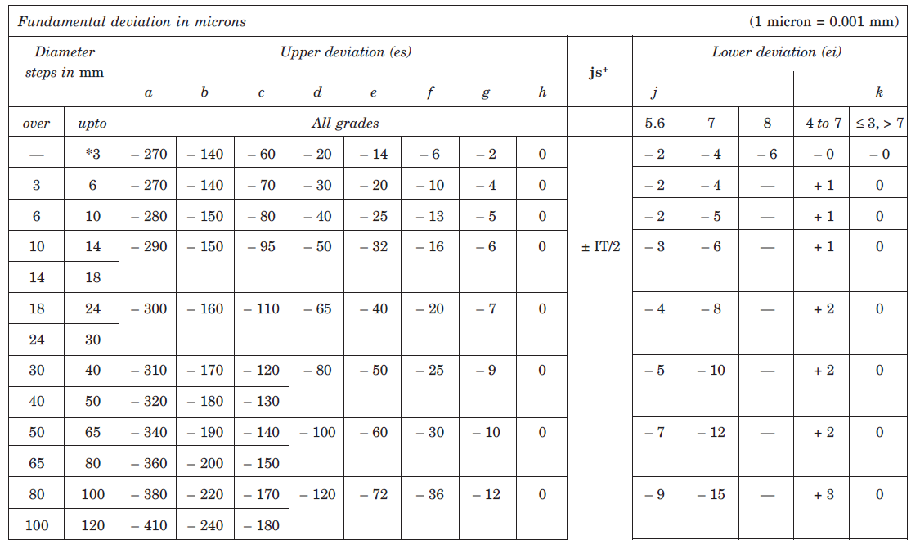
RECAP
HOLE BASIS
NOTE: CHANGE SIGNS AND CHANGE LETTER CASE
fundamental deviations are ALMOST SYMMETRIC

Slide 13

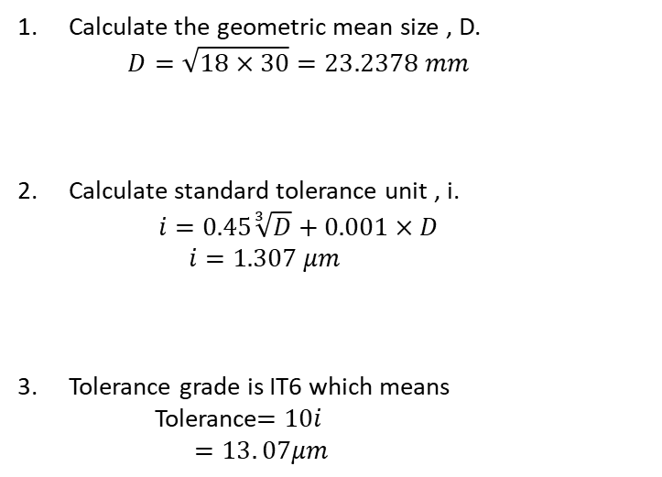
RECAP
25 H 7 f 6
Tolerance Grade
What is
Basic Size
Fundamental Deviation of shaft
Calculation Procedure for IT6 (SHAFT)
Calculate the geometric mean size , D.
  $$D=\sqrt{18×30}=23.2378 mm$$
Calculate standard tolerance unit , i.
  $$i=0.45\sqrt[3]{D}+0.001×D$$
    $$i=1.307 μm$$
Tolerance grade is IT6 which means
    Tolerance$=10i$
    $$=13. 07μm$$

Slide 14
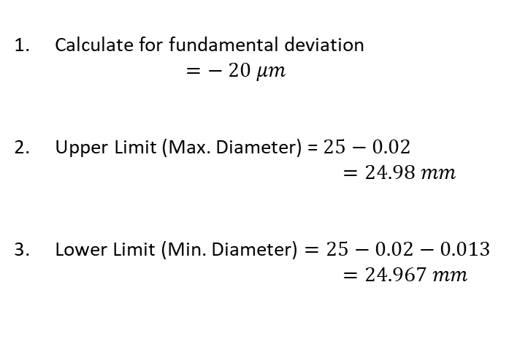
RECAP
25 H 7 f 6
Tolerance Grade
What is
Basic Size
Fundamental Deviation of shaft
Calculation Procedure for Fundamental Deviation (SHAFT)
Calculate for fundamental deviation
  $$=− 20 μm$$
Upper Limit (Max. Diameter) = $25−0.02$
            $$=24.98 mm$$
Lower Limit (Min. Diameter) $=25−0.02−0.013$
            $$=24.967 mm$$
− 0.020
Dimensional representation
φ 25
− 0.033

Slide 15
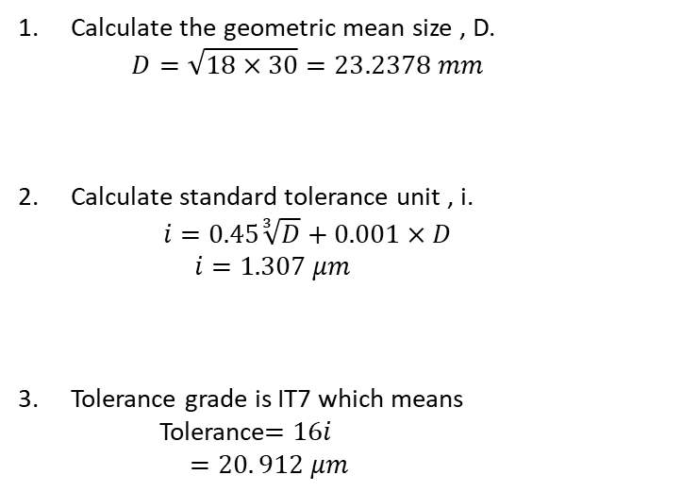
RECAP
Tolerance Grade
25 H 7 f 6
What is
Basic Size
Fundamental Deviation of Hole
Calculation Procedure for IT7 (HOLE)
Calculate the geometric mean size , D.
  $$D=\sqrt{18×30}=23.2378 mm$$
Calculate standard tolerance unit , i.
  $$i=0.45\sqrt[3]{D}+0.001×D$$
    $$i=1.307 μm$$
Tolerance grade is IT7 which means
    Tolerance$=16i$
    $$=20. 912 μm$$

Slide 16
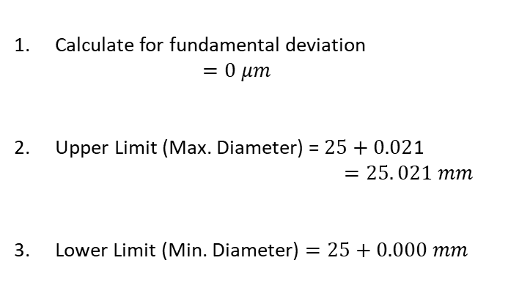
RECAP
Tolerance Grade
25 H 7 f 6
What is
Basic Size
Fundamental Deviation of Hole
Calculation Procedure for Fundamental Deviation (HOLE)
A B C D E F G H
Calculate for fundamental deviation
  $$=0 μm$$
Upper Limit (Max. Diameter) = $25+0.02$1
            $$=25. 021 mm$$
Lower Limit (Min. Diameter) $=25+0.000 mm$
NOTE: CHANGE SIGNS AND CHANGE LETTER CASE
fundamental deviations are ALMOST SYMMETRIC
Dimensional representation
0.021
φ 25
0.000

Slide 17
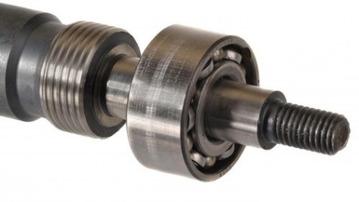
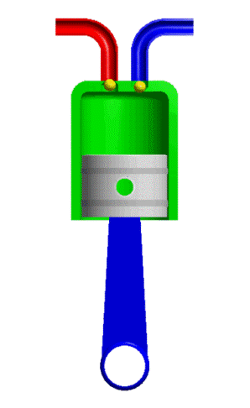
FITS: INTRODUCTION
To know how the various parts of a design fit together
It is a nature of the difference between their sizes before assembly
The sizes of mating holes and shafts lead to:
hole is larger than the shaft
hole is smaller than the shaft
hole is fractionally smaller than the shaft
Clearance
Interference
Transition
enabling the two parts to slide and / or rotate when assembled
high force and / or heat is required to assemble / disassemble
mild force is required to assemble / disassemble
https://en.wikipedia.org/wiki/Engineering_fit
Machine drawing book by N. Sidheswar, P. Kannaiah, VVS Sastry

Slide 18
GENERAL CLASSIFICATION OF FITS
FITS
Clearance fit Transition fit Interference fit
Sliding fit Running fit
Light keying fit Push fit
Force fit Press fit
Two most common basis for specifying fits are
  Shaft based system
  Hole based system

Slide 19
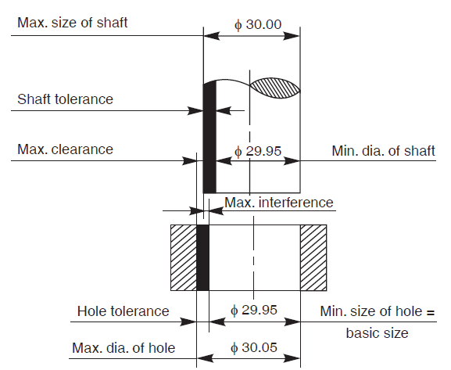
TRANSITION FITS
https://en.wikipedia.org/wiki/Engineering_fit
Machine drawing book by N. Sidheswar, P. Kannaiah, VVS Sastry

Slide 20

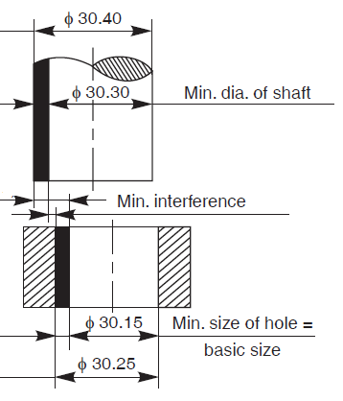




INTERFERENCE FITS
https://en.wikipedia.org/wiki/Engineering_fit
Machine drawing book by N. Sidheswar, P. Kannaiah, VVS Sastry

Slide 21
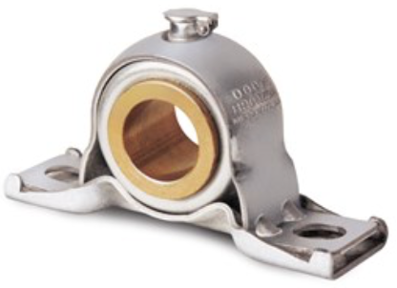
Example:
A journal bearing consists of a bronze bush of diameter 100 mm fitted into a housing and a steel shaft of 50 mm diameter, running in the bush, with oil as lubricant. Determine the working dimensions of
bore of the housing,
bush and
shaft.
Calculate the maximum and minimum interference or clearance.
http://www.chegg.com/homework-help/questions-and-answers/5-journal-bearing-must-support-load-force-f-using-fluid-viscosity-rotational-speed--bearin-q24916082

Slide 22
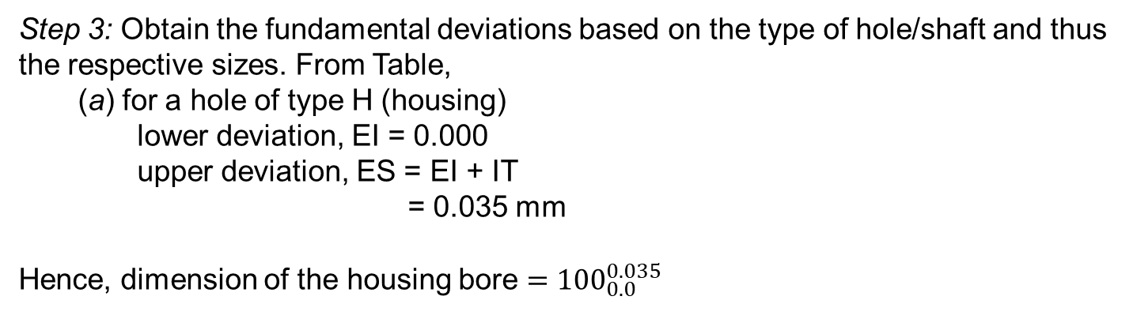
Step 1: Select the nature of assembly or fit based on the function. Referring to Table, the fits to be employed are selected as below:
  (a) for the bush and housing, H7/p6 (interference fit),
  (b) for the shaft and bush, H7/f 7 (normal running fit).
Step 2: Obtain the tolerances on the linear dimensions of the parts. From Table, the
fundamental tolerances (IT) for different grades, based on the size are:
  (a) for dia. 100 and grade 6 = 22 microns,
  (b) for dia. 100 and grade 7 = 35 microns,
  (c) for dia. 50 and grade 7 = 25 microns.
Step 3: Obtain the fundamental deviations based on the type of hole/shaft and thus the respective sizes. From Table,
  (a) for a hole of type H (housing)
    lower deviation, EI = 0.000
    upper deviation, ES = EI + IT
            = 0.035 mm
Hence, dimension of the housing bore $={100}_{0.0}^{0.035}$
Machine drawing by K L Narayana, P kannaiah and V reddy

Slide 23
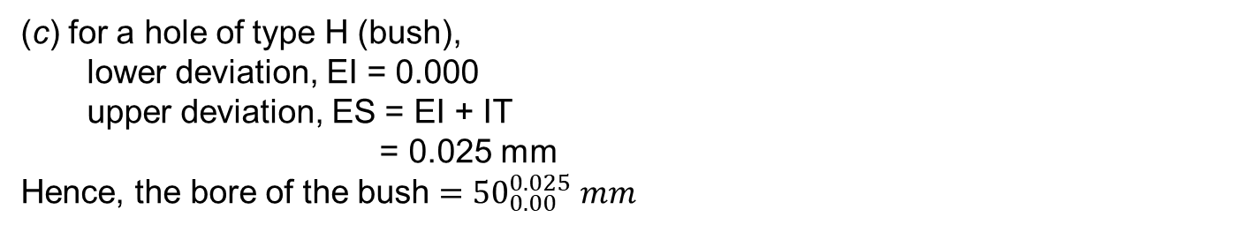
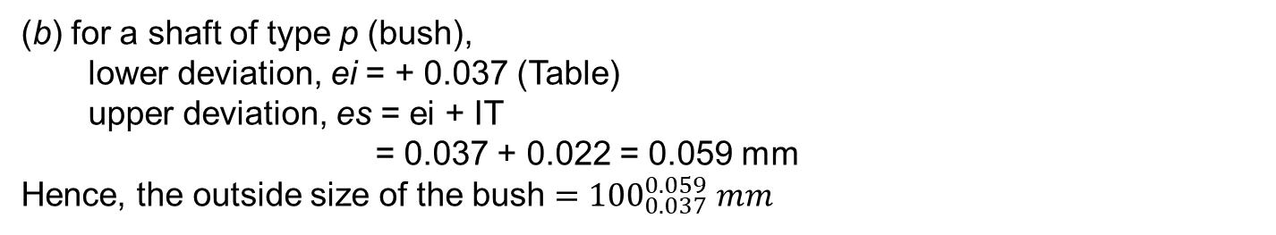
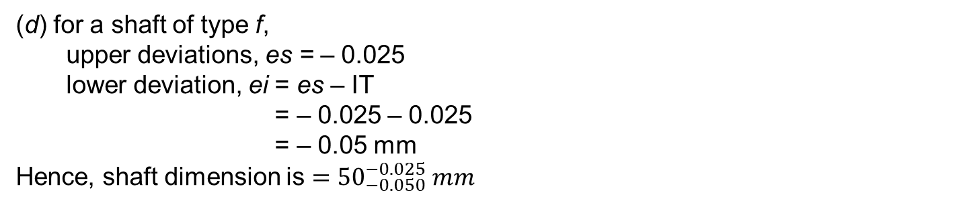
(b) for a shaft of type p (bush),
  lower deviation, ei = + 0.037 (Table)
  upper deviation, es = ei + IT
          = 0.037 + 0.022 = 0.059 mm
Hence, the outside size of the bush $={100}_{0.037}^{0.059} mm$
(c) for a hole of type H (bush),
  lower deviation, EI = 0.000
  upper deviation, ES = EI + IT
          = 0.025 mm
Hence, the bore of the bush $={50}_{0.00}^{0.025} mm$
(d) for a shaft of type f,
  upperdeviations, es = – 0.025
  lower deviation, ei= es– IT
          = – 0.025 – 0.025
          = – 0.05 mm
Hence, shaft dimension is $={50}_{−0.050}^{−0.025} mm$
Machine drawing by K L Narayana, P kannaiah and V reddy

Slide 24
Step 4: Calculate the interference/clearance
(a) between the bush and housing :
  Maximum interference = 100.00 – 100.059
            = – 0.059 mm
  Minimum interference = 100.035 – 100.037
            = – 0.002 mm
(b) between the bush and shaft :
  Maximum clearance = 50.025 – 49.050
  = + 0.075 mm
  Minimum clearance = 50.000 – 49.075
= + 0.025 mm
Machine drawing by K L Narayana, P kannaiah and V reddy

