Slide 1
ME 251
Anupam Saxena
Professor
Mechanical Engineering
Compliant and Robotic Systems Lab
Indian Institute of Technology Kanpur

Slide 2
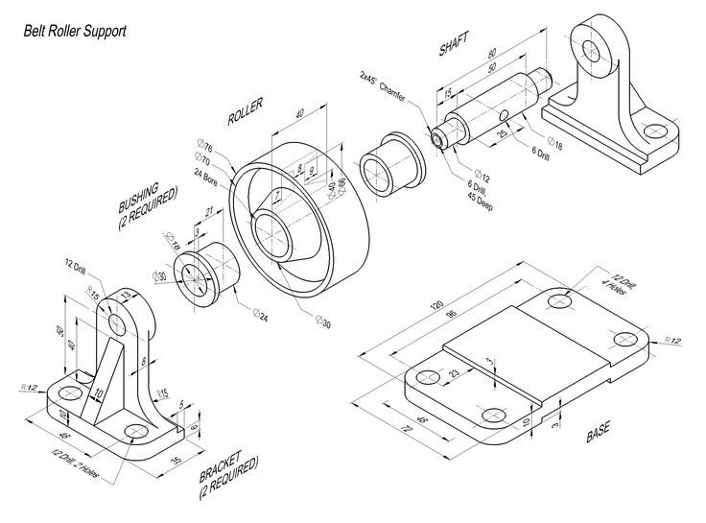
Belt Roller Support
Prepared by Anupam Saxena, Vitthal Khatik and Ishu Agrawal

Slide 3
35
BELT ROLLER SUPPORT
48
2 × φ12
21
φ30
30
2 BUSHING: 2 NOS
45
1 BRACKET: 2 NOS
ANUPAM SAXENA
ME 251 LECTURE II
PART AND ASSEMBLY DRAWINGS: EXAMPLE I
Prepared by Anupam Saxena, Vitthal Khatik and Ishu Agrawal

Slide 4
BELT ROLLER SUPPORT
26
φ78
3 ROLLER: 1 NOS
ANUPAM SAXENA
ME 251 LECTURE II
PART AND ASSEMBLY DRAWINGS: EXAMPLE I
Prepared by Anupam Saxena, Vitthal Khatik and Ishu Agrawal
30

Slide 5
BELT ROLLER SUPPORT
φ18
50
80
4 SHAFT: 1 NOS
ANUPAM SAXENA
ME 251 LECTURE II
PART AND ASSEMBLY DRAWINGS: EXAMPLE I
Prepared by Anupam Saxena, Vitthal Khatik and Ishu Agrawal

Slide 6
BELT ROLLER SUPPORT
72
4 × φ 12
120
5 BASE: 1 NOS
ANUPAM SAXENA
ME 251 LECTURE II
PART AND ASSEMBLY DRAWINGS: EXAMPLE I
Prepared by Anupam Saxena, Vitthal Khatik and Ishu Agrawal

Slide 7
BELT ROLLER SUPPORT
ANUPAM SAXENA
ME 251 LECTURE II
PART AND ASSEMBLY DRAWINGS: EXAMPLE I
Prepared by Anupam Saxena, Vitthal Khatik and Ishu Agrawal

Slide 8
BELT ROLLER SUPPORT
ANUPAM SAXENA
ME 251 LECTURE II
PART AND ASSEMBLY DRAWINGS: EXAMPLE I
Prepared by Anupam Saxena, Vitthal Khatik and Ishu Agrawal

Slide 9
BELT ROLLER SUPPORT
Way too many hidden lines …
Way too Messy …
ANUPAM SAXENA
ME 251 LECTURE II
PART AND ASSEMBLY DRAWINGS: EXAMPLE I
Prepared by Anupam Saxena, Vitthal Khatik and Ishu Agrawal

Slide 10
BELT ROLLER SUPPORT
ANUPAM SAXENA
ME 251 LECTURE II
PART AND ASSEMBLY DRAWINGS: EXAMPLE I
Prepared by Anupam Saxena, Vitthal Khatik and Ishu Agrawal

Slide 11
BELT ROLLER SUPPORT
ANUPAM SAXENA
ME 251 LECTURE II
PART AND ASSEMBLY DRAWINGS: EXAMPLE I
Prepared by Anupam Saxena, Vitthal Khatik and Ishu Agrawal

Slide 12
BELT ROLLER SUPPORT
ANUPAM SAXENA
ME 251 LECTURE II
PART AND ASSEMBLY DRAWINGS: EXAMPLE I
Prepared by Anupam Saxena, Vitthal Khatik and Ishu Agrawal

Slide 13
BELT ROLLER SUPPORT
Convention
Shaft is not hatched
ANUPAM SAXENA
ME 251 LECTURE II
PART AND ASSEMBLY DRAWINGS: EXAMPLE I
Prepared by Anupam Saxena, Vitthal Khatik and Ishu Agrawal

Slide 14
BELT ROLLER SUPPORT
BILL OF MATERIAL
PART | MATERIAL | NOS.
A
A
BRACKET | MS | 2
3
2
BUSHING | BRASS | 2
4
ROLLER | MS | 1
SHAFT | MS | 1
BASE PLATE | MS | 1
5
1
SECTION A-A
ANUPAM SAXENA
ME 251 LECTURE II
PART AND ASSEMBLY DRAWINGS: EXAMPLE I
Prepared by Anupam Saxena, Vitthal Khatik and Ishu Agrawal

Slide 15
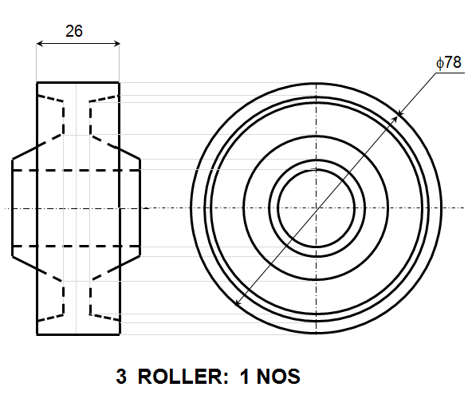
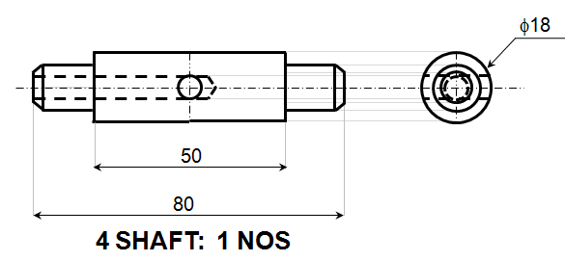
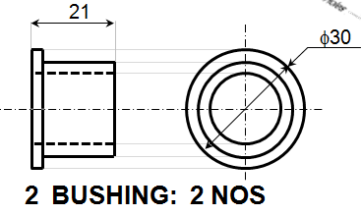
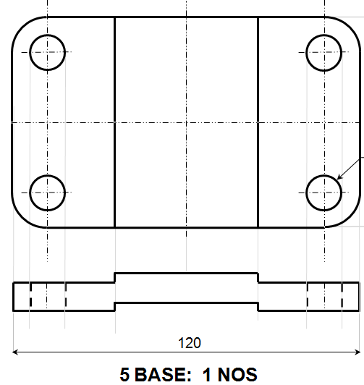
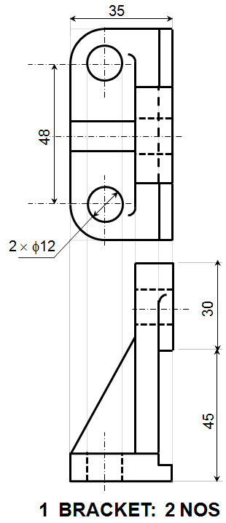
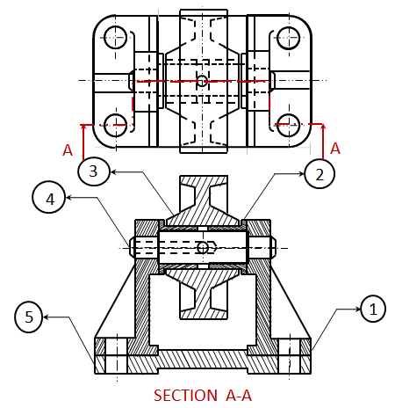
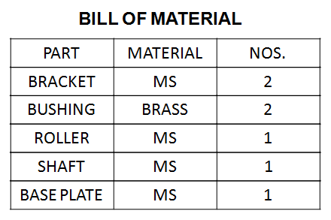
ANUPAM SAXENA
ME 251 LECTURE II
PART AND ASSEMBLY DRAWINGS: EXAMPLE I
Prepared by Anupam Saxena, Vitthal Khatik and Ishu Agrawal

Slide 16
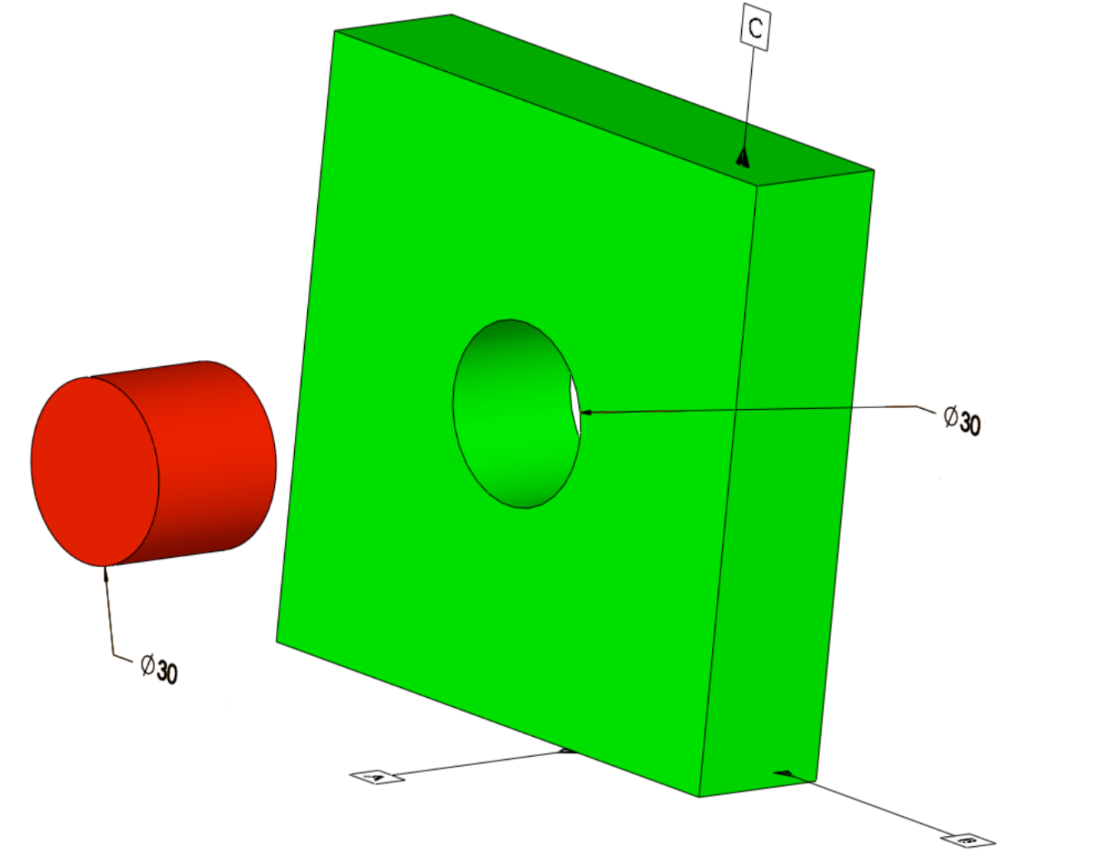
PRIMER TO FITS/TOLERANCES
Do you think that these objects are always made to their exact size?
ANUPAM SAXENA
ME 251 LECTURE II
PART AND ASSEMBLY DRAWINGS: EXAMPLE I
http://www.builditsoftware.com/2016/02/relationships-material-modifiers-fits-mmc-lmc-rfs-modifiers-fit-tolerances/

Slide 17
PRIMER TO TOLERANCES
Why it is not possible to manufacture an object to its exact size ?
Very accurate control of size leads to huge increase in manufacturing cost.
In case of complex product, compatibility of different parts with each other may become difficult.
Machine settings and human errors also contributes to the same.
Very tight control of dimensions leads to increase in inspection cost, rejection of parts.
May require special methods for simple task like six sigma.
ANUPAM SAXENA
ME 251 LECTURE II
PART AND ASSEMBLY DRAWINGS: EXAMPLE I

Slide 18
PRIMER TO TOLERANCES
What is the solution to this problem ?
Answer
By providing TOLERANCE
TOLERANCE
The permissible variation of a size ---
It is the difference between the maximum and minimum permissible limits of the given size.
ANUPAM SAXENA
ME 251 LECTURE II
PART AND ASSEMBLY DRAWINGS: EXAMPLE I

Slide 19
PRIMER TO TOLERANCES
Why it is necessary ?
It is impossible to manufacture a part or component to an exact size or geometry.
Since variation from the drawing is inevitable, acceptable degree of variation must be applied.
Large variations may affect the functionality of part like inducing vibrations.
Small variations may affect relative motion.
Small variations may also affect the economy of part.
ANUPAM SAXENA
ME 251 LECTURE II
PART AND ASSEMBLY DRAWINGS: EXAMPLE I

Slide 20
Identify MATING Surfaces and the INTENT
φ 18
0.05 ?
0.01 ?
φ 12
-0.01 ?
φ 18
-0.01 ?
-0.03 ?
-0.05 ?
φ 12
0.04 ?
0.01 ?
ANUPAM SAXENA
ME 251 LECTURE II
PART AND ASSEMBLY DRAWINGS: EXAMPLE I
Prepared by Anupam Saxena, Vitthal Khatik and Ishu Agrawal

