Slide 1
ME 251
Anupam Saxena
Professor
Mechanical Engineering
Compliant and Robotic Systems Lab
Indian Institute of Technology Kanpur

Slide 2
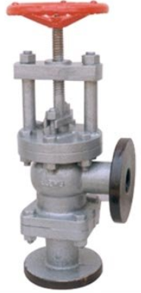
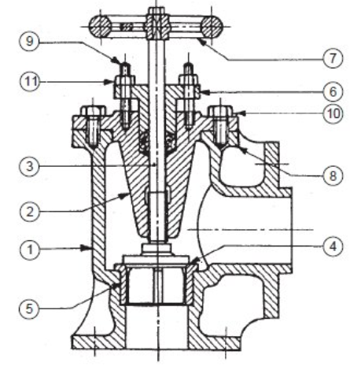
Feed Check Valve
ANUPAM SAXENA
ME 251 LECTURE IV
PART AND ASSEMBLY DRAWINGS: EXAMPLE III
Prepared by Anupam Saxena, Vitthal Khatik and Ishu Agrawal

Slide 3
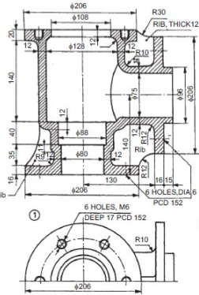
Feed Check Valve
Something left out --- what is it?
1 BODY (CAST IRON)
ANUPAM SAXENA
ME 251 LECTURE IV
PART AND ASSEMBLY DRAWINGS: EXAMPLE III
Prepared by Anupam Saxena, Vitthal Khatik and Ishu Agrawal

Slide 4
Feed Check Valve
1 BODY (CAST IRON)
ANUPAM SAXENA
ME 251 LECTURE IV
PART AND ASSEMBLY DRAWINGS: EXAMPLE III
Prepared by Anupam Saxena, Vitthal Khatik and Ishu Agrawal

Slide 5
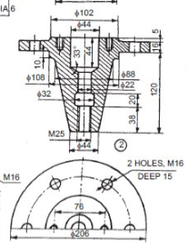
Feed Check Valve
Something left out --- what is it?
2 COVER (CAST IRON)
ANUPAM SAXENA
ME 251 LECTURE IV
PART AND ASSEMBLY DRAWINGS: EXAMPLE III
Prepared by Anupam Saxena, Vitthal Khatik and Ishu Agrawal

Slide 6
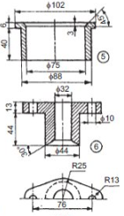

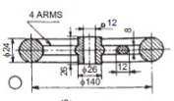
Feed Check Valve
5 VALVE SEAT (GM)
6 GLAND (GM)
7 HAND WHEEL (CI)
3 SPINDLE (MILD STEEL)
ANUPAM SAXENA
ME 251 LECTURE IV
PART AND ASSEMBLY DRAWINGS: EXAMPLE III
Prepared by Anupam Saxena, Vitthal Khatik and Ishu Agrawal

Slide 7
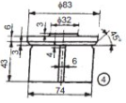
Feed Check Valve
ᶲ32
6
43
74
4 VALVE (GM)
ANUPAM SAXENA
ME 251 LECTURE IV
PART AND ASSEMBLY DRAWINGS: EXAMPLE III
Prepared by Anupam Saxena, Vitthal Khatik and Ishu Agrawal

Slide 8
Feed Check Valve
32
M16
22
76
52
18
15
8 STUD (MS)
M10
9 STUD (MS)
ANUPAM SAXENA
ME 251 LECTURE IV
PART AND ASSEMBLY DRAWINGS: EXAMPLE III

Slide 9
Feed Check Valve
M16
10 NUT (MS)
M10
11 NUT (MS)
ANUPAM SAXENA
ME 251 LECTURE IV
PART AND ASSEMBLY DRAWINGS: EXAMPLE III
Prepared by Anupam Saxena, Vitthal Khatik and Ishu Agrawal

Slide 10
Feed Check Valve
Careful of EXTRA lines when
ASSEMBLING
Make sure to number parts
and prepare the BILL of material
There may still be some mistakes…
OBSERVE!
ANUPAM SAXENA
ME 251 LECTURE IV
PART AND ASSEMBLY DRAWINGS: EXAMPLE III
Prepared by Anupam Saxena, Vitthal Khatik and Ishu Agrawal

Slide 11
Tolerances
Specification of Tolerances
Dimensional
Geometric
Dimensional Tolerance – Amount by which a specified dimension is allowed to vary.
Geometric Tolerance – These are applied to features.

Slide 12
Tolerances
Specification of Dimensional Tolerances
Unilateral Tolerance
Bilateral Tolerance
Unilateral Tolerance
Dimension of part is permitted to vary only on one side of the basic size:
20
0.4
0
Bilateral Tolerance
Dimension of part is permitted to vary both sides of the basic size:
20
0.4
-0.3

Slide 13
Tolerances
Designation of Tolerance
IT Tolerance grade of hole
25 H 7 f 6
IT Tolerance grade of shaft
Basic size of hole and shaft
Fundamental deviation of hole
Fundamental deviation of shaft

Slide 14
International Tolerance Grade (IT Grade)
Group of tolerances which has the same relative level of accuracy
IT 01 is the most precise and IT 16 is most coarse
Tolerance value depends on basic size
Measuring Tools
Materials
Fits
Commercial manufacturing
Grade | IT5 | IT6 | IT7 | IT8 | IT9 | IT10 | IT11 | IT12 | IT13 | IT14 | IT15 | IT16
Tol. | 7i | 10i | 16i | 25i | 40i | 64i | 100i | 160i | 250i | 400i | 640i | 1000i
Slide Adapted from Prof. P. Venkitanarayanan

Slide 15
Machine drawing by K L Narayana, P kannaiah and V reddy

Slide 16
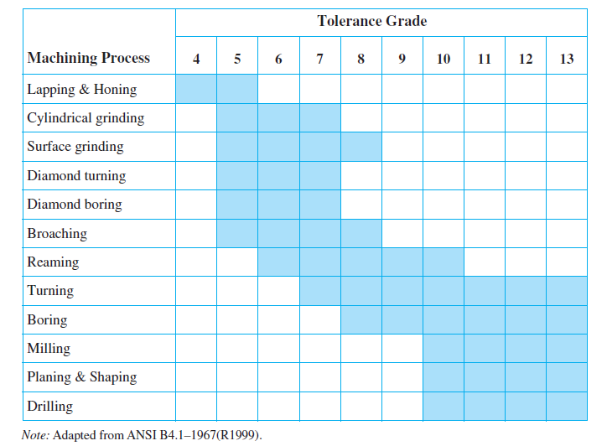
Tolerance grades for different machining processes

Slide 17
