Slide 1
ME 251
Anupam Saxena
Professor
Mechanical Engineering
Compliant and Robotic Systems Lab
Indian Institute of Technology Kanpur

Slide 2
Couplings and Fuel Injector
Couplings: https://www.youtube.com/watch?v=CwiaS075YzQ&t=410s
Oldham coupling: https://grabcad.com/library/oldham-coupling-9
Universal: https://grabcad.com/library/thompson-coupling-1
Fuel Injector: https://www.youtube.com/watch?v=_TcecM5DY-E&t=103s

Slide 3
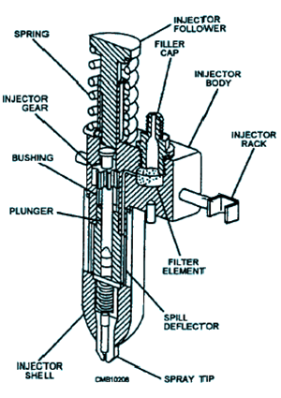

Slide 4
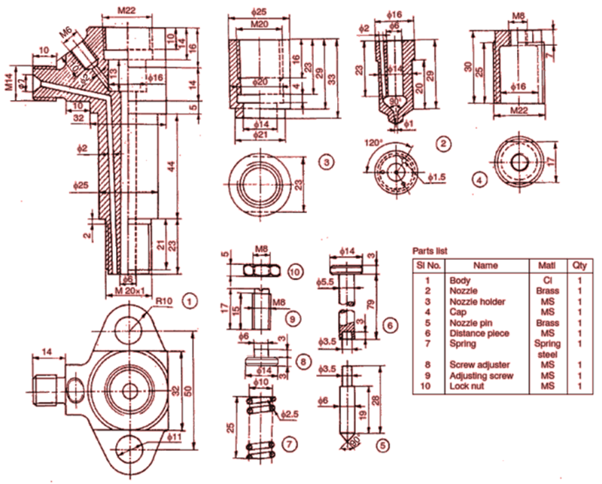

Slide 5
FUEL INJECTOR
50
`
102
1 BODY : 1 NOS

Slide 6
FUEL INJECTOR
50
`
102
1 BODY : 1 NOS

Slide 7
FUEL INJECTOR
φ16
29
2 NOZZLE : 1 NOS

Slide 8
FUEL INJECTOR
φ16
29
2 NOZZLE : 1 NOS

Slide 9
FUEL INJECTOR
φ25
23
M20
3 NOZZLE HOLDER : 1 NOS

Slide 10
FUEL INJECTOR
φ25
23
M20
3 NOZZLE HOLDER : 1 NOS

Slide 11
FUEL INJECTOR
M8
7
30
25
φ16
M22
4 CAP : 1 NOS

Slide 12
FUEL INJECTOR
M8
7
30
25
φ16
M22
4 CAP : 1 NOS

Slide 13
FUEL INJECTOR
9
φ6
19
5 NOZZLE PIN : 1 NOS

Slide 14
FUEL INJECTOR
φ14
3
79
6 DISTANCE PIECE: 1 NOS

Slide 15
FUEL INJECTOR
φ10
φ2.5
25
7 SPRING : 1 NOS

Slide 16
FUEL INJECTOR
φ10
φ2.5
25
7 SPRING : 1 NOS

Slide 17
FUEL INJECTOR
φ10
φ2.5
25
7 SPRING : 1 NOS

Slide 18
FUEL INJECTOR
25
7 SPRING : 1 NOS

Slide 19
FUEL INJECTOR
3
3
φ14
8 SCREW ADJUSTER : 1 NOS

Slide 20
FUEL INJECTOR
17
15
M8
9 ADJUSTING SCREW : 1 NOS

Slide 21
FUEL INJECTOR
5
M8
10 LOCK NUT : 1 NOS

Slide 22
?
?
?
?
?
`
BILL OF MATERIAL ?
?
?
?
?
?

Slide 23
?
?
?
?
BE CAREFUL WITH THE
LINE TYPES ---
HALF SECTION
PROBLEM !
REMOVE ADDITIONAL/
UNNECESSARY LINES
?
`
?
?
?
?
?

