Slide 1
ME 251
Anupam Saxena
Professor
Mechanical Engineering
Compliant and Robotic Systems Lab
Indian Institute of Technology Kanpur

Slide 2
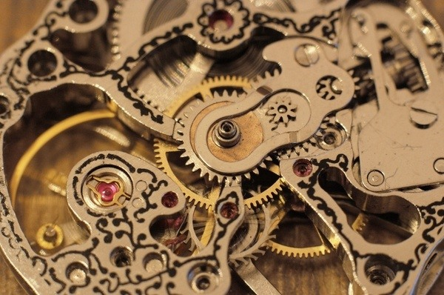
GEARS
INTRODUCTION
A gear or cogwheel ---
a rotating machine part having teeth like cuts, or cogs, which mesh with another toothed part to transmit torque.
Example: clock
http://sf.co.ua/id101135

Slide 3
GEARS
CLASSIFICATION
According to the position of axes of the shafts
Parallel Intersecting Non-intersecting and
non-parallel
According to the peripheral velocity of the gears
Low velocity Medium velocity High velocity
According to the type of gearing
External gearing Internal gearing Rack and pinion
According to position of teeth on the gear surface
Straight inclined curved

Slide 4
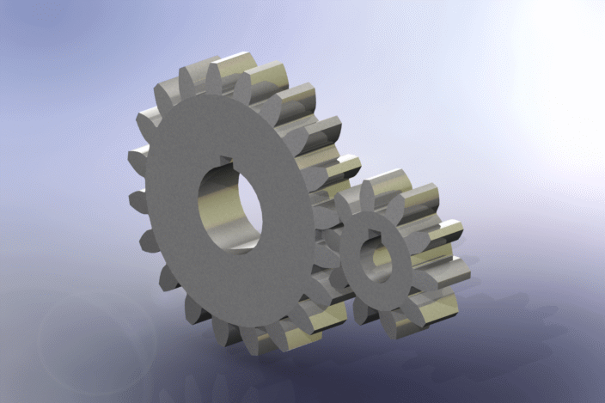
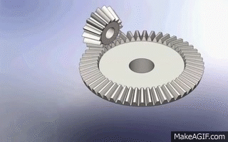
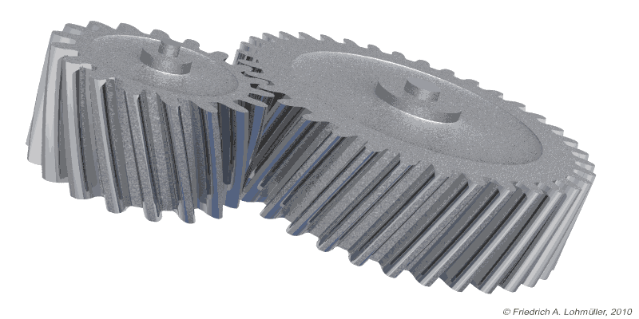
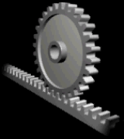
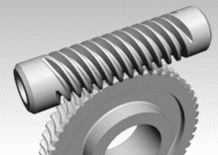
GEARS
TYPES OF GEARS
SPUR GEARS
HELICAL GEARS
BEVEL GEARS
WORM GEARS
RACK AND PINION
https://grabcad.com/library/spur-gear-pair-1
https://science.howstuffworks.com/transport/engines-equipment/gear3.htm
https://makeagif.com/gif/bevel-gear-animation-4_7N4e
https://makeagif.com/gif/bevel-gear-animation-4_7N4e

Slide 5
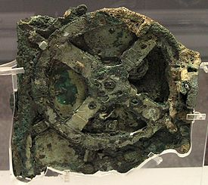
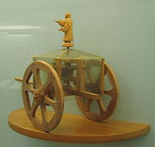
GEARS
HISTORY
Examples of early gear applications include:
The Antikythera mechanism (2nd century BC)
Ma Jun (c. 200–265 AD) used gears as part of a south-pointing chariot.
The first geared mechanical clocks were built in China in 725.
https://en.wikipedia.org/wiki/Gear

Slide 6
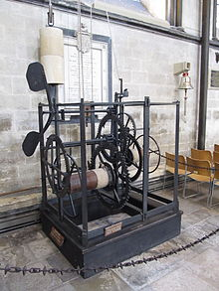
GEARS
HISTORY
Al-Jazari (c. 1206) invented the segmental gear as part of a water-lifting device.
The worm gear was invented as part of a roller cotton gin in the Indian subcontinent (c. 13th–14th centuries).
The 1386 Salisbury cathedral clock may be the world's oldest still working geared mechanical clock.
https://en.wikipedia.org/wiki/Gear

Slide 7
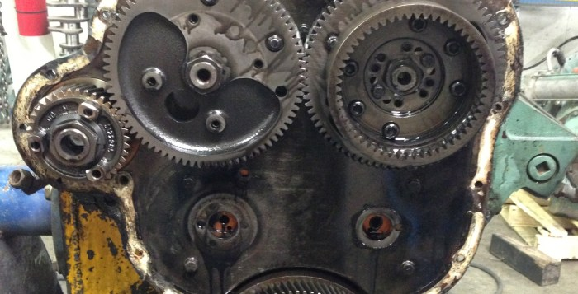
SPUR GEARS
Radially projecting teeth that have straight edges and are aligned parallel to the axis of rotation
Spur gears have high power transmission efficiency.
constant velocity ratio.
Unlike belt drives, spur gear drives have no slip.
highly reliable.
Spur gears in a marine engine
$$ω_{1}r_{1}=ω_{2}r_{2}$$
$$τ_{1}ω_{1}=τ_{2}ω_{2}$$
https://grabcad.com/library/spur-gear-pair-1
http://www.technomadia.com/2013/07/disassembling-and-dissecting-a-detroit-diesel-8v-71/

Slide 8
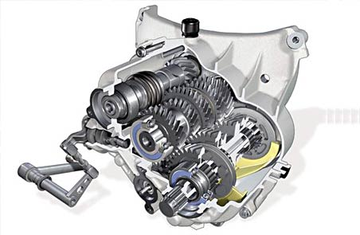
HELICAL GEARS
Teeth Not parallel to the axis of rotation, but are set at an angle
gradual engagement makes helical gears operate much more smoothly
Helical gears are preferred for heavy load applications
Automobile gearbox with helical gears
https://science.howstuffworks.com/transport/engines-equipment/gear3.htm

Slide 9
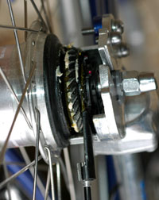
BEVEL GEARS
The axes of the two shafts intersect and the tooth-bearing faces of the gears themselves are conically shaped
Straight bevel gears have conical pitch surface and teeth are straight and tapering towards apex.
Spiral bevel gears have curved teeth at an angle allowing tooth contact to be gradual and smooth
Bevel ring gear on the rear wheel of a shaft-driven bicycle
https://en.wikipedia.org/wiki/Bevel_gear
https://makeagif.com/gif/bevel-gear-animation-4_7N4e

Slide 10
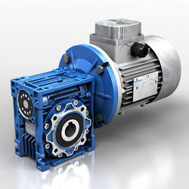
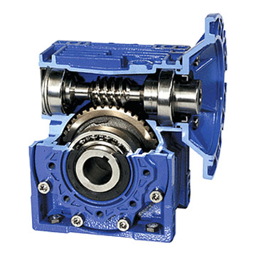
WORM GEARS
worm: a gear in the form of a screw
worm gear: a spur gear
can transfer motion at 90 degrees
worm drive can reduce rotational speed or transmit higher torque
https://en.wikipedia.org/wiki/Bevel_gear
https://makeagif.com/gif/bevel-gear-animation-4_7N4e
http://www.speedreducer.org/worm-reducers.htm

Slide 11
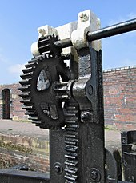
RACK AND PINION
Type of linear actuator that comprises a pair of gears which convert rotational motion into linear motion
Easiest way to convert rotation motion into linear motion
Commonly used in the steering system of cars to convert the rotary motion of the steering wheel to the side to side motion in the wheels
Lock gate controls on a canal
https://en.wikipedia.org/wiki/Rack_and_pinion

Slide 12
Spur gear tooth geometry
P_{d} - Diametral pitch
(number of teeth by pitch diameter)
1/p_{d}
π/p_{d}
1.25/p_{d}
1.571/p_{d}
d=N/p_{d}
0.25/p_{d}
0.3/p_{d}
http://shodhganga.inflibnet.ac.in/bitstream/10603/29407/8/08_chapter3.pdf

Slide 13
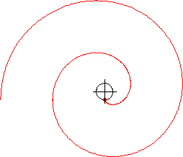
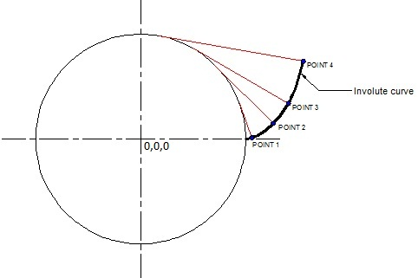
Gear tooth profile- Involute
http://www.beyondmech.com/pro-e/cad-topic-6.html

Slide 14
How to draw: Tooth profile- Involute
Base Circle
π D

Slide 15
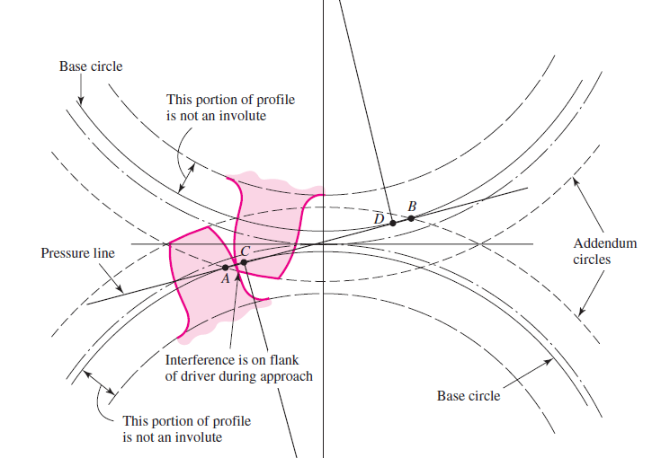
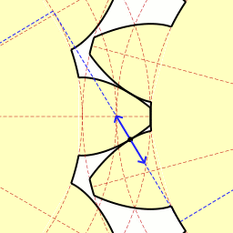
Pressure angle
Pressure angle
φ
https://en.wikipedia.org/wiki/Involute_gear
the involute teeth profile facilitates the contact point to move smoothly
Slides Adapted from Prof. P. Venkitanarayanan

Slide 16
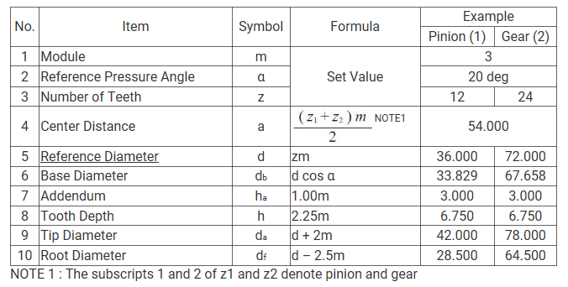
Spur gear Representation
https://khkgears.net/new/gear_knowledge/gear_technical_reference/calculation_gear_dimensions.html
Eg. PCD = 50, number of teeth (z) = 25 => m = 50/25 = 2
Chamfering at teeth

Slide 17
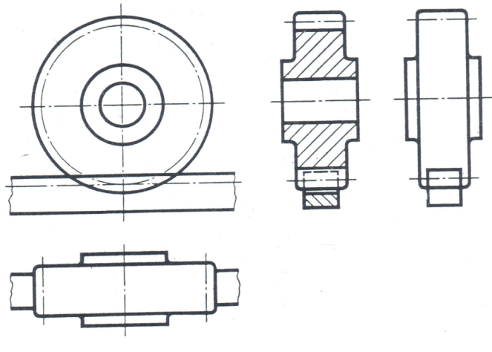
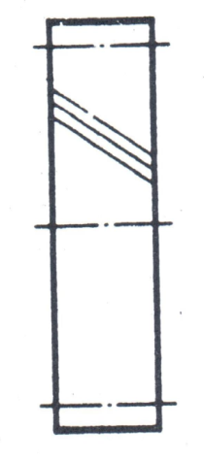
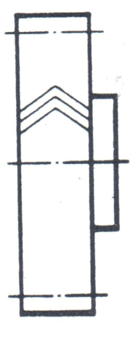
Helical spur and Rack-pinion
Right
Left
Helical gear teeth
Helical spur
Rack and Pinion

Slide 18
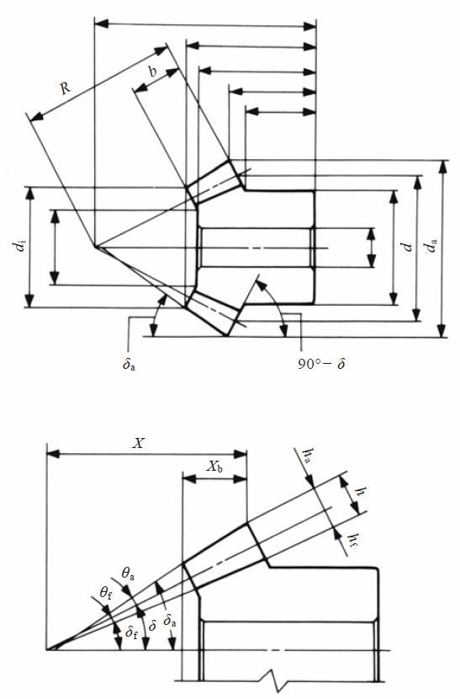
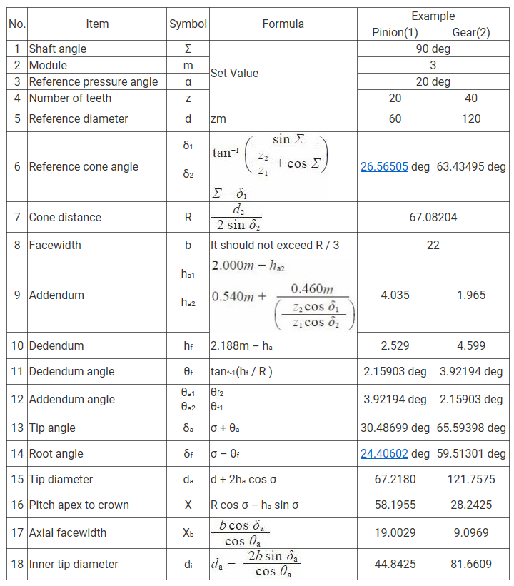
Bevel gear Representation
https://khkgears.net/new/gear_knowledge/gear_technical_reference/calculation_gear_dimensions.html

Slide 19
Bevel gear Representation
https://khkgears.net/new/gear_knowledge/gear_technical_reference/calculation_gear_dimensions.html

Slide 20
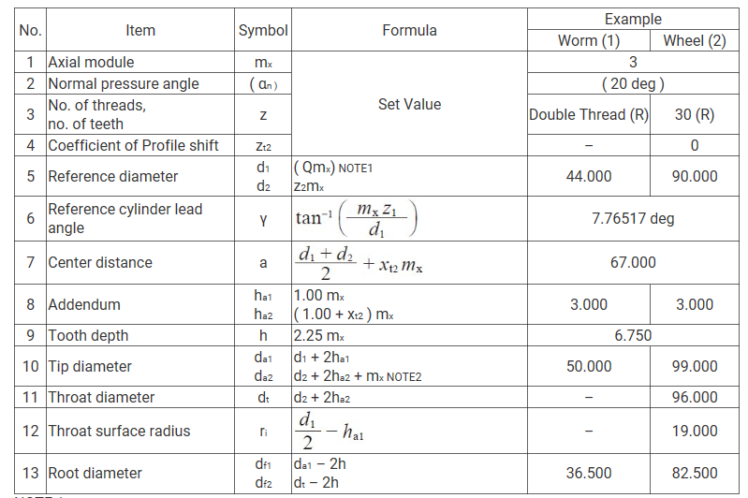
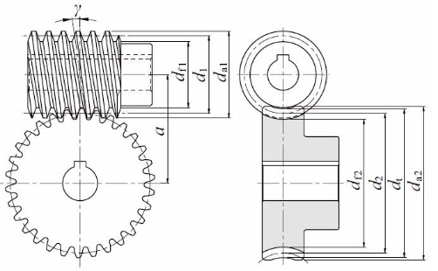
Worm gear/wheel Representation
Concept is a lot more involved and requires further/detailed reading ---
We focus on simplistic representational aspects ---
NOTE 1. Diameter factor, Q, means reference diameter of worm, d1, over axial module, mx. Q=d1 / mx
https://khkgears.net/new/gear_knowledge/gear_technical_reference/calculation_gear_dimensions.html

Slide 21
Worm gear/wheel Representation
Concept is a lot more involved and requires further/detailed reading ---
We focus on simplistic representational aspects ---
NOTE 1. Diameter factor, Q, means reference diameter of worm, d1, over axial module, mx. Q=d1 / mx
https://khkgears.net/new/gear_knowledge/gear_technical_reference/calculation_gear_dimensions.html

Slide 22
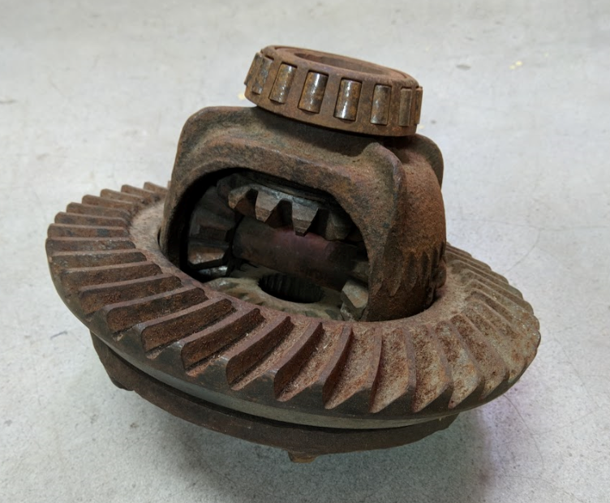
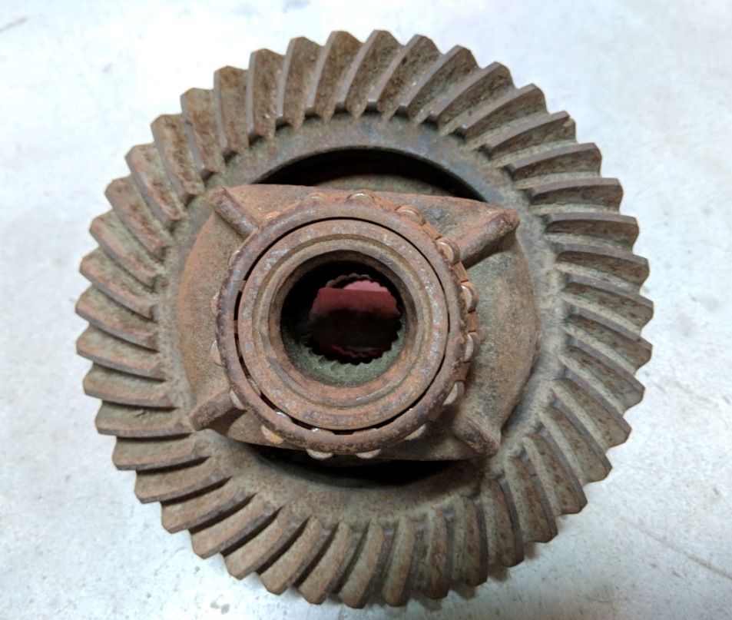
Differential Mechanism

Slide 23
Differential Mechanism Working
https://www.youtube.com/watch?v=xs2SApdWo20&feature=youtu.be

Slide 24
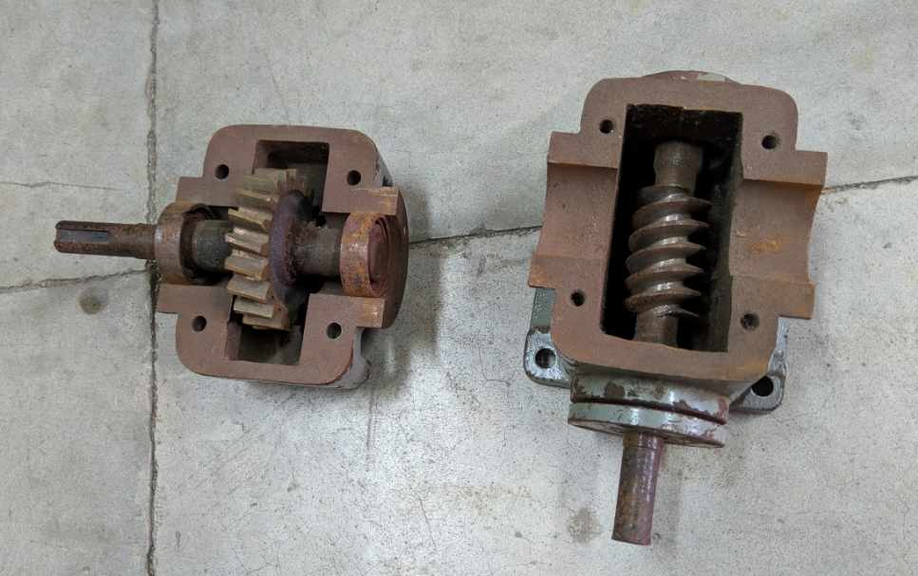
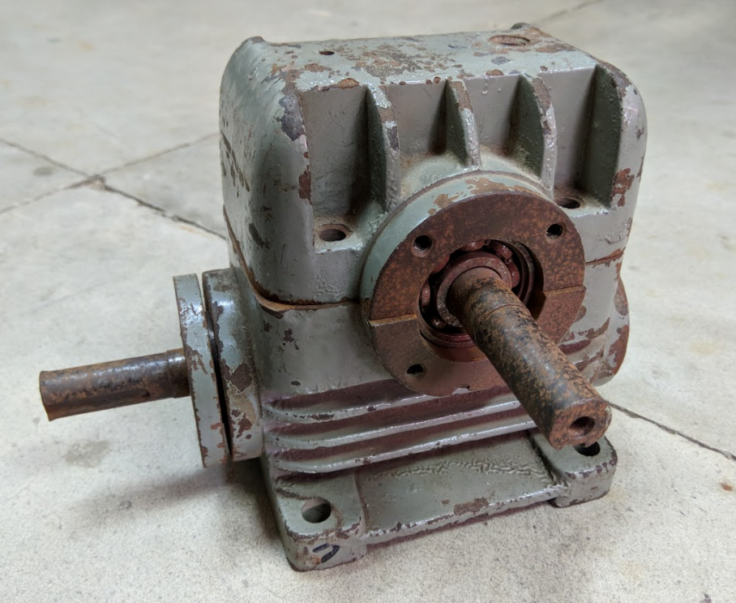
Speed Reducer

Slide 25
Mechanical Watch
https://www.youtube.com/watch?v=JAuRonHZiR8
https://www.youtube.com/watch?v=3MUL65-vZHY

