Slide 1
ME 251
Anupam Saxena
Professor
Mechanical Engineering
Compliant and Robotic Systems Lab
Indian Institute of Technology Kanpur

Slide 2
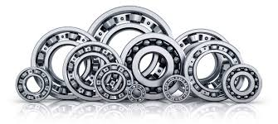
BEARINGS

Slide 3
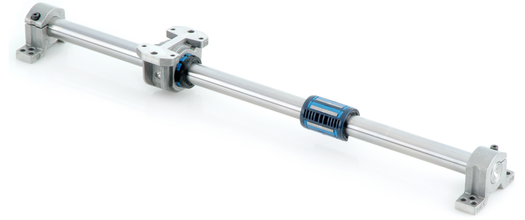
Bearings are machine elements which are used to support a rotating member viz., a shaft. They transmit the load from a rotating member to a stationary member known as frame or housing.
They permit relative motion of two members in one or two directions with minimum friction, and also prevent the motion in the direction of the applied load.
Bearings
http://www.skf.com/uk/products/motion-technologies/linear-guides-and-tables/linear-ball-bearings/linear-ball-bearing-lbc/index.html
http://nptel.ac.in/courses/112106137/pdf/5_1.pdf

Slide 4
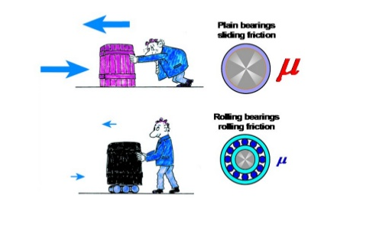
Power of Bearing
https://www.slideshare.net/moulikparmar1/bearings-57879498

Slide 5
Types of Bearings
(Based on type of contact)
Sliding Contact
Rolling Contact
(Based on type rolling element)
Ball Bearing
Roller Bearing
Deep Groove
Angular Contact
Self-align
Cylindrical R.B.
Needle R.B.
Tapered R.B.
(Based on lubrication Mechanism)
(Based on type of load carried)
(Based on type of lubrication)
Radial Bearing
Thrust
Bearing
Thick Film
Lubrication
Thin Film
Lubrication
Boundary Film
Lubrication
Hydrodynamic
Bearing
Hydrostatic
Bearing

Slide 6
Sliding Bearings
The rotating shaft has a sliding contact with the bearing.
Friction is very high.
Journal Bearings (Radial Bearing)
Bushed bearing
Pedastal Bearing (Plummer Block)
Pivot or Foot-step bearings

Slide 7
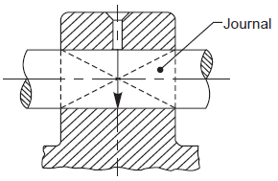
Journal Bearings (Radial Bearing)
When the load on a bearing is perpendicular (normal) to the shaft axis, the bearing is known as a journal bearing.
The term ‘journal’, refers to that part of the shaft which is in contact with the bearing
Examples:-
Load
Solid Journal Bearing
Bushed Journal Bearing
Pedastal Bearing (Plummer Block)
Bracket and Hanger Bearing
Machine drawing by K L Narayana, P kannaiah and V reddy

Slide 8
Solid Journal Bearing
Simplest among the journal bearings.
Used when the load on the bearing is small and the wear is immaterial.
Usually made of cast iron
Consists of one block in which a hole is bored
The journal rotates in this hole
The whole bearing has to be replaced once the hole surfaces are worn out
Front View
Top View
Solid Journal Bearing Assembly
Machine drawing by K L Narayana, P kannaiah and V reddy

Slide 9
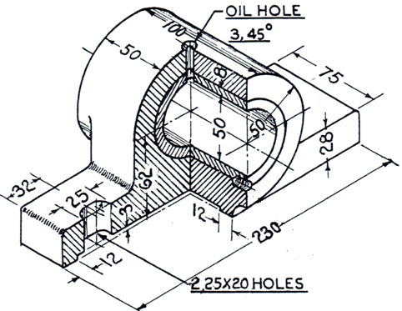
Bushed bearing
Consists of i) body and ii) bush
Body made of cast iron
Bush is made of a soft material like brass, bronze of gun metal
A set screw fitted such that half of it is in the body and half in the bush prevents the bush from rotating and sliding
Bush
Body
Slot
Set screw
Machine drawing by K L Narayana, P kannaiah and V reddy

Slide 10
Pedastal Bearing (Plummer Block)
Used for long shafts, requiring intermediate support, especially when the shaft cannot be introduced in the bearing end-wise.
Consists of a pedastal or base, a cap and a bush, split into two halves, called ‘bearing brasses’.
Split parts used facilitate easy assembly and periodical replacement of the worn-out brasses.
Bush has flanges at either ends to prevent it from sliding
Plummer Block
Machine drawing by K L Narayana, P kannaiah and V reddy

Slide 11
Pedastal Bearing (Plummer Block)
Top View
Sectional Front View
Machine drawing by K L Narayana, P kannaiah and V reddy

Slide 12
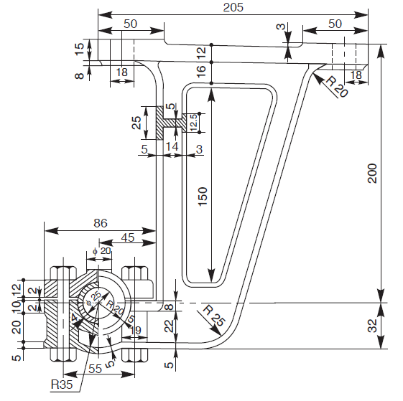
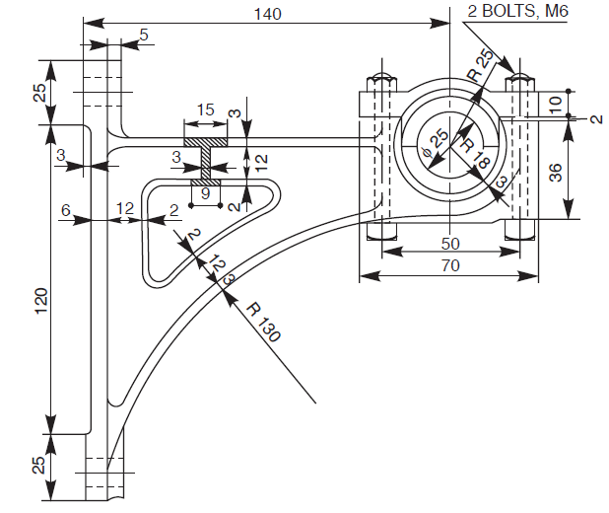
Bracket and hanger bearing
Brackets and hangers with bearings mounted, are used to support transmission or line shafts.
Bracket bearing supports a shaft running parallel to and near a wall or near a row of pillars.
Hanger bearings support a shaft running parallel to a beam or ceiling of a room. These are generally named after their shapes.
Most commonly used types being J-hangers and U-hangers.
Hanger with pedestal bearing
Wall bracket with pedestal bearing
Machine drawing by K L Narayana, P kannaiah and V reddy

Slide 13
Thrust Bearings
Thrust bearings are used to support shafts subjected to axial loads.
These bearings are classified as :
  pivot or foot-step bearings
  collar bearings
Examples:-
Pivot or Foot-step bearings
Collar Thrust Bearing
Load
Machine drawing by K L Narayana, P kannaiah and V reddy

Slide 14
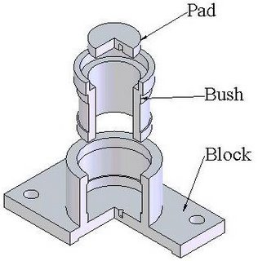
Pivot or Foot-step bearings
Used to support shafts subjected to axial loads.
Machine drawing by K L Narayana, P kannaiah and V reddy

Slide 15
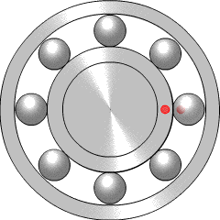
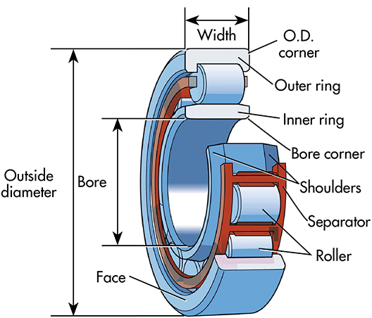
Rolling Contact or Anti-Friction Bearing
The bearings, in which a rolling friction is present, are known as rolling contact bearings.
As rolling friction is very much less than sliding friction, rolling contact bearings are called anti-frictionbearings.
Consists of four parts:
  Inner Race
  Outer Race
  Cage
  Balls or Rollers
Shigley’s Mechanical Engineering Design, Eighth Edition

Slide 16
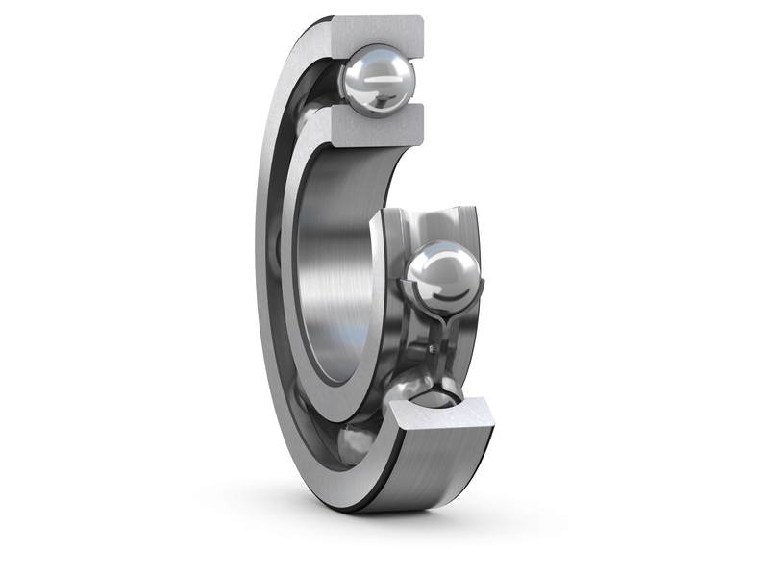
Rolling Contact or Anti-Friction Bearing
Deep Groove Ball Bearing
Assembly drawing
Technical drawing
http://www.dungannonbearingco.co.uk/category/products/bearings/deep-groove-ball-bearings/
Shigley’s Mechanical Engineering Design, Eighth Edition

Slide 17
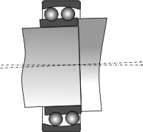
Rolling Contact or Anti-Friction Bearing
Spherical or Self-align Ball Bearing
Technical drawing
Assembly drawing
Source: https://www.astbearings.com/spherical-bearings.html
Shigley’s Mechanical Engineering Design, Eighth Edition

Slide 18
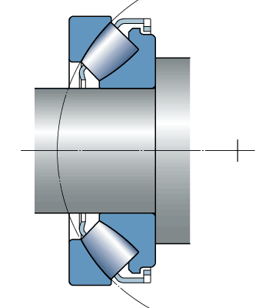
Rolling Contact or Anti-Friction Bearing
Spherical Roller Bearing
Technical drawing
Assembly drawing
Source: http://www.skf.com
Shigley’s Mechanical Engineering Design, Eighth Edition

Slide 19
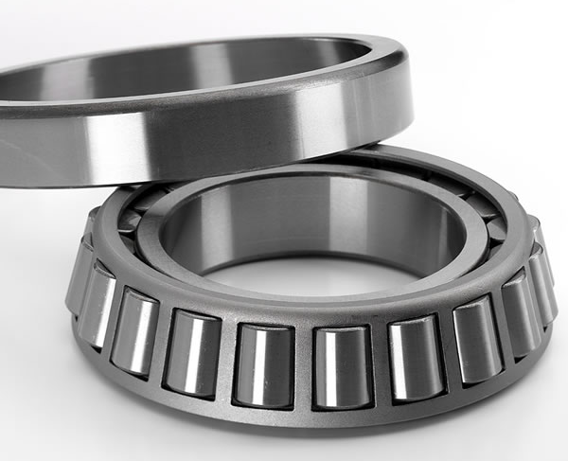
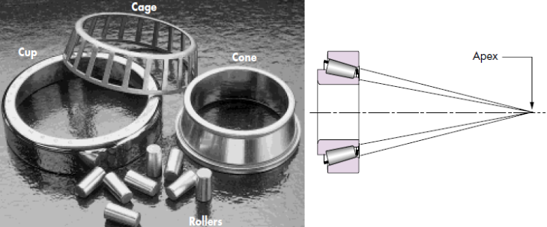
Rolling Contact or Anti-Friction Bearing
Tapered Roller Bearing
Source: https://www.globalspec.com/learnmore/mechanical_components/bearings_bushings/tapered_roller_bearings
Shigley’s Mechanical Engineering Design, Eighth Edition

Slide 20
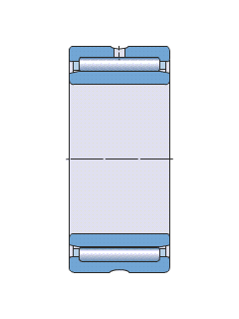
Rolling Contact or Anti-Friction Bearing
Needle Bearing
Technical drawing
Assembly drawing
Source: http://www.skf.com
Shigley’s Mechanical Engineering Design, Eighth Edition

Slide 21
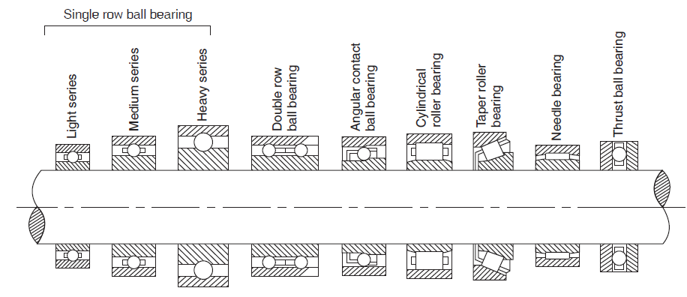
Bearing types- Summary
Absolutely no thrust load
No radial load
Radial and thrust loads
Radial and thrust loads
Radial and thrust load in one direction
Shigley’s Mechanical Engineering Design, Eighth Edition
Slides adapted from Prof. P. Venkitanarayanan

