Slide 1
Computer Aided Engineering Design
Anupam Saxena
Associate Professor
Indian Institute of Technology KANPUR 208016
Notes:
- There is a reason why the term DESIGN is highlighted in this slide
Design is a SIGNIFICANT and a BROAD term, and it is only appropriate for us to proceed with the CAD course after we understand the term DESIGN well.
- We will try to understand DESIGN through this lecture while a single lecture does not justify the purpose.
- there are many dedicated courses and programs on Design itself!

Slide 2
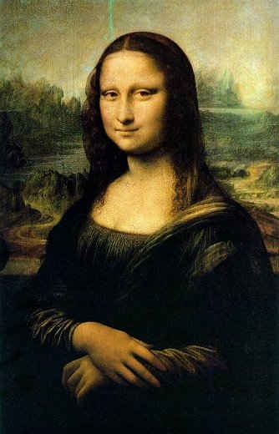
What is Design?
lairweb.org.nz
Notes:
The basic question: What is DESIGN?
IS IT ART?
This is a very famous painting by Leonardo da Vinci
People who know his work well consider him to be both, and ARTIST and an ENGINEER.
- Was he more of an ARTIST or LESS of an ENGINEER or vice versa is OPEN to SPECULATION though
- Of course, the term ‘Engineer ‘ was possibly not coined then. It emanated much later. But in his time, Leonardo was able to classify/ differentiate different mechanical or machine elements, like the gears, links, belt and pulley arrangements and more.

Slide 3
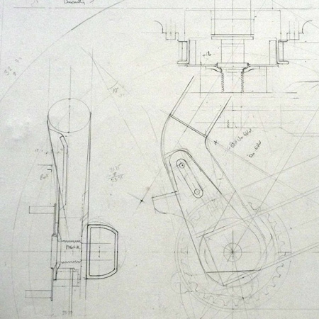
Is it Engineering?
dezeen.com
Notes:
- Is Design related to Engineering where complicated calculations are supposed to be made?

Slide 4
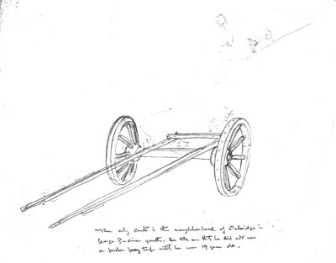
Is it Rational?
reading.ac.uk
Notes:
-or is it Rational, for example a WHEEL…
- We all know that the WHEEL is one of the proud inventions of mankind and the best way for an Efficient Motion transfer.

Slide 5
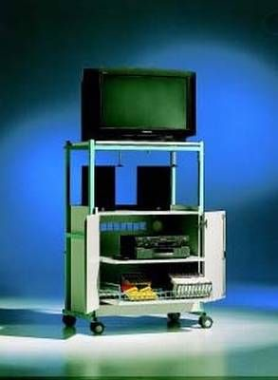
Product design!
moeco.co.uk
Notes:
Do all CULMINATE INTO product design?
- While many are looking at the Television set, I am looking at the cabinet, the music system and other paraphernalia.
- Of course, we see a variety of products now a days which are so “eye pleasing.”
- We have witnessed MANY in the first lecture!

Slide 6
Design
Notes:
May be, PRODUCT DESIGN involves all ----
- The “ART” or “Engineering” or “Rational” component may be MORE or LESS depending on the product being designed!
-for example a CAR --- the Engineering aspect seems more compared to the AESTHETIC – Though the AESTHETIC COMPONENT IS VERY MUCH PRESENT.
Ergonomics --- A Person’s COMFORT and ECONOMICS --- A MAN’s POCKET both are important aspects as well…

Slide 7
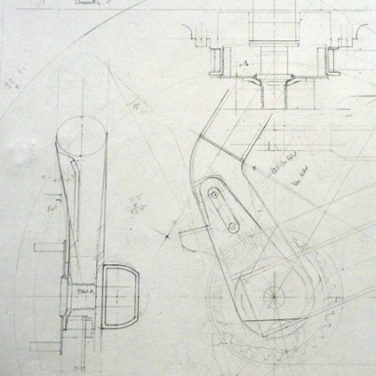
The DESIGN Process…
Imagination
yield appealing and workable, in fact efficient end products
Imagination requires freedom!
Constrained minds cannot think!
The DESIGN PROCESS may or may not follow a set of rules
A set of Rules may or may not be common in any TWO design processes
Design process ‘A’ may or may not be better than the design process ‘B’.
Notes:
A design process should involve IMAGINATION and should yield appealing and workable, rather efficient designs.
- Appealing here has implications in terms of Economics, Aesthetics, and Ergonomics.
- Economics → the product should be affordable
-- Aesthetics → the product should be pleasing to the Eye
-- Ergonomics → a human should be comfortable using it.
-- IMAGINATION REQUIRES FREEDOM!
--- CONSTRAINED MINDS CANNOT THINK !
-- A design process may or may not follow a SET OF RULES
- In Art design: Rules may be concealed: e.g., ratio of facial lineaments or features are possibly worked on before the final rendering in the form of a PORTRAIT sketch or a painting is provided
-- In Engineering design: Certain rules, e.g., those related to failure should be applied and commonly agreed upon – one cannot apply different set of failure criteria for the same design.
--A set of design rules may or may no be common between any two design processes.
-- A design process ‘A’ may or may not be better than any other design process ‘B’
-- My personal opinion: the design processes may not be comparable since many evaluation criteria based on aesthetics, ergonomics and others are possibly subjective and cannot be quantified easily.

Slide 8
The Design process I learnt…
Stage I: Function Determination – Rapid fire
Stage II: Choosing Functionality --- NEED and AFFORDABILITY
Stage III: Form Rendering – Rapid fire
Stage IV: Form choosing
Stage V: Developing Few Chosen Forms
Stage VI: Rendering Spatial Forms – Parametric Solid Modeling
Stage VII: Prototyping the selected models
Cooperative Competition Scenario
Notes:
I delineate the design process I learnt when I was an undergraduate at IIT Bombay… It follows about SEVEN or so steps…
< NAME THEM>
-We will demonstrate each step through a SMALL workshop EXMAPLE on the design of a TABLE LAMP
-- We will work in the COOPERATIVE COMPETITION SCENARIO. We have about 10 students participating in the Workshop. I divide them into 5 groups of two each. Two students in a group will collaborate while the 5 groups will be competing. At NO stage in the design process will the groups be interacting or sharing information!

Slide 9
# 2 Solid Modeling: Curtain raiser

Slide 10
Perception of Solids
Geometric/PARAMETRIC Modeling
Solid Modeling
Perception of Solids
Modeling of Curves
Modeling of Surfaces (Patches)
Topology and Solids
Solid Modeling 1-2
Transformations and Projections 1-2
Representation, Differential Geometry
Ferguson Segments
Bezier Segments 1-2
B-spline curves 1-5
NURBS
Differential Geometry
Tensor Product
Boundary Interpolating
Composite
NURBS
Geometric/PARAMETRIC Modeling
Solid Modeling
Perception of Solids
Modeling of Curves
Modeling of Surfaces (Patches)
Topology and Solids
Solid Modeling 1-2
Transformations and Projections 1-2
Representation, Differential Geometry
Ferguson Segments
Bezier Segments 1-2
B-spline curves 1-5
NURBS
Differential Geometry
Tensor Product
Boundary Interpolating
Composite
NURBS

Slide 11
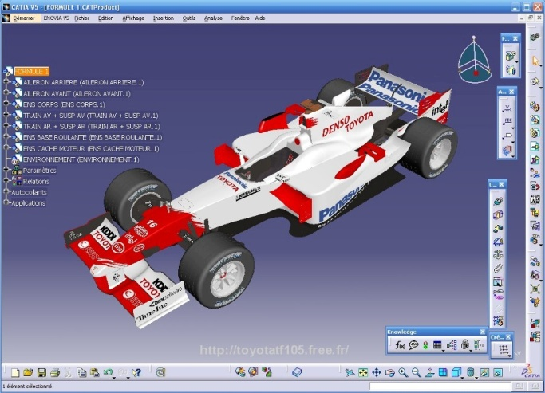
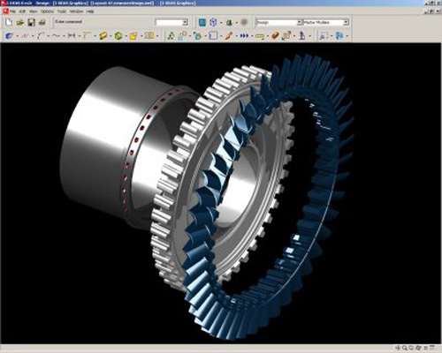
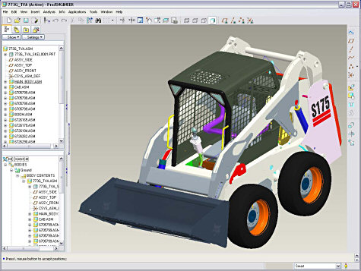
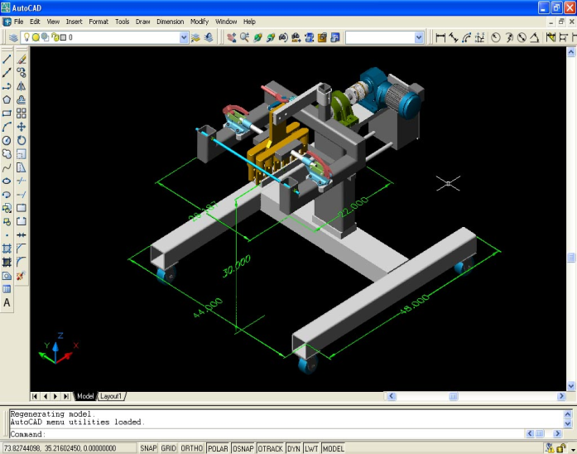
Solid Modelers
Geometric/PARAMETRIC Modeling
Solid Modeling
Perception of Solids
Modeling of Curves
Modeling of Surfaces (Patches)
Topology and Solids
Solid Modeling 1-2
Transformations and Projections 1-2
Representation, Differential Geometry
Ferguson Segments
Bezier Segments 1-2
B-spline curves 1-5
NURBS
Differential Geometry
Tensor Product
Boundary Interpolating
Composite
NURBS
CATIATM
I-DEASTM
…
Pro-engineerTM
AutoCADTM
http://www.3ds.com/products/catia/portfolio/
engineering.purdue.edu
file-extensions.org
cadalyst.com

Slide 12
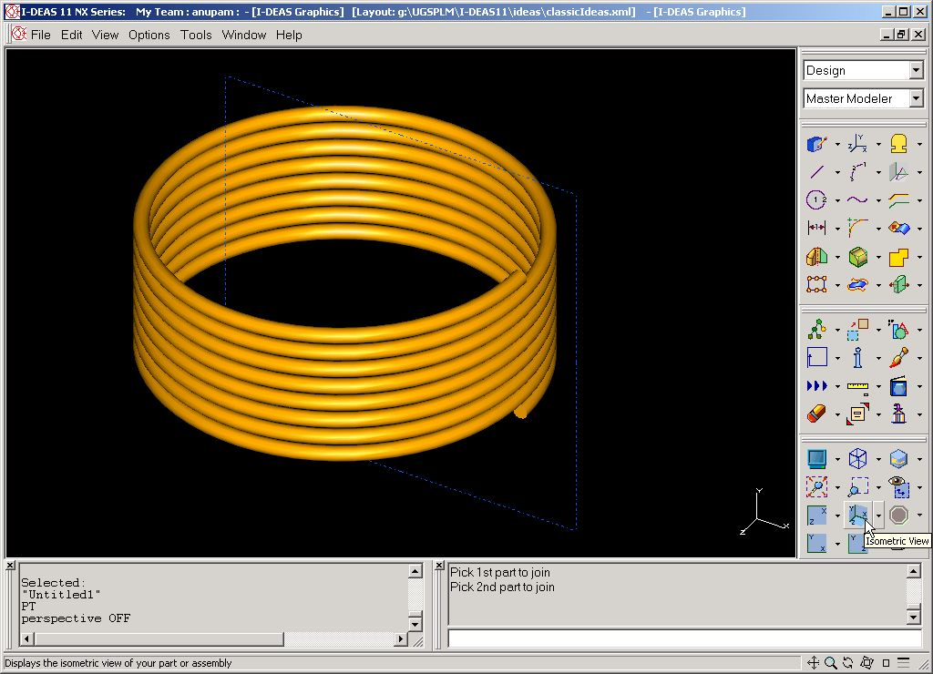
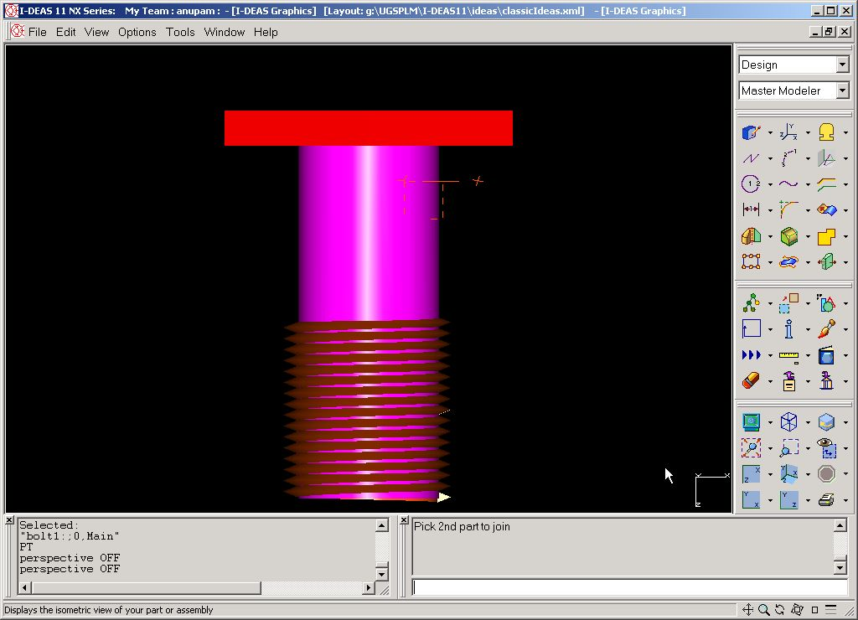
Spring and Bolt examples…
Geometric/PARAMETRIC Modeling
Solid Modeling
Perception of Solids
Modeling of Curves
Modeling of Surfaces (Patches)
Topology and Solids
Solid Modeling 1-2
Transformations and Projections 1-2
Representation, Differential Geometry
Ferguson Segments
Bezier Segments 1-2
B-spline curves 1-5
NURBS
Differential Geometry
Tensor Product
Boundary Interpolating
Composite
NURBS

Slide 13
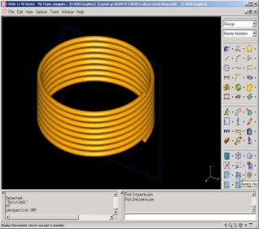
Geometric/PARAMETRIC Modeling
Solid Modeling
Perception of Solids
Modeling of Curves
Modeling of Surfaces (Patches)
Topology and Solids
Solid Modeling 1-2
Transformations and Projections 1-2
Representation, Differential Geometry
Ferguson Segments
Bezier Segments 1-2
B-spline curves 1-5
NURBS
Differential Geometry
Tensor Product
Boundary Interpolating
Composite
NURBS

Slide 14
Geometric/PARAMETRIC Modeling
Solid Modeling
Perception of Solids
Modeling of Curves
Modeling of Surfaces (Patches)
Topology and Solids
Solid Modeling 1-2
Transformations and Projections 1-2
Representation, Differential Geometry
Ferguson Segments
Bezier Segments 1-2
B-spline curves 1-5
NURBS
Differential Geometry
Tensor Product
Boundary Interpolating
Composite
NURBS

Slide 15
Geometric/PARAMETRIC Modeling
Solid Modeling
Perception of Solids
Modeling of Curves
Modeling of Surfaces (Patches)
Topology and Solids
Solid Modeling 1-2
Transformations and Projections 1-2
Representation, Differential Geometry
Ferguson Segments
Bezier Segments 1-2
B-spline curves 1-5
NURBS
Differential Geometry
Tensor Product
Boundary Interpolating
Composite
NURBS

Slide 16
Geometric/PARAMETRIC Modeling
Solid Modeling
Perception of Solids
Modeling of Curves
Modeling of Surfaces (Patches)
Topology and Solids
Solid Modeling 1-2
Transformations and Projections 1-2
Representation, Differential Geometry
Ferguson Segments
Bezier Segments 1-2
B-spline curves 1-5
NURBS
Differential Geometry
Tensor Product
Boundary Interpolating
Composite
NURBS

Slide 17
Geometric/PARAMETRIC Modeling
Solid Modeling
Perception of Solids
Modeling of Curves
Modeling of Surfaces (Patches)
Topology and Solids
Solid Modeling 1-2
Transformations and Projections 1-2
Representation, Differential Geometry
Ferguson Segments
Bezier Segments 1-2
B-spline curves 1-5
NURBS
Differential Geometry
Tensor Product
Boundary Interpolating
Composite
NURBS

Slide 18
Geometric/PARAMETRIC Modeling
Solid Modeling
Perception of Solids
Modeling of Curves
Modeling of Surfaces (Patches)
Topology and Solids
Solid Modeling 1-2
Transformations and Projections 1-2
Representation, Differential Geometry
Ferguson Segments
Bezier Segments 1-2
B-spline curves 1-5
NURBS
Differential Geometry
Tensor Product
Boundary Interpolating
Composite
NURBS

Slide 19
Geometric/PARAMETRIC Modeling
Solid Modeling
Perception of Solids
Modeling of Curves
Modeling of Surfaces (Patches)
Topology and Solids
Solid Modeling 1-2
Transformations and Projections 1-2
Representation, Differential Geometry
Ferguson Segments
Bezier Segments 1-2
B-spline curves 1-5
NURBS
Differential Geometry
Tensor Product
Boundary Interpolating
Composite
NURBS

Slide 20
Geometric/PARAMETRIC Modeling
Solid Modeling
Perception of Solids
Modeling of Curves
Modeling of Surfaces (Patches)
Topology and Solids
Solid Modeling 1-2
Transformations and Projections 1-2
Representation, Differential Geometry
Ferguson Segments
Bezier Segments 1-2
B-spline curves 1-5
NURBS
Differential Geometry
Tensor Product
Boundary Interpolating
Composite
NURBS

Slide 21
Geometric/PARAMETRIC Modeling
Solid Modeling
Perception of Solids
Modeling of Curves
Modeling of Surfaces (Patches)
Topology and Solids
Solid Modeling 1-2
Transformations and Projections 1-2
Representation, Differential Geometry
Ferguson Segments
Bezier Segments 1-2
B-spline curves 1-5
NURBS
Differential Geometry
Tensor Product
Boundary Interpolating
Composite
NURBS

Slide 22
Geometric/PARAMETRIC Modeling
Solid Modeling
Perception of Solids
Modeling of Curves
Modeling of Surfaces (Patches)
Topology and Solids
Solid Modeling 1-2
Transformations and Projections 1-2
Representation, Differential Geometry
Ferguson Segments
Bezier Segments 1-2
B-spline curves 1-5
NURBS
Differential Geometry
Tensor Product
Boundary Interpolating
Composite
NURBS

Slide 23
Geometric/PARAMETRIC Modeling
Solid Modeling
Perception of Solids
Modeling of Curves
Modeling of Surfaces (Patches)
Topology and Solids
Solid Modeling 1-2
Transformations and Projections 1-2
Representation, Differential Geometry
Ferguson Segments
Bezier Segments 1-2
B-spline curves 1-5
NURBS
Differential Geometry
Tensor Product
Boundary Interpolating
Composite
NURBS

Slide 24
Geometric/PARAMETRIC Modeling
Solid Modeling
Perception of Solids
Modeling of Curves
Modeling of Surfaces (Patches)
Topology and Solids
Solid Modeling 1-2
Transformations and Projections 1-2
Representation, Differential Geometry
Ferguson Segments
Bezier Segments 1-2
B-spline curves 1-5
NURBS
Differential Geometry
Tensor Product
Boundary Interpolating
Composite
NURBS

Slide 25
Geometric/PARAMETRIC Modeling
Solid Modeling
Perception of Solids
Modeling of Curves
Modeling of Surfaces (Patches)
Topology and Solids
Solid Modeling 1-2
Transformations and Projections 1-2
Representation, Differential Geometry
Ferguson Segments
Bezier Segments 1-2
B-spline curves 1-5
NURBS
Differential Geometry
Tensor Product
Boundary Interpolating
Composite
NURBS

Slide 26
Geometric/PARAMETRIC Modeling
Solid Modeling
Perception of Solids
Modeling of Curves
Modeling of Surfaces (Patches)
Topology and Solids
Solid Modeling 1-2
Transformations and Projections 1-2
Representation, Differential Geometry
Ferguson Segments
Bezier Segments 1-2
B-spline curves 1-5
NURBS
Differential Geometry
Tensor Product
Boundary Interpolating
Composite
NURBS

Slide 27
Geometric/PARAMETRIC Modeling
Solid Modeling
Perception of Solids
Modeling of Curves
Modeling of Surfaces (Patches)
Topology and Solids
Solid Modeling 1-2
Transformations and Projections 1-2
Representation, Differential Geometry
Ferguson Segments
Bezier Segments 1-2
B-spline curves 1-5
NURBS
Differential Geometry
Tensor Product
Boundary Interpolating
Composite
NURBS

Slide 28
Geometric/PARAMETRIC Modeling
Solid Modeling
Perception of Solids
Modeling of Curves
Modeling of Surfaces (Patches)
Topology and Solids
Solid Modeling 1-2
Transformations and Projections 1-2
Representation, Differential Geometry
Ferguson Segments
Bezier Segments 1-2
B-spline curves 1-5
NURBS
Differential Geometry
Tensor Product
Boundary Interpolating
Composite
NURBS

Slide 29
Geometric/PARAMETRIC Modeling
Solid Modeling
Perception of Solids
Modeling of Curves
Modeling of Surfaces (Patches)
Topology and Solids
Solid Modeling 1-2
Transformations and Projections 1-2
Representation, Differential Geometry
Ferguson Segments
Bezier Segments 1-2
B-spline curves 1-5
NURBS
Differential Geometry
Tensor Product
Boundary Interpolating
Composite
NURBS

Slide 30
Geometric/PARAMETRIC Modeling
Solid Modeling
Perception of Solids
Modeling of Curves
Modeling of Surfaces (Patches)
Topology and Solids
Solid Modeling 1-2
Transformations and Projections 1-2
Representation, Differential Geometry
Ferguson Segments
Bezier Segments 1-2
B-spline curves 1-5
NURBS
Differential Geometry
Tensor Product
Boundary Interpolating
Composite
NURBS

Slide 31
Geometric/PARAMETRIC Modeling
Solid Modeling
Perception of Solids
Modeling of Curves
Modeling of Surfaces (Patches)
Topology and Solids
Solid Modeling 1-2
Transformations and Projections 1-2
Representation, Differential Geometry
Ferguson Segments
Bezier Segments 1-2
B-spline curves 1-5
NURBS
Differential Geometry
Tensor Product
Boundary Interpolating
Composite
NURBS

Slide 32
Geometric/PARAMETRIC Modeling
Solid Modeling
Perception of Solids
Modeling of Curves
Modeling of Surfaces (Patches)
Topology and Solids
Solid Modeling 1-2
Transformations and Projections 1-2
Representation, Differential Geometry
Ferguson Segments
Bezier Segments 1-2
B-spline curves 1-5
NURBS
Differential Geometry
Tensor Product
Boundary Interpolating
Composite
NURBS

Slide 33
Geometric/PARAMETRIC Modeling
Solid Modeling
Perception of Solids
Modeling of Curves
Modeling of Surfaces (Patches)
Topology and Solids
Solid Modeling 1-2
Transformations and Projections 1-2
Representation, Differential Geometry
Ferguson Segments
Bezier Segments 1-2
B-spline curves 1-5
NURBS
Differential Geometry
Tensor Product
Boundary Interpolating
Composite
NURBS

Slide 34
Geometric/PARAMETRIC Modeling
Solid Modeling
Perception of Solids
Modeling of Curves
Modeling of Surfaces (Patches)
Topology and Solids
Solid Modeling 1-2
Transformations and Projections 1-2
Representation, Differential Geometry
Ferguson Segments
Bezier Segments 1-2
B-spline curves 1-5
NURBS
Differential Geometry
Tensor Product
Boundary Interpolating
Composite
NURBS

Slide 35
Geometric/PARAMETRIC Modeling
Solid Modeling
Perception of Solids
Modeling of Curves
Modeling of Surfaces (Patches)
Topology and Solids
Solid Modeling 1-2
Transformations and Projections 1-2
Representation, Differential Geometry
Ferguson Segments
Bezier Segments 1-2
B-spline curves 1-5
NURBS
Differential Geometry
Tensor Product
Boundary Interpolating
Composite
NURBS

Slide 36
Geometric/PARAMETRIC Modeling
Solid Modeling
Perception of Solids
Modeling of Curves
Modeling of Surfaces (Patches)
Topology and Solids
Solid Modeling 1-2
Transformations and Projections 1-2
Representation, Differential Geometry
Ferguson Segments
Bezier Segments 1-2
B-spline curves 1-5
NURBS
Differential Geometry
Tensor Product
Boundary Interpolating
Composite
NURBS

Slide 37
Geometric/PARAMETRIC Modeling
Solid Modeling
Perception of Solids
Modeling of Curves
Modeling of Surfaces (Patches)
Topology and Solids
Solid Modeling 1-2
Transformations and Projections 1-2
Representation, Differential Geometry
Ferguson Segments
Bezier Segments 1-2
B-spline curves 1-5
NURBS
Differential Geometry
Tensor Product
Boundary Interpolating
Composite
NURBS

Slide 38
Geometric/PARAMETRIC Modeling
Solid Modeling
Perception of Solids
Modeling of Curves
Modeling of Surfaces (Patches)
Topology and Solids
Solid Modeling 1-2
Transformations and Projections 1-2
Representation, Differential Geometry
Ferguson Segments
Bezier Segments 1-2
B-spline curves 1-5
NURBS
Differential Geometry
Tensor Product
Boundary Interpolating
Composite
NURBS

Slide 39
Geometric/PARAMETRIC Modeling
Solid Modeling
Perception of Solids
Modeling of Curves
Modeling of Surfaces (Patches)
Topology and Solids
Solid Modeling 1-2
Transformations and Projections 1-2
Representation, Differential Geometry
Ferguson Segments
Bezier Segments 1-2
B-spline curves 1-5
NURBS
Differential Geometry
Tensor Product
Boundary Interpolating
Composite
NURBS

Slide 40
Geometric/PARAMETRIC Modeling
Solid Modeling
Perception of Solids
Modeling of Curves
Modeling of Surfaces (Patches)
Topology and Solids
Solid Modeling 1-2
Transformations and Projections 1-2
Representation, Differential Geometry
Ferguson Segments
Bezier Segments 1-2
B-spline curves 1-5
NURBS
Differential Geometry
Tensor Product
Boundary Interpolating
Composite
NURBS

Slide 41
Geometric/PARAMETRIC Modeling
Solid Modeling
Perception of Solids
Modeling of Curves
Modeling of Surfaces (Patches)
Topology and Solids
Solid Modeling 1-2
Transformations and Projections 1-2
Representation, Differential Geometry
Ferguson Segments
Bezier Segments 1-2
B-spline curves 1-5
NURBS
Differential Geometry
Tensor Product
Boundary Interpolating
Composite
NURBS

Slide 42
Geometric/PARAMETRIC Modeling
Solid Modeling
Perception of Solids
Modeling of Curves
Modeling of Surfaces (Patches)
Topology and Solids
Solid Modeling 1-2
Transformations and Projections 1-2
Representation, Differential Geometry
Ferguson Segments
Bezier Segments 1-2
B-spline curves 1-5
NURBS
Differential Geometry
Tensor Product
Boundary Interpolating
Composite
NURBS

Slide 43
Geometric/PARAMETRIC Modeling
Solid Modeling
Perception of Solids
Modeling of Curves
Modeling of Surfaces (Patches)
Topology and Solids
Solid Modeling 1-2
Transformations and Projections 1-2
Representation, Differential Geometry
Ferguson Segments
Bezier Segments 1-2
B-spline curves 1-5
NURBS
Differential Geometry
Tensor Product
Boundary Interpolating
Composite
NURBS

Slide 44
Geometric/PARAMETRIC Modeling
Solid Modeling
Perception of Solids
Modeling of Curves
Modeling of Surfaces (Patches)
Topology and Solids
Solid Modeling 1-2
Transformations and Projections 1-2
Representation, Differential Geometry
Ferguson Segments
Bezier Segments 1-2
B-spline curves 1-5
NURBS
Differential Geometry
Tensor Product
Boundary Interpolating
Composite
NURBS

Slide 45
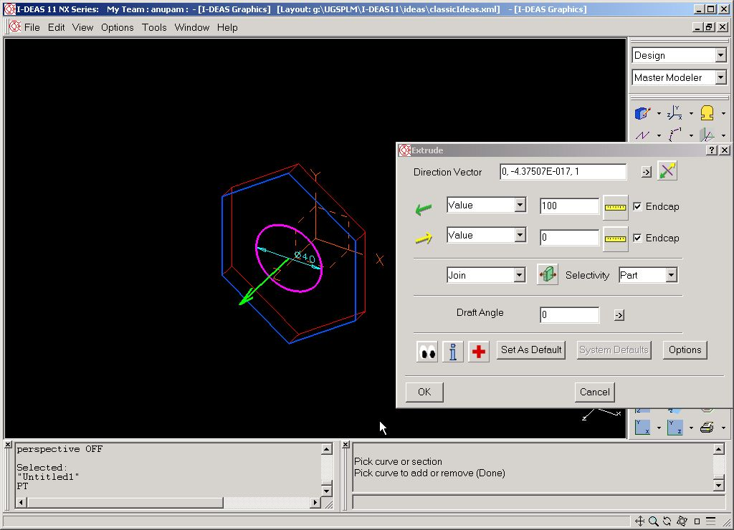
Geometric/PARAMETRIC Modeling
Solid Modeling
Perception of Solids
Modeling of Curves
Modeling of Surfaces (Patches)
Topology and Solids
Solid Modeling 1-2
Transformations and Projections 1-2
Representation, Differential Geometry
Ferguson Segments
Bezier Segments 1-2
B-spline curves 1-5
NURBS
Differential Geometry
Tensor Product
Boundary Interpolating
Composite
NURBS

Slide 46
Geometric/PARAMETRIC Modeling
Solid Modeling
Perception of Solids
Modeling of Curves
Modeling of Surfaces (Patches)
Topology and Solids
Solid Modeling 1-2
Transformations and Projections 1-2
Representation, Differential Geometry
Ferguson Segments
Bezier Segments 1-2
B-spline curves 1-5
NURBS
Differential Geometry
Tensor Product
Boundary Interpolating
Composite
NURBS

Slide 47
Geometric/PARAMETRIC Modeling
Solid Modeling
Perception of Solids
Modeling of Curves
Modeling of Surfaces (Patches)
Topology and Solids
Solid Modeling 1-2
Transformations and Projections 1-2
Representation, Differential Geometry
Ferguson Segments
Bezier Segments 1-2
B-spline curves 1-5
NURBS
Differential Geometry
Tensor Product
Boundary Interpolating
Composite
NURBS

Slide 48
Geometric/PARAMETRIC Modeling
Solid Modeling
Perception of Solids
Modeling of Curves
Modeling of Surfaces (Patches)
Topology and Solids
Solid Modeling 1-2
Transformations and Projections 1-2
Representation, Differential Geometry
Ferguson Segments
Bezier Segments 1-2
B-spline curves 1-5
NURBS
Differential Geometry
Tensor Product
Boundary Interpolating
Composite
NURBS

Slide 49
Geometric/PARAMETRIC Modeling
Solid Modeling
Perception of Solids
Modeling of Curves
Modeling of Surfaces (Patches)
Topology and Solids
Solid Modeling 1-2
Transformations and Projections 1-2
Representation, Differential Geometry
Ferguson Segments
Bezier Segments 1-2
B-spline curves 1-5
NURBS
Differential Geometry
Tensor Product
Boundary Interpolating
Composite
NURBS

Slide 50
Geometric/PARAMETRIC Modeling
Solid Modeling
Perception of Solids
Modeling of Curves
Modeling of Surfaces (Patches)
Topology and Solids
Solid Modeling 1-2
Transformations and Projections 1-2
Representation, Differential Geometry
Ferguson Segments
Bezier Segments 1-2
B-spline curves 1-5
NURBS
Differential Geometry
Tensor Product
Boundary Interpolating
Composite
NURBS

Slide 51
Geometric/PARAMETRIC Modeling
Solid Modeling
Perception of Solids
Modeling of Curves
Modeling of Surfaces (Patches)
Topology and Solids
Solid Modeling 1-2
Transformations and Projections 1-2
Representation, Differential Geometry
Ferguson Segments
Bezier Segments 1-2
B-spline curves 1-5
NURBS
Differential Geometry
Tensor Product
Boundary Interpolating
Composite
NURBS

Slide 52
Geometric/PARAMETRIC Modeling
Solid Modeling
Perception of Solids
Modeling of Curves
Modeling of Surfaces (Patches)
Topology and Solids
Solid Modeling 1-2
Transformations and Projections 1-2
Representation, Differential Geometry
Ferguson Segments
Bezier Segments 1-2
B-spline curves 1-5
NURBS
Differential Geometry
Tensor Product
Boundary Interpolating
Composite
NURBS

Slide 53
Complex modeling with ease…
creativeflight.com

Slide 54
Computer Aided Engineering Design
Anupam Saxena
Associate Professor
Indian Institute of Technology KANPUR 208016

Slide 55
# 3 How do Solid Modelers work?
Notes:
In the previous lectures, we have seen how FORMS of different products can be rendered and represented using a paper-pen approach or a Solid Modeler
- An inquisitive MIND has also put forth the following queries ---
O How do solid modelers work?
O What is the Mathematics behind the Graphics?
O Can Solids be generated Efficiently?
O Are Solid Modelers capable of modeling a Complex Solid?
O Is data storage or retrieval Efficient?
- We will start by refreshing briefly the procedure of FORM design.
- We will then study some properties of Solids in detail…

Slide 56
How do Solid Modelers perceive Solids
Geometric/PARAMETRIC Modeling
Solid Modeling
Perception of Solids
Modeling of Curves
Modeling of Surfaces (Patches)
Topology and Solids
Solid Modeling 1-2
Transformations and Projections 1-2
Representation, Differential Geometry
Ferguson Segments
Bezier Segments 1-2
B-spline curves 1-5
NURBS
Differential Geometry
Tensor Product
Boundary Interpolating
Composite
NURBS
Geometric/PARAMETRIC Modeling
Solid Modeling
Perception of Solids
Modeling of Curves
Modeling of Surfaces (Patches)
Topology and Solids
Solid Modeling 1-2
Transformations and Projections 1-2
Representation, Differential Geometry
Ferguson Segments
Bezier Segments 1-2
B-spline curves 1-5
NURBS
Differential Geometry
Tensor Product
Boundary Interpolating
Composite
NURBS

Slide 57
DESIGN: Starting Point
Functionality of a System/Component
Make a WISH list
SURVEY: Ask a lot of People
List as elaborate as possible
Can choose critical items for form generation
Can come up with many forms satisfying a set of items CHOSEN from the WISH list
Geometric/PARAMETRIC Modeling
Solid Modeling
Perception of Solids
Modeling of Curves
Modeling of Surfaces (Patches)
Topology and Solids
Solid Modeling 1-2
Transformations and Projections 1-2
Representation, Differential Geometry
Ferguson Segments
Bezier Segments 1-2
B-spline curves 1-5
NURBS
Differential Geometry
Tensor Product
Boundary Interpolating
Composite
NURBS
Notes:
<ImPromptu>

Slide 58
Understanding FORM DESIGN
FORM DESIGN
Geometric/PARAMETRIC Modeling
Solid Modeling
Perception of Solids
Modeling of Curves
Modeling of Surfaces (Patches)
Topology and Solids
Solid Modeling 1-2
Transformations and Projections 1-2
Representation, Differential Geometry
Ferguson Segments
Bezier Segments 1-2
B-spline curves 1-5
NURBS
Differential Geometry
Tensor Product
Boundary Interpolating
Composite
NURBS
MANUAL
AUTOMATED
SKETCH
PAPER-PEN
NEED SOME A PRIORI NOTION
NO IDEA ABOUT FORM
COMPONENTS
CANDIDATE FORM
ANALYZE
OPTIMIZE
CREATIVITY
SKILLS
EXPERIENCE
Notes:
We know from the Workshop that FORM rendering can be MANUAL or AUTOMATED
The Manual approach, goes with the CONVENTIONAL paper pen technique. Everyone had heard the phrase --- “Back to the Drawing Board.”
- One requires some a priori notion, or idea as to how a product to “LOOK LIKE.”
-- The MANUAL approach involves CREATIVITY, SKILLS and EXPERIENCE of a DESIGNER. It however does not give a 3-Dimensional rendering of the FORM.
- In the AUTOMATED method, one may not have much idea --- but a ROUGH idea about how a product should look…
- One can only identify COMPONENTS and INTER RELATION between them via a set of Basic RULES
- Within THOSE basic RULES, a Computer can then PROPOSE a CANDIDATE DESIGN, ANALYZE IT ---- and THEN MODIFY IT to make it BETTER than the PREVIOUS ONE.
-- An example is the linkage generation near the end of Lecture #1.

Slide 59
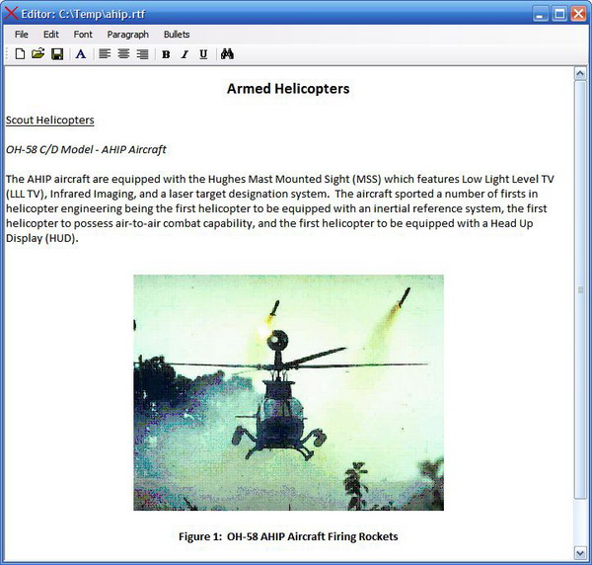
Type writer and Word processor
Geometric/PARAMETRIC Modeling
Solid Modeling
Perception of Solids
Modeling of Curves
Modeling of Surfaces (Patches)
Topology and Solids
Solid Modeling 1-2
Transformations and Projections 1-2
Representation, Differential Geometry
Ferguson Segments
Bezier Segments 1-2
B-spline curves 1-5
NURBS
Differential Geometry
Tensor Product
Boundary Interpolating
Composite
NURBS
With the Word processor
FLEXIBILITY: Can change the matter anytime, anywhere in the document
EASY TO CORRECT ERRORS
NO WASTAGE as such of paper
OFFERS A LOT OF OPTIONS for font size, font style, formatting, making tables and more.
CAN PRINT WHEN DONE, i.e., get the final product
serpentinegallery.org
codeproject.com
Notes:
- PERSONALLY… this is how I differentiate between the conventional “paper-pen” approach and the “Automated Solid Modeling or FORM design approach.”
The first one is like a type writter, while the second one is like a word processor
- <READ. Paraphrase>
-- In case of a typewritter, one needs to be SKILLFUL… the matter gets printed as one types--- in case there are more than a few mistakes, paper gets wasted --- there are not many options w.r.t formatting…
-- Note that “Typing” or “Sketching” may have their own advantages – “CREATIVE EXPRESSION may still be at its best” for some who prefer conventional approaches.

Slide 60
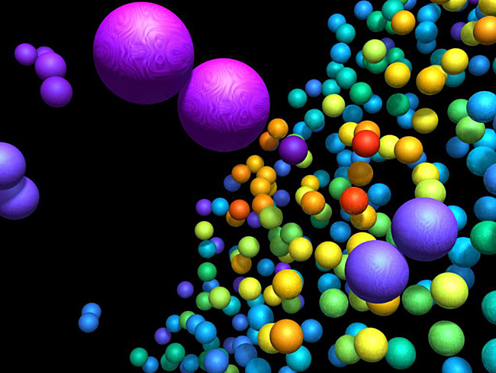
AUTOMATED FORM DESIGN
MODULAR
E.G., NATURE
FINITELY MANY DESIGNS
ALL COMPOSED FROM A SET OF ELEMENTS
~120 ODD ELEMENTS
“HUMAN DESIGNS”
MUCH LESSER ELEMENTS
Geometric/PARAMETRIC Modeling
Solid Modeling
Perception of Solids
Modeling of Curves
Modeling of Surfaces (Patches)
Topology and Solids
Solid Modeling 1-2
Transformations and Projections 1-2
Representation, Differential Geometry
Ferguson Segments
Bezier Segments 1-2
B-spline curves 1-5
NURBS
Differential Geometry
Tensor Product
Boundary Interpolating
Composite
NURBS
complex.upf.es
Notes:
Automated form design can be accomplished better if we assume that designs are Modular…
For instance those in NATURE --- there are finitely many designs out there all of which are composed of the 120 odd elements present on earth.
- Human designs can be modular, though comprising of much less components.

Slide 61
How do we perceive Solids ?
Geometric entities that occupy a “finite” volume.
Solids must satisfy a set of properties on
→ Boundedness
→ Boundary and interior
→ Boundary Determinism
→ Homogenous three-dimensionality
→ Rigidity
→ Closure
Geometric/PARAMETRIC Modeling
Solid Modeling
Perception of Solids
Modeling of Curves
Modeling of Surfaces (Patches)
Topology and Solids
Solid Modeling 1-2
Transformations and Projections 1-2
Representation, Differential Geometry
Ferguson Segments
Bezier Segments 1-2
B-spline curves 1-5
NURBS
Differential Geometry
Tensor Product
Boundary Interpolating
Composite
NURBS
Notes:
Question: How do we perceive solids?
<READ the slide, paraphrase>
Let’s explore these properties in detail!

Slide 62
Boundedness
A set V of points must occupy a finite volume in E³.
Geometric/PARAMETRIC Modeling
Solid Modeling
Perception of Solids
Modeling of Curves
Modeling of Surfaces (Patches)
Topology and Solids
Solid Modeling 1-2
Transformations and Projections 1-2
Representation, Differential Geometry
Ferguson Segments
Bezier Segments 1-2
B-spline curves 1-5
NURBS
Differential Geometry
Tensor Product
Boundary Interpolating
Composite
NURBS
Notes:
<Read the TITLE and then the matter>

Slide 63
Valid Solids ?
Geometric/PARAMETRIC Modeling
Solid Modeling
Perception of Solids
Modeling of Curves
Modeling of Surfaces (Patches)
Topology and Solids
Solid Modeling 1-2
Transformations and Projections 1-2
Representation, Differential Geometry
Ferguson Segments
Bezier Segments 1-2
B-spline curves 1-5
NURBS
Differential Geometry
Tensor Product
Boundary Interpolating
Composite
NURBS
Notes:
-- Are these Valid Solids?
<Brief PAUSE>
-- Yes! As they all occupy a finite volume in space.

Slide 64
Valid Solid ?
Geometric/PARAMETRIC Modeling
Solid Modeling
Perception of Solids
Modeling of Curves
Modeling of Surfaces (Patches)
Topology and Solids
Solid Modeling 1-2
Transformations and Projections 1-2
Representation, Differential Geometry
Ferguson Segments
Bezier Segments 1-2
B-spline curves 1-5
NURBS
Differential Geometry
Tensor Product
Boundary Interpolating
Composite
NURBS
Notes:
-- Take away the top surface of the BLOCK and the cylinder from the previous slide!
Are these now valid solids?
<Brief pause>
NO! because the respective volumes are NOT bounded anymore!

Slide 65
Boundary and interior
Let b(V) and I(V) be two subsets of V such that b(V)∪I(V) = V
b(V) comprises of boundary points
I(V) is the set of interior points.
A point p ∈ V is an interior point (p ∈ I(V)) if there exists an open ball enclosing p consisting of points in V only.
An OPEN BALL: if p₀ is the center of the ball B of radius r, and if p_{i} ∈ B, then |p_{i} – p₀| < r.
A point p is a boundary point if p ∈ V and p ∉ I(V).
Geometric/PARAMETRIC Modeling
Solid Modeling
Perception of Solids
Modeling of Curves
Modeling of Surfaces (Patches)
Topology and Solids
Solid Modeling 1-2
Transformations and Projections 1-2
Representation, Differential Geometry
Ferguson Segments
Bezier Segments 1-2
B-spline curves 1-5
NURBS
Differential Geometry
Tensor Product
Boundary Interpolating
Composite
NURBS
boundary b(V)
r
p
interior
I(V)
ball
B
Space
E³ – V
B₁
Notes:
< Read the TITLE and then READ the text>
<* Explain the figure…
the interior, the boundary, the exterior>
<After the Open Ball definition>
-- All we say is that a point p belongs to the interior of the solid, if it is enclosed by an open ball of any non-zero radius r, such that the ball itself encloses all the interior points.
-- Take the ball B_1 for example which encloses a boundary point. No matter where you place the ball to enclose a boundary point, it will always include some points of the external space E^3 – V
-- <read the last line>

Slide 66
Boundary Determinism
Jordan’s theorem for a two-dimensional Euclidean plane (E²) :
a simple (nonintersecting) closed (Jordan) curve divides E² into regions interior and exterior to the curve.
Formally, for C as a continuous simple closed curve in E², E²\C (complement of C in E²) has precisely two connected components, I(V) (interior, bounded) and E(V) (exterior, unbounded). C forms the boundary for each set.
For a pair of non-empty subsets U and V of E², U and V are connected if U ∩V = {} and U ∪V = E².
Let C = C_{I} + C_{E}. Let U = I(V) + C_{I} and V = E(V) + C_{E}. Then the above holds.
Geometric/PARAMETRIC Modeling
Solid Modeling
Perception of Solids
Modeling of Curves
Modeling of Surfaces (Patches)
Topology and Solids
Solid Modeling 1-2
Transformations and Projections 1-2
Representation, Differential Geometry
Ferguson Segments
Bezier Segments 1-2
B-spline curves 1-5
NURBS
Differential Geometry
Tensor Product
Boundary Interpolating
Composite
NURBS
E(V)
I(V)
C
Notes:
<Read the title>
<Read the first line>
This is a FUNDAMENTAL theorem that lay’s down the basis for Solid Modeling

Slide 67
Boundary Determinism
Geometric/PARAMETRIC Modeling
Solid Modeling
Perception of Solids
Modeling of Curves
Modeling of Surfaces (Patches)
Topology and Solids
Solid Modeling 1-2
Transformations and Projections 1-2
Representation, Differential Geometry
Ferguson Segments
Bezier Segments 1-2
B-spline curves 1-5
NURBS
Differential Geometry
Tensor Product
Boundary Interpolating
Composite
NURBS
Extended Jordan’s theorem
Equivalently in E³, a simple and orientable closed surface b(V) divides a solid V into the interior (I(V)) and exterior (E(V)) spaces.
if the closed surface b(V) of a solid V is known, the interior I(V) of the solid V is unambiguously determined
A clue: solids should be represented and stored as simple, closed and orientable surfaces
Notes:
<Read the TITLE>
<Paraphrase the first line>
<Read the Second line>
We will come to what are orientable surfaces LATER
<Read the third line>
Example: A sphere: If the spherical surface is known, so will the sphere be!
and the fourth line>

Slide 68
Homogenous three-dimensionality
Geometric/PARAMETRIC Modeling
Solid Modeling
Perception of Solids
Modeling of Curves
Modeling of Surfaces (Patches)
Topology and Solids
Solid Modeling 1-2
Transformations and Projections 1-2
Representation, Differential Geometry
Ferguson Segments
Bezier Segments 1-2
B-spline curves 1-5
NURBS
Differential Geometry
Tensor Product
Boundary Interpolating
Composite
NURBS
A solid set V must not have disconnected or dangling subsets as such sets defy boundary determinism above.
Notes:
<Read the title>
<Read the first line>
<show the example>
Q: Is this a valid solid?
<Brief pause>
No! Loosely, The block is of dimensionality 3, the plane has dimensionality 2 and the edge is one dimensional… A solid needs to be homogenously three-dimensional

Slide 69
Rigidity
The relative positions between any two points p₁ and p₂ in V must be invariant to re-positioning or re-orientation of the solid in E³
A solid must not be elastic in nature when subjected to repositioning
Geometric/PARAMETRIC Modeling
Solid Modeling
Perception of Solids
Modeling of Curves
Modeling of Surfaces (Patches)
Topology and Solids
Solid Modeling 1-2
Transformations and Projections 1-2
Representation, Differential Geometry
Ferguson Segments
Bezier Segments 1-2
B-spline curves 1-5
NURBS
Differential Geometry
Tensor Product
Boundary Interpolating
Composite
NURBS
Notes:
< Read the entire slide>

Slide 70
Rigidity
A deforming body under any rigid-body transformation, like translation, rotation or their combination, is NOT allowed
Notes:
<READ>

Slide 71
Closure
Geometric/PARAMETRIC Modeling
Solid Modeling
Perception of Solids
Modeling of Curves
Modeling of Surfaces (Patches)
Topology and Solids
Solid Modeling 1-2
Transformations and Projections 1-2
Representation, Differential Geometry
Ferguson Segments
Bezier Segments 1-2
B-spline curves 1-5
NURBS
Differential Geometry
Tensor Product
Boundary Interpolating
Composite
NURBS
Any set operation (union, intersection and subtraction) when applied to solids V₁ and V₂ must yield a solid V₃ satisfying all the aforementioned properties
A clue: Set operations may be used to ARRANGE components/solids
Notes:
<READ>
<Example>

Slide 72
Example: A cube
Geometric/PARAMETRIC Modeling
Solid Modeling
Perception of Solids
Modeling of Curves
Modeling of Surfaces (Patches)
Topology and Solids
Solid Modeling 1-2
Transformations and Projections 1-2
Representation, Differential Geometry
Ferguson Segments
Bezier Segments 1-2
B-spline curves 1-5
NURBS
Differential Geometry
Tensor Product
Boundary Interpolating
Composite
NURBS
6 faces, 8 vertices, 12 edges
6 faces make a simple, closed and orientable surface
6 faces are like the patches comprising the closed surface

Slide 73
Example: A sphere
Geometric/PARAMETRIC Modeling
Solid Modeling
Perception of Solids
Modeling of Curves
Modeling of Surfaces (Patches)
Topology and Solids
Solid Modeling 1-2
Transformations and Projections 1-2
Representation, Differential Geometry
Ferguson Segments
Bezier Segments 1-2
B-spline curves 1-5
NURBS
Differential Geometry
Tensor Product
Boundary Interpolating
Composite
NURBS
A simple, closed and orientable spherical surface represents a solid sphere

Slide 74
Example: A torus
Geometric/PARAMETRIC Modeling
Solid Modeling
Perception of Solids
Modeling of Curves
Modeling of Surfaces (Patches)
Topology and Solids
Solid Modeling 1-2
Transformations and Projections 1-2
Representation, Differential Geometry
Ferguson Segments
Bezier Segments 1-2
B-spline curves 1-5
NURBS
Differential Geometry
Tensor Product
Boundary Interpolating
Composite
NURBS
A simple, closed and orientable toroidal surface represents a donut

Slide 75
Example: An invalid solid
Geometric/PARAMETRIC Modeling
Solid Modeling
Perception of Solids
Modeling of Curves
Modeling of Surfaces (Patches)
Topology and Solids
Solid Modeling 1-2
Transformations and Projections 1-2
Representation, Differential Geometry
Ferguson Segments
Bezier Segments 1-2
B-spline curves 1-5
NURBS
Differential Geometry
Tensor Product
Boundary Interpolating
Composite
NURBS
7 faces
Do not form a closed surface
Does not represent a solid

Slide 76
Summary
A simple, closed and orientable surface is good enough to represent a solid.
One need not store a set V of points.
This would cause storage problems
Set operations will be slow
Solid modeling software would be very slow overall
Geometric/PARAMETRIC Modeling
Solid Modeling
Perception of Solids
Modeling of Curves
Modeling of Surfaces (Patches)
Topology and Solids
Solid Modeling 1-2
Transformations and Projections 1-2
Representation, Differential Geometry
Ferguson Segments
Bezier Segments 1-2
B-spline curves 1-5
NURBS
Differential Geometry
Tensor Product
Boundary Interpolating
Composite
NURBS

Slide 77
The Banana Trick

