Slide 1
Computer Aided Engineering Design
Anupam Saxena
Associate Professor
Indian Institute of Technology KANPUR 208016

Slide 2
Lecture #8 Solid Modeling

Slide 3
Regularized Boolean Operations
Recall that
the interior I(V) of a solid comprises all points within the solid and not those on its boundary
A point Q is exterior to the solid if there exists an open ball B of radius r centered at Q such that the ball does not intersect with the solid
A set of all exterior points is termed the exterior of the solid represented as E(V)
Geometric/PARAMETRIC Modeling
Solid Modeling
Perception of Solids
Modeling of Curves
Modeling of Surfaces (Patches)
Topology and Solids
Solid Modeling 1-2
Transformations and Projections 1-2
Representation, Differential Geometry
Ferguson Segments
Bezier Segments 1-2
B-spline curves 1-5
NURBS
Differential Geometry
Tensor Product
Boundary Interpolating
Composite
NURBS

Slide 4
Regularized Boolean Operations
Points that neither belong to the interior or exterior constitute the boundary b(V) of the solid
The closure of a solid C(V) is then defined as the union of its interior and the boundary. That is, C(V) = I(V) ∪ b(V) or I(V) + b(V)
Alternatively, the closure of a solid is the complement \E(V) of its exterior
Geometric/PARAMETRIC Modeling
Solid Modeling
Perception of Solids
Modeling of Curves
Modeling of Surfaces (Patches)
Topology and Solids
Solid Modeling 1-2
Transformations and Projections 1-2
Representation, Differential Geometry
Ferguson Segments
Bezier Segments 1-2
B-spline curves 1-5
NURBS
Differential Geometry
Tensor Product
Boundary Interpolating
Composite
NURBS

Slide 5
Regularized Boolean Operations
There are certain pitfalls of the Boolean operations
Geometric/PARAMETRIC Modeling
Solid Modeling
Perception of Solids
Modeling of Curves
Modeling of Surfaces (Patches)
Topology and Solids
Solid Modeling 1-2
Transformations and Projections 1-2
Representation, Differential Geometry
Ferguson Segments
Bezier Segments 1-2
B-spline curves 1-5
NURBS
Differential Geometry
Tensor Product
Boundary Interpolating
Composite
NURBS
A
B
A∩B
Lower dimensional result
This does not represent a valid solid

Slide 6
Regularized Boolean Operators
To eliminate lower dimensional results
Compute the result as usual
Compute the interior of the result in (a)
(c) Compute the closure of (b)
Regularized union: C[I(A∪B)]
Regularized intersection: C[I(A∩B)]
Regularized difference: C[I(A – B)]
Geometric/PARAMETRIC Modeling
Solid Modeling
Perception of Solids
Modeling of Curves
Modeling of Surfaces (Patches)
Topology and Solids
Solid Modeling 1-2
Transformations and Projections 1-2
Representation, Differential Geometry
Ferguson Segments
Bezier Segments 1-2
B-spline curves 1-5
NURBS
Differential Geometry
Tensor Product
Boundary Interpolating
Composite
NURBS

Slide 7
How does Regularization Help?
Regularized intersection: C[I(A∩B)]
Geometric/PARAMETRIC Modeling
Solid Modeling
Perception of Solids
Modeling of Curves
Modeling of Surfaces (Patches)
Topology and Solids
Solid Modeling 1-2
Transformations and Projections 1-2
Representation, Differential Geometry
Ferguson Segments
Bezier Segments 1-2
B-spline curves 1-5
NURBS
Differential Geometry
Tensor Product
Boundary Interpolating
Composite
NURBS
A
B
A∩B
Lower dimensional result
This does not represent a valid solid

Slide 8
Regularized Boolean Operations
There are certain pitfalls of the Boolean operations
Geometric/PARAMETRIC Modeling
Solid Modeling
Perception of Solids
Modeling of Curves
Modeling of Surfaces (Patches)
Topology and Solids
Solid Modeling 1-2
Transformations and Projections 1-2
Representation, Differential Geometry
Ferguson Segments
Bezier Segments 1-2
B-spline curves 1-5
NURBS
Differential Geometry
Tensor Product
Boundary Interpolating
Composite
NURBS
A
B
A∩B
Lower dimensional result
This does not represent a valid solid

Slide 9
Regularized Boolean Operations
Geometric/PARAMETRIC Modeling
Solid Modeling
Perception of Solids
Modeling of Curves
Modeling of Surfaces (Patches)
Topology and Solids
Solid Modeling 1-2
Transformations and Projections 1-2
Representation, Differential Geometry
Ferguson Segments
Bezier Segments 1-2
B-spline curves 1-5
NURBS
Differential Geometry
Tensor Product
Boundary Interpolating
Composite
NURBS
B
A
A∪B
A non-manifold solid

Slide 10
Regularized Boolean Operations
Geometric/PARAMETRIC Modeling
Solid Modeling
Perception of Solids
Modeling of Curves
Modeling of Surfaces (Patches)
Topology and Solids
Solid Modeling 1-2
Transformations and Projections 1-2
Representation, Differential Geometry
Ferguson Segments
Bezier Segments 1-2
B-spline curves 1-5
NURBS
Differential Geometry
Tensor Product
Boundary Interpolating
Composite
NURBS
B
A
A – B

Slide 11
Regularized Boolean Operations
Geometric/PARAMETRIC Modeling
Solid Modeling
Perception of Solids
Modeling of Curves
Modeling of Surfaces (Patches)
Topology and Solids
Solid Modeling 1-2
Transformations and Projections 1-2
Representation, Differential Geometry
Ferguson Segments
Bezier Segments 1-2
B-spline curves 1-5
NURBS
Differential Geometry
Tensor Product
Boundary Interpolating
Composite
NURBS
B
A
B – A

Slide 12
Regularized Boolean Operations
Regularized union: C[I(A∪B)]
Regularized intersection: C[I(A∩B)]
Regularized difference: C[I(A – B)]
Q: How do we perform regularized Boolean operations when dealing with bounding surfaces only?
A: We make sure the result is a BOUNDING surface?

Slide 13
Verify connectivity via Winged Edge Data structure
Geometric/PARAMETRIC Modeling
Solid Modeling
Perception of Solids
Modeling of Curves
Modeling of Surfaces (Patches)
Topology and Solids
Solid Modeling 1-2
Transformations and Projections 1-2
Representation, Differential Geometry
Ferguson Segments
Bezier Segments 1-2
B-spline curves 1-5
NURBS
Differential Geometry
Tensor Product
Boundary Interpolating
Composite
NURBS
Does NOT have a second face
incident to it
A
B
A∩B
F1
F2

Slide 14
Regularized Boolean Operations
Has FOUR faces incident to it
Geometric/PARAMETRIC Modeling
Solid Modeling
Perception of Solids
Modeling of Curves
Modeling of Surfaces (Patches)
Topology and Solids
Solid Modeling 1-2
Transformations and Projections 1-2
Representation, Differential Geometry
Ferguson Segments
Bezier Segments 1-2
B-spline curves 1-5
NURBS
Differential Geometry
Tensor Product
Boundary Interpolating
Composite
NURBS
B
A
A∪B
A non-manifold solid
F1
F2

Slide 15
Regularized Boolean Operations
Both edges have ONE face incident to
them
Geometric/PARAMETRIC Modeling
Solid Modeling
Perception of Solids
Modeling of Curves
Modeling of Surfaces (Patches)
Topology and Solids
Solid Modeling 1-2
Transformations and Projections 1-2
Representation, Differential Geometry
Ferguson Segments
Bezier Segments 1-2
B-spline curves 1-5
NURBS
Differential Geometry
Tensor Product
Boundary Interpolating
Composite
NURBS
B
A
A – B
F1
F2

Slide 16
Regularized Boolean Operations
Geometric/PARAMETRIC Modeling
Solid Modeling
Perception of Solids
Modeling of Curves
Modeling of Surfaces (Patches)
Topology and Solids
Solid Modeling 1-2
Transformations and Projections 1-2
Representation, Differential Geometry
Ferguson Segments
Bezier Segments 1-2
B-spline curves 1-5
NURBS
Differential Geometry
Tensor Product
Boundary Interpolating
Composite
NURBS
B
Both edges have ONE face incident to
them
A
B – A
F1
F2

Slide 17
An example with the CSG
Geometric/PARAMETRIC Modeling
Solid Modeling
Perception of Solids
Modeling of Curves
Modeling of Surfaces (Patches)
Topology and Solids
Solid Modeling 1-2
Transformations and Projections 1-2
Representation, Differential Geometry
Ferguson Segments
Bezier Segments 1-2
B-spline curves 1-5
NURBS
Differential Geometry
Tensor Product
Boundary Interpolating
Composite
NURBS

Slide 18
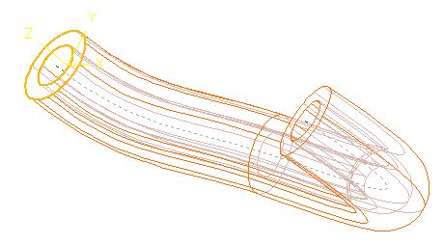
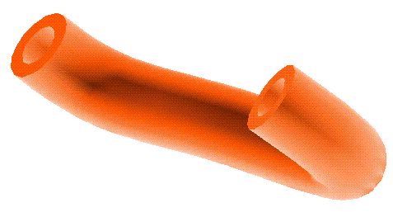
Sweep Solids
Linear sweep
extruded cross-section
ROTATIONAL
Geometric/PARAMETRIC Modeling
Solid Modeling
Perception of Solids
Modeling of Curves
Modeling of Surfaces (Patches)
Topology and Solids
Solid Modeling 1-2
Transformations and Projections 1-2
Representation, Differential Geometry
Ferguson Segments
Bezier Segments 1-2
B-spline curves 1-5
NURBS
Differential Geometry
Tensor Product
Boundary Interpolating
Composite
NURBS
revolved cross-section
generated using splines
Nonlinear sweep
TRANSLATIONAL

Slide 19
Proof of Euler Poincaré relation
v – e + f – (l – f) – 2(s – g) = 0
v – e + f = 2 – 2g – c
Geometric/PARAMETRIC Modeling
Solid Modeling
Perception of Solids
Modeling of Curves
Modeling of Surfaces (Patches)
Topology and Solids
Solid Modeling 1-2
Transformations and Projections 1-2
Representation, Differential Geometry
Ferguson Segments
Bezier Segments 1-2
B-spline curves 1-5
NURBS
Differential Geometry
Tensor Product
Boundary Interpolating
Composite
NURBS
v – e + f = 2
v – e + f = 1
v (+3) – e (+6) + f (+4) = 1 + 1 = 2
v – e + f = 2
v – e + f = 2
v (0) – e (–3)+ f (–3 + 2) = 2 + 2
v – e + f = 2 + 2s’
v – e + f = 2 + 2s’– 2g – c
v – e + f = 2(1 + s’– g) – c
v – e + f = 2(s– g) – c
v – e + f – 2(s– g) + c = 0

Slide 20
Proof of Euler Poincaré relation
v – e + f – 2(s– g) + c = 0
Geometric/PARAMETRIC Modeling
Solid Modeling
Perception of Solids
Modeling of Curves
Modeling of Surfaces (Patches)
Topology and Solids
Solid Modeling 1-2
Transformations and Projections 1-2
Representation, Differential Geometry
Ferguson Segments
Bezier Segments 1-2
B-spline curves 1-5
NURBS
Differential Geometry
Tensor Product
Boundary Interpolating
Composite
NURBS
Loop:
Any closed curve sketched traversing all the edges of a face, or a boundary component

Slide 21
Proof of Euler Poincaré relation
v – e + f – 2(1 + s’– g) + c = 0
5 faces ( f = 5), and 7 loops ( l = 7)
Geometric/PARAMETRIC Modeling
Solid Modeling
Perception of Solids
Modeling of Curves
Modeling of Surfaces (Patches)
Topology and Solids
Solid Modeling 1-2
Transformations and Projections 1-2
Representation, Differential Geometry
Ferguson Segments
Bezier Segments 1-2
B-spline curves 1-5
NURBS
Differential Geometry
Tensor Product
Boundary Interpolating
Composite
NURBS
v – e + f – 2(1 + s’– g) + c = 0
12 – 16 + 5 – 2(1 + 0 – 0) + 1 = 0
4 faces ( f = 4), but 8 loops ( l = 8)
v – e + f – 2(1 + s’– g) + c = 0
16 – 20+ 4 – 2(1 + 0 – 0) + 2 = 0
Each time a boundary component is introduced on a face, the number of faces decreases by the same amount

Slide 22
Proof of Euler Poincaré relation
Assume that the number of faces f are the same in the ORIGINAL SOLID without boundary components
Geometric/PARAMETRIC Modeling
Solid Modeling
Perception of Solids
Modeling of Curves
Modeling of Surfaces (Patches)
Topology and Solids
Solid Modeling 1-2
Transformations and Projections 1-2
Representation, Differential Geometry
Ferguson Segments
Bezier Segments 1-2
B-spline curves 1-5
NURBS
Differential Geometry
Tensor Product
Boundary Interpolating
Composite
NURBS
When boundary components c introduced, decrement in the number of faces = l − f
Adjust the formula to get
v – e + f – ( l – f) – 2(1 + s’– g) + c = 0

Slide 23
Proof of Euler Poincaré relation
What if another boundary component is introduced on the same face (two in total)
Geometric/PARAMETRIC Modeling
Solid Modeling
Perception of Solids
Modeling of Curves
Modeling of Surfaces (Patches)
Topology and Solids
Solid Modeling 1-2
Transformations and Projections 1-2
Representation, Differential Geometry
Ferguson Segments
Bezier Segments 1-2
B-spline curves 1-5
NURBS
Differential Geometry
Tensor Product
Boundary Interpolating
Composite
NURBS
v – e + f – ( l – f) – 2(1 + s’– g) + c = 0
16 – 20 + 6 – (8 – 6) – 2(1) + 2 = 0
What if a third boundary component is introduced on the same face?
v – e + f – ( l – f) – 2(1 + s’– g) + c = 0
The relation handles it WELL !
20 – 24 + 6 – (9 – 6) – 2(1) + 3 = 0
We get the Euler Poincaré formula when c = 0

Slide 24
Parametric Solid Modeling Table Lamp Shailesh Pandey
Geometric/PARAMETRIC Modeling
Solid Modeling
Perception of Solids
Modeling of Curves
Modeling of Surfaces (Patches)
Topology and Solids
Solid Modeling 1-2
Transformations and Projections 1-2
Representation, Differential Geometry
Ferguson Segments
Bezier Segments 1-2
B-spline curves 1-5
NURBS
Differential Geometry
Tensor Product
Boundary Interpolating
Composite
NURBS

Slide 25
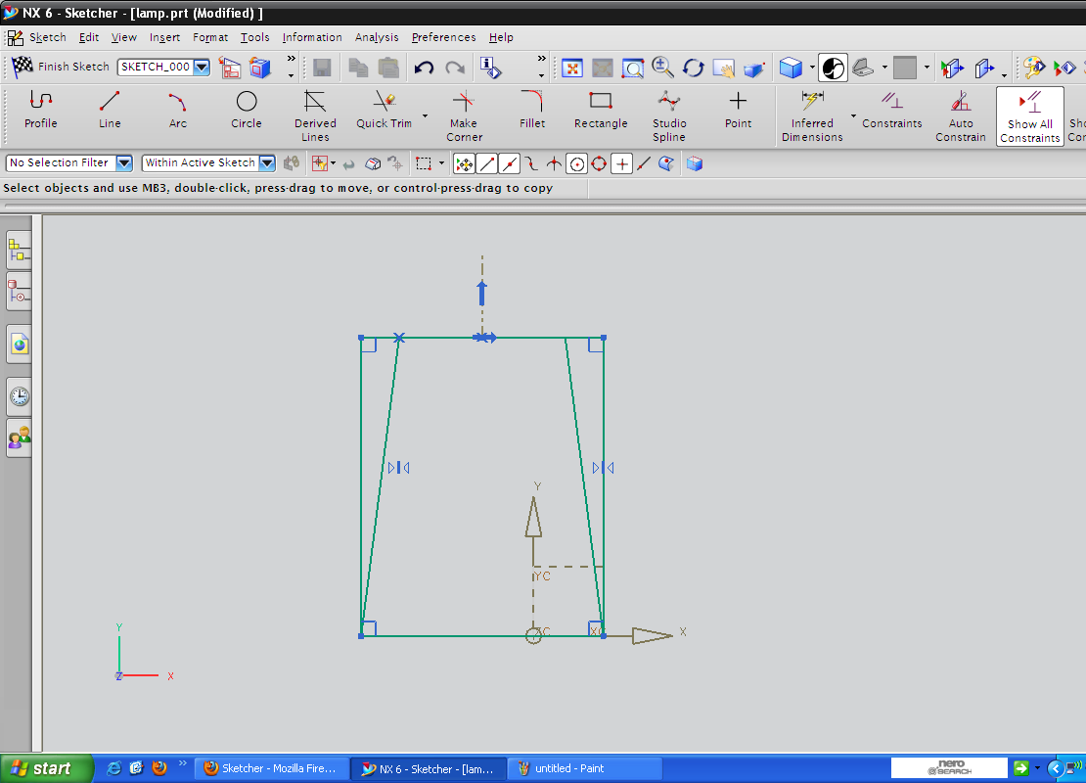
Study Lamp Design
Geometric/PARAMETRIC Modeling
Solid Modeling
Perception of Solids
Modeling of Curves
Modeling of Surfaces (Patches)
Topology and Solids
Solid Modeling 1-2
Transformations and Projections 1-2
Representation, Differential Geometry
Ferguson Segments
Bezier Segments 1-2
B-spline curves 1-5
NURBS
Differential Geometry
Tensor Product
Boundary Interpolating
Composite
NURBS

Slide 26
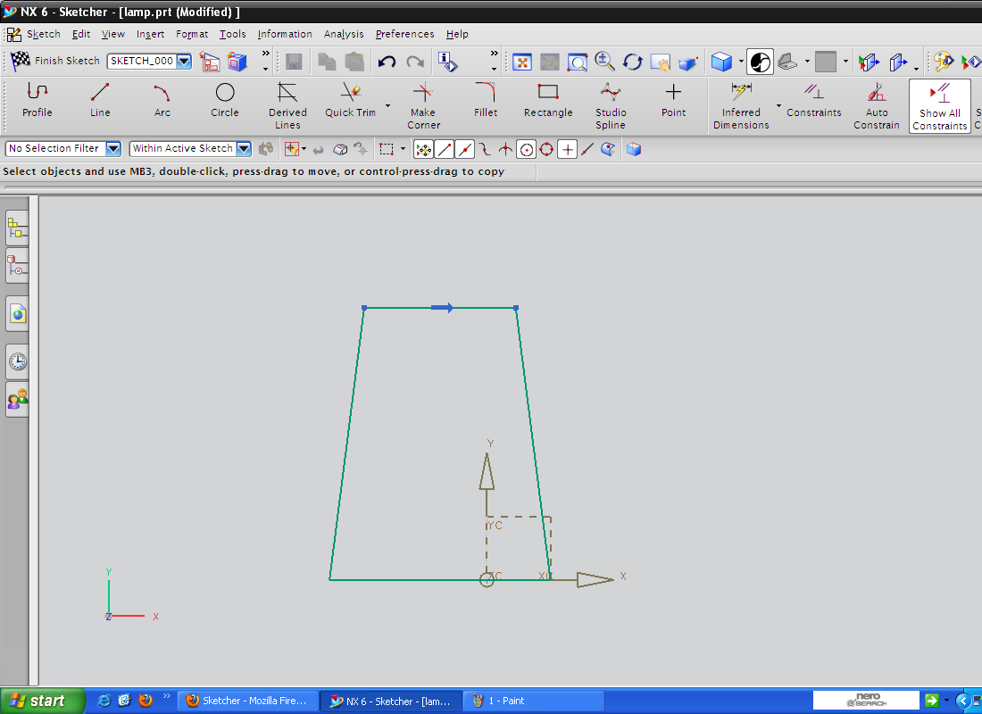
Study Lamp Design
Geometric/PARAMETRIC Modeling
Solid Modeling
Perception of Solids
Modeling of Curves
Modeling of Surfaces (Patches)
Topology and Solids
Solid Modeling 1-2
Transformations and Projections 1-2
Representation, Differential Geometry
Ferguson Segments
Bezier Segments 1-2
B-spline curves 1-5
NURBS
Differential Geometry
Tensor Product
Boundary Interpolating
Composite
NURBS

Slide 27
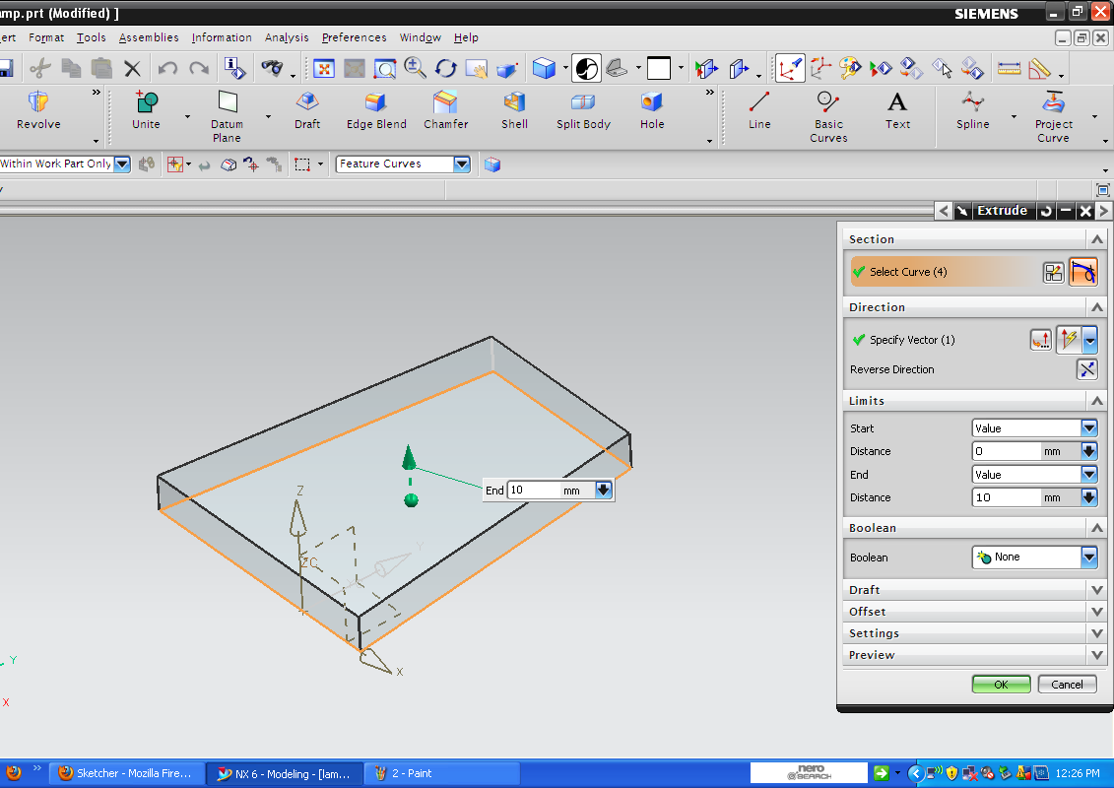
Study Lamp Design
Geometric/PARAMETRIC Modeling
Solid Modeling
Perception of Solids
Modeling of Curves
Modeling of Surfaces (Patches)
Topology and Solids
Solid Modeling 1-2
Transformations and Projections 1-2
Representation, Differential Geometry
Ferguson Segments
Bezier Segments 1-2
B-spline curves 1-5
NURBS
Differential Geometry
Tensor Product
Boundary Interpolating
Composite
NURBS

Slide 28
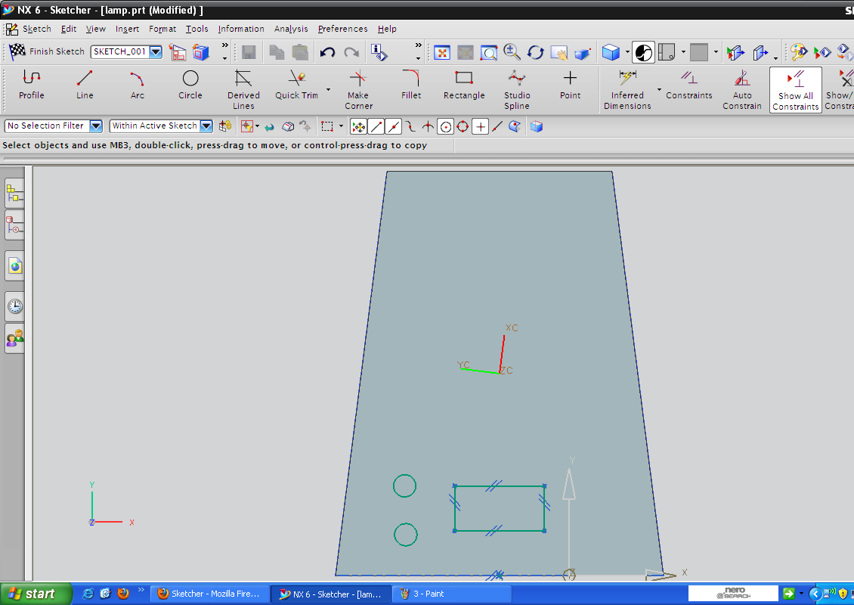
Study Lamp Design
Geometric/PARAMETRIC Modeling
Solid Modeling
Perception of Solids
Modeling of Curves
Modeling of Surfaces (Patches)
Topology and Solids
Solid Modeling 1-2
Transformations and Projections 1-2
Representation, Differential Geometry
Ferguson Segments
Bezier Segments 1-2
B-spline curves 1-5
NURBS
Differential Geometry
Tensor Product
Boundary Interpolating
Composite
NURBS

Slide 29
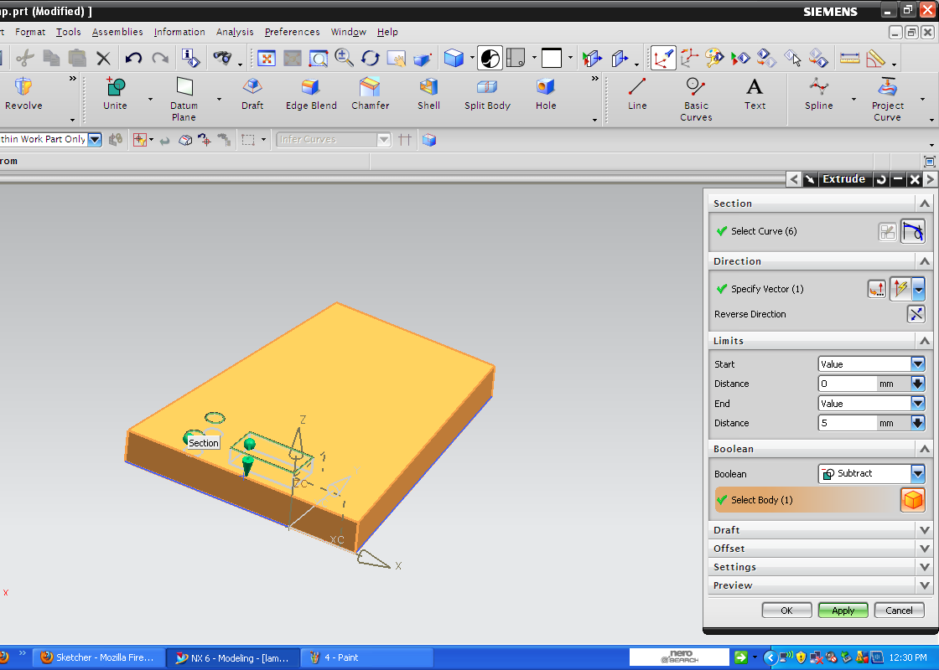
Study Lamp Design
Geometric/PARAMETRIC Modeling
Solid Modeling
Perception of Solids
Modeling of Curves
Modeling of Surfaces (Patches)
Topology and Solids
Solid Modeling 1-2
Transformations and Projections 1-2
Representation, Differential Geometry
Ferguson Segments
Bezier Segments 1-2
B-spline curves 1-5
NURBS
Differential Geometry
Tensor Product
Boundary Interpolating
Composite
NURBS

Slide 30
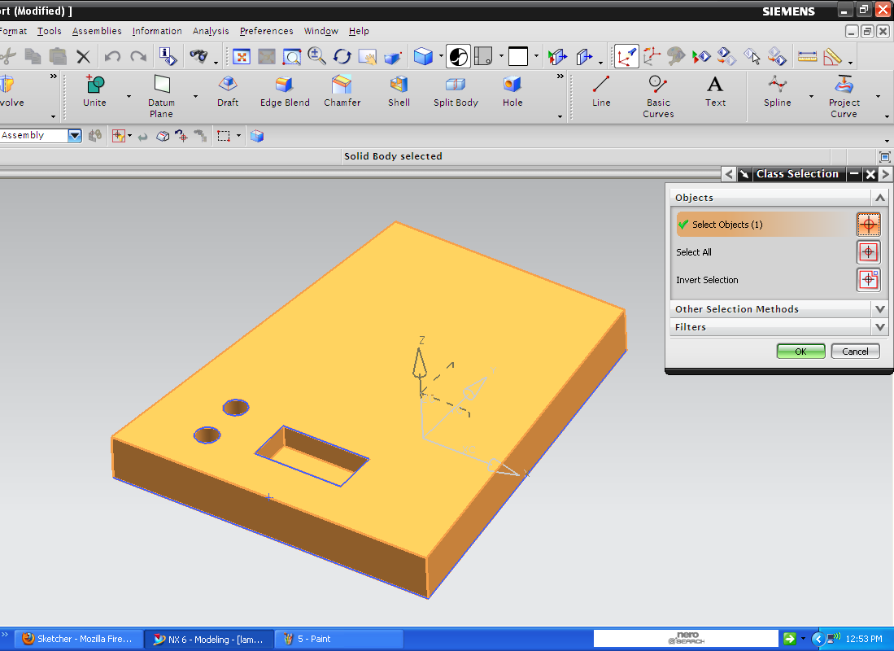
Study Lamp Design
Geometric/PARAMETRIC Modeling
Solid Modeling
Perception of Solids
Modeling of Curves
Modeling of Surfaces (Patches)
Topology and Solids
Solid Modeling 1-2
Transformations and Projections 1-2
Representation, Differential Geometry
Ferguson Segments
Bezier Segments 1-2
B-spline curves 1-5
NURBS
Differential Geometry
Tensor Product
Boundary Interpolating
Composite
NURBS

Slide 31
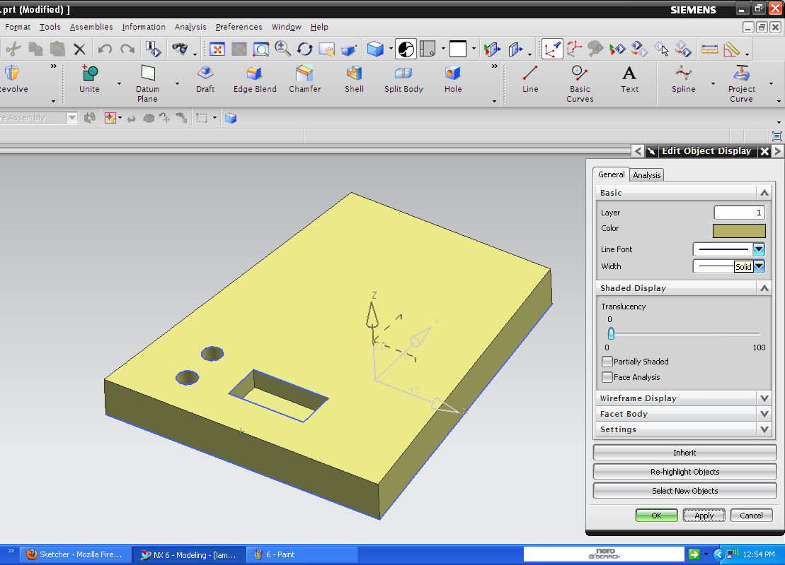
Study Lamp Design
Geometric/PARAMETRIC Modeling
Solid Modeling
Perception of Solids
Modeling of Curves
Modeling of Surfaces (Patches)
Topology and Solids
Solid Modeling 1-2
Transformations and Projections 1-2
Representation, Differential Geometry
Ferguson Segments
Bezier Segments 1-2
B-spline curves 1-5
NURBS
Differential Geometry
Tensor Product
Boundary Interpolating
Composite
NURBS

Slide 32
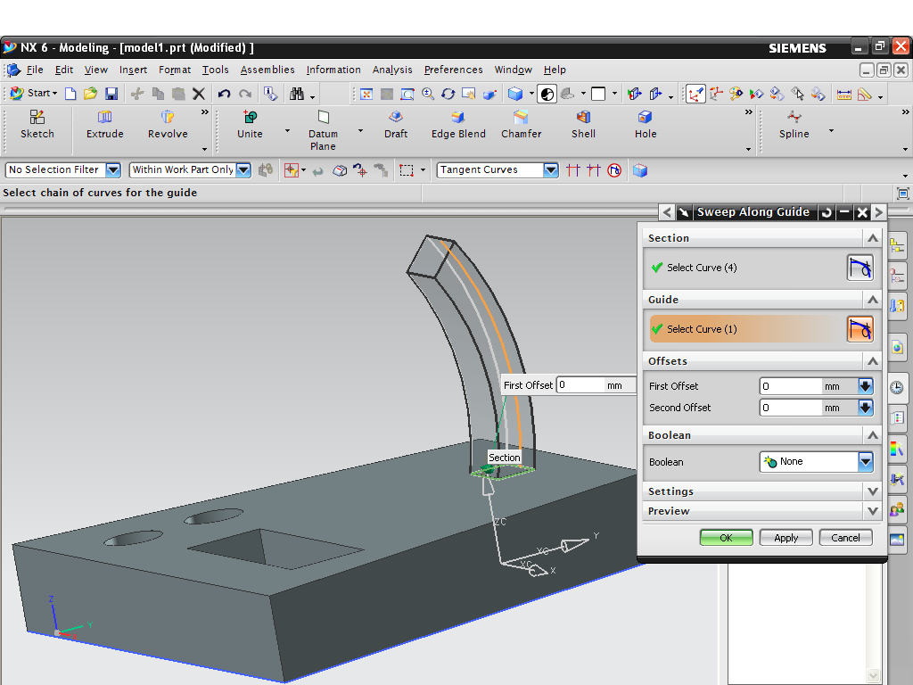
Study Lamp Design
Geometric/PARAMETRIC Modeling
Solid Modeling
Perception of Solids
Modeling of Curves
Modeling of Surfaces (Patches)
Topology and Solids
Solid Modeling 1-2
Transformations and Projections 1-2
Representation, Differential Geometry
Ferguson Segments
Bezier Segments 1-2
B-spline curves 1-5
NURBS
Differential Geometry
Tensor Product
Boundary Interpolating
Composite
NURBS

Slide 33
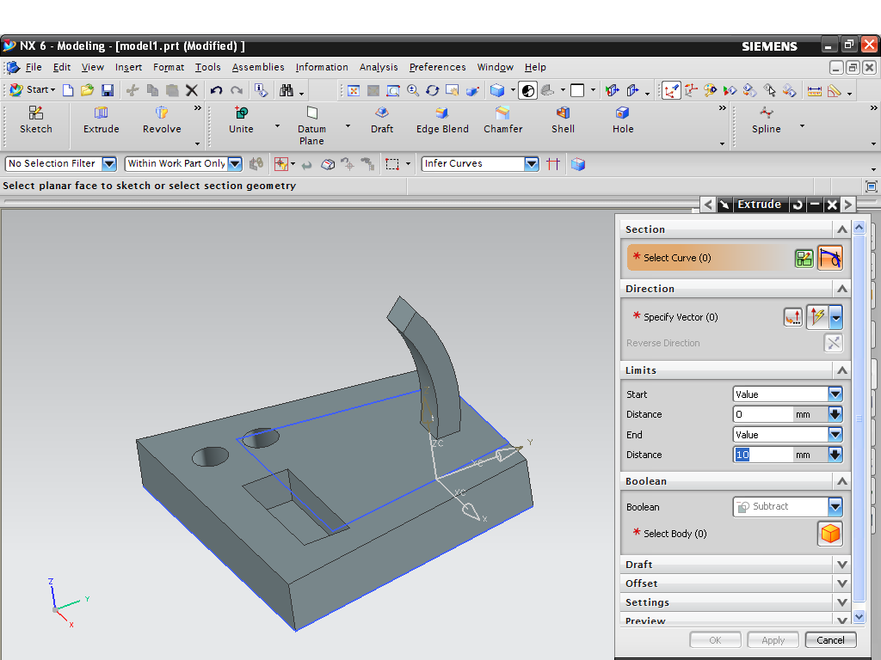
Study Lamp Design
Geometric/PARAMETRIC Modeling
Solid Modeling
Perception of Solids
Modeling of Curves
Modeling of Surfaces (Patches)
Topology and Solids
Solid Modeling 1-2
Transformations and Projections 1-2
Representation, Differential Geometry
Ferguson Segments
Bezier Segments 1-2
B-spline curves 1-5
NURBS
Differential Geometry
Tensor Product
Boundary Interpolating
Composite
NURBS

Slide 34
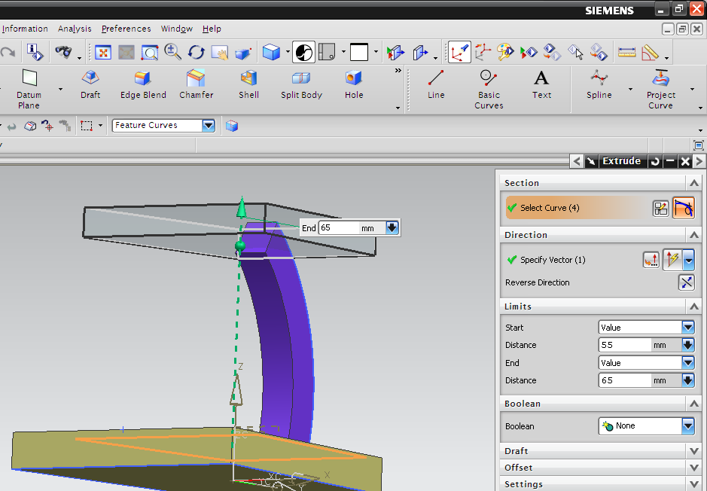
Study Lamp Design
Geometric/PARAMETRIC Modeling
Solid Modeling
Perception of Solids
Modeling of Curves
Modeling of Surfaces (Patches)
Topology and Solids
Solid Modeling 1-2
Transformations and Projections 1-2
Representation, Differential Geometry
Ferguson Segments
Bezier Segments 1-2
B-spline curves 1-5
NURBS
Differential Geometry
Tensor Product
Boundary Interpolating
Composite
NURBS

Slide 35
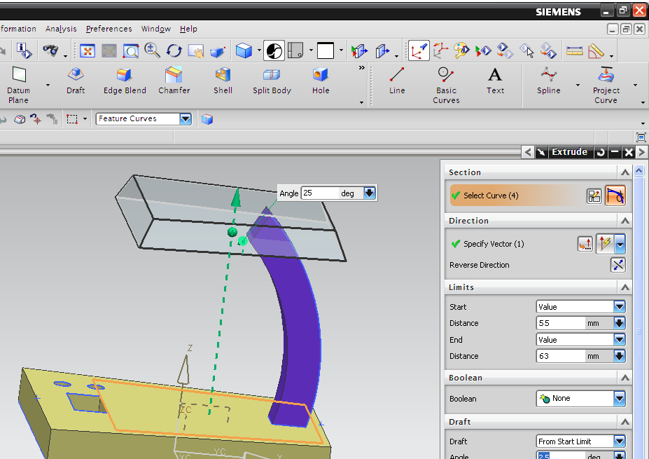
Study Lamp Design
Geometric/PARAMETRIC Modeling
Solid Modeling
Perception of Solids
Modeling of Curves
Modeling of Surfaces (Patches)
Topology and Solids
Solid Modeling 1-2
Transformations and Projections 1-2
Representation, Differential Geometry
Ferguson Segments
Bezier Segments 1-2
B-spline curves 1-5
NURBS
Differential Geometry
Tensor Product
Boundary Interpolating
Composite
NURBS

Slide 36
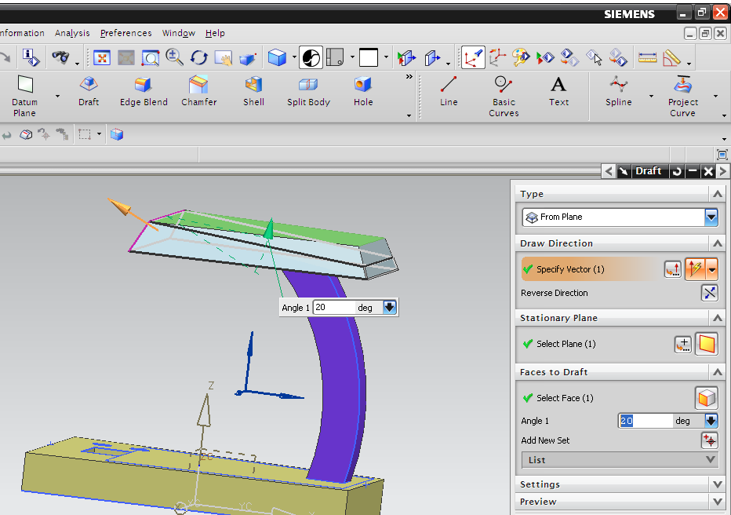
Study Lamp Design
Geometric/PARAMETRIC Modeling
Solid Modeling
Perception of Solids
Modeling of Curves
Modeling of Surfaces (Patches)
Topology and Solids
Solid Modeling 1-2
Transformations and Projections 1-2
Representation, Differential Geometry
Ferguson Segments
Bezier Segments 1-2
B-spline curves 1-5
NURBS
Differential Geometry
Tensor Product
Boundary Interpolating
Composite
NURBS

Slide 37
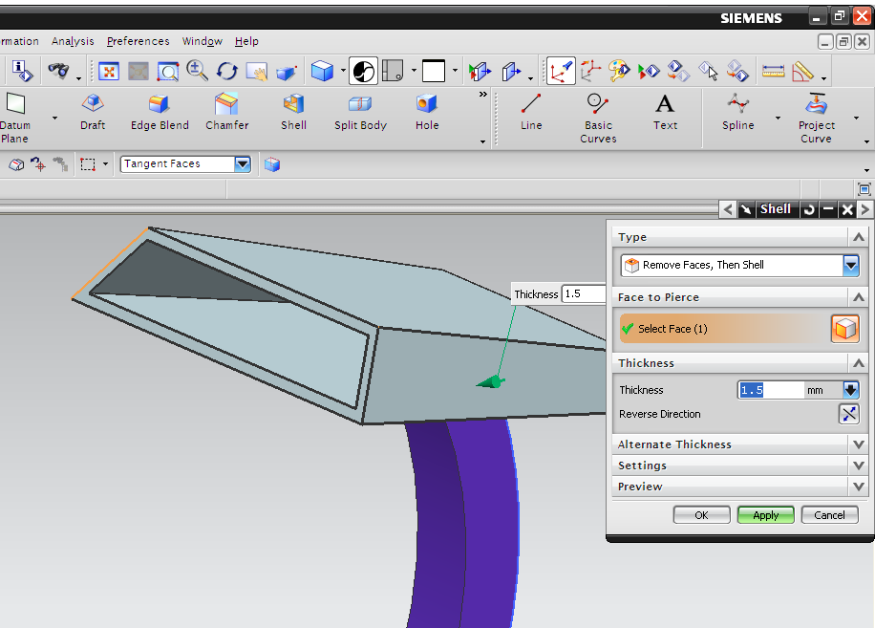
Study Lamp Design
Geometric/PARAMETRIC Modeling
Solid Modeling
Perception of Solids
Modeling of Curves
Modeling of Surfaces (Patches)
Topology and Solids
Solid Modeling 1-2
Transformations and Projections 1-2
Representation, Differential Geometry
Ferguson Segments
Bezier Segments 1-2
B-spline curves 1-5
NURBS
Differential Geometry
Tensor Product
Boundary Interpolating
Composite
NURBS

Slide 38
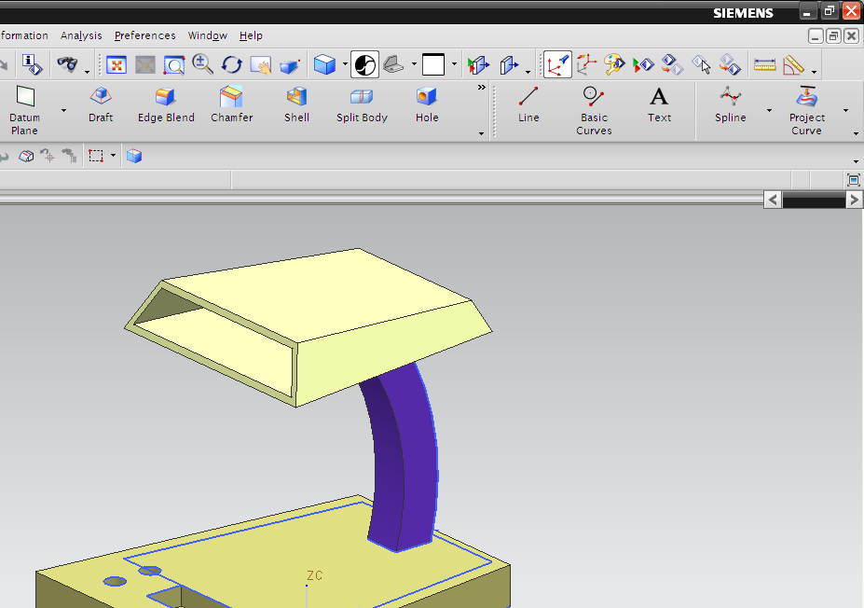
Study Lamp Design
Geometric/PARAMETRIC Modeling
Solid Modeling
Perception of Solids
Modeling of Curves
Modeling of Surfaces (Patches)
Topology and Solids
Solid Modeling 1-2
Transformations and Projections 1-2
Representation, Differential Geometry
Ferguson Segments
Bezier Segments 1-2
B-spline curves 1-5
NURBS
Differential Geometry
Tensor Product
Boundary Interpolating
Composite
NURBS

Slide 39
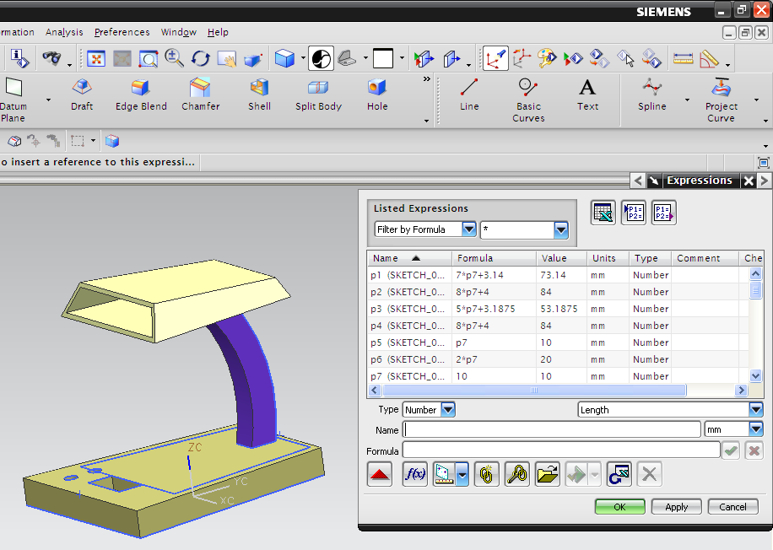
Study Lamp Design
Geometric/PARAMETRIC Modeling
Solid Modeling
Perception of Solids
Modeling of Curves
Modeling of Surfaces (Patches)
Topology and Solids
Solid Modeling 1-2
Transformations and Projections 1-2
Representation, Differential Geometry
Ferguson Segments
Bezier Segments 1-2
B-spline curves 1-5
NURBS
Differential Geometry
Tensor Product
Boundary Interpolating
Composite
NURBS

Slide 40
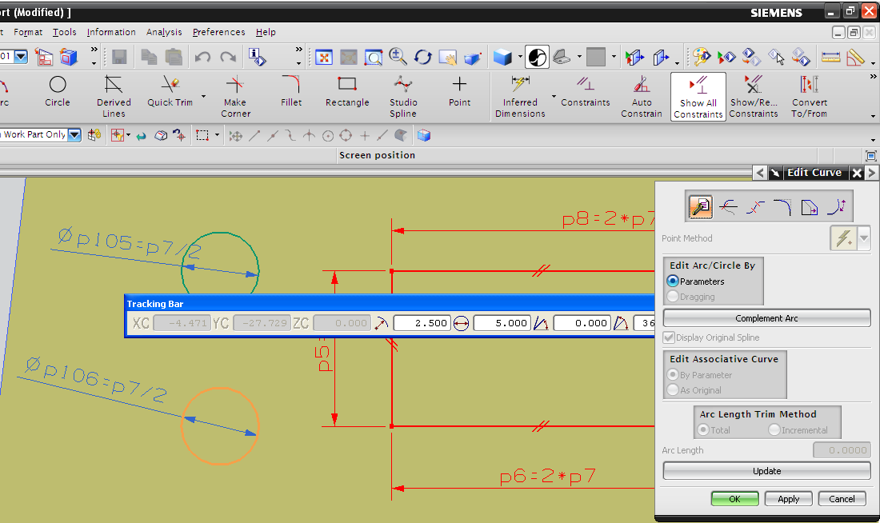
Study Lamp Design
Geometric/PARAMETRIC Modeling
Solid Modeling
Perception of Solids
Modeling of Curves
Modeling of Surfaces (Patches)
Topology and Solids
Solid Modeling 1-2
Transformations and Projections 1-2
Representation, Differential Geometry
Ferguson Segments
Bezier Segments 1-2
B-spline curves 1-5
NURBS
Differential Geometry
Tensor Product
Boundary Interpolating
Composite
NURBS

Slide 41
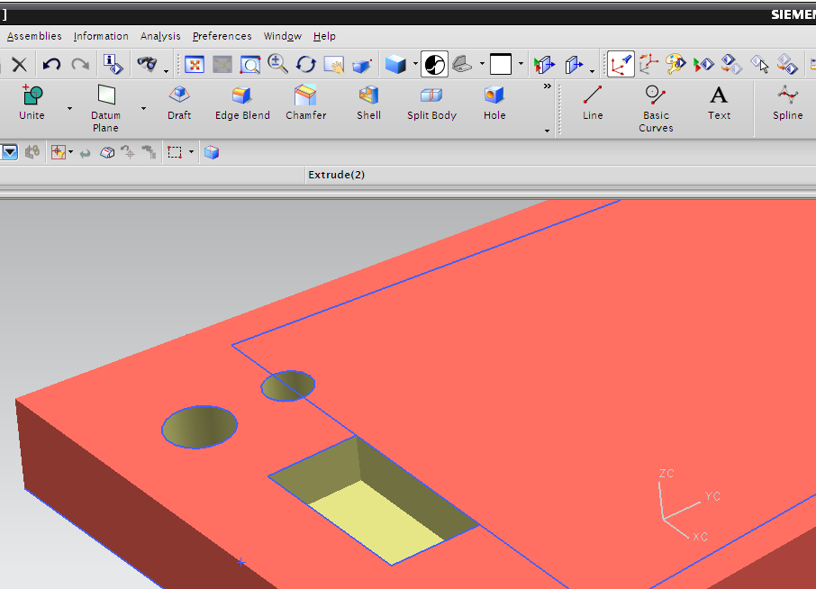
Study Lamp Design
Geometric/PARAMETRIC Modeling
Solid Modeling
Perception of Solids
Modeling of Curves
Modeling of Surfaces (Patches)
Topology and Solids
Solid Modeling 1-2
Transformations and Projections 1-2
Representation, Differential Geometry
Ferguson Segments
Bezier Segments 1-2
B-spline curves 1-5
NURBS
Differential Geometry
Tensor Product
Boundary Interpolating
Composite
NURBS

Slide 42
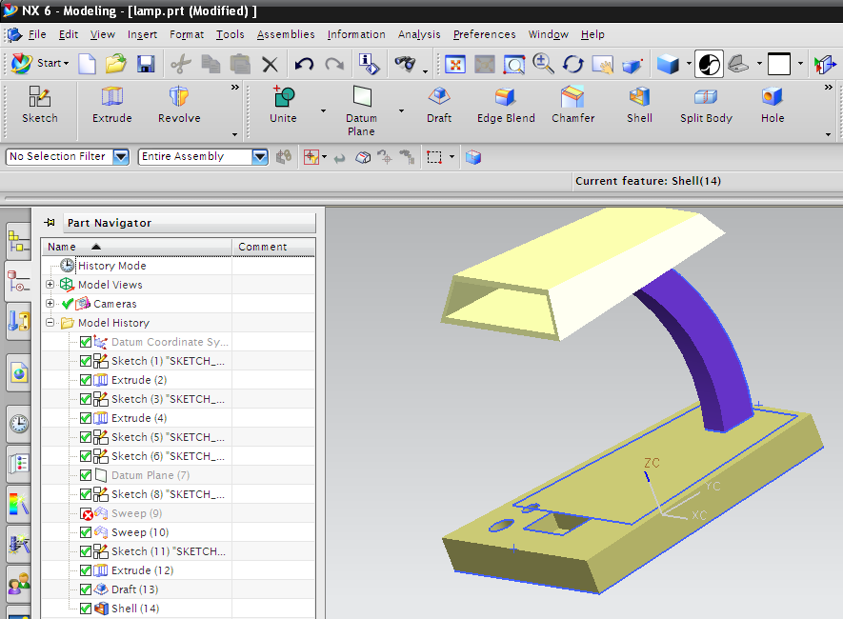
Study Lamp Design
Geometric/PARAMETRIC Modeling
Solid Modeling
Perception of Solids
Modeling of Curves
Modeling of Surfaces (Patches)
Topology and Solids
Solid Modeling 1-2
Transformations and Projections 1-2
Representation, Differential Geometry
Ferguson Segments
Bezier Segments 1-2
B-spline curves 1-5
NURBS
Differential Geometry
Tensor Product
Boundary Interpolating
Composite
NURBS

Slide 43
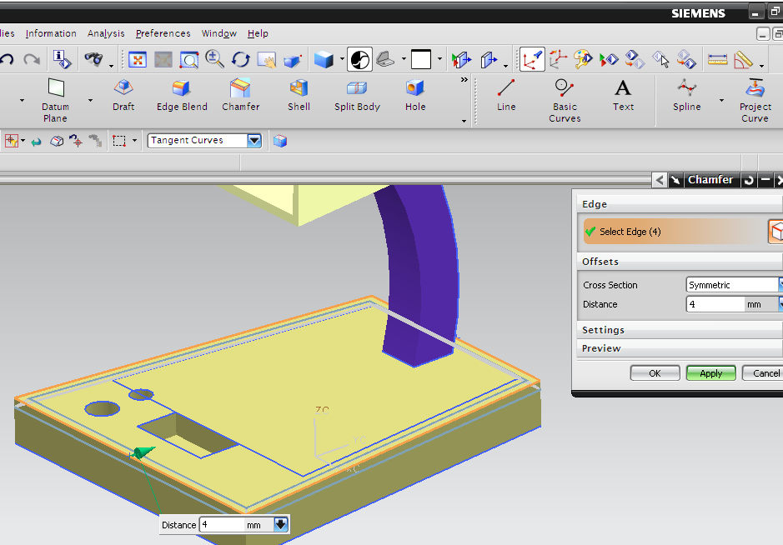
Study Lamp Design
Geometric/PARAMETRIC Modeling
Solid Modeling
Perception of Solids
Modeling of Curves
Modeling of Surfaces (Patches)
Topology and Solids
Solid Modeling 1-2
Transformations and Projections 1-2
Representation, Differential Geometry
Ferguson Segments
Bezier Segments 1-2
B-spline curves 1-5
NURBS
Differential Geometry
Tensor Product
Boundary Interpolating
Composite
NURBS

Slide 44
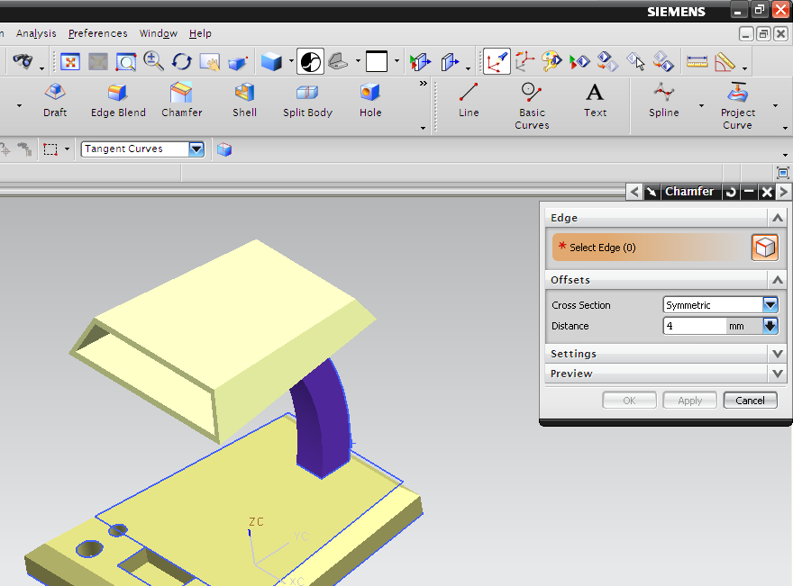
Study Lamp Design
Geometric/PARAMETRIC Modeling
Solid Modeling
Perception of Solids
Modeling of Curves
Modeling of Surfaces (Patches)
Topology and Solids
Solid Modeling 1-2
Transformations and Projections 1-2
Representation, Differential Geometry
Ferguson Segments
Bezier Segments 1-2
B-spline curves 1-5
NURBS
Differential Geometry
Tensor Product
Boundary Interpolating
Composite
NURBS

Slide 45
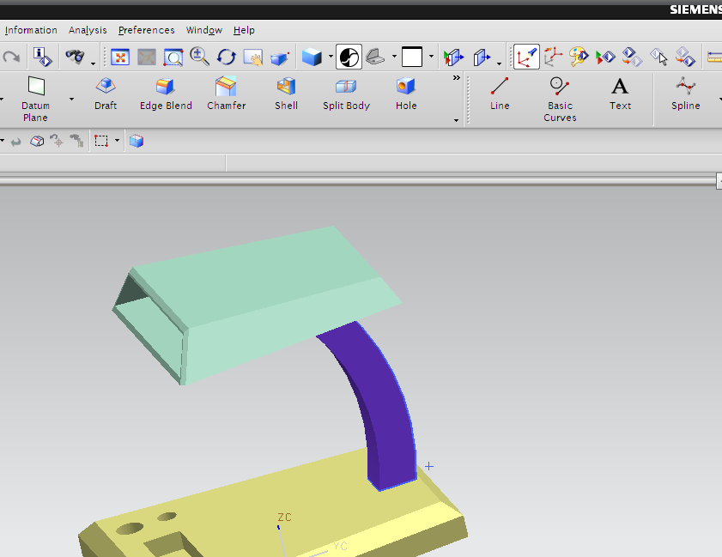
Study Lamp Design
Geometric/PARAMETRIC Modeling
Solid Modeling
Perception of Solids
Modeling of Curves
Modeling of Surfaces (Patches)
Topology and Solids
Solid Modeling 1-2
Transformations and Projections 1-2
Representation, Differential Geometry
Ferguson Segments
Bezier Segments 1-2
B-spline curves 1-5
NURBS
Differential Geometry
Tensor Product
Boundary Interpolating
Composite
NURBS

Slide 46
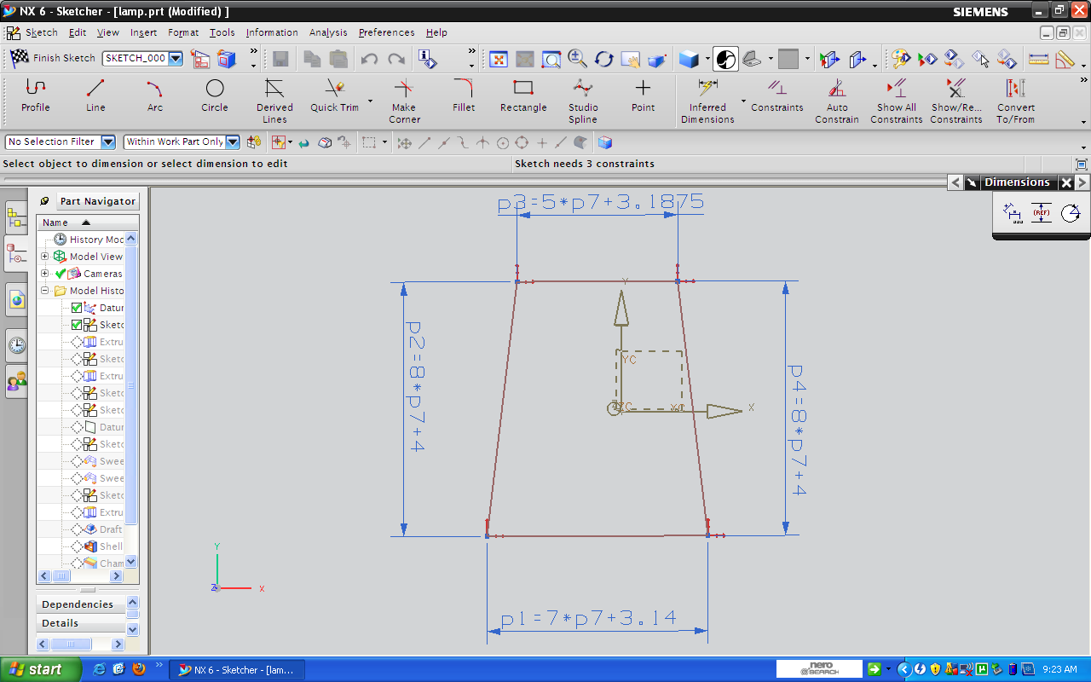
Study Lamp Design
Geometric/PARAMETRIC Modeling
Solid Modeling
Perception of Solids
Modeling of Curves
Modeling of Surfaces (Patches)
Topology and Solids
Solid Modeling 1-2
Transformations and Projections 1-2
Representation, Differential Geometry
Ferguson Segments
Bezier Segments 1-2
B-spline curves 1-5
NURBS
Differential Geometry
Tensor Product
Boundary Interpolating
Composite
NURBS

Slide 47
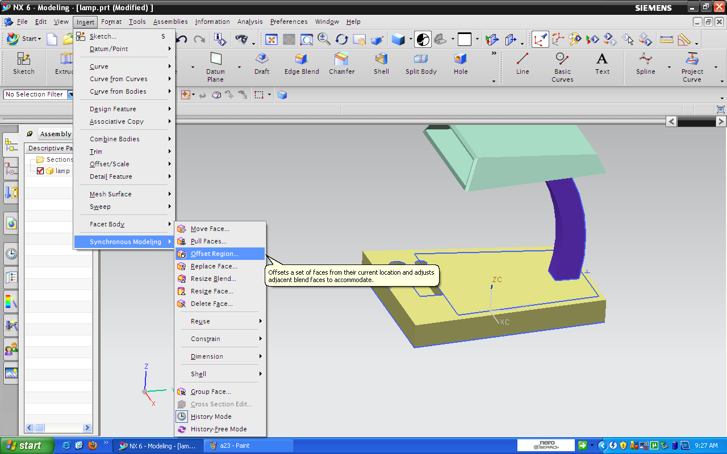
Study Lamp Design
Geometric/PARAMETRIC Modeling
Solid Modeling
Perception of Solids
Modeling of Curves
Modeling of Surfaces (Patches)
Topology and Solids
Solid Modeling 1-2
Transformations and Projections 1-2
Representation, Differential Geometry
Ferguson Segments
Bezier Segments 1-2
B-spline curves 1-5
NURBS
Differential Geometry
Tensor Product
Boundary Interpolating
Composite
NURBS

Slide 48
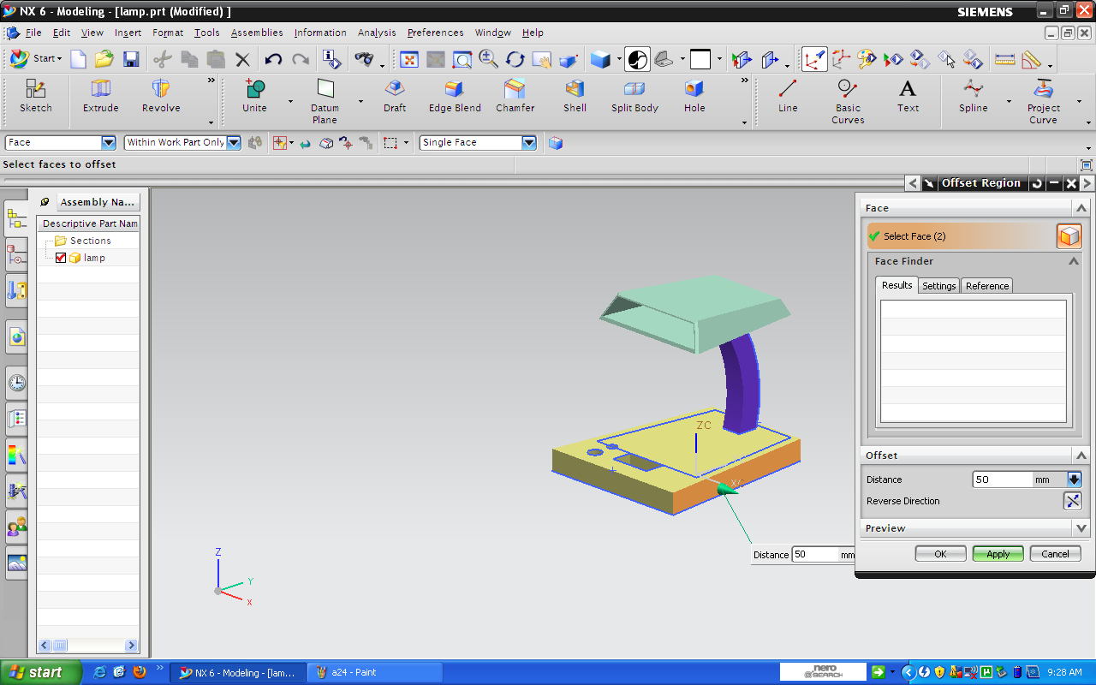
Study Lamp Design
Geometric/PARAMETRIC Modeling
Solid Modeling
Perception of Solids
Modeling of Curves
Modeling of Surfaces (Patches)
Topology and Solids
Solid Modeling 1-2
Transformations and Projections 1-2
Representation, Differential Geometry
Ferguson Segments
Bezier Segments 1-2
B-spline curves 1-5
NURBS
Differential Geometry
Tensor Product
Boundary Interpolating
Composite
NURBS

Slide 49
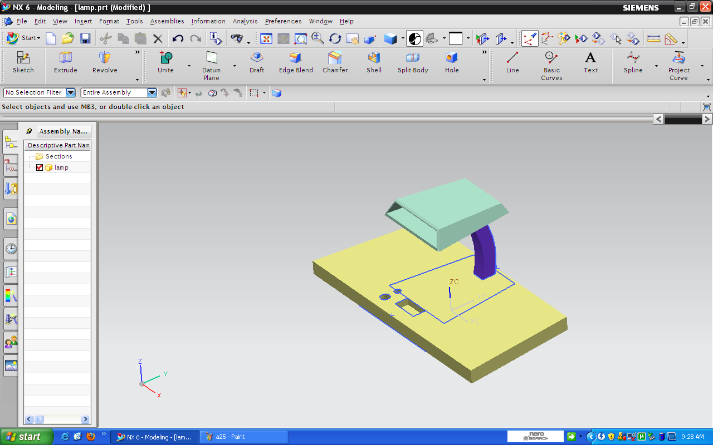
Study Lamp Design
Geometric/PARAMETRIC Modeling
Solid Modeling
Perception of Solids
Modeling of Curves
Modeling of Surfaces (Patches)
Topology and Solids
Solid Modeling 1-2
Transformations and Projections 1-2
Representation, Differential Geometry
Ferguson Segments
Bezier Segments 1-2
B-spline curves 1-5
NURBS
Differential Geometry
Tensor Product
Boundary Interpolating
Composite
NURBS

Slide 50
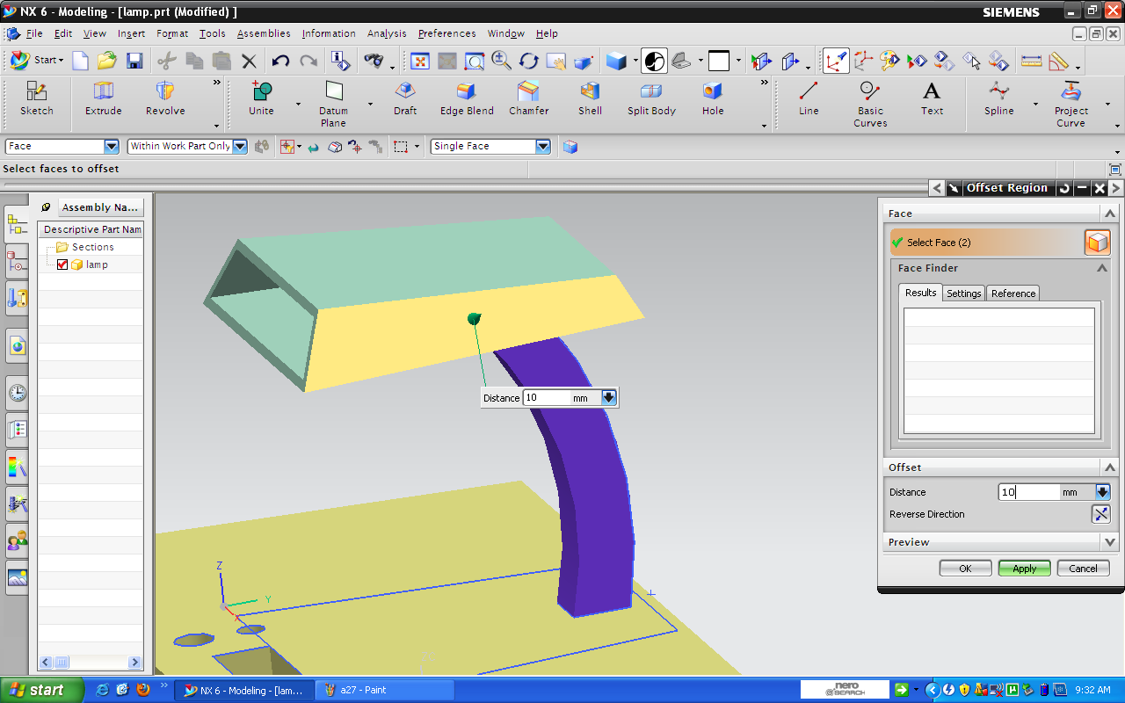
Study Lamp Design
Geometric/PARAMETRIC Modeling
Solid Modeling
Perception of Solids
Modeling of Curves
Modeling of Surfaces (Patches)
Topology and Solids
Solid Modeling 1-2
Transformations and Projections 1-2
Representation, Differential Geometry
Ferguson Segments
Bezier Segments 1-2
B-spline curves 1-5
NURBS
Differential Geometry
Tensor Product
Boundary Interpolating
Composite
NURBS

Slide 51
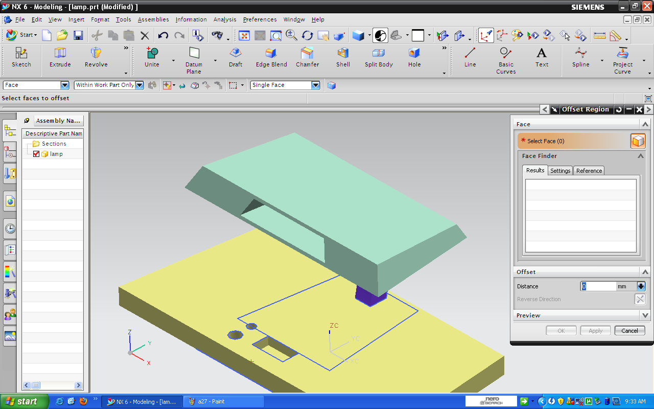
Study Lamp Design
Geometric/PARAMETRIC Modeling
Solid Modeling
Perception of Solids
Modeling of Curves
Modeling of Surfaces (Patches)
Topology and Solids
Solid Modeling 1-2
Transformations and Projections 1-2
Representation, Differential Geometry
Ferguson Segments
Bezier Segments 1-2
B-spline curves 1-5
NURBS
Differential Geometry
Tensor Product
Boundary Interpolating
Composite
NURBS

Slide 52
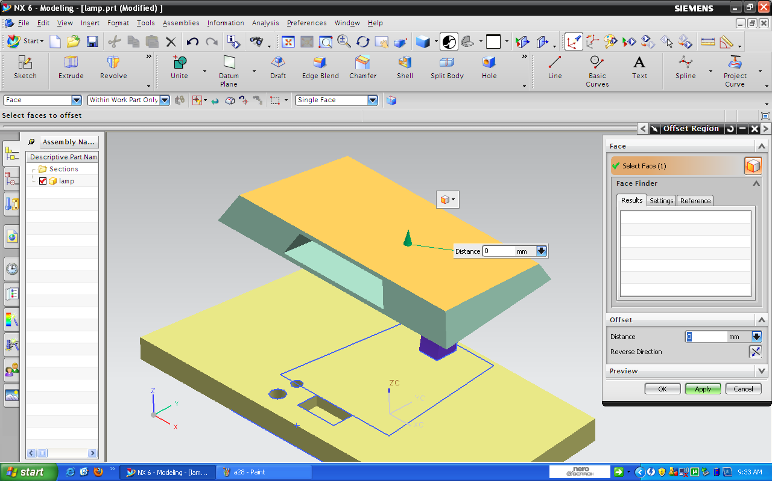
Study Lamp Design
Geometric/PARAMETRIC Modeling
Solid Modeling
Perception of Solids
Modeling of Curves
Modeling of Surfaces (Patches)
Topology and Solids
Solid Modeling 1-2
Transformations and Projections 1-2
Representation, Differential Geometry
Ferguson Segments
Bezier Segments 1-2
B-spline curves 1-5
NURBS
Differential Geometry
Tensor Product
Boundary Interpolating
Composite
NURBS

Slide 53
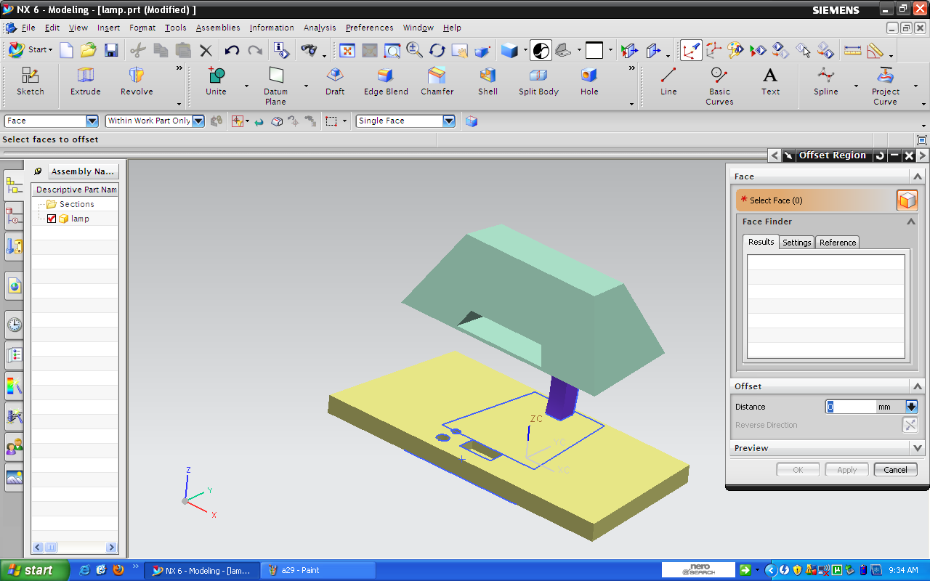
Study Lamp Design
Geometric/PARAMETRIC Modeling
Solid Modeling
Perception of Solids
Modeling of Curves
Modeling of Surfaces (Patches)
Topology and Solids
Solid Modeling 1-2
Transformations and Projections 1-2
Representation, Differential Geometry
Ferguson Segments
Bezier Segments 1-2
B-spline curves 1-5
NURBS
Differential Geometry
Tensor Product
Boundary Interpolating
Composite
NURBS

Slide 54
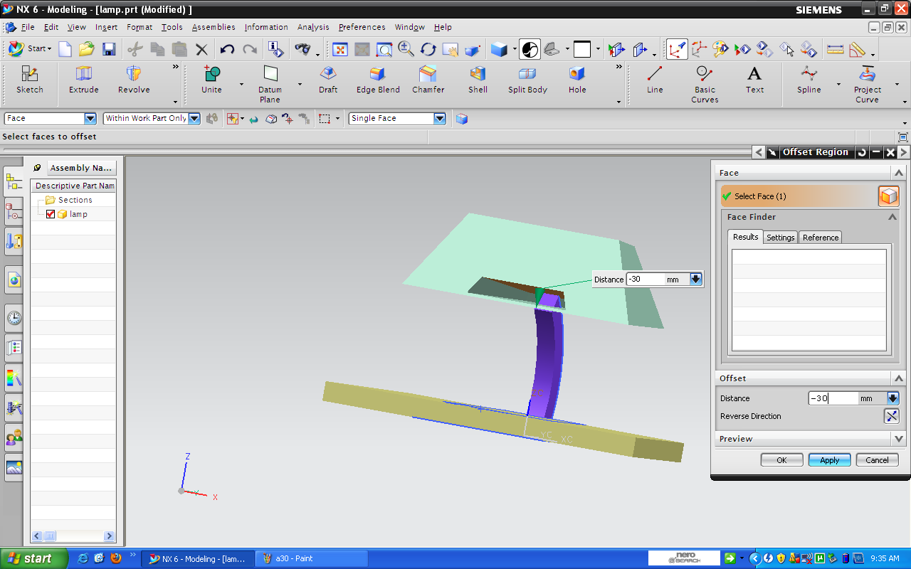
Study Lamp Design
Geometric/PARAMETRIC Modeling
Solid Modeling
Perception of Solids
Modeling of Curves
Modeling of Surfaces (Patches)
Topology and Solids
Solid Modeling 1-2
Transformations and Projections 1-2
Representation, Differential Geometry
Ferguson Segments
Bezier Segments 1-2
B-spline curves 1-5
NURBS
Differential Geometry
Tensor Product
Boundary Interpolating
Composite
NURBS

Slide 55
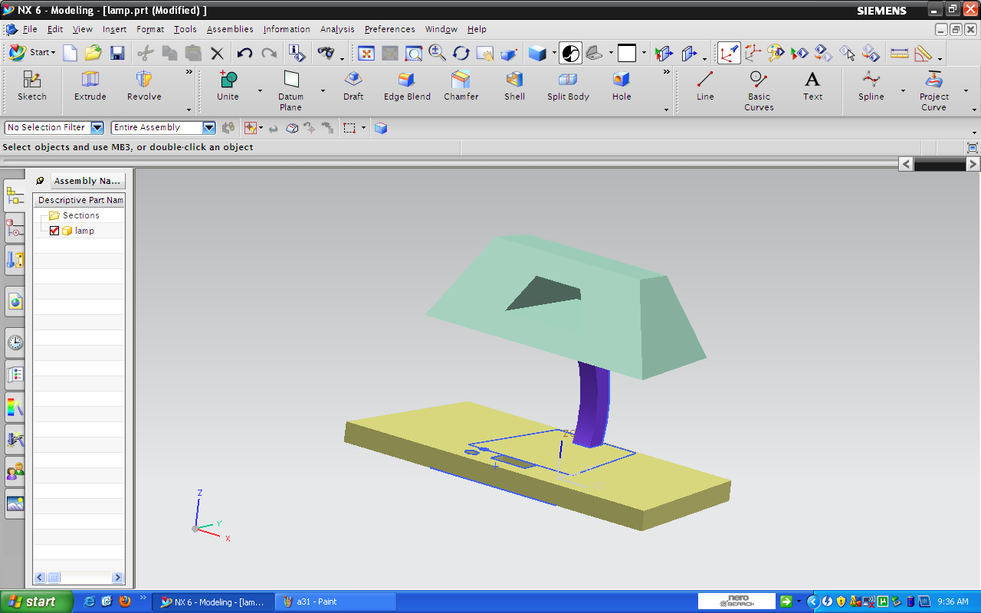
Study Lamp Design
Geometric/PARAMETRIC Modeling
Solid Modeling
Perception of Solids
Modeling of Curves
Modeling of Surfaces (Patches)
Topology and Solids
Solid Modeling 1-2
Transformations and Projections 1-2
Representation, Differential Geometry
Ferguson Segments
Bezier Segments 1-2
B-spline curves 1-5
NURBS
Differential Geometry
Tensor Product
Boundary Interpolating
Composite
NURBS

Slide 56
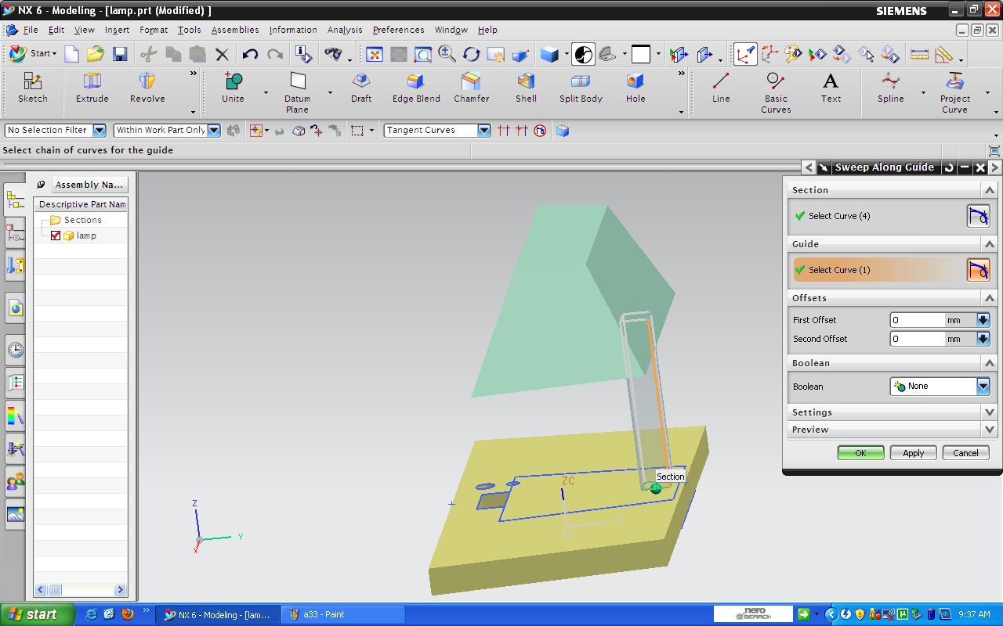
Study Lamp Design
Geometric/PARAMETRIC Modeling
Solid Modeling
Perception of Solids
Modeling of Curves
Modeling of Surfaces (Patches)
Topology and Solids
Solid Modeling 1-2
Transformations and Projections 1-2
Representation, Differential Geometry
Ferguson Segments
Bezier Segments 1-2
B-spline curves 1-5
NURBS
Differential Geometry
Tensor Product
Boundary Interpolating
Composite
NURBS

Slide 57
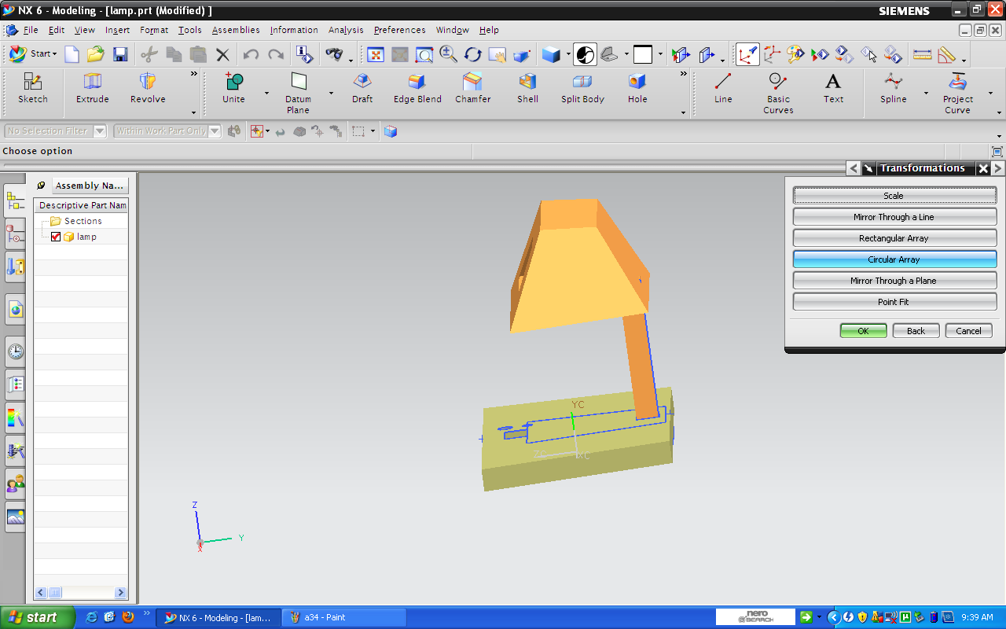
Study Lamp Design
Geometric/PARAMETRIC Modeling
Solid Modeling
Perception of Solids
Modeling of Curves
Modeling of Surfaces (Patches)
Topology and Solids
Solid Modeling 1-2
Transformations and Projections 1-2
Representation, Differential Geometry
Ferguson Segments
Bezier Segments 1-2
B-spline curves 1-5
NURBS
Differential Geometry
Tensor Product
Boundary Interpolating
Composite
NURBS

Slide 58
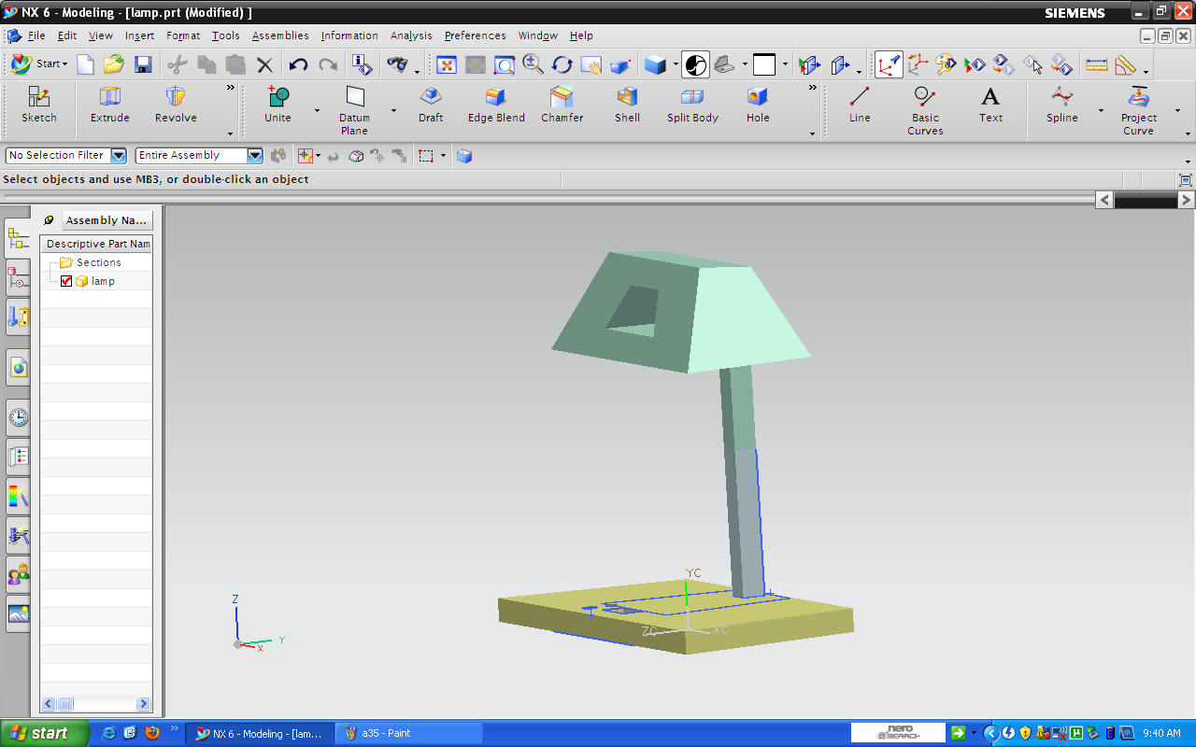
Study Lamp Design
Geometric/PARAMETRIC Modeling
Solid Modeling
Perception of Solids
Modeling of Curves
Modeling of Surfaces (Patches)
Topology and Solids
Solid Modeling 1-2
Transformations and Projections 1-2
Representation, Differential Geometry
Ferguson Segments
Bezier Segments 1-2
B-spline curves 1-5
NURBS
Differential Geometry
Tensor Product
Boundary Interpolating
Composite
NURBS

Slide 59
Study Lamp Design
Geometric/PARAMETRIC Modeling
Solid Modeling
Perception of Solids
Modeling of Curves
Modeling of Surfaces (Patches)
Topology and Solids
Solid Modeling 1-2
Transformations and Projections 1-2
Representation, Differential Geometry
Ferguson Segments
Bezier Segments 1-2
B-spline curves 1-5
NURBS
Differential Geometry
Tensor Product
Boundary Interpolating
Composite
NURBS

