Slide 1
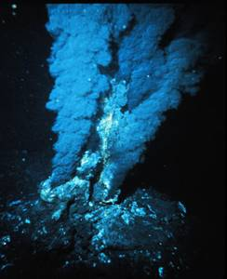
Black geyser in deep sea hydrothermal vent.
Curr. Sci.(1997), 73,842-854.

Slide 2
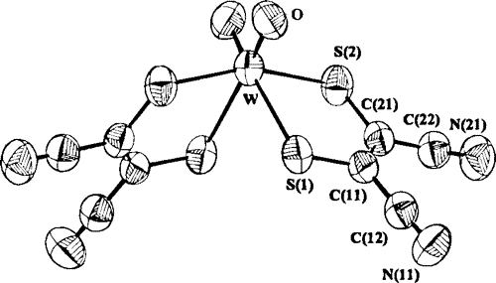
Modeling the Tungsten Site of Inactive and Active Forms of Hyperthermophilic Pyrococcus furiosus Aldehyde Ferredoxin Oxidoreductase
J. Am. Chem. Soc., (1996), 118 ,1387–1397

Slide 3
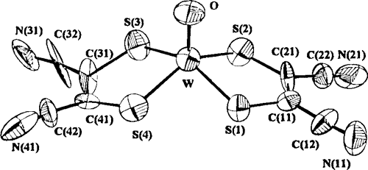
A Functional Mimic of the New Class of Tungstoenzyme, Acetylene Hydratase
J. Am. Chem. Soc.,(1997), 119, 4315-4316

Slide 4
Functional model of sulfite oxidase
J. Am. Chem. Soc. ,(1994), 116, 9061-70

Slide 5
Reason of Fishy Smell

Slide 6
functional model for the tungsten-formate dehydrogenase of clostridium thermoaceticum.
Proc.-Indian Acad. Sci., Chem. Sci. (1992), 104, 533-4.

Slide 7
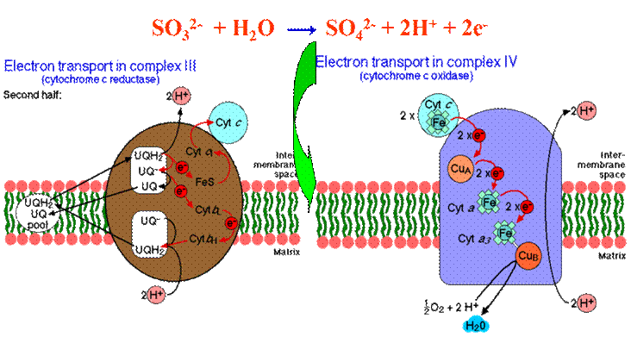
HSO₃⁻ + H₂O → S0
HSO₃⁻ , the substrate of
hepatic sulfite oxidase
Chem. Commun. (2001), 1786-1787.

