Slide 1
Water-induced formation and photoluminescence of carbon nanotube-based composites of Gadolinium(III) and Platinum(II) Dithiolenes
Chem. Eur. J., (2014), 20, 01-06

Slide 2
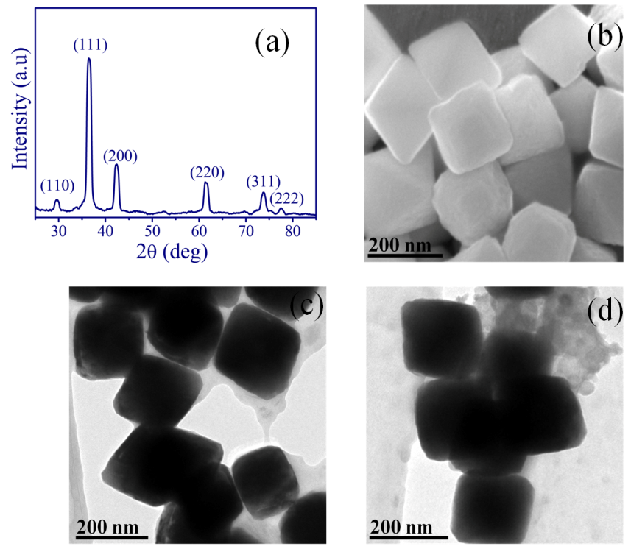
Nanodomain cubic copper (I) oxide as reusable catalyst in the synthesis of amides by amidation of aryl halides with isocyanides
Doi:10.1016/j.tetlet.2014.12.060

Slide 3
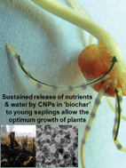
Carbon nanoparticles in ‘biochar’ boost wheat (Triticum aestivum) plant growth
RSC Adv., (2014), 4, 39948-39954

Slide 4
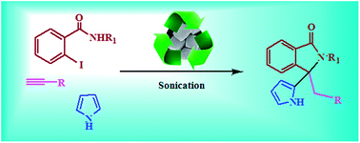
Nanodomain cubic cuprous oxide as reusable catalyst in the synthesis of 3-alkyl/aryl-3-(pyrrole-2-yl/indole-3-yl)-2-phenyl-2,3-dihydro-isoindolinones in aqueous medium
RSC Adv., (2014),4, 7024-7029

Slide 5
Influence of water soluble carbon dots on the growth of wheat plant
Appl. Nanosci., (2014)DOI:10.1007/s13204-014-0355-9

Slide 6
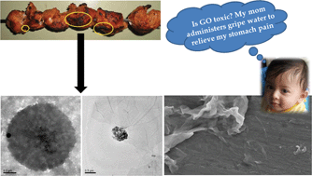
Involuntary graphene intake with food and medicine
RSC Adv., (2014),4, 30162-30167

Slide 7
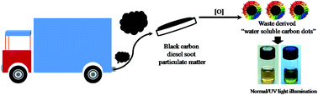
Water soluble carbon dots
Black carbon
Diesel soot particulate matter
Normal light/UV light illumination
Pollutant soot of diesel engine exhaust transformed to carbon dots for multicoloured imaging of E. coli and cholesterol sensing
RSC Adv., (2014),4, 30100-30107

Slide 8
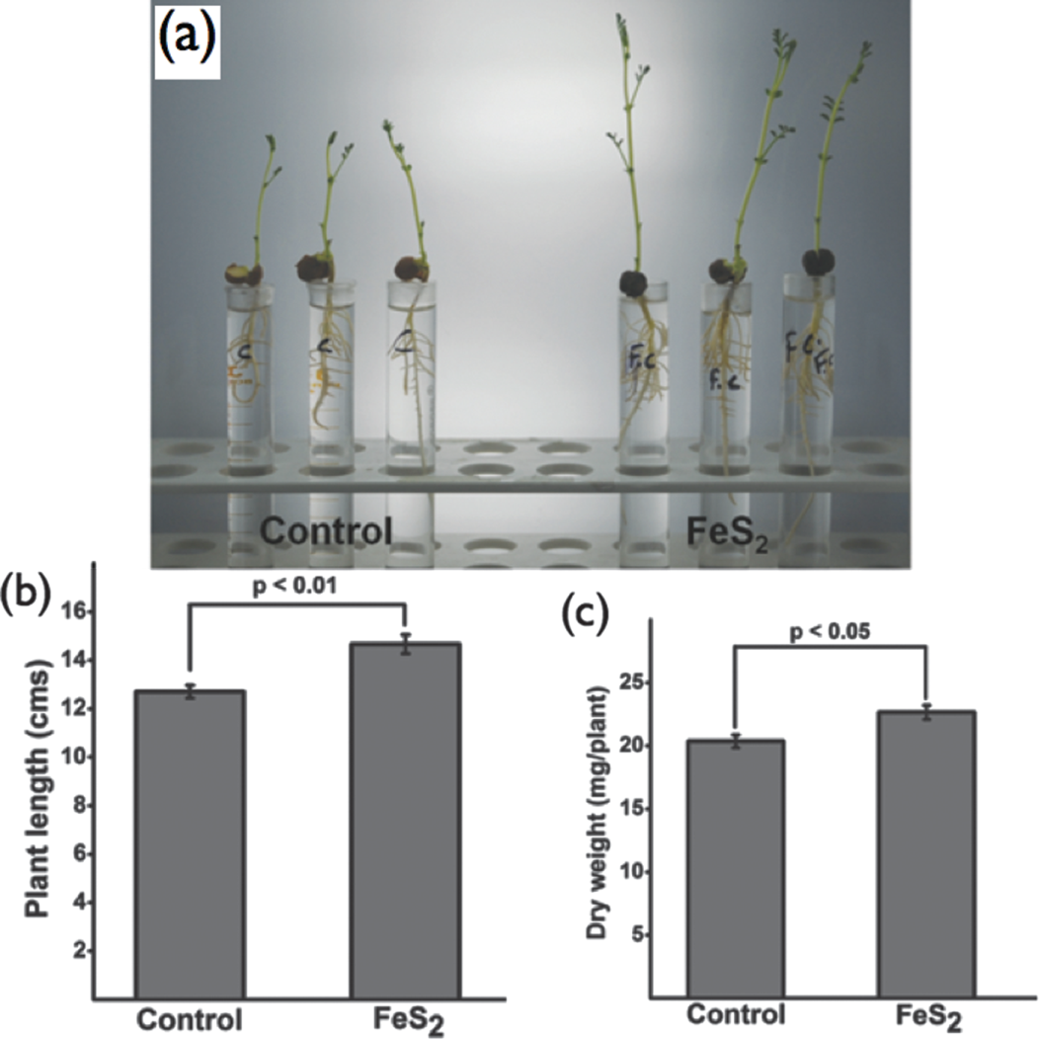
Iron pyrite, a potential photovoltaic material, increases plant biomass upon seed pre-treatment
Mater. Express,(2014), 4, 23-31

Slide 9
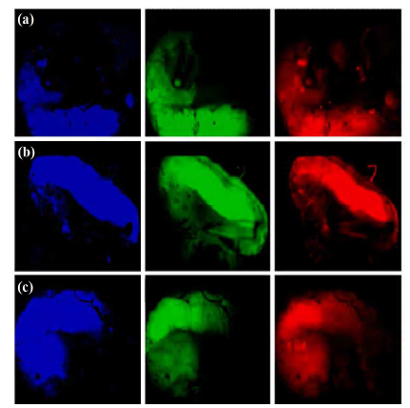
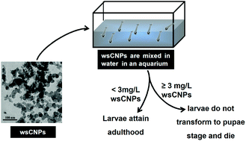
Water soluble nano carbons arrest the growth of mosquito.
RSC Adv., (2013),3, 22504-22508.

Slide 10
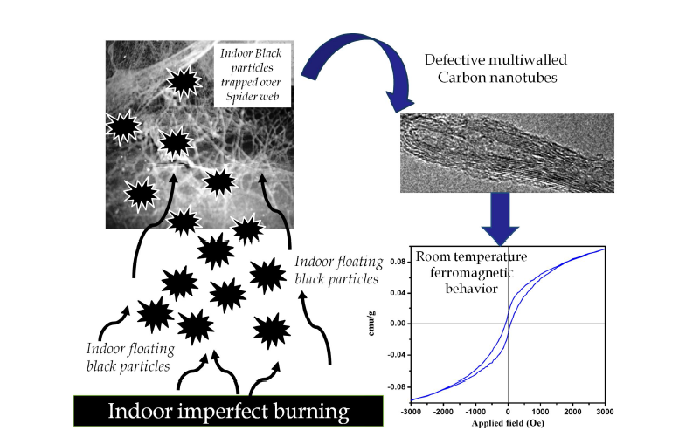
Ferromagnetic Behavior of Anthopogenic Multiwalled Carbon Nanotubes Trapped in Spider Web Indoor
J. Nanosci. Nanotechnol.,(2014), 14, 2532-2538

Slide 11
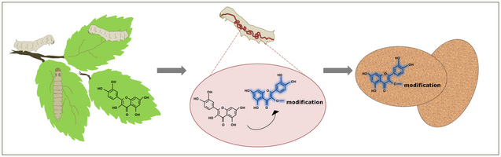
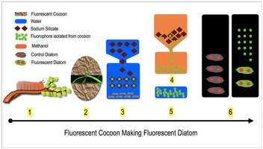
Fluorescent silk cocoon creating fluorescent diatom using a “water glass-fluorophore ferry”
Sci. Rep.,(2013), DOI: 10.1038/srep03290

Slide 12

Nanospheres of copper(III) 1,2-dicarbomethoxy-1,2-dithiolate and its composite with water soluble carbon nanotubes
New J. Chem., 2013,37, 2708-2715

Slide 13
Fluorescence imaging of human erythrocytes by carbon nanoparticles from food stuff and their fluorescence enhancement by blood plasma
Mater. Express,(2013), 3, 201-209.

Slide 14
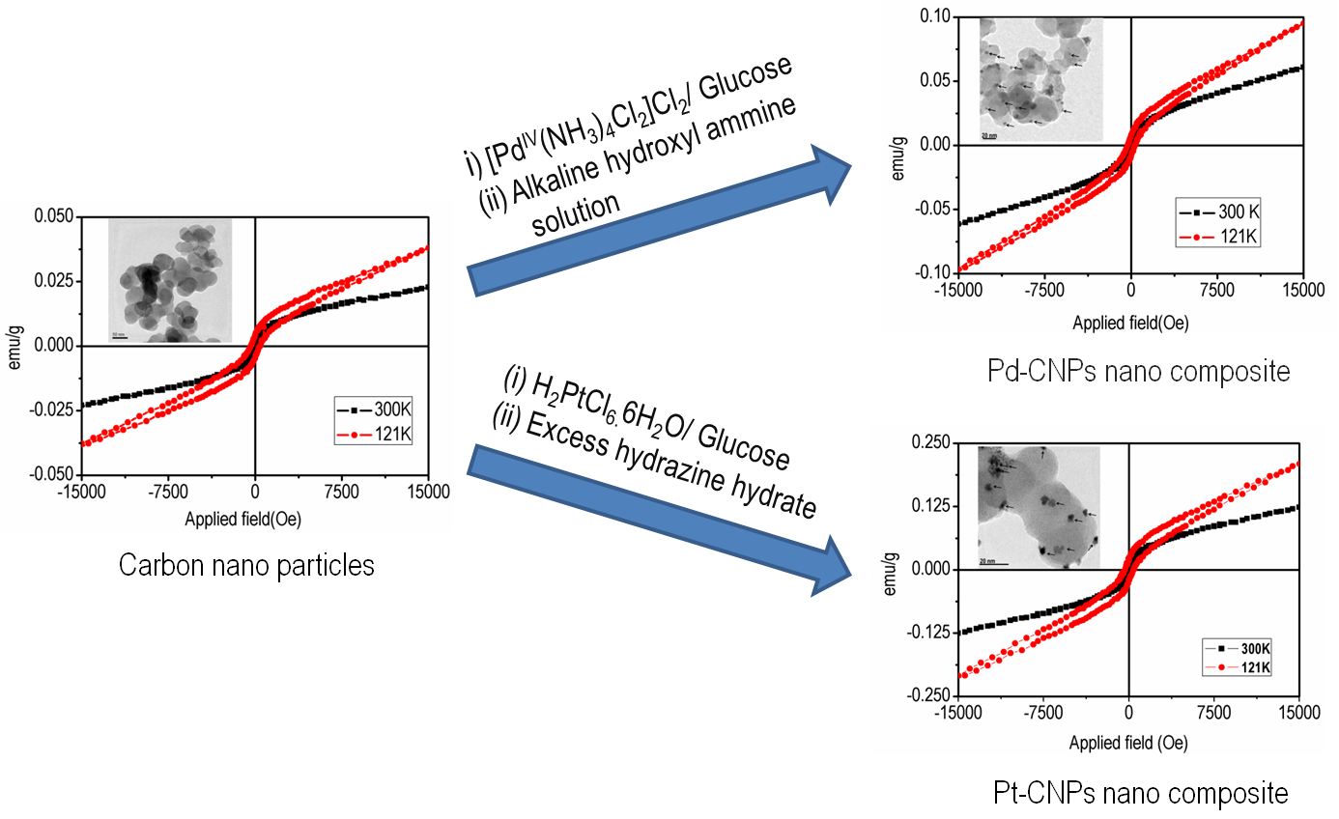
Magnetic and electrocatalytic properties of nano-Pd and Pt-carbon nano-onion composite
Adv. Sci. Eng. Med ,(2013), 5, 1181-1186.

Slide 15
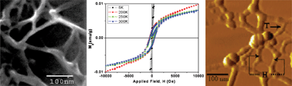
Isolation of water soluble carbon nanotubes with network structure possessing multipodal junctions and its magnetic property
RSC Adv., (2013),3, 7306-7312

Slide 16
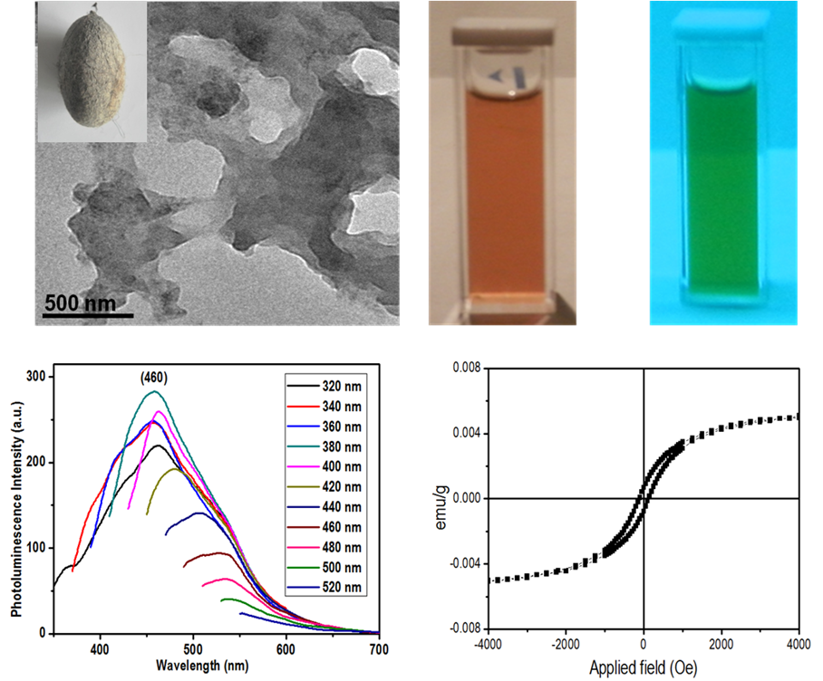
Graphene Oxide from Silk Cocoon , Magnetic Fluorophore for Multi-photon Imaging.
3 Biotech.,( 2013) 4, 67–75

Slide 17
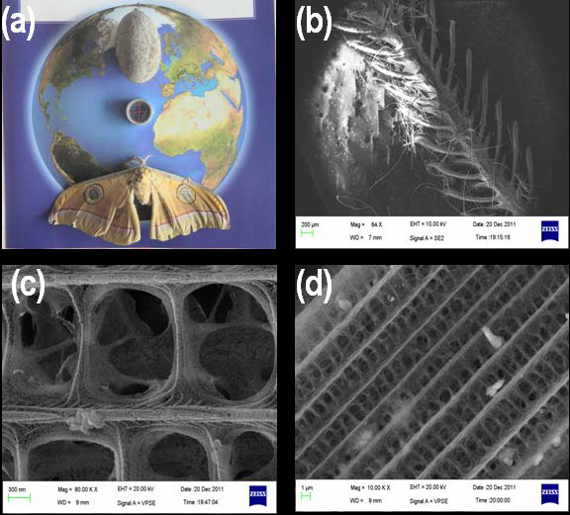
Presence of stable carbon centric free radicals and ferromagnetic elements in the antennae and the wings of nocturnal silk moth: nanomagnet to evade predator .
Mater. Express, (2013), 3, 43-50.

Slide 18
Molecular discriminators using single wall carbon nanotubes
Nanotechnology,(2012), 23, 385304

Slide 19

Enhanced persistence of fog under illumination for carbon nanotube fog condensation nuclei
J. Appl. Phys.,(2012),112, 024901-1- 024901-4

Slide 20
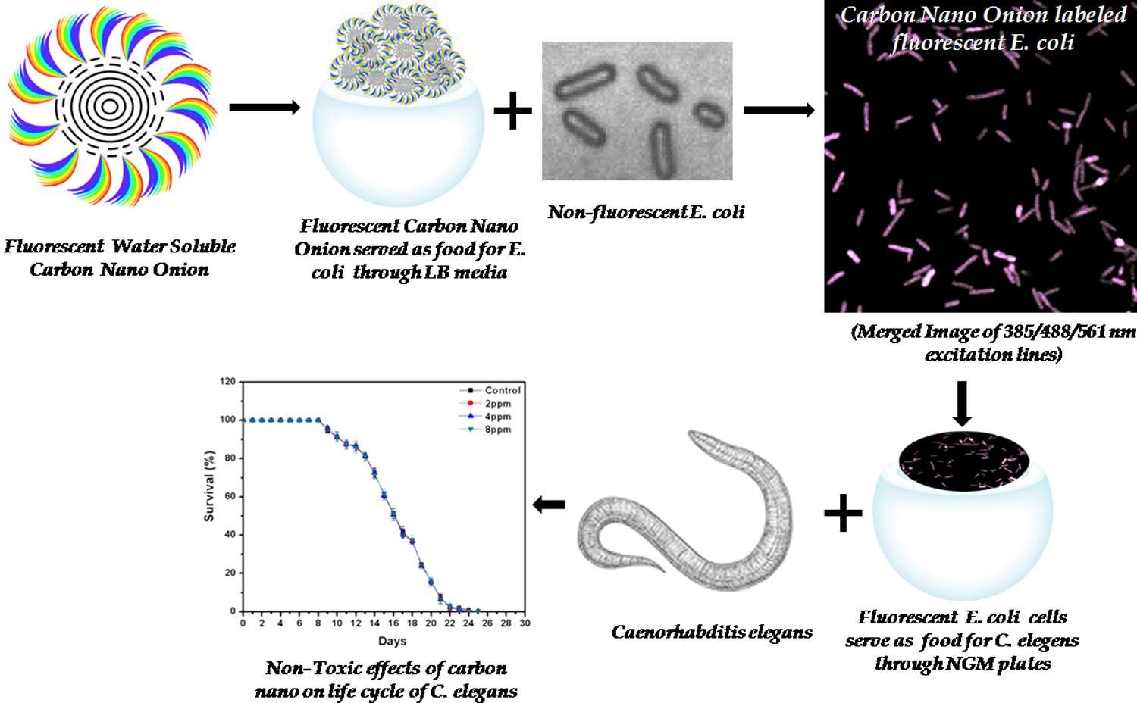
Carbon Nano-Onions as Nontoxic and High-Fluorescence Bioimaging Agent in Food Chain—An In Vivo Study from Unicellular E. coli to Multicellular C. elegans
Mater. Express(2012), 2, 105-114

Slide 21
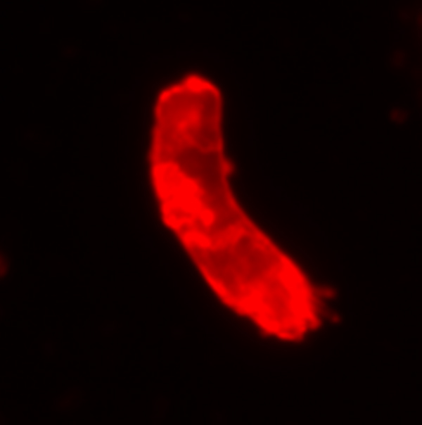
E-coli-CNT
(Mater. Express (2012), 2, 105-114)

Slide 22
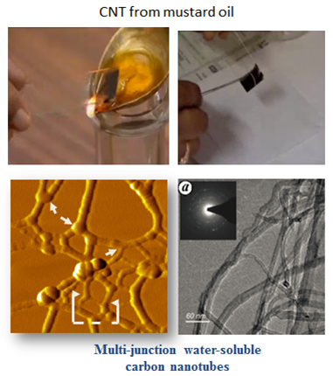
Multi junction WSCNT preparation form mustard oil soot
Pramana J. Phys. (2005), 65, 681-697

Slide 23
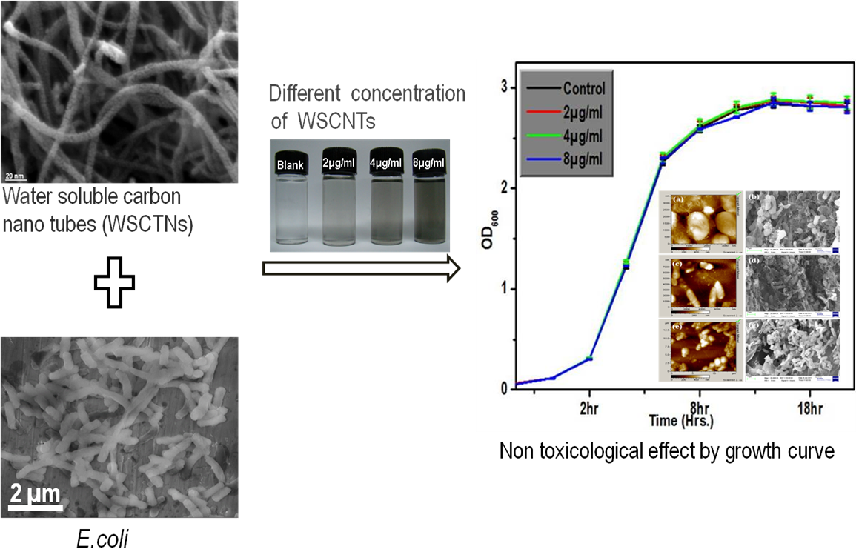
Non-Toxicity of Water Soluble Multi-Walled Carbon Nanotube on Escherichia-coli Colonies
J. Nanosci. Nanotechnol.,(2012), 12, 1754-63

Slide 24
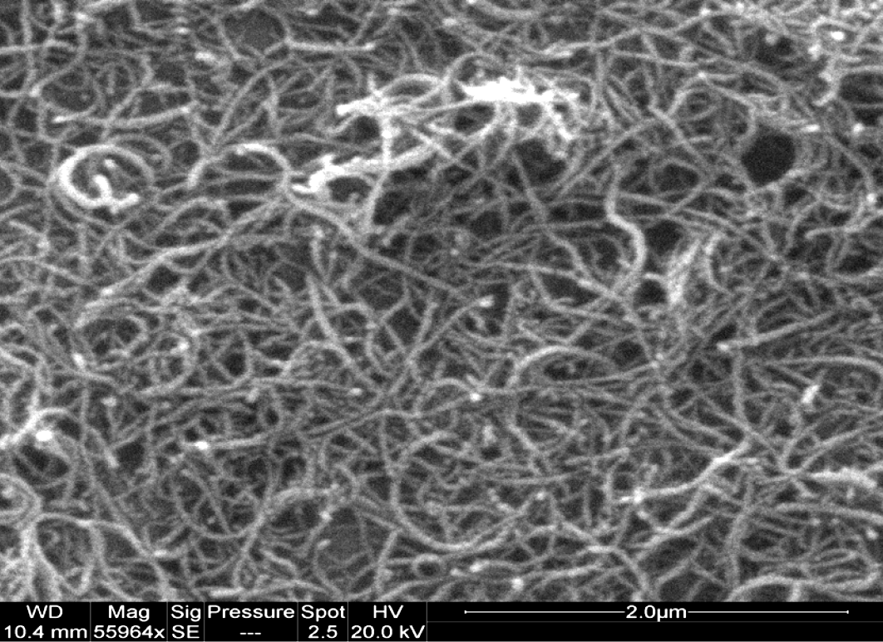
Water Soluble CNT
Adv. Sci. Lett.,(2011), 4, 558 - 560

Slide 25
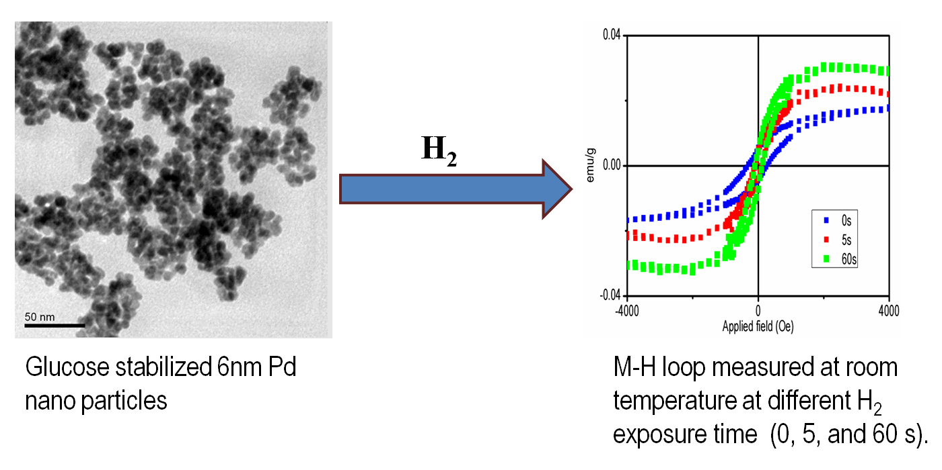
Glucose stabilized magnetic Palladium nanoparticles exhibiting enhanced magnetic properties under exposure to hydrogen
Mater. Express.,(2012), 2, 275-284

Slide 26
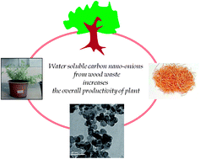
wsCNO increases plant growth
Water soluble carbon nano-onions from wood wool as growth promoter for gram plants
Nanoscale, (2012),4, 7670-7675

Slide 27
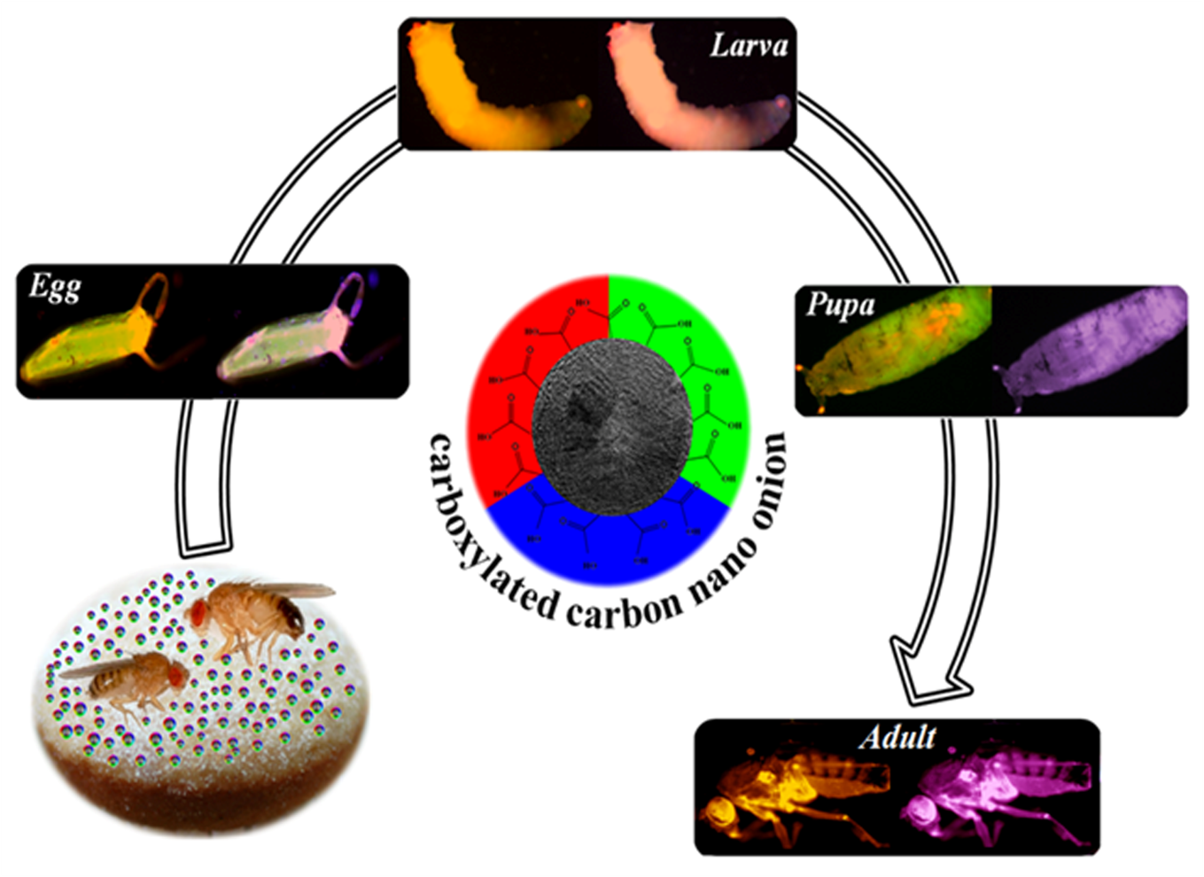
Carbon nano-onions for imaging the life cycle of Drosophila Melanogaster
Small, ( 2011), 7, 3170-3177

Slide 28
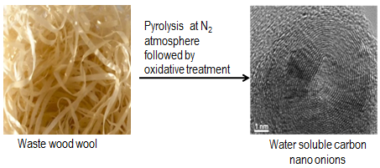
Water soluble carbon nano-onions from wood wool as growth promoters for gram plants
Nanoscale, (2012), 4, 7670 –7675

Slide 29
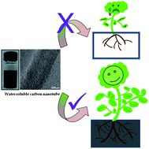
Growth stimulation of gram (Cicer arietinum) plant by water soluble carbon nanotubes
Nanoscale, (2011),3, 1176-1181

Slide 30
Multiwalled carbon nanotube-polystyrene composite modified
Pt electrode as an electrochemical gas sensor
Adv. Sci. Lett. (2011), 4, 558-560

Slide 31
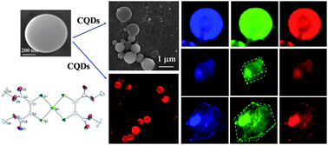
Nano composites of carbon quantum dots–nickel(II) dithiolene as Nano lights
New J. Chem., (2013), 37, 2708-2715

Slide 32
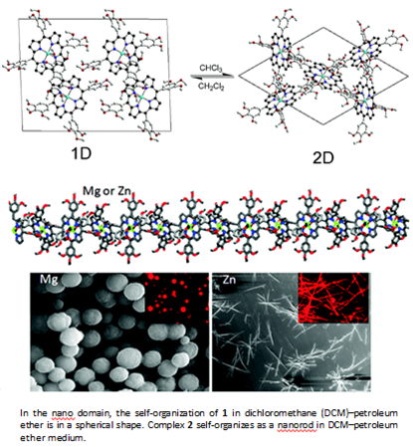
substrate based assembly of simple inorganic complexes led to aggregation with different shapes retaining the original identity mimicking stem cell.
Cryst. Growth Des., (2011), 11, 5410–5414

Slide 33
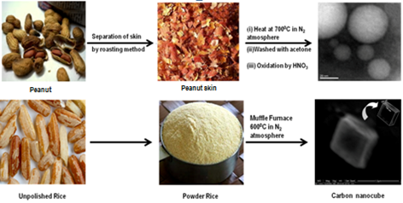
Synthesis and characterization of nano carbons from food
Diam& Relat. Mater., (2012), 24, 11-14
Nanosci. Nanotechnol., (2010), 10, 4064-4067

Slide 34
0B243B
Colour code

