Slide 1
ME 251
Anupam Saxena
Professor
Mechanical Engineering
Compliant and Robotic Systems Lab
Indian Institute of Technology Kanpur

Slide 2
Geometrical tolerances
Tolerance on size alone is not sufficient to ensure proper functioning of parts
Accuracy on form and position is equally significant!
Form variation: It is the variation of actual form from the geometrically ideal form
Position variation: Variation of the actual position of the form feature from the geometrically ideal position with reference to another feature
Slide Adapted from Prof. P. Venkitanarayanan

Slide 3
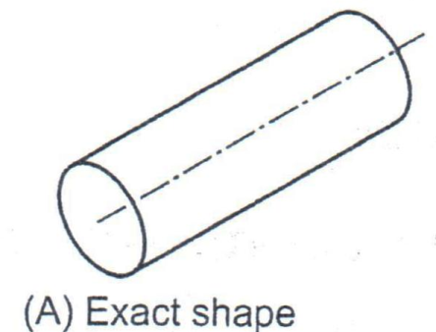
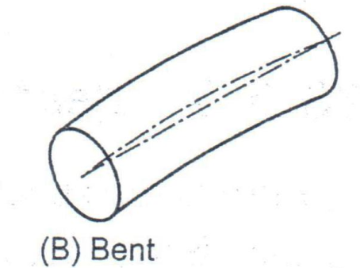
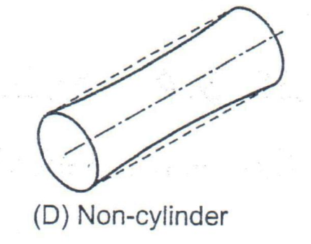
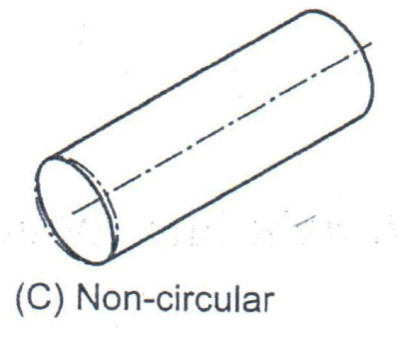
Geometrical shape variations
Slide Adapted from Prof. P. Venkitanarayanan

Slide 4
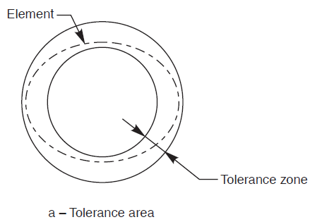
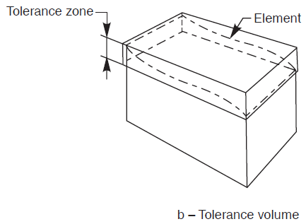
Geometrical tolerances
Form tolerances limit the deviations of an individual feature from its ideal geometrical form
Tolerance zone: It is the imaginary area or volume within which the controlled feature of the manufactured part should be contained completely
Slide Adapted from Prof. P. Venkitanarayanan

Slide 5
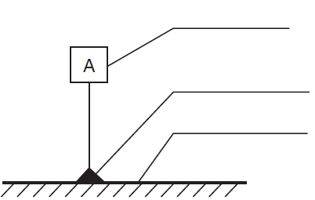
Indicating Geometrical Tolerances in Drawing
Leader line
Datum letter
Arrow
Tolerance Value
Toleranced feature
Tolerance Symbol
Datum letter
Datum triangle
Datum feature
Datum: It is a theoretically exact geometric reference (axis, plane, line) to which the tolerance features are related
Slide Adapted from Prof. P. Venkitanarayanan

Slide 6
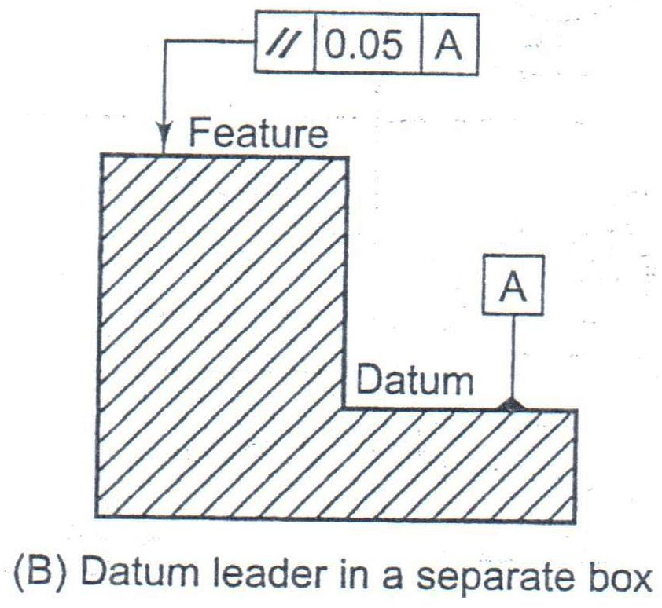
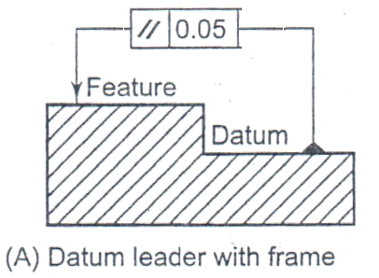
Indicating Geometrical Tolerances in Drawing
The datum feature is near the tolerated feature
The datum feature is far off from the tolerated feature
Slide Adapted from Prof. P. Venkitanarayanan

Slide 7
Geometrical tolerance symbols
Straightness
Flatness
Circularity
Form tolerances
Cylindricity
Profile of line
Profile of surface

Slide 8
Angularity
Perpendicularity
Orientation tolerances
Parallelism
Concentricity
Position
Position tolerances
Symmetry

Slide 9
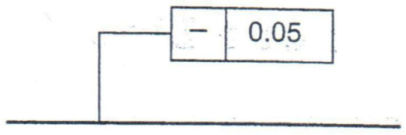
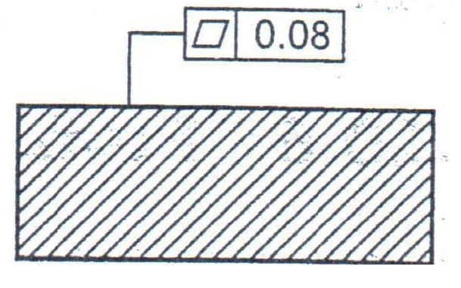
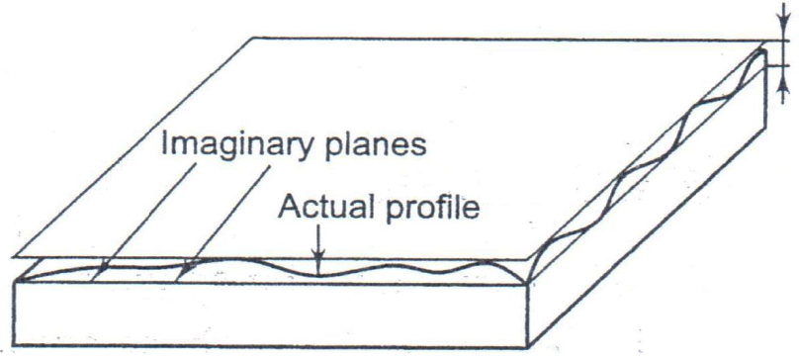
Geometrical Tolerances
Straightness
Flatness
Slide Adapted from Prof. P. Venkitanarayanan

Slide 10
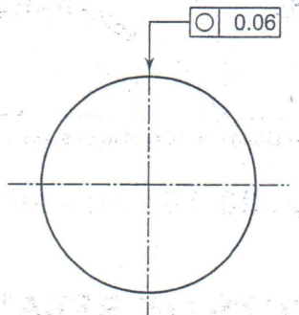
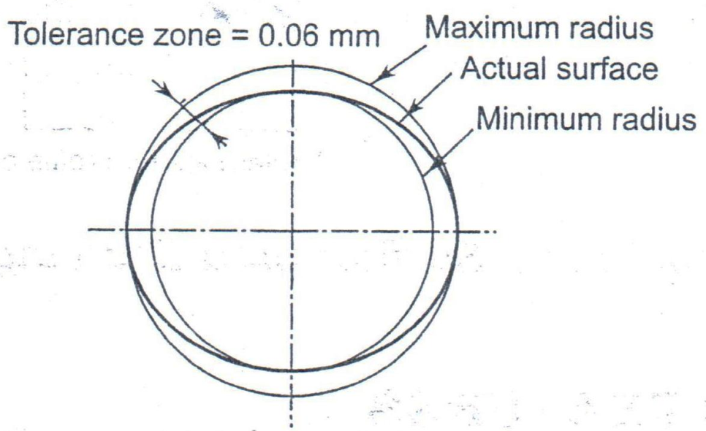
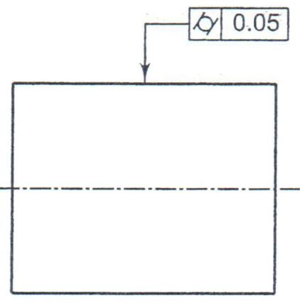
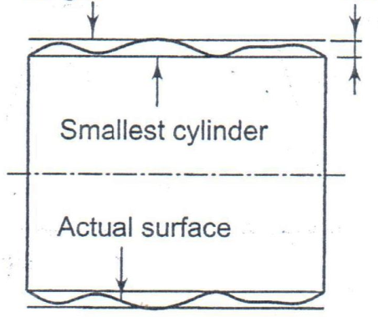
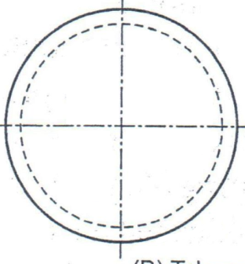
Geometrical Tolerances
Circularity
Cylindricity
Slide Adapted from Prof. P. Venkitanarayanan

Slide 11
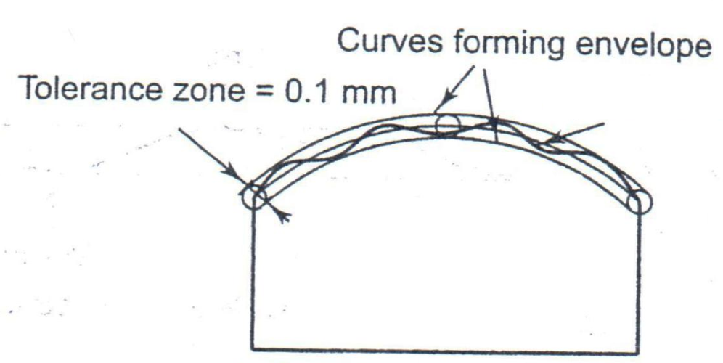
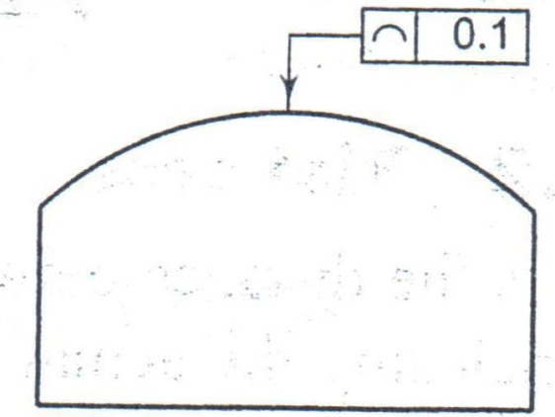
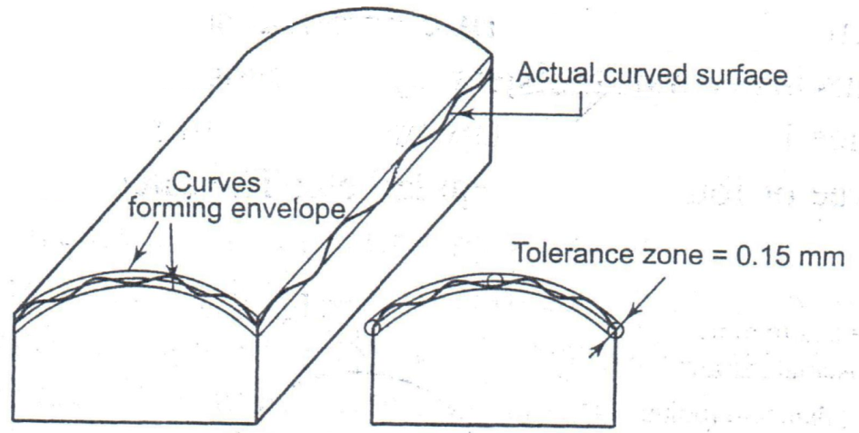
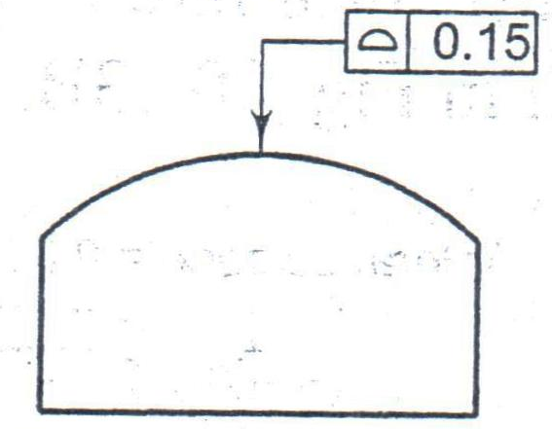
Geometrical Tolerances
Actual line
Profile of line
Profile of surface
Slide Adapted from Prof. P. Venkitanarayanan

Slide 12
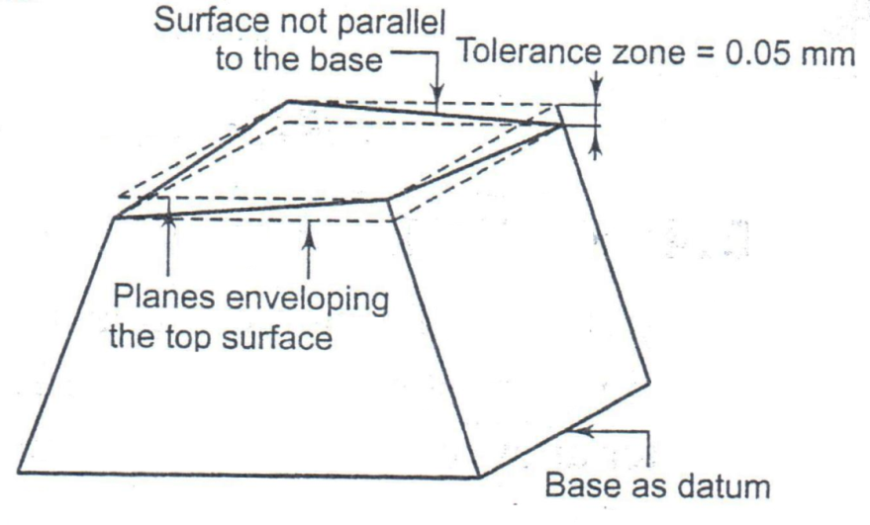
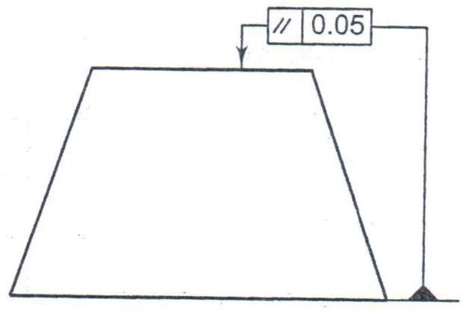
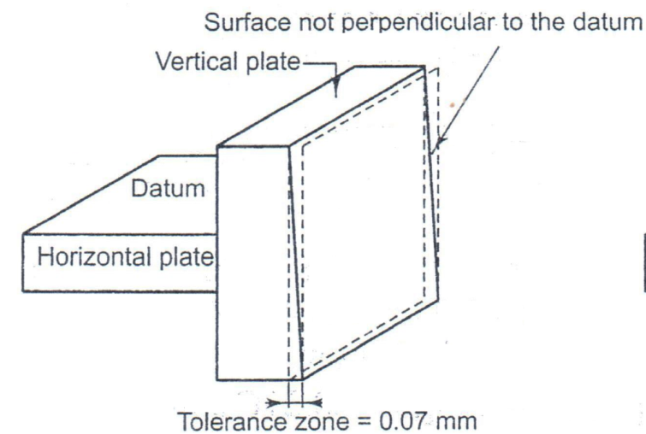
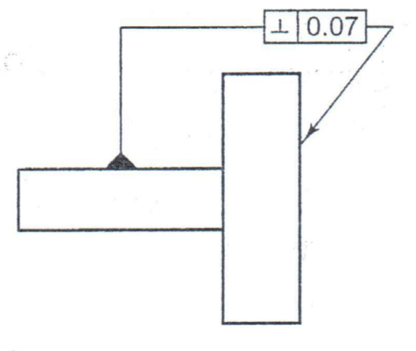
Geometrical Tolerances
Parallelism
Perpendicularity
Slide Adapted from Prof. P. Venkitanarayanan

