Slide 1
ME 251
Anupam Saxena
Professor
Mechanical Engineering
Compliant and Robotic Systems Lab
Indian Institute of Technology Kanpur

Slide 2
Feed Check Valve
PART LIST
NO. | PART | MATERIAL | QTY
1 | BODY | CI | 1
2 | COVER | CI | 1
3 | SPINDLE | MS | 1
4 | VALVE | GM | 1
5 | VALVE SEAT | GM | 1
6 | GLAND | GM | 1
7 | HAND WHEEL | CI | 1
8 | STUD | MS | 6
9 | STUD | MS | 2
10 | NUT | MS | 6
11 | NUT | MS | 3
Prepared by Anupam Saxena, Vitthal Khatik and Ishu Agrawal

Slide 3
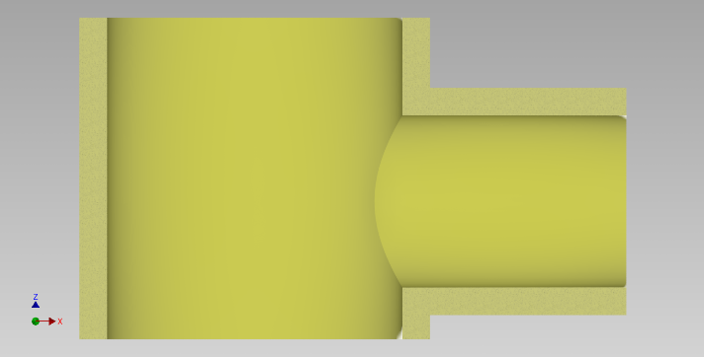
Feed Check Valve
PART LIST
NO. | PART | MATERIAL | QTY
1 | BODY | CI | 1
2 | COVER | CI | 1
3 | SPINDLE | MS | 1
4 | VALVE | GM | 1
5 | VALVE SEAT | GM | 1
6 | GLAND | GM | 1
7 | HAND WHEEL | CI | 1
8 | STUD | MS | 6
9 | STUD | MS | 2
10 | NUT | MS | 6
11 | NUT | MS | 3
Prepared by Anupam Saxena, Vitthal Khatik and Ishu Agrawal

Slide 4
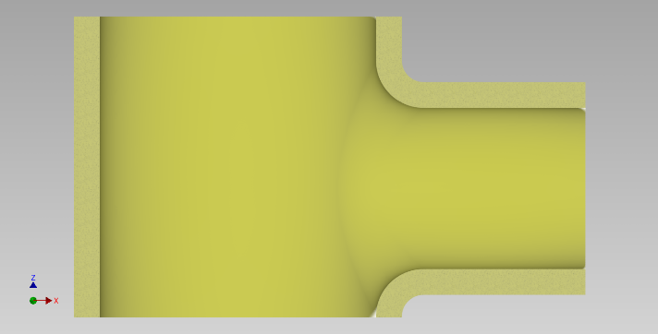
Feed Check Valve
PART LIST
NO. | PART | MATERIAL | QTY
1 | BODY | CI | 1
2 | COVER | CI | 1
3 | SPINDLE | MS | 1
4 | VALVE | GM | 1
5 | VALVE SEAT | GM | 1
6 | GLAND | GM | 1
7 | HAND WHEEL | CI | 1
8 | STUD | MS | 6
9 | STUD | MS | 2
10 | NUT | MS | 6
11 | NUT | MS | 3
Prepared by Anupam Saxena, Vitthal Khatik and Ishu Agrawal

Slide 5
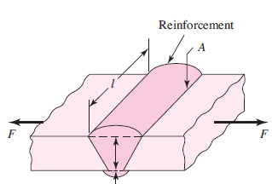
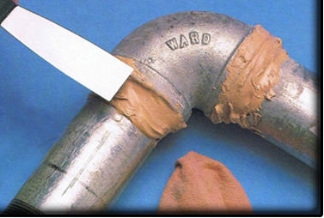
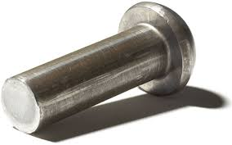
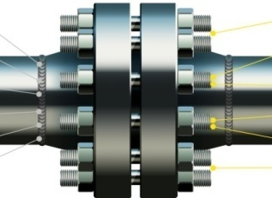
THREADED FASTENERS
Engineering systems are composed of parts which are joined together
Methods of joining
Adhesive bonding
Welding
Using threaded fasteners
Riveting

Slide 6
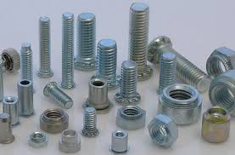
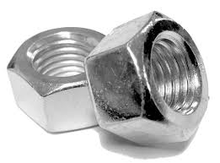
THREADED FASTENERS
Threads
Helical feature made on the outer surface of a cylindrical part

Slide 7
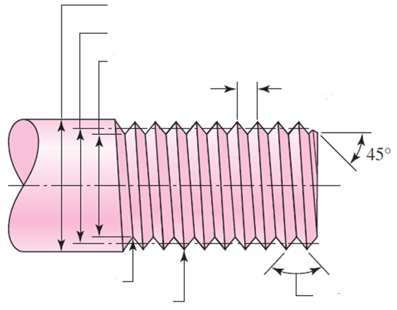
THREADED FASTENERS
Major diameter
Pitch diameter
Minor or root diameter
Pitch
Chamfer
Root
Crest
Flank
Thread angle
Pitch is distance measured parallel to axis between corresponding points on adjacent threads

Slide 8
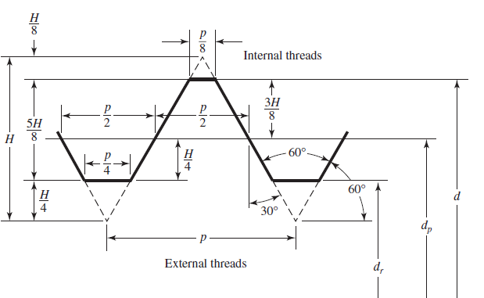
Standard ISO Metric thread profile
THREADED FASTENERS
Pitch
R=H/6
Minor diameter
Major diameter
Pitch diameter

Slide 9
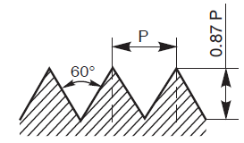
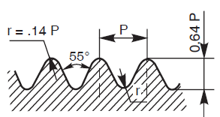
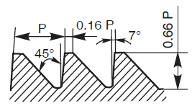
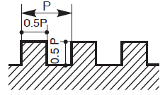
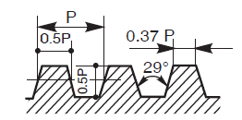
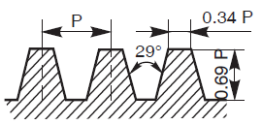
Other Thread Profiles
THREADED FASTENERS
Sharp V
White worth
Buttress
Square
ACME
Worm

Slide 10
Why so many profiles?
THREADED FASTENERS
V threads:
Large flank area and hence more friction. Used in effective positioning
Difficult to make. Relatively weak
Whiteworh thread: Radius at crest and root reduces stress concentration
Square thread:
Good for power transmission
Flanks are perpendicular to thread axis allowing high load capacity
ACME thread: More stronger than square thread and easier to cut compared to square thread
Buttress thread: Used for transmitting power in one direction
Worm: Used in power transmission with speed reduction

Slide 11
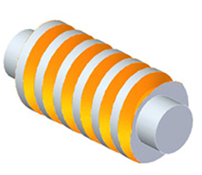
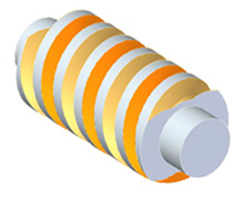
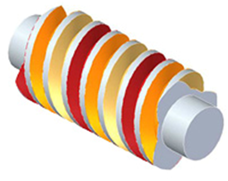
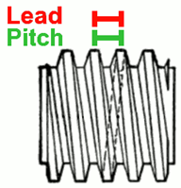
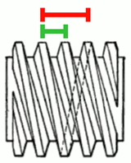
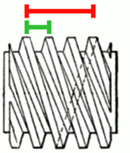
Single start and Multi-start threads
THREADED FASTENERS
Single start
Double start
Triple start
Used when fast action is required

Slide 12
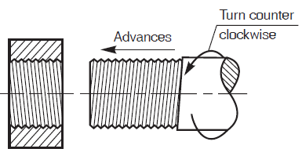
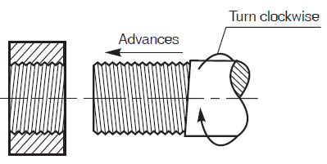
Left and Right hand threads
THREADED FASTENERS
Left hand

Slide 13
Thread designation
THREADED FASTENERS
Major diameter (mm)
Pitch (mm)
Fine & Course
Bolt grade
M 16 x 1.5 8 g LH DOUBLE
Hand or Helix
Metric thread
Tolerance
Number of starts

Slide 14
THREADED FASTENERS
Thread Designation
M10 × 1.25 – METRIC thread of nominal diameter 10 mm and pitch 1.25 mm
SQ 40 × 10 – SQUARE thread of nominal diameter 40 mm and pitch 10 mm
ACME 40 × 8 – ACME thread of nominal diameter 40 mm and pitch 8 mm
WORM 40 × 10 – WORM thread of nominal diameter 40 mm and pitch 10 mm

Slide 15
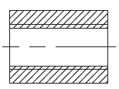
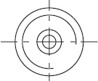
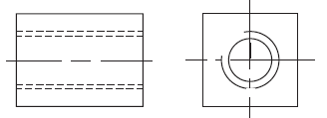
Conventional representation of threads in drawings
THREADED FASTENERS
Visible threads
Root (LT-B) represented by Partial circle
Crest (LT-A)
Root (LT-B)
Sectional front view
Hidden threads
The distance between the line representing crest and root should be close to the actual distance but not less than 0.7 mm
In the sectional view, the hatching lines should extend till the crest of the thread

Slide 16
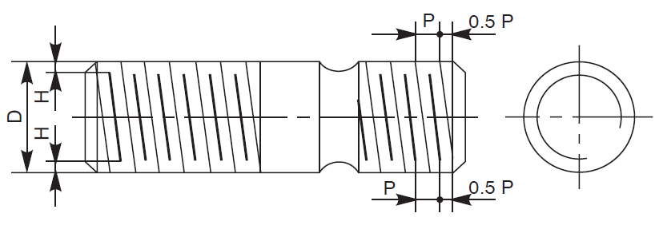
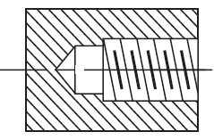
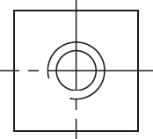
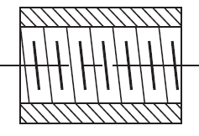
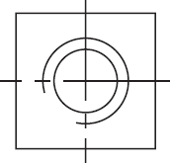
Schematic representation of V threads in drawings
THREADED FASTENERS
Visible threads
Sectional view of internal threads
Gives more details than the simplified representation
Used only for visible external threads or sectional view of internal threads- hatching ends at the root line in sectional view

Slide 17
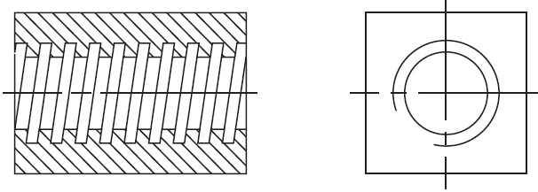
Schematic representation of square threads
THREADED FASTENERS
Visible threads
Sectional view of internal threads
Note the hatching in the sectional view

Slide 18
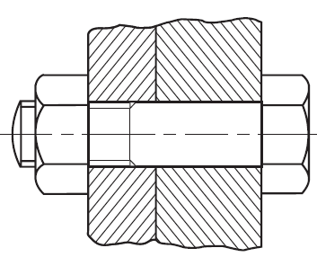
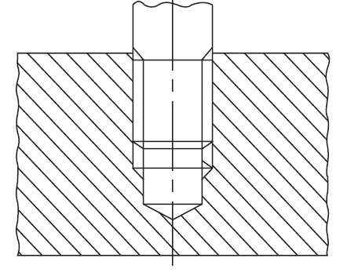
Representation of threads in an Assembly
THREADED FASTENERS
Bolts and threads are not sectioned in a sectional view

Slide 19
THREADED FASTENERS
Bolts and nuts- size and proportions
D
2D
30º
0.75 D
R=1.5D
L
2D
D
D

Slide 20
Drawing a hexagonal nut
THREADED FASTENERS
2D
D
D
R=1.5D

Slide 21
Source: https://donyango.carbonmade.com/projects/4388020

Slide 22
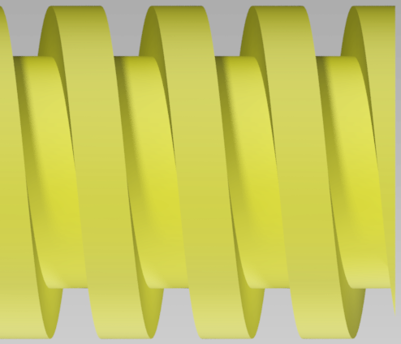
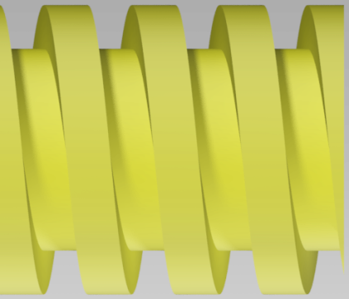
THREADED FASTENERS
CAR JACK ASSEMBLY
900
φ20
L
H
P
H
D
H = 0.5P
L=P
H
ACTUAL
ACTUAL and SCHEMATIC overlapped
LEAD SCREW

Slide 23
Source: https://donyango.carbonmade.com/projects/4388020

Slide 24
Source: https://donyango.carbonmade.com/projects/4388020

Slide 25
THREADED FASTENERS
CAR JACK ASSEMBLY
300
180
120
100
60
70
10
80
4 X R100
5
5
BASE

Slide 26
THREADED FASTENERS
CAR JACK ASSEMBLY
250
φ10
HANDLE

Slide 27
THREADED FASTENERS
CAR JACK ASSEMBLY
220
50
45
5
250
LOWER CHANNEL

Slide 28
THREADED FASTENERS
CAR JACK ASSEMBLY
62.5
57.5
45
20
15
10
Ø20
SCREW RIGID CONNECTION

Slide 29
THREADED FASTENERS
CAR JACK ASSEMBLY
15.0
10.0
61.5
12.5
20.0
Ø25.0
SCREW THROUGH CONNECTION

Slide 30
THREADED FASTENERS
CAR JACK ASSEMBLY
2 X φ10
250
2 X R12.5
UPPER CHANNEL

Slide 31
THREADED FASTENERS
CAR JACK ASSEMBLY
4 X Ø10
40
35
22.5
40
120
5
160
50
UPPER DECK

Slide 32
THREADED FASTENERS

