Slide 1
ME 251
Anupam Saxena
Professor
Mechanical Engineering
Compliant and Robotic Systems Lab
Indian Institute of Technology Kanpur

Slide 2
COUPLINGS
Couplings
used to directly transfer rotary motion from one shaft to another
Types
Fast or rigid coupling
Flexible coupling
Loose or disengaging (clutch)

Slide 3
Rigid Coupling
COUPLINGS
Rigid shaft couplings
used for connecting shafts having collinear axes
Types
Muff Coupling
Flanged Coupling

Slide 4
Butt muff coupling (rigid type)
COUPLINGS
the ends of the two shafts to be coupled butt against each other, with the sleeve keyed to them
https://grabcad.com/library/butt-muff-coupling-1
Machine drawing by K L Narayana, P kannaiah and V reddy

Slide 5
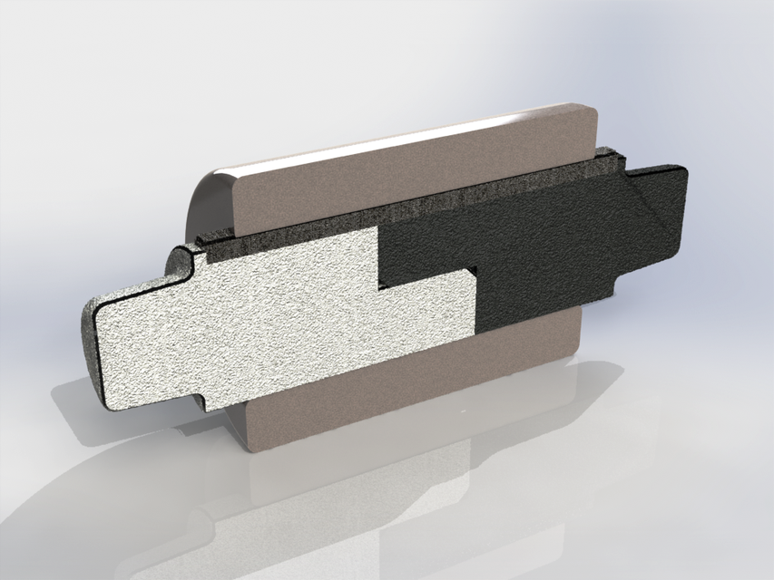
COUPLINGS
Half-lap muff coupling (rigid type)
The taper in the shaft ends prevent them from axially separating
Good for situations involving large axial loads
https://grabcad.com/library/half-lap-muff-coupling
Machine drawing by K L Narayana, P kannaiah and V reddy

Slide 6
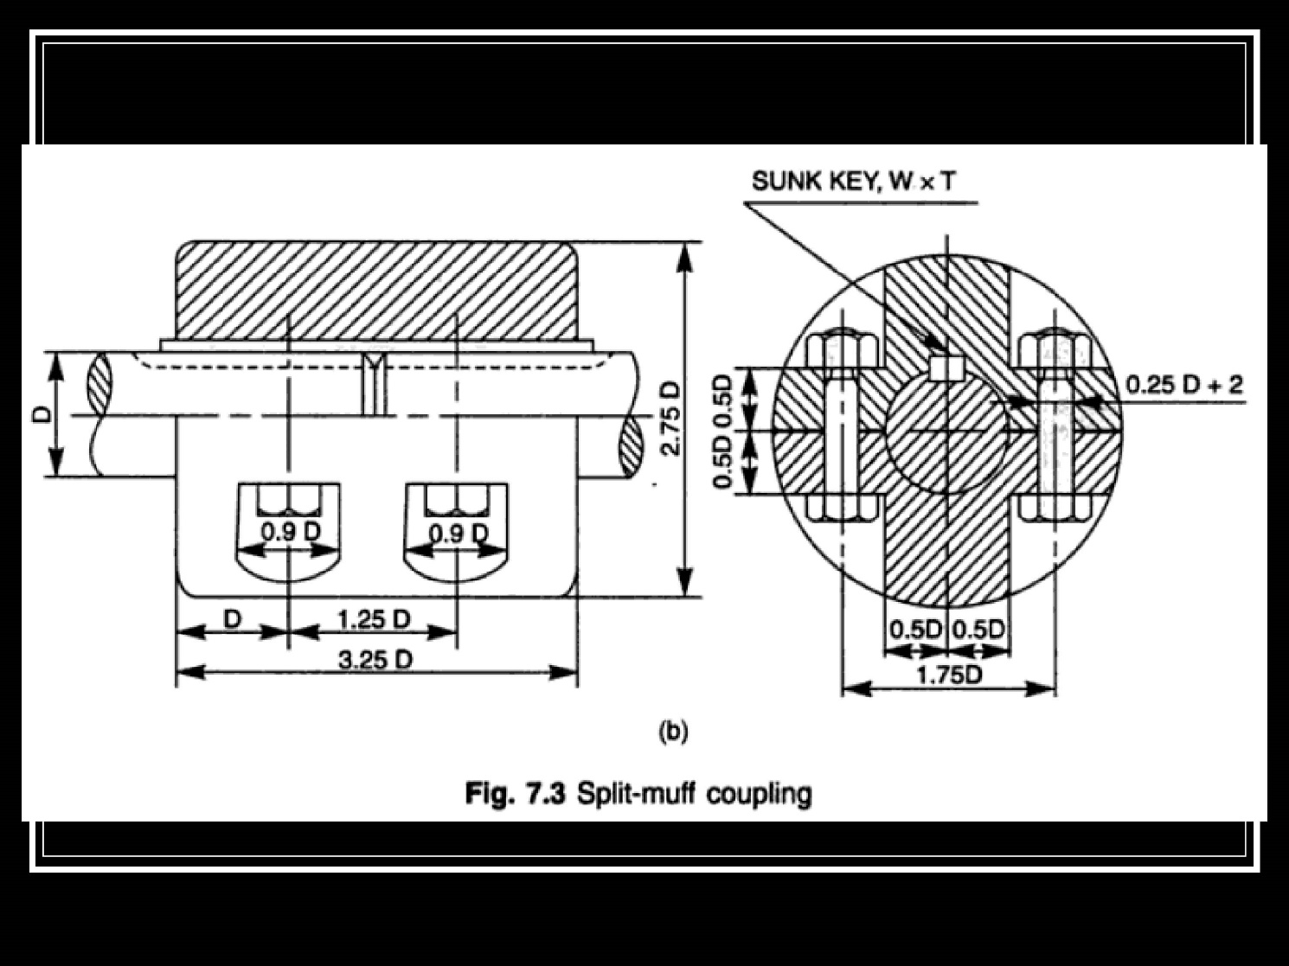
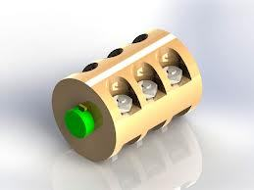
Split muff coupling (rigid type)
COUPLINGS
The muff is made in two semi-cylindrical halves joined together by bolts
Keys are placed in position then the muff is assembled
Torque is transmitted by key as well as by clamping friction
Used in heavy duty applications
https://www.stlfinder.com/model/split-muff-coupling-52587/1964005
https://www.learnpick.in/prime/documents/ppts/details/167/design-shaft-couplings

Slide 7
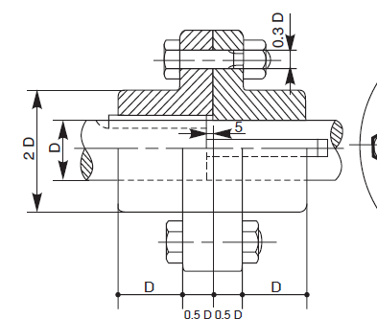
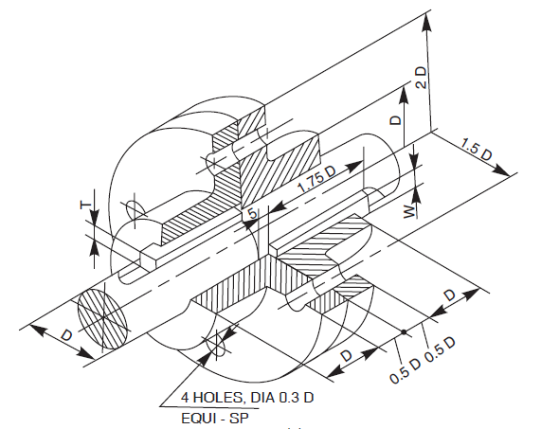
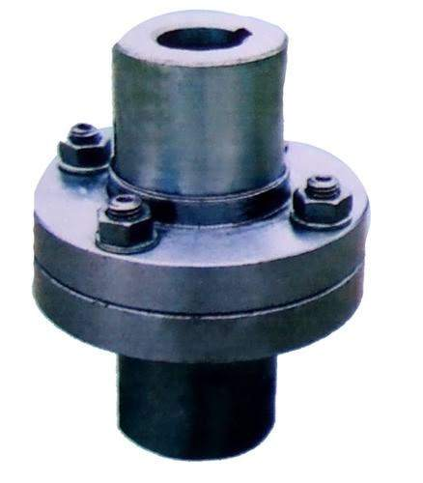
Flanged coupling (rigid type)
COUPLINGS
Flanges are either fit or provided at the ends of shafts.
They are fastened together through a number of bolts and nuts.
http://marineengineersblogs.blogspot.com/2013/06/types-of-coupling_17.html
Machine drawing by K L Narayana, P kannaiah and V reddy

Slide 8
Flexible Coupling
COUPLINGS
These permit relative rotation or variation in the alignment of shaft axes within certain limits.
Types
Bushed Pin Type Flanged Coupling
Compression Coupling

Slide 9
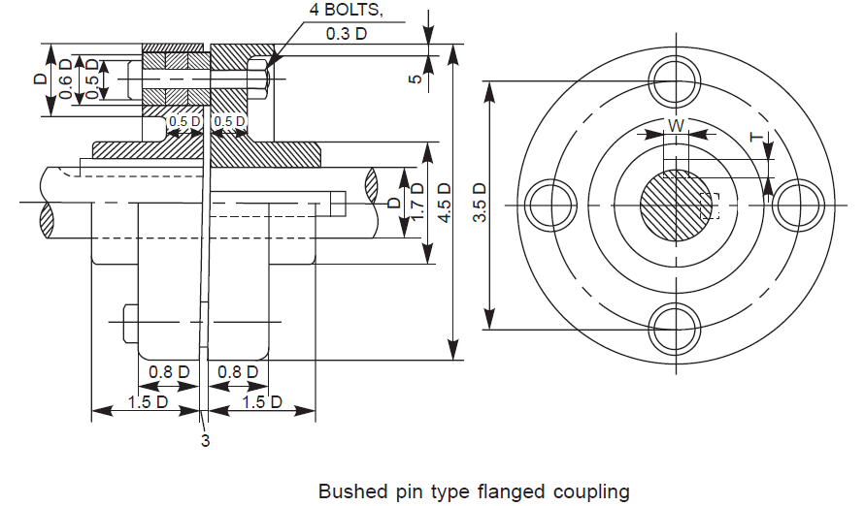
Bushed Pin Type Flanged Coupling (Flexible type)
COUPLINGS
Modified version of a protected flanged coupling
The flexible medium takes care of misalignment and acts as a shock absorber.
Used to connect prime mover or an electric motor and a centrifugal pump.
Image taken from Machine Drawing by Dr. K L Narayan,Dr. P. Kannaiah, K. Venkata Reddy

Slide 10
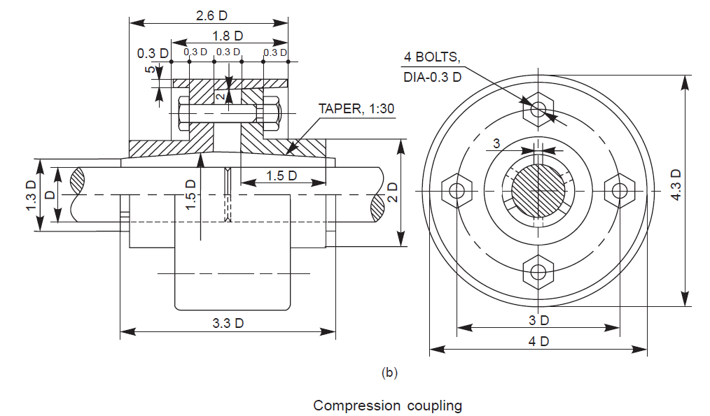
Compression Coupling (Flexible type)
COUPLINGS
This coupling takes care of both axial and angular misalignment of shafts.
Friction between the shafts and sleeve assists in power transmission.
Image taken from Machine Drawing by Dr. K L Narayan,Dr. P. Kannaiah, K. Venkata Reddy

Slide 11
Disengaging Coupling
COUPLINGS
Disengaging couplings are used when power transmission from one shaft to another is intermittent.
A dis-engaging coupling in general consists of one part firmly fixed to the driving shaft and another one mounted with provision for sliding over the driven shaft.
Types
Claw Coupling
Cone Coupling

Slide 12
Claw coupling (clutch type)
COUPLINGS
Each flange has a number of identical claws which engage into the corresponding recesses in the flange.
One flange is firmly fit to the driving shaft through a taper sunk key and the other is placed over the driven shaft by two feather keys, so that it can slide freely on it.
https://grabcad.com/library/claw-coupling
Machine drawing by K L Narayana, P kannaiah and V reddy

Slide 13
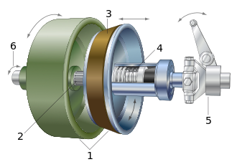
Conical Friction coupling (clutch type)
COUPLINGS
Two shafts may be coupled together via two flanges with conical surfaces (on the inside of one and on the outside of the other) by virtue of friction
https://en.wikipedia.org/wiki/Cone_clutch
Machine drawing by K L Narayana, P kannaiah and V reddy

Slide 14
Non Aligned Couplings
COUPLINGS
Non-aligned couplings
transmit power between two shafts which are not coaxial.
Examples
Universal Coupling (Hooke’s Joint)
Oldham Coupling

Slide 15
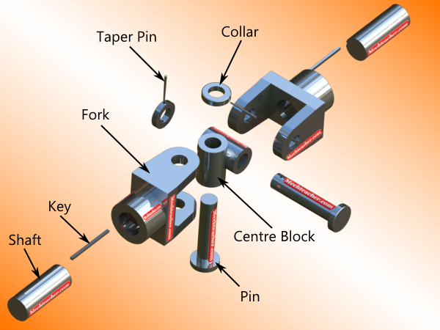
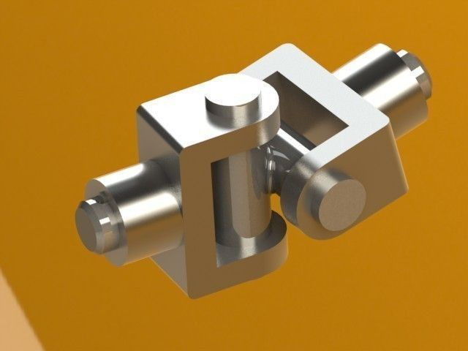
Universal Coupling (Hooke’s Joint)
COUPLINGS
It is a rigid coupling that connects two shafts, whose axes intersect if extended.
The angle between the shafts may be varied even while the shafts are rotating.
Applications – Control Mechanisms, Tool Drives, Centrifugal Blowers.
https://www.google.com/search?q=universal+coupling&client=firefox-b-ab&source=lnms&tbm=isch&sa=X&ved=0ahUKEwj-npL1przbAhVDwI8KHfMfDkAQ_AUICigB&biw=1280&bih=621#imgrc=E8RxiaauXIyZbM:
http://mechteacher.com/universal-joint/

Slide 16
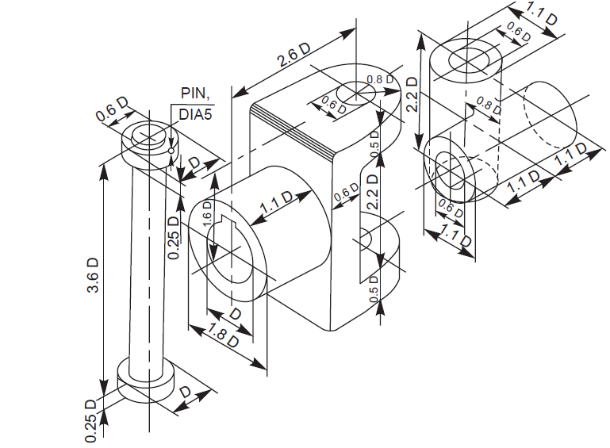
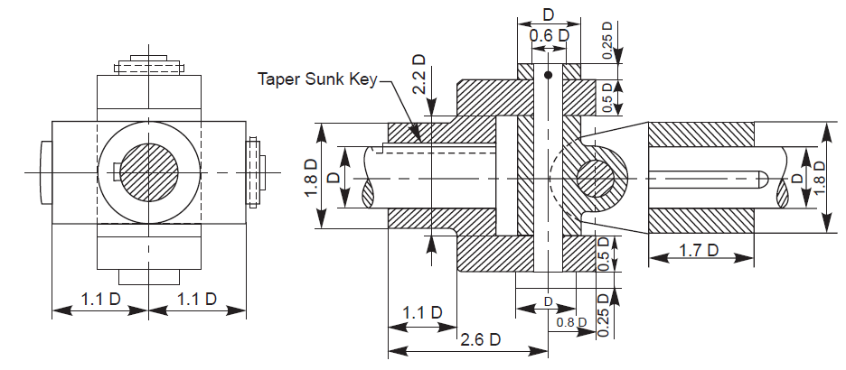
COUPLINGS
Universal Coupling (cont..)
Image taken from Machine Drawing by Dr. K L Narayan,Dr. P. Kannaiah, K. Venkata Reddy

Slide 17
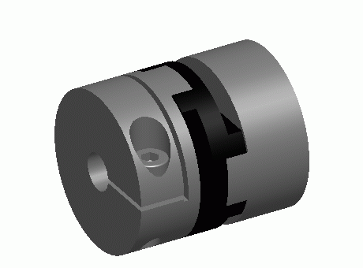
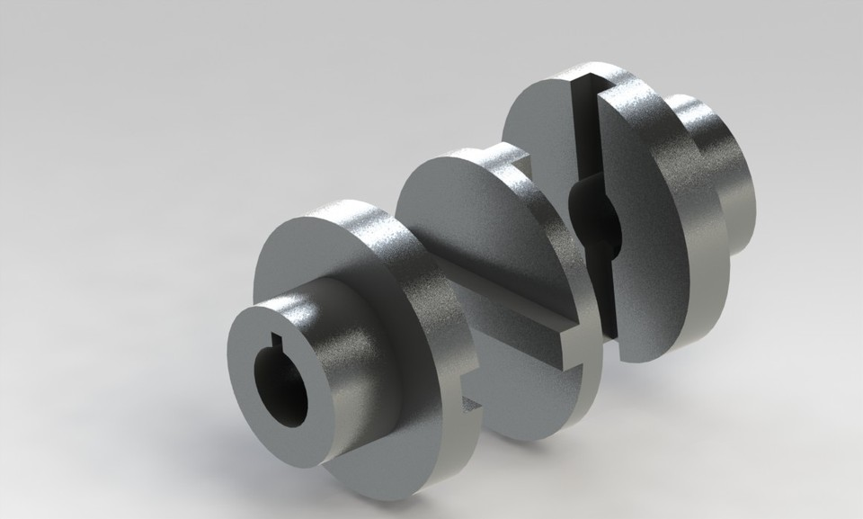
Oldham Coupling
COUPLINGS
It is used to connect two parallel shafts whose axes are at a small distance apart.
Power transmission takes place between the shafts, because of the positive connection between the flanges and the central disc.
Exploded View
Assembled View
Source: https://www.traceparts.com/en/product/technische-antriebselemente-gmbh-germany-oldham-coupling?CatalogPath=TRACEPARTS%3ATP01003006002&Product=80-13122007-537900

Slide 18
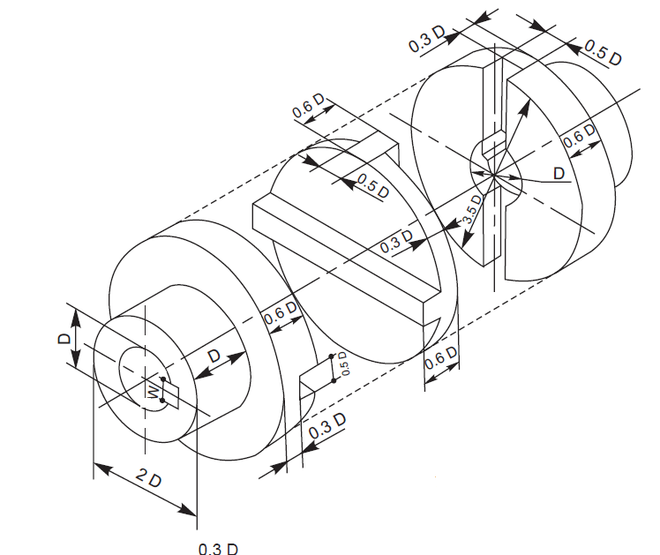
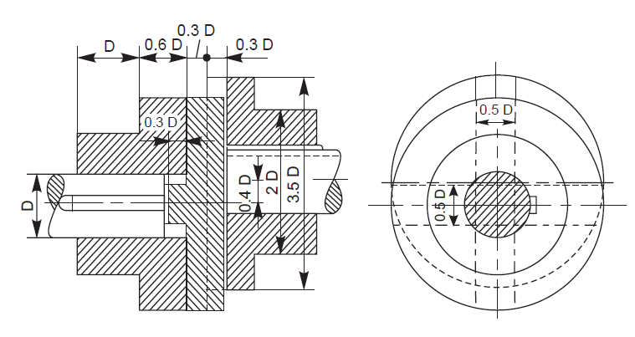
Oldham Coupling
COUPLINGS
Image taken from Machine Drawing by Dr. K L Narayan,Dr. P. Kannaiah, K. Venkata Reddy

