Slide 1
Predicting Enhancers in Co-Expressed Genes
Harshit Maheshwari
Prabhat Pandey

Slide 2
Outline
Transcription Factor
Enhances
Problem Statement
Predicting Transcription Factor Binding Sites
Predicting Enhancers in a Gene Sequence
Making use of Co-Expressed Genes
Results
Limitations and Future Work
References
Suggestions and Questions

Slide 3
Transcription Factor
Gene expression is the process by which information from a gene is used in the synthesis of a functional gene product.
Transcription is the first step of gene expression, in which a particular segment of DNA is copied into RNA by the enzyme, RNA polymerase.
Transcription factors are proteins that bind to specific DNA sequences, thereby controlling the flow (or transcription) of genetic information from DNA to messenger RNA.
Notes:
http://en.wikipedia.org/wiki/Transcription_factor

Slide 4
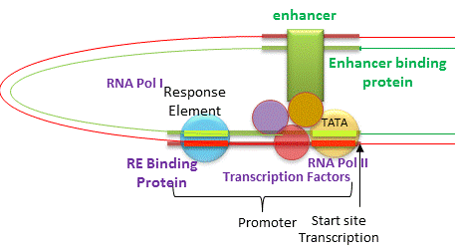
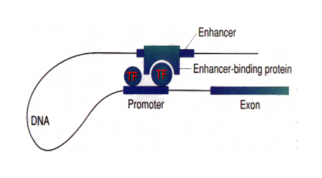
Enhancers
Enhancers are DNA sequence that control efficiency and rate of transcription of a gene
They tell when and where a gene promoter can be used and how much of the gene product to make.
Notes:
http://classes.biology.ucsd.edu/bicd130.SU207/documents/Lecture5DifGeneExpression.pdf
http://employees.csbsju.edu/hjakubowski/classes/ch331/bind/olbindtransciption.html

Slide 5
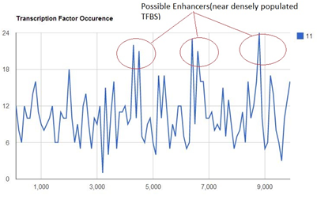
Problem Statement
To find Transcription factor binding sites in DNA sequences
To predict putative enhancers in a co-expressed gene by clustering the TFBS

Slide 6
The ‘Workflow’
Step1: Prediction of TFBS
P-Match Algorithm
Step 2: Clustering of TFBS
Sliding Window Approach
Trie-Based Approach
Step 3: Filtering Process
Filter Enhancers by making use of Co-Expressed Genes

Slide 7
P-Match Algorithm
Combines both pattern matching and weight-matrix approach
How does it work ?
PWM are computed initially from nucleotide frequency matrix by using:
where,

Slide 8
P-Match Algorithm(cont.)
D-Score is computed which estimates similarity between a TF and a gene sub-sequence
We have used two value of d-Scores:
d_matrix – 0.9
d_core – 0.9

Slide 9
Clustering of TFBS
Sliding Window Approach
A window of fixed size is used to scan dense regions of enhancers .
Regions are labeled as ‘dense’ if they exceed the MINTFBS number (in our implementation we have MINTFBS as 15)
Limitation: Dense clusters of TFBSs but with the size very small with respect to window size may miss out.

Slide 10
Clustering of TFBS(contd)
Trie-Based Approach
All clusters with number of TFBSs greater than a threshold(MINTFBS) is generated such that the distance between far-end TFBSs are not greater than maximum length allowed.
It starts with pairing up each of the TFBSs to both its neighbours. In the next iteration, the pairs are paired to both their neighbouring pairs and so on. The process builds up a trie in a bottom-up way.
During the process the clustered TFBSs that satisfy clustering criteria are added to the potential enhancers list and the clusters in which distance between farthest TFBSs cross the MAXLENGTH are discarded from clustering process.

Slide 11
Filtering Step
Studies have found that co-expressed genes are more likely to contain shared enhancers.
So, if an enhancer is present in most of the co-expressed genes, it has high probability of actually being an enhancer.
As the previous steps are error-prone, we don’t do an exact match, but based on the following score:

Slide 12
Results
Enhancers validation require a ChIP-seq based experiments.
RedFly is a database of cis-regulatory modules of Drosophila Melanogaster’s genes reported in biological research papers.
Validation on above step won’t capture correctness of filtering step.

Slide 13
Results (contd…)
Gene | No. of Enhacers predicted | No. of Enhancers matched with RedFly | No. of Enhancers not matched with RedFly | No. of True Negatives
DPP | 9 | 6 | 4 | 2
HOE-I | 12 | 7 | 6 | 1
tadr | 24 | 11 | 9 | 2
wash | 15 | 5 | 4 | 1
Rab10 | 18 | 6 | 5 | 1
Deaf1 | 19 | 9 | 6 | 3
Bace | 14 | 7 | 5 | 2

Slide 14
Limitations
Does not work well if the set of Co-Expressed Genes is not correct.
May give potentially larger number of enhancers if a single gene is provided as input.
Quality of results depend on user interference.

Slide 15
References
Chekmenev, D. S., Haid, C., & Kel, A. E. (2005). P-Match: transcription factor binding site search by combining patterns and weight matrices. Nucleic acids research, 33(suppl 2), W432-W437.
Gallo, S. M., Li, L., Hu, Z., & Halfon, M. S. (2006). REDfly: a regulatory element database for Drosophila. Bioinformatics, 22(3), 381-383.
Choi, D., Fang, Y., & Mathers, W. D. (2006). Condition-specific coregulation with cis-regulatory motifs and modules in the mouse genome.Genomics, 87(4), 500-508.

Slide 16
Thank You. Suggestions? Questions?

