Slide 1
LABORATORY DATA MANAGEMENT SYSTEM
HarsHit Maheshwari (10290)
N V Subba Rao (10466)
Guided by Prof. T.V. Prabhakar

Slide 2
AIM
To build a laboratory data management system which would allow scientists to document research, experiments and procedures performed in laboratories.
Ease of use and security will be the two main concerns addressed by the software.

Slide 3
4+1 ARCHITECTURE DIAGRAM

Slide 4
LOGICAL VIEW
LDMS
Content Rendering Component
Data Organizer
Content Review Component

Slide 5
PROCESS VIEW
DownloadHTML/PDF
Content Rendering Component
Search
Personal Layer
GenericLayer
Authentication Component
Content Review Component
Data Organizer
Server
Content Creator
(Speech Enabled)
Speech Recognition

Slide 6
PHYSICAL VIEW
Google Server
(Speech Recognition)
Web Browser
Web Server
(XAMPP)
HTTP
Database
Server (MySQL)
Client
Server

Slide 7
FUNCTIONALITIES
Data added by users is verified by a Principal Investigator (PI) before being added to the repository
Each revision has an associated timestamp and corresponding edit information.
The system will enable the users to add new reports using voice enabled input (speech recognition).
User can add media components such as images in their reports.
Comments can can be added to the reports by any user viewing them.
Reports that are submitted can be downloaded in the form of HTML and PDF files.
Users can also add their comments to the displayed reports.

Slide 8
TECHNOLOGIES USED
HTML5, CSS, Javascript (AJAX)
PHP, MySQL
JQuery
Bootstrap
Google Speech Recognition API
wkhtmltopdf (webkit & Qt)

Slide 9
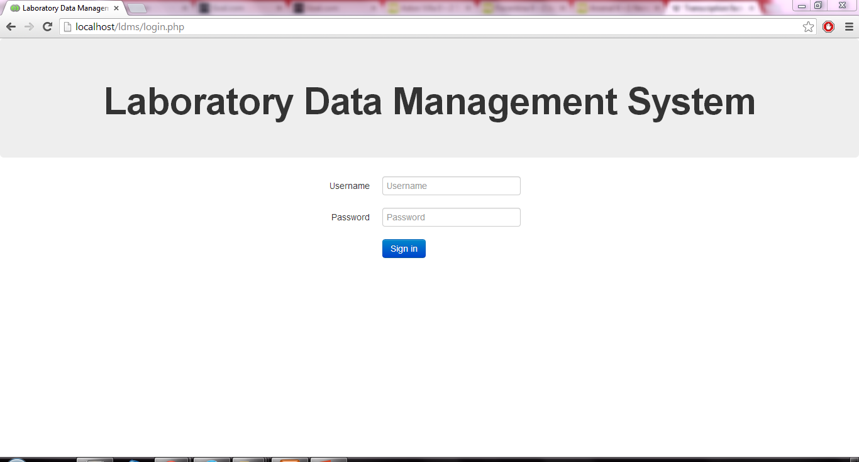
SNAPSHOTS

Slide 10
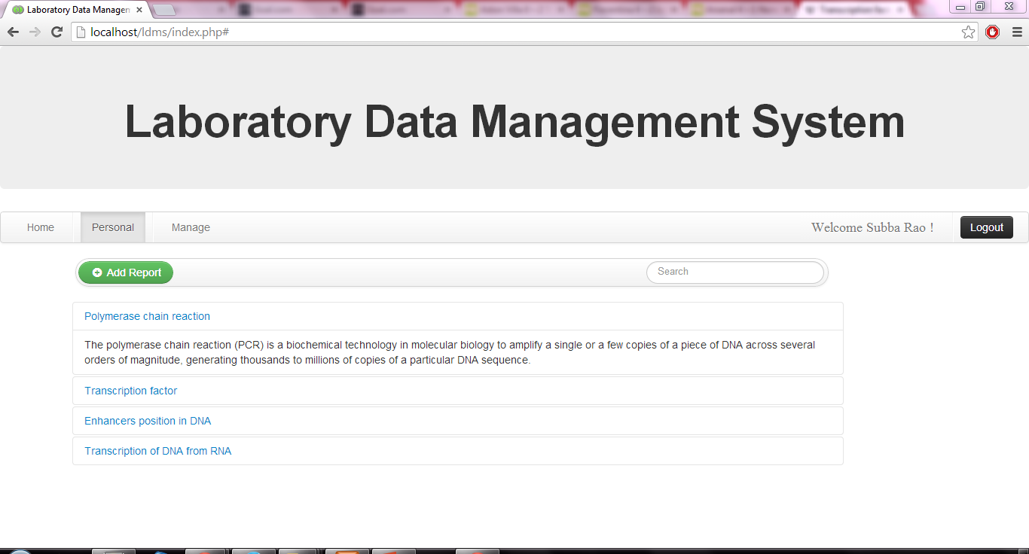
SNAPSHOTS

Slide 11
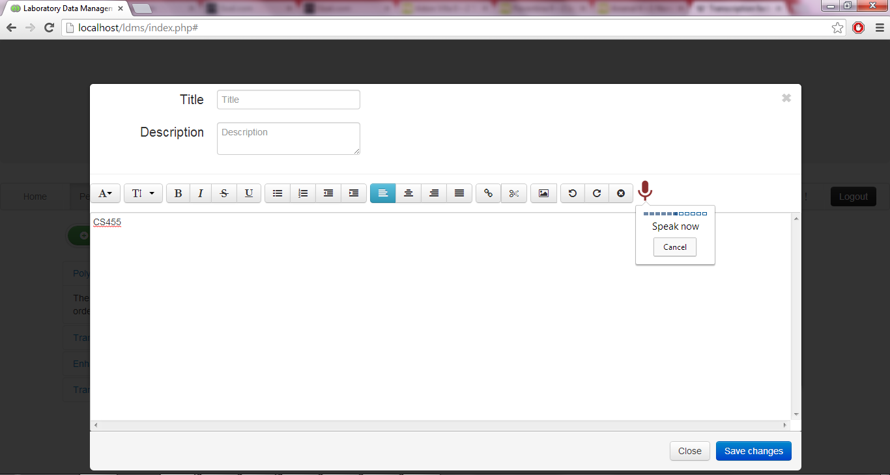
SNAPSHOTS

Slide 12
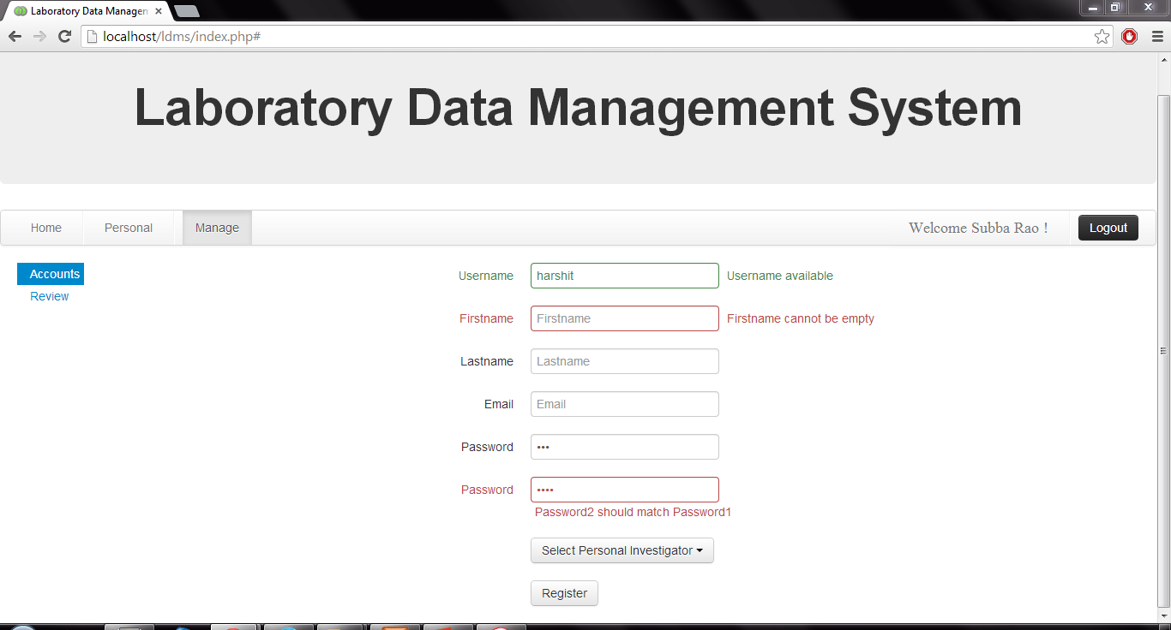
SNAPSHOTS

