Slide 1
7 Old and 7 new tools for quality assurance
Dr. Raghu Nandan Sengupta
Professor
Department of Industrial and Management Engineering
All figures are taken from(unless otherwise mentioned):
Introduction to Statistical process Control
Douglas. C Montgomery
6th Edition

Slide 2
7 Old tools for Quality Assurance
A comprehensive statistical process control system uses seven tools to reduce variability and eliminate waste
1. Histogram or stem-and-leaf plot
2. Check sheet
3. Pareto chart
4. Cause-and-effect diagram
5. Defect concentration diagram
6. Scatter diagram
7. Control chart(this will be discussed separately in greater detail in the next module of this course)

Slide 3
Stem and Leaf Plot
Graphical representation of data
Let there be a set of 9 numbers {101,102,103,104,105,106,107,108,109}
To construct a stem and leaf plot, the numbers are divided into two parts – the stem and the leaves
Here the stem will be 10 and leaves will be {1,2,3,4,5,6,7,8,9}
Generally number of stems should be less

Slide 4
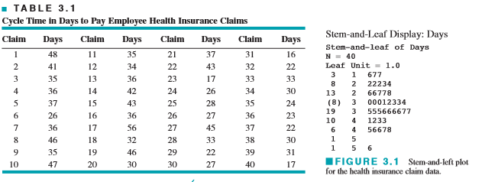
Stem and Leaf Plot
Above example is ordered which makes it easy to find out the percentiles
the 100 kth percentile is a value such that at least 100 k% of the data values are at or below this value and at least 100 (1 − k)% of the data values are at or above this value

Slide 5
Histogram
Continuous data is divided into intervals which are called class intervals, cells or bins
The number of bins does not have any agreed rule
One heuristic is h=1+log₂n where n=sample size and h= number of bins
Gives a visual impression of the shape of the distribution of the measurements and some information about the inherent variability in the data
Histogram is best suited for larger data sets containing, say, 75 to 100 or more observations
Choice of number of bins becomes less influential in determining the shape of the distribution

Slide 6
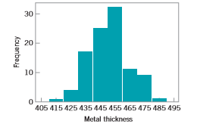
Histogram – An Example

Slide 7
Check Sheet
Measure of DMAIC – collection of data
Check sheet is used to collect data in an organized way
Specify the type of data to be collected, the part or operation number, the date, the analyst, and any other information useful in diagnosing the cause of poor performance
A trial run to validate the check sheet layout and design

Slide 8
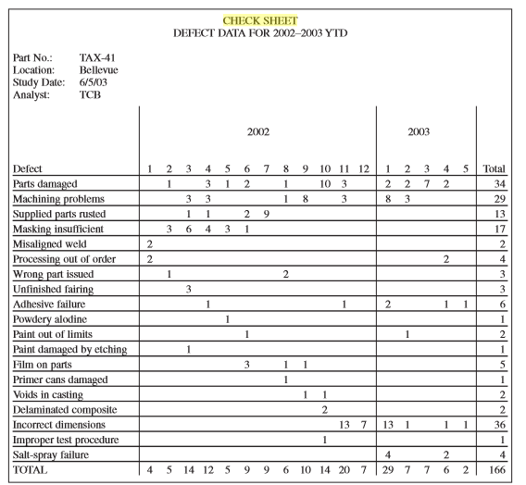
A Check Sheet to Record Defects in Aerospace
Time-oriented summary is particularly valuable in looking for trends or other meaningful patterns

Slide 9
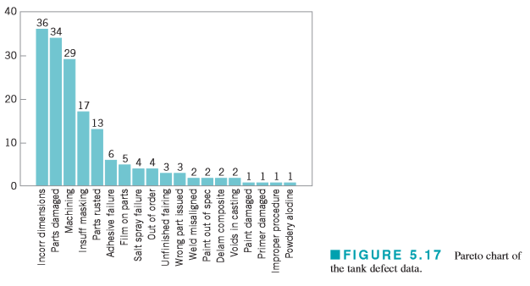
Pareto Chart
A frequency distribution (or histogram) of attribute data arranged by category
Used both in Measure and Analyze step of DMAIC

Slide 10
Pareto Chart
Pareto chart does not automatically identify the most important defects, but only the most frequent
When the list of defects contains a mixture of those that might have extremely serious consequences and others of much less importance, one of two methods can be used:
Use a weighting scheme to modify the frequency counts.
Accompany the frequency Pareto chart analysis with a cost or exposure Pareto chart

Slide 11
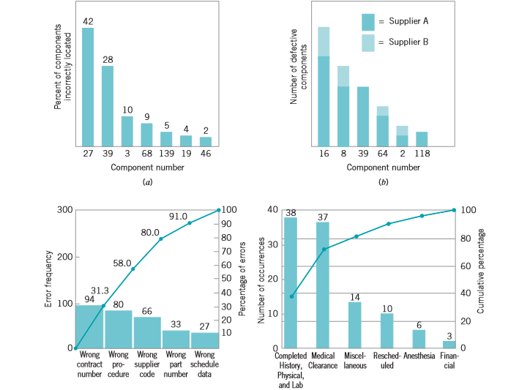
Variations of Pareto Chart

Slide 12
Cause and Effect Diagram
Once a problem has been identified, we have to look for possible sources of this problem
Cause and effect diagram is used in the analyze and improve steps of DMAIC to find potential causes
Also known as Ishikawa diagrams, these methods finds its application in both manufacturing and service industry
Several alternative classification methods of the causes

Slide 13
Cause and Effect Diagram
5Ms used in manufacturing industry
Machine(Technology), Method (process),Material (Includes Raw Material etc.), Man Power (Physical/mental work), Measurement (Inspection)
Some people have included three more Ms
Mother Nature, Management and Maintenance
8Ps used in marketing
Product/Service, Price, Place, Promotion, People/personnel, Process, Physical Evidence, Packaging
5Ss used in the service industry
Surroundings, Suppliers, Systems, Standard documentation skills, Scope of work

Slide 14
Constructing a Cause and Effect Diagram

Slide 15
Cause and Effect Diagram – An Example

Slide 16
Defect Concentration Diagram
A defect concentration diagram is a picture of the unit, showing all relevant views
Then the various types of defects are drawn on the picture, and the diagram is analyzed to determine whether the location of the defects on the unit conveys any useful information about the potential causes of the defects.
Useful in the Analyze step if the DMAIC

Slide 17
Defect Concentration Diagram

Slide 18
Scatter diagram
Useful plot for identifying a potential relationship between two variables.
Let us say data is collected in pairs for two variables(x and y)
The shape of plot of y against x will give us some indication of relationship between x and y
Scatter diagrams are very useful in regression modelling
It must be kept in mind that scatter diagram gives potential relationship and not causality
Designed Experiments may give us some causality

Slide 19
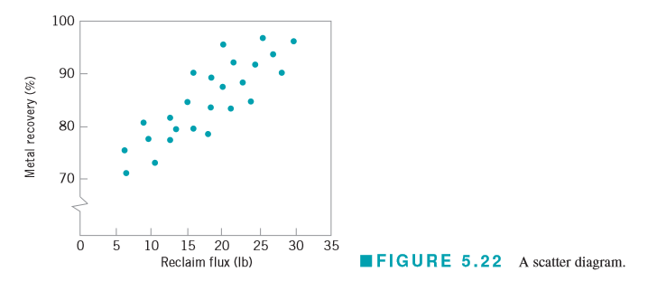
Scatter Diagram – An example
The scatter diagram indicates a strong positive correlation between metal recovery and flux amount

Slide 20
An Application of SPC
Improve quality and productivity in a copper plating operation at a printed circuit board fabrication facility
High levels of defects such as brittle copper and copper voids and by long cycle time
Improvement team was formed
Plating tank operator, the manufacturing engineer responsible for the process, and a quality engineer
Define
Concentrate on reducing the flow time through the process, as the missed delivery targets were considered to be the most serious obstacle to improving productivity

Slide 21
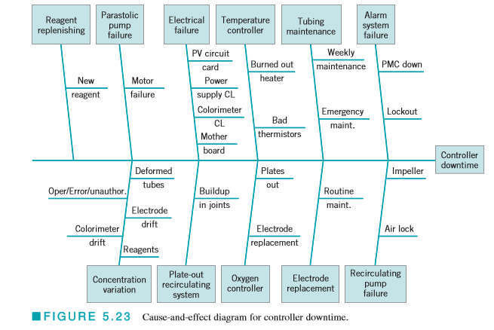
An Application of SPC
Measure
Excessive downtime on the controller that regulated the copper concentration in the plating tank was a major factor in the excessive flow time; controller downtime translated directly into lost production
Analyze
Brainstorming -> cause and Effect Diagram

Slide 22
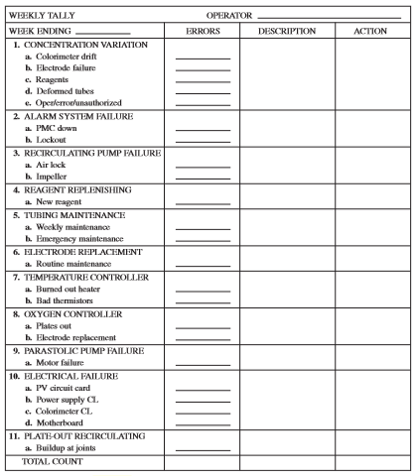
An Application of SPC
Data collection for controller downtime was necessary
The cause and effect diagram was used to design the check sheet

Slide 23
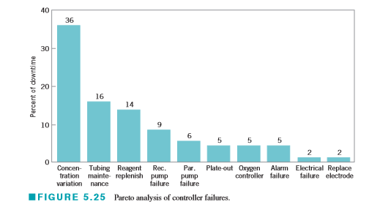
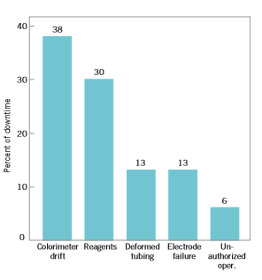
An Application of SPC
Based on the data Pareto charts were made

Slide 24
7 New tools for Quality Control
In 1976 the UJSW(Union of Japanese Scientists and Engineers) collected and promoted 7 Management and Planning(MP) tools
The 7 tools were
Affinity Diagram
Relations Diagram
Tree Diagram
Matrix Diagram
Matrix Data Analysis(beyond the scope of broad discussion)
Often replaced by prioritization matrix due to the complex mathematical nature
A prioritization matrix is an L shaped matrix that uses pairwise comparison of a list of options to select criteria
Arrow Diagram
Process Decision and Program Chart

Slide 25
Affinity Diagram
Also kwon as affinity chart, K-J method variation
When to use
After a brainstorming session
When analyzing verbal data such as survey
How to create one affinity diagram
Record each idea with a marking pen on a separate sticky note or card.
Look for ideas that seem to be related in some way. Place them side by side
When ideas are grouped, select a heading for each group. Look for a note in each grouping that captures the meaning of the group.
Combine groups into “supergroups” if appropriate

Slide 26
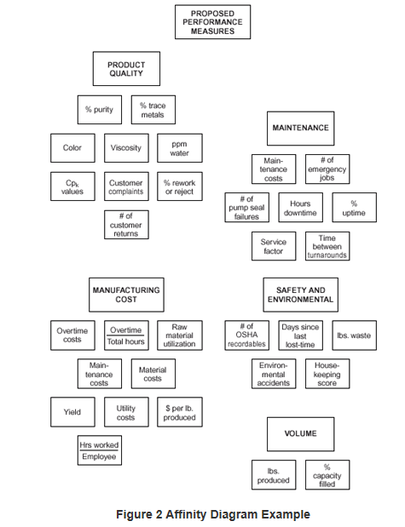
An Application of SPC

Slide 27
Relations Diagram
The relations diagram shows cause–and–effect relationships.
When to Use a Relations Diagram
When trying to understand links between ideas or cause–and–effect relationships
When a complex solution is being implemented.
After generating an affinity diagram or cause and effect diagram
Basic Steps
Write a statement defining the issue that the relations diagram will explore.
Brainstorm ideas about the issue and write them on cards or notes
Place one idea at a time on the work surface and ask: “Is this idea related to any others?”
For each idea, ask, “Does this idea cause or influence any other idea?” Draw arrows if answer is yes.
Analyze the diagram

Slide 28
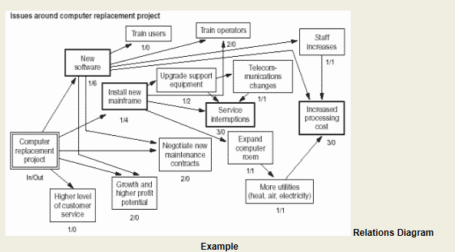
Relations Diagram
For source of image see reference

Slide 29
Tree Diagram
The tree diagram starts with one item that branches into two or more, each of which may branch into two or more
It is used to break down broad categories into finer and finer levels of detail
When to Use a Tree Diagram
When developing actions to carry out a solution or other plan
When probing for the root cause of a problem.
When evaluating implementation issues for several potential solutions.

Slide 30
Tree Diagram
Procedure for a tree diagram
Develop a statement of the goal, project, plan, problem or whatever is being studied. It is the first node.
Ask a question that will lead you to the next level of detail
Do a “necessary and sufficient” check for the level
Each of the new idea statements now becomes the subject: a goal, objective or problem statement.
Continue to turn each new idea into a subject statement and repeat the process
Do a “necessary and sufficient” check of the entire diagram.

Slide 31
Tree Diagram
For source of image see reference

Slide 32
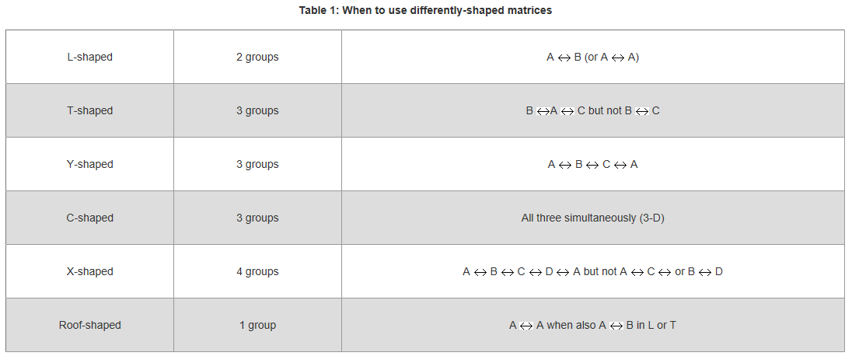
Matrix diagram
The matrix diagram shows the relationship between two, three or four groups of information
Strength of relationship and roles played
When to use matrix diagrams
For source of image see reference

Slide 33
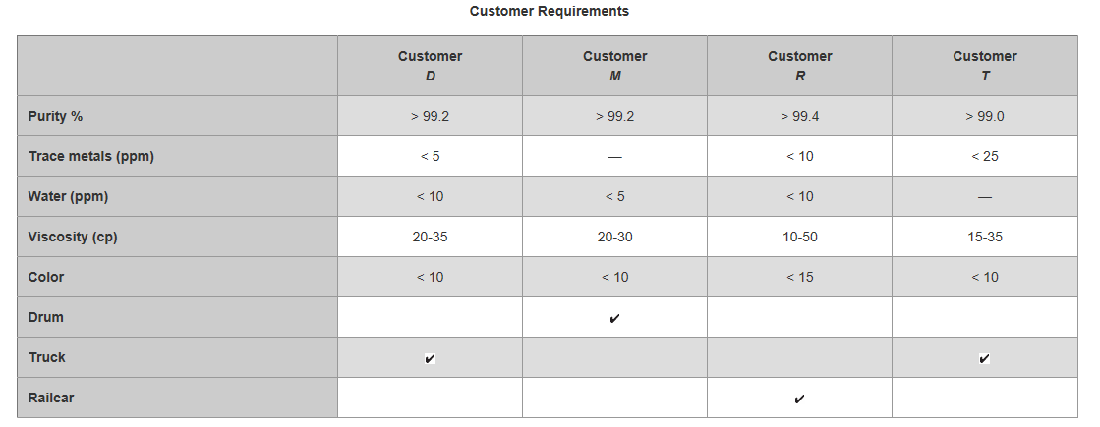
L Shaped Matrix Diagram
For source of image see reference

Slide 34
T Matrix Diagram
For source of image see reference

Slide 35
Y Matrix Diagram
For source of image see reference

Slide 36
Arrow Diagram
The arrow diagram shows the required order of tasks in a project or process
It can be used for:
Determining best schedule for the entire project
Potential scheduling and resource problems and their solutions.
Calculate the critical path of the project
When to use an arrow diagram
When scheduling and monitoring tasks within a complex project or process with interrelated tasks and resources.
When you know the steps of the project or process, their sequence and how long each step takes
When project schedule is critical, with serious consequences for completing the project late or significant advantage to completing the project early

Slide 37
How to use an Arrow Diagram
List all the necessary tasks in the project or process
Determine the correct sequence of the tasks
Create a table with four columns —prior tasks, this task, simultaneous tasks, following tasks.
Diagram the network of tasks.
Time should flow from left to right and concurrent tasks should be vertically aligned.
Between each two tasks, draw circles for “events.”
Look for three common problem situations and redraw them using “dummies” or extra events

Slide 38
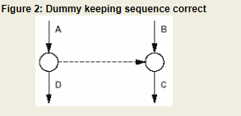
When to use Dummy Events
Two simultaneous tasks start and end at the same events
Use a dummy and an extra event to separate them
Task C cannot start until both tasks A and B are complete; a fourth task, D, cannot start until A is complete, but need not wait for B
Use a dummy between the end of task A and the beginning of task C.
For source of image see reference
For source of image see reference

Slide 39
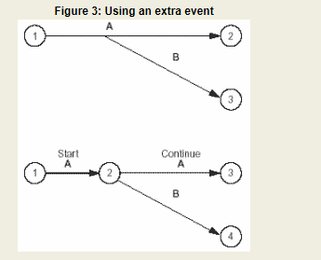
Dummy Events
A second task can be started before part of a first task is done
Add an extra event where the second task can begin and use multiple arrows to break the first task into two subtasks
For source of image see reference

Slide 40
Arrow Diagram
When the network is correct, label all events in sequence with event numbers in the circles. It can be useful to label all tasks in sequence, using letters
Once this is completed CPM or critical path method can be used for scheduling the tasks
Let us look at some basic steps and terminology related to CPM

Slide 41
Critical Path Method
Determine task times
Determine the “critical path,” the longest path from the beginning to the end of the project
Length of the critical path: the sum of all the task times on the path.
Calculate the earliest times each task can start(Earliest Start ES) and finish(Earliest Finish EF), based on how long preceding tasks take
Start with the first task, where ES = 0
For subsequent tasks:
ES=the largest EF of the tasks leading into this one
EF=ES + task time for this task

Slide 42
Critical Path Method
Calculate the latest times each task can start and finish without upsetting the project schedule, based on how long later tasks will take. These are called latest start (LS) and latest finish (LF).
Start from the last task, where the latest finish is the project deadline, and work backwards
Latest finish (LF) = the smallest LS of all tasks immediately following this one
Latest start (LS) = LF – task time for this task
Calculate slack time for each task and project
Total slack = LS – ES = LF – EF
Free slack = the earliest ES of all tasks immediately following this one – EF

Slide 43
Process Decision Program Chart
The process decision program chart (PDPC) systematically identifies what might go wrong in a plan under development.
When to use PDPC
Before implementing a plan, especially when the plan is large and complex.
When the plan must be completed on schedule.
When the price of failure is high.
When the project is identified as risky

Slide 44
PDPC Procedure
Obtain or develop a tree diagram of the proposed plan
High-level diagram showing the objective, a second level of main activities , third level of broadly defined tasks
For each task on the third level, brainstorm what could go wrong.
Review all the potential problems and eliminate any that are improbable or whose consequences would be insignificant.
For each potential problem, brainstorm possible countermeasures.
Decide how practical each countermeasure is.

Slide 45
PDPC Example
For source of image see reference

Slide 46
References
https://en.wikipedia.org/wiki/Ishikawa_diagram
http://asq.org/learn-about-quality/new-management-planning-tools/overview/overview.html
http://asq.org/learn-about-quality/idea-creation-tools/overview/affinity.html
http://asq.org/learn-about-quality/new-management-planning-tools/overview/tree-diagram.html
http://asq.org/learn-about-quality/new-management-planning-tools/overview/arrow-diagram.html
http://asq.org/learn-about-quality/new-management-planning-tools/overview/matrix-diagram.html
http://asq.org/learn-about-quality/new-management-planning-tools/overview/process-decision-program-chart.html

