Slide 1

Sampling plans and Acceptance Sampling
Dr. Raghu Nandan Sengupta
Professor
Department of Industrial and Management Engineering
All figures are taken from(unless otherwise mentioned):
Introduction to Statistical process Control
Douglas. C Montgomery
6th Edition

Slide 2

ACCEPTANCE SAMPLING
Acceptance sampling is a method used to accept or reject product lots based on a random sample of the product.
The purpose of acceptance sampling is to sentence lots (accept or reject) (also known as lot disposition) rather than to estimate the quality of a lot.
Acceptance sampling plans do not improve quality, directly.
The nature of sampling is such that acceptance sampling will accept some lots and reject others even though they are of the same quality.
The most effective use of acceptance sampling is as an auditing tool to help ensure that the output of a process meets requirements.
ACCEPTANCE SAMPLING PLANS – General Introduction

Slide 3
Situations where acceptance sampling is likely to be useful
When testing is destructive.
When the cost of 100% inspection is extremely high.
When 100 % inspection is not technologically feasible or would require so much calendar time that production scheduling would be seriously impacted.
When there are many items to be inspected and the inspection error rate is sufficiently high that 100% inspection might cause a higher percentage of defective.
When the supplier has an excellent quality history, and some reduction in inspection from 100% is desired, but the supplier’s process capability is sufficiently low as to make no inspection an unsatisfactory alternative.
When there are potentially serious product liability risks, and although the supplier’s process is satisfactory, a program for continuously monitoring the product is necessary.
ACCEPTANCE SAMPLING PLANS (vs. 100% Inspection)

Slide 4
Types of Sampling Plans
One major classification is by data type, variables and attributes
Another is based on the number of samples required for a decision :
      Single-sampling plans
      Double-sampling plans
      Multiple-sampling plans
      Sequential-sampling plans
Single-, double-, multiple-, and sequential sampling plans can be designed to produce equivalent results. Factors to consider include:
      Administrative efficiency
      Type of information produced by the plan
      Average amount of inspection required by plan
      Impact of the procedure on manufacturing flow
ACCEPTANCE SAMPLING PLANS – Types of Plans

Slide 5
Lot Formation and Random Sampling
There are a number of important considerations in forming lots for inspection, including:
  Lots should be homogeneous.
  Larger lots are preferred over smaller ones.
  Lots should be conformable to materials-handling systems used in both supplier and consumer facilities.
ACCEPTANCE SAMPLING PLANS – Lot Formation and Sampling

Slide 6
Single Sampling Plan for attributes
Suppose that a lot of size N has been submitted for inspection. A single-sampling plan is defined by the sample size n and the acceptance number c. Thus, if the lot size is N = 10,000, then the sampling plan:
    n=89
    c=2
  means that from a lot of size 10,000 a random sample of n = 89 units is inspected and the number of nonconforming or defective items d observed.
If the number of observed defectives d is less than or equal to c =2, the lot will be accepted.
If the number of observed defectives d is greater than 2, the lot will be rejected.

Slide 7
ACCEPTANCE SAMPLING
The nature of sampling is such that acceptance sampling will accept some lots and reject others even though they are of the same quality. Thus, acceptance sampling can reject “good” lots and accept “bad” lots.
Producer’s Risk
●The probability of rejecting a good lot.
In order to calculate this probability there must be a numerical definition as to what constitutes “good”.
AQL (Acceptable Quality Level) - the numerical definition of a good lot.
The ANSI/ASQC standard describes AQL as “the maximum percentage or proportion of nonconforming items or number of nonconformities in a batch that can be considered satisfactory as a process average”.
ACCEPTANCE SAMPLING PLANS – Producer’s Risk

Slide 8
Consumer’s Risk
The probability of accepting a bad lot.
In order to calculate this probability there must be a numerical definition as to what constitutes “bad”.
LTPD (Lot Tolerance Percent Defective) or RQL (Rejectable Quality Level) LQL (Limiting Quality Level) The numerical definition of a bad lot.
The ANSI/ASQC standard as “the maximum percentage or proportion of nonconforming items or the number of nonconformities in a batch for which the customer wishes the probability of acceptance to be a specified low value.
ACCEPTANCE SAMPLING PLANS – Consumer’s Risk

Slide 9
Operating Characteristic (OC) Curve
● OC Curve is a curve showing the relationship between the probability of acceptance P_{a} (on y-axis) and the proportion defective p of the lot (on x-axis).
● OC Curve is typically used to represent the four parameters of a sampling plan
  Producer’s Risk,
  Consumer’s Risk,
  AQL and
  LTPD (or RQL) of the sampling plan.
ACCEPTANCE SAMPLING PLANS – Consumer’s Risk

Slide 10

ACCEPTANCE SAMPLING
100%
This curve distinguishes perfectly between good and bad lots.
75%
50%
P_{a} : Probability of Accepting Lot
ACCEPTANCE SAMPLING PLANS – OC Curve
25%
Ideal or Perfect OC Curve
.03
.06
.09
p : Lot Quality (Fraction Defective)

Slide 11
ACCEPTANCE SAMPLING
Underlying Distribution (for ‘number of defectives’ in a sample)
Binomial – samples come from large lots or from a stream of lots selected at random from a process (Type B OC Curve)
Hypergeometric – from an isolated lot of finite size (Type A OC Curve)
Note: If the sample is less than 20 units the binomial distribution is used to build the OC Curve; otherwise, the Poisson distribution is used
ACCEPTANCE SAMPLING PLANS – OC Curve

Slide 12
ACCEPTANCE SAMPLING
ACCEPTANCE SAMPLING PLANS – OC Curve

Slide 13
SPECIFIC POINTS ON THE OC CURVE
The poorest quality level for the supplier’s process that a consumer would consider to be acceptable as a process average is called the acceptable quality level (AQL)
  AQL is a property of the supplier’s manufacturing process, not a property of the sampling plan
The protection obtained for individual lots of poor quality is established by the lot tolerance percent defective (LTPD) (Also called rejectable quality level (RQL) and the limiting quality level (LQL))
  LTPD is a level of lot quality specified by the consumer, not a characteristic of the sampling plan
Sampling plans can be designed to have specified performance at the AQL and the LTPD points
ACCEPTANCE SAMPLING PLANS – OC Curve

Slide 14
ACCEPTANCE SAMPLING
1
α = .10
0.9
0.8
0.7
0.6
0.5
Probability of accepting lot
ACCEPTANCE SAMPLING PLANS – OC Curve
LTPD
0.4
0.3
0.2
“Good”
Indifferent
“Bad”
0.1
β = .10
0
0
.05
.10
.15
.20
.25
AQL
Lot quality (fraction defective)

Slide 15
ACCEPTANCE SAMPLING
100%
OC Curves come in various shapes depending on the sample size and risk of α and β errors
75%
50%
This curve is more discriminating
Probability of Accepting Lot
ACCEPTANCE SAMPLING PLANS – OC Curve
25%
This curve is less discriminating
.03
Lot Quality (Fraction Defective)

Slide 16


OC Curve Calculations
The probability of observing exactly d defectives is:
The probability of acceptance is simply the probability that d is less than or equal to c:

Slide 17
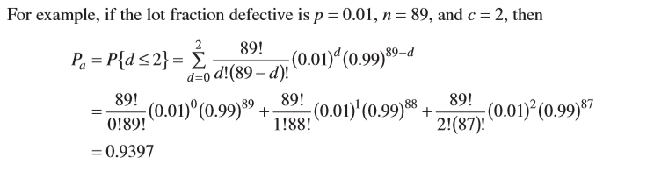
An example

Slide 18
Effect of n and c on OC curve
ACCEPTANCE SAMPLING PLANS – OC Curve

Slide 19
Other Aspects of OC Curve Behavior
ACCEPTANCE SAMPLING PLANS – OC Curve

Slide 20
RECTIFYING INSPECTION
RECTIFYING INSPECTION
The rectifying inspection refers to the inspection programs when 100% inspection or screening of rejected lots (with all discovered defective items are either removed or replaced with known good items). Consequently, average fraction defective in the stream of outgoing lots is lower than the fraction defective in the incoming lots.
ACCEPTANCE SAMPLING PLANS – Rectifying Inspection

Slide 21
Average Outgoing Quality (AOQ)
Average of inspected lots (100%) and uninspected lots
ACCEPTANCE SAMPLING PLANS – AOQ
Pac = Probability of accepting lot
p = Fraction defective
N = Lot size
n = Sample size

Slide 22
Average Outgoing Quality Limit (AOQL)
Approximate AOQL = .082
ACCEPTANCE SAMPLING PLANS – AOQL
AOQ (Fraction defective out)
Incoming fraction defective (p)

Slide 23
AVERAGE TOTAL INSPECTION (ATI)
AVERAGE TOTAL INSPECTION (ATI)
If the lots contain no defectives, no lots will be rejected, and the amount of inspection will per lot will be the sample size n.
If the items are all defective, every lot will be submitted for 100% inspection, and the amount of inspection per lot will be the lot size N.
If the lot quality (p) 0 < p < 1, the average amount of inspection per lot will be between the sample size n and lot size N.
If the lot is of quality p and the probability of acceptance is P_{a} , then the average total inspection per lot will be
ATI = n + (1 – P_{a})(N – n)
ACCEPTANCE SAMPLING PLANS – Average Total Inspection

Slide 24
AVERAGE TOTAL INSPECTION (ATI)
ACCEPTANCE SAMPLING PLANS – Average Total Inspection

Slide 25
ACCEPTANCE SAMPLING
Acceptable Quality Level (AQL)
  Percentage of defective items a customer is willing to accept from you (a property of mfg. process)
Lot Tolerance Percent Defective (LTPD)
  Upper limit on the percentage of defects a customer is willing to accept ( a property of the consumer)
Average Outgoing Quality (AOQ)
  Average of rejected lots and accepted lots
Average Outgoing Quality Limit (AOQL)
  Maximum AOQ for a range of fractions defective
Average Total Inspection (ATI)
  Average number of units inspected per lot
ACCEPTANCE SAMPLING PLANS – Points

Slide 26
Designing Sampling Plans
(Single Sampling Plans)
Operationally,
three values need to be determined before a sampling plan can be implemented (for single sampling plans):
  N = (lot size) the number of units in the lot
  n = (sample size) the number of units in the sample
  c = (acceptance number) the maximum number of nonconforming units in the sample for which the lot will be accepted.
ACCEPTANCE SAMPLING PLANS – Design of Sampling Plans
While there is not a straightforward way of determining these values directly given desired values of the parameters, tables have been developed.
Below is an excerpt of one of these tables.

Slide 27
Designing Sampling Plans
(Single Sampling Plans)
Three alternatives for specifying sampling plans
  Producers Risk (1-) and AQL specified
  Consumers Risk β and LTPD specified
  All four parameters specified
Example 1: Given a producers risk of .05 and an AQL of .015 determine a sampling plan
    c = 1: n = .355/.015 ~ 24
    c = 4: n = 1.97/.015 ~ 131
Example 2: Given a consumers risk of .1 and a LTPD of .08 determine a sampling plan
    c = 0: n = 2.334/.08 ~ 29
    c = 5: n = 9.274/.08 ~ 116
Example 3 : Given producers risk of .05, consumers risk of .1, LTPD 4.5%, and AQL of 1% find a sampling plan.
  Since 4.5/1 = 4.5 is between c= 3 and c = 4. Using the n(AQL) column the sample sizes suggested are 137 and 197 respectively. Note using this column will ensure a producers risk of .05. Using the n(LTPD) column will ensure a consumers risk of .1
ACCEPTANCE SAMPLING PLANS – Design of Sampling Plans

Slide 28
Double Sampling Plan
In an effort to reduce the amount of inspection double (or multiple) sampling is used. Whether or not the sampling effort will be reduced depends on the defective proportions of incoming lots. Typically, four parameters are specified:
  n₁ = number of units in the first sample
  c₁ = acceptance number for the first sample
  n₂ = number of units in the second sample
  c₂ = acceptance number for both samples
ACCEPTANCE SAMPLING PLANS – Double Sampling Plan
Advantage of a double-sampling plan over single sampling is that it may reduce (??..) total amount of required inspection.
Suppose first sample in a double-sampling plan is smaller than for a single- sampling plan
    If lot is accepted or reject on first sample, cost of inspection is lower
    Also, possible to reject a lot without completing inspection of second sample.

Slide 29
Double Sampling Plan
A double sampling plan proceeds as follows:
A random sample of size n₁ is drawn from the lot.
If the number of defective units (say d₁ ) ≤ c₁ the lot is accepted.
If d₁> c₂ the lot is rejected.
If neither of these conditions are satisfied a second sample of size n₂ is drawn from the lot.
If the number of defectives in the combined samples (d₁ + d₂) > c₂ the lot is rejected. If not the lot is accepted.
ACCEPTANCE SAMPLING PLANS – Double Sampling Plan

Slide 30
Double Sampling Plan
ACCEPTANCE SAMPLING PLANS – Double Sampling Plan

Slide 31
Double Sampling Plan
OC Curve
ACCEPTANCE SAMPLING PLANS – Double Sampling Plan

Slide 32
Double Sampling Plan
OC Curve
ACCEPTANCE SAMPLING PLANS – Double Sampling Plan

Slide 33


OC Curve Calculation
n₁ = 50, c₁ = 1, n₂ = 100, c₂ = 3. If Pa denotes the probability of acceptance on the combined samples, and P^{I}_{a} and P^{II}_{a} denote the probability of acceptance on the first and second samples,
P^{I}_{a} is just the probability that we will observe d₁ ≤ c₁ = 1 defectives out of a random sample of n₁ = 50 items.

Slide 34

Calculations
If p = 0.05 is the fraction defective in the incoming lot,
A second sample is drawn only if there are two or three defectives on the first sample—that is, if c₁ < d₁ ≤ c₂.

Slide 35
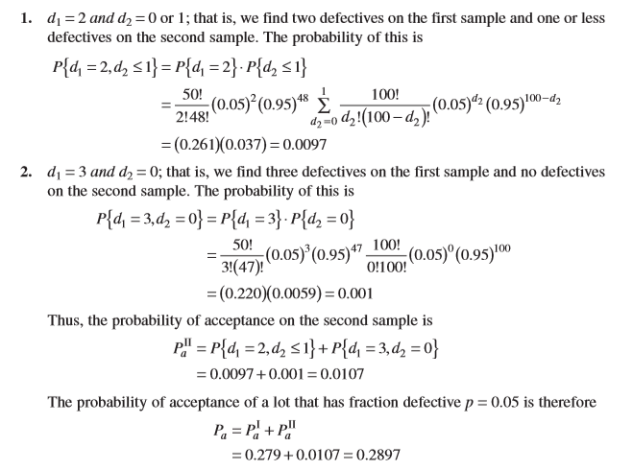
Calculations

Slide 36
AVERAGE SAMPLE NUMBER (ASN)
AVERAGE SAMPLE NUMBER (ASN)
In double sampling, the size of sample selected depends on whether or not the second sample is necessary.
The probability of drawing a second sample varies with the fraction defective (p) in the incoming lot.
With the complete inspection of the second sample, the average sample size in double sampling is equal to the
(size of the first sample) x (probability that there will only one sample)
+ (size of the combined sample) x (probability that a second sample will be necessary)
Therefore a general formula
ASN = n₁P_{I} + (n₁ + n₂)(1 – P_{I}) = n₁+ n₂(1 – P_{I})
P_{I} is the probability of making a decision on the first sample
= P{lot is accepted on the first sample} + P{lot is rejected on the first sample}
The plot of ASN versus p is called ASN curve.
ACCEPTANCE SAMPLING PLANS – Average Sample Number

Slide 37
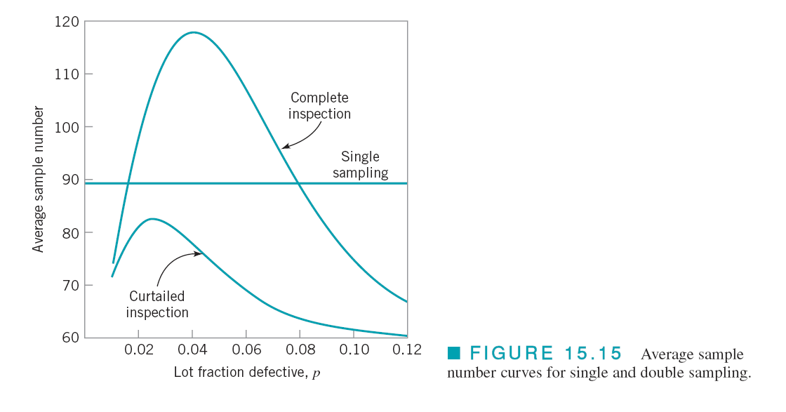
AVERAGE SAMPLE NUMBER (ASN)
AVERAGE SAMPLE NUMBER (ASN) for Single and Double Sampling Plans
ACCEPTANCE SAMPLING PLANS – Average Sample Number

Slide 38
AVERAGE SAMPLE NUMBER (ASN)
AVERAGE SAMPLE NUMBER (ASN) With Curtailement
ACCEPTANCE SAMPLING PLANS – Average Sample Number

Slide 39
Double Sampling Plan
RECTIFYING INSPECTION AND AVERAGE TOTAL INSPECTION (ATI)
ACCEPTANCE SAMPLING PLANS – Rectifying Inspection and ATI

Slide 40
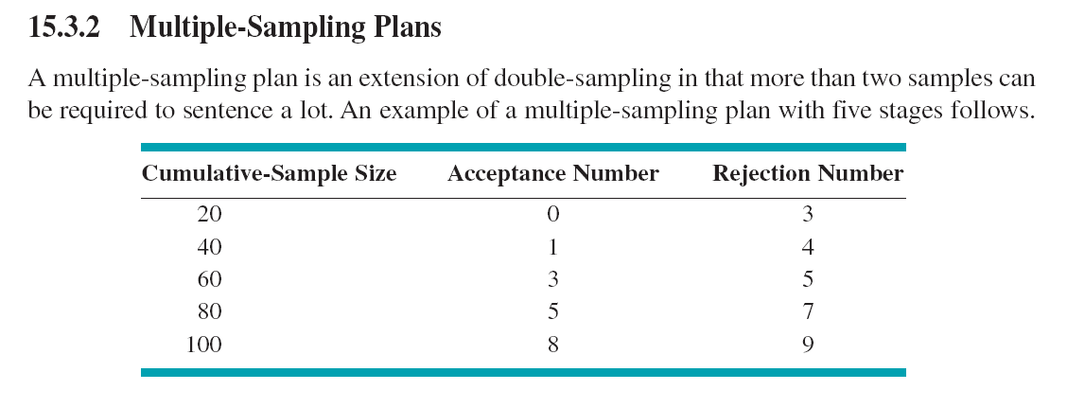
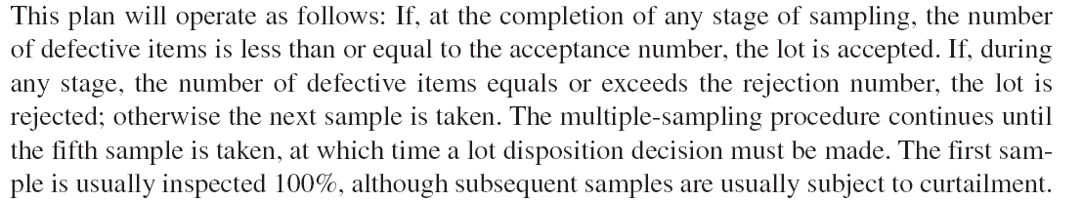
Multiple Sampling Plan
ACCEPTANCE SAMPLING PLANS – Multiple Sampling Plans

Slide 41
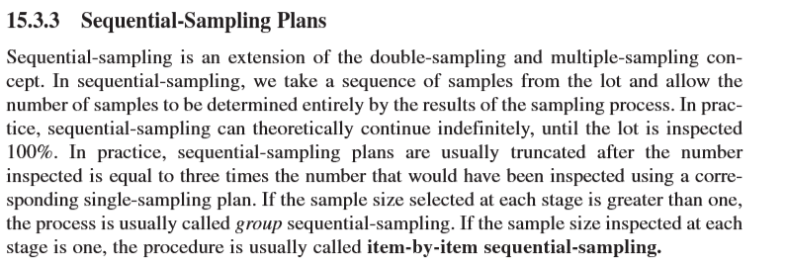
Sequential Sampling Plan
ACCEPTANCE SAMPLING PLANS – Sequential Sampling Plans

Slide 42
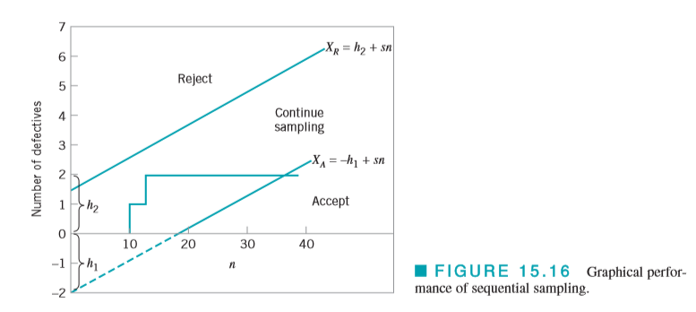
Example of Sequential Sampling

Slide 43
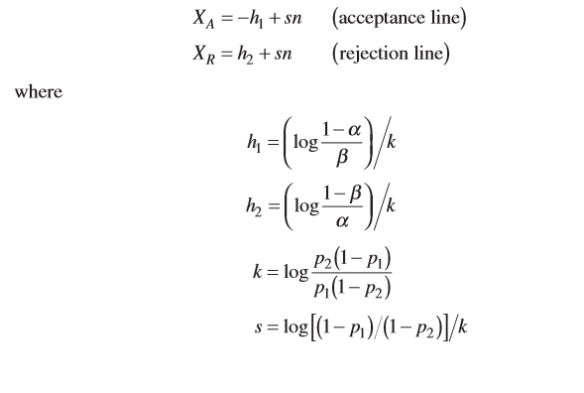
Sequential Sampling Plan
ACCEPTANCE SAMPLING PLANS – Sequential Sampling Plans

Slide 44
Sampling procedure for inspection by attributes developed during World War II and is the most widely used acceptance-sampling system for attributes in the world today
A collection of sampling schemes; therefore an acceptance-sampling system
Provides for three types of sampling: single, double, and multiple
Primary focal point is the acceptable quality level (AQL)
  Different AQLs may be designated for different types of defects: critical, major, and minor
  Generally specified in contract or by authority responsible for sampling
Sample size is determined by lot size and by choice of inspection level
ACCEPTANCE SAMPLING PLANS – Military Standard 105E

Slide 45
Military Standard
ACCEPTANCE SAMPLING PLANS – Military Standard 105E

Slide 46
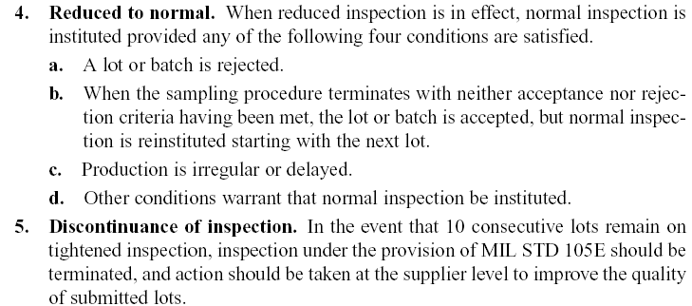
Military Standard
ACCEPTANCE SAMPLING PLANS – Military Standard 105E

Slide 47
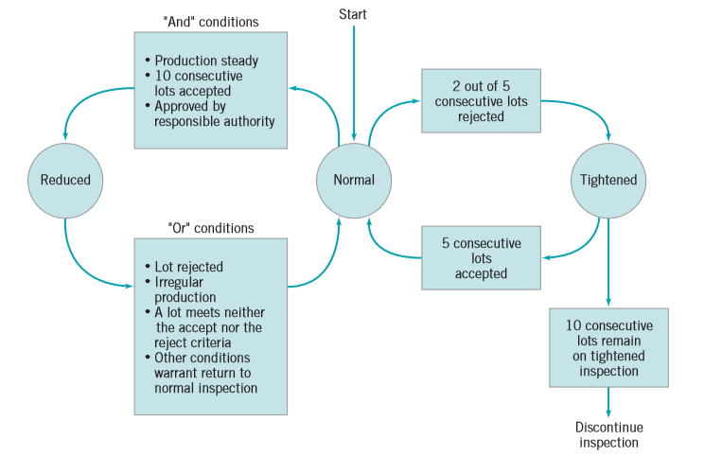
Military Standard- Switching Rules
ACCEPTANCE SAMPLING PLANS – Military Standard 105E

Slide 48
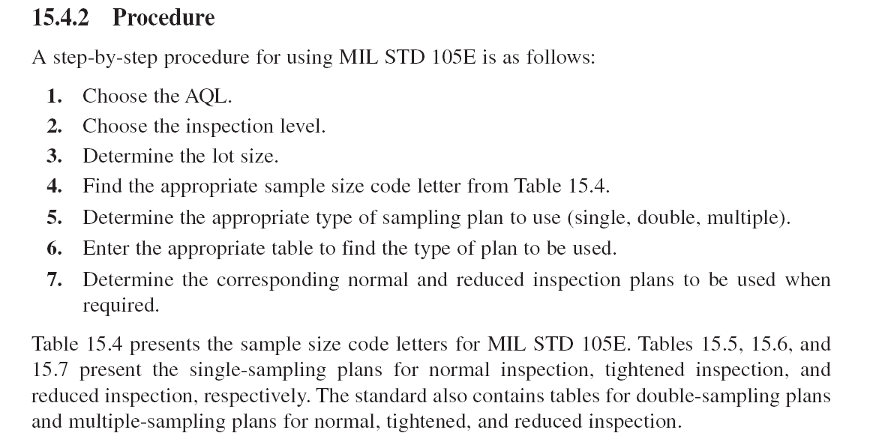
ACCEPTANCE SAMPLING PLANS – Military Standard 105E

Slide 49
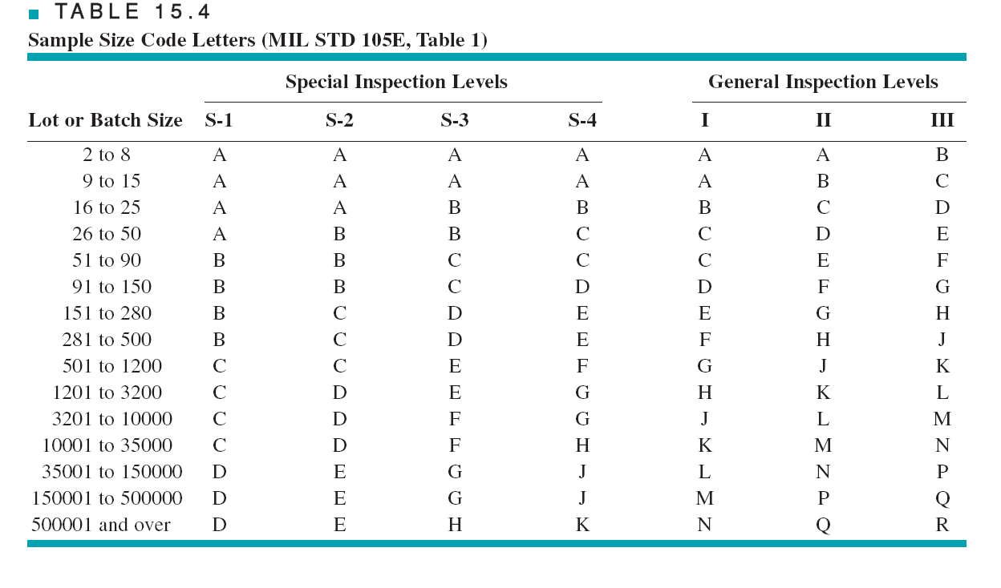
ACCEPTANCE SAMPLING PLANS – Military Standard 105E
Refer to Tables 15.5, -6 and -7 in the textbook on pp. 658 – 660.

Slide 50
Discussions
Several points about MIL STD 105E should be emphasized:
MIL STD 105E is AQL-oriented
Not all possible sample sizes are possible (2,3,5,8,13,20,32,50, etc.)
Sample sizes are related to lot sizes
Switching rules are subject to criticism for both misswitching between inspection plans and discontinuation even though there has been no actual quality deterioration
But a flagrant and common abuse of MIL STD 105E is failure to use the switching rules at all
ACCEPTANCE SAMPLING PLANS – Military Standard 105E

Slide 51
ACCEPTANCE SAMPLING PLANS – Dodge- Romig Sampling Plans

Slide 52
AOQL Plans:
Dodge-Romig (1959) tables give AOQL sampling plans for specified AOQL values
Six classes of values for process average are specified for various lot sizes
Tables are available for both single and double sampling
Designed so that average total inspection at a given AOQL and process average is approximately a minimum
Refer to Table 15.8 for an example
ACCEPTANCE SAMPLING PLANS – Dodge- Romig Sampling Plans
LTPD Plans:
Dodge-Romig LTPD tables are designed so that the probability of lot acceptance at the LTPD is 0.1
Tables are provided for various LTPD values
Six classes of values for process average are specified for various lot sizes
Refer to Table 14-9 for an example

Slide 54
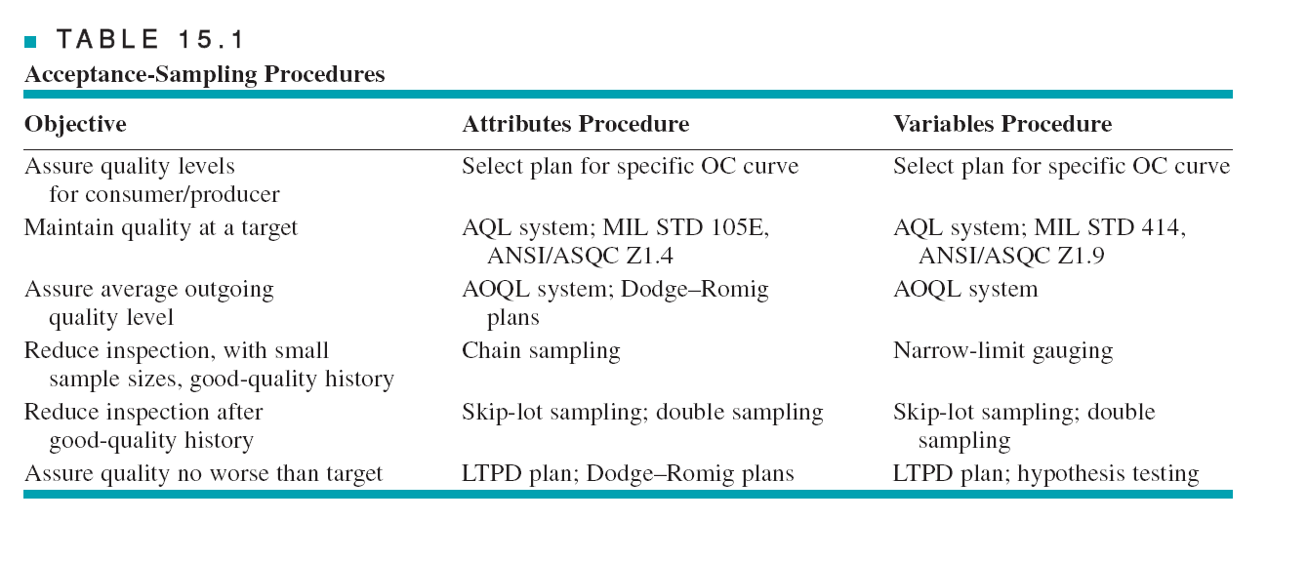
Guidelines for Using Acceptance Sampling
An acceptance-sampling plan consists of sample size and acceptance/rejection criteria for lot sentencing
An acceptance-sampling scheme is a set of procedures consisting of acceptance-sampling plans in which lot sizes, sample sizes, and acceptance/rejection criteria along with amount of 100% inspection and sampling are related
A sampling system is a unified collection of one or more schemes
ACCEPTANCE SAMPLING PLANS – Guidelines for Acceptance Sampling

