Slide 1
Process capability analysis
Dr. Raghu Nandan Sengupta
Professor
Department of Industrial and Management Engineering
All figures are taken from(unless otherwise mentioned):
Introduction to Statistical process Control
Douglas. C Montgomery
6th Edition

Slide 2
Introduction
Statistical techniques can be helpful throughout the product cycle, including development activities prior to manufacturing, in quantifying process variability, in analyzing this variability relative to product requirements or specifications, and in assisting development and manufacturing in eliminating or greatly reducing this variability.
This general activity is called process capability analysis
Process capability refers to the uniformity of the process.
There are two ways to think of this variability:
1. The natural or inherent variability in a critical-to-quality characteristic at a specified time; that is, “instantaneous” variability
2. The variability in a critical-to-quality characteristic over time
We define process capability analysis as a formal study to estimate process capability

Slide 3
Major uses of Process capability Analysis
1. Predicting how well the process will hold the tolerances
2. Assisting product developers/designers in selecting or modifying a process
3. Assisting in establishing an interval between sampling for process monitoring
4. Specifying performance requirements for new equipment
5. Selecting between competing suppliers and other aspects of supply chain management
6. Planning the sequence of production processes when there is an interactive effect of processes on tolerances
7. Reducing the variability in a process

Slide 4
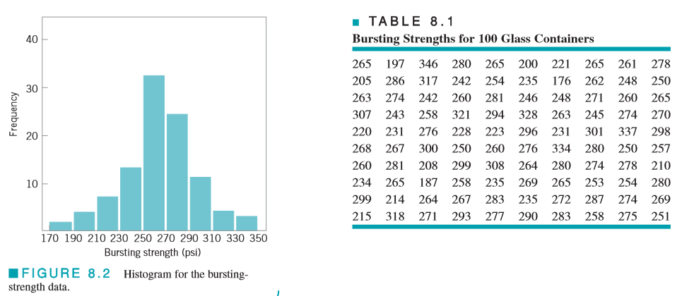
Using Histogram – An Example

Slide 5
Solution

Slide 6
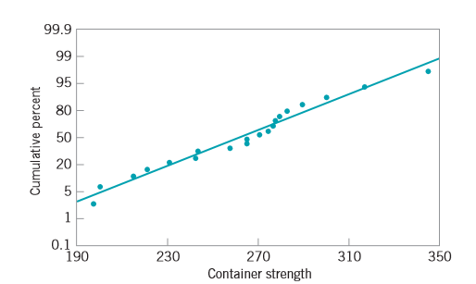
Probability Plotting
20 observations on glass container bursting strength: 197, 200, 215, 221, 231, 242, 245, 258, 265, 265, 271, 275, 277, 278, 280, 283, 290, 301, 318, and 346
Fig 8.4

Slide 7
Interpretation
Mean of the normal distribution is the fiftieth percentile, which we may estimate from Fig. 8.4 as approximately 265 psi, and the standard deviation of the distribution is the slope of the straight line.
It is convenient to estimate the standard deviation as the difference between the eighty-fourth and the fiftieth percentiles. For the strength data shown above and using Fig. 8.4, we find that
Note that and are not far from the sample average and standard deviation s = 32.02.
Care should be exercised in using probability plots. If the data do not come from the assumed distribution, inferences about process capability drawn from the plot may be seriously in error

Slide 8
Process Capability Ratios
Recall
(8.4)

Slide 9
Process Capability Ratios
Equations (8.4) and (8.5) assume that the process has both upper and lower specification limits. For one-sided specifications, one-sided process-capability ratios are used. One sided PCRs are defined as follows:

Slide 10
An example

Slide 11
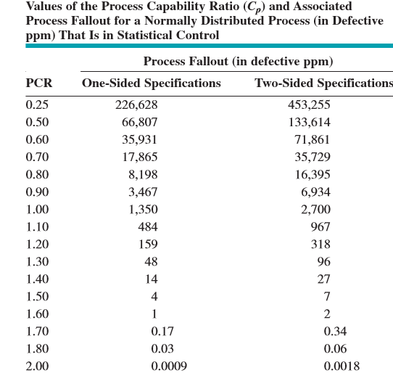
Values of Process Capability Ratio
Several values of the PCR Cp along with the associated values of process fallout, expressed in defective parts or nonconforming units of product per million (ppm)

Slide 12
Assumptions
1. The quality characteristic has a normal distribution.
2. The process is in statistical control.
3. In the case of two-sided specifications, the process mean is centered between the lower and upper specification limits.
These assumptions are absolutely critical to the accuracy and validity of the reported numbers, and if they are not valid, then the reported quantities may be seriously in error.
Stability or statistical control of the process is also essential to the correct interpretation of any PCR
What we actually observe in practice is an estimate of the PCR. This estimate is subject to error in estimation, since it depends on sample statistics

Slide 13
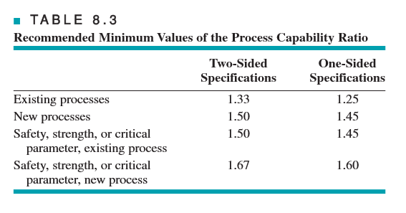
Minimum Values for PCR

Slide 14
Process Capability Analysis using control chart
Histograms, probability plots, and process capability ratios summarize the performance of the process. They do not necessarily display the potential capability of the process because they do not address the issue of statistical control
The control chart should be regarded as the primary technique of process capability analysis.
The x and R charts should be used whenever possible, because of the greater power and better information they provide relative to attributes charts.
However, both p charts and c (or u) charts are useful in analyzing process capability.

Slide 15
An example

Slide 16
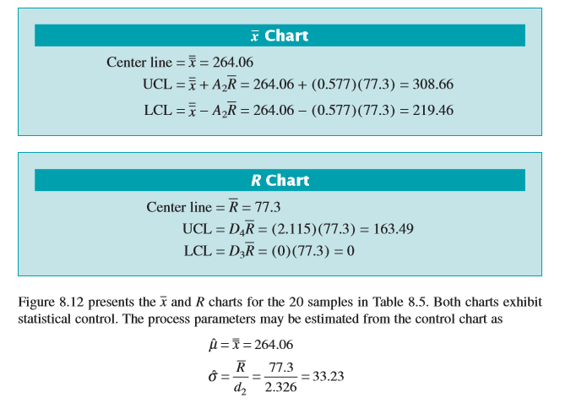
CALCULATION

Slide 17
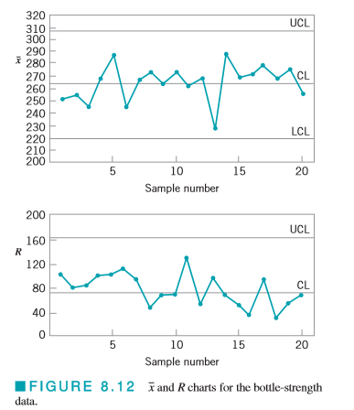
Control Charts

Slide 18
Conclusions
This example illustrates a process that is in control but operating at an unacceptable level.
There is no evidence to indicate that the production of nonconforming units is operator-controllable. Engineering and/or management intervention will be required either to improve the process or to change the requirements if the quality problems with the bottles are to be solved.
The objective of these interventions is to increase the process capability ratio to at least a minimum acceptable level.
The control chart can be used as a monitoring device or logbook to show the effect of changes in the process on process performance. Sometimes the process capability analysis indicates an out-of-control process.
It is unsafe to estimate process capability in such cases. The process must be stable in order to produce a reliable estimate of process capability.

Slide 19
Process Capability Using Designed Experiments
A designed experiment is a systematic approach to varying the input controllable variables in the process and analyzing the effects of these process variables on the output.
Designed experiments are also useful in discovering which set of process variables is influential on the output, and at what levels these variables should be held to optimize process performance.
One of the major uses of designed experiments is in isolating and estimating the sources of variability in a process. For example, consider a machine that fills bottles with a soft-drink beverage. Each machine has a large number of filling heads that must be independently adjusted.
The quality characteristic measured is the syrup content (in degrees brix) of the finished product. There can be variation in the observed brix (σ²_{B}) because of machine variability (σ²_{M}), head variability (σ²_{H}), and analytical test variability (σ²_{A}). The variability in the observed brix value is

Slide 20
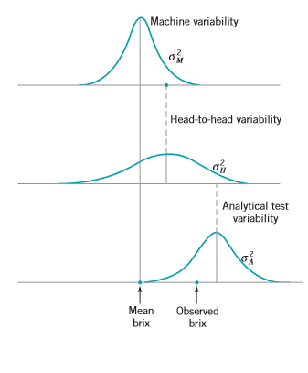
Explanation
An experiment can be designed, involving sampling from several machines and several heads on each machine, and making several analyses on each bottle, which would allow estimation of the variances.
Suppose that the results appear as in Fig. 8.13. Since a substantial portion of the total variability in observed brix is due to variability between heads, this indicates that the process can perhaps best be improved by reducing the head-to-head variability. This could be done by more careful setup or by more careful control of the operation of the machine.

Slide 21
Process Capability Analysis Using Attribute Data
When dealing with nonconformities or defects, a defects per unit (DPU) statistic is often used as a measure of capability, where
Here the unit is something that is delivered to a customer and can be evaluated or judged as to its suitability. Some examples include: 1. An invoice 2. A shipment 3. A customer order 4. An enquiry or call.
The defects or nonconformities are anything that does not meet the customer requirements, such as: 1. An error on an invoice 2. An incorrect or incomplete shipment 3. An incorrect or incomplete customer order 4. A call that is not satisfactorily completed

Slide 22
DPMO
The DPU measure does not directly take the complexity of the unit into account. A widely used way to do this is the defect per million opportunities (DPMO) measure
Opportunities are the number of potential chances within a unit for a defect to occur. For example, on a purchase order, the number of opportunities would be the number of fields in which information is recorded times two, because each field can either be filled out incorrectly or blank (information is missing).
It is important to be consistent about how opportunities are defined, as a process may be artificially improved simply by increasing the number of opportunities over time.

Slide 23
Gauge Capability
Generally, in any activity involving measurements, some of the observed variability will be inherent in the units or items that are being measured, and some of the variability will result from the measurement system that is used.
The measurement system will consist (minimally) of an instrument or gauge, and it often has other components, such as the operator(s) that uses it and the conditions or different points in time under which the instrument is used.
There may also be other factors that impact measurement system performance, such as setup or calibration activities.
The purpose of most measurement systems capability studies is to:
1. Determine how much of the total observed variability is due to the gauge or instrument
2. Isolate the components of variability in the measurement system 3
3. Assess whether the instrument or gauge is capable (that is, is it suitable for the intended application)

Slide 24
R & R
In this section we will introduce the two R’s of measurement systems capability:
Repeatability (do we get the same observed value if we measure the same unit several times under identical conditions), and
Reproducibility (how much difference in observed values do we experience when units are measured under different conditions, such as different operators, time periods, and so forth).
Other important aspects of measurement systems capability
The linearity of a measurement system reflects the differences in observed accuracy and/or precision experienced over the range of measurements made by the system.
Stability, or different levels of variability in different operating regimes, can result from warm-up effects, environmental factors, inconsistent operator performance, and inadequate standard operating procedure.
Bias reflects the difference between observed measurements and a “true” value obtained from a master or gold standard, or from a different measurement technique known to produce accurate values.

Slide 25
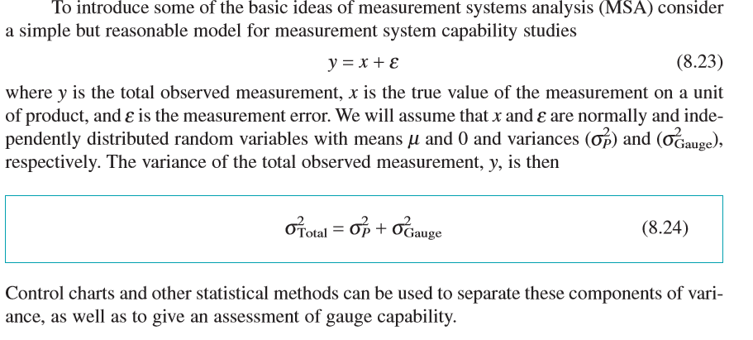
R & R

Slide 26
An example

Slide 27
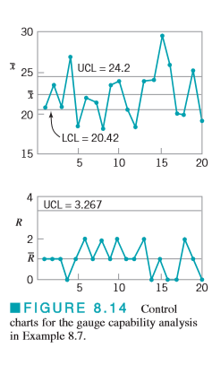
An example (continued)

Slide 28
Precision to Tolerance Ratio
Precision to Tolerance Ratio
Values of the estimated ratio P/T of 0.1 or less often are taken to imply adequate gauge capability.

Slide 29
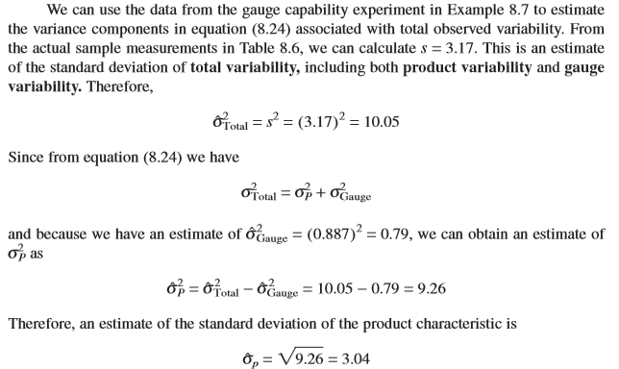
Estimating variance components

Slide 30
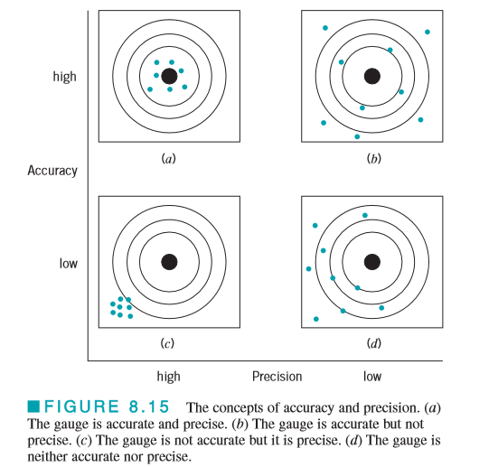
Accuracy and precision

