Slide 1
Dielectric Materials
ESO 205
Nature and Properties of Materials
Topics to discuss
  Principles of dielectrics
  Dielectrics Loss and Breakdown
  Polarizations
  Frequency dependence
  Ferro-, Piezo- and Pyro- electrics

Slide 2
Why are these important?
A variety of applications
  Sensors
    Force, strain and temperature sensing
  Actuators
    Example: quartz watches, piezoelectric motor
  Memories or data storage
    DRAMs, FRAMs
  Transducers
    Naval and aerospace applications

Slide 3
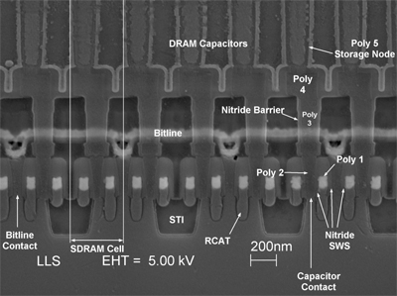
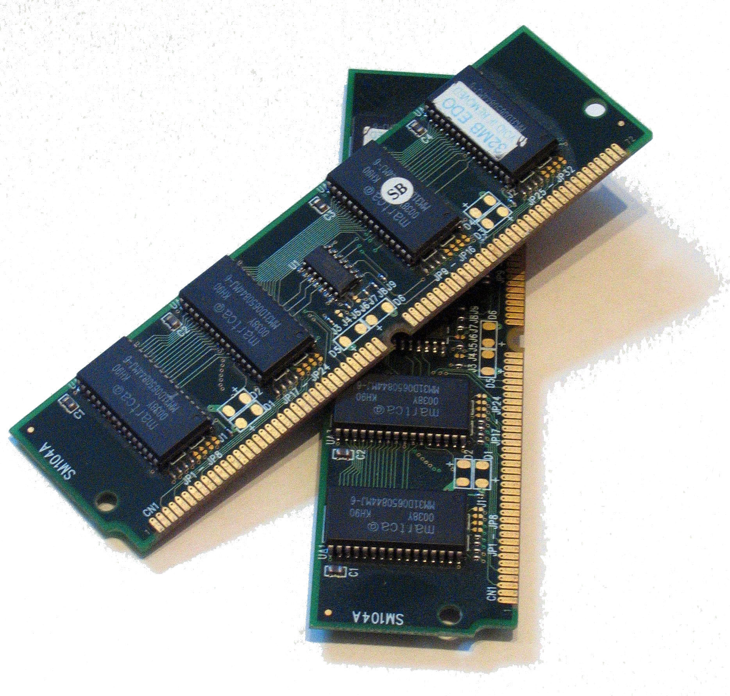
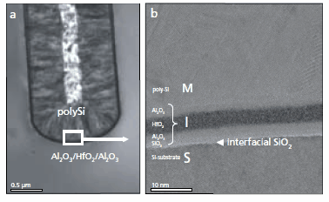
http://www.eetimes.com/document.asp?doc_id=1276895
DRAMs
Materials:
SiO₂, Ta₂O₅, HfO₂

Slide 4
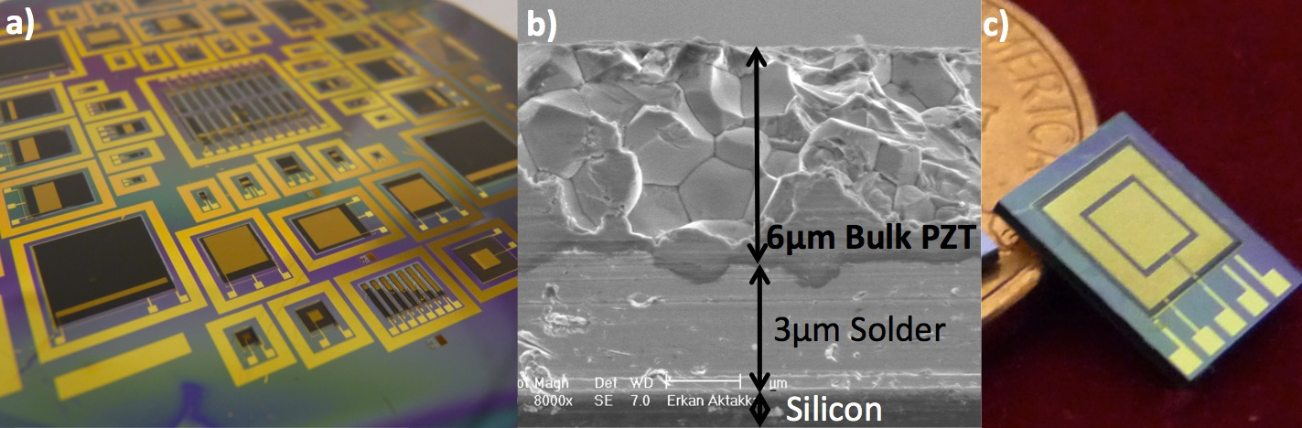
High-force high-deflection piezoelectric diaphragm actuator
Materials:
Pb(ZrTi)O₃, BaTiO₃, PbTiO₃

Slide 5
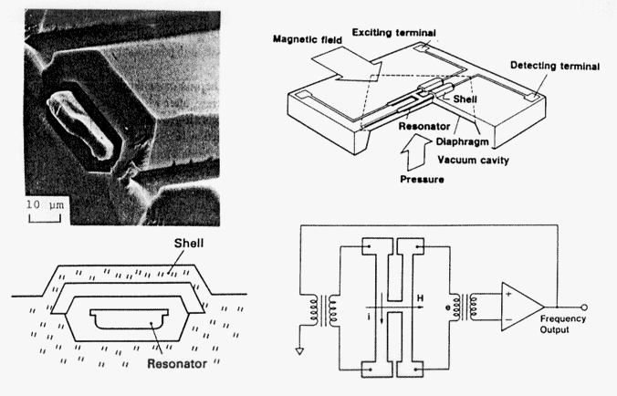
Yokogawa resonant pressure sensor
The resonator is excited by the application of an alternating current in a DC magnetic biasing field, with a variable-gain amplifier used to maintain a constant vibration amplitude.
http://www.wtec.org/loyola/mems/c5_s3.htm

Slide 6
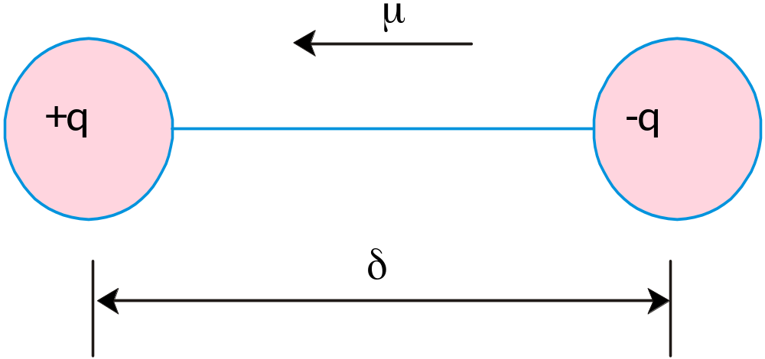
Basic Characteristics
At zero field, the centers of positive and negative charges coincide.
Upon application of a dc or static electric field, there is short range migration of charges.
However, there is a limited movement of charges leading to the formation of charge dipoles and the material, in this state, is considered as ‘polarized’. These dipoles are aligned in the direction of the applied field.
E

Slide 7
Basic Characteristics
The applied field can also align the dipoles that were already present in the material i.e. material containing dipoles without application of the field.
  Polar materials
Of course, both these effects may be present in single material i.e. dipoles can be aligned as well as be induced by the applied field.
Net effect is called as ‘Polarization’ of the material.

Slide 8

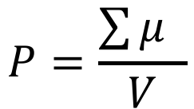
Dipole Moment (C.m)
$$μ=q.d$$
Vectors
Polarization (C/m²)
$$P=\frac{\sum{μ} }{V}$$
(Dipole moment per unit volume)
So, if all the dipoles were aligned in a direction, then
P=N.μ
Conversely, if all the dipoles were aligned in random directions, then
P=N.Σμ=0

Slide 9
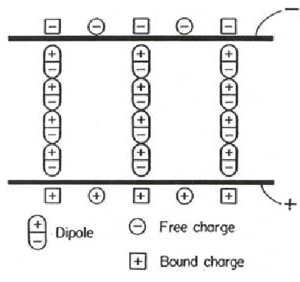
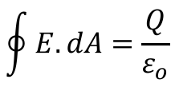
Capacitor
The air-gap can store energy
If we can move charges temporarily, more charge can be stored
Bound charge around ionic cores in a material can lead to dielectric properties
Surface charge
Dipolar Polarization
Not possible to distinguish between two by Gauss’s law
$$\oint{E.dA}=\frac{Q}{ε_{o}}$$

Slide 10
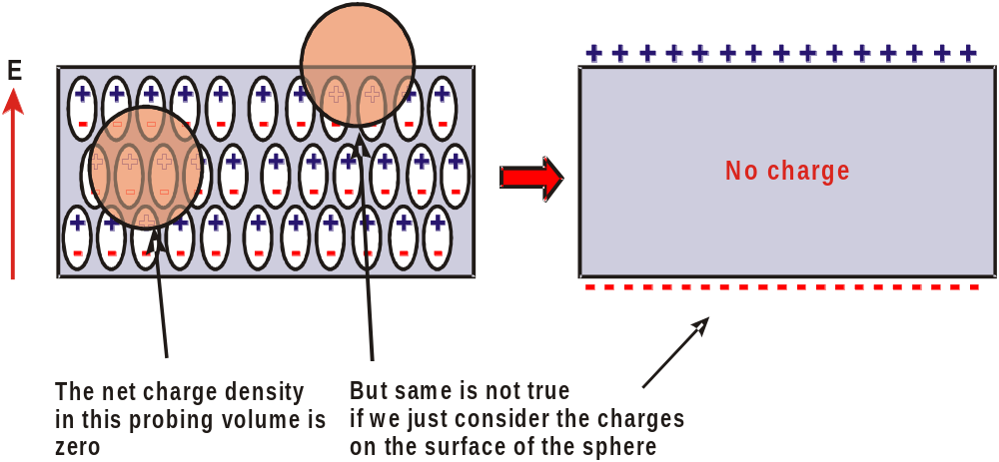
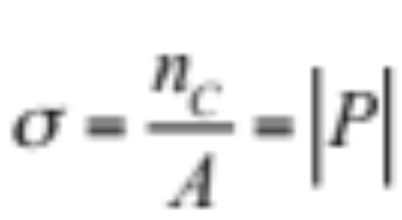
Polarization and Surface Charge
Surface charge density

Slide 11
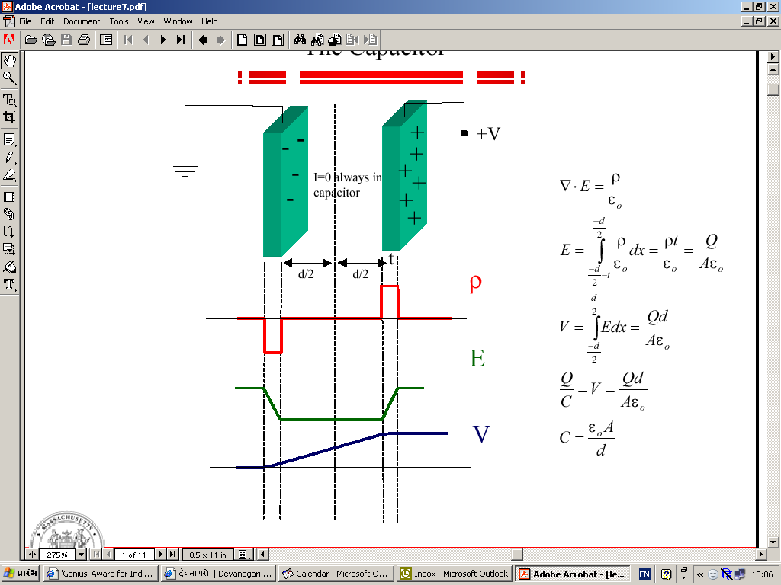
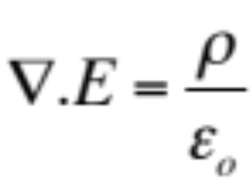
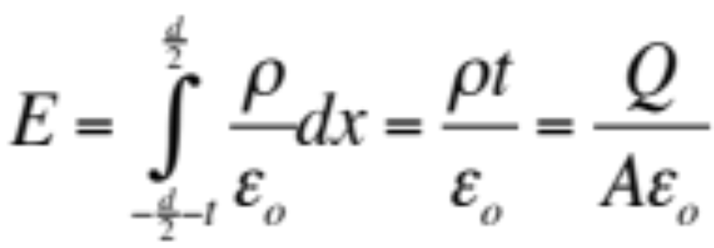
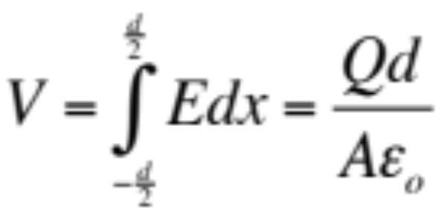
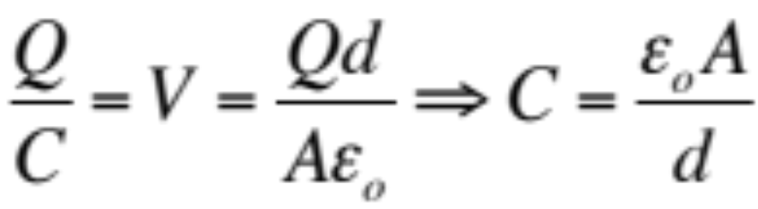
Parallel Plate Capacitor (Vacuum)
Maxwell Equation

Slide 12
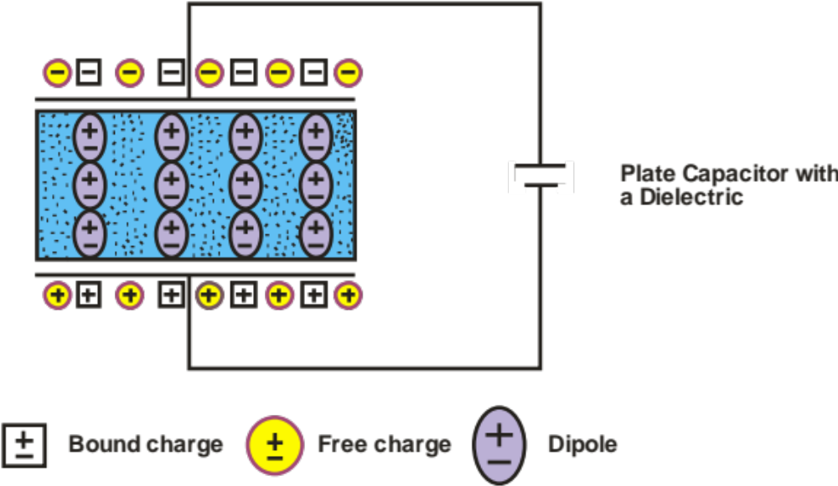
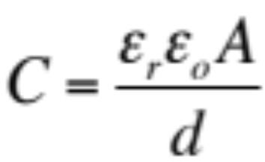
Capacitor with a Dielectric
ε_{r} : Relative dielectric constant of the dielectric (>1)
As a result to sustain same polarization, the voltage dropped reduces.
In other words, other requires lesser voltage to sustain similar charge storage OR
If the voltage is kept same, the charge density goes up.
This is what works for DRAMs with high dielectric constant materials.

Slide 13
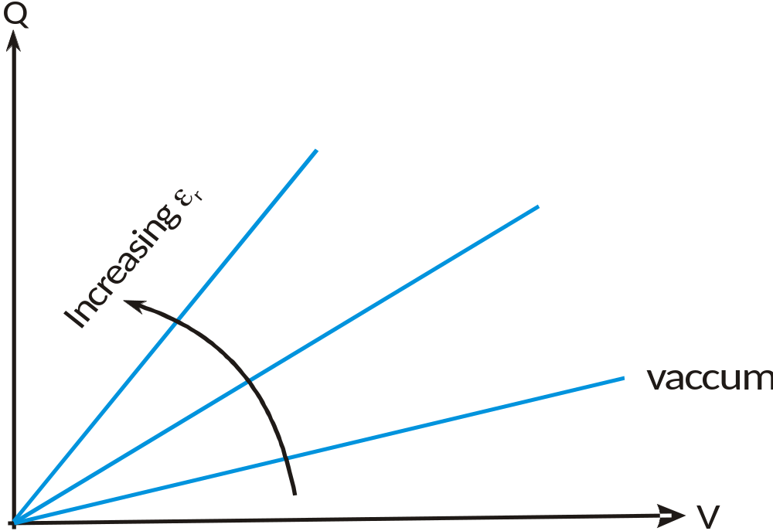
Capacitor with a Dielectric

Slide 14
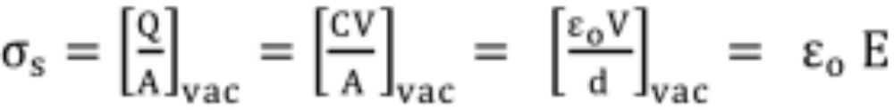
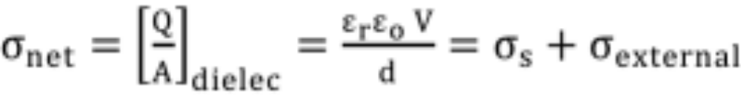
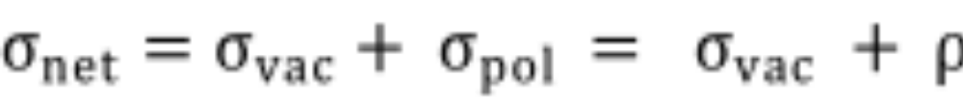
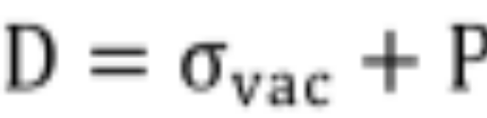
For a capacitor in vacuum
For a capacitor with a dielectric
Dielectric Displacement
Extra term due to Dielectric

Slide 15
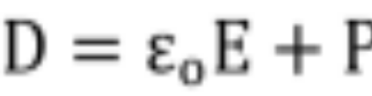
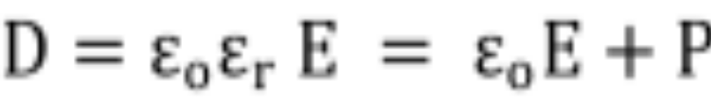
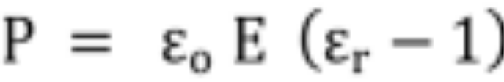
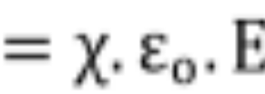
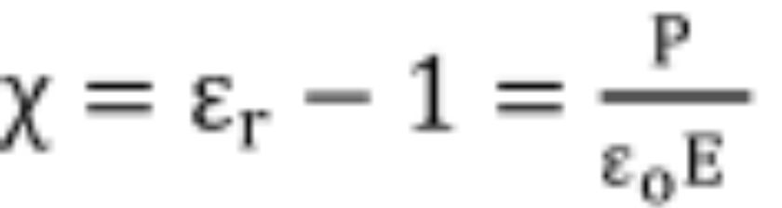
Dielectric susceptibility
Susceptibility is ratio of polarized charge or excess charge to the surface charge in a vacuum capacitor: expresses response of the capacitor to the applied field, determined by dielectric constant.

Slide 16
air | 1.005364
glass | 4 - 7
glass, pyrex 7740 | 5.0
gutta percha | 2.6
jet fuel (jet a) | 1.7
lead oxide | 25.9
lead magnesium niobate | 10,000
lead sulfide (galena) | 200
lead titanate | 200
paper | 3.3, 3.5
plexiglas | 3.1
polyester | 3.2 - 4.3
polyethylene | 2.26
polypropylene | 2.2 - 2.3
polystyrene | 2.55
polyvinyl chloride (pvc) | 4.5
porcelain | 6 - 8
potassium niobate | 700
potassium tantalate niobate, 0 ℃ | 34,000
potassium tantalate niobate, 20 ℃ | 6,000
diamond | 5.87
quartz, crystalline | 4.60
quartz, fused | 3.8
rubber, vulcanized | 2.9
salt | 5.9
selenium | 6.0
silicon | 11.8
silicon carbide (αSiC) | 10.2
silicon dioxide | 4.5
silicone oil | 2.7 - 2.8
soil | 10 - 20
strontium titanate, +25 ℃ | 332
strontium titanate, –195 ℃ | 2080
sulfur | 3.7
tantalum pentoxide | 27
teflon | 2.1
tin antimonide | 147
tin telluride | 1770
titanium dioxide (rutile) | 114

Slide 17
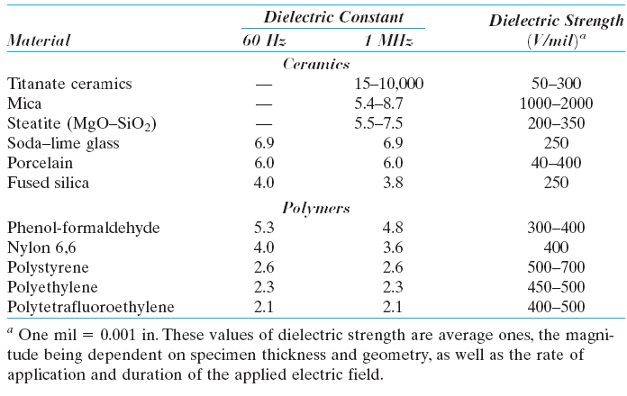
Ref: Materials Science and Engineering, Callister

Slide 18
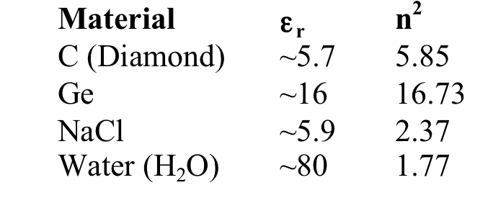
Compare Optical (index of refraction) and Electrical Measurements of ε
ε_{r} = n²
Electromagnetic Theory
Electronic Polarization
Electronic and Ionic Polarization
Electronic, Ionic and Dipolar Polarization

Slide 19
Origin of Polarization
True dipoles creating polarization in materials (not surface effect)
What is the response of these various dipole mechanisms to various E-field frequencies?
Polarization mechanisms and their frequency dependence
  electronic polarization
  ionic polarization
  molecular polarization

Slide 20
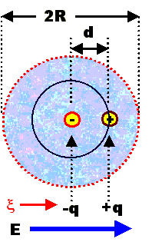
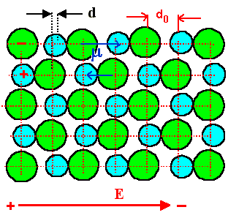
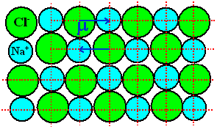
Types of Polarization
Electronic Polarization (α_{e})
Elemental solids
Ionic Polarization (α_{i})
Ionic solids

Slide 21
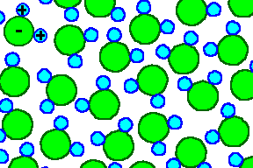
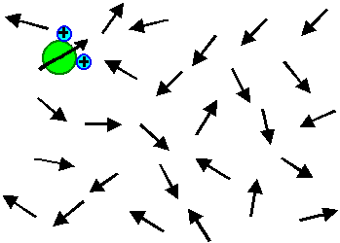
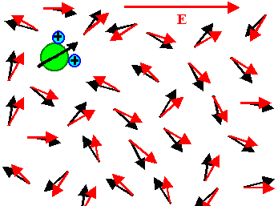
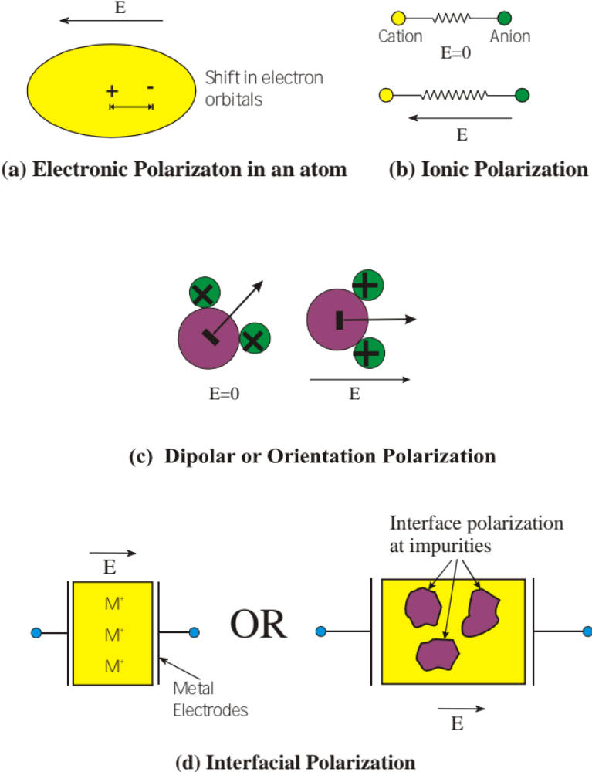
Orientation Polarization (α_{o})
Polar Molecules such as Ice

Slide 22
Interfacial Polarization (α_{o})

Slide 23
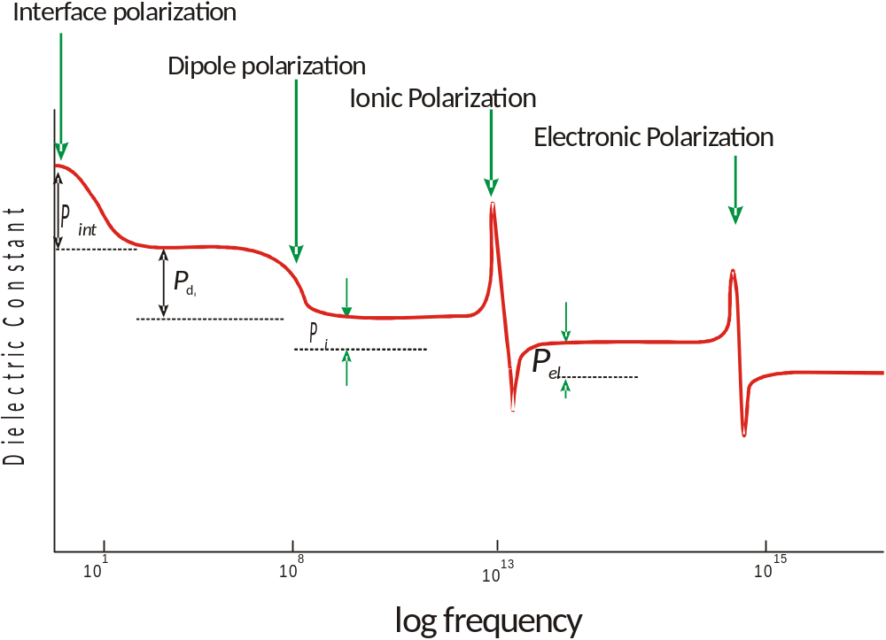
Frequency Dependence
Increasing Mass of dipole

Slide 24
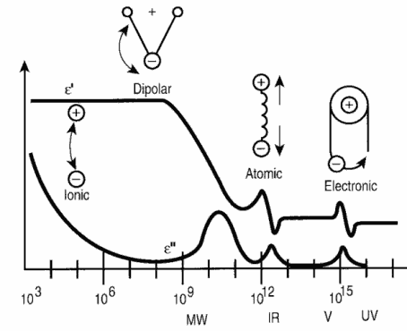
Dielectric Constant vs. Frequency
Dipolar
Ionic
Electronic
Space Charge

Slide 25
Material | ε_{r} | n² | Dominant mechanisms
C (Diamond) | ~5.7 | 5.85 | Electronic
Ge | ~16 | 16.73 | Electronic
NaCl | ~5.9 | 2.37 | Electronic and Ionic
Water (H₂O) | ~80 | 1.77 | Electronic, Ionic and Dipolar

Slide 26
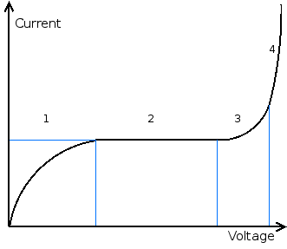
Dielectric Strength
Parameter of usefulness
Defined as maximum field which dielectric can withstand before failure
Marked by sudden and rapid increase in the conductivity i.e. high electron concentration in the conduction band.
Intrinsic Mechanisms
  Rise in electron temperature
  Population increase in the conduction band
Thermal Breakdown
  Joule heating, faster than dissipation
  Reduces the intrinsic dielectric strength
Discharge breakdown
  Ionization in the vicinity of the dielectric followed by subsequent breakdown
1: Free ions accelerated by the field induce a current.
2: These will be saturated after a certain voltage and give a constant current,
3 and 4: Caused by ion avalanche

Slide 27
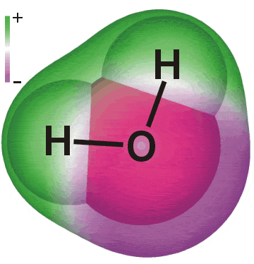
Classification of Dielectrics
+
-
+
Non-polar dielectrics
  Dielectrics having no dipole moment in the absence of electric field
  Example: Inert gases, N₂, CH₄
Polar Dielectrics
  Dielectrics having finite dipole moment in the absence of electric field
  Permanent dipole moment
  Example; H₂O, CH₃Cl etc

Slide 28
Crystallographic Considerations
Total of Crystal systems: 7
Bravais Lattices: 14
Point groups: 32 (based on symmetry considerations)

Slide 29
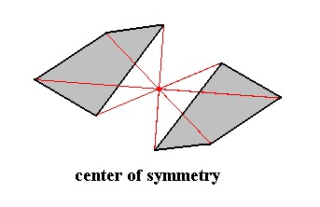
Center of Symmetry
The term centrosymmetric refers to a space group which contains an inversion center as one of its symmetry elements
For every point (x, y, z) in the unit cell, there is an indistinguishable point (-x, -y, -z).

Slide 30
Crystal class
Cubic
Tetragonal
Orthorhombic
Hexagonal
Trigonal
Monoclinic
Triclinic
Total Number
Centro symmetric Point groups
m3 | m3m
4 or m | 4 or mmm
mmm
6 or m | 6 or mmm
3 | 3m
2 or m
1
11 groups
Noncentrosymmetric Point groups
Polar |  | Non-polar
none |  | 432 |  | 3m | 23
4 | 4mm | 4 |  | 42m | 22
mm2 |  | 222
6 | 6mm | 6 | 6m2 | 622
3 | 3m | 32
2 | m | none
1 |  | none
10 groups |  | 11 groups

Slide 31
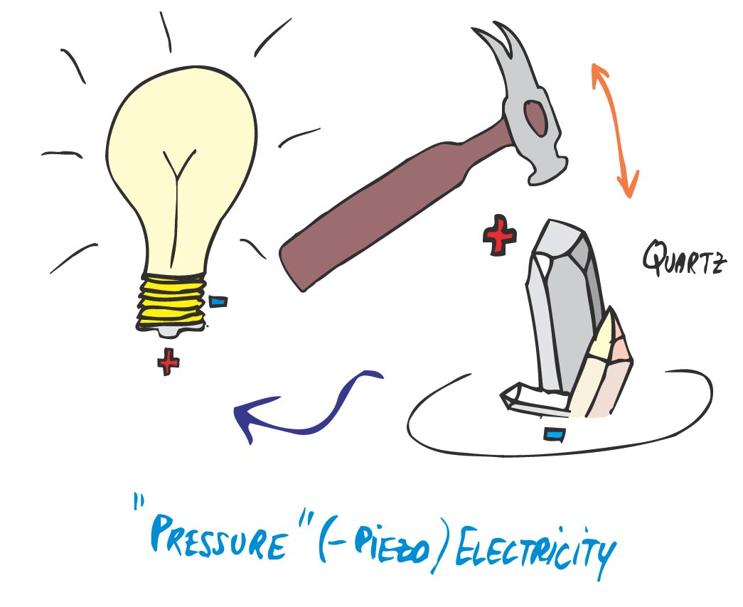
Noncentrosymmetric Point groups
Polar |  | Non-polar
none |  | 432 |  | 3m | 23
4 | 4mm | 4 |  | 42m | 22
mm2 |  | 222
6 | 6mm | 6 | 6m2 | 622
3 | 3m | 32
2 | m | none
1 |  | none
10 groups |  | 11 groups
X
Piezoelectrics
(except 432)
F

Slide 32
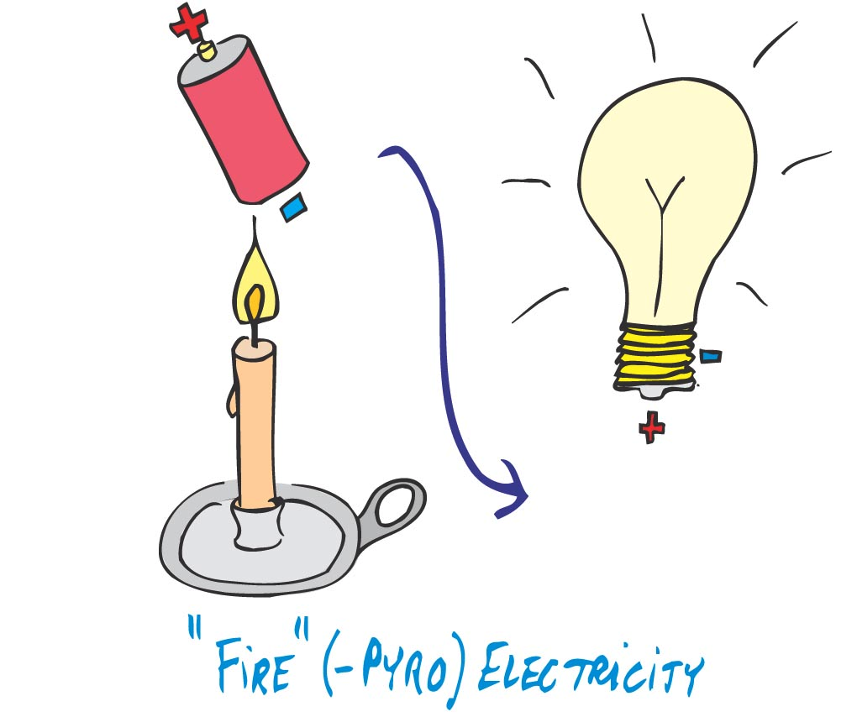
X
Noncentrosymmetric Point groups
Polar |  | Non-polar (X)
none |  | 432 |  | 3m | 23
4 | 4mm | 4 |  | 42m | 22
mm2 |  | 222
6 | 6mm | 6 | 6m2 | 622
3 | 3m | 32
2 | m | none
1 |  | none
10 groups |  | 11 groups
Pyroelectrics
(10 Polar Groups)

Slide 33
Pyroelectrics
Polar Crystals
  These crystals can be spontaneously polarized and polarization can be compensated through external or internal conductivity or twinning or domain formation.
Since spontaneous polarization depends upon the temperature, a change is temperature leads to development of electric charge on faces of the crystal perpendicular to the polar axis.
  Pyroelectric effect.
  All 10 classes of polar crystals are pyroelectric.

Slide 34
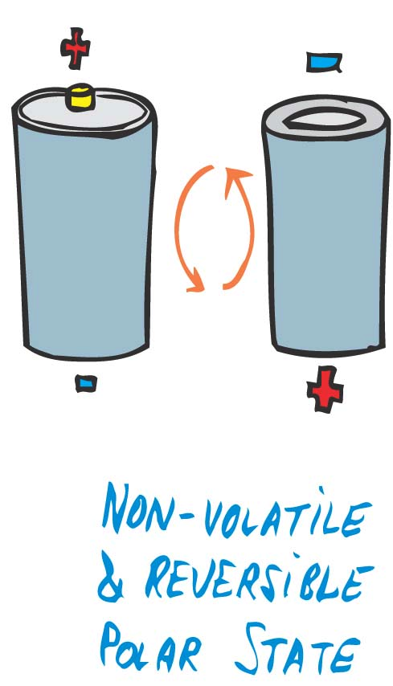
Ferroelectrics
In the some of these polar non-centrosymmetric crystals, the polarization along the polar axis can be reversed by reversing the polarity of electric field.
  Ferroelectric materials
  Spontaneously polarizable with reversible polarization.

Slide 35
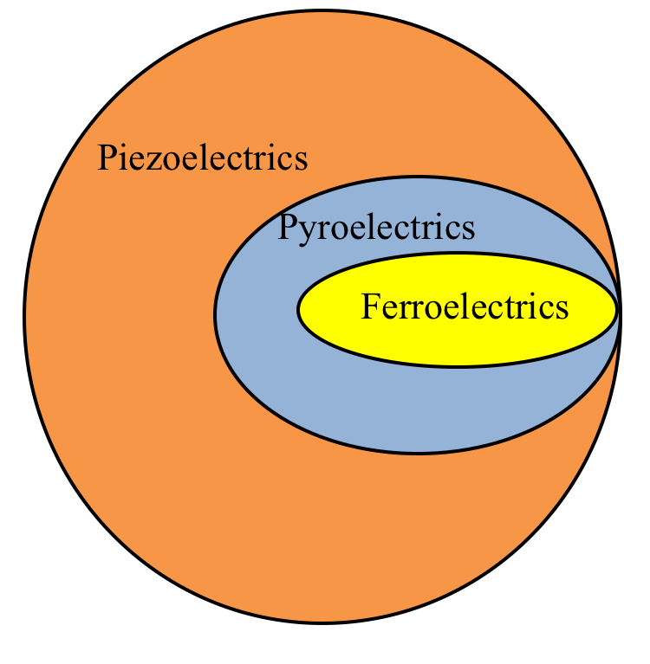
10 polar PGs
20 Noncentrosymmetric PGs

Slide 36
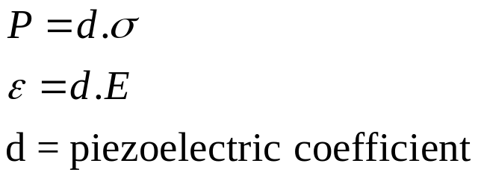
Piezoelectric Effect
Charge development
Stress
Piezoelectric Materials: Non Centro-symmetric structure is only requirement
Applications: Transducers, Resonators etc.

Slide 37

Piezoelectric effect

Slide 38
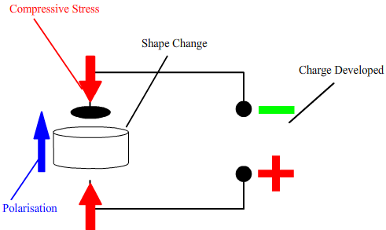
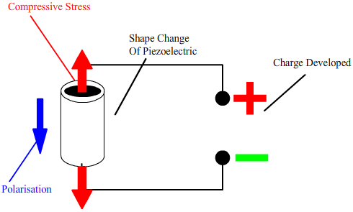
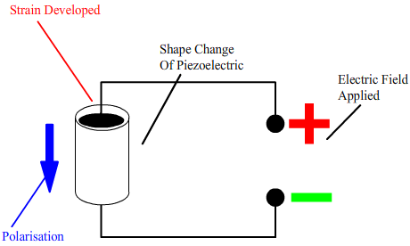


Slide 39


Applications
Atomic force microscopes and scanning tunneling microscopes
Inkjet printers
Diesel engines
X-ray shutters
XY stages for micro scanning used in infrared cameras.
Motion of a patient precisely inside active CT and MRI scanners
Ultrasound imaging
Actuators
Buzzer

Slide 40
Piezoelectric effect
+ + +
Unit Cell Under Mechanical
Compression (“pushing” force):
Electrical polarity as shown
+
-
+
Unit Cell at Rest
-
+
-
“+” = Silicon
- - -
“-” = Oxygen
- - -
-
Neutral Charge
Unit Cell Under mechanical
Tension (“pulling” force):
Electrical polarity reverses.
+
+
-
-
+
+
+ + +

Slide 41


Piezoelectric effect
P: polarization
F: Force

Slide 42

Piezoelectric effect
Linearity of piezo-effect

Slide 43


Piezoelectric effect
PVDF

Slide 44


Pyroelectricity
Charge
In addition to piezoelectricity, have a unique polar axis
Non-centrosymmetric crystals exhibit this effect
Applications: imaging, detectors
ΔT
where p = pyroelectric coefficient (C m⁻² T⁻¹).

Slide 45

Ferroelectricity
Pyroelectric materials with reversible polarization upon reversal of applied field
Remnant polarization at zero field
Applications
  Memories
  Sensors
  Actuators

Slide 46


Slide 47

Domain Formation
E
P_{R}
before poling, P_{R}=0
After Poling, P_{R}≠0
Reorientation of domains in a polycrystalline ferroelectric material after poling

Slide 48

Dielectric Const vs Temperature
Vaiation of Dielectric constant and polarization with temperature (Potassium Dihydrogen Phosphate, a ferroelectric)

Slide 49


Spontaneous Polarization: Ferroelectrics
Curie-Weiss Law
The Curie-Weiss law illustrated for (Ba,Sr)TiO₃
From L.L.Hench and J.K.West,Principles of Electronic Ceramics,Wiley,1990,p.243.

Slide 50

Ferroelectrics
Each unit cell a dipole!
Large P_{R} (remnant polarization, P(E=0))
Coercive Field E_{C}, electric field required to bring P back to zero.

Slide 51
Ferroelectrics
Most ferroelectrics are perovskite structured
Lack of a centre of symmetry is a requirement: most ferroelectric materials are Tetragonal or orthorhombic
Local metastable positions away from equilibrium are created
A
O
B
A
B
(a)
(b)
A typical ABO₃ perovskite unit-cell e.g. PbTiO₃. Remanent polarization is zero when the structure is cubic (paraelectric phase) and it is non-zero in the ferroelectric phase which has tetragonal structure.
Schematic representation of structure and dipoles in a hypothetical 2-D crystal

Slide 52

Properties of Common Ferroelectrics

Slide 53
Perovskite Structure
ABO₃ type of structure: BaTiO₃ , CaTiO₃ , SrTiO₃,
Distortions common: could be non-cubic
Known as the BaTiO₃ or CaTiO₃ lattice
Three different atoms in the base: ABO₃
A at (0,0,0), O at (½, ½, ,0) and B at (½, ½, ½).
  Primitive Cubic Lattice
Co-ordinations
  B: Octahedral
  A: 12-fold

Slide 54

Perovskite

Slide 55

Tetragonal BaTiO₃

Slide 56

Tolerance Factor
t=1 for ideal perovskite
t<1 for most perovskite with distorted structures

Slide 57

Dimensions of a pseudocubic unit-cell of BaTiO₃ (Phil Mag, 7, 1019, (1949))
Temperature dependence of dielectric constant (Phys. Rev., 76, 1221 (1949)

Slide 58
Summary
Dielectrics are insulating materials with Eg > 3 eV
A dielectric material increases the charge storage capacity of plate capacitor: dielectric constant
Every dielectric has a breakdown strength
Types of polarization
  Electronic, Ionic, Molecular, Space charge
  Strong frequency dependence
Dielectrics can be defined as Polar and Nonpolar dielectrics
Polar dielectrics are those having finite dipole moment at RT
  Defined as Ferro-, Pyro- and Piezo-electrics depending on the nature of polarization and dependence on stress, temperature and electrical field.
  Find applications in variety of areas

