Slide 1
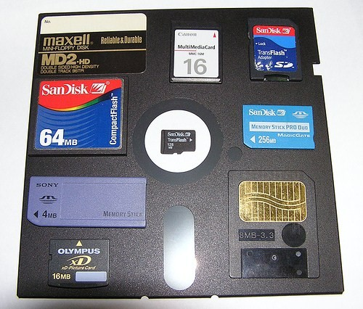
Storage technologies
BY:
SHIVENDRA
GAURAV

Slide 2
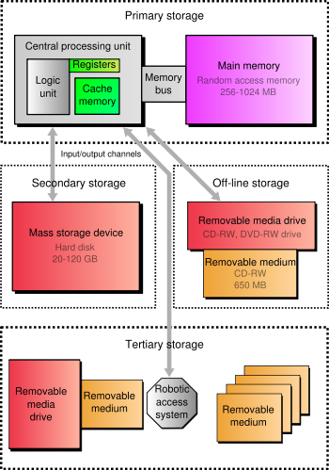
Hierarchy of storage
PRIMARY SECONDARY TERTIARY OFF – LINE

Slide 3
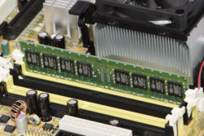
Primary storage
It is the only one directly accessible to the CPU.
The CPU continuously reads instructions stored there and executes them.
This led to a modern Random Access Memory (RAM).
there are two more sub-layers of the primary storage, besides main large-capacity RAM:
Processor Registers &
Processor Cache
Main memory is directly or indirectly connected to the CPU via a memory bus, today sometimes referred to as a Front Side Bus.

Slide 4
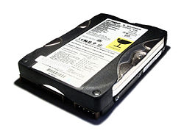
SECONDARY STORAGE
The computer usually uses its input\output channels to access secondary storage.
It transfers desired data using intermediate area in primary storage.
Secondary storage does not lose the data when the device is powered down—it is non-volatile.
In modern computers, Hard Disks are usually used as secondary storage.
The secondary storage is often formatted according to a Filesystem format.
which provides the abstraction necessary to organize data into files and directories.

Slide 5

TERTIARY STORAGE
It involves a robotic mechanism which will mount and dismount removable mass storage media into a storage device according to the system's demands.
When a computer needs to read information from the tertiary storage, it will first consult a catalog database to determine which tape or disc contains the information.
Next, the computer will instruct a robotic arm to fetch the medium and place it in a drive.
When the computer has finished reading the information, the robotic arm will return the medium to its place in the library.

Slide 6

Off - line storage
Also known as disconnected storage, is a computer data storage on a medium or a device that is not under the control of a processing unit.
It must be inserted or connected by a human operator before a computer can access it again.
Unlike tertiary storage, it cannot be accessed without human interaction.
Since it is physically inaccessible from a computer, and so data confidentiality or integrity cannot be affected by computer-based attack techniques.
Off-line storage is used to transfer information, since the detached medium can be easily physically transported.

Slide 7
Characteristics of storage
VOLATILITY
MUTABILITY
ACCESSIBILITY
CORE CHARACTERISTICS ARE :-
ADDRESSABILITY
MEASURING CHARACTERISTICS ARE :-
CAPACITY
PERFORMANCE

Slide 8
Volatility
Non-volatile memory
This Will retain the stored information even if it is not constantly supplied with electric power
It used for most of secondary, tertiary, and off-line storage
Volatile
memory
Requires constant power to maintain the stored information
Since primary storage is required to be very fast, it predominantly uses volatile memory.

Slide 9
Mutability
Read/write storage
Allows information to be overwritten at any time.
It is typically used read/write storage also for secondary storage.
Read Only storage
Write Once Storage (WORM) allows the information to be written only once at some point after manufacture.
These are called immutable storage, Immutable storage is used for tertiary and off-line storage
Slow Write, Fast Read Storage
Read/Write storage which allows information to be overwritten multiple times.
But with the write operation being much slower than the read operation

Slide 10
Accessibility
Random Access
Any location in storage can be accessed at any moment in approximately the same amount of time
Such characteristic is well suited for primary and secondary storage.
Sequential Access
The accessing of pieces of information will be in a serial order, one after the other
Such characteristic is typical of off-line storage.

Slide 11
MEASURING CHARACTERISTICS
CAPACITY :-
Raw Capacity
The total amount of stored information that a storage device or medium can hold .
It is expressed as a quantity of bits or bytes (e.g. 10.4 megabytes).
Density
The compactness of stored information.
It is the storage capacity of a medium divided with a unit of length, area or volume (e.g. 1.2 megabytes per square inch).
PERFORMANCE :-
Latency
The time it takes to access a particular location in storage.
The relevant unit of measurement is typically nanosecond for primary storage, millisecond for secondary storage, and second for tertiary storage.
Throughput
The rate at which information can be read from or written to the storage.
It is usually expressed in terms of megabytes per second or MB/s, though bit rate may also be used.

Slide 12
Fundamental storage technologies
Semiconductor Magnetic Optical Paper
SOME UNCOMMON STORAGE TECHNOLOGIES :-
Vacuum Tube Memory
Electro-Acoustic Memory
Phase-Change Memory
Holographic Storage

Slide 13
Semiconductor :-
Semiconductor Memory uses semiconductor-based integrated circuits to store information.
Both volatile and non-volatile forms of semiconductor memory exist.
Primary Storage almost exclusively consists of dynamic volatile semiconductor memory or dynamic random access memory.
A type of non-volatile semiconductor memory known as flash memory has steadily gained share as off-line storage for home computers.
Non-volatile semiconductor memory is also used for secondary storage in various advanced electronic devices and specialized computers.

Slide 14
Magnetic storage
Magnetic storage uses different patterns of magnetization on a magnetically coated surface to store information.
Magnetic storage is non-volatile.
The information is accessed using one or more read/write heads which may contain one or more recording transducers.
The information is accessed using one or more read/write heads which may contain one or more recording transducers.
Magnetic Storage will take these forms :-
Magnetic disk
  Floppy disk, used for off-line storage
  Hard disk, used for secondary storage
Magnetic tape data storage, used for tertiary and off-line storage
Magnetic Storage was also used for primary storage in a form of magnetic drum, or core memory, core rope memory, thin film memory, twistor memory or bubble memory.

Slide 15
Optical storage
Optical storage, the typical Optical disc, stores information in deformities on the surface of a circular disc and reads this information by illuminating the surface with a laser diode and observing the reflection .
Optical disc storage is non-volatile.
The deformities may be permanent (read only media ), formed once (write once media) or reversible (recordable or read/write media).
The following forms are currently in common use :-
CD, CD-ROM, DVD, BD-ROM :- Read only storage, used for mass distribution of digital information (music, video, computer programs)
CD-R, DVD-R, DVD+R BD-R :- Write once storage, used for tertiary and off-line storage
CD-RW, DVD-RW, DVD+RW, DVD-RAM, BD-RE :- Slow write, fast read storage, used for tertiary and off-line storage .
Ultra Density Optical or UDO is similar in capacity to BD-R or BD-RE and is slow write, fast read storage used for tertiary and off-line storage.

Slide 16
Paper data storage
Paper data storage, typically in the form of paper tape or punch cards.
It has long been used to store information for automatic processing, particularly before general-purpose computers existed.
Information was recorded by punching holes into the paper or cardboard medium.
It was read mechanically (or later optically) to determine whether a particular location on the medium was solid or contained a hole.

Slide 17
Uncommon storage technologies
Vacuum Tube Memory :-
Selectron tube used a large vacuum tube to store information as Primary Storage devices .
Electro-Acoustic Memory :-
It used mercury to store information which was dynamically volatile , cycle sequential read/write storage and was used for primary storage.
Phase-Change Memory :-
It uses different mechanical phases of phase change material to store information in an X-Y addressable matrix, and reads the information by observing the varying electric resistance of the material.
Most rewritable and many write once optical disks already use phase change material to store information.
Holographic Storage :-
Itstores information optically inside crystals or photopolymers. Holographic storage would be non-volatile, sequential access, and either write once or read/write storage. It might be used for secondary and off-line storage.

Slide 18
Network connectivity
A secondary or tertiary storage may connect to a computer utilizing computer networks. This concept does not pertain to the primary storage, which is shared between multiple processors in a much lesser degree.
TYPES OF NETWORK CONNECTIVITY :-
Direct - Attached Storage
Network-Attached Storage
is mass storage attached to a computer which another computer can access at file level over a local-area network, a private wide-area network, or in the case of online file storage, over the Internet.
NAS is associated with the NFS and CIFS/SMB protocols
Storage Area Network
It provides other computers with storage capacity .
The difference between NAS and SAN, is that NAS manages file systems to client computers, while SAN gives access at block-addressing level, leaving it to attaching systems to manage file systems within the capacity.
It is a traditional mass storage, that does not use any network .
This term was coined lately, together with NAS and SAN.

Slide 19
Robotic storage
Large quantities of individual magnetic tapes, and optical or magneto-optical discs may be stored in robotic tertiary storage devices.
In tape storage field they are known as tape libraries, and in optical storage field optical jukeboxes, or optical disk libraries per analogy .
Robotic-access storage devices may have a number of slots, each holding individual media, and usually one or more picking robots that traverse the slots and load media to built-in drives. The arrangement of the slots and picking devices affects performance.
Important characteristics of such storage are possible expansion options: adding slots, modules, drives, robots.
Robotic storage is used for backups, and for high-capacity archives in imaging, medical, and video industries.
For e.g. tape libraries may have from 10 to more than 100,000 slots, and provide terabytes or petabytes of near-line information.

Slide 20
Purpose of storage
All forms of storage have some drawbacks. Therefore a computer system usually contains several kinds of storage, each with an individual purpose.
Traditionally the most important part of every computer is the central processing unit (CPU, or simply a processor), because it actually operates on data, performs any calculations, and controls all the other components.
Without a significant amount of memory, a computer would merely be able to perform fixed operations and immediately output the result.
almost all computers use a variety of memory types, organized in a storage hierarchy around the CPU, as a tradeoff between performance and cost.
A piece of information can be handled by any computer whose storage space is large enough to accommodate the binary representation of the piece of information, or simply data.
A form of information can be converted into a string of bits, or binary digits, each of which has a value of 1 or 0. The most common unit of storage is the byte, equal to 8 bits .
Without a significant amount of memory, a computer would merely be able to perform fixed operations and immediately output the result.
Most modern computers are Von Neumann machines .

Slide 21
Random - access memory
Random-access memory(RAM) is a computer data storage. Today it takes the form of integrated circuits that allow the stored data to be accessed in any order, i.e. at random .
The word random thus refers to the fact that any piece of data can be returned in a constant time, regardless of its physical location and whether or not it is related to the previous piece of data.
RAM is mostly associated with volatile types of memory , where the information is lost after the power is switched off.
RAM generally store a bit of data in either the state of a flip-flop, as in SRAM (static RAM), or as a charge in a capacitor , as in DRAM (dynamic RAM).
The RAM comes in an easily upgraded form of modules called memory modules which can be easily replaced when they are damaged or too small for current purposes .
Smaller amounts of RAM (mostly SRAM) are also integrated in the CPU and other ICs on the motherboard, as well as in hard-drives .
Software can "partition" a portion of a computer's RAM, allowing it to act as a much faster hard drive that is called a RAM disk .
As both SRAM and DRAM are volatile, other forms of computer storage, such as disks and magnetic tapes, have been used as "permanent" storage in traditional computers .
Several new types of non-volatile RAM, which will preserve data while powered down, are under development. The technologies used include carbon nanotubes and the magnetic tunnel effect.

Slide 22
TYPES OF RAM :-
SRAM
DRAM
STATIC RAM (SRAM)
Static random access memory is a type of semiconductor memory does not need to be periodically refreshed, as SRAM uses bistable latching circuitry to store each bit.
SRAM exhibits data remanence but is still volatile in the conventional sense that data is eventually lost when the memory is not powered.
An SRAM cell has three different states it can be in: standby where the circuit is idle, reading when the data has been requested and writing when updating the contents.
The power consumption of SRAM varies widely depending on how frequently it is accessed; when used at high frequencies, and some ICs can consume many watts at full speed.
DYNAMIC RAM (DRAM)
Dynamic random access memory is a type of random access memory that stores each bit of data in a separate capacitor within an integrated circuit.
Since real capacitors leak charge, the information eventually fades unless the capacitor charge is refreshed periodically.
The advantage of DRAM is its structural simplicity: only one transistor and a capacitor are required per bit, compared to six transistors in SRAM.
DRAM is usually arranged in a square array of one capacitor and transistor per cell
it is in the class of volatile memory devices, since it loses its data when the power supply is removed.

Slide 23
SOME EXAMPLE OF STORAGE DEVICES
PRIMARY STORAGE
SECONDARY STORAGE
TERTIARY STORAGE
OFF - LINE STORAGE
Delay lines, Williams tubes, or rotating magnetic drums till 1954 .
These unreliable methods were mostly replaced by magnetic core memory .
Electronic memory via solid-state silicon chip technology.
Random Access Memory (RAM).
Hard Disks are now usually used as secondary storage .
Flash memory , Floppy disks are also Secondary Storage Devices.
Magnetic tape, Paper Tape, Punch Cards.
Some other are Standalone RAM Disks, and Zip Drives.
The removable Mass storage Media are used as Tertiary Storage Devices .
The are primarily useful for large data stores, accessed without human operators.
Typical examples include Tape Libraries and Optical Jukebox are also used.
Magnet optical (A Thermomagnetic technology) disks are now also used
In modern personal computers, most secondary and tertiary storage devices are also used for off-line storage .
The Optical Discs and Flash Memory devices are most popular .
In enterprise uses, magnetic tape is predominant & to some extent removable hard disk drives .

