Slide 1

IME602: Probability and Statistics-DATA ANALYSIS
Raghu Nandan Sengupta
Industrial & Management Engineering Department
Indian Institute of Technology Kanpur

Slide 2
Objective
The primary objective of a Probability and Statistics course is to equip students with the fundamental principles of probability theory and statistical methods, enabling them to analyze and interpret data, understand uncertainty, and make informed decisions. Participants will learn about probability distributions, statistical inference techniques, hypothesis testing, ANOVA, Regression and Forecasting. The course will train students in understanding the core ideas of probability, conditional probability, data analysis, regression, etc., so that one can apply them in engineering, business and research problems. Furthermore, the course will equip the students to study different distributions, their properties and applications. In the domain of statistical inference, the students will hone their mathematical and statistical skills to determine estimates of distributions and study their properties, which will be of importance in interval as well as in hypothesis testing. The last part of the course will deal with ANOVA, Regression and Forecasting models. With a good grasp in these important topics of Probability & Statistics the students will definitely benefit in their masters and doctoral programs by applying the knowledge, gained in this course in engineering (electrical, mechanical, civil, computer science, etc.), management (SCM, quantitative finance, marketing, optimization, etc.), economics, social sciences, etc., in order to tackle and solve interesting problems both from theoretical as well as practical viewpoints.

Slide 3
Key learning take away
Will help students master the rich repertoire of theory in different areas of probability and statistics.
Will facilitate students with both the basic and advanced theoretical background in probability and statistics.
Will equip learners with the requisite skills in utilizing different techniques through practical applications.
Will help improve statistical decision-making in myriad of theoretical and practical examples, be it engineering, management science, psychology, biological sciences, environmental engineering, etc.

Slide 4
Syllabus/Course Content
Axioms of probability; Conditional probability; Joint probability; Discrete and continuous random variables; Functions of random variables; Moments of random variables; Generating functions; Limit theorems; Jointly distributed random variables; Descriptive and inferential Statistics; Sampling theory and sampling distributions, Method for statistical inference; Theory of point estimation and estimation of parameters; Theory of interval estimation; Theory of hypotheses testing; Analysis of Variance; Linear and multiple linear regression; Forecasting; Introduction to statistical Packages, e.g., MATLAB.

Slide 5
Plan of classes (considering 15 to 16 weeks)
S No. | Coverage of Topics | Week(s)
01 | Axioms of probability; Conditional probability, Joint Probability, etc. | 01 to 02
02 | Discrete and continuous random variables; Functions of random variables | 03 to 05
03 | Moments of random variables; Generating functions; Limit theorems | 06
04 | Jointly distributed random variables | 07
05 | Descriptive and inferential Statistics; Sampling theory and sampling distributions | 08 to 10
06 | Method for statistical inference; Theory of point estimation and estimation of parameters | 11 to 12
07 | Theory of interval estimation | 13
08 | Theory of hypotheses testing; Analysis of Variance | 14
09 | Linear and multiple linear regression | 15
10 | Forecasting | 16

Slide 6
Text Books
Montgomery, D. C. and Runger, G. C., Applied Statistics and Probability for Engineers, John Wiley & Sons, Inc., 2004, ISBN-10: 9788126562947; ISBN-13: 978-8126562947.
  https://industri.fatek.unpatti.ac.id/wp-content/uploads/2019/03/088-Applied-Statistics-and-Probability-for-Engineers-Douglas-C.-Montgomery-George-C.-Runger-Edisi-5-2011.pdf
Larson, H. J., Introduction to Probability Theory and Statistical Inference, John Wiley & Sons, 1982, ISBN-10: 0471059099; ISBN-13: 978-0471059097.
Rohatgi, V. K. and Saleh, A. K. Md. E., An Introduction to Probability and Statistics, John Wiley & Sons, 2015, ISBN-13: 978-1-118-79964-2.
  https://pkklib.iitk.ac.in/index.php/resources/e-books/e-text-books/33703:an-introduction-to-probability-and-statistics
Ross, S. M., Introduction to Probability Models, Harcourt Indian Private Ltd., 2014, ISBN-10: 0124079482; ISBN-13: 978-0124079489.
  https://faculty.ksu.edu.sa/sites/default/files/introduction-to-probability-model-s.ross-math-cs.blog_.ir_.pdf

Slide 7
Reference Text Books
Casella, G. and Berger, R. L., Statistical Inference, Duxbury Advanced Series, 2002, ISBN-10: 81-315-0394-1.
Cox, D. R. and Hinkley, D. V., Theoretical Statistics, Chapman and Hall, 1974, ISBN-10: 0-412-12420-3.
Cràmer, H., Mathematical Methods of Statistics, Princeton University Press, 1999, ISBN-13: 978-0-691-00547-8.
Feller, W., An Introduction to Probability Theory and its Applications (Volume I), John Wiley & Sons, 2000, ISBN-10: 9971-51-315-3.
Feller, W., An Introduction to Probability Theory and its Applications (Volume II), John Wiley & Sons, 2000, ISBN-10: 9971-51-298-X.

Slide 8
Reference Text Books (contd…)
Goon, A. M., Gupta, M. K. and Dasgupta, B., An Outline of Statistical Theory (Volume I), The World Press Private Limited, Calcutta, 1998.
Goon, A. M., Gupta, M. K. and Dasgupta, B., An Outline of Statistical Theory (Volume II), The World Press Private Limited, Calcutta, 2000, ISBN (10): 81-87567-26-0.
Goon, A. M., Gupta, M. K. and Dasgupta, B., Fundamentals of Statistics (Volume I), The World Press Private Limited, Calcutta, 2000, ISBN (10): 81-87567-25-2.
Goon, A. M., Gupta, M. K. and Dasgupta, B., Fundamentals of Statistics (Volume II), The World Press Private Limited, Calcutta, 2001, ISBN (10): 81-87567-18-X.
Hogg, R. V. and Craig, A. T., Introduction to Mathematical Statistics, Pearson Education, 2004, ISBN (10): 81-7808-630-1.
  https://minerva.it.manchester.ac.uk/~saralees/statbook2.pdf

Slide 9
Reference Text Books (contd…)
Loeve, Michel, Probability Theory, Affiliated East West Press Pvt. Ltd., 1963.
Mood, A. M., Graybill, F. A. and Boes, D. E., Introduction to the Theory of Statistics, Tata McGraw Hill Publication, 2001, ISBN (10): 0-07-044520-6.
Montgomery, D. C., Peck, E. A. and Vining, G. G., Introduction to Linear Regression Analysis, Wiley India Pvt Ltd, 2006, ISBN-10: 8126510471, ISBN-13: 978-8126510474.
  https://www.kwcsangli.in/uploads/3--Introduction_to_Linear_Regression_Analysis__5th_ed._Douglas_C._Montgomery__Elizabeth_A._Peck__and_G._.pdf
Parzen, E., Modern Probability Theory and its Application, John Wiley & Sons, 1992, ISBN (10): 0471668257.

Slide 10
Reference Text Books (contd…)
Lehmann, E. L. and Romano, J. P., Testing Statistical Hypotheses, Springer Verlag Publishers, 2005, ISBN (10): 0387988645.
Draper, N. R. and Smith, H., Applied Regression Analysis, Wiley & Sons, 1981, ISBN (10): 0471170828.
Walpole, R. E., Myers, R. H., Myers, S. L. and Ye, K., Probability and Statistics for Engineers and Scientists, Pearson Education, 2007, ISBN (10): 81-317-1552-3.
Yule, G. U. and Kendall, M. G., An Introduction to the Theory of Statistics, Universal Book Stall, 1999, ISBN (10): 81-85461-71-6.

Slide 11
Software/Language
MATLAB <http://www.mathworks.com/> .
  One can find sever based MATLAB at https://www.iitk.ac.in/ccnew/
R <https://www.r-project.org/>
SPSS https://www.spss.co.in/
SAS <https://www.sas.com/en_in/home.html>
STATA <https://www.stata.com/>
MINITAB <https://www.minitab.com>

Slide 12
Coverage
Data Representation
Frequency Data
Non-Frequency Data
Qualitative Variables
Quantitative Variables
Scale of Measurement
Frequency
Relative Frequency

Slide 13
Coverage : (contd…)
Cumulative Frequency
Cumulative Relative Frequency
Central Tendencies (Mean, Median, Mode)
Dispersion (Standard Deviation, Variance, Skewness, Kurtosis)
Covariance, Correlation

Slide 14
Examples Explained
News paper vendor: wants to maximize profit.
Production manager: wants to minimize waiting time of jobs on machines and thus reduce inventory and costs.
Marketing manager: wants to recommend the best changes for a product (which is being sold in the market) so that it will do well.
Policy makers: wants to allocate resources optimally in order to meet the demand while at the same time ensure minimial costs

Slide 15
Statistics
The word STATISTICS is derived from the Italian word stato, which means ″state″ and statista refers to a person involved with the affairs of the state.

Slide 16
Statistics: (contd…)
Now a days, STATISTICS (in a plural sense) is the study of qualitative and quantitative data from our surrounding, be it environment or any system so as to draw meaningful conclusions about the environment or system.
It also means (in the singular sense) the body of methods that are meant for treatment of such data

Slide 17
Main steps in the study of Statistics
Method of collection of data (primary or secondary)
Scrutiny of data
Presentation of data (non frequency data, frequency data)

Slide 18
Main steps in the study of Statistics (contd…)
Analysis of data through statistical models/methods
Conclusions from results thus obtained
Modification of statistical models/methods depending on results obtained

Slide 19
Descriptive Statistics
Presentation of data
Non frequency data
Frequency data

Slide 20
Non frequency data,
Time series or Historical data
Consider the case where the representation of the values of one or more variables like population of India, price of petroleum etc., may be given for different periods of time.
For instance we may be interested in knowing the population change over time or the change of production of petroleum over time.

Slide 21
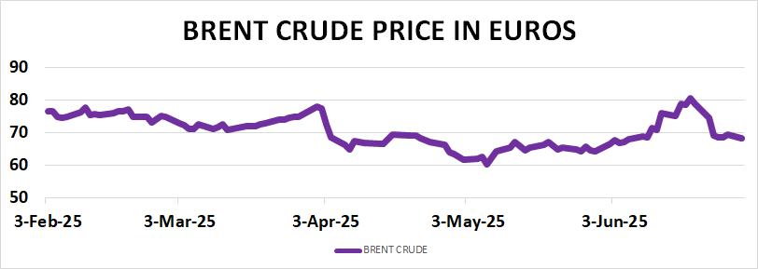
Non frequency representation of data (Line diagram): Example # 01

Slide 22
Non frequency data Time series representation (Line diagram) (contd…) : Example # 02

Slide 23
Non frequency representation of data (Tabular Format) (contd…) : Example # 03
Average Monthly Temp in °F at NY Central Park (Data: https://www.weather.gov/)
Year | Jan | Feb | Mar | Apr | May | Jun | July | Aug | Sep | Oct | Nov | Dec
2010 | 32.5 | 33.1 | 48.2 | 57.9 | 65.3 | 74.7 | 81.3 | 77.4 | 71.1 | 58.1 | 47.9 | 32.8
2011 | 29.7 | 36.0 | 42.3 | 54.3 | 64.5 | 72.3 | 80.2 | 75.3 | 70.0 | 57.1 | 51.9 | 43.3
2012 | 37.3 | 40.9 | 50.9 | 54.8 | 65.1 | 71.0 | 78.8 | 76.7 | 68.8 | 58.0 | 43.9 | 41.5
2013 | 35.1 | 33.9 | 40.1 | 53.0 | 62.8 | 72.7 | 79.8 | 74.6 | 67.9 | 60.2 | 45.3 | 38.5
2014 | 28.6 | 31.6 | 37.7 | 52.3 | 64.0 | 72.5 | 76.1 | 74.5 | 69.7 | 59.6 | 45.3 | 40.5
2015 | 29.9 | 23.9 | 38.1 | 54.3 | 68.5 | 71.2 | 78.8 | 79.0 | 74.5 | 58.0 | 52.8 | 50.8
2016 | 34.5 | 37.7 | 48.9 | 53.3 | 62.8 | 72.3 | 78.7 | 79.2 | 71.8 | 58.8 | 49.8 | 38.3
2017 | 38.0 | 41.6 | 39.2 | 57.2 | 61.1 | 72.0 | 76.8 | 74.0 | 70.5 | 64.1 | 46.6 | 33.4
2018 | 31.7 | 42.0 | 40.1 | 49.5 | 66.9 | 71.7 | 77.6 | 78.1 | 70.7 | 57.7 | 44.4 | 40.1
2019 | 32.5 | 36.2 | 41.7 | 55.5 | 62.2 | 71.7 | 79.6 | 75.5 | 70.4 | 59.9 | 43.9 | 38.3

Slide 24
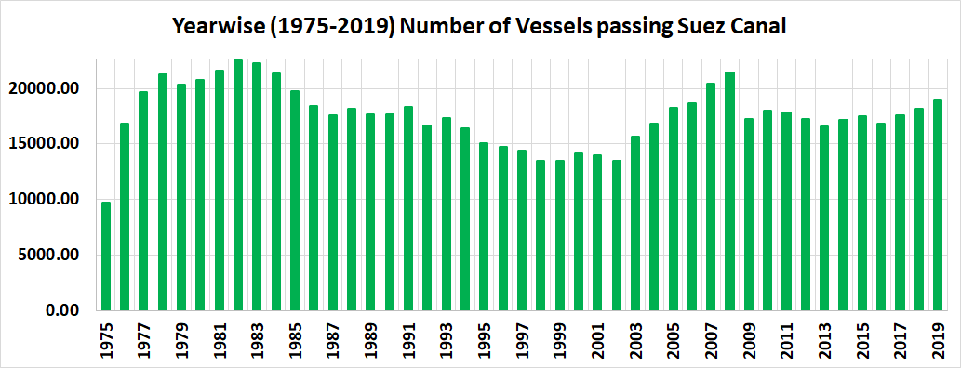
Non frequency representation of data (Histogram) (contd…) : Example # 04

Slide 25
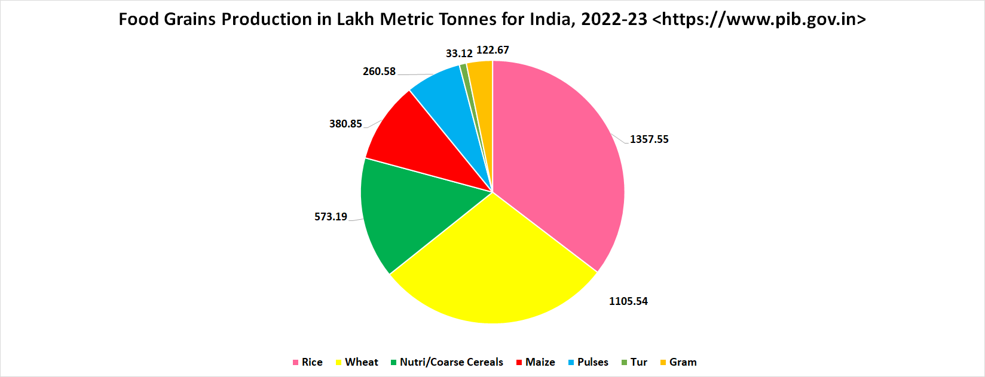
Non frequency representation of data (Pie Chart) (contd…) : Example # 05

Slide 26
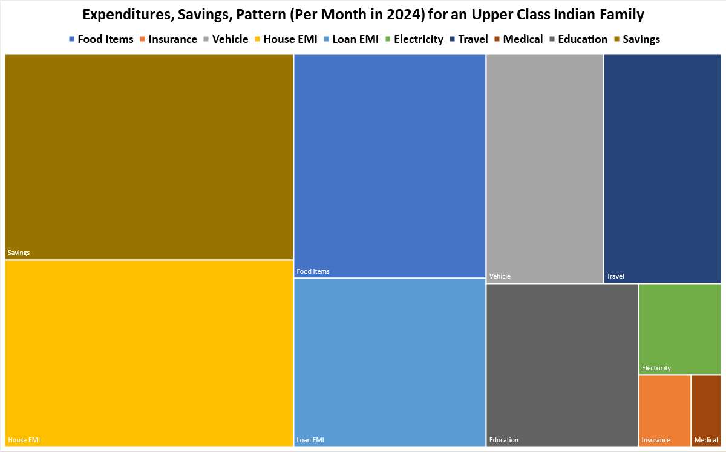
Non frequency representation of data (Tree Map) (contd…) : Example # 06

Slide 27
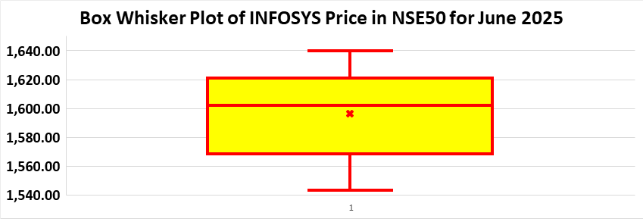
Non frequency representation of data (Box Whisker Plot) (contd…) : Example # 07

Slide 28
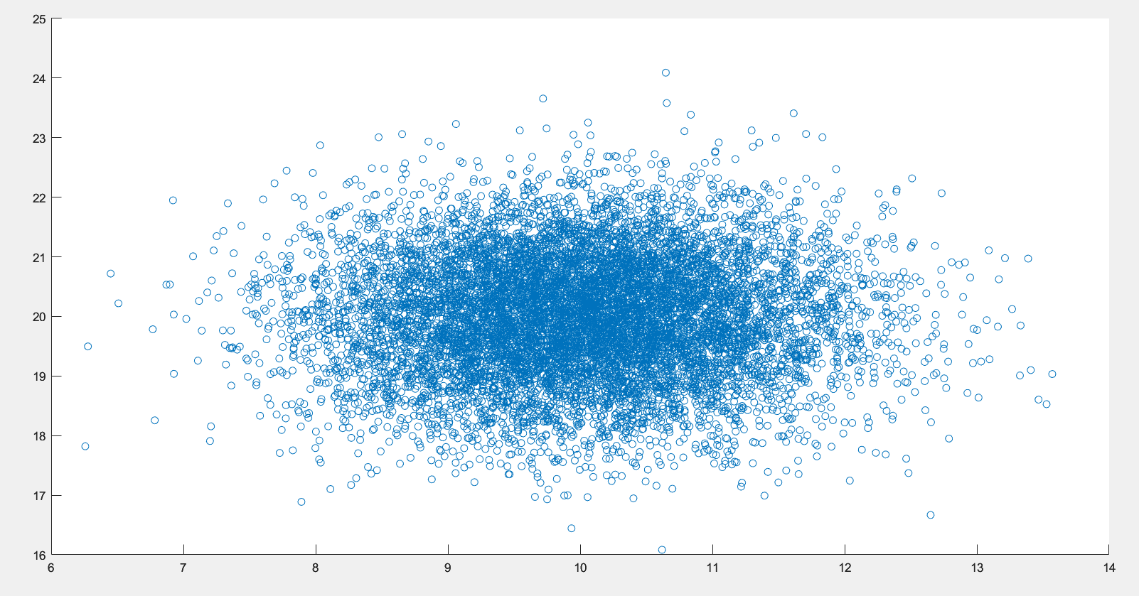
Non frequency representation of data (2D Scatter Plot) (contd…) : Example # 08

Slide 29
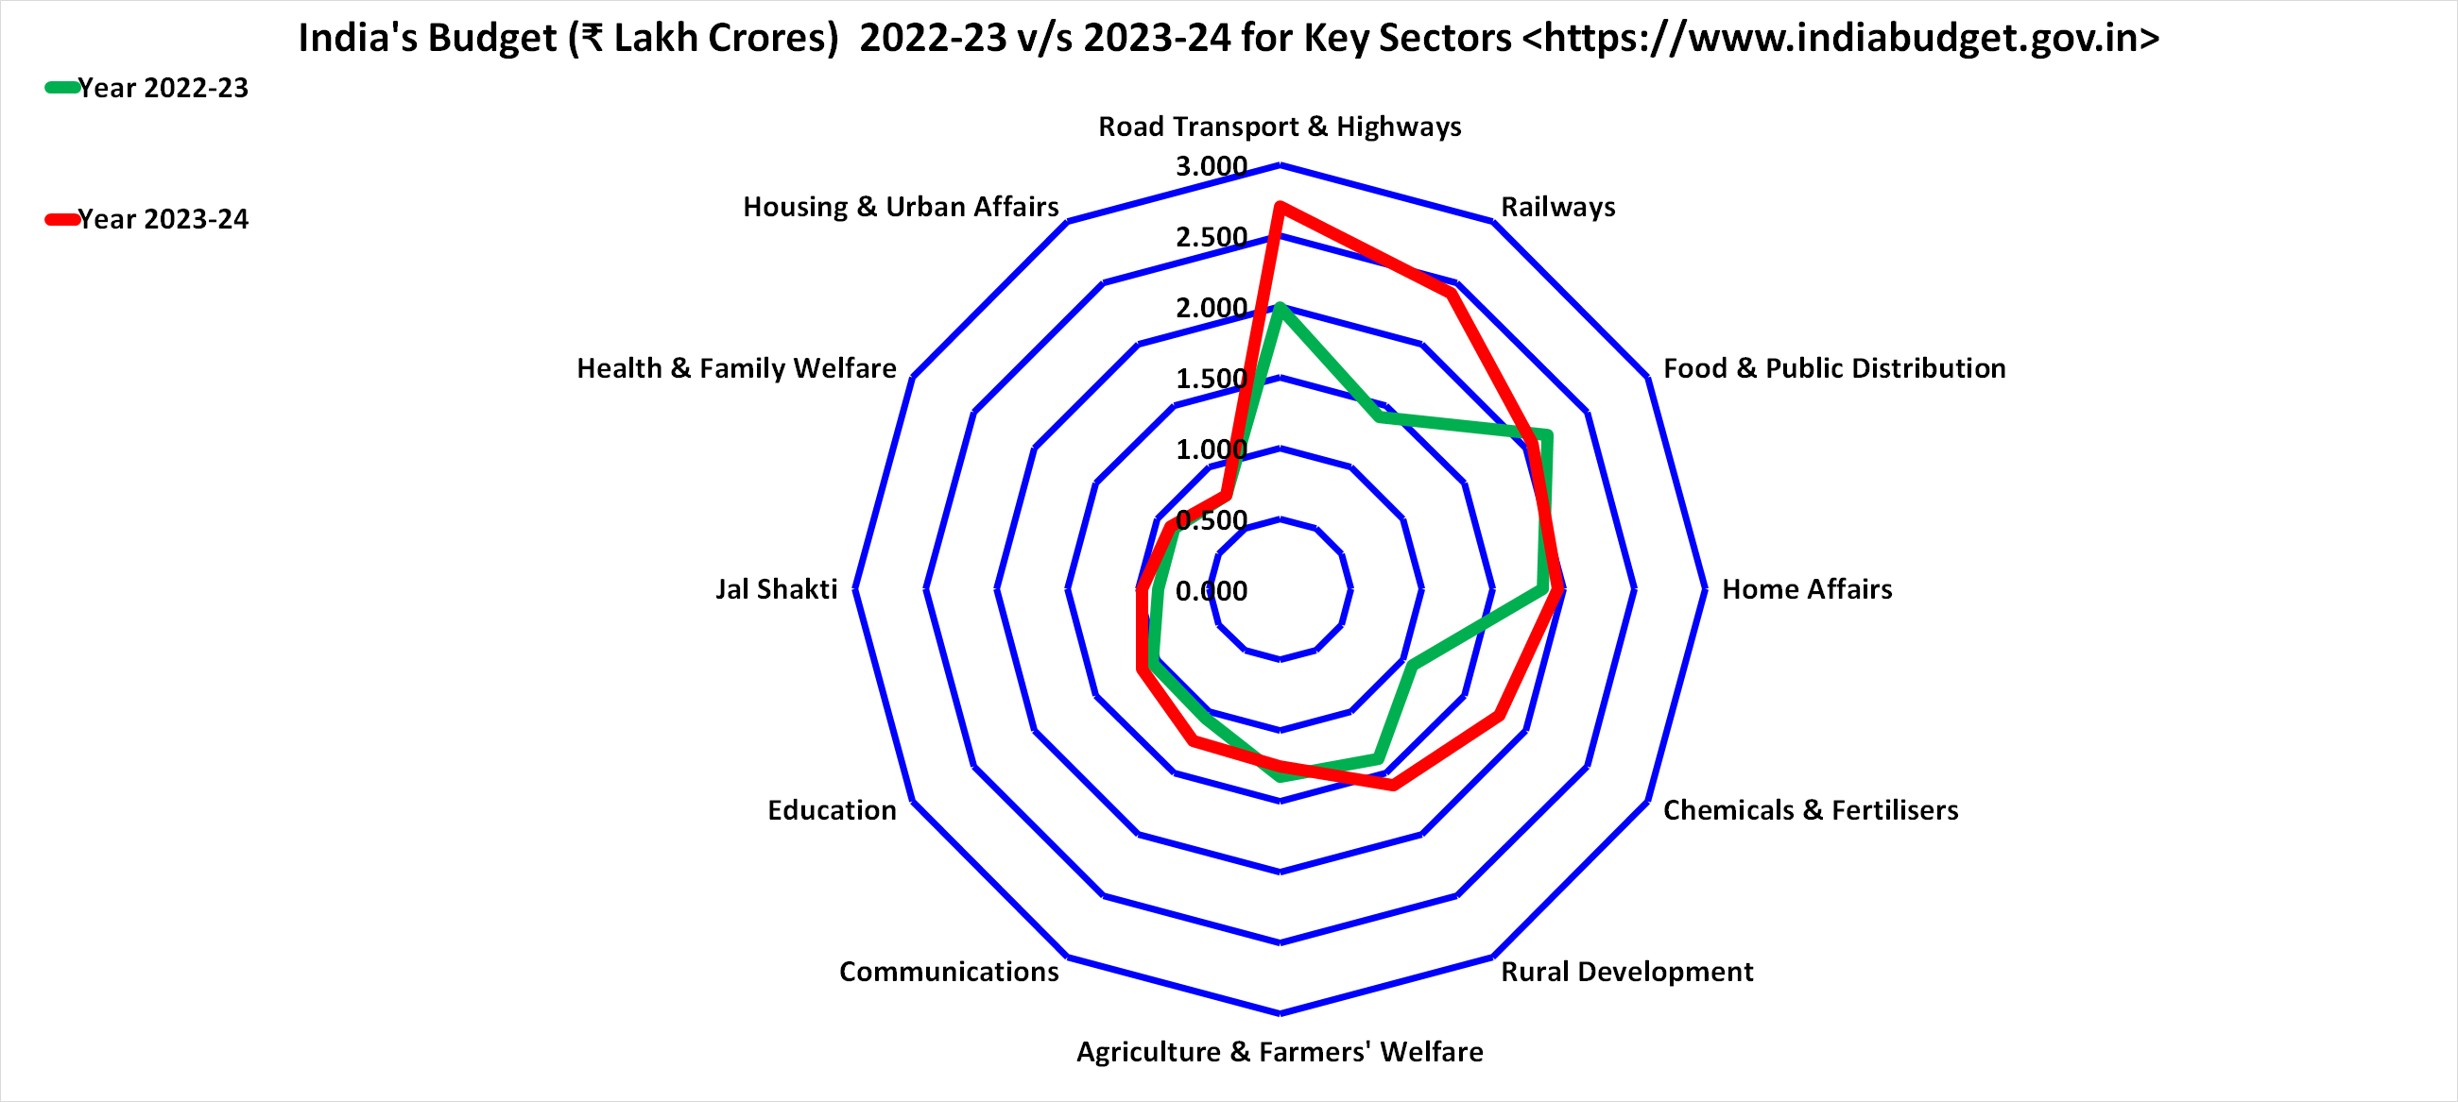
Non frequency representation of data (Radar Plot) (contd…) : Example # 09

Slide 30
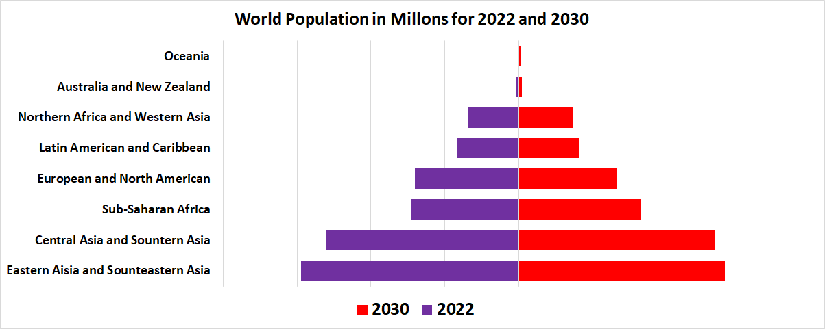
Non frequency representation of data (Population Pyramid) (contd…) : Example # 10

Slide 31
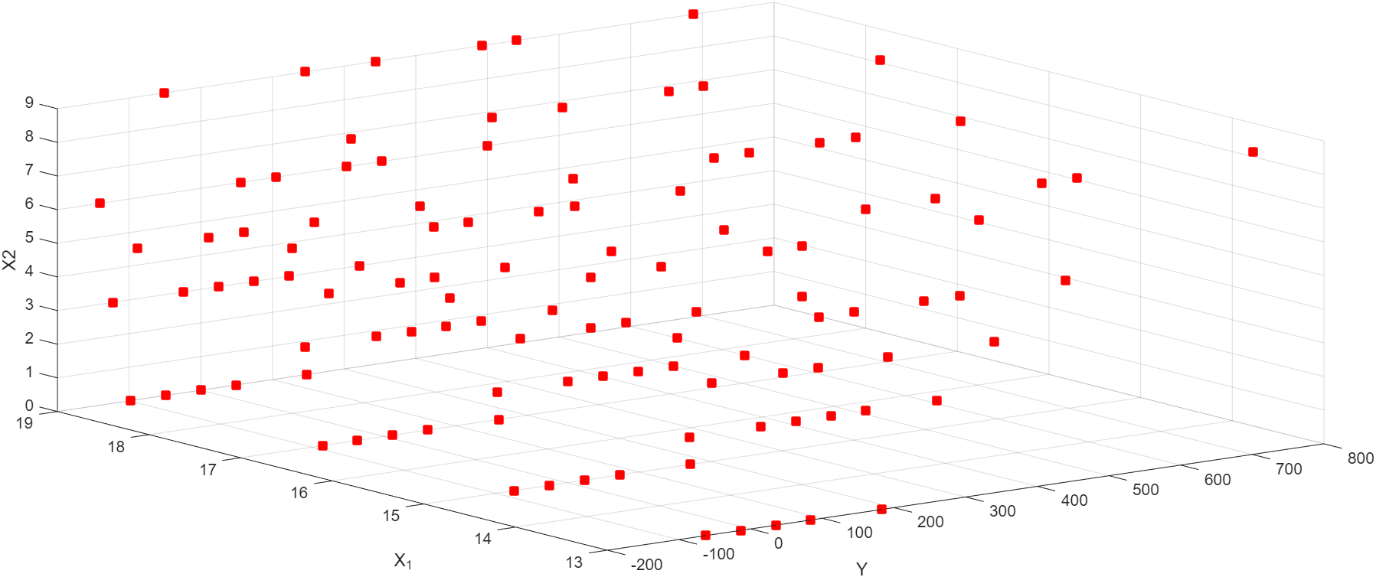
Non frequency representation of data (3D Plot) (contd…): Example # 11

Slide 32
Non frequency representation of data (contd…)
Hierarchical Clustering Dendrogram
Circular Dendrogram
Waterfall Diagram
Surface Plot
Sunburst
Funnel diagram
Stacked plots
Pie to Pie Diagram

Slide 33
Non frequency representation of data (contd…)
Pie to Chart Diagram
Heat Map
Spider Chart
Chernoff Face
Star Diagram
Correlation or Covariance Matrix
Geospatial Graphs

Slide 34
Non frequency data
Spatial series representation of data
It may be that the values of one or more variables are given for different individuals in a group for the same period of time.
But instead of considering the group as such we may be more interested in studying the way the values of the variable(s) change from individual to individual in that group.

Slide 35
Frequency data
We have the data on one or more variables for different individuals for different periods of time or for different points.
But now we are more interested in the characteristic(s) of the group rather than the individuals in that group.
In studying the IQ level of students in a school we may be interested in such group characteristics as the percentage of students with IQ higher than 130 or the percentage of students with average IQ less than 90, etc.

Slide 36
Frequency data: Tabular representation: Example # 12
India at a glance Year
(% of GDP) 1983 1993 2002 2003
Agriculture 36.6 31.0 22.7 22.2
Industry 25.8 26.3 26.6 26.6
Mfg 16.3 16.1 15.6 15.8
Services 37.6 42.8 50.7 51.2
Pvt Consump 71.8 37.4 65.0 64.9
GOI consump 10.6 11.4 12.5 12.8
Import 8.1 10.0 15.6 16.0
Domes save 17.6 22.5 24.2 22.2
Interests paid 0.4 1.3 0.7 18.3
Note: 2003 refers to 2003-2004; data are preliminary. Gross domestic savings figures are taken directly from India′s central statistical organization.

Slide 37
Frequency data: Diagrammatic representation
This is the most commonly used for representing time series. The line diagram (also called histogram) is a graph showing the relationship of the given variable with time.
There may be three types of line diagram, for the scales used for both the axes of co-ordinates may be arithmetic (or natural) scales, or one of them may be arithmetic and the other logarithmic, or both may be logarithmic.
A line diagram where the vertical scale is logarithmic but the horizontal scale is of the ordinary arithmetic type is called a ratio chart or semi-logarithmic chart.
When both the vertical as well as the horizontal axes are logarithmic then the chart is called the doubly-logarithmic chart.

Slide 38
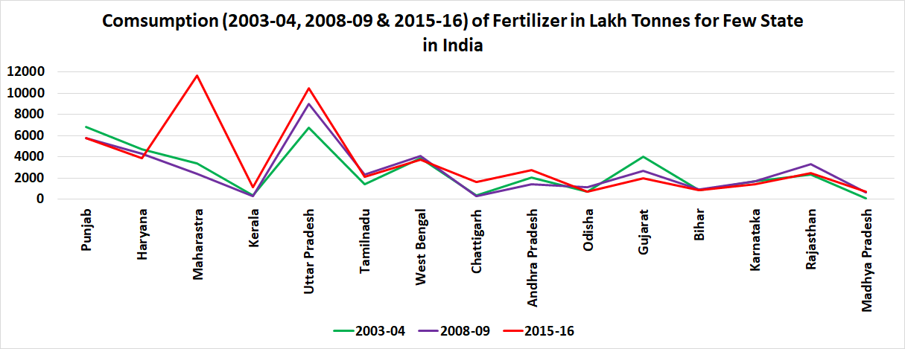
Frequency data: Line diagram representation: Example # 13

Slide 39
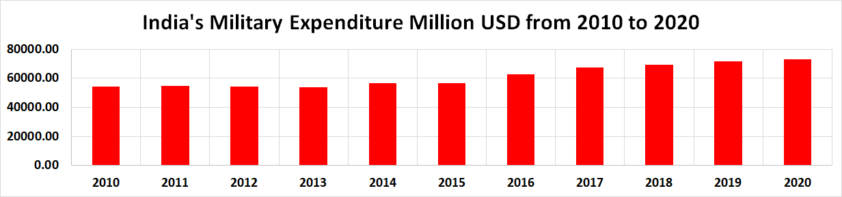
Frequency data: Bar diagram (vertical histogram) representation: Example # 14

Slide 40
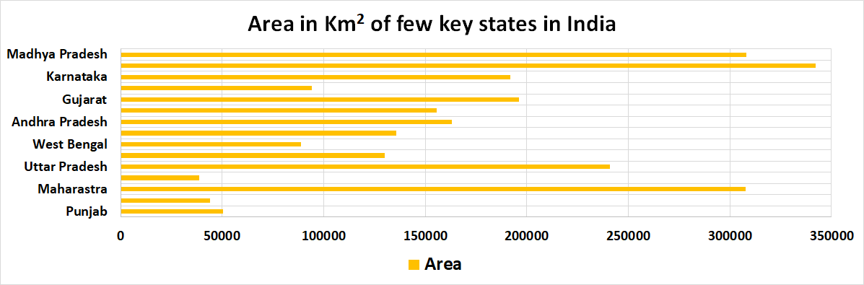
Frequency data: Bar diagram (horizontal histogram) representation: Example # 15

Slide 41
Frequency data
Pictorial diagram representation
In this type of presentation we can represent the data more vividly and in many a cases it is the popular method of representing the data.
A suitable symbol is first chosen to represent a definite number/quantities of units of the variable.
Against each data or observation the symbol is represented proportionally so that we can get the idea of the variable quantities against that data point.

Slide 42
Frequency data
Pictorial diagram representation (contd…) : Example # 16
Number of universities in the following states in USA (each ∏ symbol represents 5 universities
States | Numbers
Alabama | ∏ ∏ ∏ ∏ ∏ ∏
Alaska | ∏
Arizona | ∏ ∏ ∏
Arkansas | ∏ ∏ ∏ ∏
Colorado | ∏ ∏ ∏ ∏ ∏
Connecticut | ∏ ∏ ∏ ∏ ∏
Delaware | ∏
Kansas | ∏ ∏ ∏ ∏ ∏ ∏

Slide 43
Frequency data
Statistical map representation (contd…) : Example # 17
Shown here diagrammatically is the regional seismicity in Alaska of earthquakes of all magnitudes reported between 01/01/1960 to 11/09/2002.
The colour code as shown indicates the depth of the event. Thus blue: 0 < h ≤ 33 km, green: 33 < h ≤ 75 km, red: 75 < h <= 125 km and yellow : h > 125 km.
The larger circles are earthquakes of M 7.0 and higher from 1900-11/09/2002. The colour of circle indicates the depth of the event, as above.
The star indicates the location of the 03/11/2002

Slide 44
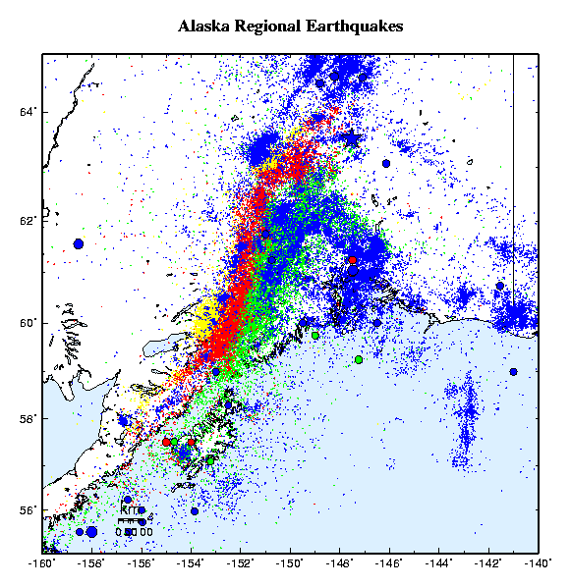
Frequency data
Statistical map representation (contd…): Example # 17

Slide 45
Frequency data Divided Bar diagram representation (contd…): Example # 18
Consider we have the time spent in hours by student appearing for the CBSE examination for the preparation of Mathematics, Physics, Chemistry, Biology, Vernacular and English.
We collect the student's preparation pattern for a five day period and want to represent the data thus obtained.
In that case we would use the divided bar diagram as illustrated below.

Slide 46
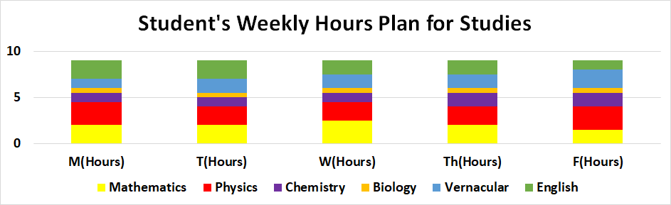
Frequency data Divided Bar diagram representation (contd…): Example # 18(a)

Slide 47
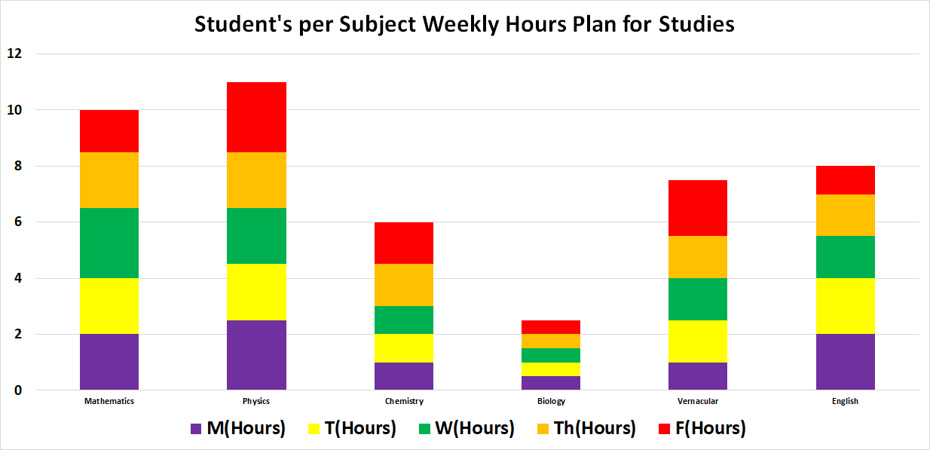
Frequency data Divided Bar diagram representation (contd…): Example # 18(b)

Slide 48
Frequency data Stacked Column diagram representation (contd…): Example # 19
The method of depicting the data is almost similar to the divided bar diagram representation, but here we represent the percentage wise figures for the variables for each data point.
Consider we are have the expenditure in rupees for the four main categories for a family in the months of January to June.
Remembering that the total amount spent for each month can be different, we depict the percentage wise consumption in food for the four categories.

Slide 49
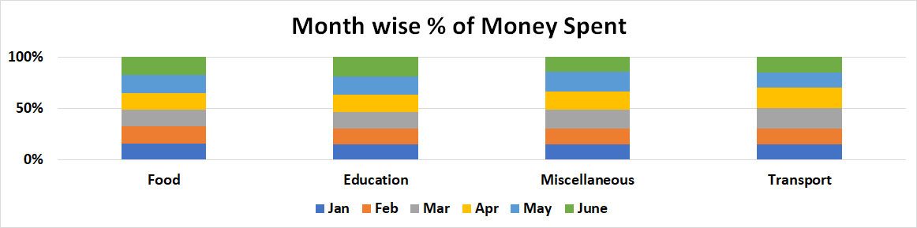
Frequency data Stacked Column bar representation (contd…): Example # 19(a)

Slide 50
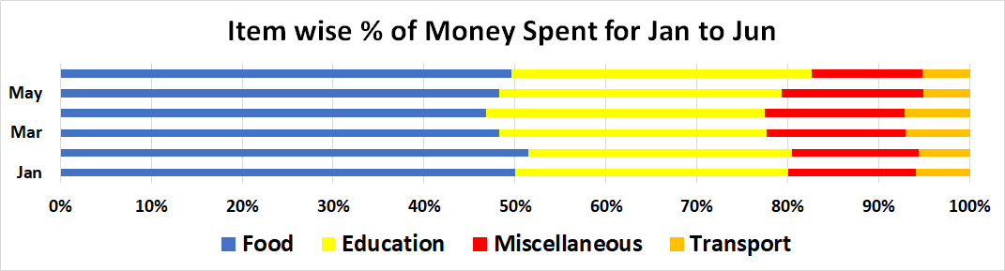
Frequency data Stacked Horizontal bar representation (contd…): Example # 19(b)

Slide 51
Frequency data Pie Chat/diagram representation (contd…) : Example # 20
When the values of a variable are given for a number of categories, as in spatial series, we may be interested in a comparison of the categories or series or the contribution of each category to the total.
Here the proportions or percentages of various categories, rather than the absolute values for the categories, will be the principal subject of study.

Slide 52
Frequency data Pie Chat/diagram representation (contd…) : Example # 20

Slide 53
Frequency data Textual representation (contd…) : Example # 21
In textual representation of data we depict the information through text.
Consider for the year 2004-2005 we know the number of post graduate students who have registered in different engineering course at IIT Kanpur.
The figures are 83 in Aerospace, 88 in Chemical, 139 in Civil, 222 in Electrical, 176 in Mechanical, 115 in Computer Science.
Given this data we may be required to utilize this information to answer some queries.

Slide 54
Frequency data Stem Leaf Diagram representation (contd…) : Example # 22
The stem and leaf representation is a quick way of looking at the data set.
It contains the information of a histogram but avoids the loss of information in a histogram that results from aggregating the data into intervals.
The stem and leaf display is based on the tallying principle but also uses the decimal base of our number system.
In the steam and leaf representation, the stem is the number without its rightmost digit (the leaf).
The steam is written to the left of a vertical line separating the steam from the leaf.
Suppose we have the numbers 105, 106, 107, 109, 100, 108.
Then if we use the steam and leaf representation we would depict the numbers as 10 | 567908

Slide 55
Frequency data Box Whisker Plot representation (contd…)
The box plot is also called the box whisker plot.
A box plot is a set of five summary measures of distribution of the data which are
  Median
  1st quartile (lower quartile)
  3rd quartile (upper quartile)
  Smallest/minimum observation/x₍₁₎ = min_{∀x1,…, xn}(X₁, …, X_{n}}
  Largest/maximum observation/x_{(n)} = max_{∀x1,…, xn}(X₁, …, X_{n}}

Slide 56
Frequency data Box Whisker Plot representation (contd…)
X = (6, 4, 2, 23, 43, 40, 102, 98, 125, 50, 50, 62, 50, 23, 75, 45)
Median = 47.5
1st quartile (lower quartile) = 23.0
3rd quartile (upper quartile) = 68.5
Smallest/minimum observation/x₍₁₎ = 2
Largest/maximum observation/x_{(n)} = 125

Slide 57
Frequency data Box Whisker Plot representation (contd…)
BOX
Minimum
Maximum
Whisker
LQ
Median
UQ

Slide 58
Frequency data Box Whisker Plot representation (contd…)
Here:
UQ – LQ = Inter quartile range (IQR)
X = Smallest observation within 1.5(IQR) of LQ
Y = Largest observation within 1.5(IQR) of UQ

Slide 59
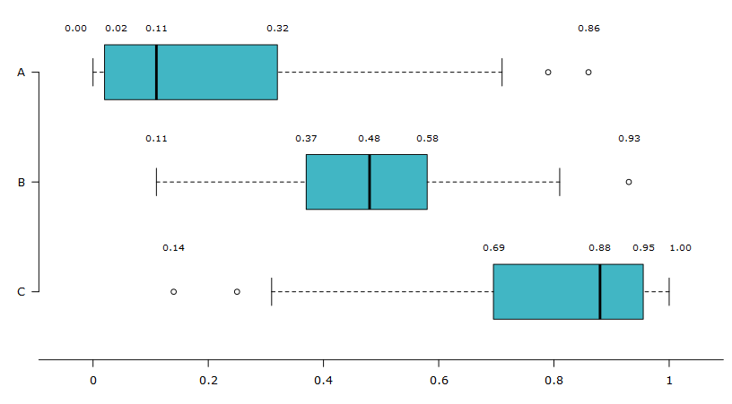
Frequency data Box Whisker Plot representation (contd…) : Example # 23

Slide 60
Definitions
Quantitative variable: It can be described by a number for which arithmetic operations such as averaging make sense. The measurements are the actual numerical values of a variable.
Qualitative (or categorical) variable: It simply records a qualitative, e.g., good, bad, right, wrong, etc. Qualitative variables could be described by numbers, although such a description might be arbitrary, e.g., good = 1, bad = 0, right = 1, wrong = 0, etc.

Slide 61
Scales of measurement
Nominal scale: In this scale numbers are used simply as labels for groups or classes.
If we are dealing with a data set which consists of colours blue, red, green and yellow, then we can designate blue = 3, red = 4, green = 5 and yellow = 6.
We can state that the numbers stand for the category to which a data point belongs.
It must be remembered that nothing is sacrosanct regarding the numbering against each category.
This scale is used for qualitative data rather than quantitative data.

Slide 62
Scales of measurement (contd…)
Ordinal Scale: In this scale of measurement, data elements may be ordered according to relative size or quality.
For example a customer or a buyer can rank a particular characteristics of a car as good, average, bad and while doing so he/she can assign some numeric value which may be as follows, characteristic good = 10, average = 5 and bad = 0.

Slide 63
Scales of measurement (contd…)
Interval Scale: For the interval scale we specify intervals in a way so as to note a particular characteristic, which we are measuring and assign that item or data point under a particular interval depending on the data point.
Consider we are measuring the age of school going students between classes 5 to 12 in the city of Kanpur.
We may form intervals 10-12 years, 12-14 years,....., 18-20 years.
Now when we have one data point, i.e., the age of a student we put that data under any one particular interval, e.g., if the student's age is 11 years, we immediately put that under the interval 10-12 years.

Slide 64
Scales of measurement (contd…)
Ratio Scale: If two measurements are in ratio scale, then we can take ratios of measurements.
The ratio scale represents the reading for each recorded data in a way which enables us to take a ratio of the readings in order to depict it either pictorially or in figures.
Examples of ratio scale are measurements of weight, height, area, length etc.

Slide 65
Definitions (contd…)
Population: Consists of the set of all measurements in which the investigator is interested.
Example can be all the students in the city of Kanpur. The population is also called the universe.
A population is denoted by N
Sample: Is a subset of measurements selected from the population.
Sampling from the population is often done randomly, such that every possible sample of n elements will have an equal chance of being selected.
A sample selected in this way is called a simple random sample or just a random sample.
Example can be the students in Kendriya Vidalaya inside IIT Kanpur campus.
A sample is denoted by n

Slide 66
Definitions (contd…)
Tally number: By tally number we mean the tally we give depending upon the number of times that particular value of the variable occurs in the total universe or sample.
Frequency (absolute frequency)
  By frequency (absolute frequency) we mean the number of data points which fall within a given class or for a given value in a frequency distribution.
  It means that it denotes the number of occurrence or happening of a particular outcome.
  We denote frequency (absolute frequency) with f_{i}.

Slide 67
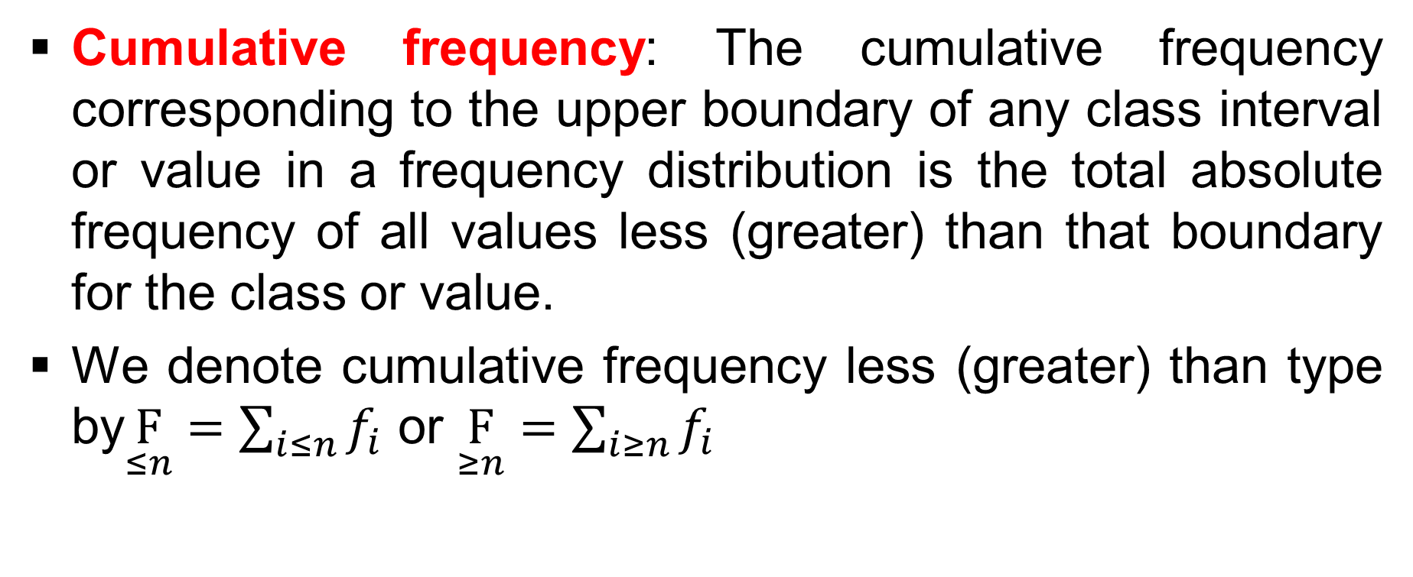
Definitions (contd…)

Slide 68
Example # 24
Consider we have the following data related to the size in numbers of thirty families in the city of Jaipur.
2, 6, 3, 4, 4, 5, 3, 6, 4, 4, 5, 3, 2, 3, 6, 5, 4, 4, 4, 3, 2, 4, 5, 6, 7, 4, 4, 5, 3, 3.
Now the question is how do we represent the data using tally numbers, frequencies, cumulative frequencies?

Slide 69
Example # 24 (contd…)
# of members | Tally # | f_{i} | F_{≤n} | F_{≥n}
2 | III | 3 | 3 | 30
3 | IIII II | 7 | 10 | 27
4 | IIII IIII | 10 | 20 | 20
5 | IIII | 5 | 25 | 10
6 | IIII | 4 | 29 | 5
7 | I | 1 | 30 | 1

Slide 70
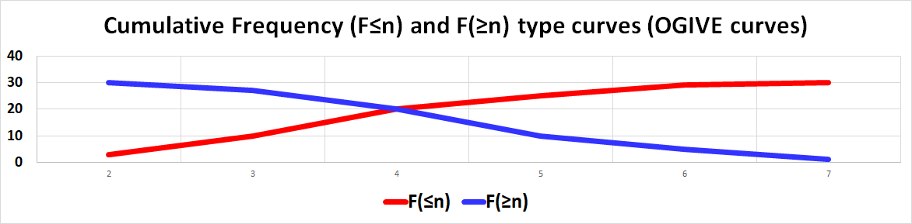
Example # 24 (contd…)

Slide 71
Example (contd…)
A cumulative frequency diagram is called the ogive.
The abscissa of the point of intersection represents the median of the data.

Slide 72
Guidelines for depicting frequency tables
The classes should be mutually exclusive and exhaustive
The number of classes should be neither too small not too large
As far as practicable, the classes should be of equal lengths

Slide 73
Example # 25
The following data relates to the height in cms of forty individuals.
160.1, 167.2, 181.3, 154.7, 172.3, 161.3, 182.4, 158.2, 167.3, 159.4, 150.1, 157.3, 152.8, 155.8, 146.0, 162.0, 147.9, 149.9, 173.4, 166.4, 182.3, 151.2, 168.3, 170.1, 187.6, 163.4, 183.3, 171.9, 179.4, 166.8, 179.2, 168.3, 165.2, 166.7, 165.1, 166.3, 166.3, 173.4, 164.2, 164.9
We are required to prepare a frequency distribution table showing the frequencies and the cumulative frequencies.
We are required to draw a histogram to exhibit the frequency distribution graphically.
We are required to draw the two ogives.

Slide 74
Example # 25 (contd…)
Frequency table for the heights
Class Interval | f_{i} | CF(F_{≤n}) | CF(F_{≥n})
145.95-152.95 | 6 | 6 | 40
152.95-159.95 | 5 | 11 | 34
159.95-166.95 | 13 | 24 | 29
166.95-173.95 | 9 | 33 | 16
173.95-180.95 | 2 | 35 | 7
180.95-187.95 | 5 | 40 | 5

Slide 75
Example # 25 (contd…)
To draw the cumulative frequency less (greater) than type, first specify the class intervals.
Then depict the class intervals along the horizontal axis and the cumulative frequency less (greater) than type along the vertical axis.
Against each class interval mark the point by the corresponding cumulative frequency less (greater) than type value.
Join the points (the values) depicting the cumulative frequencies less (greater) than type with straight lines, which will give us the respective ogives

Slide 76
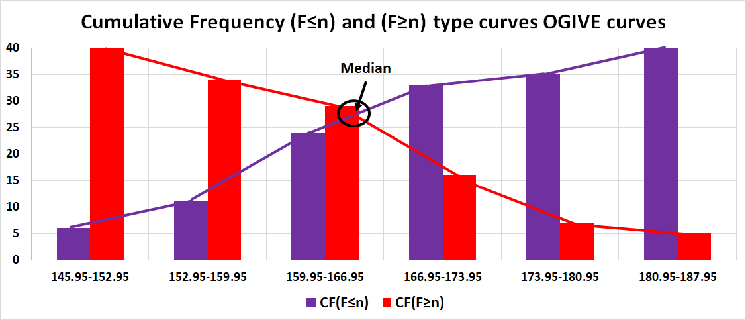
Example # 25 (contd…)

Slide 77
Definitions
Class limit: The end points of any class
Class boundaries: The end points of any class interval
Relative frequency: It is the ratio of (f_{𝑖} /∑f_{𝑖}) = (f_{𝑖}/F)
Note: Using this concept of relative frequency and cumulative relative frequency less (greater) than type we can also draw the cumulative relative frequencies curves

Slide 78
Definitions: Different measures
Measure of central tendency
  Mean (Arithmetic mean (AM), Geometric mean (GM), Harmonic mean (HM))
  Median
  Mode
Measure of dispersion
  Variance or Standard deviation
  Skewness
  Kurtosis

Slide 79
Definitions: Different measures (contd…)
Given n number of observations, x₁,….., x_{n} we define the following
  Arithmetic Mean (AM) = (1/n)(x₁ + … + x_{n})
  Geometric Mean (GM) = (x₁ * …. * x_{n})^{(1/n)}
  Harmonic Mean (HM) = n/(1/x₁ + …. 1/x_{n})

Slide 80
Definitions: Different measures (contd…)
HM is the reciprocal of the AM of the reciprocals, and vice versa, i.e., HM(x₁,…, x_{n}) = 1/AM(x₁,…, x_{n}) and AM(x₁,…, x_{n}) = 1/HM(x₁,…, x_{n})
Normalized values: The fundamental property of the GM, which does not hold for any other mean, is that for two sequences X = (x₁,…, x_{n}) and Y = (y₁,…, y_{n}) of equal length, GM(X_{i}/Y_{i}) = GM(X_{i})/GM(Y_{i})

Slide 81
Definitions: Different measures (contd…)
The relationship between AM, GM, and HM for a set of positive numbers is expressed as AM ≥ GM ≥ HM, where equality holds only when all the numbers in the set are identical.
Additionally, GM² = (AM)(HM)

Slide 82
Arithmetic Mean
When estimating the long-term expectation of a random variable, the arithmetic mean is a natural choice, e.g. finding the average age of a group of persons, average income of a group of people etc.
X = (2, 3, 4, 5, 10), them AM = (1/5)(2+3+4+5+10) = 4.8

Slide 83
Geometric Mean
Used for Average proportional growth rate, Aspect ratios, Paper formats
Suppose you have an investment, P, which earns 10% the first year, 50% the second year, and 30% the third year and we are interested in finding an equivalent average rate of return, say r
Then: P(1+0.1)(1+0.5)(1+0.3) = P(1+r)³ from where we get r = 28.97%

Slide 84
Harmonic Mean
Used for Average speed, design stream flow estimation for waste load allocation, Density of alloy, Electricity, Optics, Estimation of effective petrochemical and geophysical properties of a heterogeneous system of porous media
Consider a car travels a distance d with a velocity of v₁ = 50 km/hr and returns back the same distance with a velocity of v₂ = 60 km/hr
  We are to find the average velocity, v_{A}
  v_{A} = 2d/{(d/v₁) + (d/v₂)} = 2/{(1/50) + (1/60)} = 54.55 km/hr
If d₁,…, d_{k} are the respective distances and v₁,…., v_{k} are average velocities then the overall average velocity is [(d₁ +….+ d_{k})/{(d₁/v₁) + …. + (d_{k}/v_{k})}]

Slide 85
Median
Median: The median of a data set is the value below which lies half of the data points. To find the median we use F(x_{median}) = 0.5.
X = (2, 42, -12, 10, 42, -12, 6, 10, 6, 2, 2, 2, 2, 10, 2, -42, -42)
X_{median} = 2

Slide 86
Mode
Mode: The mode of a data set is the value that occurs most frequently. Hence f(x_{mode}) ≥ f(x); ∀ x.
X = (2, 42, -12, 10, 42, -12, 6, 10, 6, 2, 2, 2, 2, 10, 2, -42, -42)
X_{mode} = 2

Slide 87
Comparison of Mean, Median, Mode
X = (6, 4, 2, 23, 34, 4, 102, 95, 75, 55, 55, 62, 50, 25, 87, 55)
  Average of X = 45.875
  Median of X = 52.500
  Mode of X = 55
  Minimum of X = 2
  Maximum of X = 102
Y = (6, 4, 2, 23, 43, 40, 102, 98, 100, 50, 55, 62, 50, 25, 100, 5)
  Average of Y = 47.813
  Median of Y = 46.500
  Mode of Y = 100
  Minimum of Y = 2
  Maximum of Y = 102
Compare the Average values of X and Y
Compare the Median values of X and Y

Slide 88
Comparison of Mean, Median, Mode (Contd…)
Difference of (X−Y) = (0, 0, 0, 0, −9, −36, 0, −3, −25, 5, 0, 0, 0, 0, −13, 50)
  Average of (X−Y) = −1.938
  Median of (X−Y) = 0
  Mode of (X−Y) = 0
  Minimum of (X−Y) = −36
  Maximum of (X−Y) = 50

Slide 89
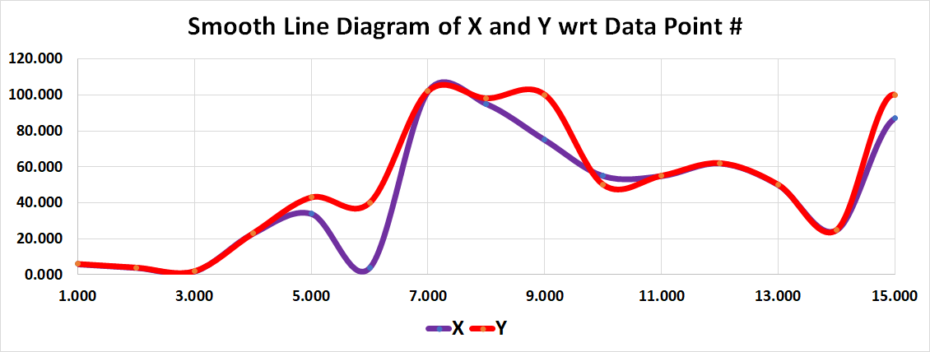
Comparison of Mean, Median, Mode (Contd…)

Slide 90
Variance, Standard deviation
Variance of sample: s² = (1/n){(x₁ − AM)² + ..... + (x_{n} - AM)²}, though not the right formulae, σ² = E{X − E(X)}² for population and based on σ² we find s², which we will see later.
Standard deviation of sample, called Standard Error SE(X): s = [(1/n){(x₁ − AM)² + ..... + (x_{n} − AM)²}]^{(1/2)}, though not the right formulae, as σ = [E{X − E(X)}²]^{(1/2)} for population and based on σ² we find s², and then s, which we will see later.

Slide 91
Variance, Standard deviation (contd…)
X = (10, -20, -32, 12, 2, 4, 9, -12, 10, 30, 40)
AM = (1/11)(10 +….+ 40) = 53/11 = 4.818
s² = (1/11){(10 – 4.818)² + ….. + (40 – 4.818)²} = 387.058
s = 19.674

Slide 92
Skewness
Skewness (Fisher definition): γ₁ = E[{X - E(X)}/σ}³] = E[{X – E(X)}³]/[E{X – E(X)}²]^{3/2}.
X = (-20, -20, -40, 50, 60, 70, 80, 10, 10, 10, 20).
AM = (1/11)(-20 + …. + 20) = 230/11 = 20.909.

Slide 93
Skewness (contd…)
V(X) = (1/11){(-20 – 20.909)² + ….. + (20 – 20.909)²} = 15690.909/11 = 1426.446
E[{X – E(X)}³] = (1/11){(-20 – 20.909)³ + ……. + (20 – 20.909)³} = 3836.213.
γ₁ = 3836.213/(1426.446)^{(3/2)} = 0.071.

Slide 94
Kurtosis
Kurtosis: γ₂ = E[{X - E(X)}/σ}⁴] = E[{X – E(X)}⁴]/[E{X – E(X)}²]²
X = (-20, -20, -40, 50, 60, 70, 80, 10, 10, 10, 20).
AM = (1/11)(-20 + …. + 20) = 230/11 = 20.909.

Slide 95
Kurtosis (contd…)
V(X) = (1/11){(-20 – 20.909)² + ….. + (20 – 20.909)²} = 15690.909/11 = 1426.446
E[{X – E(X)}⁴] = (1/11){(-20 – 20.909)⁴ + ……. + (20 – 20.909)⁴} = 3678067.072.
γ₂ = 3678067.072/(1426.446)² = 1.808.

Slide 96
Co-Variance
σ_{X,Y} = Cov(X, Y) = E[{X – E(X)}{Y – E(Y)}]
σ_{X,Y} = Cov(X, Y) = E(XY) – E(X)E(Y)
X = (2, 3, 4, 5, 6, 7, 8, 9) and Y (32, 45, –67, 12, 24, 90, 70, –102)
Cov(X, Y) = 50.875 – 5.5*13 = 50.875 – 71.5 = – 20.625

Slide 97
Correlation Coefficient
Cov(X, Y) = E[{X – E(X)}{Y – E(Y)}]
Cov(X, Y) = ρ_{X,Y}σ_{X}σ_{Y}
ρ_{X,Y} = Cov(X, Y)/(σ_{X}σ_{Y}), −1 ≤ ρ_{X,Y} ≤ +1
X = (2, 3, 4, 5, 6, 7, 8, 9) and Y (32, 45, − 67, 12, 24, 90, 70, -102)
σ²_{X} = 5.25
σ²_{Y} = 3788.75
ρ_{X,Y} = − 20.625/{(√5.25)(√3788.75)} = − 0.14624

Slide 98
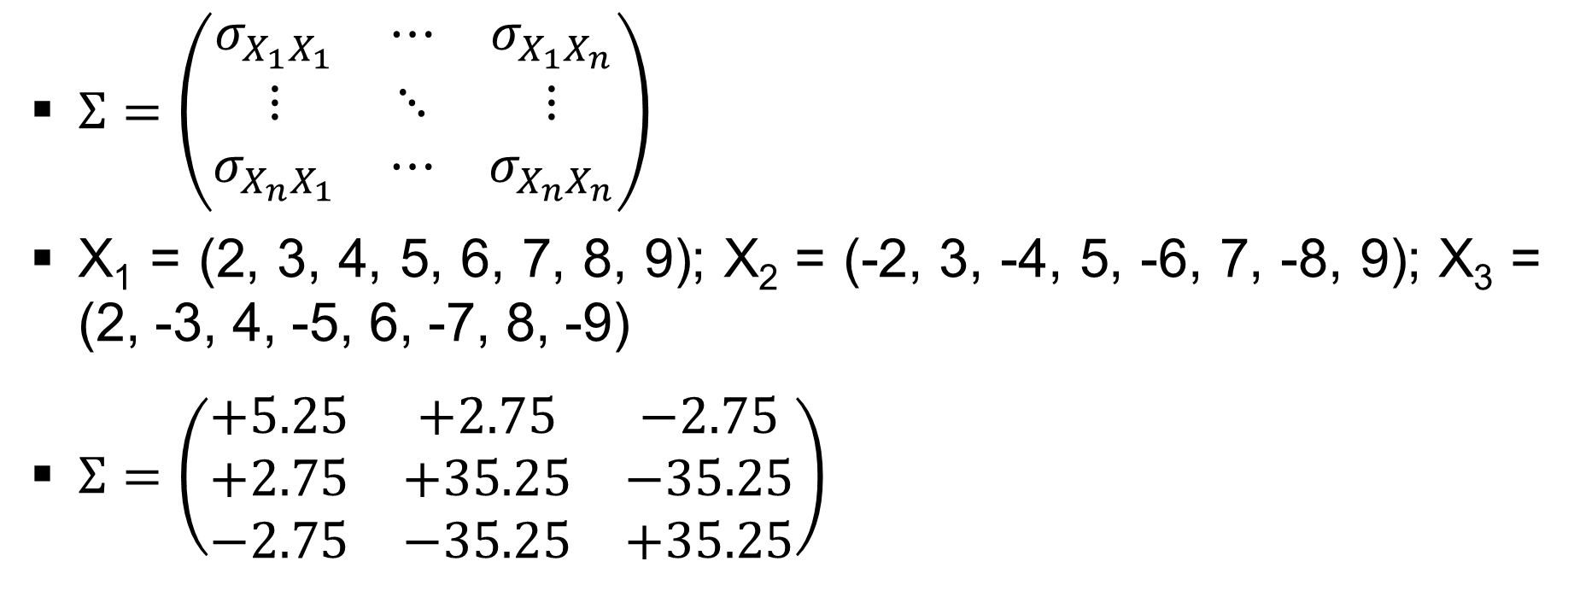
Variance-CoVariance Matrix

Slide 99
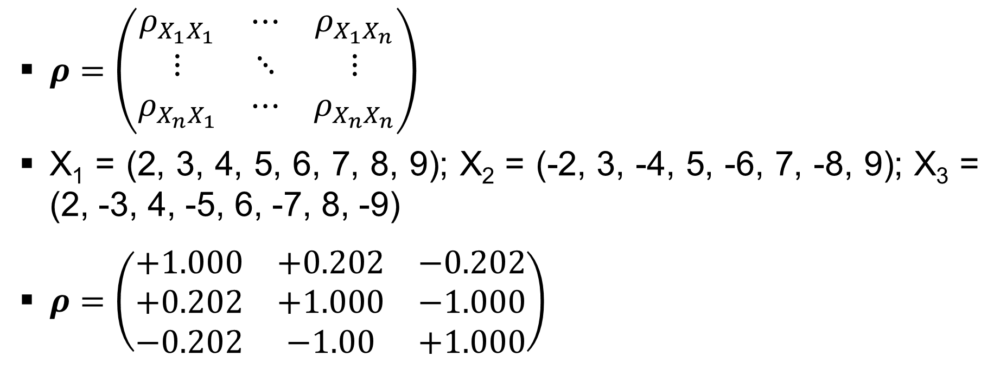
Correlation Matrix

Slide 100
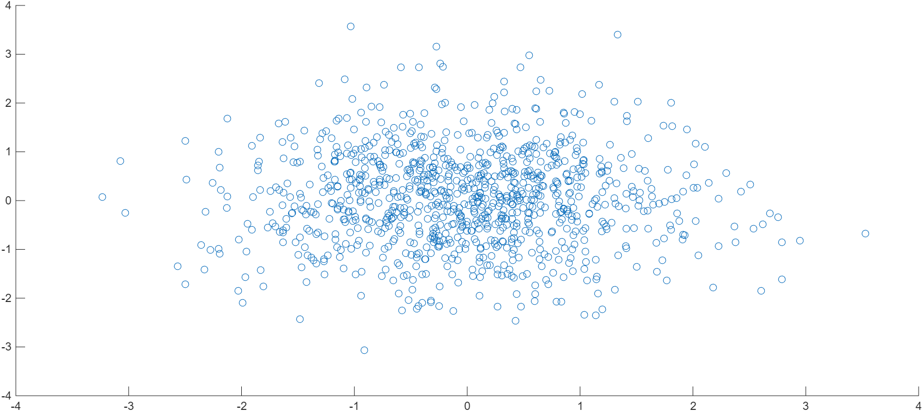
Correlation Coefficient Graph (ρ_{X,Y} ≈ 0)

Slide 101
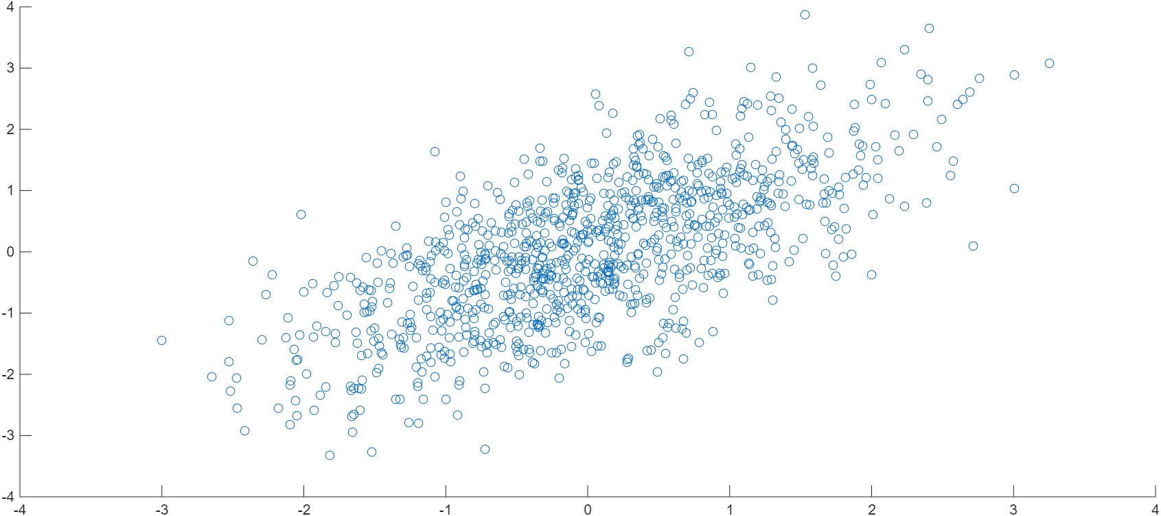
Correlation Coefficient Graph (ρ_{X,Y} = +ve)
Best fit line

Slide 102
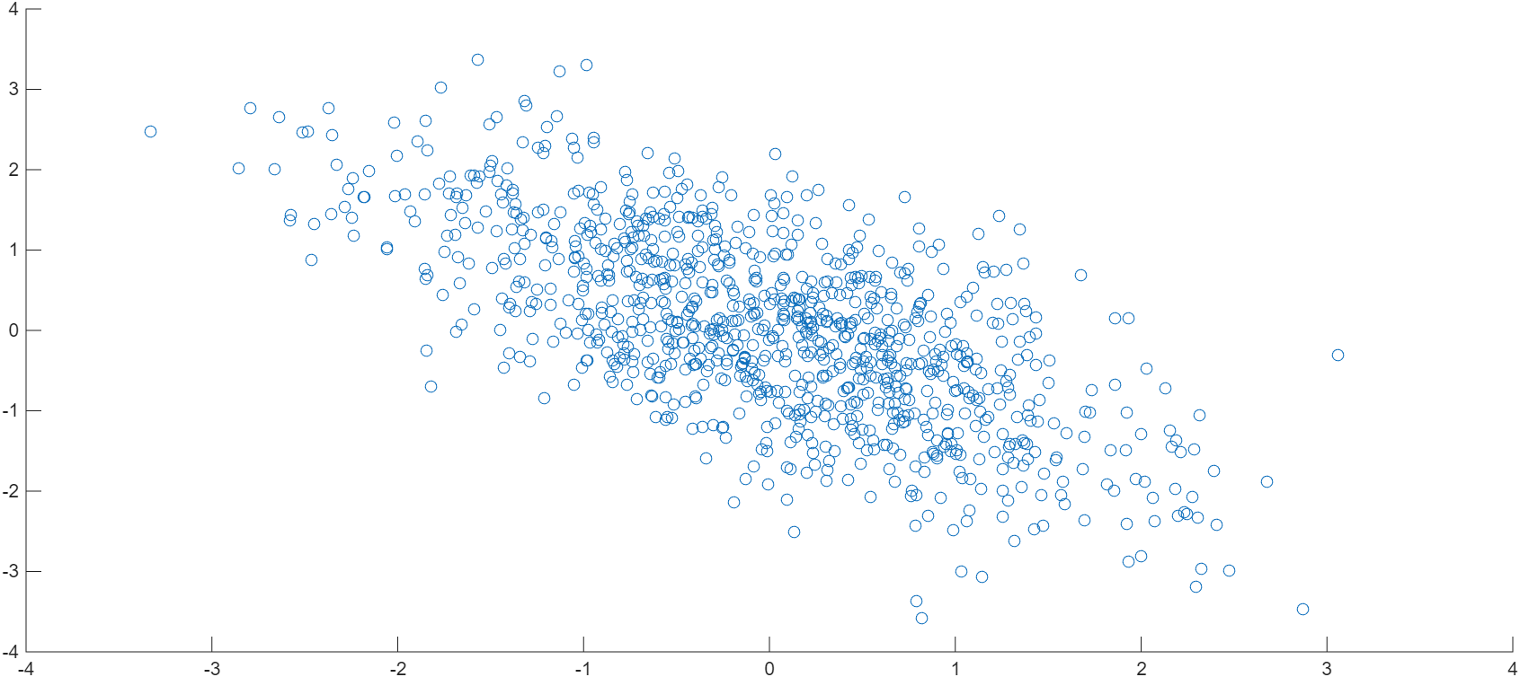
Correlation Coefficient Graph (ρ_{X,Y} = -ve)
Best fit line

Slide 103
Co-Variance,Co-Skewness, Co-Kurtosis
Cov(∑a_{𝑖}X_{𝑖}, ∑b_{𝑗}Y_{𝑗}) = ∑∑a_{𝑖}b_{𝑗}Cov(X_{𝑖},Y_{𝑗})
Co-Skewness(X,Y,Z) = E[{X−E(X)}{Y−E(Y)}{Z−E(Z)}]
Skewness: s_{X,Y,Z} = E[{X−E(X)}{Y−E(Y)}{Z−E(Z)}]/(σ_{X}σ_{Y}σ_{Z})

Slide 104
Co-Variance,Co-Skewness, Co-Kurtosis (contd…)
Co-Kurtosis(U,V,W,X) = E[{U−E(U)}{V−E(V)}{W−E(W)}{X−E(X)}]
Kurtosis: k_{U,V,W,X} = E[{U−E(U)}{V−E(V)}{W−E(W)}{X−E(X)}]/(σ_{U}σ_{V}σ_{W}σ_{X})

Slide 105
Expected Value, Variance
Discrete Case
  E(X) = ∑_{∀x}{xP(X=x)}
  V(X) = ∑_{∀x}{x−E(X)}²P(X=x)
Continuous Case
  E(X) = ∫_{∀x}xf(x)dx
  V(X) = ∫_{∀x}{x−E(X)}²f(x)dx

Slide 106
Expected Value, Variance for discrete r.v
E(X) = ∑_{∀x}xP(X=x)
V(X) = ∑_{∀x}{x − E(X)}²P(X=x) = E(X²) − {E(X)}²
X=(−12, +4, +10, +22) with probabilities (1/2, 1/6, 1/6, 1/6)
E(X) = −12(1/2) + 4(1/6) + 10(1/6) + 22(1/6) = 0
V(X) = (−12 − 0)²(1/2) + (4 − 0)²(1/6) + (10 − 0)²(1/6) + (22 − 0)²(1/6) = 172

Slide 107
Expected Value, Variance for continuous r.v
X ∈ [1, 3] and f(x) = ½
E(X) = ∫_{∀x}xf(x)dx
E(X) = (1/2)∫xdx = (1/2)(x²/2)_{x=1,3} = (1/2)(3²/2 − 1²/2) = (1/2)(9/2 − 1/2) = 8/4 = 2

Slide 108
Expected Value, Variance for continuous r.v
X ∈ [1, 3] and f(x) = ½
V(X) = σ² = ∫_{∀x}{x − E(X)}²f(x)dx = E(X²) − {E(X)}²
V(X) = ∫_{∀x}{x − E(X)}²f(x)dx
V(X) = ∫_{∀x}(x − 2)²f(x)dx
V(X) = ∫_{∀x}(x² − 4x + 4)f(x)dx = (1/2)(x³/3 − 4x²/2 + 4x)|_{x=1,3}
V(X) = (1/2)(27/3 − 36/2 + 12) − (1/2)(1/3 − 2 + 4)
V(X) = (1/2)(9 − 18 + 12) − (1/2)(1/3 − 2 + 4) = 3/2 − 7/6 = 1/3

Slide 109
Descriptive statistics
Suppose the data are available in the form of a frequency distribution.
Assume there are K (𝑗 = 1,…, K) classes
Observations in 𝑗^{th} class are X_{𝑗,1}, …., X_{𝑗,f𝑗} with corresponding frequencies n_{𝑗,1}, …, n_{𝑗,f𝑗} such that n_{𝑗,1}+ …+ n_{𝑗,f𝑗} = n_{𝑗}.
n₁ + …. + n_{K} = n.
n_{𝑗,1} + .… + n_{𝑗,f𝑗} = n_{𝑗}, for 𝑗 = 1,…, K.

Slide 110
Descriptive statistics (contd…)
Corresponding AMs are AM_{𝑗} = (1/n_{𝑗})(n_{𝑗,1}X_{𝑗,1}+ ….+ n_{𝑗,f𝑗}X_{𝑗,f𝑗}).
AM_{combined} = {1/(n₁ + .. +n_{K})}{ (n_{1,1}X_{1,1}, …., n_{1,f1}X_{1,f1}) + … + (n_{K,1}X_{K,1}, …., n_{K,fK}X_{K,fK})}.
AM_{combined} = (1/n){(AM₁)(n₁) + ….. + (AM_{K}) (n_{K})}

Slide 111
Descriptive statistics (contd…)
σ_{j} = [(1/n_{𝑗}){(X_{𝑗,1} – AM_{𝑗})²n_{𝑗,1} + ….. + (X_{𝑗,f𝑗} – AM_{𝑗})²n_{𝑗,f𝑗}}]^{(1/2)}
σ_{combined} = [(1/n){(AM₁ – AM_{combined})²n₁ + ….. + (AM_{K} – AM_{combined})²n_{K}}]^{(1/2)}
σ_{combined} = [(1/n)[{n₁σ²₁ + …. + n_{K}σ²_{K}} + {(AM₁ – AM_{combined})²n₁ + …. + (AM_{K} – AM_{combined})²n_{K}}]]^{(1/2)}

Slide 112
Example # 26
In a batch of 10 children the IQ of the dull boy is 36 below the average IQ of the other children.
Shown that the standard deviation of IQ for all the children cannot be less than 10.8.
If the standard deviation is actually 11.4, determine what is the standard deviation when the dull boy is left out.

Slide 113
Example # 26 (contd…)
Take K = 2, such that n₁ = 1 (dull boy) and n₂ = 9 (rest of the boys).
It is given that AM₂ – AM₁ = 36 and we also know that σ₁ = 0.
Hence: σ_{combined} = [(1/10)*[{1*0 + 9*σ²₂} + {(AM₁ – AM_{combined})²*1 + (AM_{K} – AM_{combined})²*9}]]^{(1/2)}
σ_{combined} = (0.9*σ²₂ + 116.64)^{(1/2)} > 10.8
If σ_{combined} = 11.4, we have σ₂ = 3.9.

