Slide 1

IME602: Probability and Statistics-PROBABILITY
Raghu Nandan Sengupta
Industrial & Management Engineering Department
Indian Institute of Technology Kanpur

Slide 2
Coverage
Conditional probability
Multiplication theorem of probability
Independent events
Theorem total probability
Bayes’ theorem
Independent and dependent events
Conditional events
Laws of Probability
Addition theorem

Slide 3
Set Theory: Definition/Rules
Set theory: Branch of mathematical logic that studies sets
Set: A well defined collection of objects, called numbers or elements of the set

Slide 4
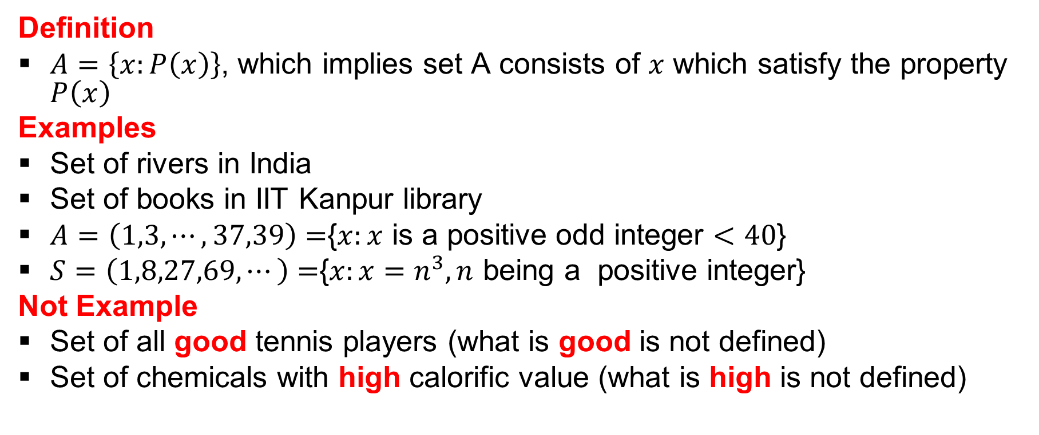
Set Theory: Definition/Rules : (contd…)
Definition
$A=\left\{x:P\left(x\right)\right\}$, which implies set A consists of $x$ which satisfy the property $P\left(x\right)$
Examples
Set of rivers in India
Set of books in IIT Kanpur library
$A=\left(1,3,⋯,37,39\right)=${$x:x$ is a positive odd integer $<40$}
$S=\left(1,8,27,69,⋯\right)=${$x:x=n^{3}, n$ being a positive integer}
Not Example
Set of all good tennis players (what is good is not defined)
Set of chemicals with high calorific value (what is high is not defined)

Slide 5
Set Theory: Definition/Rules : (contd…)
A set with no elements is a null set or empty set
A null set or an empty set is denoted by { } or φ
Examples
  Set of all triangles with two centroids
  A = {x: x is a real number satisfying the equation x² + 3 =0}
{φ} or {0} is not a null set or an empty set

Slide 6
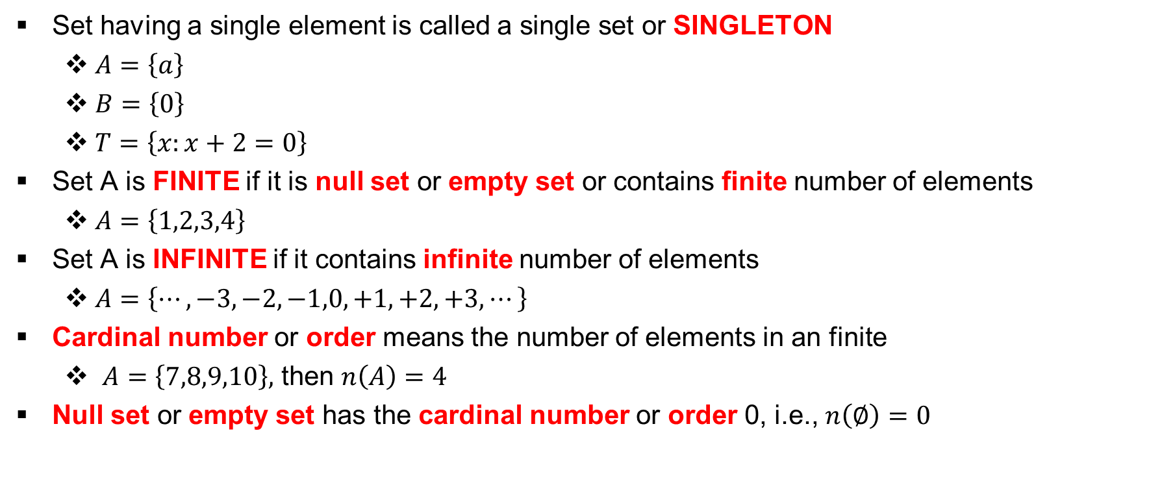
Singleton, Finite, Infinite, Cardinality
Set having a single element is called a single set or SINGLETON
  $A=\left\{a\right\}$
  $B=\left\{0\right\}$
  $T=\left\{x:x+2=0\right\}$
Set A is FINITE if it is null set or empty set or contains finite number of elements
  $A=\left\{1,2,3,4\right\}$
Set A is INFINITE if it contains infinite number of elements
  $A=\left\{⋯,−3,−2,−1,0,+1,+2,+3,⋯\right\}$
Cardinal number or order means the number of elements in an finite
  $A=\left\{7,8,9,10\right\},$ then $n\left(A\right)=4$
Null set or empty set has the cardinal number or order 0, i.e., $n\left(∅\right)=0$

Slide 7
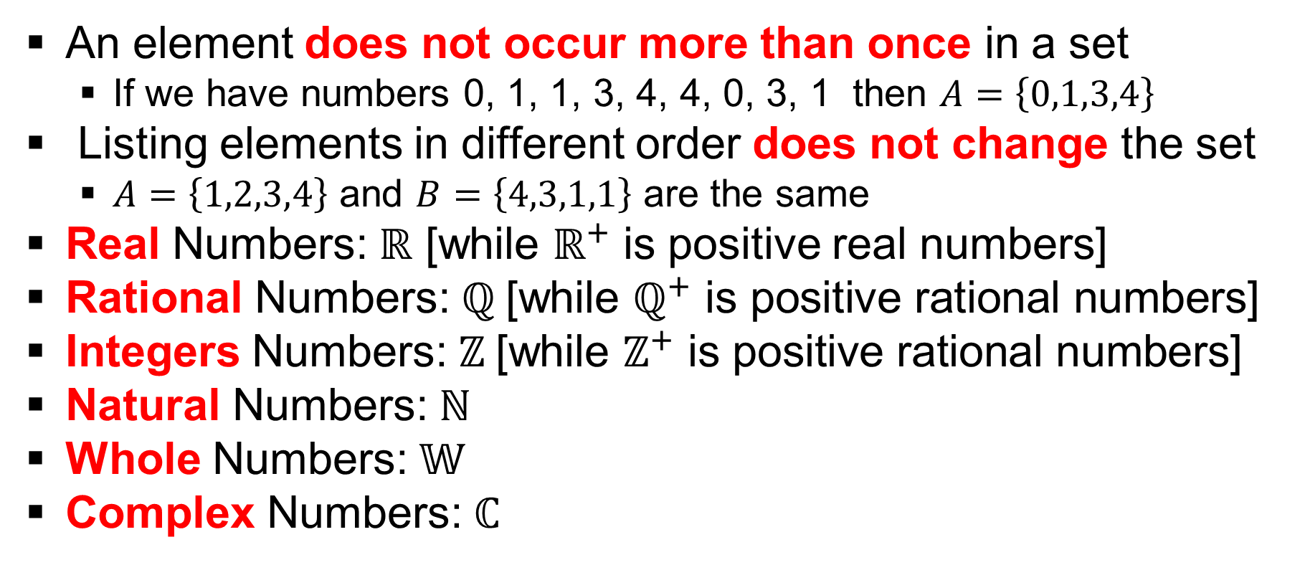
Set: Important Facts and Information
An element does not occur more than once in a set
  If we have numbers 0, 1, 1, 3, 4, 4, 0, 3, 1 then $A=\left\{0,1,3,4\right\}$
Listing elements in different order does not change the set
  $A=\left\{1,2,3,4\right\}$ and $B=\left\{4,3,1,1\right\}$ are the same
Real Numbers: $ℝ$ [while $ℝ^{+}$ is positive real numbers]
Rational Numbers: $ℚ \text{[}\text{while} ℚ^{+} \text{is} \text{positive} \text{rational} \text{numbers}\text{]}$
Integers Numbers: $ℤ \text{[}\text{while} ℤ^{+} \text{is} \text{positive} \text{rational} \text{numbers}\text{]}$
Natural Numbers: $ℕ$
Whole Numbers: $𝕎$
Complex Numbers: $ℂ$

Slide 8
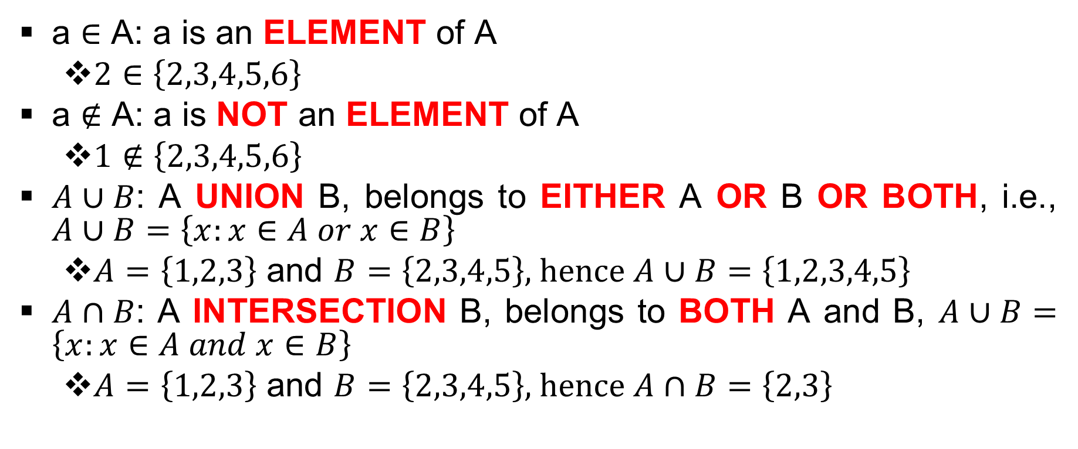
Symbols
a $∈$ A: a is an ELEMENT of A
  $2∈\left\{2,3,4,5,6\right\}$
a ∉ A: a is NOT an ELEMENT of A
  $1∉\left\{2,3,4,5,6\right\}$
$A∪B$: A UNION B, belongs to EITHER A OR B OR BOTH, i.e., $A∪B=\left\{x:x∈A or x∈B\right\}$
  $A=\left\{1,2,3\right\}$ and $B=\left\{2,3,4,5\right\}$, hence $A∪B=\left\{1,2,3,4,5\right\}$
$A∩B$: A INTERSECTION B, belongs to BOTH A and B, $A∪B=\left\{x:x∈A and x∈B\right\}$
  $A=\left\{1,2,3\right\}$ and $B=\left\{2,3,4,5\right\}$, hence $A∩B=\left\{2,3\right\}$

Slide 9
Symbols : (contd…)
$A⊆B$: A is a SUBSET of B, i.e., every element of A is in B
$B⊇A$: B is a SUPERSET of A
  $\left\{1,2,3\right\}⊆\left\{3,2,1\right\}$
$A⊂B$ : A is a PROPER SUBSET of B, i.e., every element of A is in B, but B has elements which are NOT elements of A
$B⊃A$: B is a PROPER SUPERSET of A
  $\left\{1,2\right\}⊂\left\{3,2,1\right\}$
  $\left\{a,b,c,d\right\}⊃\left\{a,b,d\right\}$
$⊄,⊅,⊈,⊉$ have their usual meaning of negation

Slide 10
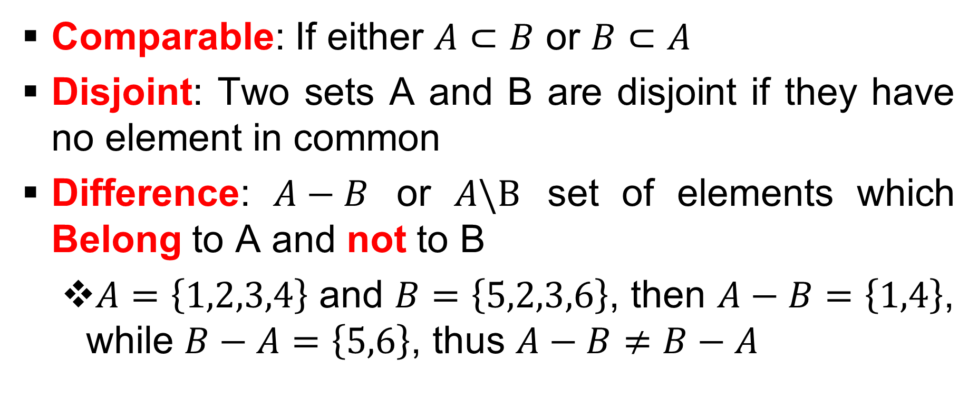
Definitions
Comparable: If either $A⊂B$ or $B⊂A$
Disjoint: Two sets A and B are disjoint if they have no element in common
Difference: $A−B$ or $A\backslash B$ set of elements which Belong to A and not to B
  $A=\left\{1,2,3,4\right\}$ and $B=\left\{5,2,3,6\right\}$, then $A−B=\left\{1,4\right\}$, while $B−A=\left\{5,6\right\}$, thus $A−B≠B−A$

Slide 11
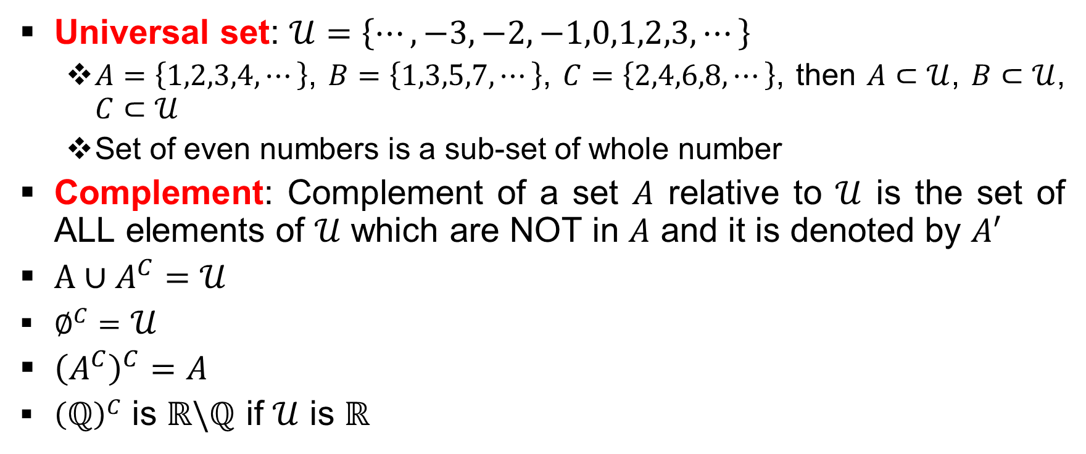
Definitions : (contd…)
Universal set: $𝒰=\left\{⋯,−3,−2,−1,0,1,2,3,⋯\right\}$
  $A=\left\{1,2,3,4,⋯\right\}$, $B=\left\{1,3,5,7,⋯\right\}$, $C=\left\{2,4,6,8,⋯\right\}$, then $A⊂𝒰$, $B⊂𝒰$, $C⊂𝒰$
  Set of even numbers is a sub-set of whole number
Complement: Complement of a set $A$ relative to $𝒰$ is the set of ALL elements of $𝒰$ which are NOT in $A$ and it is denoted by $A^{′}$
$A∪A^{C}=𝒰$
$∅^{C}=$ $𝒰$
${\left(A^{C}\right)}^{C}=A$
${\left(ℚ\right)}^{C}$ is $ℝ\backslash ℚ$ if $𝒰$ is $ℝ$

Slide 12
Theorems
If $A⊆B$ and $B⊆C$ then $A⊆C$
If $A⊆B$ and $B⊆A$ then $A=B$
$∅$ is a PROPER SUBSET of ever set except itself
Every non-empty set $A$ has TWO distinct sub-sets, namely $A$ and $∅$

Slide 13
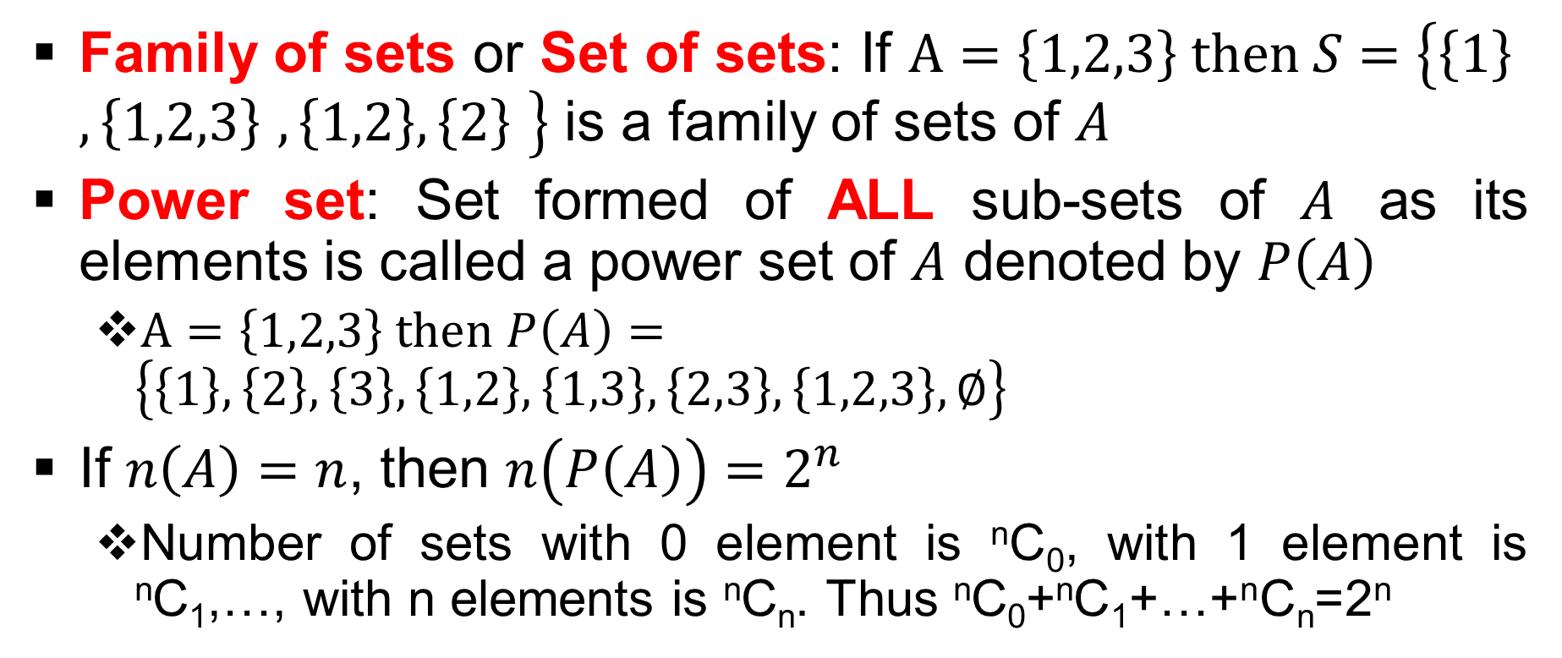
Theorems : (contd…)
Family of sets or Set of sets: If $A=\left\{1,2,3\right\} then S=\left\{\left\{1\right\} ,\left\{1,2,3\right\} ,\left\{1,2\right\},\left\{2\right\} \right\}$ is a family of sets of $A$
Power set: Set formed of ALL sub-sets of $A$ as its elements is called a power set of $A$ denoted by $P\left(A\right)$
  $A=\left\{1,2,3\right\} then P\left(A\right)=\left\{\left\{1\right\},\left\{2\right\},\left\{3\right\},\left\{1,2\right\},\left\{1,3\right\},\left\{2,3\right\},\left\{1,2,3\right\},∅\right\}$
If $n\left(A\right)=n$, then $n\left(P\left(A\right)\right)=2^{n}$
  Number of sets with 0 element is ^{n}C₀, with 1 element is ^{n}C₁,…, with n elements is ^{n}C_{n}. Thus ^{n}C₀+^{n}C₁+…+^{n}C_{n}=2^{n}

Slide 14
Venn Euler Diagram
U
B is Yellow (Remember A is inside B)
A is Red

Slide 15
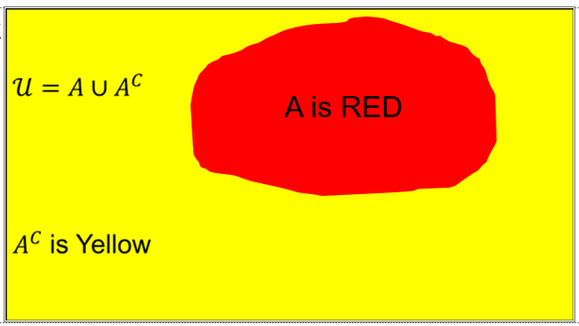
Venn Euler Diagram : (contd…)

Slide 16
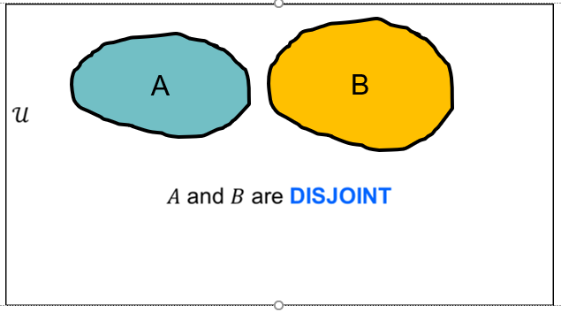
Venn Euler Diagram : (contd…)

Slide 17
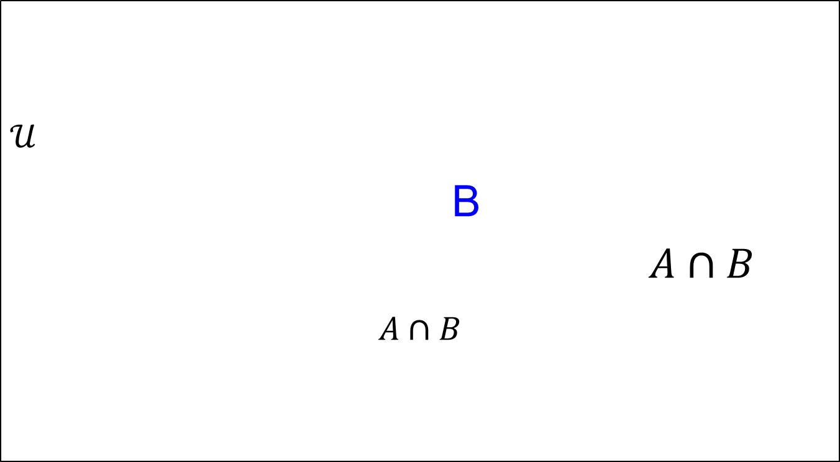
Venn Euler Diagram : (contd…)
A

Slide 18

Venn Euler Diagram : (contd…)
A

Slide 19
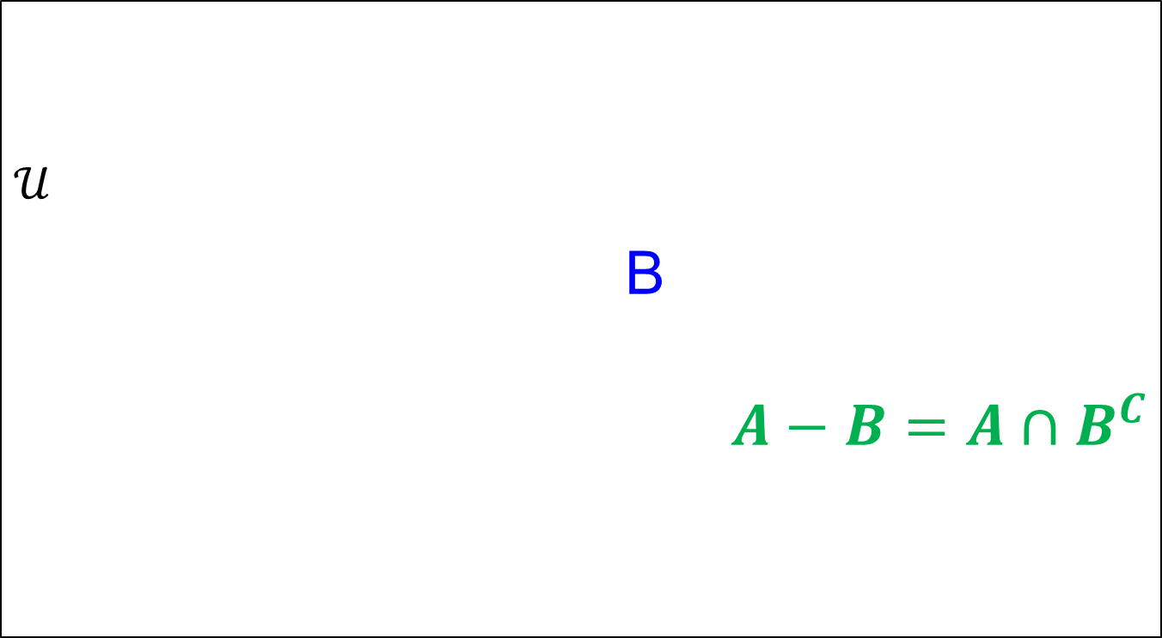
Venn Euler Diagram
A

Slide 20
Venn Euler Diagram : (contd…)
U
B-A=B∩A^{C}
A
B

Slide 21
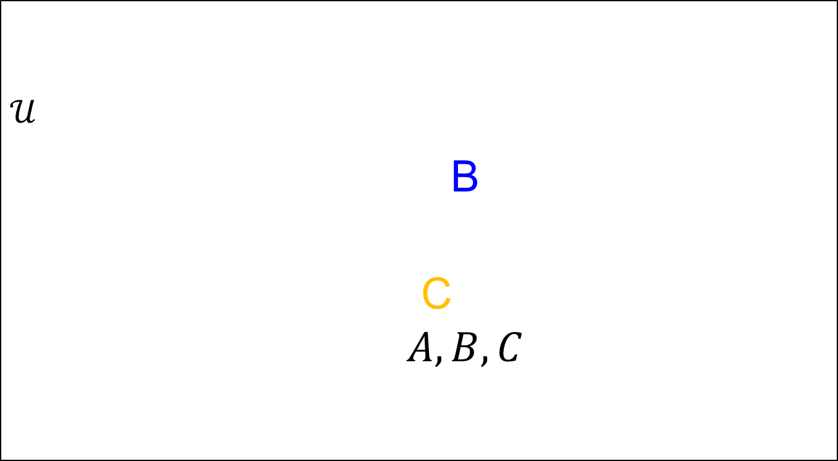
Venn Euler Diagram : (contd…)
A

Slide 22

Venn Euler Diagram : (contd…)
$B_{1}$ $B_{2}$ $B_{3}$ $B_{4}$ $B_{5}$
$B_{6}$
$B_{7}$
$B_{8}$ $B_{9}$ $B_{10}$ $B_{11}$ $B_{12}$ $B_{13}$
$B_{14}$
$B_{15}$
A

Slide 23
Exclusive and Exhaustive
$B_{j}$,$j=1,2,⋯.14,15$ are mutually EXCLUSIVE and EXHAUSTIVE
  EXCLUSIVE: If they CANNOT occur at the same time
  EXHAUSTIVE: If AT LEAST ONE of the events must occur
$A=\left(A∩B_{1}\right)∪\left(A∩B_{2}\right)∪\left(A∩B_{3}\right)∪\left(A∩B_{4}\right)∪\left(A∩B_{5}\right)∪\left(A∩B_{6}\right)∪\left(A∩B_{7}\right)∪\left(A∩B_{8}\right)∪\left(A∩B_{9}\right)∪\left(A∩B_{10}\right)∪\left(A∩B_{11}\right)∪\left(A∩B_{12}\right)∪\left(A∩B_{13}\right)∪\left(A∩B_{14}\right)∪\left(A∩B_{15}\right)$, i.e., $\bigcup_{j=1}^{15}{\left(A∩B_{j}\right)}$

Slide 24
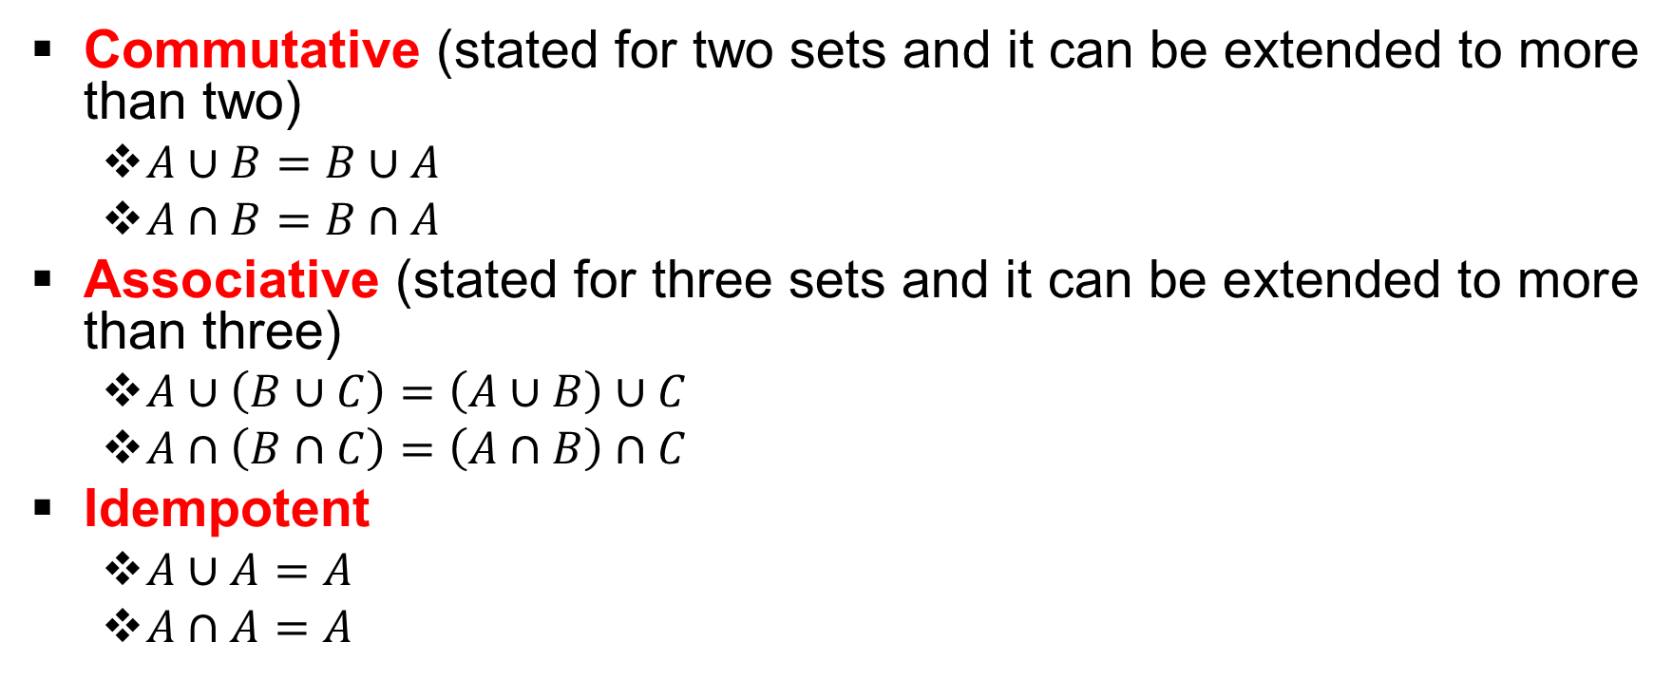
Law of Algebra for Sets
Commutative (stated for two sets and it can be extended to more than two)
  $A∪B=B∪A$
  $A∩B=B∩A$
Associative (stated for three sets and it can be extended to more than three)
  $A∪\left(B∪C\right)=\left(A∪B\right)∪C$
  $A∩\left(B∩C\right)=\left(A∩B\right)∩C$
Idempotent
  $A∪A=A$
  $A∩A=A$

Slide 25
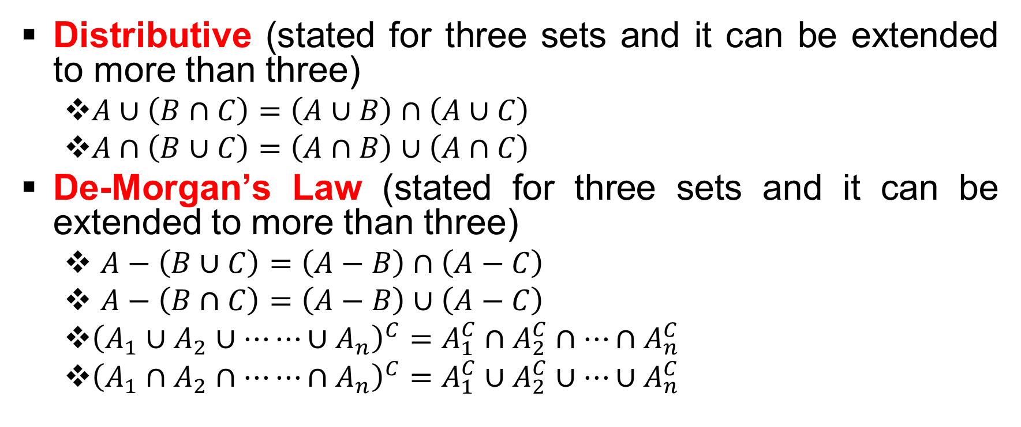
Law of Algebra for Sets : (contd…)
Distributive (stated for three sets and it can be extended to more than three)
  $A∪\left(B∩C\right)=\left(A∪B\right)∩\left(A∪C\right)$
  $A∩\left(B∪C\right)=\left(A∩B\right)∪\left(A∩C\right)$
De-Morgan’s Law (stated for three sets and it can be extended to more than three)
  $A−\left(B∪C\right)=\left(A−B\right)∩\left(A−C\right)$
  $A−\left(B∩C\right)=\left(A−B\right)∪\left(A−C\right)$
  ${\left(A_{1}∪A_{2}∪⋯⋯∪A_{n}\right)}^{C}=A_{1}^{C}∩A_{2}^{C}∩⋯∩A_{n}^{C}$
  ${\left(A_{1}∩A_{2}∩⋯⋯∩A_{n}\right)}^{C}=A_{1}^{C}∪A_{2}^{C}∪⋯∪A_{n}^{C}$

Slide 26
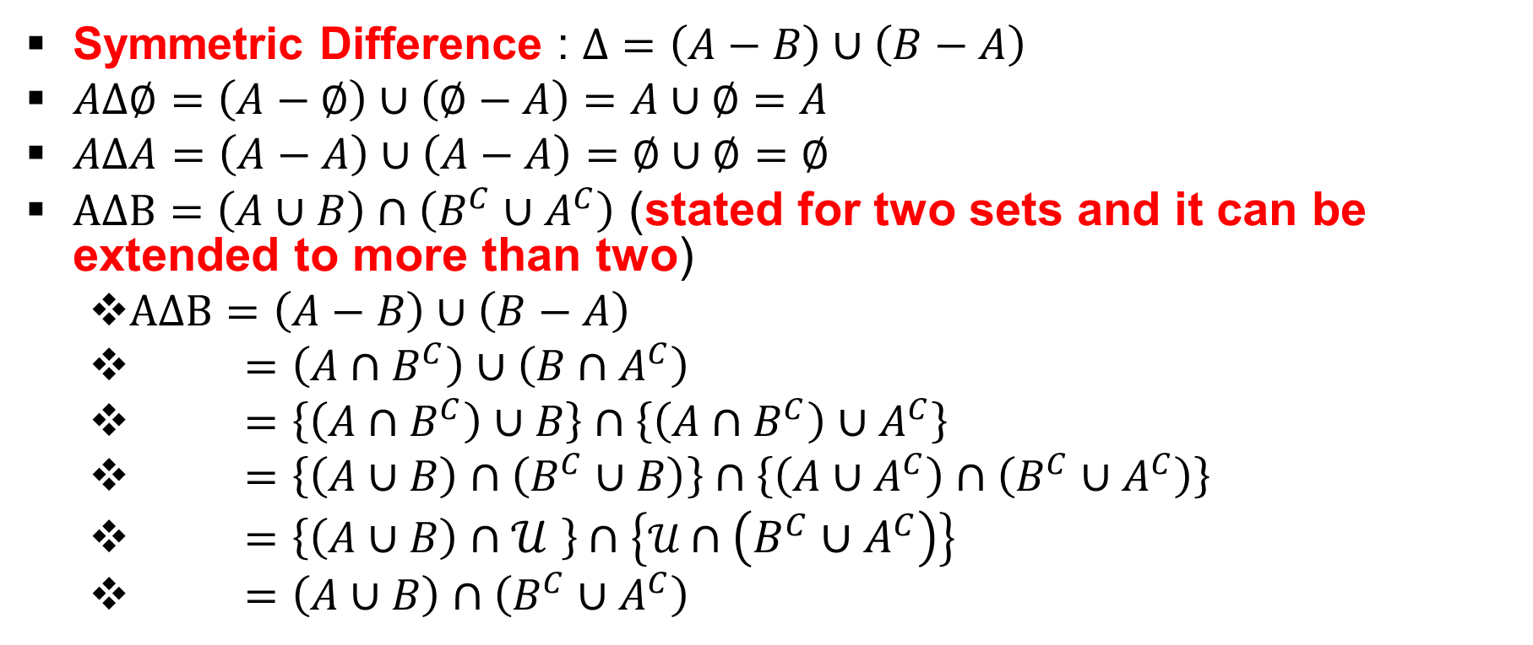
Symmetric Difference
Symmetric Difference : $Δ=\left(A−B\right)∪\left(B−A\right)$
$AΔ∅=\left(A−∅\right)∪\left(∅−A\right)=A∪∅=A$
$AΔA=\left(A−A\right)∪\left(A−A\right)=∅∪∅=∅$
$AΔB=\left(A∪B\right)∩\left(B^{C}∪A^{C}\right)$ (stated for two sets and it can be extended to more than two)
  $AΔB=\left(A−B\right)∪\left(B−A\right)$
  $=\left(A∩B^{C}\right)∪\left(B∩A^{C}\right)$
  $=\left\{\left(A∩B^{C}\right)∪B\right\}∩\left\{\left(A∩B^{C}\right)∪A^{C}\right\}$
  $=\left\{\left(A∪B\right)∩\left(B^{C}∪B\right)\right\}∩\left\{\left(A∪A^{C}\right)∩\left(B^{C}∪A^{C}\right)\right\}$
  $=\left\{\left(A∪B\right)∩𝒰 \right\}∩\left\{𝒰∩\left(B^{C}∪A^{C}\right)\right\}$
  $=\left(A∪B\right)∩\left(B^{C}∪A^{C}\right)$

Slide 27
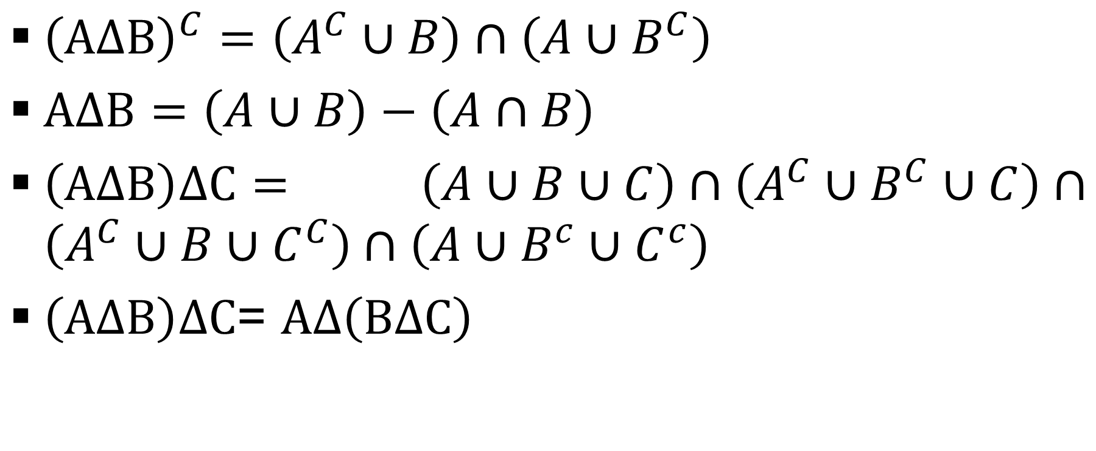
Symmetric Differnce (can be extended to more than two/three sets)
${\left(AΔB\right)}^{C}=\left(A^{C}∪B\right)∩\left(A∪B^{C}\right)$
$AΔB=\left(A∪B\right)−\left(A∩B\right)$
$\left(AΔB\right)ΔC=$ $\left(A∪B∪C\right)∩\left(A^{C}∪B^{C}∪C\right)∩\left(A^{C}∪B∪C^{C}\right)∩\left(A∪B^{c}∪C^{c}\right)$
$\left(AΔB\right)ΔC$= $AΔ\left(BΔC\right)$

Slide 28
Probability
Probability is the branch of mathematics concerning numerical descriptions of how likely an event is to occur, or how likely it is that a proposition is true
Probability of an event is defined as a quantitative measure of uncertainty of the occurrence of the event

Slide 29
Probability : (contd…)
Probability (P(A)): Of an event is defined as a quantitative measure of uncertainty of the occurrence of the event.
Objective probability: Based on game of chance and which can be mathematically proved or verified . If the experiment is the same for two different persons, then the value of objective probability would remain the same. It is the limiting definition of relative frequency. Example: The probability of getting the number 5 when we roll a fair die.
Subjective probability: Based on personal judgment, intuition and subjective criteria. Its value will change from person to person. Example one person sees the chance of India winning the test series with Australia high while the other person sees it to be low.

Slide 30
Random event
Random experiment: Is an experiment whose outcome cannot be predicted with certainty.
Sample space (Ω) : The set of all possible outcomes of a random experiment.
Sample point (ω_{i}): The elements of the sample space.
Event (A): Is a subset of the sample space such that it is a collection of sample point(s).

Slide 31
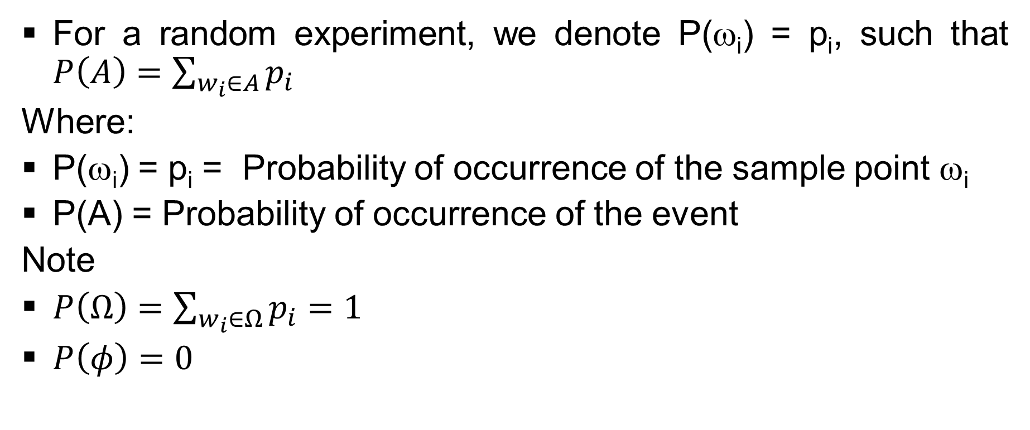
Random event : (contd…)

Slide 32
Population, Sample
In statistics, a population (N)is a set of similar items or events which is of interest for some question or experiment, e.g.,
  Set of all stars within the Milky Way galaxy
  All students of Class XII in India taking JEE Main in 2023
A subset of a statistical population can be called a sample, (n),
  Set of all stars within the solar system
  All students of Class XII in Sheiling House School, Kanpur in India taking JEE Main in 2023

Slide 33
Population and Sample : (contd…)
N
Sample 5 (n₅)
Sample 4 (n₄)
Sample 2 (n₂)
Sample 1 (n₁)
Sample 3 (n₃)

Slide 34
Example # 27
Suppose there are two dice each with faces 1, 2,....., 6 and they are rolled simultaneously. This rolling of the two dice would constitute our random experiment
Then we have:
  Ω = {(1,1), (1,2), (1,3), (1,4), (1,5), (1,6), (2,1),.….., (5,6), (6,1), (6,2), (6,3), (6,4), (6,5), (6,6)}.
  ω_{i} = (1,1), (1,2),…., (6,5), (6,6)
  We define the event is such that the outcomes for each die are equal in one simultaneous throw, then A = {(1, 1), (2, 2),….., (6, 6)}
  P(ω_{i}): p₁ = p₂ = ….. = p₃₆ = 1/36
  P(A) = p₁ + p₈ + p₁₅ + p₂₂ + p₂₉ + p₃₆ = 6/36

Slide 35
Example # 28
Suppose a coin is tossed repeatedly till the first head is obtained.
Then we have:
  Ω = {(H), (T,H), (T,T,H),………}
  ω_{i} = (H), (T,H), (T,T,H),…..
  We define the event such that at most 3 tosses are needed to obtain the first head, then A = {(H), (T,H), (T,T,H)}
  P(ω_{i}): p₁ = ½, p₂ = (½)², p₃ = (½)³, p₄ = (½)⁴,..…
  P(A) = p₁ + p₂ + p₃ = 7/8

Slide 36
Classical definition of probability
Under this definition we consider the following:
Sample space is finite.
All the sample points are equally likely, i.e., they have equal probability of occurrence or equal relative frequency of occurrence.

Slide 37
Example # 29
In a club there 10 members of whom5 are Asians and the rest are Americans.
A committee of 3 members has to be formed and these members are to be chosen randomly.
Find the probability that there will be at least 1 Asian and at least 1 American in the committee.
Total number of cases = ¹⁰C₂ and the number of cases favouring the formation of the committee is ⁵C₂*⁵C₁ + ⁵C₁*⁵C₂
Hence P(A) = 100/120

Slide 38
Exercise
There is box containing 10 coloured balls out of which 4 are red, 4 are blue and 2 are white.
If you draw a ball at random what is the probability that it is a white ball?
If you draw two balls consecutively and with replacement then what is the probability that both the balls are red?
If you draw two balls consecutively and without replacement, then what is the probability that the first is blue and the second is white?

Slide 39
Axiomatic definition of probability
Under this definition we consider the following:
Sample space is infinite.
Sample points are not equally likely.

Slide 40
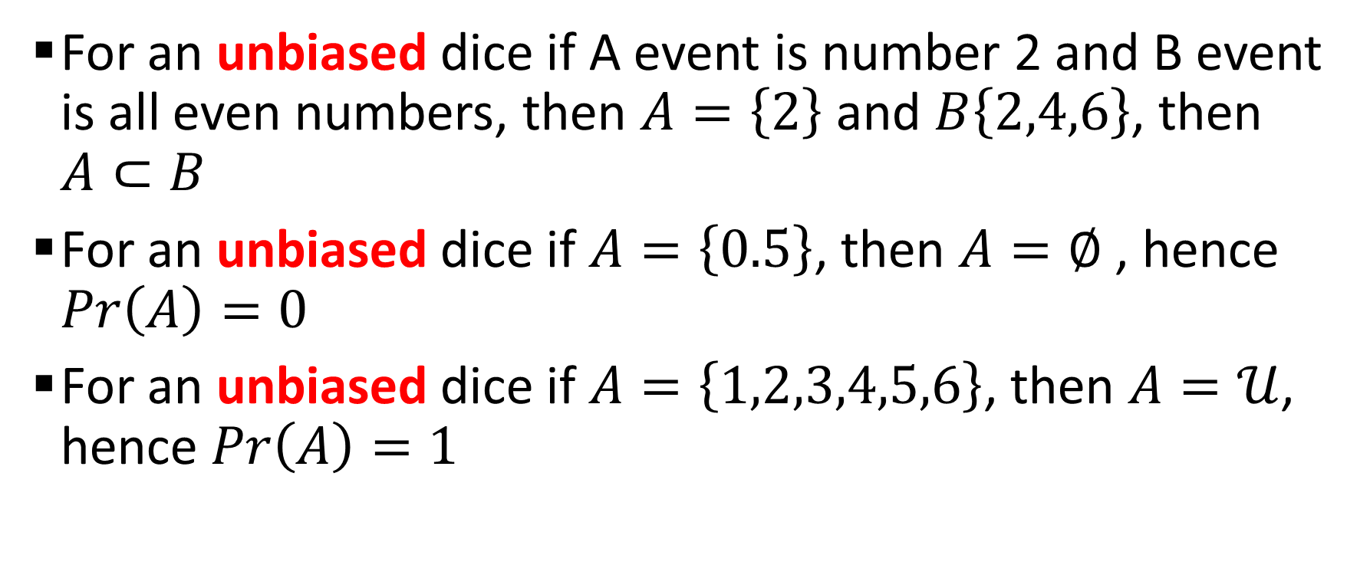
Example # 30
For an unbiased dice if A event is number 2 and B event is all even numbers, then $A=\left\{2\right\}$ and $B\left\{2,4,6\right\}$, then $A⊂B$
For an unbiased dice if $A=\left\{0.5\right\}$, then $A=∅$ , hence $Pr\left(A\right)=0$
For an unbiased dice if $A=\left\{1,2,3,4,5,6\right\}$, then $A=𝒰$, hence $Pr\left(A\right)=1$

Slide 41
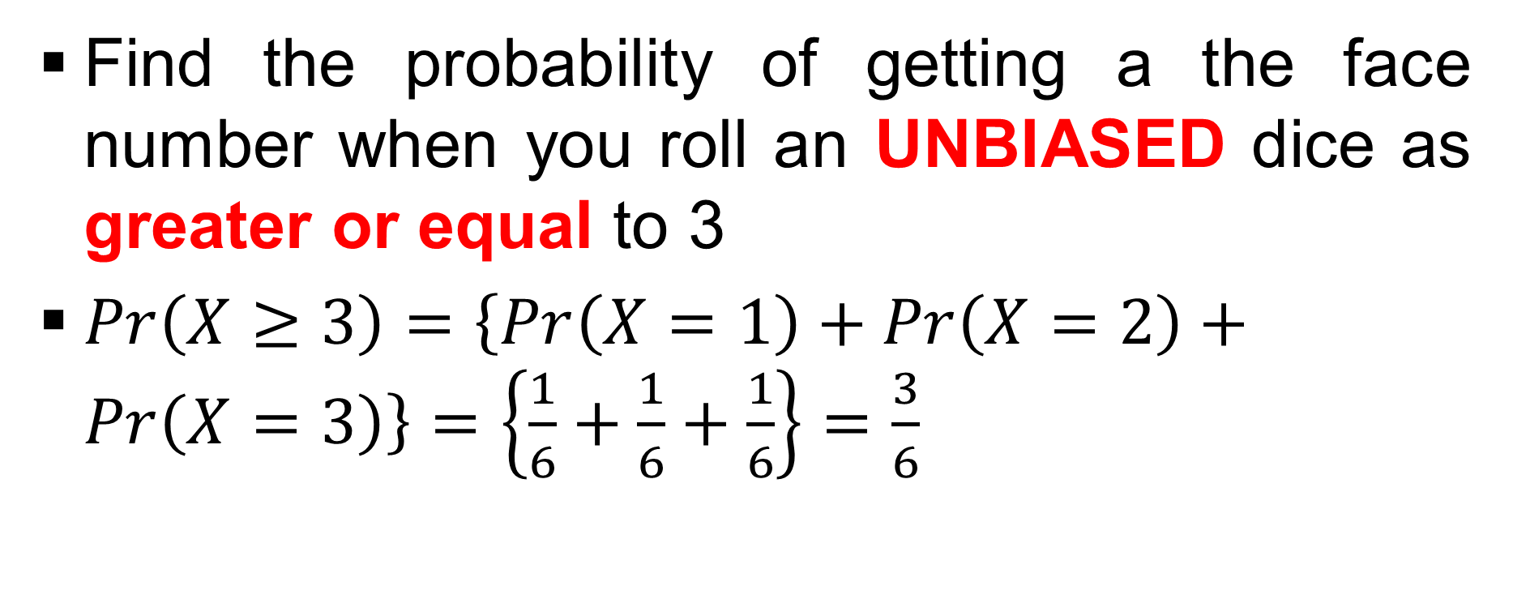
Example # 31
Find the probability of getting a the face number when you roll an UNBIASED dice as greater or equal to 3
$Pr\left(X≥3\right)=\left\{Pr\left(X=1\right)+Pr\left(X=2\right)+Pr\left(X=3\right)\right\}=\left\{\frac{1}{6}+\frac{1}{6}+\frac{1}{6}\right\}=\frac{3}{6}$

Slide 42
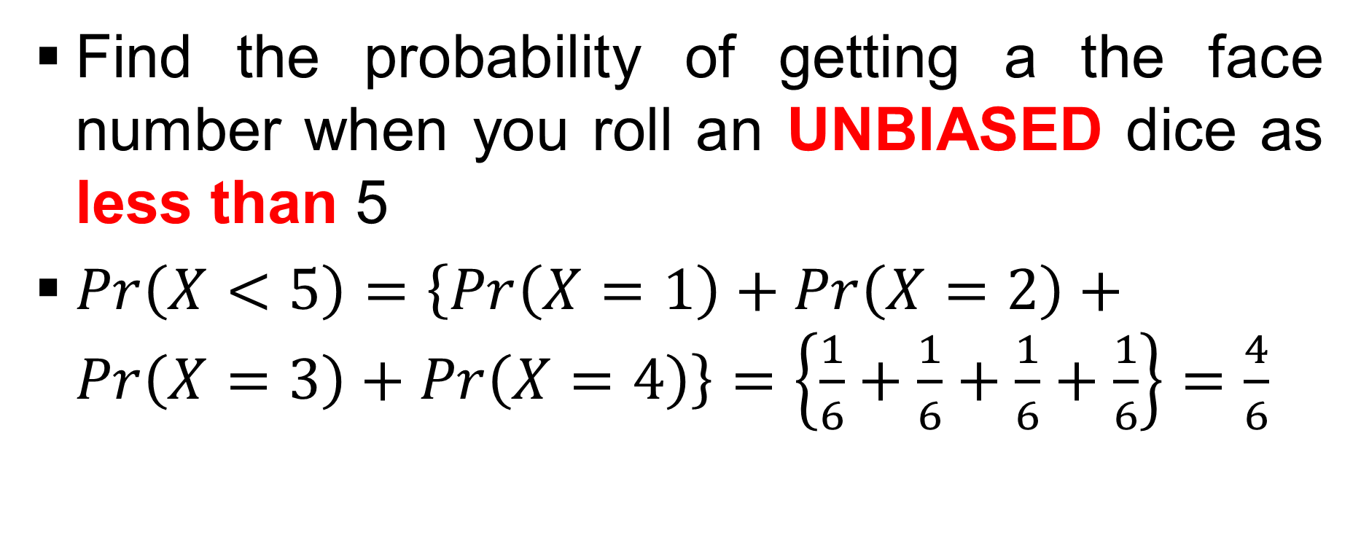
Example # 32
Find the probability of getting a the face number when you roll an UNBIASED dice as less than 5
$Pr\left(X<5\right)=\left\{Pr\left(X=1\right)+Pr\left(X=2\right)+Pr\left(X=3\right)+Pr\left(X=4\right)\right\}=\left\{\frac{1}{6}+\frac{1}{6}+\frac{1}{6}+\frac{1}{6}\right\}=\frac{4}{6}$

Slide 43
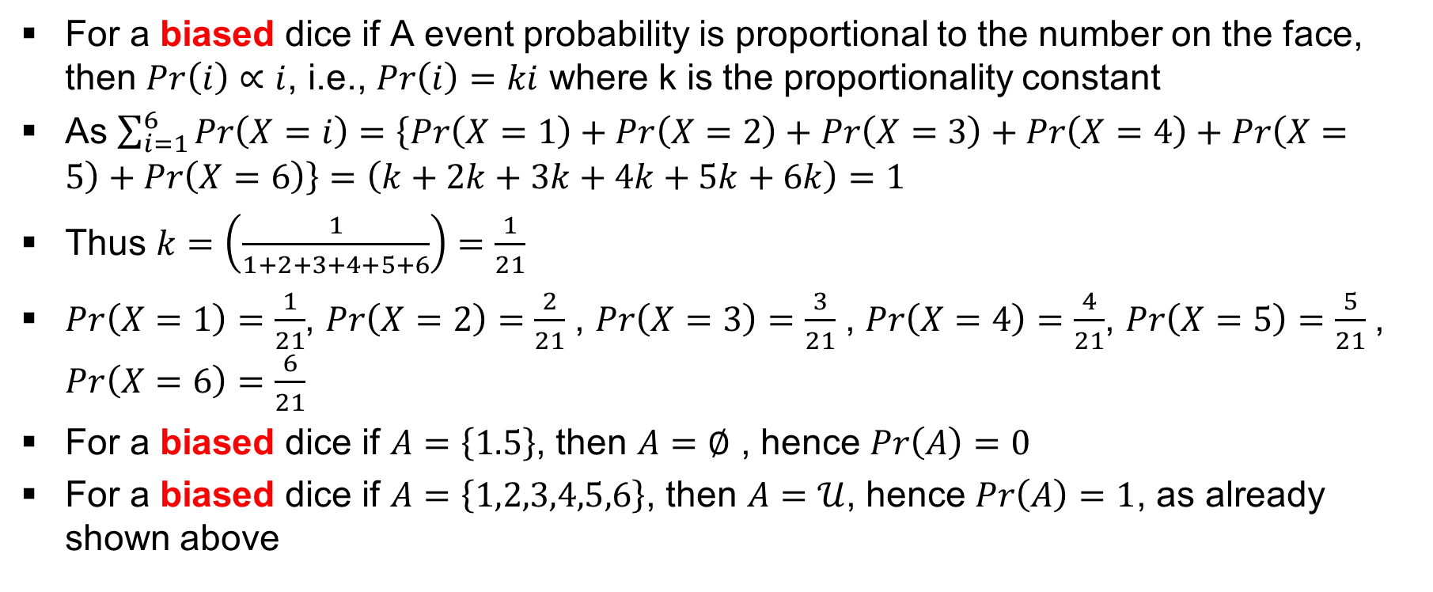
Example # 33
For a biased dice if A event probability is proportional to the number on the face, then $Pr\left(i\right)∝i$, i.e., $Pr\left(i\right)=ki$ where k is the proportionality constant
As $\sum_{i=1}^{6}{Pr\left(X=i\right)}=\left\{Pr\left(X=1\right)+Pr\left(X=2\right)+Pr\left(X=3\right)+Pr\left(X=4\right)+Pr\left(X=5\right)+Pr\left(X=6\right)\right\}=\left(k+2k+3k+4k+5k+6k\right)=1$
Thus $k=\left(\frac{1}{1+2+3+4+5+6}\right)=\frac{1}{21}$
$Pr\left(X=1\right)=\frac{1}{21}$, $Pr\left(X=2\right)=\frac{2}{21}$ , $Pr\left(X=3\right)=\frac{3}{21}$ , $Pr\left(X=4\right)=\frac{4}{21}$, $Pr\left(X=5\right)=\frac{5}{21}$ , $Pr\left(X=6\right)=\frac{6}{21}$
For a biased dice if $A=\left\{1.5\right\}$, then $A=∅$ , hence $Pr\left(A\right)=0$
For a biased dice if $A=\left\{1,2,3,4,5,6\right\}$, then $A=𝒰$, hence $Pr\left(A\right)=1$, as already shown above

Slide 44
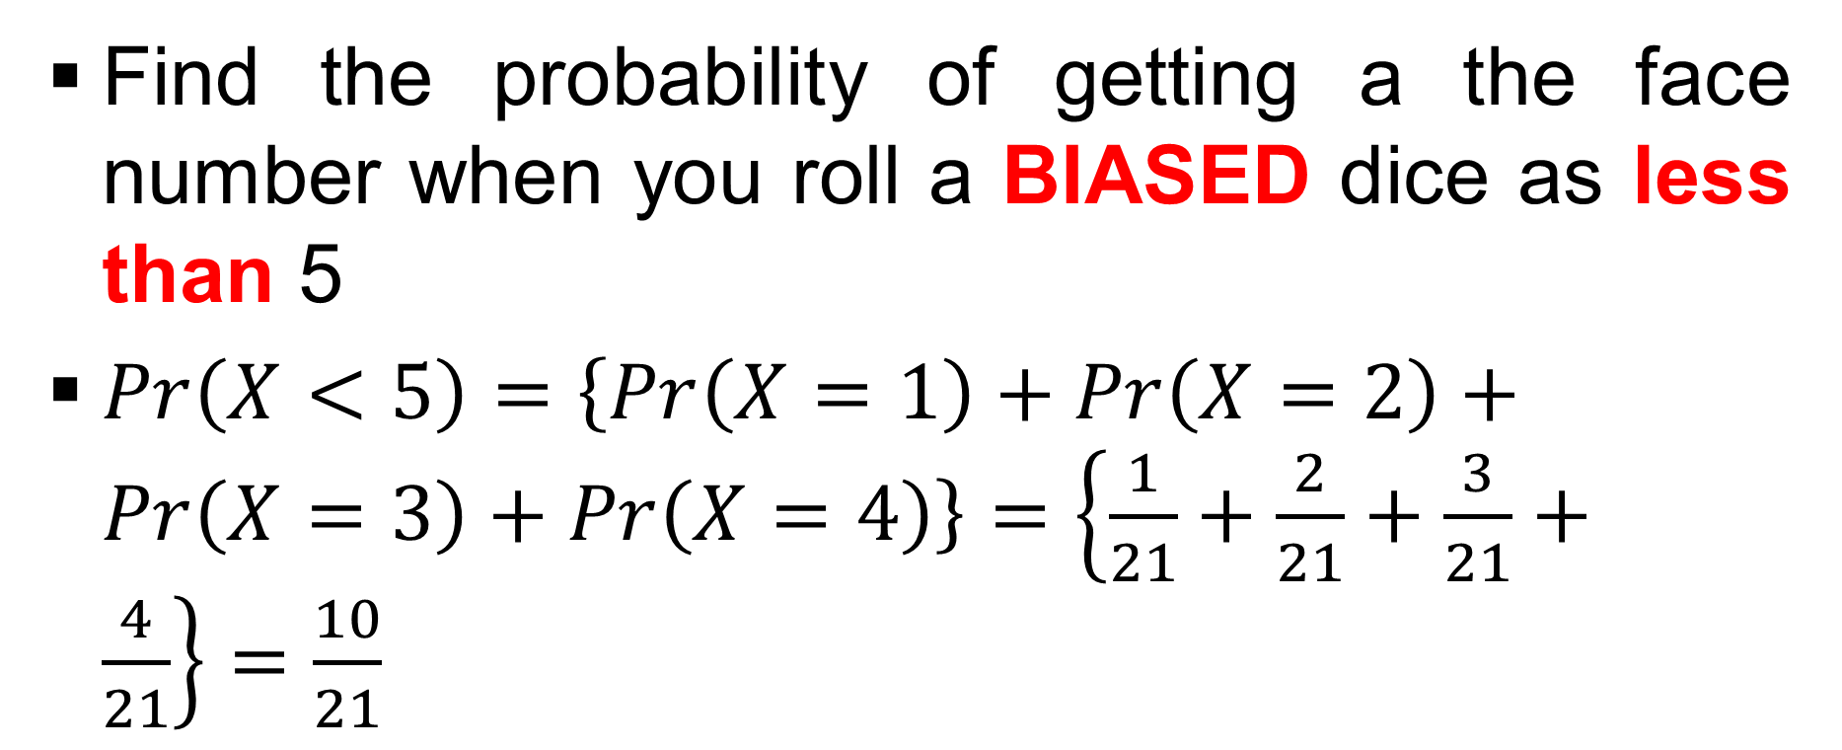
Example # 33 : (contd…)
Find the probability of getting a the face number when you roll a BIASED dice as less than 5
$Pr\left(X<5\right)=\left\{Pr\left(X=1\right)+Pr\left(X=2\right)+Pr\left(X=3\right)+Pr\left(X=4\right)\right\}=\left\{\frac{1}{21}+\frac{2}{21}+\frac{3}{21}+\frac{4}{21}\right\}=\frac{10}{21}$

Slide 45
Example # 33 : (contd…)
Find the probability of getting a the face number when you roll a BIASED dice as less than 5
$Pr\left(X<5\right)=\left\{Pr\left(X=1\right)+Pr\left(X=2\right)+Pr\left(X=3\right)+Pr\left(X=4\right)\right\}=\left\{\frac{1}{21}+\frac{2}{21}+\frac{3}{21}+\frac{4}{21}\right\}=\frac{10}{21}$

Slide 46
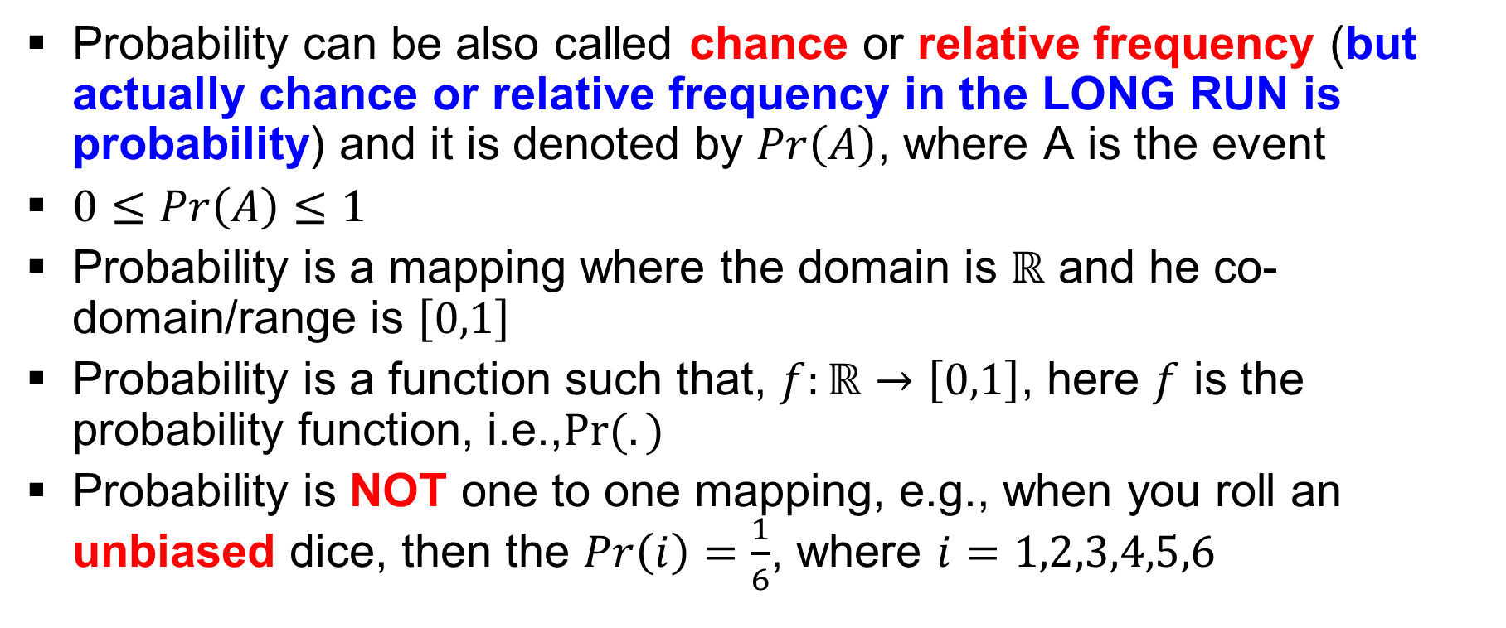
Probability
Probability can be also called chance or relative frequency (but actually chance or relative frequency in the LONG RUN is probability) and it is denoted by $Pr\left(A\right)$, where A is the event
$0≤Pr\left(A\right)≤1$
Probability is a mapping where the domain is $ℝ$ and he co-domain/range is $\left[0,1\right]$
Probability is a function such that, $f:ℝ→\left[0,1\right]$, here $f$ is the probability function, i.e.,$Pr⁡(.)$
Probability is NOT one to one mapping, e.g., when you roll an unbiased dice, then the $Pr\left(i\right)=\frac{1}{6}$, where $i=1,2,3,4,5,6$

Slide 47
Example # 34
Suppose we continue with example 2 which we have just discussed and we define the event B , that al least 5 tosses are needed to produce the first head
  Ω = {(H), (T,H), (T,T,H),………}
  ω_{i} = (H), (T,H), (T,T,H),…..
  P(ω_{i}): p₁ = ½, p₂ = (½)², p₃ = (½)³, p₄ = (½)⁴,..…
  P(B) = p₅+p₆+p₇+ ….. = 1 – (p₁+p₂+p₃+p₄) = 1 – {1/2+1/4+1/8+1/16} = 1/16

Slide 48
Exercise
Two fair coins are tossed simultaneously and such simultaneously tossing is repeated till you get two tails together.
What is the probability that you need at most two such simultaneous tossing to achieve our objective?

Slide 49
Theorem in probability
For any event A, B ∈ Ω
  0 ≤ P(A) ≤ 1
  If A ⊂ B, then P(A) ≤ P(B)
  P(A U B) = P(A) + P(B) – P(A ∩ B)
  P(A^{C}) = 1 – P(A)
  P(Ω) = 1
  P(φ) = 0
  ∑_{𝑖∈𝑛}P(A_{𝑖}) = 1

Slide 50
Probability as a Function
0 1/6 1
Domain Co-domain/Range
1•
2•
3•
4•
5•
6•

Slide 51
Probability, Chance, Relative Frequency
Consider you have the following readings for the speeds (km/hr) of 20 car travelling past a crossing: 65, 66, 70, 64, 72, 70, 66, 77, 75, 65, 64, 69, 49, 53, 54, 55, 55, 70, 73, 66\
Sum of relative frequency is 1 as it SHOULD be
Interval | Frequency | Relative Frequency
<51 | 1 | 01/20
51 to 55 | 4 | 04/20
56 to 60 | 0 | 00/20
61 to 65 | 4 | 04/20
66 to 70 | 7 | 07/20
71 to 75 | 3 | 03/20
>75 | 1 | 01/20

Slide 52
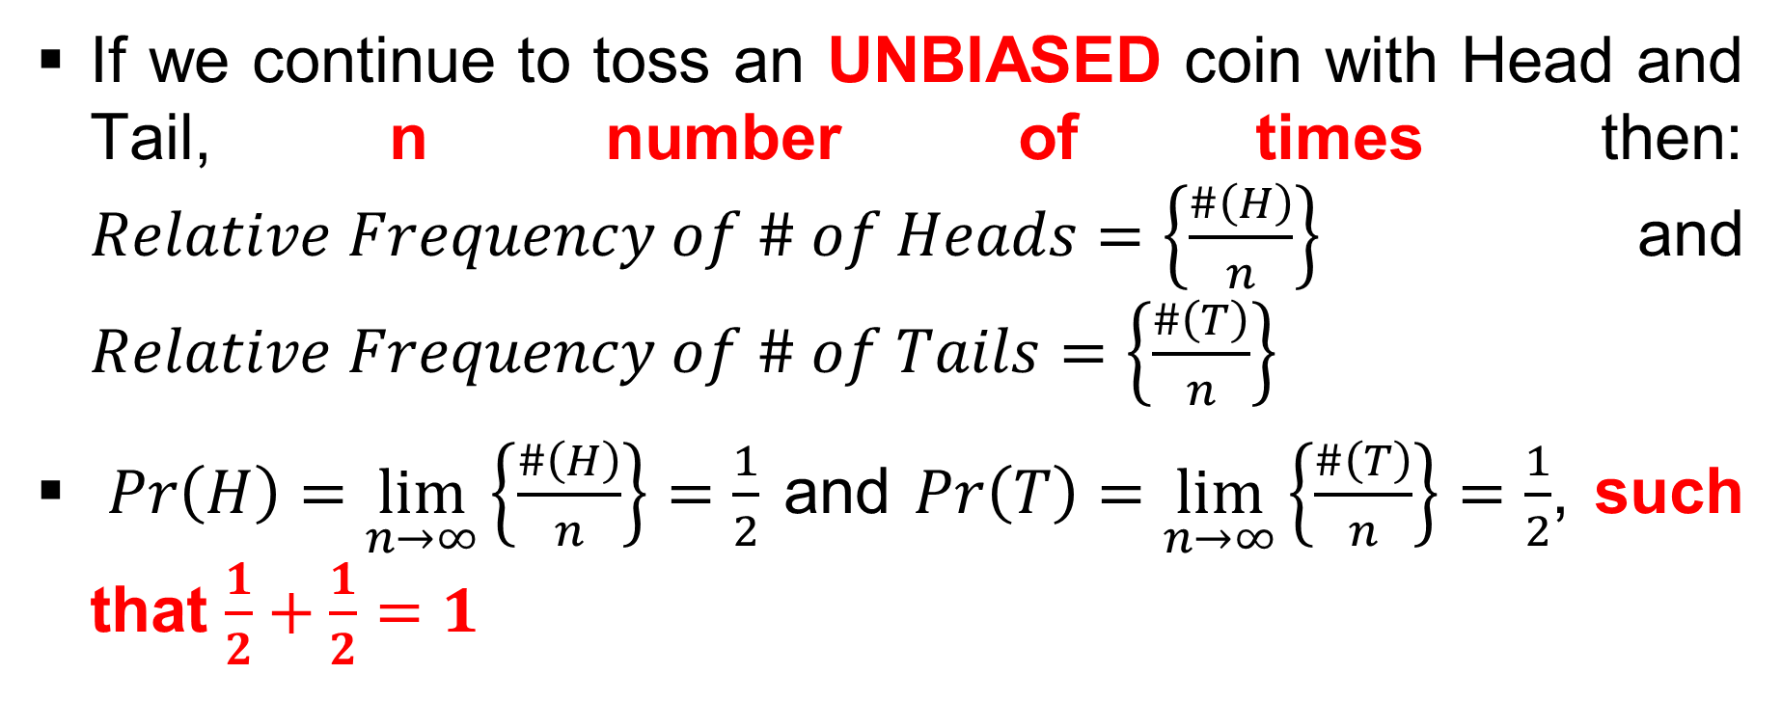
Probability, Chance, Relative Frequency (Unbiased)
If we continue to toss an UNBIASED coin with Head and Tail, n number of times then: $Relative Frequency of \# of Heads=\left\{\frac{\#\left(H\right)}{n}\right\}$ and $Relative Frequency of \# of Tails=\left\{\frac{\#\left(T\right)}{n}\right\}$
$Pr\left(H\right)=\lim_{n→∞}\left\{\frac{\#\left(H\right)}{n}\right\}=\frac{1}{2}$ and $Pr\left(T\right)=\lim_{n→∞}\left\{\frac{\#\left(T\right)}{n}\right\}=\frac{1}{2}$, such that $\frac{1}{2}+\frac{1}{2}=1$

Slide 53
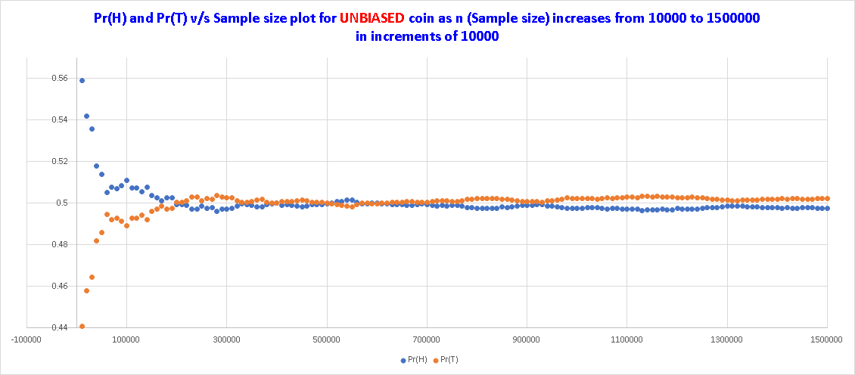
Probability, Chance, Relative Frequency (Unbiased)

Slide 54
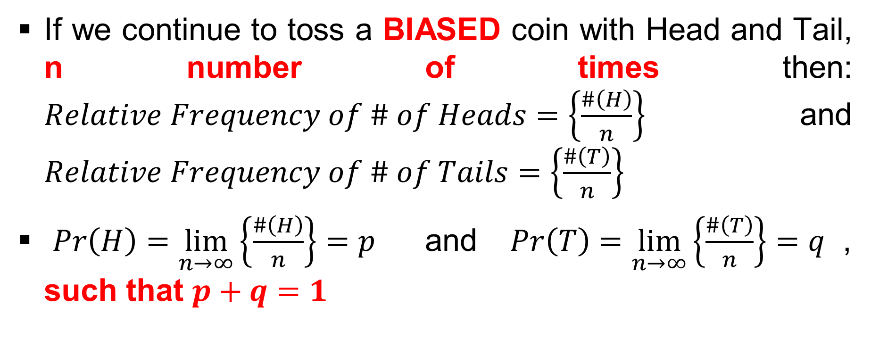
Probability, Chance, Relative Frequency (Biased)
If we continue to toss a BIASED coin with Head and Tail, n number of times then: $Relative Frequency of \# of Heads=\left\{\frac{\#\left(H\right)}{n}\right\}$and $Relative Frequency of \# of Tails=\left\{\frac{\#\left(T\right)}{n}\right\}$
$Pr\left(H\right)=\lim_{n→∞}\left\{\frac{\#\left(H\right)}{n}\right\}=p$ and $Pr\left(T\right)=\lim_{n→∞}\left\{\frac{\#\left(T\right)}{n}\right\}=q$, such that $p+q=1$

Slide 55
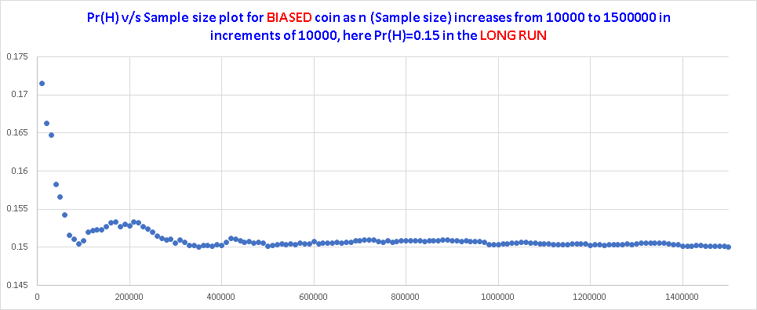
Probability, Chance, Relative Frequency (Biased)

Slide 56
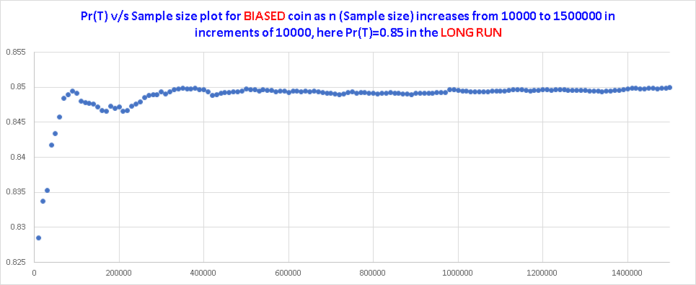
Probability, Chance, Relative Frequency (Biased)

Slide 57
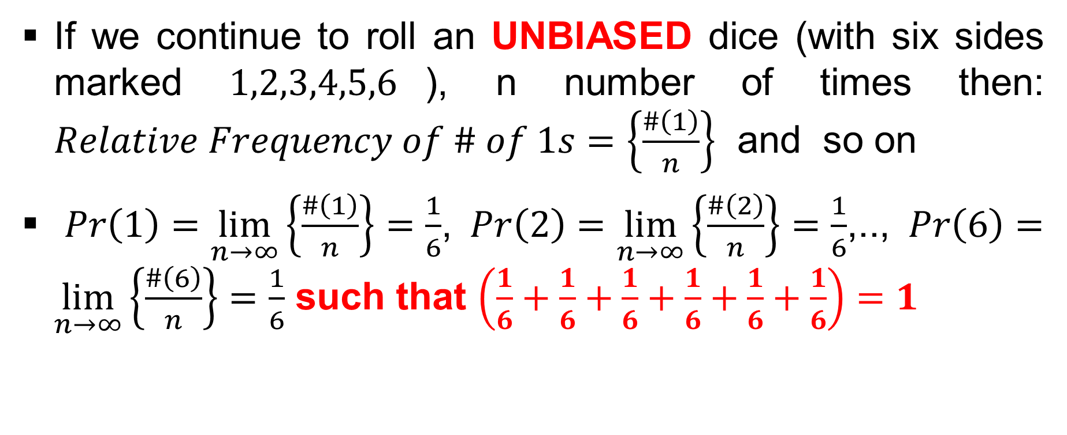
Probability, Chance, Relative Frequency (Unbiased)
If we continue to roll an UNBIASED dice (with six sides marked $1,2,3,4,5,6$), n number of times then: $Relative Frequency of \# of 1s=\left\{\frac{\#\left(1\right)}{n}\right\}$ and so on
$Pr\left(1\right)=\lim_{n→∞}\left\{\frac{\#\left(1\right)}{n}\right\}=\frac{1}{6}$, $Pr\left(2\right)=\lim_{n→∞}\left\{\frac{\#\left(2\right)}{n}\right\}=\frac{1}{6}$,.., $Pr\left(6\right)=\lim_{n→∞}\left\{\frac{\#\left(6\right)}{n}\right\}=\frac{1}{6}$ such that $\left(\frac{1}{6}+\frac{1}{6}+\frac{1}{6}+\frac{1}{6}+\frac{1}{6}+\frac{1}{6}\right)=1$

Slide 58
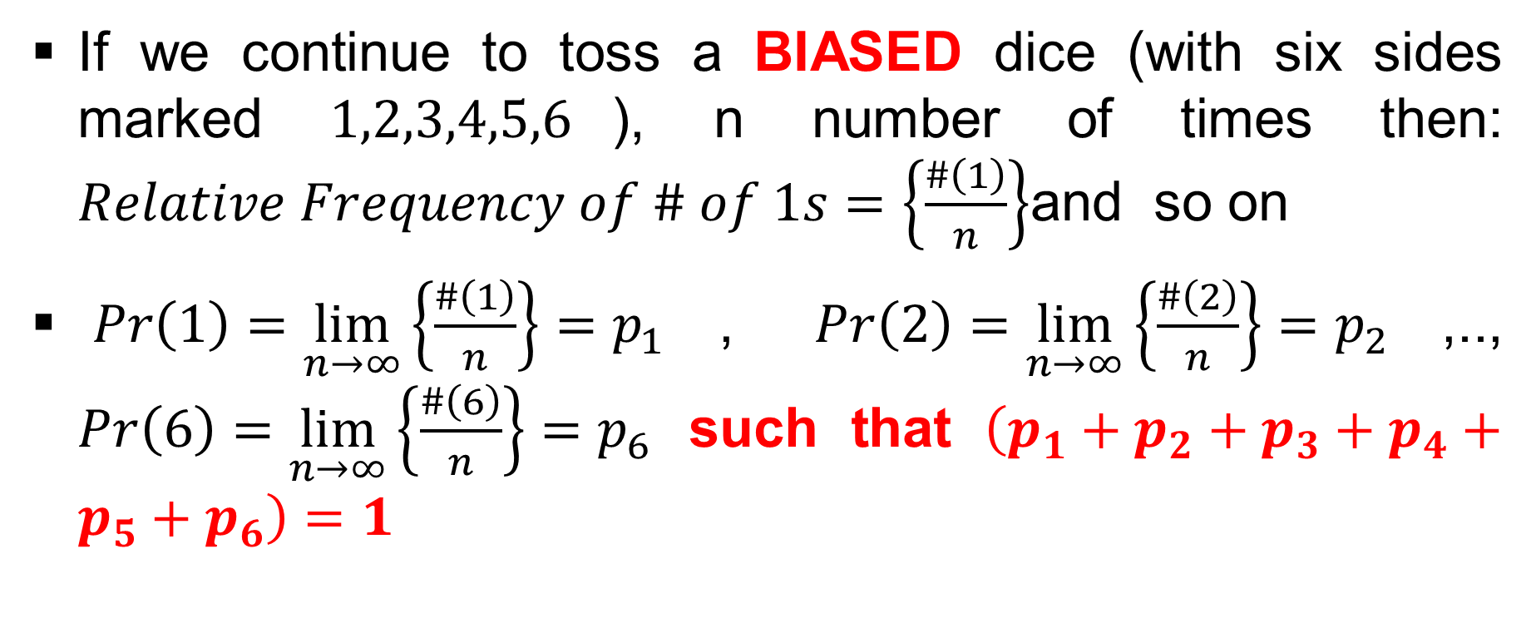
Probability, Chance, Relative Frequency (Biased)
If we continue to toss a BIASED dice (with six sides marked $1,2,3,4,5,6$), n number of times then: $Relative Frequency of \# of 1s=\left\{\frac{\#\left(1\right)}{n}\right\}$and so on
$Pr\left(1\right)=\lim_{n→∞}\left\{\frac{\#\left(1\right)}{n}\right\}=p_{1}$, $Pr\left(2\right)=\lim_{n→∞}\left\{\frac{\#\left(2\right)}{n}\right\}=p_{2}$,.., $Pr\left(6\right)=\lim_{n→∞}\left\{\frac{\#\left(6\right)}{n}\right\}=p_{6}$ such that $\left(p_{1}+p_{2}+p_{3}+p_{4}+p_{5}+p_{6}\right)=1$

Slide 59
Properties of Distribution Function
F(x) is non-decreasing in x, i.e., if x₁ ≤ x₂, then F(x₁) ≤ F(x₂)
Lt_{x→−∞}F(x) = Lt_{x→−∞}P(X ≤ x) = 0
Lt_{x→+∞}F(x) = Lt_{x→+∞}P(X ≤ x) = 1
F(x) is right continuous

Slide 60
Definitions (Mutually Exclusive)
Mutually exclusive: Consider n events A₁, ….., A_{n}. They are mutually exclusive if no two of them can occur together, i.e., P(A_{𝑖} ∩ A_{𝑗}) = P(φ) = 0, ∀ 𝑖, 𝑗 (𝑖 ≠ 𝑗) ∈ n.

Slide 61
Definitions (Mutually Exhaustive)
Mutually exhaustive: Consider n events A₁, ….., A_{n}. They are mutually exhaustive if at least one of them must occur and P(A₁U…..UA_{n}) = P(Ω) = 1.

Slide 62
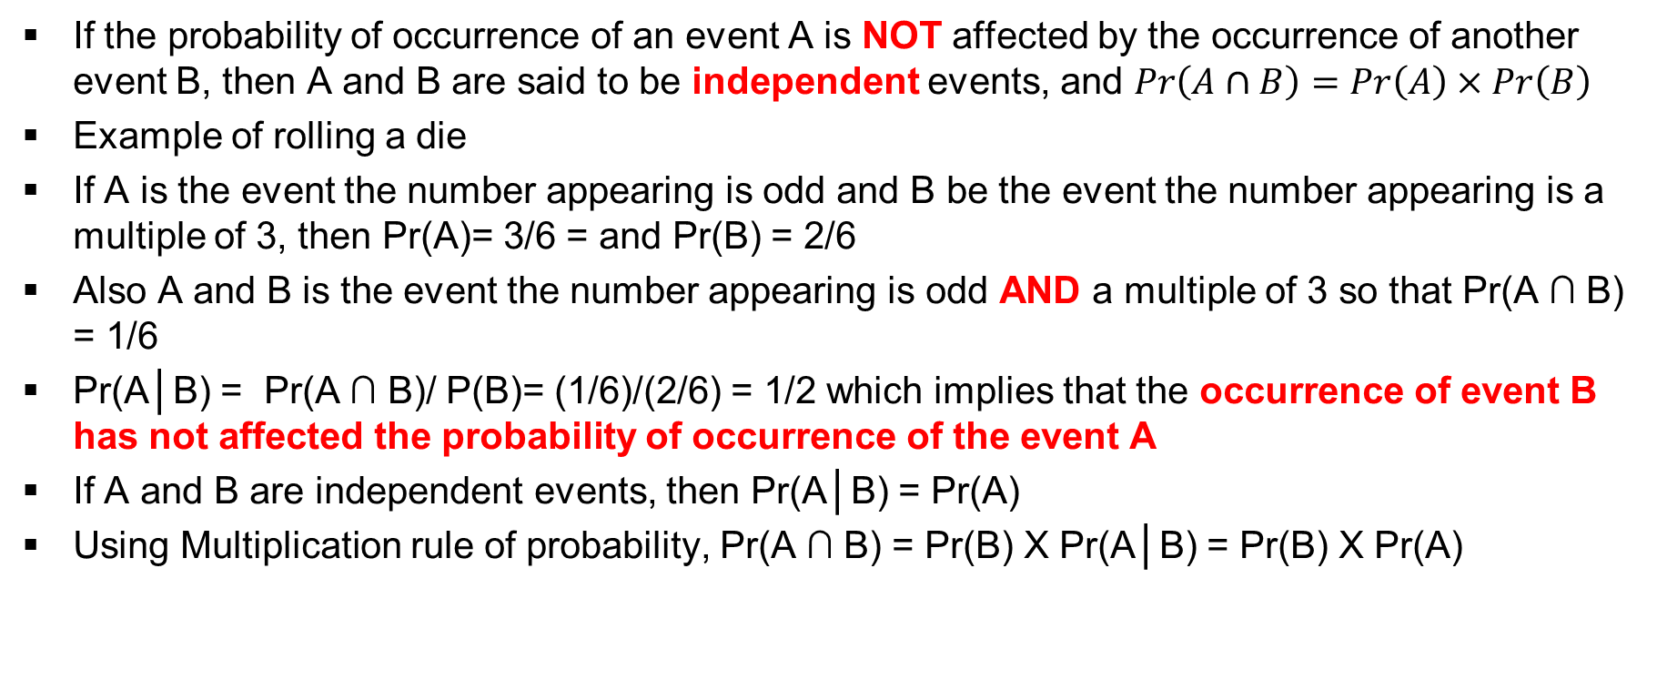
Definitions (Indepence of Events)
If the probability of occurrence of an event A is NOT affected by the occurrence of another event B, then A and B are said to be independent events, and $Pr\left(A∩B\right)=Pr\left(A\right)×Pr\left(B\right)$
Example of rolling a die
If A is the event the number appearing is odd and B be the event the number appearing is a multiple of 3, then Pr(A)= 3/6 = and Pr(B) = 2/6
Also A and B is the event the number appearing is odd AND a multiple of 3 so that Pr(A ∩ B) = 1/6
Pr(A│B) = Pr(A ∩ B)/ P(B)= (1/6)/(2/6) = 1/2 which implies that the occurrence of event B has not affected the probability of occurrence of the event A
If A and B are independent events, then Pr(A│B) = Pr(A)
Using Multiplication rule of probability, Pr(A ∩ B) = Pr(B) X Pr(A│B) = Pr(B) X Pr(A)

Slide 63
Example # 35
Suppose a fair die with faces 1, 2,….., 6 is rolled. Then Ω = {1, 2, 3, 4, 5, 6}.
Let us define the events A₁ = {1, 2}, A₂ = {3, 4, 5, 6} and A₃ = {3, 5}
  The events A₂ and A₃ are neither mutually exclusive nor exhaustive
  A₁ and A₃ are mutually exclusive but not exhaustive
  A₁, A₂ and A₃ are not mutually exclusive but are exhaustive
  A₁ and A₂ are mutually exclusive and exhaustive

Slide 64
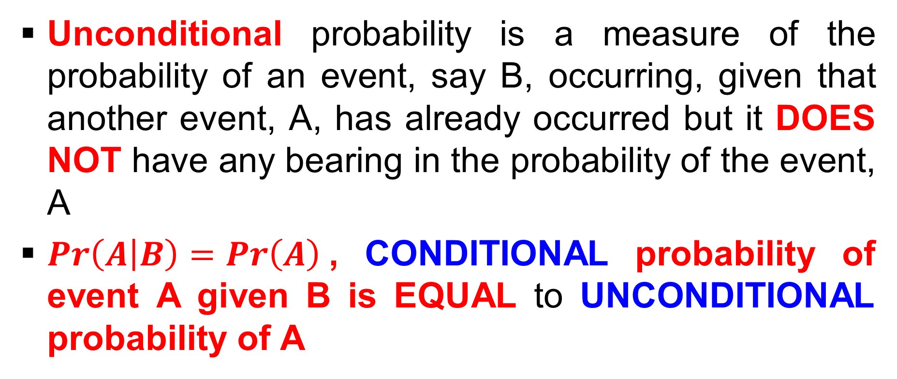
Un-Conditional probability
Unconditional probability is a measure of the probability of an event, say B, occurring, given that another event, A, has already occurred but it DOES NOT have any bearing in the probability of the event, A
$Pr\left(A | B\right)=Pr\left(A\right)$, CONDITIONAL probability of event A given B is EQUAL to UNCONDITIONAL probability of A

Slide 65
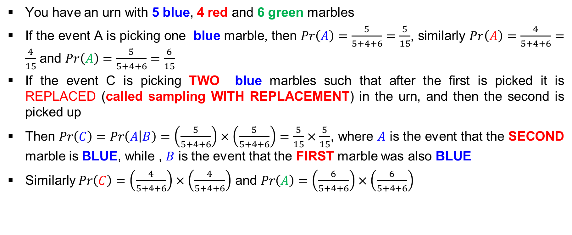
Example # 36 (a)
You have an urn with 5 blue, 4 red and 6 green marbles
If the event A is picking one blue marble, then $Pr\left(A\right)=\frac{5}{5+4+6}=\frac{5}{15}$, similarly $Pr\left(A\right)=\frac{4}{5+4+6}=\frac{4}{15}$ and $Pr\left(A\right)=\frac{5}{5+4+6}=\frac{6}{15}$
If the event C is picking TWO blue marbles such that after the first is picked it is REPLACED (called sampling WITH REPLACEMENT) in the urn, and then the second is picked up
Then $Pr\left(C\right)=Pr\left(A | B\right)=\left(\frac{5}{5+4+6}\right)×\left(\frac{5}{5+4+6}\right)=\frac{5}{15}×\frac{5}{15}$, where $A$ is the event that the SECOND marble is BLUE, while , $B$ is the event that the FIRST marble was also BLUE
Similarly $Pr\left(C\right)=\left(\frac{4}{5+4+6}\right)×\left(\frac{4}{5+4+6}\right)$ and $Pr\left(A\right)=\left(\frac{6}{5+4+6}\right)×\left(\frac{6}{5+4+6}\right)$

Slide 66
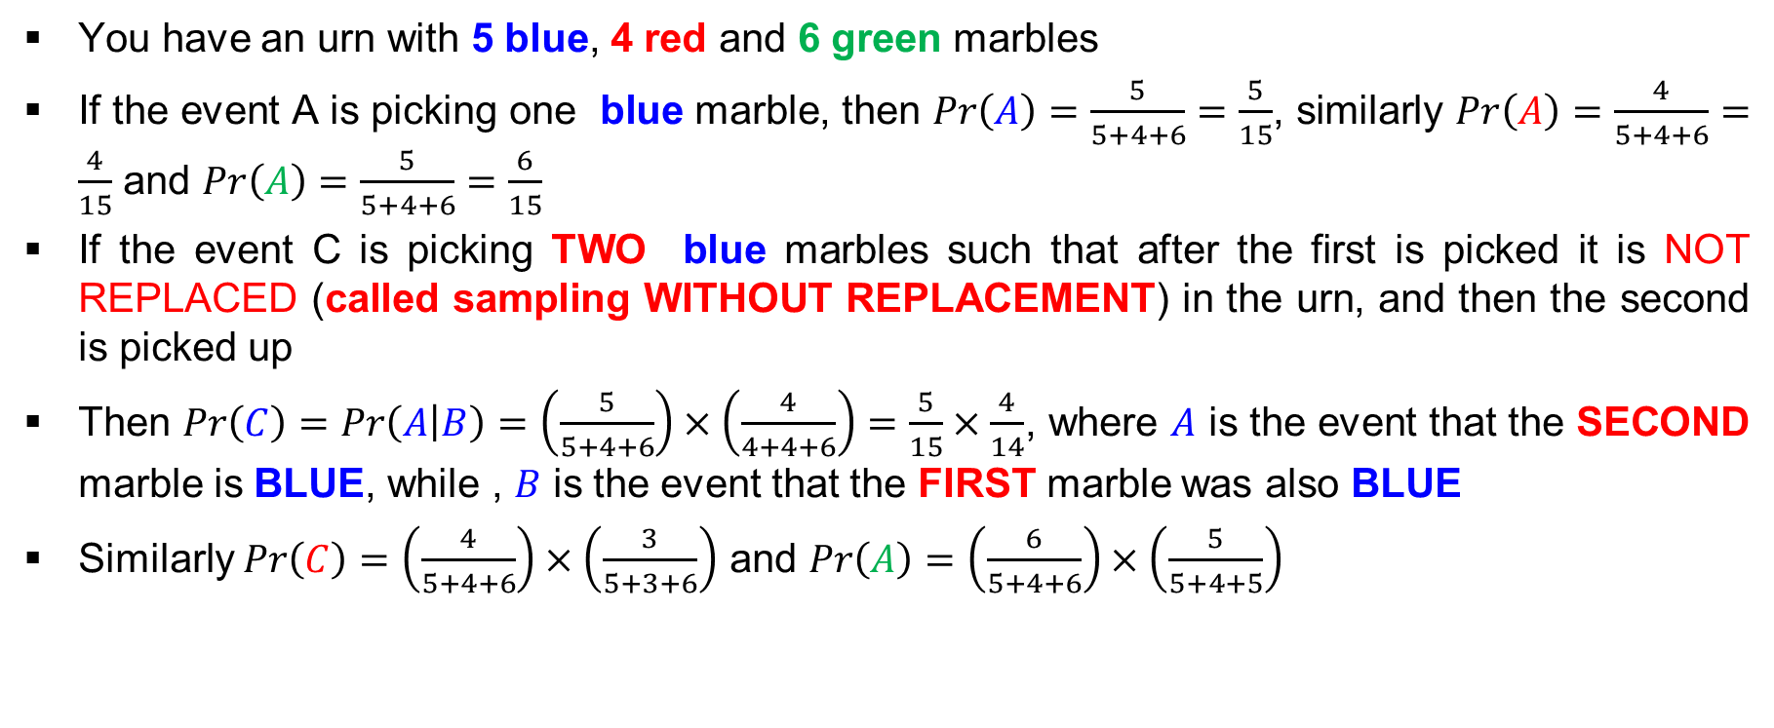
Example # 36 (b)
You have an urn with 5 blue, 4 red and 6 green marbles
If the event A is picking one blue marble, then $Pr\left(A\right)=\frac{5}{5+4+6}=\frac{5}{15}$, similarly $Pr\left(A\right)=\frac{4}{5+4+6}=\frac{4}{15}$ and $Pr\left(A\right)=\frac{5}{5+4+6}=\frac{6}{15}$
If the event C is picking TWO blue marbles such that after the first is picked it is NOT REPLACED (called sampling WITHOUT REPLACEMENT) in the urn, and then the second is picked up
Then $Pr\left(C\right)=Pr\left(A | B\right)=\left(\frac{5}{5+4+6}\right)×\left(\frac{4}{4+4+6}\right)=\frac{5}{15}×\frac{4}{14}$, where $A$ is the event that the SECOND marble is BLUE, while , $B$ is the event that the FIRST marble was also BLUE
Similarly $Pr\left(C\right)=\left(\frac{4}{5+4+6}\right)×\left(\frac{3}{5+3+6}\right)$ and $Pr\left(A\right)=\left(\frac{6}{5+4+6}\right)×\left(\frac{5}{5+4+5}\right)$

Slide 67
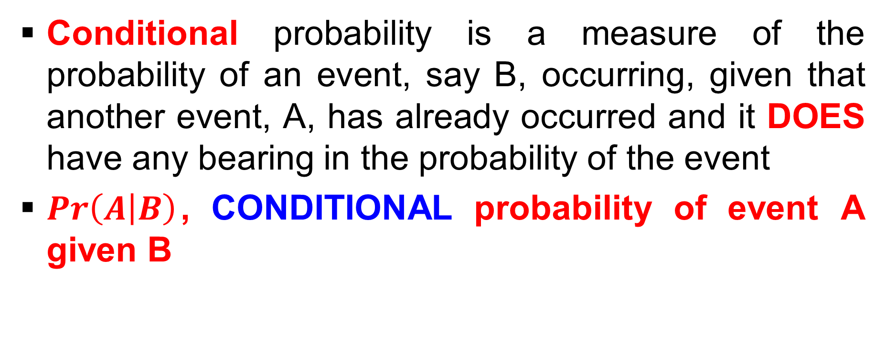
Conditional probability
Conditional probability is a measure of the probability of an event, say B, occurring, given that another event, A, has already occurred and it DOES have any bearing in the probability of the event
$Pr\left(A | B\right)$, CONDITIONAL probability of event A given B

Slide 68
Example # 37
Let A and B be two events such that P(B) > 0.
Then the conditional probability of A given B is P(A|B) = P(A∩B)/P(B).
Assume Ω = {1, 2, 3, 4, 5, 6}, A = {2}, B = {2, 4, 6}, then A∩B = {2}
Hence:
  P(A|B) = P(A∩B)/P(B) = (1/6)/(3/6) = 1/3
  P(B|A) = P(B∩A)/P(A) = (1/6)/(1/6) = 1

Slide 69
Baye′s Theorem
Let B₁,….., B_{n} be mutually exclusive and exhaustive events such that P(B_{𝑖}) > 0, for every 𝑖 = 1, …., n
A be any event such that P(A) = ∑_{𝑖=1,..,n}P(A|B_{𝑖})P(B_{𝑖})
Then P(B_{j}|A) = P(A|B_{𝑗})P(B_{𝑗})/∑_{𝑖=1,..,n}P(A|B_{𝑖})P(B_{𝑖})
Read the proof

Slide 70
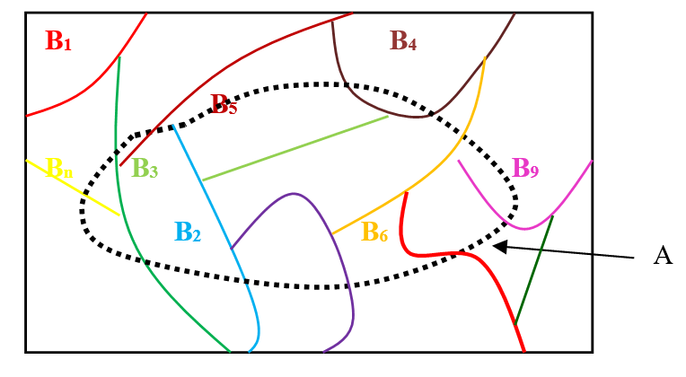
Baye′s Theorem (contd…)

Slide 71
Baye′s Theorem (contd…)
Let A, B, C be events, then
P(A|B∩C) = P[A∩(B∩C)]/P(B∩C)
P(A|B∩C) = P(B|A∩C)P(A|C)/P(B|C)
Read the proof
Let A₁, …. , A_{n} be events, then in a similar manner P(A₁|A₂∩…. ∩A_{n}) can be expressed
Read the proof

Slide 72
Example # 38
In an examination each question has four alternatives, answer of which only one is correct.
If a student knows the correct alternative then he/she is definitely able to identify it.
Otherwise he/she picks one of the alternatives at random.
Given that a student has identified the correct alternative what is the conditional probability that he/she knew it, assuming 70% of the student know the correct alternative to the question under consideration.

Slide 73
Example # 38 (contd…)
Let us define the following events
  A = The student identifies the correct alternative
  B₁ = The student knows the correct alternative
  B₂ = The student does not know the correct alternative
  Then we know that P(B₁) = 0.7, P(B₂) = 0.3, P(A|B₁) = 1 and P(A|B₂) = 0.25 from which we have P(B₁|A) = 0.9032

Slide 74
Exercise
The marketing manager of a toy manufacturing company is considering the marketing of a new toy.
In the past 40% of the toys introduced by the company have been successful and 60% have been unsuccessful. Before the toy is marketed, a market research is conducted and a report, either favourable or unfavourable, is compiled.
In the past, 80% of the successful toys received a favourable market research report, and 30% of the unsuccessful received a favourable market research report.
The marketing manager wants to know the probability that the toy will be successful if it receives a favourable report

Slide 75
Few Inequalities in Probability
Boole's Inequality
Bonferroni's Inequality
Poincare's Theorem
Tchebychev's/Chebyshev's Inequality
Markov's Inequality
Cauchy–Schwarz Inequality
Jensen’s Inequality
Kolmogorov's Inequality
Chernoff Bounds
Hölder's Inequalities

Slide 76
Few Inequalities in Probability (contd…)
Define the probability space (Ω,ℱ,P).
  Ω: Sample space
  ℱ: Set of sub-sets of Ω
  P: Function mapping of ℱ to [0,1]

Slide 77
Boole's Inequality
If A_{𝑖}, 𝑖 = 1,…., k are events in A, i.e., A_{𝑖} ∈ A
P(∪_{𝑖=1,..,k}A_{𝑖}) ≤ ∑_{𝑖=1,..,k}P(A_{𝑖})
Read the proof

Slide 78
Bonferroni's Inequality
If A_{𝑖}, 𝑖 = 1,…., k are events in A, i.e., A_{𝑖} ∈ A
P(∩_{𝑖=1,..,k}A_{𝑖}) ≥ 1 − ∑_{𝑖=1,..,k}P(A^{C}_{𝑖})
Read the proof

Slide 79
Poincare's Theorem
If A_{𝑖}, 𝑖 = 1,…., k are events in A, i.e., A_{𝑖} ∈ A
P(∪_{𝑖=1,..,k}A_{𝑖}) = ∑_{𝑖=1,..,k}P(A_{𝑖}) − ∑ _{𝑖<j=1,..,k}P(A_{𝑖}∩A_{j}) + ∑_{𝑖<j<ℓ=1,..,k}P(A_{𝑖}∩A_{j} ∩A _{ℓ}) − ….. + (−1)^{k−1}P(A₁∩….. ∩A_{k})
Read the proof

Slide 80
Tchebychev′s/Chebyshev′s Inequality
Let X be a r.v such that
  E[X] exists
  V[X] exists
Then for every positive t we have P(|X – E(X)| ≥ t) ≤ V(X)/t²
Read the proof

Slide 81
Markov′s Inequality
Let X be a non-negative r.v such that
  E[X] exists
Then for every positive t we have P(X ≥ t) ≤ E[X]/t
Read the proof

Slide 82
Cauchy–Schwarz Inequality
If X and Y are two r.v., then E(XY)² ≤ E(X²)E(Y²)
If X₁,…, X_{k} are k number of r.v.’s, then E(X₁…X_{k})² ≤ E(X₁²)….E(X_{k}²)
Read BOTH the proofs

Slide 83
Jensen's inequality
Suppose X is a random variable such that P (𝑎 ≤ X ≤ 𝑏) = 1, then
  If g is a convex function in [a, b], then E{𝑔(X)} ≥ 𝑔{E(X)}
  If g is a concave function in [a, b], then E{𝑔(X)} ≤ 𝑔{E(X)}
Read the proof

Slide 84
Kolmogorov′s Inequality
Let X₁,…. , X_{n} be independent r.v such that E[X_{𝑖}] = 0 and Var[X_{𝑖}] = σ_{𝑖} ², 𝑖 = 1, ….., n
Then, for all a > 0, P(max|X₁ + …. + X_{𝑛}| ≥ 𝑎) ≤ (1/𝑎²)∑σ_{𝑖} ²
Read the proof

Slide 85
Chernoff Bounds
If X is a r.v., then for any real value of t
  P(X ≥ t) = P(e^{sX} ≥ e^{st}), for s>0
  P(X ≤ t) = P(e^{sX} ≥ e^{st}), for s<0
Read the proof

Slide 86
Hölder's Inequalities (for Integrals)
Consider p₁,.., p_{k} > 1, with {(1/p₁)+… + (1/p_{k})} = 1
Also assume functions f₁(x), …., f_{k}(x) and a and b be the integral limits
Then ∫_{a≤x≤b}|f₁(X)……f_{k}(X)|dx ≤ {∫_{a≤x≤ b}|f₁(X)|^{p1}dx}^{(1/p1)}……. {∫_{a≤x≤ b}|f_{k}(X)|^{pk}dx}^{(1/pk)}
Read the proof
Verify when p₁ =….. = p_{k} = k we get Cauchy–Schwarz Inequality

Slide 87
Hölder's Inequalities (for Sums)
Consider p₁,.., p_{k} > 1, with (1/p₁)+… + (1/p_{k}) = 1
Also assume a₁, …., a_{k}
Then Σ_{𝑖=1,…,k}|a₁……a_{k}| ≤ {Σ_{𝑖=1,…,k}|a₁|^{p1}}^{(1/p1)}……. {Σ_{𝑖=1,…,k}|a_{k}|^{pk}}^{(1/pk)}
Read the proof
Verify when p₁ =….. = p_{k} = k we get Cauchy–Schwarz Inequality

Slide 88
Few Inequalities in Probability (contd…)
Markov inequality is the weakest
Tchebychev’s inequality is stronger than Markov's inequality
Chernoff bound is the strongest bound

