Slide 1

IME602: Probability and Statistics-DISTRIBUTIONS
Raghu Nandan Sengupta
Industrial & Management Engineering Department
Indian Institute of Technology Kanpur

Slide 2
Coverage
Joint Distribution
Marginal Distribution
Expected Value
Variance
Independence
Pair Independence
Mutual Independence
Distributions

Slide 3
Coverage
Discrete Distributions
Continuous Distributions
Normal approximation to Binomial distribution
De Moivre Laplace Limit Theorems
Bernoulli's Theorem
Relationship between Poisson and Exponential distribution
Central Limit Theorem
Q-Q Plots

Slide 4
Joint and Marginal Probability
Y X | Y₁ | . | . | Y_{M}
X₁ | p_{1,1} | . | . | p_{1,M} | ∑_{𝑗=1,…,M}p_{1,𝑗}
. | . | . |  | . | .
. | . | . |  | . | .
X_{L} | p_{L,1} | . |  | p_{L,M} | ∑_{𝑗=1,…,M}p_{L,𝑗}
 | ∑_{𝑖=1,.,L}p_{𝑖,1} |  |  | ∑_{𝑖=1,.,L}p_{𝑖,M} | 1

Slide 5
Joint and Marginal Probability (contd….)
Given two discrete r.v.’s, X and Y
  Joint probability of X and Y is P(X = x_{𝑖}, Y= y_{𝑗}) = p_{X=𝑖,Y=𝑗}
  ∑_{∀X𝑖}∑_{∀Y𝑗}P(X = x_{𝑖,} Y= y_{𝑗}) = ∑_{𝑖=1,.,L}∑_{𝑗=1,…,M}p_{X=𝑖,Y=𝑗} = 1
Given two continuous r.v.’s X and Y
  Joint probability of X and Y is f(X = x_{𝑖}, Y= y_{𝑗})
  ∫_{∀x}∫_{∀y}f(X = x_{𝑖}, Y= y_{𝑗})dxdy = 1

Slide 6
Joint and Marginal Probability (contd….)
Given two discrete r.v.’s, X and Y
  Marginal probability of X is P(X = x_{𝑖}) = ∑_{∀Y𝑗}P(X = x_{𝑖}, Y= y_{𝑗}) = p_{X=𝑖,Y}
  ∑_{∀X𝑖}p_{X=𝑖,Y} = 1
Given two continuous r.v.’s X and Y
  Marginal probability of X is f(X = x_{𝑖}) = ∫_{∀y𝑗}f(X = x_{𝑖}, Y= y_{𝑗})dy_{𝑗} = f(X = x_{𝑖})_{∀Y}
  ∫_{∀xi}f(X = x_{𝑖})_{∀Y}dx_{𝑖} = 1

Slide 7
Joint and Marginal Probability (contd….)
Marginal probability of X given Y=1,2,3,4 | Marginal probability of Y given X=1,2,3,4
p_{X,Y=1} = ∑_{𝑖=1,2,3,4}p_{𝑖,1} | p_{X=1,Y} = ∑_{𝑖=1,2,3,4}p_{1,j}
p_{X,Y=2} = ∑_{𝑖=1,2,3,4}p_{𝑖,2} | p_{X=2,Y} = ∑_{𝑖=1,2,3,4}p_{2,j}
p_{X,Y=3} = ∑_{𝑖=1,2,3,4}p_{𝑖,3} | p_{X=3,Y} = ∑_{𝑖=1,2,3,4}p_{3,j}
p_{X,Y=4} = ∑_{𝑖=1,2,3,4}p_{𝑖,4} | p_{X=4,Y} = ∑_{𝑖=1,2,3,4}p_{4,j}

Slide 8
Expected Value ad Variance given Joint and Marginal Probabilities
Given two discrete r.v.’s, X and Y
  Conditional Expected Value of X given Y: E(X|Y=𝑗) = ∑_{𝑖=1,.,L}(x_{𝑖,Y=j}p_{𝑖,Y=𝑗})
  Conditional Variance of X given Y: V(X|Y=𝑗) = ∑_{𝑖=1,.,L}[{X_{𝑖, 𝑗} − E(X|Y = j)}²p_{𝑖,Y=𝑗}]
Given two continuous r.v.’s X and Y
  Conditional Expected Value of X given Y: E(X|Y=𝑗) = ∫_{∀x} x_{Y=𝑗}f(x_{Y=𝑗}|Y=Y_{𝑗})dx_{Y=𝑗}
  Conditional Variance of X given Y: V(X|Y=𝑗) = ∫_{∀x}[{X_{𝑖,𝑗} − E(X|Y = j)}²f(x_{Y=𝑗}|Y=Y_{𝑗})dx_{Y=𝑗}]

Slide 9
Example # 39
Two unbiased dice are tossed
X is the r.v. for the 1st die
Y is the r.v. for the 2nd die
Z is the r.v. denoted by Z = max (X, Y)
Draw/Find
  Bi-variate table for X and Z
  3D graph P(X=x,Z=z) wrt X and Z
  E(X|Z=3)
  V(Z|X=4)

Slide 10
Example # 39 (contd…)
X | Y | Z=Max(X,Y) | X | Y | Z=Max(X,Y) | X | Y | Z=Max(X,Y)
1 | 1 | 1 | 1 | 3 | 3 | 1 | 5 | 5
2 | 1 | 2 | 2 | 3 | 3 | 2 | 5 | 5
3 | 1 | 3 | 3 | 3 | 3 | 3 | 5 | 5
4 | 1 | 4 | 4 | 3 | 4 | 4 | 5 | 5
5 | 1 | 5 | 5 | 3 | 5 | 5 | 5 | 5
6 | 1 | 6 | 6 | 3 | 6 | 6 | 5 | 6
1 | 2 | 2 | 1 | 4 | 4 | 1 | 6 | 6
2 | 2 | 2 | 2 | 4 | 4 | 2 | 6 | 6
3 | 2 | 3 | 3 | 4 | 4 | 3 | 6 | 6
4 | 2 | 4 | 4 | 4 | 4 | 4 | 6 | 6
5 | 2 | 5 | 5 | 4 | 5 | 5 | 6 | 6
6 | 2 | 6 | 6 | 4 | 6 | 6 | 6 | 6

Slide 11
Example # 39 (contd…)
X Z | 1 | 2 | 3 | 4 | 5 | 6
1 | 1/36 | 0/36 | 0/36 | 0/36 | 0/36 | 0/36 | 1/36
2 | 1/36 | 2/36 | 0/36 | 0/36 | 0/36 | 0/36 | 3/36
3 | 1/36 | 1/36 | 3/36 | 0/36 | 0/36 | 0/36 | 5/36
4 | 1/36 | 1/36 | 1/36 | 4/36 | 0/36 | 0/36 | 7/36
5 | 1/36 | 1/36 | 1/36 | 1/36 | 5/36 | 0/36 | 9/36
6 | 1/36 | 1/36 | 1/36 | 1/36 | 1/36 | 6/36 | 11/36
 | 6/36 | 6/36 | 6/36 | 6/36 | 6/36 | 6/36 | 36/36

Slide 12
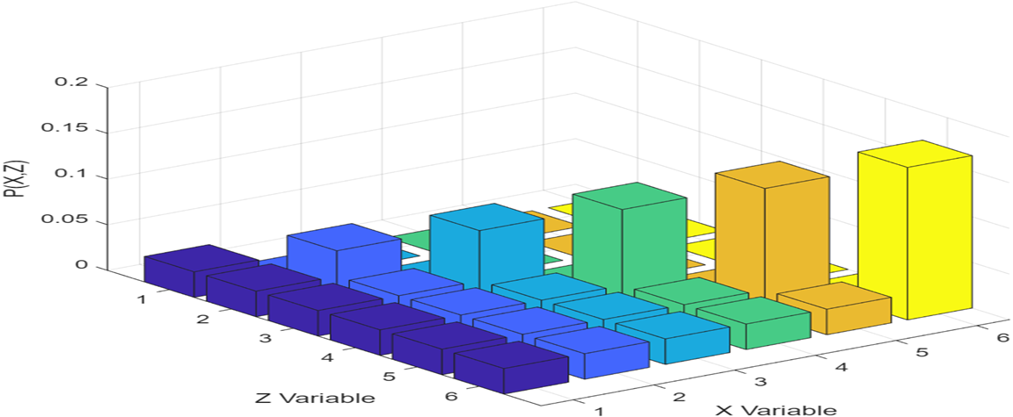
Example # 39 (contd…)

Slide 13
Example # 39 (contd…)
E(X|Z=3) = 1(1/36) + 2(1/36) + 3(3/36) +4(0/36) + 5(0/36) + 6(0/36) = 12/36 = 1/3
E(Z|X=4) = 1(0/36) + 2(0/36) + 3(0/36) + 4(4/36) + 5(1/36) + 6(1/36) = 27/36 = 3/4
V(Z|X=4) = (1−3/4)²(0/36) + (2−3/4)²(0/36) + (3−3/4)²(0/36) + (4−3/4)²(4/36) + (5−3/4)²(1/36) + (6−3/4)²(1/36) = 2.44

Slide 14
Example # 40
One unbiased dice (1st dice) of SIX (06) faces (marked 1,2,3,4,5,6) and another unbiased dice (2nd dice) also of SIX (06) faces (marked -1,-2,-3,-4,-5,-6) are tossed
X is the r.v. for the 1st die with SIX (06) faces
Y is the r.v. for the 2nd die with SIX (06) faces
Z is the r.v. denoted by Z = min(X, Y)
With this information the the Bi-Variate plot diagram of P(Y,Z) wrt Y (X-axis) and Z (Y-axis) is?

Slide 15
Example # 40 (contd…)
X | Y | Z=Min(X,Y) | X | Y | Z=Min(X,Y) | X | Y | Z=Min(X,Y)
1 | -1 | -1 | 3 | -1 | -1 | 5 | -1 | -1
1 | -2 | -2 | 3 | -2 | -2 | 5 | -2 | -2
1 | -3 | -3 | 3 | -3 | -3 | 5 | -3 | -3
1 | -4 | -4 | 3 | -4 | -4 | 5 | -4 | -4
1 | -5 | -5 | 3 | -5 | -5 | 5 | -5 | -5
1 | -6 | -6 | 3 | -6 | -6 | 5 | -6 | -6
2 | -1 | -1 | 4 | -1 | -1 | 6 | -1 | -1
2 | -2 | -2 | 4 | -2 | -2 | 6 | -2 | -2
2 | -3 | -3 | 4 | -3 | -3 | 6 | -3 | -3
2 | -4 | -4 | 4 | -4 | -4 | 6 | -4 | -4
2 | -5 | -5 | 4 | -5 | -5 | 6 | -5 | -5
2 | -6 | -6 | 4 | -6 | -6 | 6 | -6 | -6

Slide 16
Example # 40 (contd…)
Z Y | -1 | -2 | -3 | -4 | -5 | -6
-1 | 6/36 | 0/36 | 0/36 | 0/36 | 0/36 | 0/36 | 6/36
-2 | 0/36 | 6/36 | 0/36 | 0/36 | 0/36 | 0/36 | 6/36
-3 | 0/36 | 0/36 | 6/36 | 0/36 | 0/36 | 0/36 | 6/36
-4 | 0/36 | 0/36 | 0/36 | 6/36 | 0/36 | 0/36 | 6/36
-5 | 0/36 | 0/36 | 0/36 | 0/36 | 6/36 | 0/36 | 6/36
-6 | 0/36 | 0/36 | 0/36 | 0/36 | 0/36 | 6/36 | 61/36
 | 6/36 | 6/36 | 6/36 | 6/36 | 6/36 | 6/36 | 36/36

Slide 17
Example # 40 (contd…): MATLAB Code
% Define the possible values for Y and Z
y_values = [-1, -2, -3, -4, -5, -6];
z_values = [-1, -2, -3, -4, -5, -6];
% Define the joint probability mass function (PMF)
% P(Y=y_i, Z=z_j)
% This matrix must sum to 1
P_joint = [0.17,0,0,0,0,0;
0,0.17,0,0,0,0;
0,0,0.17,0,0,0;
0,0,0,0.17,0,0;
0,0,0,0,0.17,0;
0,0,0,0,0,0.17];
% Verify that the sum of probabilities is 1 (or very close due to floating point)
sum_P_joint = sum(P_joint(:));
fprintf('Sum of joint probabilities: %.4f\n', sum_P_joint);
% Visualize the joint PMF using a 3D bar plot

Slide 18
Example # 40 (contd…): MATLAB Code
figure;
bar3(P_joint);
set(gca, 'XTickLabel', y_values);
set(gca, 'YTickLabel', z_values);
xlabel('Y Values');
ylabel('Z Values');
zlabel('P(Y,Z)');
title('Bi-Variate PMF of P(Y,Z)');
% Calculate marginal PMFs
P_y = sum(P_joint, 2); % Sum across columns to get P(Y)
P_z = sum(P_joint, 1); % Sum across rows to get P(Z)
fprintf('Marginal PMF for Y:\n');
disp(P_y);
fprintf('Marginal PMF for Z:\n');
disp(P_z);

Slide 19
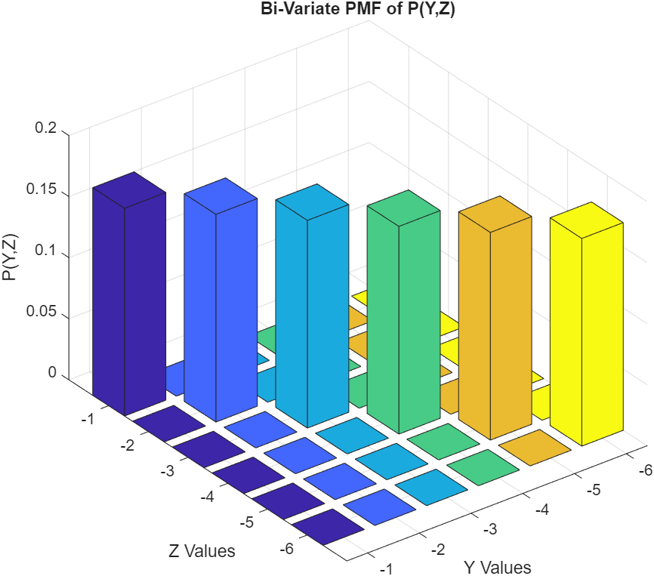
Example # 40 (contd…)

Slide 20
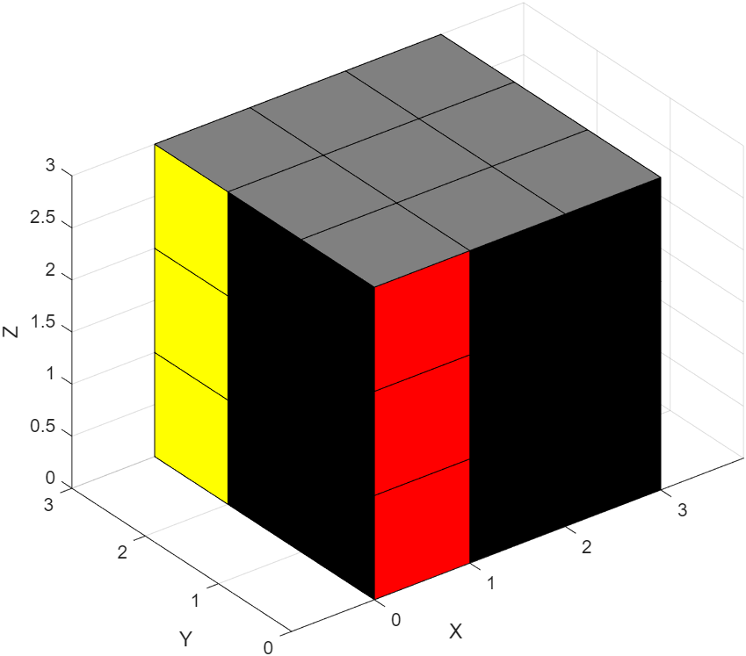
Tri-Variate Case of three r.v.’s X, Y, Z

Slide 21
Tri-Variate Case of three r.v.’s X, Y, Z (contd…)
Given three discrete r.v.’s, X, Y and Z
  Joint probability of X, Y and Z is P(X = x_{𝑖}, Y= y_{j}, Z = z_{k}) = p_{X=𝑖,Y=j, Z=k}
  ∑_{∀X𝑖}∑_{∀Yj}∑_{∀Zk}P(X=x_{𝑖},Y=y_{j},Z=z_{k}) = ∑_{𝑖=1,.,L}∑_{j=1,…,M}∑_{k=1,…,N}p_{X=𝑖,Y=j,Z=k} = 1
Given three continuous r.v.’s X, Y and Z
  Joint probability of X, Y and Z is f(X = x_{𝑖}, Y= y_{j}, Z = z_{k})
  ∫_{∀x}∫_{∀y}∫_{∀z}f(X = x_{𝑖}, Y= y_{j}, Z = z_{k})dxdydz = 1

Slide 22
Tri-Variate Case of three r.v.’s X, Y, Z (contd…)
Given three discrete r.v.’s, X, Y and Z one can formulate the Marginal probabilities, Conditional Expected Values, Conditional Expected Variances
Given three continuous r.v.’s, X, Y and Z one can formulate the Marginal probabilities, Conditional Expected Values, Conditional Expected Variances

Slide 23
Independence of two and more events
Two events A and B are called independent if P(A∩B) = P(A)P(B)
Three events A, B and C are called independent if P(A∩B∩C) = P(A)P(B)P(C)

Slide 24
Pairwise Independence
If events A, B, and C are pairwise independent, then:
  P(A∩B) = P(A)P(B)
  P(A∩C) = P(A)P(C)
  P(B∩C) = P(B)P(C)

Slide 25
Mutual Independence
Events A, B, and C are mutually independent, then P(A∩B∩C) = P(A)P(B)P(C)
Events A₁, ….., A_{k} are mutually independent, then P(A₁∩….∩A_{k}) = P(A₁)….P(A_{k})

Slide 26
Independence Rule
Independence of two events does not necessarily imply the independence of three events.
Pairwise independence (independence of each pair within a set of events) is a necessary condition for mutual independence (independence of the entire set), it is not sufficient.
k−1 independence does not mean k independence
k independence implies k−1,…., 2 independence

Slide 27
Example # 41
Consider a fair coin tossed twice, then the outcomes are {HH,HT,TH,TT}.
  A: Event that the first toss is Head, i.e., {HH, HT}
  B: Event that the second toss is Head, i.e., {HH, TH}
  C: Event that both tosses are the same, i.e., {HH, TT}
P(A) = 1/2, P(B) = 1/2 and P(C) = 1/2

Slide 28
Example # 41 (contd…)
P(A∩B) = 1/4 = (1/2)(1/2) = P(A)P(B)
P(B∩C) = 1/4 = (1/2)(1/2) = P(B)P(C)
P(A∩C) = 1/4 = (1/2)(1/2) = P(A)P(C)
P(A∩B∩C) = 1/4 ≠ P(A)P(B)P(C) = (1/2)(1/2)(1/2) = 1/8
These events are pairwise independent (as all the two-way intersection probabilities are products of individual probabilities), but not mutually independent.

Slide 29
Distribution
Depending on outcome of an experiment a random variable (r.v) is used to denote the outcome.
We usually denote the r.v. using X, Y or Z and the corresponding probability mass function (pmf) and probability density function (pdf) is denoted by P(X=x) or P(X=𝑖) and f(x); P(Y=y) or P(Y=j) and f(y) or P(Z=z) or P(Z=k) and f(z)
Discrete: probability mass function (pmf)
Continuous: probability density function (pdf)

Slide 30
P(X=x) and F(x) for Discrete Case
P(X = 𝑖) = p_{𝑖} for 𝑖 = 1,….., k
F(x) = P(X ≤ x) = ∑_{X≤x}P(X = x)
1 − F(x ) = P(X > x) = ∑_{X>x}P(X = x)
P(X = 1) +….. + P(X = k) = P(Ω) = 1

Slide 31
f(x) and F(x) for Continuous Case
f(x) is pdf for x ∈ ℝ
F(x) = P(X ≤ x) = ∫_{X≤x}f(x)dx = ∫_{X≤x}dF(x)
1 − F(x ) = P(X > x) = ∫_{X≥x}f(x)dx
∫_{∀x}f(x)dx = 1
Remember for continuous case, conceptually f(x) = 0, but ∫_{−∞≤x+∞}f(x)dx =1

Slide 32
Discrete distribution
Uniform discrete distribution
Binomial distribution
Negative binomial distribution
Geometric distribution
Hypergeometric distribution
Poisson distribution
Log distribution

Slide 33
Bernoulli Trails
Each trial has two possible outcomes, say a success and a failure.
The trials are independent
The probability of success remains the same and so does the probability of failure from one trial to another

Slide 34
Uniform discrete distribution
[X ~ UD (a , b) ]
f(x) = 1/n, x = a, a + k,….., b {= a + (n − 1)k}
a and b are the parameters, a < b ∈ ℝ
E(X) = μ_{m} = a + (1/2)(n − 1)k = (a + b)/2
V(X) = k²{(n² − 1)/12}
Median = μ_{e} = (a + b)/2
Mode = μ_{o} = No single value

Slide 35
Uniform discrete distribution
[X ~ UD (a , b) ] (contd…)
X ~ UD(1/2, 29)
P(X= 𝑖) = 1/20
Where a = 1/2, k = 3/2, b = a + (n − 1)k = (1/2) + (20 − 1)(3/2) 29, n = 20
E(X) = a + (1/2)*(n − 1)k = (1/2) + (1/2)*(20 − 1)(3/2) = 14.75 = {(1/2) + 29}*(1/2)
V(X) = k²{(n² − 1)/12} = (3/2)²{(20² − 1)/12} = 74.8125

Slide 36
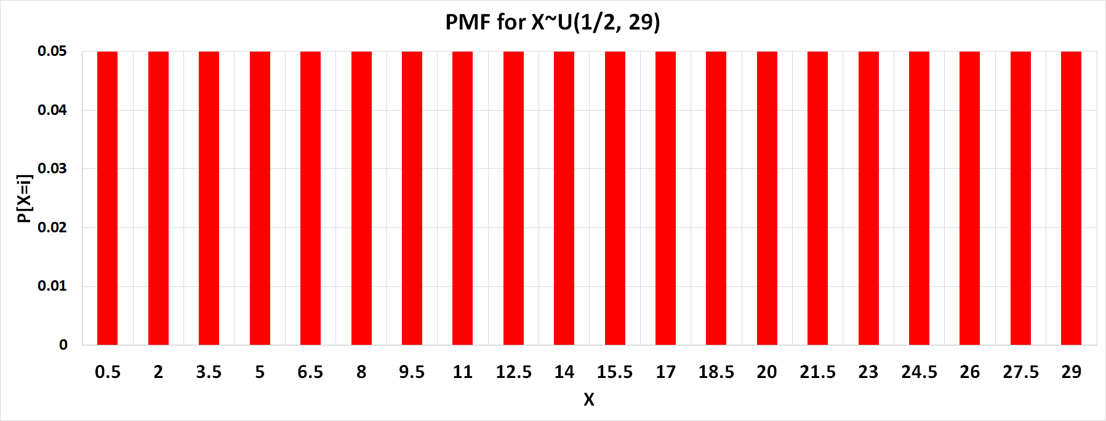
Uniform discrete distribution
[X ~ UD (a , b) ] (contd…)

Slide 37
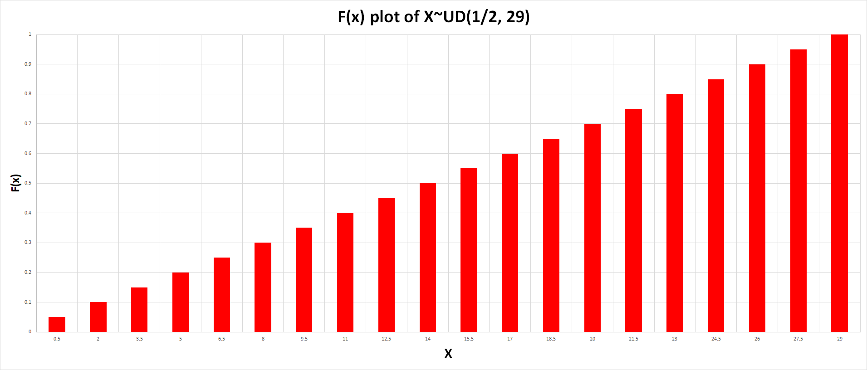
Uniform discrete distribution
[X ~ UD (a , b) ] (contd…)

Slide 38
Binomial distribution
[X ~ B (p , n)]
f(x) = ^{n}C_{x}p^{x}q^{n-x}, x = 0, 1, 2,…..,n
n and p are the parameters where p ∈ [0, 1] and n ∈ ℤ⁺
E(X) = μ_{m} = np
V[X] = npq
Median = μ_{e} = ⎣np⎦ or ⎡np⎤
Mode = μ_{o}= ⎣(n+1)p⎦ or ⎡(n+1)p⎤ − 1

Slide 39
Binomial distribution
[X ~ B (p , n)] (contd…)
Consider you are checking the quality of the product coming out of the shop floor.
A product can either pass (with probability p = 0.8) or fail (with probability q = 0.2) and for checking you take such 50 products (n = 50).
If X is the random variable denoting the number of success in these 50 inspections, we have X~⁵⁰C_{x}(0.8)^{x}(0.2)^{50-x}

Slide 40
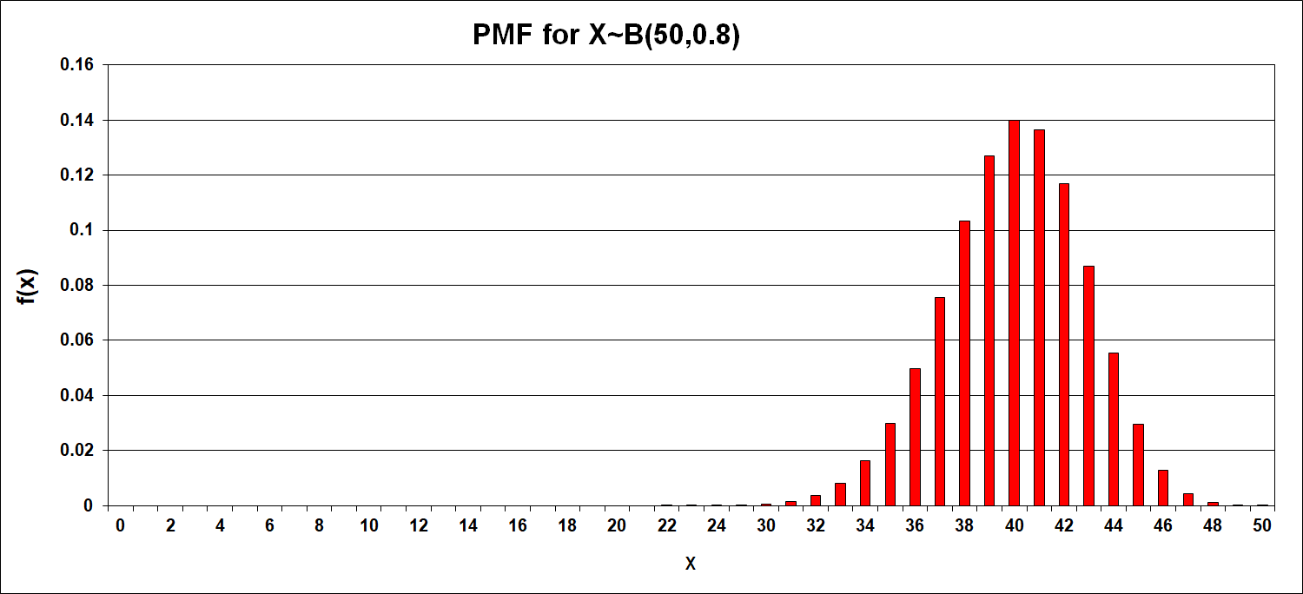
Binomial distribution
[X ~ B (p , n)] (contd…)

Slide 41
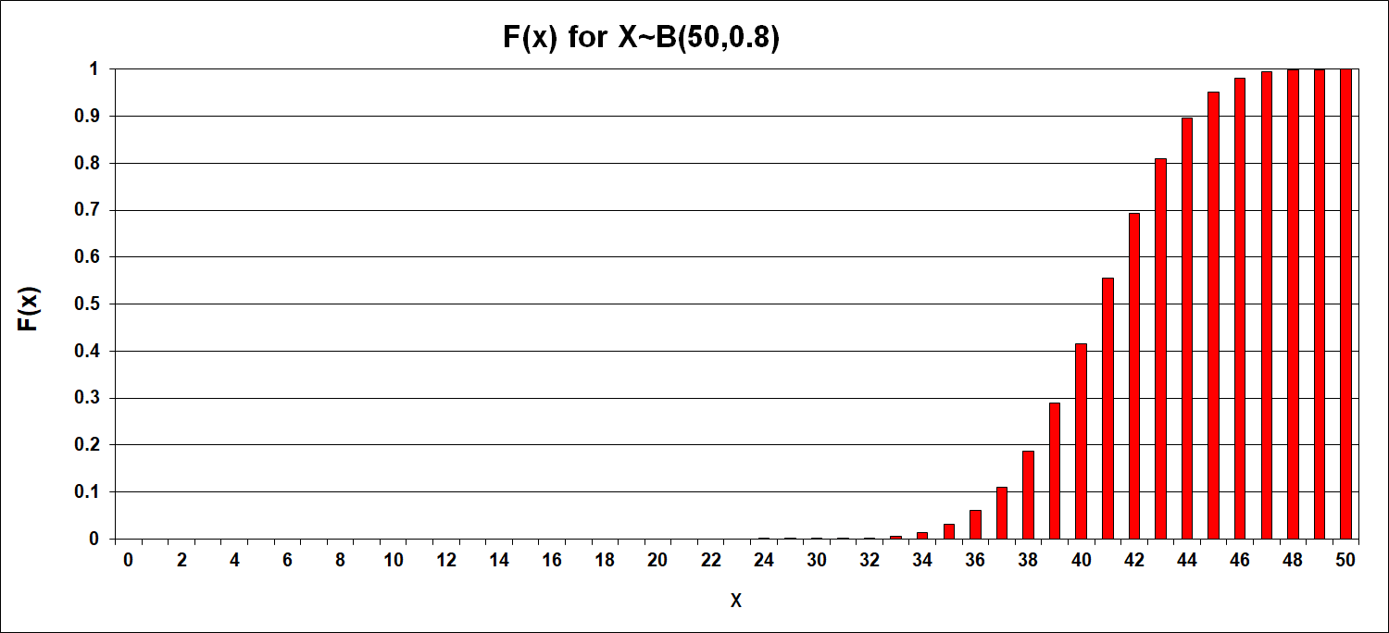
Binomial distribution
[X ~ B (p , n)] (contd…)

Slide 42
Example # 42
20% of the BSNL shares are owned by Mr.Murali Lal.
A random sample of 5 shares is chosen.
What is the probability that at most 2 of them will be found to be owned by Mr.Murali Lal?

Slide 43
Example # 42 (contd…)
Here p=0.2, q=0.8.
Hence the required probability is:
  P(X ≤ 2) = P(X=0) + P(X=1) + P(X=2)
  P(X ≤ 2) = ⁵C₀0.2⁰0.8⁵ + ⁵C₁0.2¹0.8⁴ + ⁵C₂(0.2)²(0.8)³
E(X) = 5*0.2 = 1.0
V(X) = 5*0.2*0.8 = 0.8

Slide 44
Exercise
Mr. Abhishek Bhatia finds that 70% of the students have answered question # 1 correctly in his chemistry examination.
A random sample of 10 answer scripts is chosen.
What is the probability that at least 3 of the students have correctly answered the question # 1?

Slide 45
Negative binomial distribution
[X ~ NB (p , r)]
f(x) = ^{r+x−1}C_{r−1}p^{r}q^{x}, x = 0, 1,.…..
p and r are the parameters where p ∈ [0, 1] and r ∈ ℤ⁺
E(X) = μ_{m}= rq/p
V[X] = rq/p²
Median = μ_{e} = No single value
Mode = μ_{o} = ⎣(r – 1)q/p⎦

Slide 46
Negative binomial distribution
[X ~ NB (p , r)] (contd…)
Consider the example above where you are still inspecting items from the production line.
Now you are interested in finding the probability distribution of the number of failures preceding the 5th success of getting the right product.
Then, with p=0.8, q=0.2, X~^{5+x-1}C₅₋₁(0.8)⁵(0.2)^{x}

Slide 47
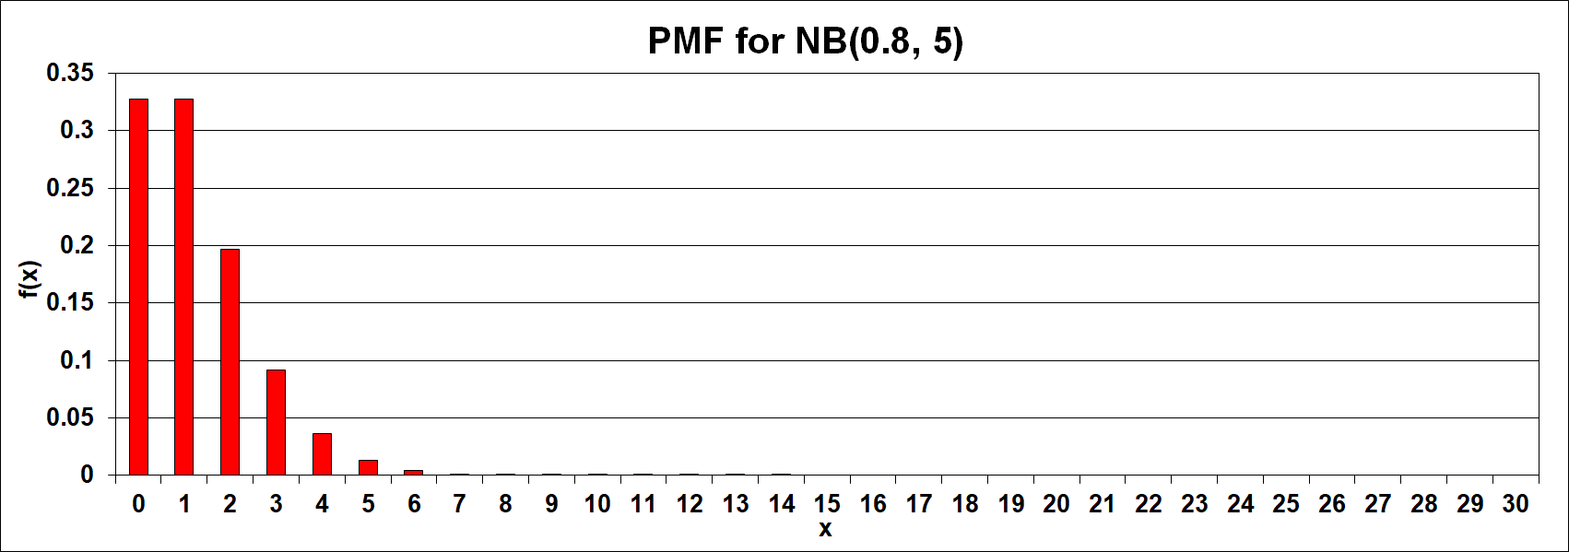
Negative binomial distribution
[X ~ NB (p , r)] (contd…)

Slide 48
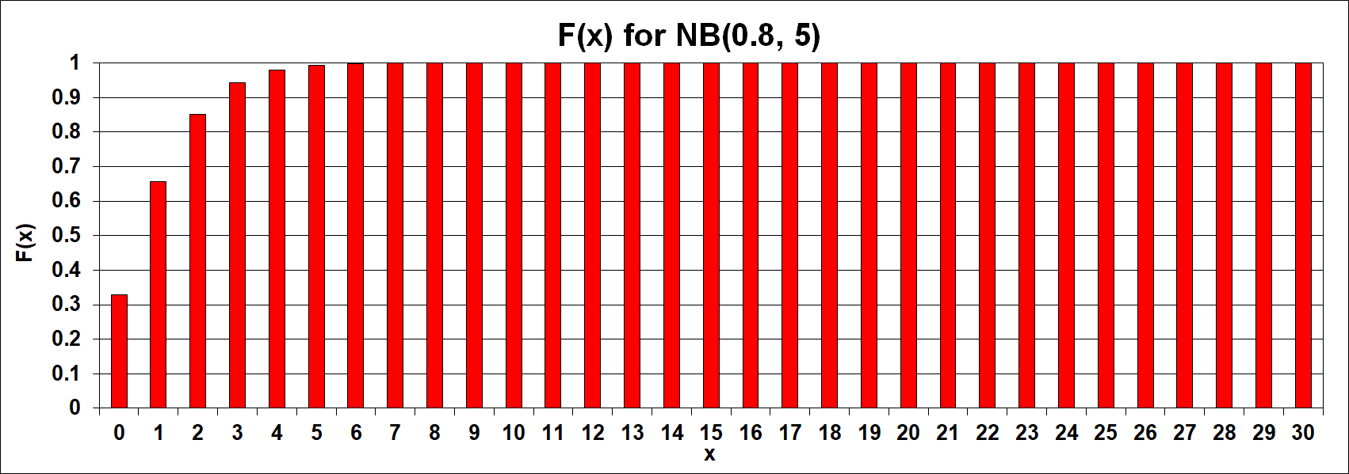
Negative binomial distribution
[X ~ NB (p , r)] (contd…)

Slide 49
Example # 43
Suppose that the probability of a manufacturing process producing a defective item is 0.05.
Suppose further that the quality of any one item is independent of the quality of any other item produced.
If a Mr. Rao the quality control officer selects items at random from the production line and stops his inspection when he gets 10 good items.
Then what is the probability of getting 2 defective items before he stops inspection?

Slide 50
Example # 43 (contd…)
Here p=0.95, q=0.05.
Hence the required probability is P(X=2) = ¹⁰⁺²⁻¹C₁₀ ₋₁(0.95)¹⁰(0.05)²
E(X) = (5(0.05))/0.95 = 0.263
V(X) = (5(0.05))/0.95² = 0.277

Slide 51
Exercise
Mr. Agrawal is the immigration official at IGIA and he knows that the probability of an Indian origin person coming in any flight from abroad is 10%.
He notes down the country of origin of persons and stop when he knows he has noted down exactly 3 people of Indian origin.
Then what is the probability of Mr.Agrawal noting down 2 non Indian origin people before he stops his checking?

Slide 52
Geometric distribution
[X ~ G (p)]
f(x) = pq^{x}, x = 0,1,…..
p is the parameter where p ∈ [0, 1]
E(X) = μ_{m}= q/p (r = 1 in the Negative Binomial distribution case)
V[X] = q/p² (r = 1 in the Negative Binomial distribution case)
Median = μ_{e} = ⎡–1/{log₂(1 – p)}⎤ – 1
Mode = μ_{o}= 0

Slide 53
Geometric distribution
[X ~ G (p)] (contd…)
Consider the example above.
But now you are interested in finding the probability distribution of the number of failures preceding the 1st success of getting the right product.
Then, we have p=0.8, q=0.2, X~(0.8)(0.2)^{x}

Slide 54
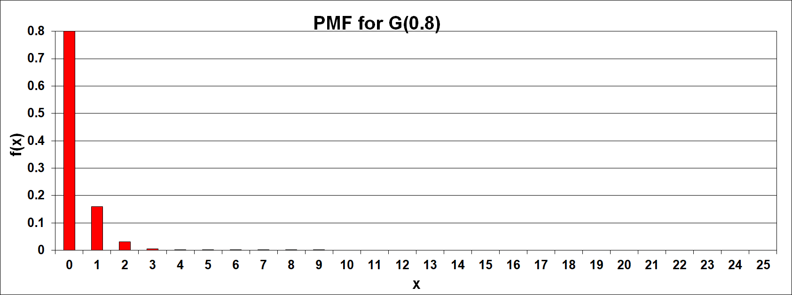
Geometric distribution
[X ~ G (p)] (contd…)

Slide 55
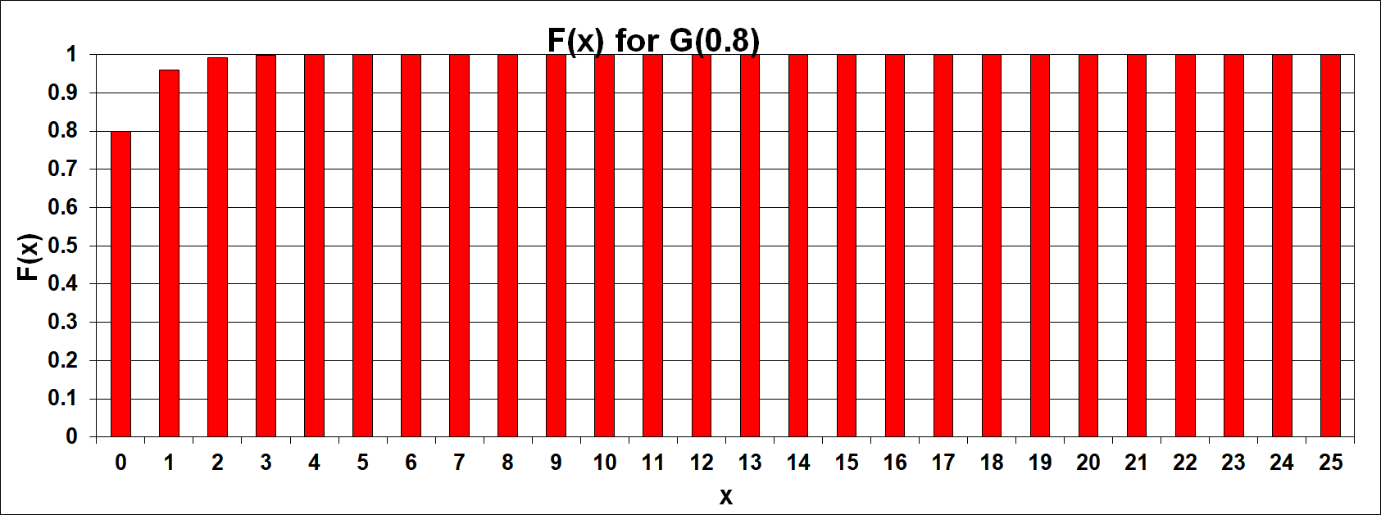
Geometric distribution
[X ~ G (p)] (contd…)

Slide 56
Example # 44
A recent study indicates that Colgate toothpaste has a market share of 45% (versus 55% of Pepsodent).
Miss. Dabawallah the marketing research executive firm wants to conduct a new taste test for which she wants users of Colgate. Potential participants for the test are selected by random screening of users of toothpaste to find Colgate users.
What is the probability that 5 users will have to be interviewed by Miss. Dabawallah to find the 1st Colgate toothpaste user?

Slide 57
Example # 44 (contd…)
Here p=0.45, q=0.55.
Hence the required probability is P(X=4) = (0.45)¹(0.55)⁴
E(X) = 0.55/0.45 = 1.22
V(X) = 0.55/0.45² = 2.72

Slide 58
Exercise
Mr.Moti Singh is a lottery ticket sales person and he knows that the probability of a person coming to him to check whether he/she has won the lottery is 1%.
What is the probability that 10 persons arrive before the winner arrives?

Slide 59
Hypergeometric distribution
[X ~ HG (N, n, p)]
f(x) = ^{Np}C_{x}^{Nq}C_{n-x}/^{N}C_{n}, 0 ≤ x ≤ Np and 0 ≤ (n – x) ≤ Nq
N, n and p are the parameters
E(X) = μ_{m}= np
V[X] = npq{(N – n)/(N – 1)}
Median = μ_{e} = ⎣np⎦ or ⎡np⎤
Mode = μ_{o}= ⎡{(n + 1)(Np + 1)}/(N + 2)⎤ – 1 or ⎣{(n + 1)(Np + 1)}/(N + 2)⎦

Slide 60
Hypergeometric distribution
[X ~ HG (N, n, p)] (contd…)
Consider the example above. But now you are interested in finding the probability distribution of the number of failures(success) of getting the wrong(right) product when we choose n number of products for inspection out of the total population N.
If the population is 100 and we choose 10 out of those, then the probability distribution of getting the right product, denoted by X is given by X~⁸⁵C_{x}¹⁵C_{10-x}/¹⁰⁰C₁₀
Remember
  p (0.85) and q (0.15) are the proportions of getting a good item and bad item respectively.
  In this distribution we are considering the choosing is done without replacement

Slide 61
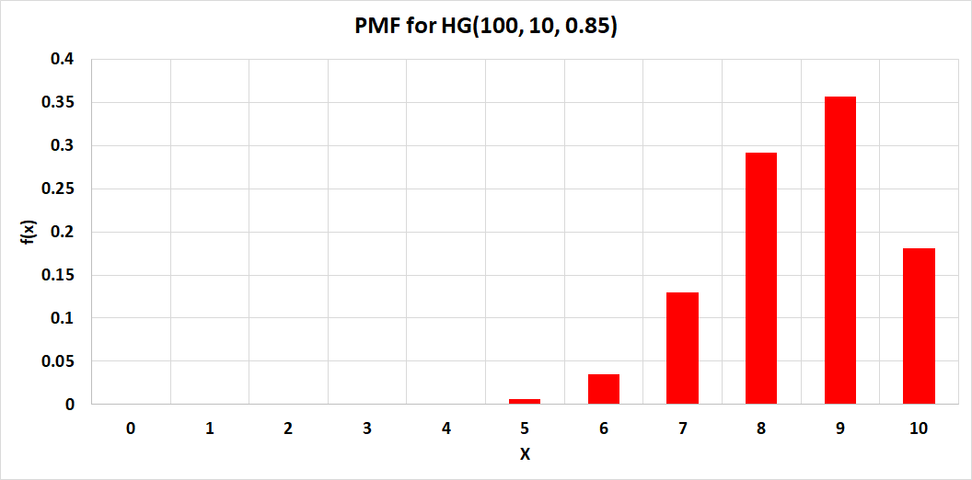
Hypergeometric distribution
[X ~ HG (N, n, p)] (contd…)

Slide 62
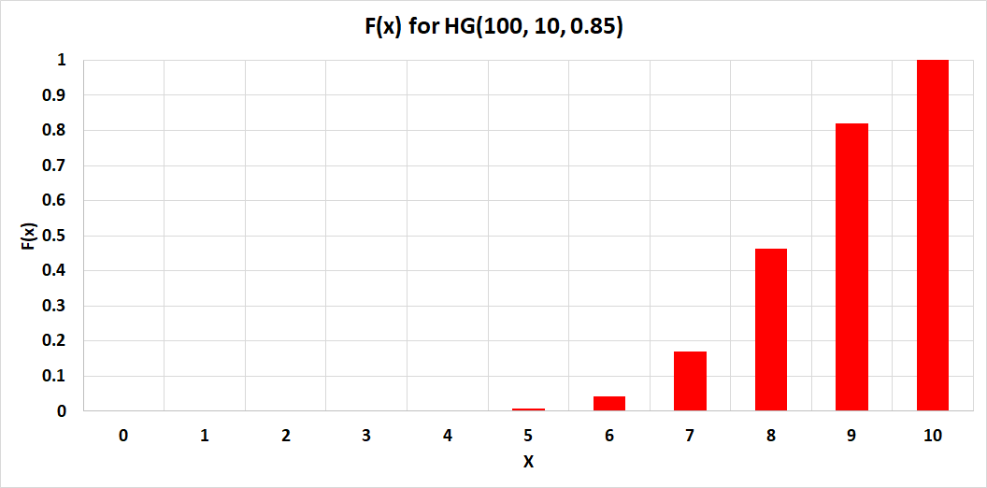
Hypergeometric distribution
[X ~ HG (N, n, p)] (contd…)

Slide 63
Example # 45
Suppose that automobiles arrive at a Mr. Ghosh′s garage in lots of 10 and that for time and resource considerations, he can inspect only 5 out of each 10 for safety.
The 5 cars are randomly chosen from the 10 on the lot.
If 2 out of the 10 cars on the lot are below standards for safety, what is the probability that at most 1 out of the 5 cars to be inspected by Mr.Ghosh will be found not meeting the safety standards?

Slide 64
Example # 46 (contd…)
Here N=10, n=5, Np=2, Nq=8
Hence the required probability is
P(X≤1) = P(X=0) + P(X=1)
P(X≤1) = ²C₀⁸C₅/¹⁰C₅ + ²C₁⁸C₄/¹⁰C₅

Slide 65
Exercise
Mrs. Patanaik is the teacher of class III consisting of 30 students. Daily during morning prayer session she would like to check whether all her students have brought their respective lunches.
But due to paucity of time each day she has to randomly select 10 students and finds that on an average out of this 10, 4 do not bring their lunches.
If on any particular day she selects 10 students then what is the probability that exactly 5 students would not have brought their respective lunches.

Slide 66
Poisson distribution
[X ~ P (λ)]
f(x) = e^{-λ}λ^{x}/x!, x = 0,1,2,…..
λ is the parameter where λ > 0
E(X) = μ_{m} = λ
V[X] = λ
Median = μ_{e} = ⎣λ + 1/3 – 1/(50λ)⎦
Mode = μ_{o} = ⎡λ⎤ – 1 or ⎣λ⎦

Slide 67
Poisson distribution
[X ~ P (λ)] (contd…)
Consider the arrival of the number of customers at the bank teller counter.
If we are interested in finding the probability distribution of the number of customers arriving at the counter in specific intervals of time and we know that the average number of customers arriving is 5.
Then, we have λ=5, X~e⁻⁵5^{x}/x!

Slide 68
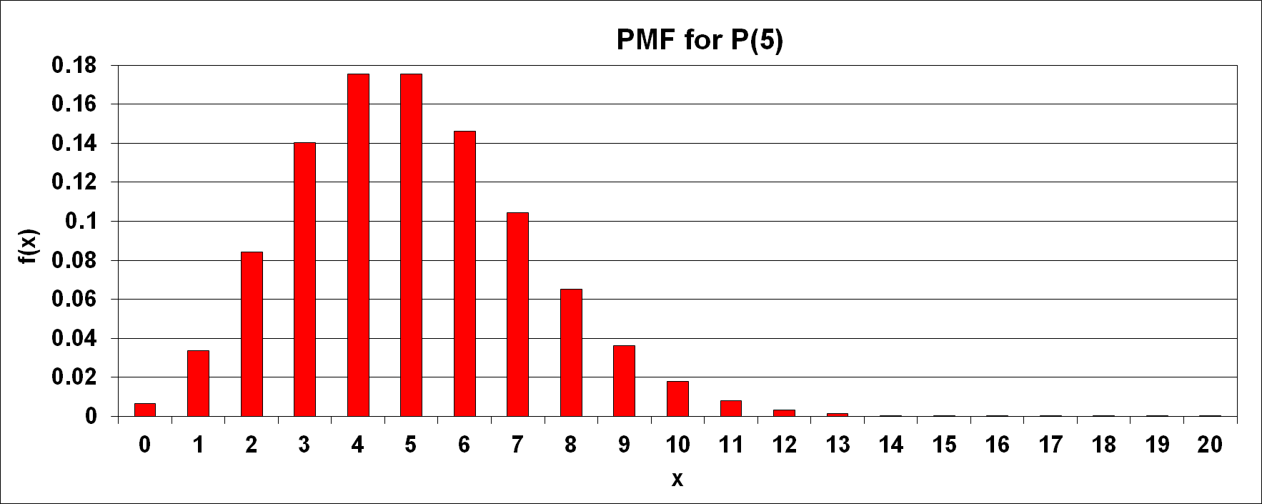
Poisson distribution
[X ~ P (λ)] (contd…)

Slide 69
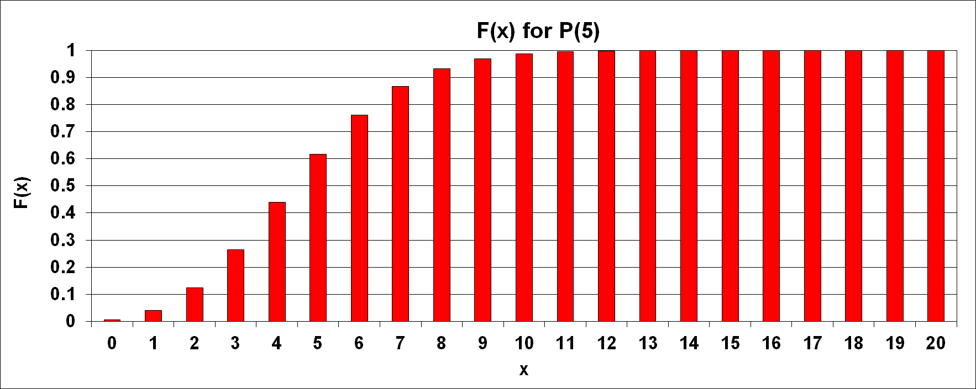
Poisson distribution
[X ~ P (λ)] (contd…)

Slide 70
Example # 47
Mr. Gurneek Singh who is the cashier at the departmental store cash counter notices that the average number of customer arriving at the cash counter per 5 minutes is 10.
Then what is the probability that more than 5 customers arrive at the cash counter with the interval of 5 minutes?

Slide 71
Example # 47 (contd…)
Here λ=10.
Hence the required probability is
  P(X≥6) = 1 – {P(X=0) + P(X=1) + P(X=2) + P(X=3) + P(X=4) + P(X=5)}
  P(X≥6) = 1 – {exp(-10)10⁰/0! + e⁻¹⁰10¹/1! + exp(-10)10²/2! + exp(-10)10³/3! + exp(-10)10⁴/4! + exp(-10)10⁵/5!}

Slide 72
Exercise
Mr. Pankaj Yadav is the shop floor manager and he notices that the average number of jobs arriving at the lathe machine per hour is 25.
He wants to find out what is the probability of exactly 10 jobs arrive in an hour at the lathe machine?

Slide 73
Logarithmic distribution
[X ~ L (p)]
f(x) = –(ℓ𝑜𝑔_{𝑒} 𝑝)⁻¹𝑥⁻¹(1 – 𝑝)^{𝑥}, x = 1,2,3,…..
𝑝 is the parameter where 𝑝 ∈ (0, 1)
E(X) = μ_{m}= –(1–𝑝)/(𝑝ℓ𝑜𝑔_{𝑒} 𝑝)
V[X] = –(1–𝑝)[1+(1–𝑝)/ℓ𝑜𝑔_{𝑒} 𝑝]/(𝑝²ℓ𝑜𝑔_{𝑒} 𝑝)
Median = μ_{e} =
Mode = μ_{o}= 1

Slide 74
Logarithmic distribution
[X ~ L (p)] (contd…)
Emission of gases from engines against fuel type
Used to represent the distribution of the number of items of a product purchased by a buyer in a specified period of time

Slide 75
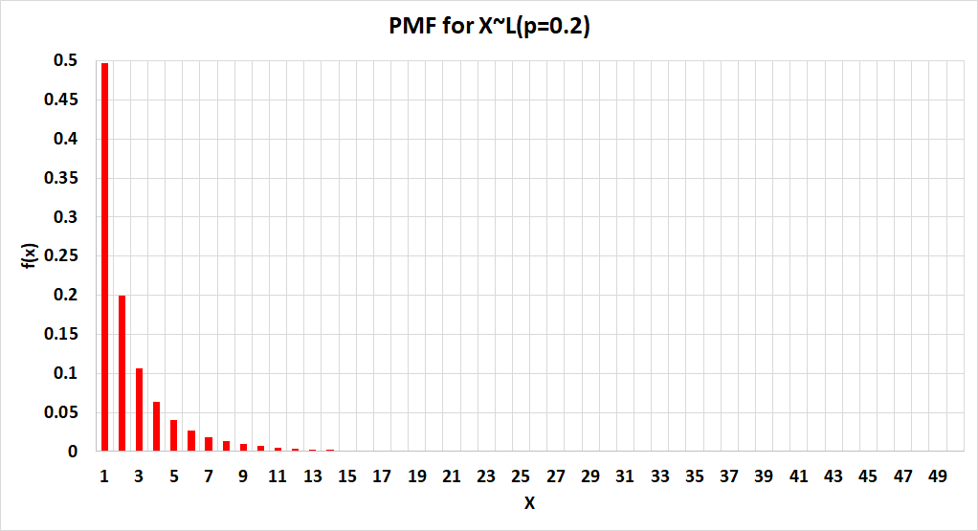
Logarithmic distribution
[X ~ L (p)] (contd…)

Slide 76
Logarithmic distribution
[X ~ L (p)] (contd…)

Slide 77
Continuous distribution
Uniform distribution
Exponential distribution
Normal distribution
Log-normal distribution
Chi-Square distribution (related to Normal distribution)

Slide 78
Continuous distribution (contd…)
t-distribution (related to Normal distribution)
F-distribution (related to Normal distribution)
Gamma distribution
Weibull distribution
Beta distribution

Slide 79
Continuous distribution (contd…)
Cauchy distribution
Double exponential distribution
Pareto distribution
Logistic distribution
Extreme Value Distribution (Type-I): Gumble distribution
Extreme Value Distribution (Type-II): Fréchet distribution
Extreme Value Distribution (Type-III): Weibull distribution

Slide 80
Continuous distribution (contd…)
A continuous distribution has three parameters which are:
  α: Shape parameter
  β: Scale parameter
  γ: Location parameter
Remember for continuous case, conceptually f(x) = 0, but ∫_{−∞≤x+∞}f(x)dx =1

Slide 81
Uniform distribution
[X ~ U (a, b)]
f(x) = 1/(b – a), a ≤ x ≤ b
a and b are the parameters where a, b ∈ ℝ and a < b
E(X) =μ_{m}= (a + b)/2
V[X] = (b – a)²/12
Median = μ_{e}= (a + b)/2
Mode = μ_{o}= No single value
Example: Choosing any number between 1 and 10, both inclusive, from the real line

Slide 82
Uniform distribution
[X ~ U (a, b)] (contd…): MATLAB Code for f(x)
%PLOT OF PDF OF UNIFORM CONTINUOUS DISTRIBUTION U(a,b)
% Define the range of x values for the plot
a = 2; % Lower bound
b = 8; % Upper bound
% Define the range of x values for the plot
x = a:0.1:b;
% Calculate the PDF values using unifpdf
y = unifpdf(x, a, b);
% Plot the PDF of U(a, b)
plot(x, y, 'LineWidth', 5); % Plot x vs y with a specified line width;
% Add labels and title for clarity
xlabel('X Values'); % Label the x-axis
ylabel('f(x) or PDF of U(a, b) Distribution'); % Label the y-axis
title(['f(x) or PDF of U(a, b) Distribution (Lower bound a = ', num2str(a), ', Upper bound b = ', num2str(b), ')']); % Set the plot title
% Optional: Add a grid for better readability
grid on; % Add a grid to the plot

Slide 83
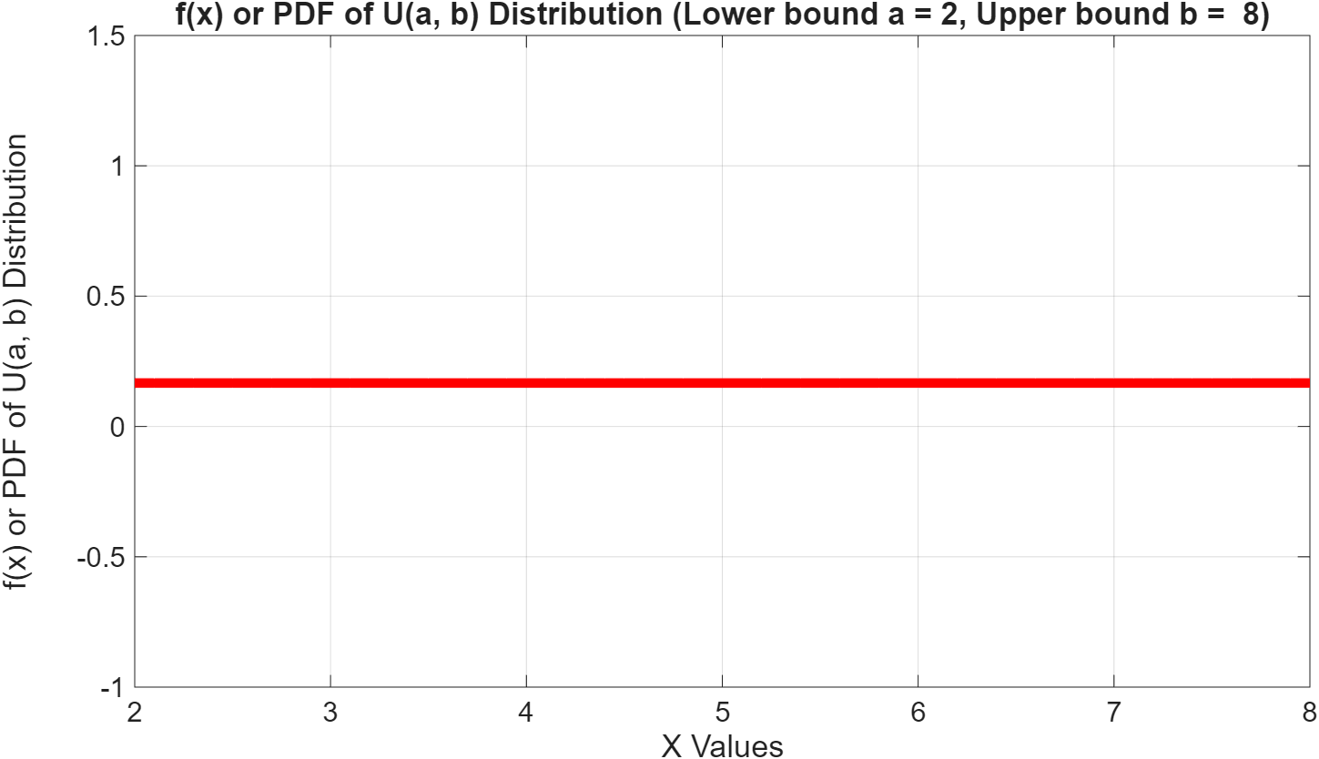
Uniform distribution
[X ~ U (a, b)] (contd…): f(x)

Slide 84
Uniform distribution
[X ~ U (a, b)] (contd…): MATLAB Code for F(x)
%PLOT OF CDF OF UNIFORM CONTINUOUS DISTRIBUTION U(a,b)
% Define the range of x values for the plot
a = 2; % Lower bound
b = 8; % Upper bound
% Define the range of x values for the plot
x = a:0.1:b;
% Calculate the PDF values using unifcdf
y = unifcdf(x, a, b);
% Plot the CDF of U(a, b)
plot(x, y, 'LineWidth', 5); % Plot x vs y with a specified line width;
% Add labels and title for clarity
xlabel('X Values'); % Label the x-axis
ylabel('F(x)=P[X≤x] or CDF of U(a, b) Distribution'); % Label the y-axis
title(['Plot of F(x)=P[X≤x] or CDF of U(a, b) Distribution (Lower bound a = ', num2str(a), ', Upper bound b = ', num2str(b), ')']); % Set the plot title
% Optional: Add a grid for better readability
grid on; % Add a grid to the plot

Slide 85
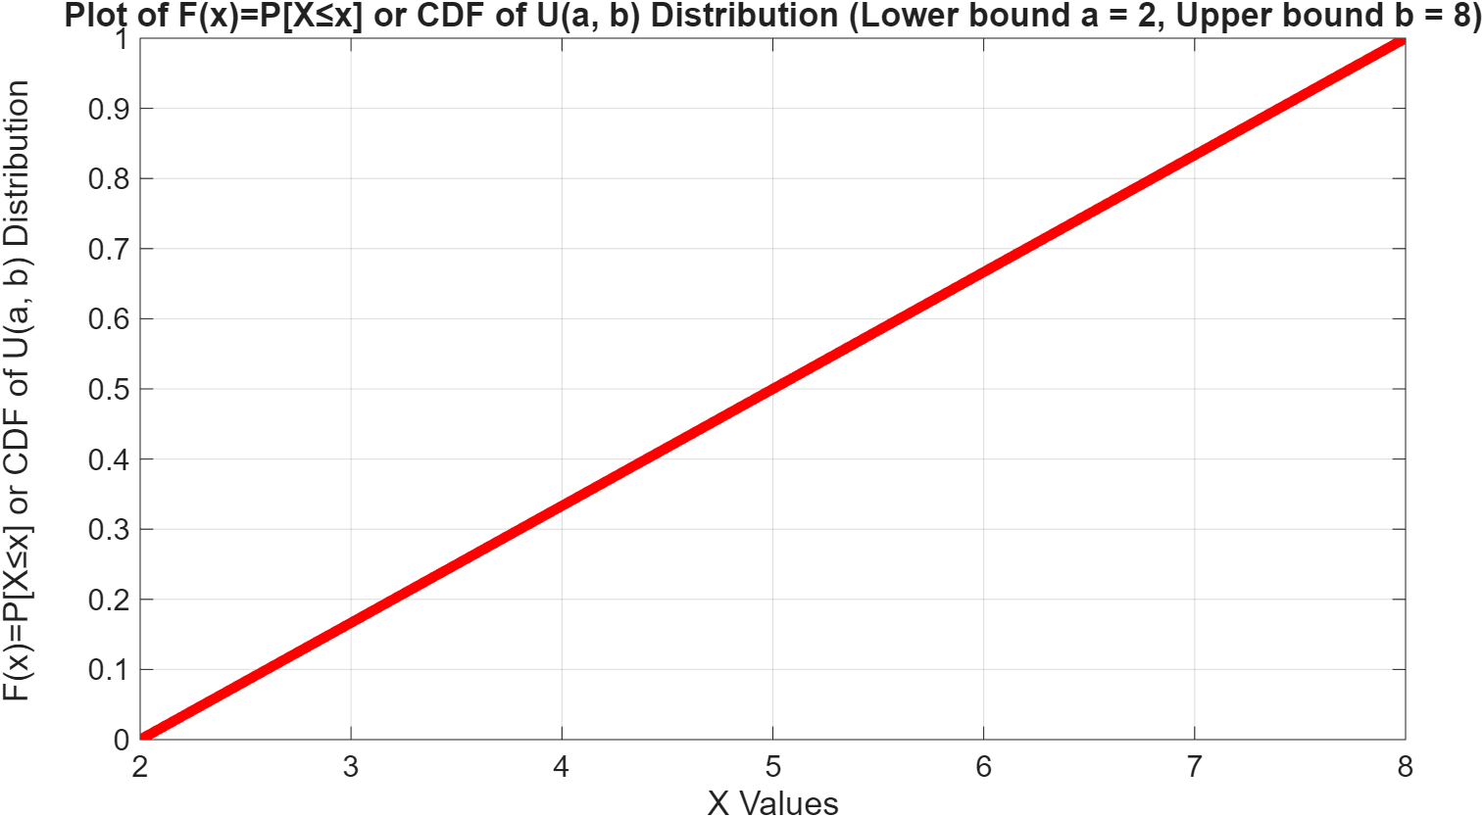
Uniform distribution
[X ~ U (a, b)] (contd…): F(x)

Slide 86
Exponential distribution
[ X ~ E (a, θ)] (contd…)
f(x) = (1/θ)exp{–(x – a)/θ}, a < x < ∞, θ > 0
a (location) and θ (scale) are the parameters
E(X) = μ_{m}= a + θ
V[X] = θ²
Median = μ_{e} = {a + θlog(2)}
Mode = μ_{o}= 0

Slide 87
Exponential distribution
[ X ~ E (a, θ)] (contd…): MATLAB Code for f(x)
%PLOT OF PDF OF EXPONENTIAL DISTRIBUTION E(a, θ)
% Define the range of x values for the plot
a = 2; % Location parameter X ≥ a
b = 8; % Some maximum value of X as needed to plot
theta = 4; % Scale parameter
% Define the range of x values for the plot
x = a:0.1:b;
% Calculate the PDF values using exppdf
y = exppdf(x, theta);
% Plot the PDF of E(a, θ)
plot(x, y, 'LineWidth', 5); % Plot x vs y with a specified line width;
% Add labels and title for clarity
xlabel('X Values'); % Label the x-axis
ylabel('f(x) or PDF of E(a, θ) Distribution'); % Label the y-axis
title(['f(x) or PDF of E(a, θ) Distribution (a = ', num2str(a), ', θ = ', num2str(theta), ')']); % Set the plot title
% Optional: Add a grid for better readability
grid on; % Add a grid to the plot

Slide 88
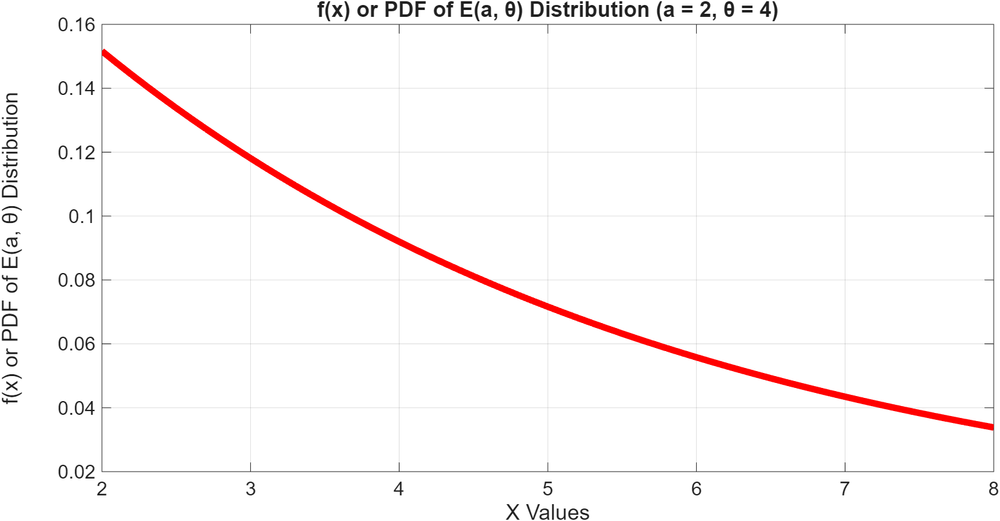
Exponential distribution
[ X ~ E (a, θ)] (contd…): f(x)

Slide 89
Exponential distribution
[ X ~ E (a, θ)] (contd…): MATLAB Code for F(x)
%PLOT OF CDF OF EXPONENTIAL DISTRIBUTION E(a, θ)
% Define the range of x values for the plot
a = 2; % Location parameter X ≥ a
b = 30; % Some maximum value of X as needed to plot
theta = 4; % Scale parameter
% Define the range of x values for the plot
x = a:0.1:b;
% Calculate the PDF values using expcdf
y = expcdf(x, theta);
% Plot the CDF of E(a, θ)
plot(x, y, 'LineWidth', 5); % Plot x vs y with a specified line width;
% Add labels and title for clarity
xlabel('X Values'); % Label the x-axis
ylabel('F(x)=P[X≤x] or CDF of E(a, θ) Distribution'); % Label the y-axis
title(['Plot of F(x)=P[X≤x] or CDF of E(a, θ) Distribution (a = ', num2str(a), ', θ = ', num2str(theta), ')']); % Set the plot title
% Optional: Add a grid for better readability
grid on; % Add a grid to the plot

Slide 90
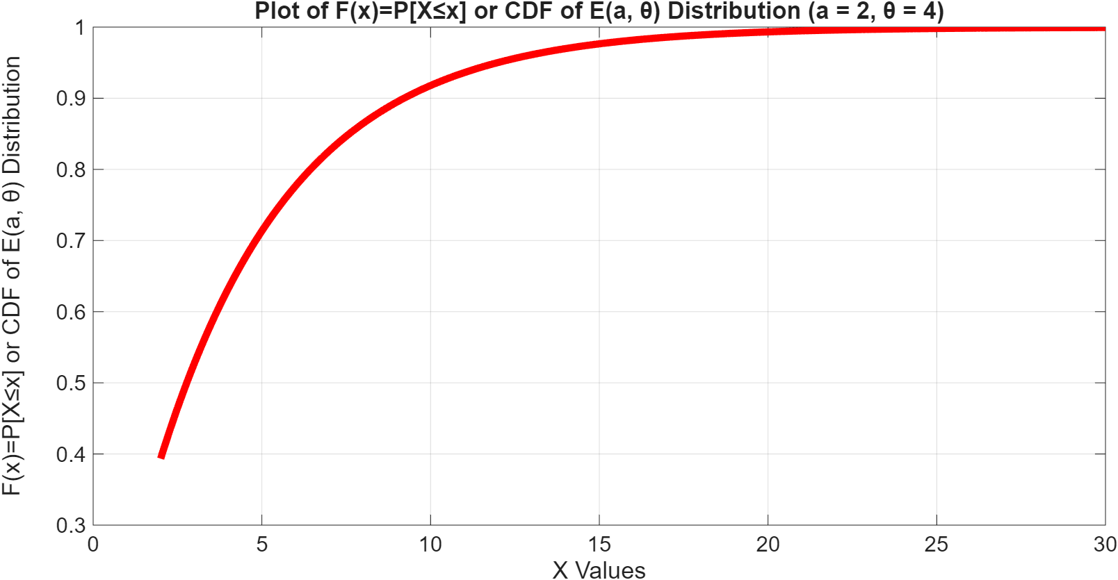
Exponential distribution
[ X ~ E (a, θ)] (contd…): F(x)

Slide 91
Example # 48
Mr. K.Bharadwaj an electrician knows that the time a bulb operates before it gets fused is exponentially distributed with a mean life of 100 hours.
What is the probability that any bulb will work continuously for at least 200 hours?

Slide 92
Example # 48 (contd…)
Here θ = 100.
We are required to find P(X ≥ 200) = 1 – P(X ≤ 200)
P(X ≥ 200) = 1 – P(X ≤ 200) = 1 – ∫_{0≤x≤ 200}(1/100)exp(–x/100)dx
P(X ≥ 200) = 0.1353

Slide 93
Exercise
Mr. Lyndoh the owner of an electronics shop knows that the average life of a tape recorder he sells is 1.5 years.
What is the probability that any such tape recorder would function for at most 3 years?

Slide 94
Normal distribution
[X ~ N ( μ, σ²)]
f(x) = {1/(√2πσ²)}exp[(x − μ)²/2σ²], -∞ < x < ∞
μ (location), σ² (σ: scale) are the parameters where μ ∈ ℝ and σ² > 0
E(X) = μ_{m}= μ
V[X] = σ²
Median = μ_{e}= μ
Mode = μ_{o}= μ

Slide 95
Normal distribution
[X ~ N ( μ, σ²)] (contd…)
Consider the average age of a student between class VII and VIII selected at random from all the schools in the city of Kanpur

Slide 96
Normal distribution
[X ~ N ( μ, σ²)] (contd…): MATLAB Code for f(x)
%PLOT OF PDF OF NORMAL DISTRIBUTION N(μ, σ²)
% Define the range of x values for the plot
a = -20; % Some minimum value of X as needed to plot
b = +20; % Some maximum value of X as needed to plot
mu = 5; % Location parameter
sigma = 4; % Scale parameter
% Define the range of x values for the plot
x = a:0.1:b;
% Calculate the PDF values using normpdf
y = normpdf(x, mu, sigma);
% Plot the PDF of N(μ, σ²)
plot(x, y, 'LineWidth', 5); % Plot x vs y with a specified line width;
% Add labels and title for clarity
xlabel('X Values'); % Label the x-axis
ylabel('f(x) or PDF of N(μ, σ^2) Distribution'); % Label the y-axis
title(['f(x) or PDF of N(μ, σ^2) Distribution (μ = ', num2str(mu), ', σ = ', num2str(sigma), ')']); % Set the plot title
% Optional: Add a grid for better readability
grid on; % Add a grid to the plot

Slide 97
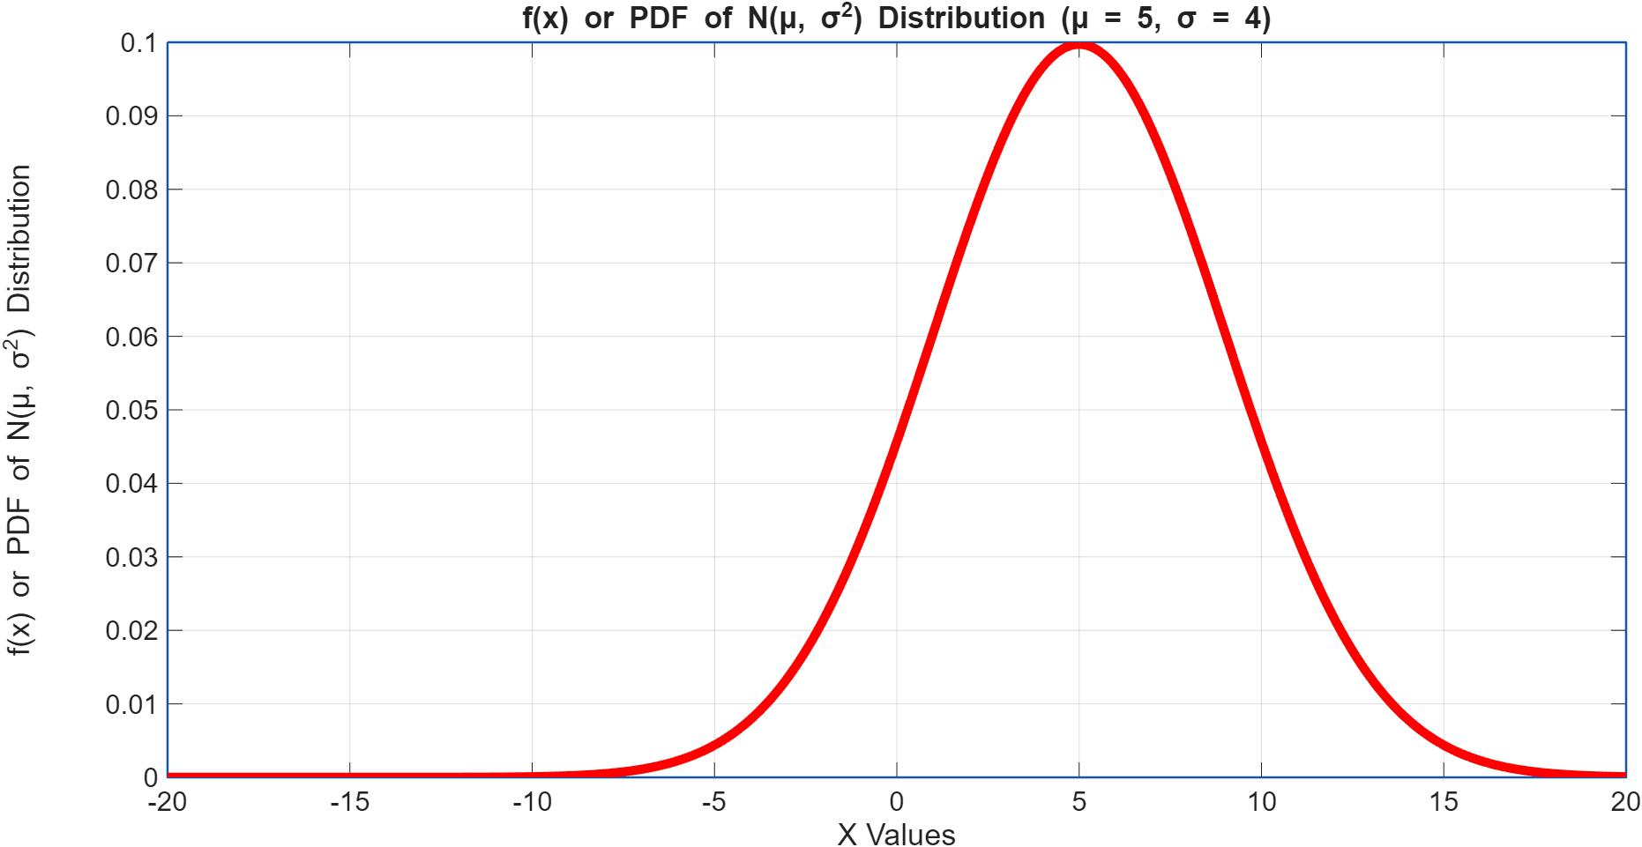
Normal distribution
[X ~ N ( μ, σ²)] (contd…): f(x)

Slide 98
Normal distribution
[X ~ N ( μ, σ²)] (contd…): MATLAB Code for F(x)
%PLOT OF CDF OF NORMAL DISTRIBUTION N(μ, σ²)
% Define the range of X values for the plot
a = -20; % Some minimum value of X as needed to plot
b = +20; % Some maximum value of X as needed to plot
mu = 5; % Location parameter
sigma = 4; % Scale parameter
% Define the range of x values for the plot
x = a:0.1:b;
% Calculate the PDF values using normcdf
y = normcdf(x, mu, sigma);
% Plot the CDF of N(μ, σ²)
plot(x, y, 'LineWidth', 5); % Plot x vs y with a specified line width;
% Add labels and title for clarity
xlabel('X Values'); % Label the x-axis
ylabel('F(x)=P[X≤x] or CDF of N(μ, σ^2) Distribution'); % Label the y-axis
title(['Plot of F(x)=P[X≤x] or CDF of N(μ, σ^2) Distribution (μ = ', num2str(mu), ', σ = ', num2str(sigma), ')']); % Set the plot title
% Optional: Add a grid for better readability
grid on; % Add a grid to the plot

Slide 99
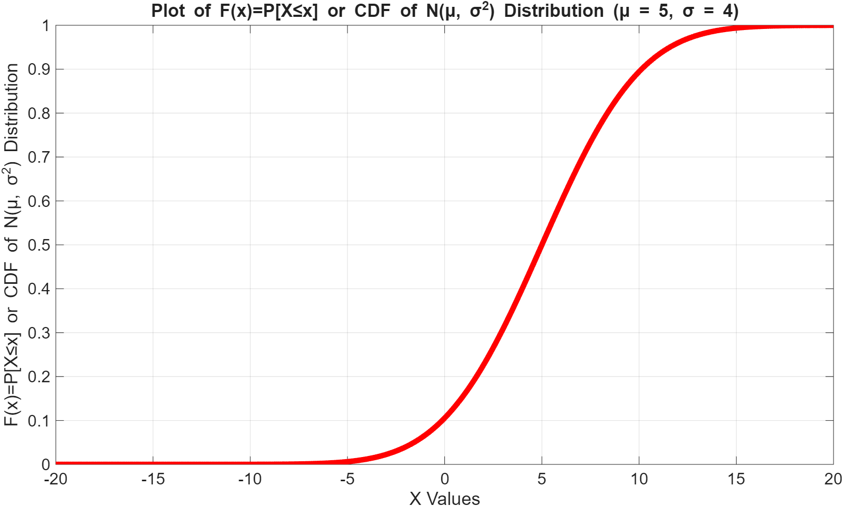
Normal distribution
[X ~ N ( μ, σ²)] (contd…): F(x)

Slide 100
Standard Normal Distribution, Z~N(0,1)
Putting Z=(X−μ_{X})/σ_{X} in the normal distribution with r.v., X, X~N(μ_{X}, σ²_{X}) and we obtain the standard normal distribution of the form f(z) = {1/(√2π)}exp(−z²/2), where μ_{Z} = 0 and σ²_{Z} = 1, i.e., Z~N(0,1)
F(x) = P(X ≤ x) = F(z) = F(Z ≤ z)
f(z) = φ(z)
F(z) = F(Z ≤ z) = ∫_{−∞<Z≤z}f(z)dz = ∫_{−∞<Z≤z}dF(z) = Φ(z)
F(Z ≥ z) = 1 − F(Z ≤ z) = 1 − Φ(z)

Slide 101
Standard Normal Distribution, Z~N(0,1) (contd…): MATLAB Code for f(z)
%PLOT OF PDF OF NORMAL DISTRIBUTION N(0, 1)
% Define the range of Z values for the plot
a = -20; % Some minimum value of Z as needed to plot
b = +20; % Some maximum value of Z as needed to plot
mu = 0; % Location parameter
sigma = 1; % Scale parameter
% Define the range of Z values for the plot
z = a:0.1:b;
% Calculate the PDF values using normpdf
y = normpdf(z, mu, sigma);
% Plot the PDF of N(0, 1)
plot(z, y, 'LineWidth', 5); % Plot x vs y with a specified line width;
% Add labels and title for clarity
xlabel('X Values'); % Label the x-axis
ylabel('f(x) or PDF of N(0, 1) Distribution'); % Label the y-axis
title(['f(x) or PDF of N(0, 1) Distribution (μ = ', num2str(mu), ', σ = ', num2str(sigma), ')']); % Set the plot title
% Optional: Add a grid for better readability
grid on; % Add a grid to the plot

Slide 102
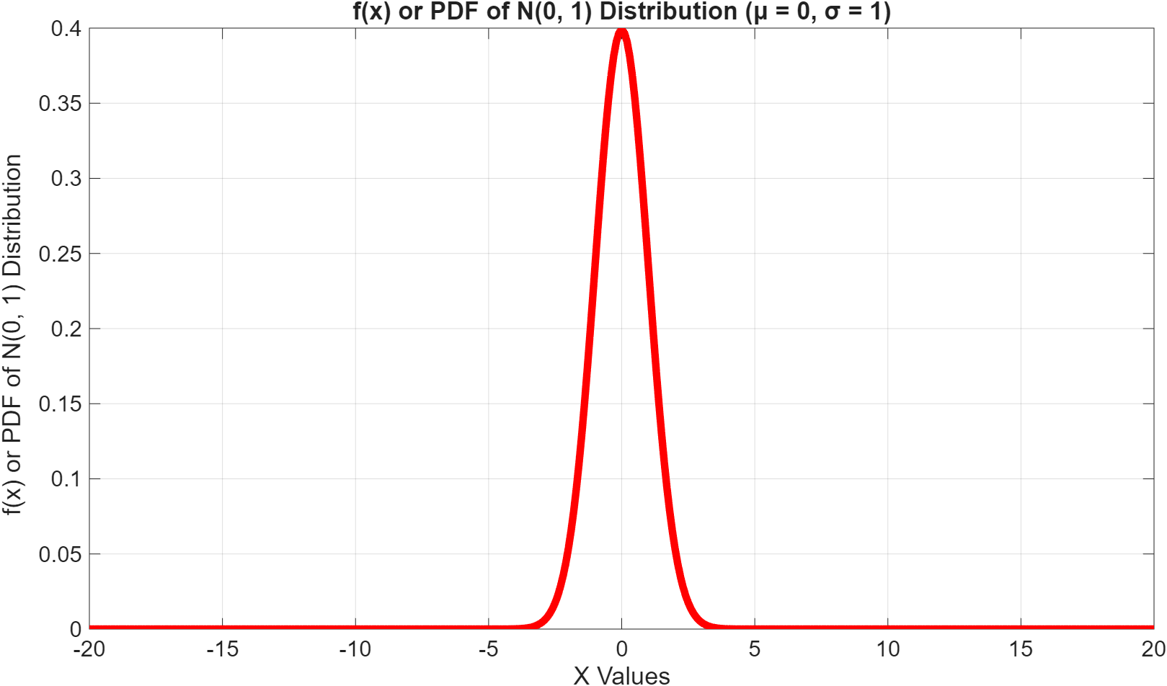
Standard Normal Distribution, Z~N(0,1) (contd…): f(z)

Slide 103
Standard Normal Distribution, Z~N(0,1) (contd…): MATLAB Code for F(z)
%PLOT OF CDF OF NORMAL DISTRIBUTION N(0, 1)
% Define the range of X values for the plot
a = -20; % Some minimum value of X as needed to plot
b = +20; % Some maximum value of X as needed to plot
mu = 0; % Location parameter
sigma = 1; % Scale parameter
% Define the range of x values for the plot
z = a:0.1:b;
% Calculate the PDF values using normcdf
y = normcdf(z, mu, sigma);
% Plot the CDF of N(0, 1)
plot(x, y, 'LineWidth', 5); % Plot x vs y with a specified line width;
% Add labels and title for clarity
xlabel('X Values'); % Label the x-axis
ylabel('F(x)=P[X≤x] or CDF of N(0, 1) Distribution'); % Label the y-axis
title(['Plot of F(x)=P[X≤x] or CDF of N(0, 1) Distribution (μ = ', num2str(mu), ', σ = ', num2str(sigma), ')']); % Set the plot title
% Optional: Add a grid for better readability
grid on; % Add a grid to the plot

Slide 104
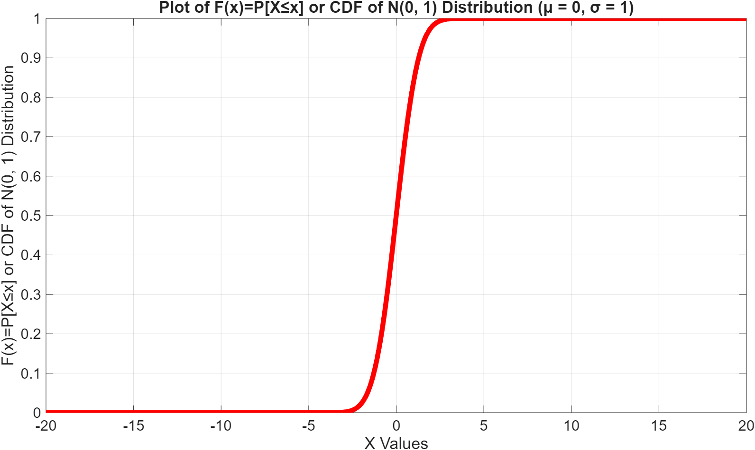
Standard Normal Distribution, Z~N(0,1) (contd…): F(z)

Slide 105
Standard Normal Distribution, Z~N(0,1) (contd…)
Z ~ N(0,1) given by the equation f(z) = {1/(√2π)}exp(−z²/2)
The area within an interval (a,b) is given by F( a ≤ Z ≤ b) = ∫_{a≤z≤b}{1/(√2π)}exp(−z²/2)dz which is not integrable algebraically.
Taylor’s expansion of the above assists in speeding up the calculation, which is F(Z ≤ z) = (1/2) + {1/(√2π)}Σ_{k=0 to +∞}{(−1)^{k}z^{(2k+1)}}/{(2k+1)2^{k}k!}

Slide 106
Standard Normal Distribution, Z~N(0,1) (contd…): f(z)
df(x)/dx = 0 and d²f(x)/dx² = 0
For f(x) = {1/(√2πσ²)}exp{−(x − μ)²/2σ²}
Inflexion points are: x = (μ − σ) and (μ + σ)
For f(z) = {1/(√2π)}exp(−z²/2)
Inflexion points are: z = −1 and +1

Slide 107
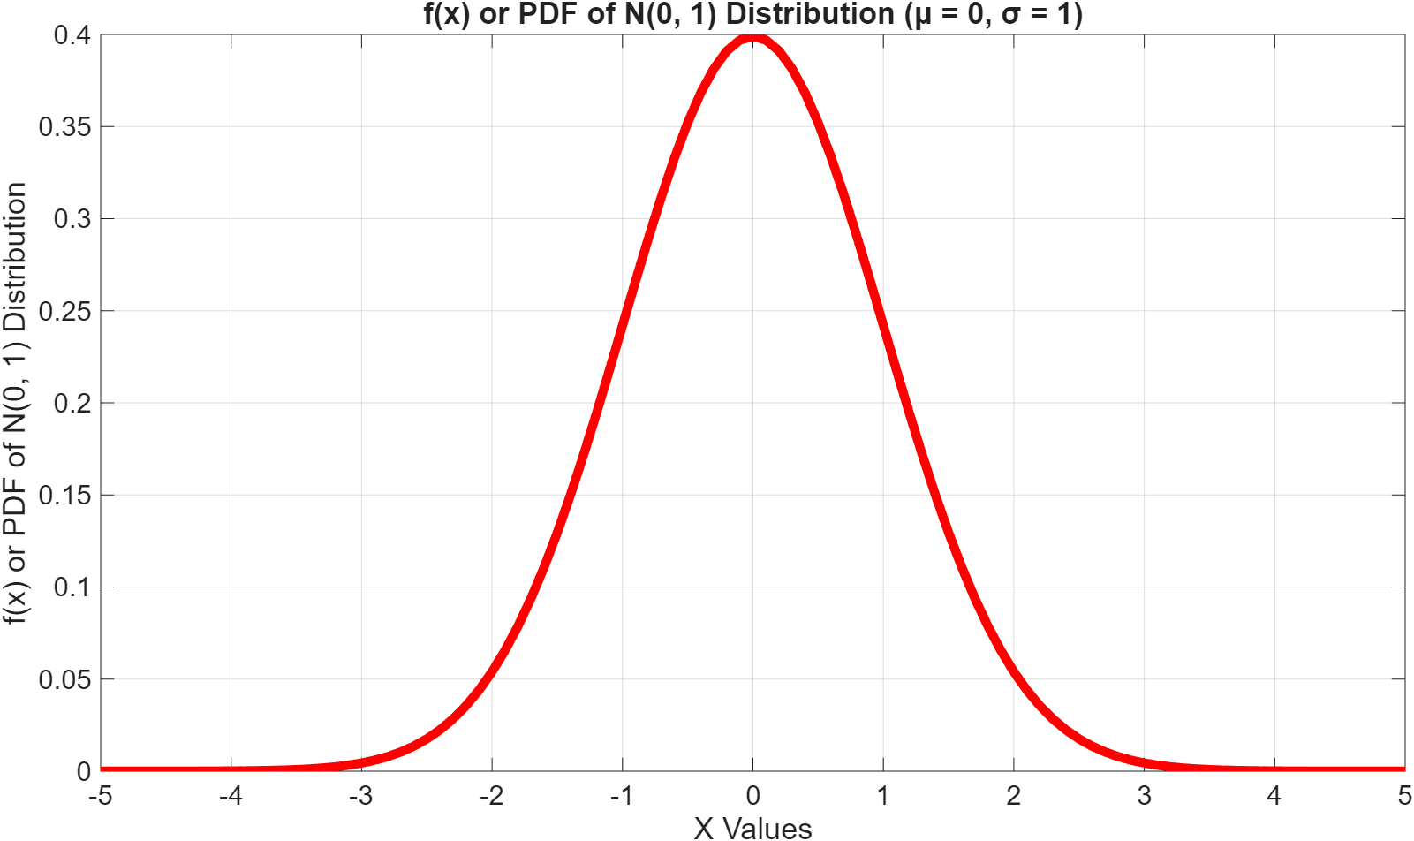
Standard Normal Distribution, Z~N(0,1) (contd…): f(z)
Inflexion points

Slide 108
Normal distribution results
φ(−z) = φ (z), i.e., f(−z) = f(z)
Φ(−z) = 1−Φ(z), i.e., P(Z ≤ z) = 1 – P(Z ≥ z)
P(a ≤ X ≤ b) = Φ[(b − μ_{X})/σ_{X}] − Φ[(a − μ_{X})/σ_{X}]
P(X ≤ b) = Φ[(b − μ_{X})/σ_{X}]
P(a ≤ X) = 1 − Φ[(a − μ_{X})/σ_{X}]

Slide 109
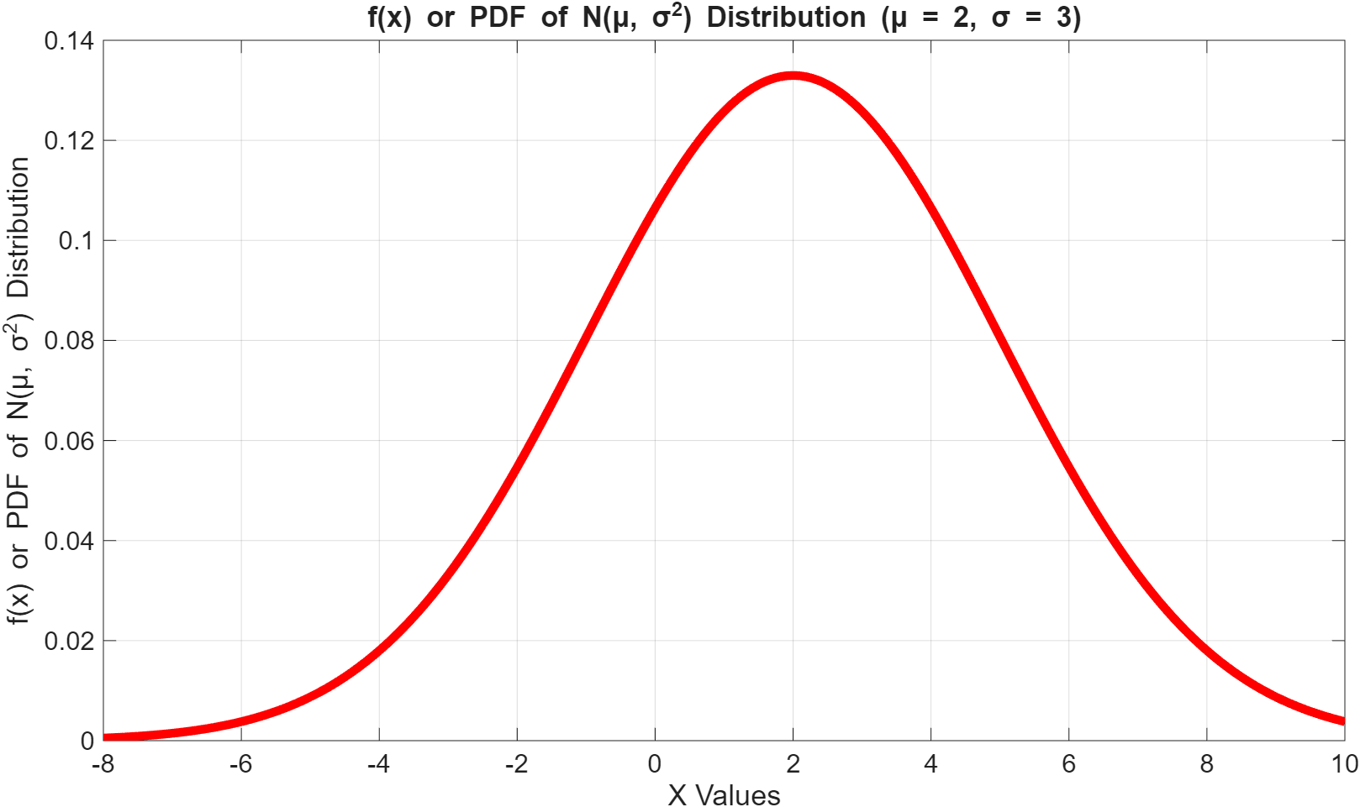
Normal distribution results (contd…) : f(x)
b
a

Slide 110
Finding Probabilities using Standard Normal Distribution: P(0 < Z < 1.56)
Standard Normal Probabilities
S
t
a
n
d
a
r
d
N
o
r
m
a
l
D
i
s
t
r
i
b
u
t
i
o
n
z .00 .01 .02 .03 .04 .05 .06 .07 .08 .09
0.0 0.0000 0.0040 0.0080 0.0120 0.0160 0.0199 0.0239 0.0279 0.0319 0.0359
0.1 0.0398 0.0438 0.0478 0.0517 0.0557 0.0596 0.0636 0.0675 0.0714 0.0753
0.2 0.0793 0.0832 0.0871 0.0910 0.0948 0.0987 0.1026 0.1064 0.1103 0.1141
0.3 0.1179 0.1217 0.1255 0.1293 0.1331 0.1368 0.1406 0.1443 0.1480 0.1517
0.4 0.1554 0.1591 0.1628 0.1664 0.1700 0.1736 0.1772 0.1808 0.1844 0.1879
0.5 0.1915 0.1950 0.1985 0.2019 0.2054 0.2088 0.2123 0.2157 0.2190 0.2224
0.6 0.2257 0.2291 0.2324 0.2357 0.2389 0.2422 0.2454 0.2486 0.2517 0.2549
0.7 0.2580 0.2611 0.2642 0.2673 0.2704 0.2734 0.2764 0.2794 0.2823 0.2852
0.8 0.2881 0.2910 0.2939 0.2967 0.2995 0.3023 0.3051 0.3078 0.3106 0.3133
0.9 0.3159 0.3186 0.3212 0.3238 0.3264 0.3289 0.3315 0.3340 0.3365 0.3389
1.0 0.3413 0.3438 0.3461 0.3485 0.3508 0.3531 0.3554 0.3577 0.3599 0.3621
1.1 0.3643 0.3665 0.3686 0.3708 0.3729 0.3749 0.3770 0.3790 0.3810 0.3830
1.2 0.3849 0.3869 0.3888 0.3907 0.3925 0.3944 0.3962 0.3980 0.3997 0.4015
1.3 0.4032 0.4049 0.4066 0.4082 0.4099 0.4115 0.4131 0.4147 0.4162 0.4177
1.4 0.4192 0.4207 0.4222 0.4236 0.4251 0.4265 0.4279 0.4292 0.4306 0.4319
1.5 0.4332 0.4345 0.4357 0.4370 0.4382 0.4394 0.4406 0.4418 0.4429 0.4441
1.6 0.4452 0.4463 0.4474 0.4484 0.4495 0.4505 0.4515 0.4525 0.4535 0.4545
1.7 0.4554 0.4564 0.4573 0.4582 0.4591 0.4599 0.4608 0.4616 0.4625 0.4633
1.8 0.4641 0.4649 0.4656 0.4664 0.4671 0.4678 0.4686 0.4693 0.4699 0.4706
1.9 0.4713 0.4719 0.4726 0.4732 0.4738 0.4744 0.4750 0.4756 0.4761 0.4767
2.0 0.4772 0.4778 0.4783 0.4788 0.4793 0.4798 0.4803 0.4808 0.4812 0.4817
2.1 0.4821 0.4826 0.4830 0.4834 0.4838 0.4842 0.4846 0.4850 0.4854 0.4857
2.2 0.4861 0.4864 0.4868 0.4871 0.4875 0.4878 0.4881 0.4884 0.4887 0.4890
0
.
4
0
.
3
)
z
(
0
.
f
2
0
.
1
1.56
{
0
.
0
-
5
-
4
-
3
-
2
-
1
0
1
2
3
4
5
Z
Look in row labeled 1.5 and column labeled .06 to find
P(0 ≤ z ≤ 1.56) = .4406

Slide 111
Example # 49
In an examination 20% of the students failed (i.e., obtained a score which is less than or equal to 40 marks out of 100) and 10% of the students obtained a grade A (score of 70 marks of above out of 100).
Assuming normal distribution of marks find the mean and the standard deviation of the distribution

Slide 112
Example # 49 (contd…)
P(X ≤ 40) = 0.2 = P[(X−μ_{X})/σ_{X} ≤ (40−μ_{X})/σ_{X}] = P(Z ≤ z₁) = Φ(z₁) = −0.84
P(X ≥ 70) = 0.1 = P[(X−μ_{X})/σ_{X} ≥ (70−μ_{X})/σ_{X}] = P(Z ≥ z₂) = 1 − P(Z ≤ z₂) = 1 − Φ(z₂).
Hence Φ(z₂) = 0.9
Solve the two equation to obtain
  z₁ = (40 − μ_{X})/σ_{X} = − 0.84
  z₂ = (70 − μ_{X})/σ_{X} = + 0.90
μ_{X} = 54.12; σ_{X} = 17.64

Slide 113
Normal distribution results (contd…)
P(μ_{X}−σ_{X} ≤ X ≤ μ_{X}+σ_{X}) = P[{(μ_{X}−σ_{X})−μ_{X}}/σ_{X} ≤ (X−μ_{X})/σ_{X} ≤ {(μ_{X}+σ_{X})−μ_{X}}/σ_{X}] = P{−1 ≤ Z ≤ +1} = 68.27
P(μ_{X}−2σ_{X} ≤ X ≤ μ_{X}+2σ_{X}) = P[{(μ_{X}−2σ_{X})−μ_{X}}/σ_{X} ≤ (X−μ_{X})/σ_{X} ≤ {(μ_{X}+2σ_{X})−μ_{X}}/σ_{X}] = P{−2 ≤ Z ≤ +2} = 95.45
P(μ_{X}−3σ_{X} ≤ X ≤ μ_{X}+3σ_{X}) = P[{(μ_{X}−3σ_{X})−μ_{X}}/σ_{X} ≤ (X−μ_{X})/σ_{X} ≤ {(μ_{X}+3σ_{X})−μ_{X}}/σ_{X}] = P{−3 ≤ Z ≤ +3} = 99.73

Slide 114
Exercise
Dr. Satish Kashyap finds that his patient′s height are normally distributed with mean 165 cms and standard deviation 20 cms.
What is the probability of a patient height being between 160 to 170 cms?

Slide 115
Log-normal distribution
[X ~ LN ( μ, σ²)]
f(x) = {1/xσ√(2π)}exp{−(log_{e}x−μ)²/2σ²}; 0 < x < ∞
μ (logarithmic of location), σ² (σ = logarithmic of scale) are the parameters where μ ∈ R and σ² > 0
E(X) = μ_{m}= exp{μ + (σ²/2)}
V[X] = {exp(σ²) − 1}exp(2μ + σ²)
Median = μ_{e}= exp(μ)
Mode = μ_{o}= exp(μ − σ²)
Example: Stock prices return distribution

Slide 116
Log-normal distribution
[X ~ LN ( μ, σ²)] (contd….): MATLAB Code for f(x)
%PLOT OF PDF OF LOG NORMAL DISTRIBUTION LN(μ, σ2)
% Define the range of x values for the plot
a = 0; % Minimum value of X as needed to plot
b = +30; % Some maximum value of X as needed to plot
mu = 2; % Location parameter
sigma = 1.5; % Scale parameter
% Define the range of X values for the plot
x = a:0.1:b;
% Calculate the PDF values using lognpdf
y = lognpdf(x, mu, sigma);
% Plot the PDF of LN(μ, σ2)
plot(x, y, 'LineWidth', 5); % Plot x vs y with a specified line width;
% Add labels and title for clarity
xlabel('X Values'); % Label the x-axis
ylabel('f(x) or PDF of LN(μ, σ^2) Distribution'); % Label the y-axis
title(['f(x) or PDF of LN(μ, σ^2) Distribution (μ = ', num2str(mu), ', σ = ', num2str(sigma), ')']); % Set the plot title
% Optional: Add a grid for better readability
grid on; % Add a grid to the plot

Slide 117
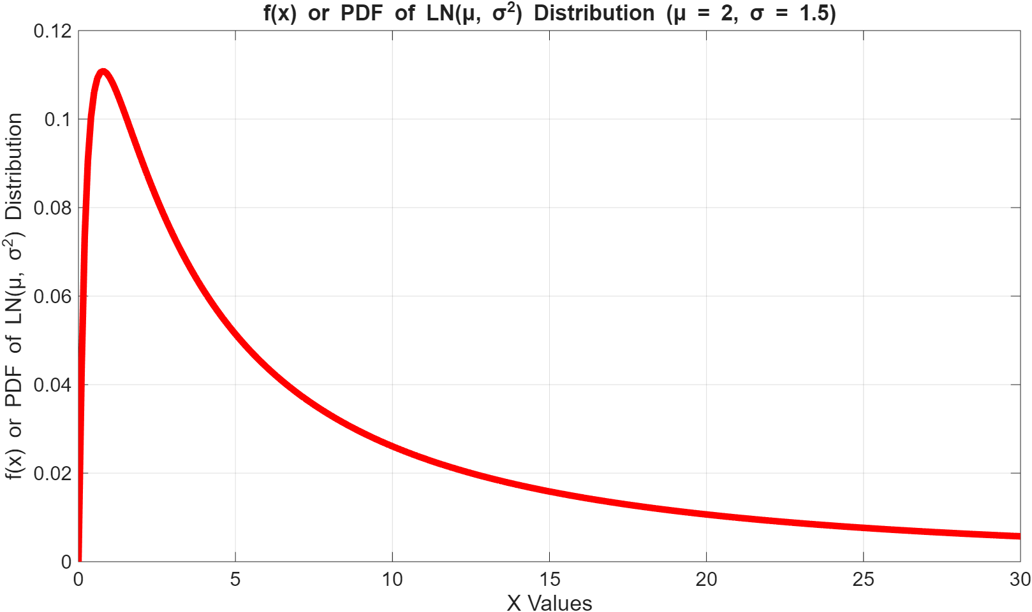
Log-normal distribution
[X ~ LN ( μ, σ²)] (contd….): f(x)

Slide 118
Log-normal distribution
[X ~ LN ( μ, σ²)] (contd….): MATLAB Code for F(x)
%PLOT OF CDF OF LOG NORMAL DISTRIBUTION LN(μ, σ²)
% Define the range of X values for the plot
a = 0; % Minimum value of X as needed to plot
b = +50; % Some maximum value of X as needed to plot
mu = 2; % Location parameter
sigma = 1.5; % Scale parameter
% Define the range of X values for the plot
x = a:0.1:b;
% Calculate the PDF values using logncdf
y = logncdf(x, mu, sigma);
% Plot the CDF of LN(μ, σ²)
plot(x, y, 'LineWidth', 5); % Plot x vs y with a specified line width;
% Add labels and title for clarity
xlabel('X Values'); % Label the x-axis
ylabel('F(x)=P[X≤x] or CDF of LN(μ, σ^2) Distribution'); % Label the y-axis
title(['Plot of F(x)=P[X≤x] or CDF of LN(μ, σ^2) Distribution (μ = ', num2str(mu), ', σ = ', num2str(sigma), ')']); % Set the plot title
% Optional: Add a grid for better readability
grid on; % Add a grid to the plot

Slide 119
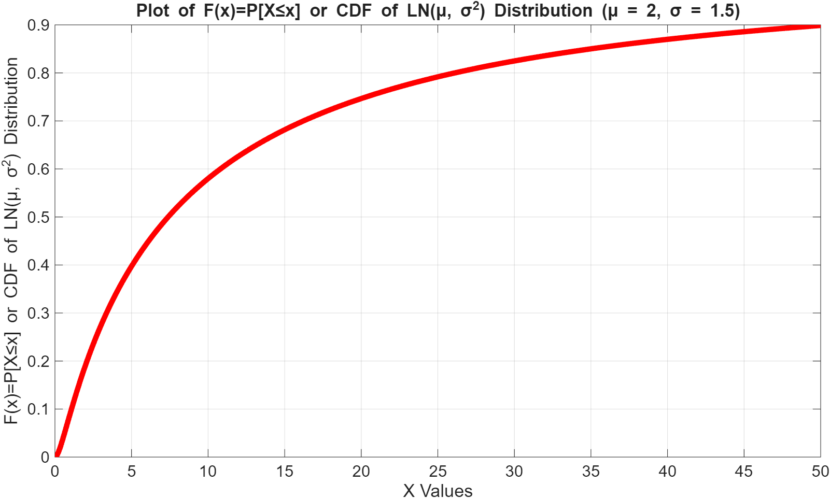
Log-normal distribution
[X ~ LN ( μ, σ²)] (contd….): F(x)

Slide 120
Example # 50

Slide 121
Chi-Square distribution
[X ~ χ_{n}²]
f(x) = 1/{Γ(n/2)2^{(n/2)}}x^{{(n/2)−1}}{exp^{(−x/2)}}
Suppose Z₁,….., Z_{n} are ′n′ independent observations from N(0, 1)
Z²₁ + ….. + Z²_{n} ~ χ²_{n}
n is the parameter (degree of freedom) where n ∈ ℤ⁺
E(X) = μ_{m} = n
V[X] = 2n
Median = μ_{e} = n{1 − (2/9n)}³
Mode = μ_{o} = max(n − 2, 0)

Slide 122
Chi-Square distribution
[X ~ χ_{n}²] (contd….): MATLAB Code for f(x)
%PLOT OF PDF OF χ_{n}² DISTRIBUTION
% Define the range of x values for the plot
x = 0:0.1:20;
% Define the degrees of freedom for the Chi-square distribution
degreesOfFreedom = 7; % Example: 7 degrees of freedom
% Calculate the PDF values using chi2pdf
y = chi2pdf(x, degreesOfFreedom);
% Plot the PDF
plot(x, y, 'LineWidth', 5); % Plot x vs y with a specified line width
% Add labels and title for clarity
xlabel('X=χ2 Values'); % Label the x-axis
ylabel('f(x) or PDF of χ_{n}² Distribution'); % Label the y-axis
title(['Plot of f(x) or PDF of χ_{n}² Distribution (Degrees of Freedom = ', num2str(degreesOfFreedom), ')']);
% Optional: Add a grid for better readability
grid on; % Add a grid to the plot

Slide 123
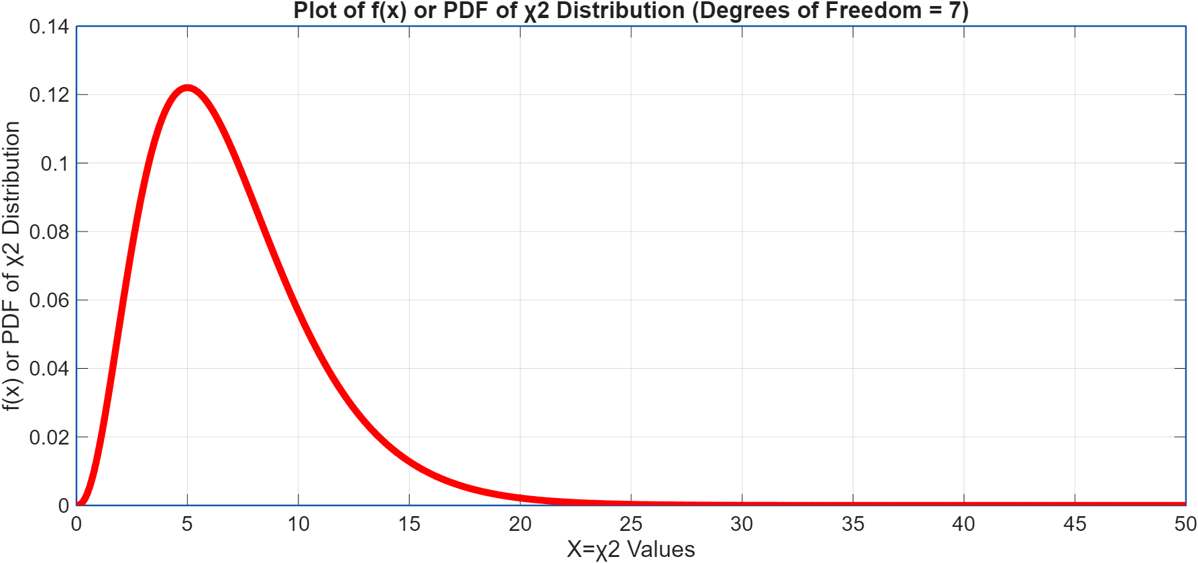
Chi-Square distribution
[X ~ χ_{n}²] (contd….): f(x)

Slide 124
Chi-Square distribution
[X ~ χ_{n}²] (contd….): MATLAB Code for F(x)
%PLOT OF CDF OF χ_{n}² DISTRIBUTION
% Define the range of x values for the plot
x = 0:0.1:20;
% Define the degrees of freedom for the Chi-square distribution
degreesOfFreedom = 7; % Example: 7 degrees of freedom
% Calculate the CDF values using chi2cdf
y = chi2cdf(x, degreesOfFreedom);
% Plot the CDF
figure; % Create a new figure window
plot(x, y, 'LineWidth', 5); % Plot x vs y with a specified line width
% Add labels and title for clarity
xlabel('X=χ2 Values'); % Label the x-axis
ylabel('F(x)=P[X≤x] or CDF of χ_{n}² Distribution');
%ylabel('Cumulative Probability ()'); % Label the y-axis
title(['Plot of F(x)=P[X≤x] or CDF of χ_{n}² Distribution (Degrees of Freedom = ', num2str(degreesOfFreedom), ')']);
% Optional: Add a grid for better readability
grid on; % Add a grid to the plot

Slide 125
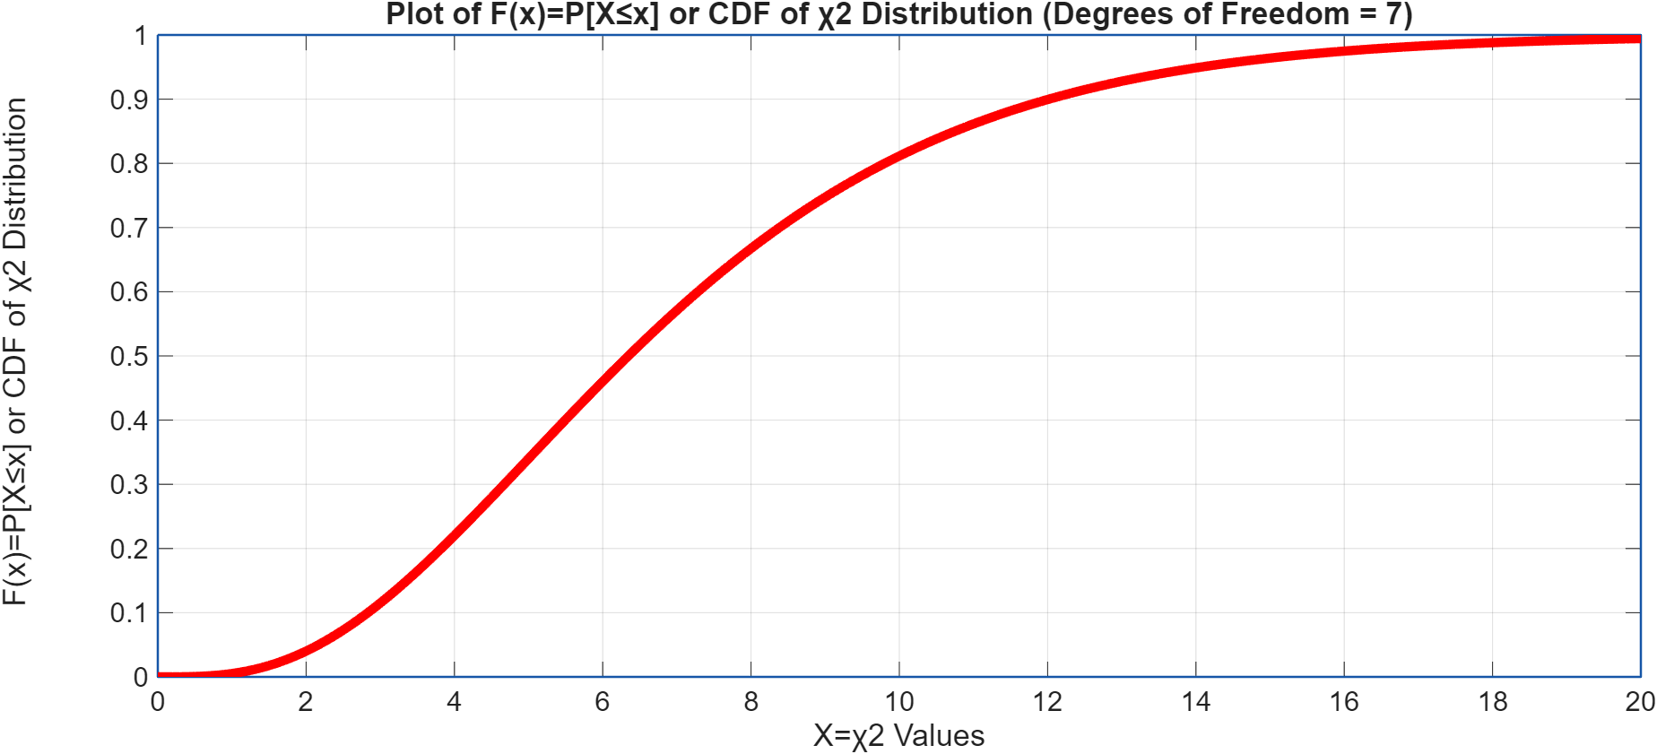
Chi-Square distribution
[X ~ χ_{n}²] (contd….): F(x)

Slide 126
Chi-Square distribution
[X ~ χ_{n}²] (contd….):
Used for checking and verifying interval estimation and hypothesis testing related problems concerning
  Population variance (σ²) and
  Sample variance (s²)

Slide 127
Example # 51

Slide 128
t distribution
[X ~ t_{n}]
f(x) = [Γ{(n+1)/2}/{Γ(n/2)√(nπ)}]{1+x²/n}^{−{(n +1)/2}}
Suppose Z ~ N(0, 1), Y~χ²_{n} and they are independent, then
Z/√(Y/n) ~ t_{n}
n is the parameter (degree of freedom) where n ∈ ℤ⁺
E(X) = μ_{m} = 0 for n > 1
V[X] = n/(n − 2) for n > 2
Median = μ_{e} = 0
Mode = μ_{o} = 0

Slide 129
t distribution
[X ~ t_{n}] (contd….): MATLAB Code for f(x)
%PLOT OF PDF OF t_{n} DISTRIBUTION
% Define the range of x values for the plot
x = -5:0.1:5;
% Define the degrees of freedom for the t-distribution
degreesOfFreedom = 7; % Degrees of freedom
% Calculate the PDF values using tpdf function
y = tpdf(x, degreesOfFreedom);
% Plot the PDF
plot(x, y, 'LineWidth', 5); % Plot x vs y with a specified line width
xlabel('X = t_{n} Values'); % Label the x-axis
ylabel('f(x) or PDF of t_{n} Distribution'); % Label the y-axis
title(['Plot of f(x) or PDF of t_{n} Distribution (Degrees of Freedom = ', num2str(degreesOfFreedom), ')']);
% Optional: Add a grid for better readability
grid on; % Add a grid to the plot

Slide 130
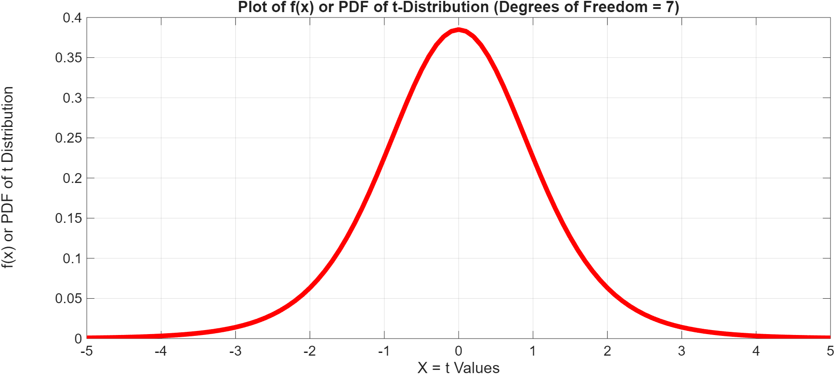
t distribution
[X ~ t_{n}] (contd….): f(x)

Slide 131
t distribution
[X ~ t_{n}] (contd….): MATLAB Code for F(x)
%PLOT OF CDF OF t_{n} DISTRIBUTION
% Define the range of x-values for plotting
x = -5:0.01:5; % Adjust the range as needed
% Define the degrees of freedom for the t-distribution
degreesOfFreedom = 7; % Degrees of freedom
% Calculate the CDF values using tcdf function
y = tcdf(x, degreesOfFreedom);
% Plot the CDF
figure; % Create a new figure window
plot(x, y, 'LineWidth', 5); % Plot x vs y with a specified line width
% Add labels and title for clarity
xlabel('X=t Values'); % Label the x-axis
ylabel('F(x)=P[X≤x] or CDF of t_{n} Distribution'); % Label the y-axis
%ylabel('Cumulative Probability ()');
title(['Plot of F(x)=P[X≤x] or CDF of t_{n} Distribution (Degrees of Freedom = ', num2str(degreesOfFreedom), ')']);
% Optional: Add a grid for better readability
grid on; % Add a grid to the plot

Slide 132
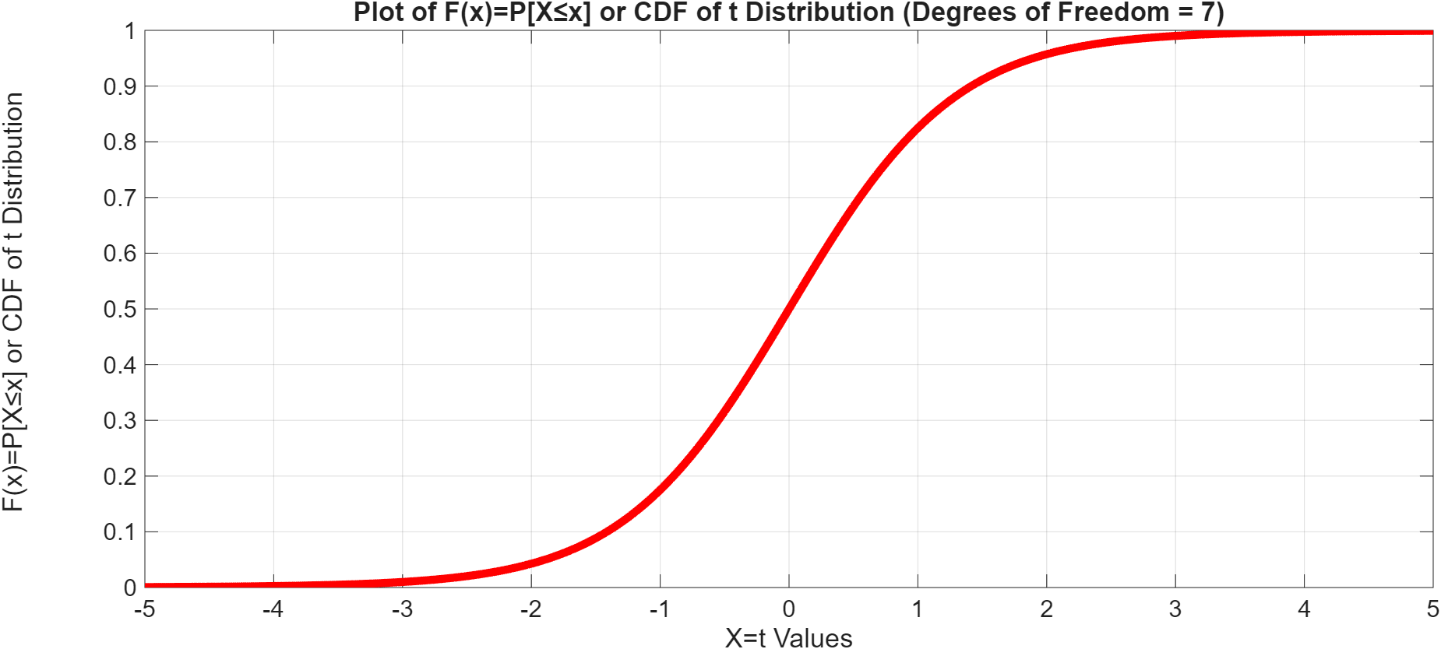
t distribution
[X ~ t_{n}] (contd….): F(x)

Slide 133
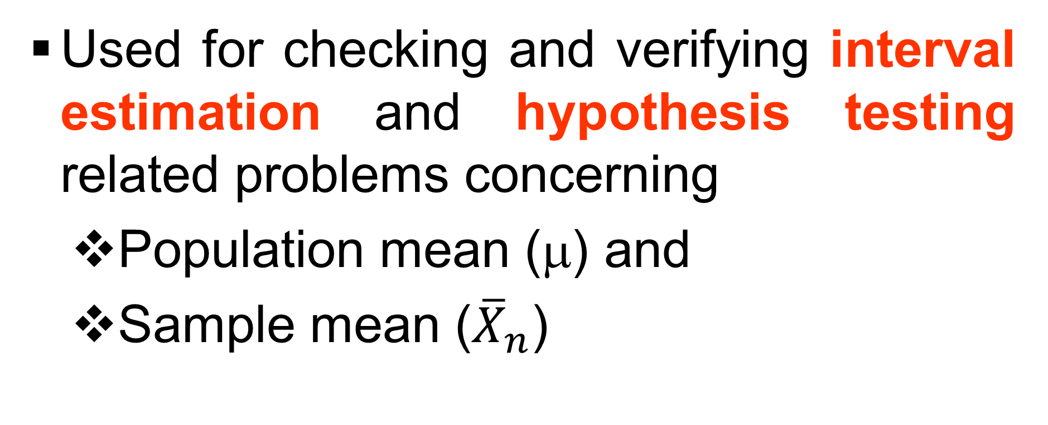
t distribution
[X ~ t_{n}] (contd….):

Slide 134
Example # 52

Slide 135
F distribution
[X ~ F (n,m)]
f(x) = [n^{n/2}m^{m/2}Γ{(n+m)/2}x^{{(n/2)-1}}]/[Γ(n/2)Γ(m/2)(nx+m)^{{(n+m)/2}}]; 0 < x < ∞
Suppose X~χ²_{n}, Y~χ²_{m} and they are independent
(X/n)/(Y/m) ~ F_{n,m}
m, n is the parameters (degree of freedom) where m, n ∈ ℤ⁺
E(X) = μ_{m} = m/(m – 2), (m > 2)
V[X] = 2m²(n + m – 2)/{n(m – 2)²(m – 4)}, (m > 4)
Median = μ_{e} =
Mode = μ_{o}= {m(n – 2)}/{n(m + 2)}

Slide 136
F distribution
[X ~ F(n,m)] (contd….): MATLAB Code for f(x)
%PLOT OF PDF OF F(v1, v2) DISTRIBUTION
% Define the range of x-values for plotting
x = 0:0.01:5; % Adjust the upper limit as needed based on the degrees of freedom
% Define the numerator and denominator which are degrees of freedom for the F distribution
v1 = 5; % Numerator degrees of freedom
v2 = 10; % Denominator degrees of freedom
% Compute the F-distribution PDF values using fpdf
y = fpdf(x, v1, v2);
% Plot the PDF
figure; % Create a new figure window
plot(x, y, 'LineWidth', 5); % Plot x vs y with a specified line width
xlabel('X = F(v1, v2) Values'); % Label the x-axis
ylabel('f(x) or PDF of F(v1, v2) Distribution'); % Label the y-axis
title(['f(x) or PDF of F(v1, v2) Distribution (Degrees of Freedom v1 = ', num2str(v1), ', Degrees of Freedom v2 = ', num2str(v2), ')']); % Set the plot title
% Optional: Add a grid for better readability
grid on; % Add a grid to the plot

Slide 137
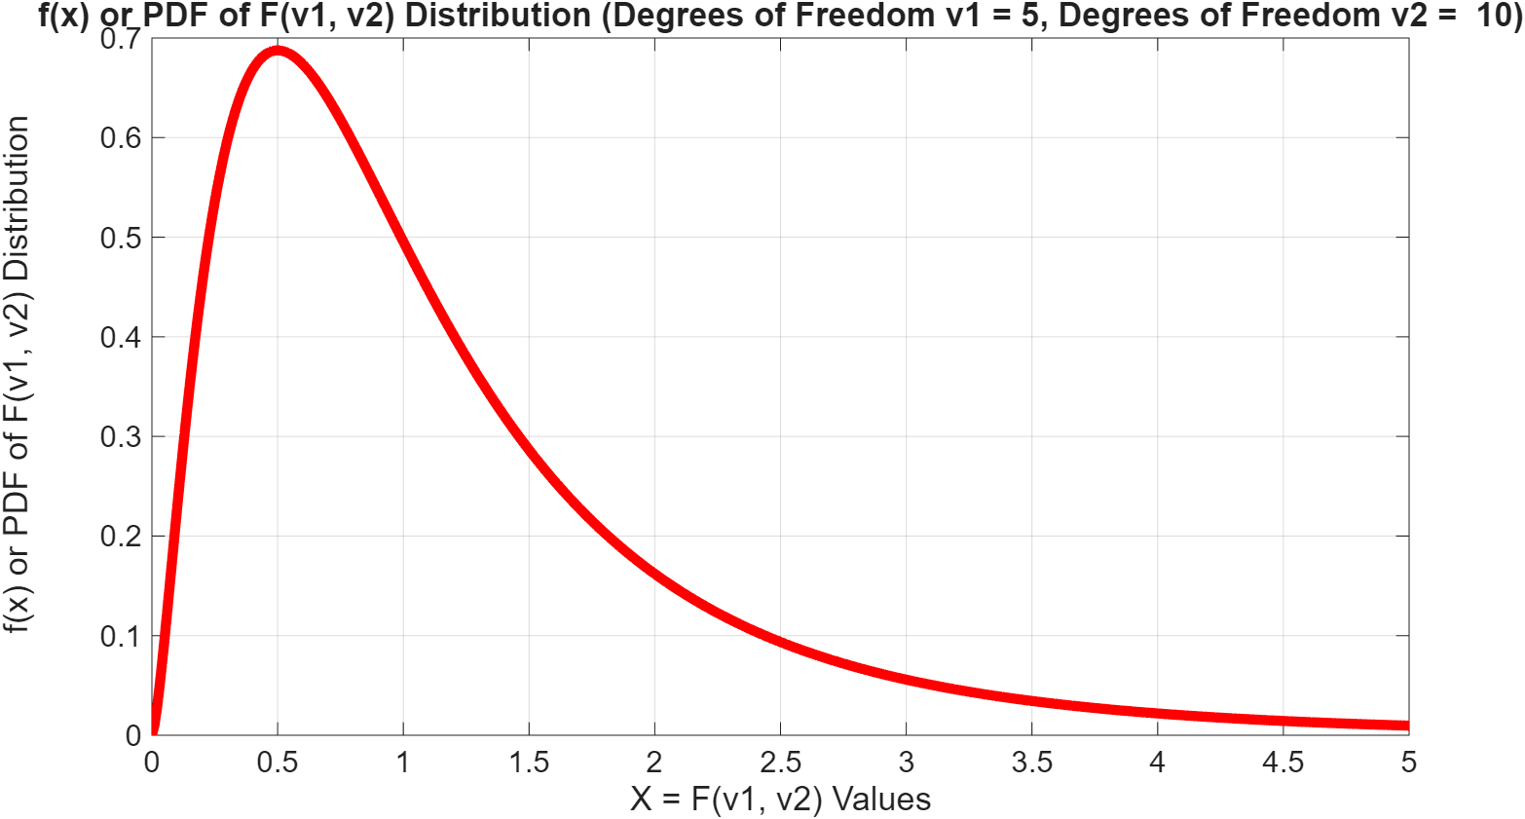
F distribution
[X ~ F(n,m)] (contd….): f(x)

Slide 138
F distribution
[X ~ F(n,m)] (contd….): MATLAB Code for F(x)
%PLOT OF CDF OF F(v1, v2) DISTRIBUTION
% Define degrees of freedom for the F-distribution
% Define the range of x-values for plotting the CDF
% The F-distribution is defined for x≥0
x = 0:0.01:5; % Adjust the upper limit as needed based on the degrees of freedom
% Define the numerator and denominator which are degrees of freedom for the F distribution
v1 = 5; % Numerator degrees of freedom
v2 = 10; % Denominator degrees of freedom
% Compute the F-distribution PDF values using fcdf
y = fcdf(x, v1, v2);
% Plot the CDF of F(v1, v2)
figure; % Create a new figure
plot(x, y, 'LineWidth', 5); % Plot x vs y with a specified line width
xlabel('X = F(v1, v2) Values'); % Label the x-axis
ylabel('F(x)=P[X≤x] or CDF of F(v1, v2) Distribution'); % Label the y-axis
title(['Plot of F(x)=P[X≤x] or CDF of F(v1, v2) Distribution (Degrees of Freedom v1 = ', num2str(v1), ', Degrees of Freedom v2 = ', num2str(v2), ')']); % Set the plot title
% Optional: Add a grid for better readability
grid on; % Add a grid to the plot

Slide 139
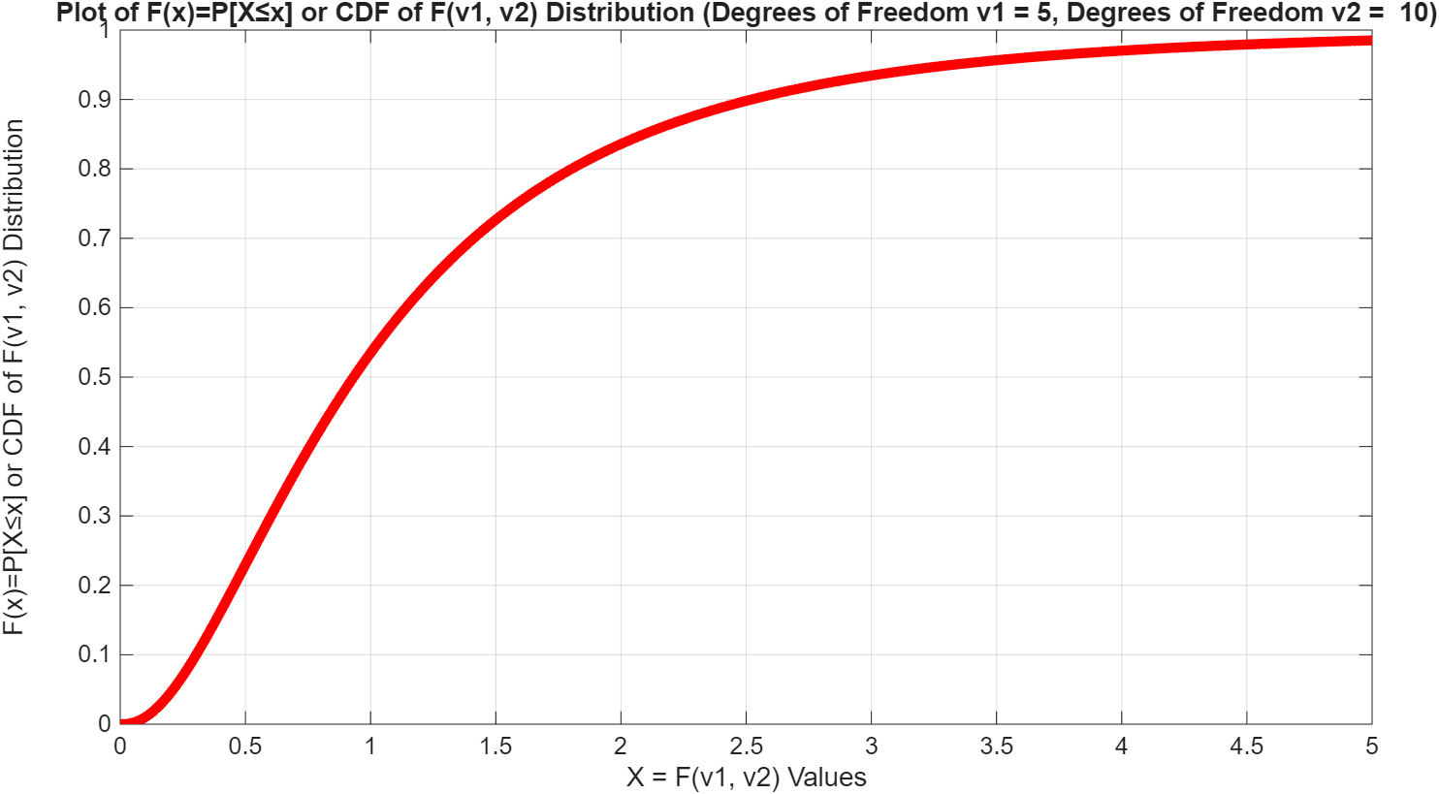
F distribution
[X ~ F(n,m)] (contd….): F(x)

Slide 140
F distribution
[X ~ F(n,m)] (contd….):
Used for checking and verifying interval estimation and hypothesis testing related problems concerning
  Population variances (σ_{X}², σ_{Y}²) and
  Sample variances (s_{X}², s_{Y}²)

Slide 141
Example # 53

Slide 142
Gamma distribution
[ X ~ G(α, β, γ)]
f(x) = β^{−α}Γ⁻¹(α)(x−γ)^{(α−1)}exp{−(x−γ)/β}, x > γ
α > 0: Shape parameter
β > 0: Scale parameter
γ: Location parameter
E(X) = μ_{m}= αβ + γ
V[X] = αβ²
Median = μ_{e}=
Mode = μ_{o}= (α − 1)β

Slide 143
Gamma distribution
[ X ~ G(α, β, γ)] (contd…): MATLAB Code for f(x)
%PLOT OF PDF OF GAMMA(α , β, γ) DISTRIBUTION
% Define the range of x-values for plotting
x = 0:0.01:20; % Adjust the upper limit as needed
% Define α, β and γ for the GAMMA(α , β, γ) distribution
alpha = 2; % Shape parameter
beta = 3; % Scale parameter
gamma = 0; % Location parameter
% Compute the GAMMA(α , β, γ) distribution PDF values using gampdf
y = gampdf(x, alpha, beta);
% Plot the PDF of GAMMA(α , β, γ) distribution
figure; % Create a new figure window
plot(x, y, 'LineWidth', 5); % Plot x vs y with a specified line width
xlabel('X Values'); % Label the x-axis
ylabel('f(x) or PDF of GAMMA(α , β, γ) Distribution'); % Label the y-axis
title(['f(x) or PDF of GAMMA(α , β, γ) Distribution (α = ', num2str(alpha), ', β = ', num2str(beta), ‘, γ = ', num2str(gamma), ')']); % Set the plot title
% Optional: Add a grid for better readability
grid on; % Add a grid to the plot

Slide 144
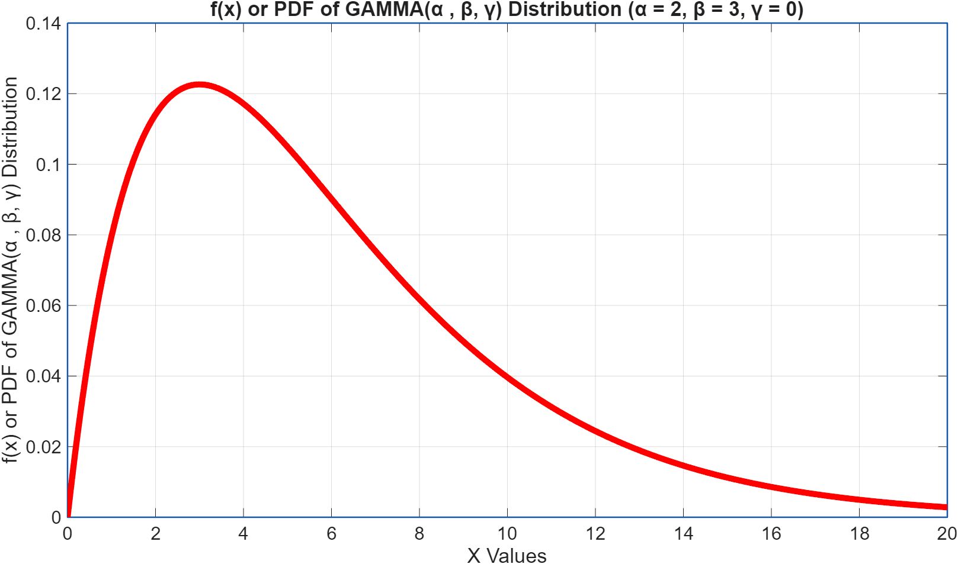
Gamma distribution
[ X ~ G(α, β, γ)] (contd…): f(x)

Slide 145
Gamma distribution
[ X ~ G(α, β, γ)] (contd…): MATLAB Code for F(x)
%PLOT OF CDF OF GAMMA(α , β, γ) DISTRIBUTION
% Define the range of x-values for plotting
x = 0:0.01:20; % Adjust the upper limit as needed
% Define α, β and γ for the GAMMA(α , β, γ) distribution
alpha = 2; % Shape parameter
beta = 3; % Scale parameter
gamma = 0; % Location parameter
% Compute the GAMMA(α , β, γ) distribution CDF values using gamcdf
y = gamcdf(x, alpha, beta);
% Plot the CDF of GAMMA(α , β, γ) distribution
figure; % Create a new figure window
plot(x, y, 'LineWidth', 5); % Plot x vs y with a specified line width
xlabel('X Values'); % Label the x-axis
ylabel('F(x)=P[X≤x] or CDF of GAMMA(α , β, γ) Distribution'); % Label the y-axis
title(['Plot of F(x)=P[X≤x] or CDF of GAMMA(α , β, γ) Distribution (α = ', num2str(alpha), ', β = ', num2str(beta), ‘, γ = ', num2str(gamma), ')']); % Set the plot title
% Optional: Add a grid for better readability
grid on; % Add a grid to the plot

Slide 146
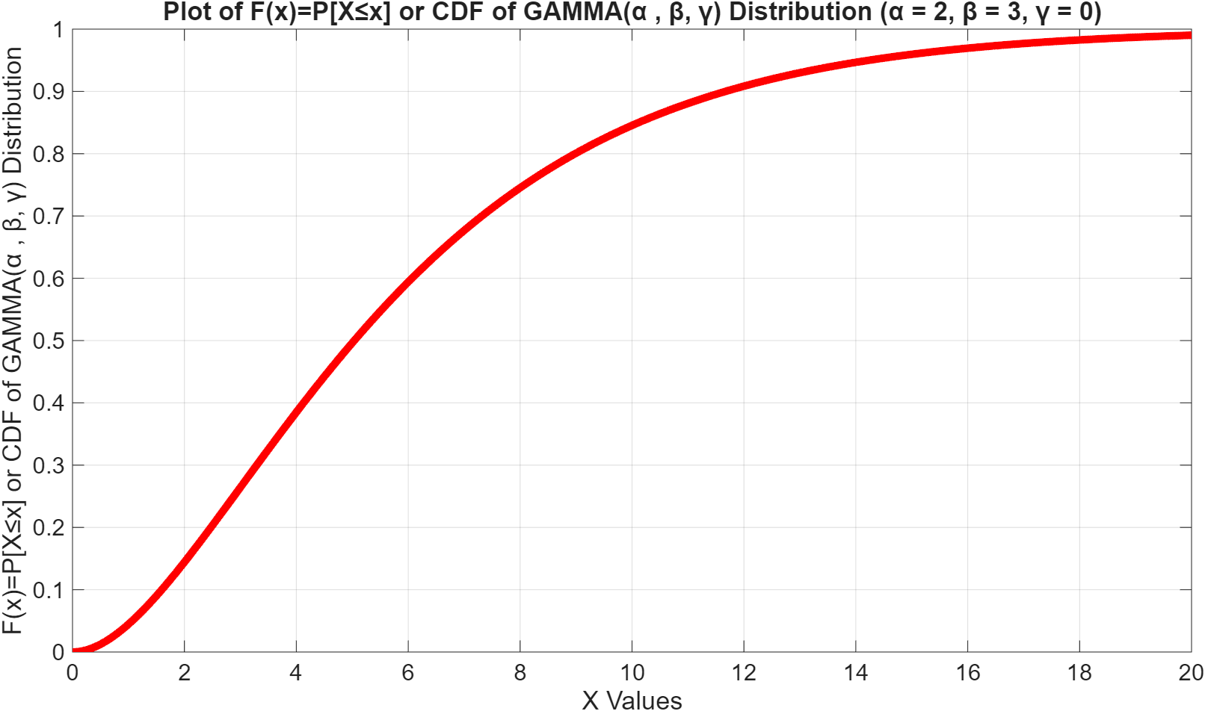
Gamma distribution
[ X ~ G(α, β, γ)] (contd…): F(x)

Slide 147
Example # 54

Slide 148
Weibull distribution
[X ~ W(α, β, γ)]
f(x) = (α/β){(x−γ)/β}^{(α−1)}exp[−{(x−γ)/β}^{α}], x > γ
α > 0: Shape parameter
β > 0: Scale parameter
γ: Location parameter
E(X) = μ_{m}= γ + βΓ{1 + (1/α)}
V[X] = β²[Γ{1 + (2/α)} − [Γ{1 + (1/α)}]²]
Median = μ_{e}= β{𝑙n(2)}^{(1/α)}
Mode = μ_{o}= β{(α −1)/α}^{(1/α)}

Slide 149
Weibull distribution
[ X ~ W(α, β, γ)] (contd…): MATLAB Code for f(x)
%PLOT OF PDF OF WEIBULL(α , β, γ) DISTRIBUTION
% Define the range of x-values for plotting
x = 0:0.1:30; % Adjust the upper limit as needed
% Define α, β and γ for the WEIBULL(α , β, γ) distribution
alpha = 6; % Shape parameter
beta = 2; % Scale parameter
gamma = 0; % Location parameter
% Compute the WEIBULL(α , β, γ) distribution PDF values using gwblpdf
y = wblpdf(x, alpha, beta);
% Plot the PDF of WEIBULL(α , β, γ) distribution
figure; % Create a new figure window
plot(x, y, 'LineWidth', 5); % Plot x vs y with a specified line width
xlabel('X Values'); % Label the x-axis
ylabel('f(x) or PDF of WEIBULL(α , β, γ) Distribution'); % Label the y-axis
title(['f(x) or PDF of WEIBULL(α , β, γ) Distribution (α = ', num2str(alpha), ', β = ', num2str(beta), ‘, γ = ', num2str(gamma), ')']); % Set the plot title
% Optional: Add a grid for better readability
grid on; % Add a grid to the plot

Slide 150
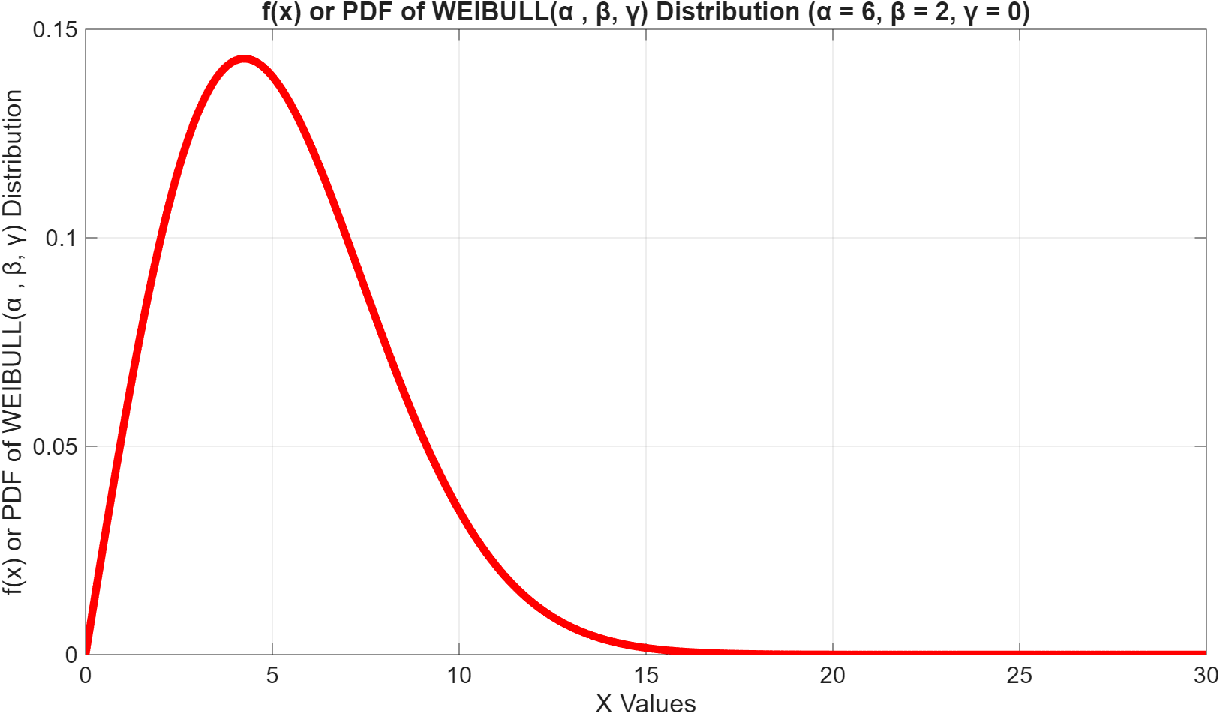
Weibull distribution
[ X ~ W(α, β, γ)] (contd…): f(x)

Slide 151
Weibull distribution
[ X ~ W(α, β, γ)] (contd…): MATLAB Code for F(x)
%PLOT OF CDF OF WEIBULL(α , β, γ) DISTRIBUTION
% Define the range of x-values for plotting
x = 0:0.1:30; % Adjust the upper limit as needed
% Define α, β and γ for the WEIBULL(α , β, γ) distribution
alpha = 6; % Shape parameter
beta = 2; % Scale parameter
gamma = 0; % Location parameter
% Compute the WEIBULL(α , β, γ) distribution CDF values using wblcdf
y = wblcdf(x, alpha, beta);
% Plot the CDF of WEIBULL(α , β, γ) distribution
figure; % Create a new figure window
plot(x, y, 'LineWidth', 5); % Plot x vs y with a specified line width
xlabel('X Values'); % Label the x-axis
ylabel('F(x)=P[X≤x] or CDF of WEIBULL(α , β, γ) Distribution'); % Label the y-axis
title(['Plot of F(x)=P[X≤x] or CDF of WEIBULL(α , β, γ) Distribution (α = ', num2str(alpha), ', β = ', num2str(beta), ‘, γ = ', num2str(gamma), ')']); % Set the plot title
% Optional: Add a grid for better readability
grid on; % Add a grid to the plot

Slide 152
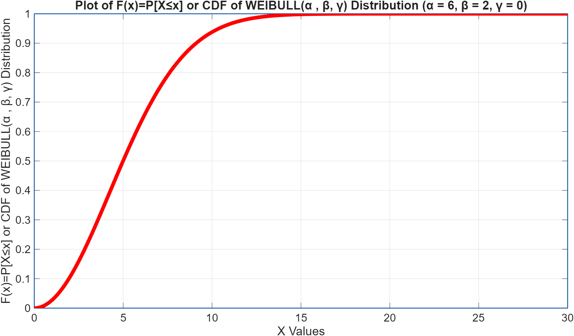
Weibull distribution
[ X ~ W(α, β, γ)] (contd…): F(x)

Slide 153
Example # 55

Slide 154
Beta distribution
[X~ Beta (α, β, γ)]
f(x) = [Γ(α,β)/{Γ(α)Γ(β)}]{(x−δ₁)^{(α−1)}(δ₂−x)^{(β−1)}}/(δ₂−δ₁)^{(α+β−1)}, δ_{1⁡}<x< δ₂
α > 0: Shape parameter # 01
β > 0: Shape parameter # 02
δ₁: Minimum value of x
δ₂: Maximum value of x
E(X) = μ_{m} = (δ₂ − δ₁ + 1) + α/(α + β)
V[X] = αβ/{(α + β)²(α + β + 1)}
Median = μ_{e}=
Mode = μ_{o}=

Slide 155
Beta distribution
[X~ Beta (α, β, γ)] (contd…): MATLAB Code for f(x)
% Define the range of x values for the Beta distribution (0 to 1)
delta_1=0;
delta_2=1;
x = delta_1:0.01:delta_2;
% Define the shape parameters for the Beta distribution
alpha = 2; % Alpha parameter (shape)
beta = 5; % Beta parameter (shape)
% Calculate the PDF values
y = betapdf(x, alpha, beta);
% Plot the Beta PDF
plot(x, y, 'LineWidth', 2);
title(['f(x) or PDF of BETA (α, β) (α = ', num2str(alpha), ', β = ', num2str(beta), ')']);
xlabel('X Value');
ylabel('f(x) or PDF of BETA (α, β)');
grid on;

Slide 156
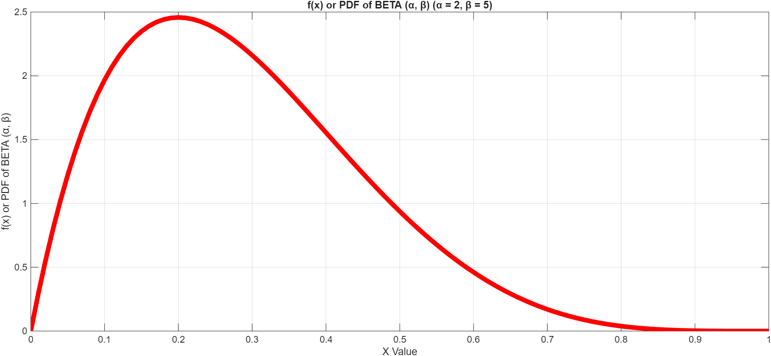
Beta distribution
[X~ Beta (α, β, γ)] (contd…): f(x)

Slide 157
Beta distribution
[X~ Beta (α, β, γ)] (contd…): MATLAB Code for F(x)
% Define the range of x values for the Beta distribution (0 to 1)
delta_1=0;
delta_2=1;
x = delta_1:0.01:delta_2;
% Define the shape parameters for the Beta distribution
alpha = 2; % Alpha parameter (shape)
beta = 5; % Beta parameter (shape)
% Calculate the PDF values
y = betacdf(x, alpha, beta);
% Plot the Beta CDF
plot(x, y, 'LineWidth', 2);
title(['F(x) or CDF of BETA (α, β) (α = ', num2str(alpha), ', β = ', num2str(beta), ')']);
xlabel('X Value');
ylabel('F(x) or CDF of BETA (α, β)');
grid on;

Slide 158
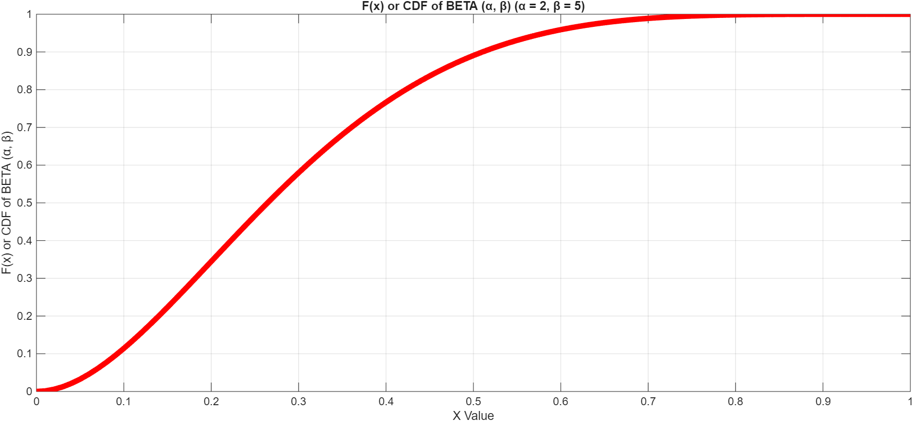
Beta distribution
[X~ Beta (α, β, γ)] (contd…):

Slide 159
Example # 56

Slide 160
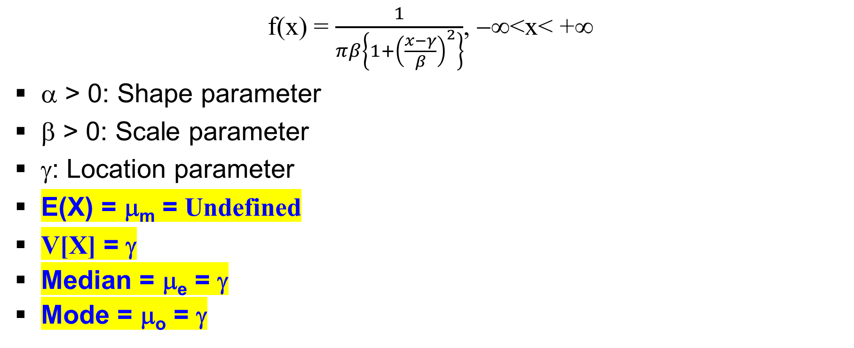
Cauchy distribution
[X ~ Cauchy (α, β, γ)]
f(x) = $\frac{1}{πβ\left\{1+{\left(\frac{x−γ}{β}\right)}^{2}\right\}}$, −∞⁡<x< +∞
α > 0: Shape parameter
β > 0: Scale parameter
γ: Location parameter
E(X) = μ_{m} = Undefined
V[X] = γ
Median = μ_{e} = γ
Mode = μ_{o} = γ

Slide 161
Cauchy distribution
[X ~ Cauchy (α, β, γ)] (contd…): MATLAB Code for f(x)
% Define the parameters for the Cauchy distribution
gamma = 2; % Location parameter (median)
beta = 3; % Scale parameter
% Define the x-axis range
x_min=-25;
x_max=+25;
x = x_min:0.1:x_max;
% Calculate the Cauchy PDF manually
y = (1 ./ (pi * beta)) .* (1 ./ (1 + ((x - gamma) ./ beta).^2));
% Plot the distribution
figure;
plot(x, y, 'LineWidth', 2);
% Add labels and a title
title(['f(x) or PDF of Cauchy Distribution (β, γ) (β = ', num2str(beta), ', γ = ', num2str(gamma), ')']);
xlabel('X Value');
ylabel('f(x) or PDF of Cauchy Distribution (β, γ)');
grid on;

Slide 162
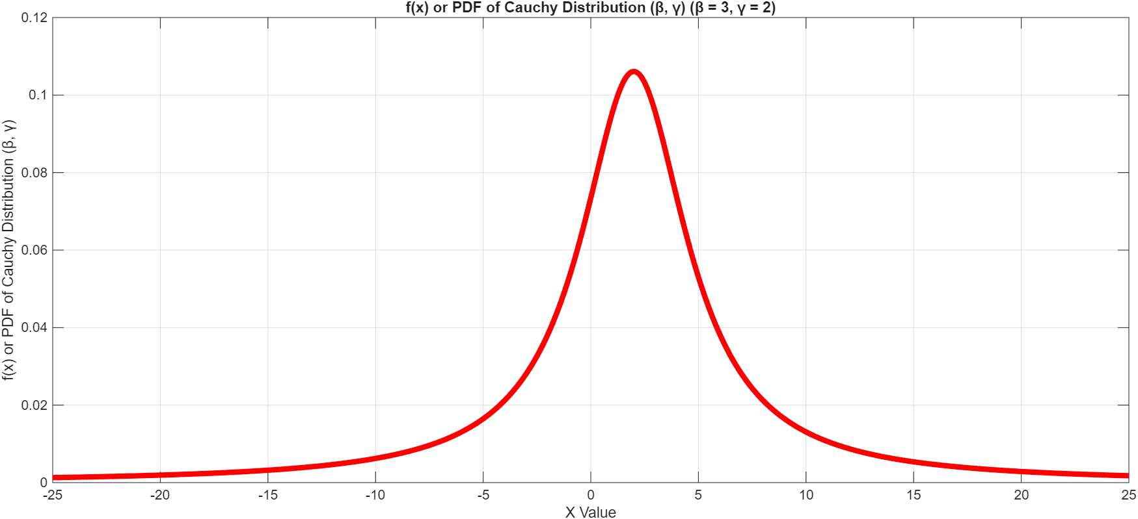
Cauchy distribution
[X ~ Cauchy (α, β, γ)] (contd…): f(x)

Slide 163
Cauchy distribution
[X ~ Cauchy (α, β, γ)] (contd…): MATLAB Code for F(x)
% Define Cauchy distribution parameters
gamma = 2; % Location parameter
beta = 3; % Scale parameter (half-width at half-maximum)
nu = 1; % Degrees of freedom for Student's t, nu = 1 is a Cauchy distribution
% Create a t location-scale probability distribution object
pd = makedist('tLocationScale', 'mu', gamma, 'sigma', beta, 'nu', nu);
% Define the values for which you want to compute the CDF
x_min=-25;
x_max=+25;
x = x_min:0.1:x_max;
% Compute the CDF at each value in x
y = cdf(pd, x);
% Plot the CDF
plot(x, y);
title(['F(x) or CDF of CAUCHY Distributon (β, γ) (β = ', num2str(beta), ', γ = ', num2str(gamma), ')']);
xlabel('X Value');
ylabel('F(x) or CDF of Cauchy Distribution (β, γ)');
grid on;

Slide 164
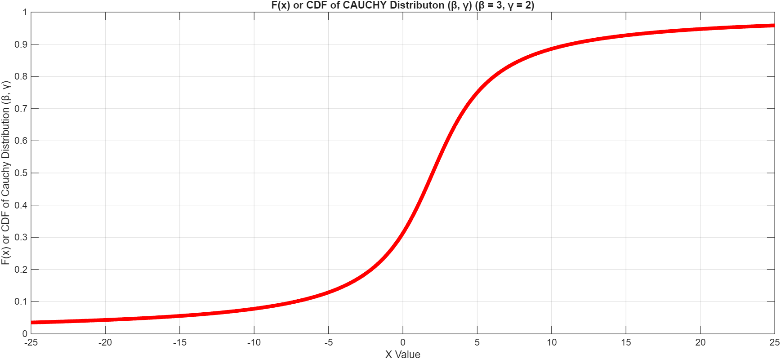
Cauchy distribution
[X ~ Cauchy (α, β, γ)] (contd…):

Slide 165
Example # 57

Slide 166
Double Exponential/Laplace distribution
[X~ DE (α, β, γ)]
f(x) = (1/2β)exp{−(|x − γ|/β)} , −∞<x<+∞
α: Shape parameter
β > 0: Scale parameter
γ: Location parameter
E(X) = μ_{m} = γ
V[X] = 2β²
Median = μ_{e} = γ
Mode = μ_{o} = γ

Slide 167
Double Exponential/Laplace distribution
[X~ DE (α, β, γ)] (contd…): MATLAB Code for f(x)
%PLOT OF PDF OF LAPLACE/DOUBLE EXPONENTIAL (α , β, γ) DISTRIBUTION
% Define the scale, shape, location parameters for plotting
gamma = 3; % Location parameter
beta = 2; % Scale parameter (must be > 0)
% Define the range of x-values for plotting
x_min=-20;
x_max=+20;
x = x_min:0.01:x_max;
% Calculate the PDF values for LAPLACE/DOUBLE EXPONENTIAL (α , β, γ)
% f(x) = (1 / (2*beta)) * exp(-abs(x - gamma) / beta)
pdf_values = (1 / (2 * beta)) * exp(-abs(x - gamma) / beta);
% Plot the PDF
figure; % Create a new figure window
plot(x, pdf_values, 'LineWidth', 2);
title(['f(x) or PDF of LAPLACE/DOUBLE EXPONENTIAL (β, γ) (β = ', num2str(beta), ', γ = ', num2str(gamma), ')']);
xlabel('X Values'); % Label the x-axis
ylabel('f(x) or PDF of LAPLACE DISTRIBUTION (α , β, γ)'); % Label the y-axis
grid on;

Slide 168
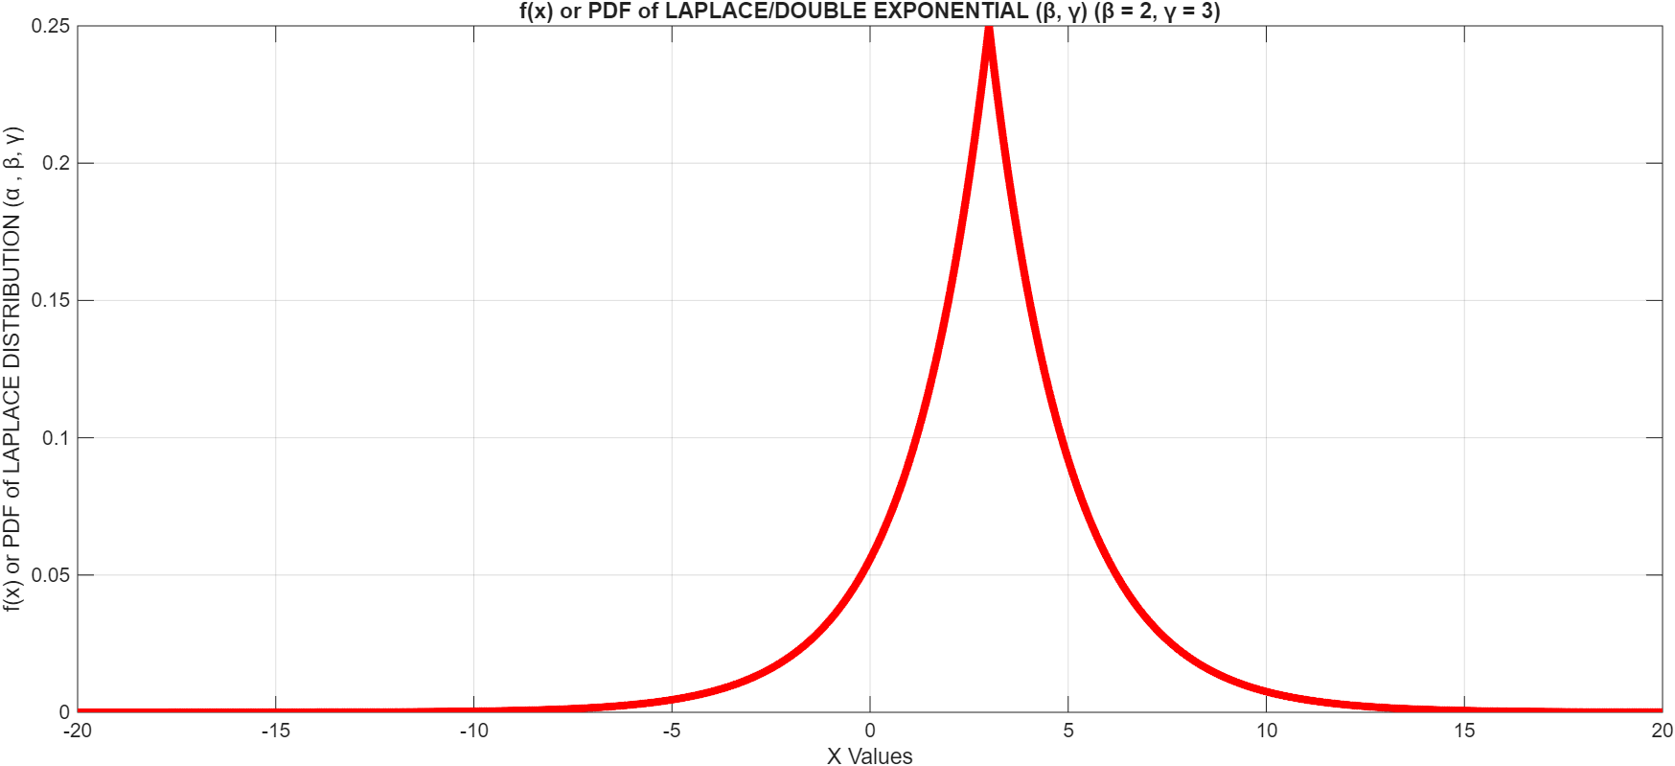
Double Exponential/Laplace distribution
[X ~ DE (α, β, γ)] (contd…): f(x)

Slide 169
Double Exponential/Laplace distribution
[X ~ DE (α, β, γ)] (contd…): MATLAB Code for F(x)
%PLOT OF CDF OF LAPLACE/DOUBLE EXPONENTIAL (α , β, γ) DISTRIBUTION
% Define the scale, shape, location parameters for plotting
gamma = 3; % Location parameter
beta = 2; % Scale parameter (must be > 0)
% Define the range of x-values for plotting
x_min=-20;
x_max=+20;
x = x_min:0.01:x_max;
% Calculate the CDF values for LAPLACE/DOUBLE EXPONENTIAL (α , β, γ)
% F(x; gamma, beta) = 0.5 * exp((x - gamma) / beta) for x < gamma AND F(x; gamma, beta) = 1 - 0.5 * exp(-(x - gamma) / beta) for x >= gamma
cdf_double_exp = zeros(size(x)); % Initialize CDF array
for i = 1:length(x)
if x(i) < gamma
cdf_double_exp(i) = 0.5 * exp((x(i) - gamma) / beta);
else
cdf_double_exp(i) = 1 - 0.5 * exp(-(x(i) - gamma) / beta);
end
end
figure; % Create a new figure and plot the CDF
plot(x, cdf_double_exp, 'LineWidth', 1.5);
title(['F(x) or CDF of LAPLACE/DOUBLE EXPONENTIAL (β, γ) (β = ', num2str(beta), ', γ = ', num2str(gamma), ')']);
xlabel('X Values'); % Label the x-axis
ylabel('F(x) or CDF of LAPLACE DISTRIBUTION (β, γ)'); % Label the y-axis
grid on;

Slide 170
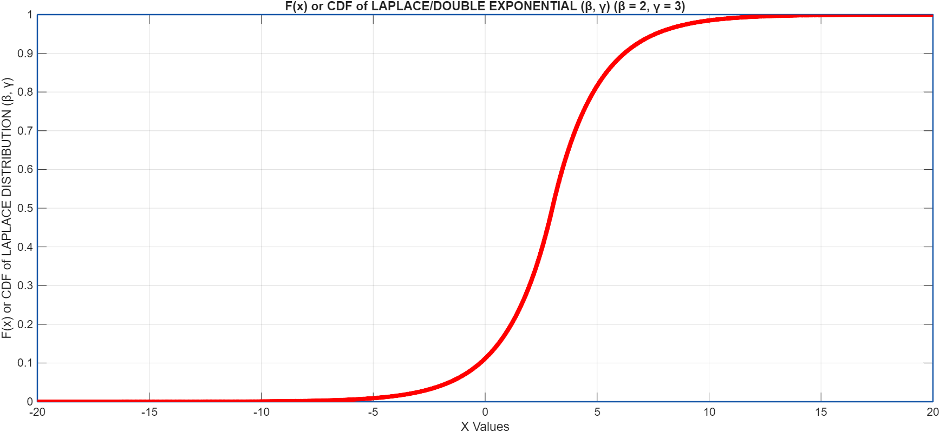
Double Exponential/Laplace distribution
[X ~ DE (α, β, γ)] (contd…): F(x)

Slide 171
Example # 58

Slide 172
Pareto distribution
[X ~ Pareto(α, β, γ)]
f(x) = (1/β)[1 + α{(x−γ)/β}] ^{−{1 + (1/α)}}, x > γ
α > 0: Shape parameter
β ∈ (−∞, +∞): Scale parameter
γ: Location parameter
E(X) = μ_{m} = γ + β/(1 − α)
V[X] = β²/{(1 − α)²(1 − 2α)}
Median = μ_{e} = γ + β(2^{α} − 1)/α
Mode = μ_{o} = γ

Slide 173
Pareto distribution
[X ~ Pareto(α, β, γ)] (contd…): MATLAB Code for f(x)
%PLOT OF PDF OF PARETO (α , β, γ) DISTRIBUTION
% Define the scale, shape, location parameters for plotting
alpha = 1; %Shape parameter
beta = 2; % Scale parameter
gamma = 3; % Location parameter
% Define the range of x-values for plotting
x_min=gamma;
x_max=+20;
x = x_min:0.01:x_max;
% Calculate the PDF values for PARETO (α , β, γ) DISTRIBUTION
% f(x) = (1/beta) *(1+alpha((x - gamma)/beta))^(-(1+1/alpha))
pdf_values = (1/beta) *(1+alpha*((x - gamma)/beta)).^(-(1+1/alpha));
% Plot the PDF
figure; % Create a new figure window
plot(x, pdf_values, 'LineWidth', 2);
title(['f(x) or PDF of PARETO (α , β, γ) DISTRIBUTION (α = ', num2str(alpha), ', β = ', num2str(beta), ‘, γ = ', num2str(gamma), ')']); % Set the plot title
xlabel('X Values'); % Label the x-axis
ylabel('f(x) or PDF of PARETO (α , β, γ) DISTRIBUTION'); % Label the y-axis
grid on;

Slide 174
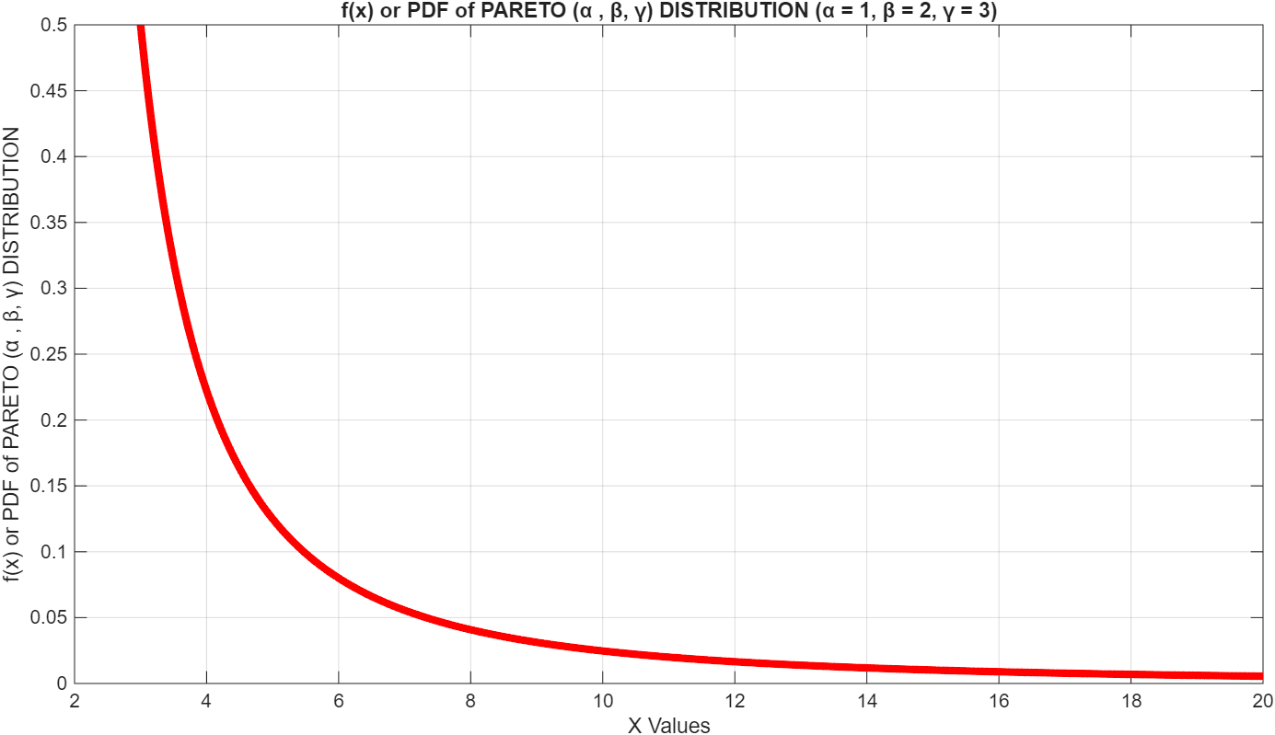
Pareto distribution
[X ~ Pareto(α, β, γ)] (contd…): f(x)

Slide 175
Pareto distribution
[X ~ Pareto(α, β, γ)] (contd…): MATLAB Code for F(x)
%PLOT OF CDF OF PARETO (α , β, γ) DISTRIBUTION
% Define the scale, shape, location parameters for plotting
alpha = 1; %Shape parameter
beta = 2; % Scale parameter
gamma = 3; % Location parameter
% Define the range of x-values for plotting
x_min=gamma;
x_max=+20;
x = x_min:0.01:x_max;
% Calculate the CDF values for PARETO (α , β, γ) DISTRIBUTION
% f(x) = 1-(1+alpha*((x-gamma)/beta))^(-(1/alpha))
cdf_values = 1-(1+alpha*((x-gamma)/beta)).^(-(1/alpha));
% Plot the PDF
figure; % Create a new figure window
plot(x, cdf_values, 'LineWidth', 2);
title(['F(x) or CDF of PARETO (α , β, γ) DISTRIBUTION (α = ', num2str(alpha), ', β = ', num2str(beta), ‘, γ = ', num2str(gamma), ')']); % Set the plot title
xlabel('X Values'); % Label the x-axis
ylabel('F(x) or CDF of PARETO (α , β, γ) DISTRIBUTION'); % Label the y-axis
grid on;

Slide 176
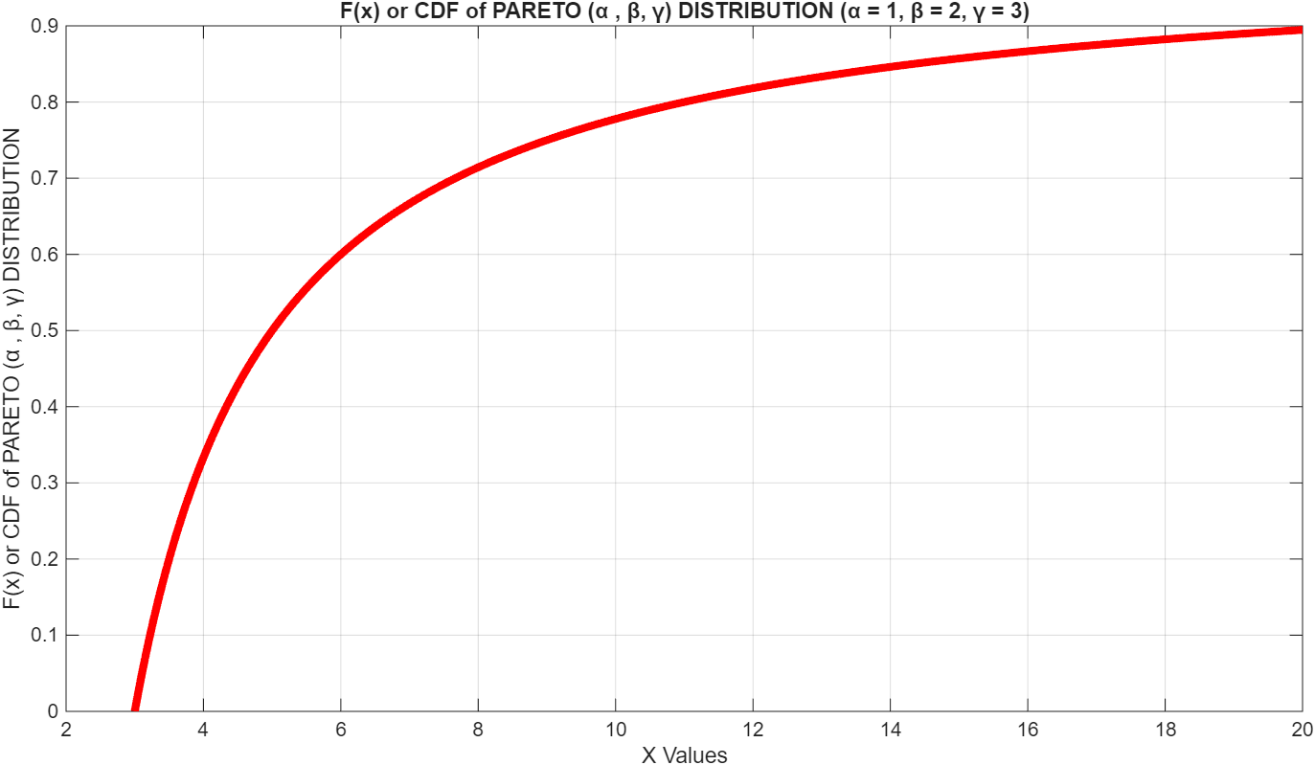
Pareto distribution
[X ~ Pareto(α, β, γ)] (contd…): F(x)

Slide 177
Example # 59

Slide 178
Logistic distribution
[X ~ Logistic(α, β, γ)]
f(x) = (α/β){(x−γ)/β}^{(α −1)}[1 + {(x−γ)/β}^{α}]⁻², x > γ
α > 0: Shape parameter
β ∈ (−∞, +∞): Scale parameter
γ: Location parameter
E(X) = μ_{m} = γ + β/(1 − α)
V[X] = β²/{(1 − α)²(1 − 2α)}
Median = μ_{e} = γ + β(2^{α} − 1)/α
Mode = μ_{o} = γ

Slide 179
Logistic distribution
[X ~ Logistic(α, β, γ)] (contd…): MATLAB Code for f(x)
%PLOT OF PDF OF LOGISTIC (α , β, γ) DISTRIBUTION
% Define the scale, shape, location parameters for plotting
alpha = 3; %Shape parameter
beta = 1; % Scale parameter
gamma = 5; % Location parameter
% Define the range of x-values for plotting
x_min=gamma;
x_max=+20;
x = x_min:0.01:x_max;
% Calculate the PDF values for LOGISTIC (α , β, γ) DISTRIBUTION
% f(x) = (alpha/beta) *((x - gamma)/beta)^(alpha-1)*(1+((x - gamma)/beta)^(alpha))^-2
pdf_values = (alpha/beta) *((x - gamma)/beta).^(alpha-1)./(1+((x - gamma)/beta).^(alpha)).^2;
% Plot the PDF
figure; % Create a new figure window
plot(x, pdf_values, 'LineWidth', 2);
title(['f(x) or PDF of LOGISTIC (α , β, γ) DISTRIBUTION (α = ', num2str(alpha), ', β = ', num2str(beta), ', γ = ', num2str(gamma), ')']); % Set the plot title
xlabel('X Values'); % Label the x-axis
ylabel('f(x) or PDF of LOGISTIC (α , β, γ) DISTRIBUTION'); % Label the y-axis
grid on;

Slide 180
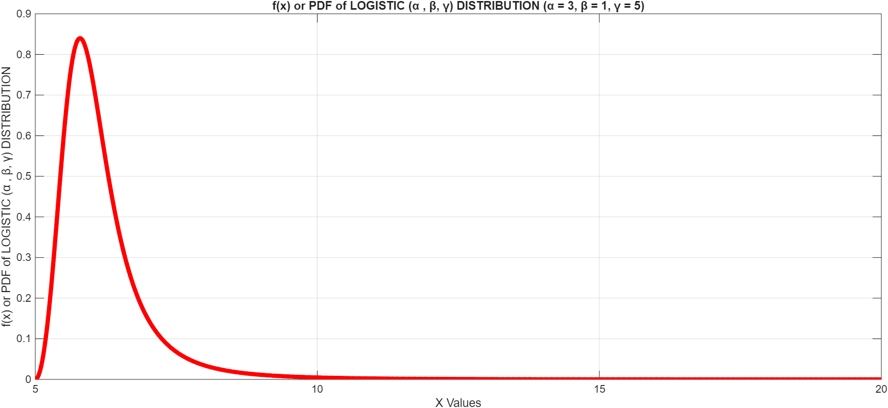
Logistic distribution
[X ~ Logistic(α, β, γ)] (contd…): f(x)

Slide 181
Logistic distribution
[X ~ Logistic(α, β, γ)] (contd…): MATLAB Code for F(x)
%PLOT OF CDF OF LOGISTIC (α , β, γ) DISTRIBUTION
% Define the scale, shape, location parameters for plotting
alpha = 3; %Shape parameter
beta = 1; % Scale parameter
gamma = 5; % Location parameter
% Define the range of x-values for plotting
x_min=gamma;
x_max=+20;
x = x_min:0.01:x_max;
% Calculate the CDF values for LOGISTIC (α , β, γ) DISTRIBUTION
% F(x) =(1+exp(-((x - gamma)/beta)))^(-alpha)
cdf_values = (1+exp(-((x - gamma)/beta))).^(-alpha);
% Plot the CDF
figure; % Create a new figure window
plot(x, cdf_values, 'LineWidth', 2);
title(['F(x) or CDF of LOGISTIC (α , β, γ) DISTRIBUTION (α = ', num2str(alpha), ', β = ', num2str(beta), ', γ = ', num2str(gamma), ')']); % Set the plot title
xlabel('X Values'); % Label the x-axis
ylabel('F(x) or CDF of LOGISTIC (α , β, γ) DISTRIBUTION'); % Label the y-axis
grid on;

Slide 182
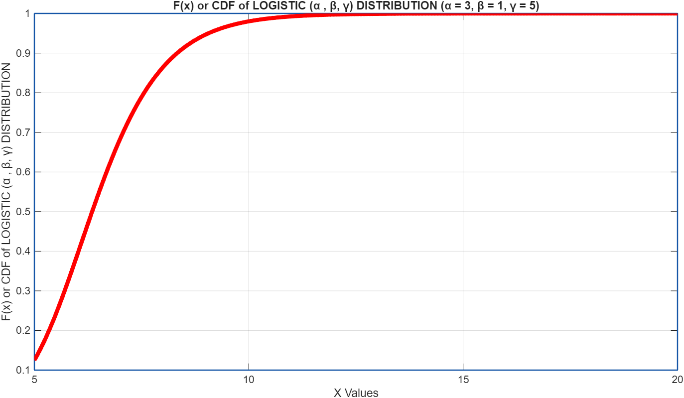
Logistic distribution
[X ~ Logistic(α, β, γ)] (contd…): F(x)

Slide 183
Example # 60

Slide 184
Extreme Value Distribution
[X ~ EVD(α, β, γ)]: Type-I: Gumble distribution
f(x) =, x > γ
α > 0: Shape parameter
β ∈ (−∞, +∞): Scale parameter
γ: Location parameter
E(X) = μ_{m} =
V[X] =
Median =
Mode = μ_{o} =

Slide 185
Extreme Value Distribution
[X ~ EVD(α, β, γ)]: Type-I: Gumble distribution (contd…): MATLAB Code for f(x)

Slide 186
Extreme Value Distribution
[X ~ EVD(α, β, γ)]: Type-I: Gumble distribution (contd…): f(x)

Slide 187
Extreme Value Distribution
[X ~ EVD(α, β, γ)]: Type-I: Gumble distribution (contd…): MATLAB Code for F(x)

Slide 188
Extreme Value Distribution
[X ~ EVD(α, β, γ)]: Type-I: Gumble distribution (contd…): F(x)

Slide 189
Example # 61

Slide 190
Extreme Value Distribution
[X ~ EVD(α, β, γ)]: Type-II: Fréchet distribution
f(x) =, x > γ
α > 0: Shape parameter
β ∈ (−∞, +∞): Scale parameter
γ: Location parameter
E(X) = μ_{m} =
V[X] =
Median =
Mode = μ_{o} =

Slide 191
Extreme Value Distribution
[X ~ EVD(α, β, γ)]: Type-II: Fréchet distribution (contd…): MATLAB Code for f(x)

Slide 192

Extreme Value Distribution
[X ~ EVD(α, β, γ)]: Type-II: Fréchet distribution (contd…): f(x)

Slide 193
Extreme Value Distribution
[X ~ EVD(α, β, γ)]: Type-II: Fréchet distribution (contd…): MATLAB Code for F(x)

Slide 194

Extreme Value Distribution
[X ~ EVD(α, β, γ)]: Type-II: Fréchet distribution (contd…): F(x)

Slide 195
Example # 62

Slide 196
Extreme Value Distribution
[X ~ EVD(α, β, γ)]: Type-III: Weibull distribution
f(x) =, x > γ
α > 0: Shape parameter
β ∈ (−∞, +∞): Scale parameter
γ: Location parameter
E(X) = μ_{m} =
V[X] =
Median =
Mode = μ_{o} =

Slide 197
Extreme Value Distribution
[X ~ EVD(α, β, γ)]: Type-III: Weibull distribution (contd…): MATLAB Code for f(x)

Slide 198

Extreme Value Distribution
[X ~ EVD(α, β, γ)]: Type-III: Weibull distribution (contd…): f(x)

Slide 199
Extreme Value Distribution
[X ~ EVD(α, β, γ)]: Type-III: Weibull distribution (contd…): MATLAB Code for F(x)

Slide 200

Extreme Value Distribution
[X ~ EVD(α, β, γ)]: Type-III: Weibull distribution (contd…): F(x)

Slide 201
Example # 63

Slide 202
Normal approximation to Binomial distribution
Let X ~ B(𝑛, 𝑝) where 𝑛 is large and 𝑝 is small.
Then the distribution can be approximated by the Normal distribution X ~ N(𝑛𝑝, 𝑛𝑝𝑞)
Read the proof

Slide 203
De Moivre Laplace Limit Theorems
P(𝑎 ≤ X ≤ 𝑏) ≅ Φ[{𝑏 − 𝑛𝑝}/(√𝑛𝑝𝑞)] − Φ[{𝑎 − 𝑛𝑝}/(√𝑛𝑝𝑞)]
P(𝑎 ≤ X) ≅ 1 − Φ[{𝑎 − 𝑛𝑝}/(√𝑛𝑝𝑞)]
P(X ≤ 𝑏) ≅ Φ[{𝑏 − 𝑛𝑝}/(√𝑛𝑝𝑞)]
Read the proof

Slide 204
Bernoulli′s Theorem
Let X_{𝑛} be the number of success in ′𝑛′ number of Bernoulli trials, each with success probability ′𝑝′
Then for arbitrary positive ε we have Lt P[|X_{𝑛} /𝑛 – 𝑝|) ≤ ε] = 1 as 𝑛 → ∞
Read the proof

Slide 205
Relationship between Poisson and Exponential distribution
If a process has the intervals between successive events as independent and identical and it is Exponentially distributed
Then the number of events in a specified time interval will be a Poisson distribution
Read the proof

Slide 206

Central Limit Theorem

Slide 207
Example # 64

Slide 208
Example # 65

Slide 209
Normal distribution
[X ~ N ( μ, σ²)] : Checking Normality of data
List the observation number in the column # 1,call it i.
List the data in column # 2.
Sort the data from the smallest to the largest and place in column # 3.
For each i^{th} of the n observations, calculate the corresponding tail area of the standard normal distribution (Z) as follows, A = (i – 0.375)/(n + 0.25). Put the values in column # 4.
Use NORMSINV(A) function in MS-EXCEL to produce a column of normal scores. Put these values in column # 5.
Make a copy of the sorted data (be sure to use paste special and paste only the values) in column # 6.
Make a scatter plot of the data in columns # 5 and # 6.

Slide 210
Normal distribution
[X ~ N ( μ, σ²)] (contd…): Checking Normality of data

Slide 211
Q-Q plots
Q-Q plots is a simple graphical plot used to ascertain whether a dataset plausibly came from a specific theoretical distribution.
One plots the quantiles of the sample data (Y-axis) against the corresponding quantiles of the theoretical distribution (X-Axis).
If the data points roughly fall on a straight 45-degree line, it suggests the data follows the chosen theoretical distribution

Slide 212

Q-Q plots (contd…)

Slide 213

Q-Q plots (contd…)

Slide 214

Q-Q plots (contd…)

Slide 215

Q-Q plots (contd…)

Slide 216

Q-Q plots (contd…)

Slide 217

Q-Q plots (contd…)

Slide 218

Q-Q plots (contd…)

Slide 219
SAT problem
This data set [ ] includes eight variables:
STATE: Name of state
COST: Current expenditure per pupil (measured in thousands of dollars per averagedaily attendance in public elementary and secondary schools)
RATIO: Average pupil/teacher ratio in public elementary and secondary schools during Fall 1994
SALARY: Estimated average annual salary of teachers in public elementary and secondary schools during 1994-95 (in thousands of dollars)
PERCENT: percentage of all eligible students taking the SAT in 1994-95
VERBAL: Average verbal SAT score in 1994-95
MATH: Average math SAT score in 1994-95
TOTAL: Average total score on the SAT in 1994-95

Slide 220
SAT problem (contd…)

Slide 221
SAT problem (contd…)

Slide 222
SAT problem (contd…)

Slide 223
SAT problem (contd…)
 | COST | RATIO | SALARY | PERCENT | VERBAL | MATH | TOTAL
Mean | 5.90526 | 16.858 | 34.82892 | 35.24 | 457.14 | 508.78 | 965.92
Median | 5.7675 | 16.6 | 33.2875 | 28 | 448 | 497.5 | 945.5
Maximum | 9.774 | 24.3 | 50.045 | 81 | 516 | 592 | 1107
Minimum | 3.656 | 13.8 | 25.994 | 4 | 401 | 443 | 844
Standard Deviation(1) | 1.362807 | 2.266355 | 5.941265 | 26.76242 | 35.17595 | 40.20473 | 74.82056
Standard Deviation(2) | 1.34911 | 2.243577 | 5.881552 | 26.49344 | 34.82241 | 39.80065 | 74.06857

Slide 224
SAT problem (contd…)
 | COST | RATIO | SALARY | PERCENT | VERBAL | MATH | TOTAL
COST | 1.820097 | -1.12303 | 6.901753 | 21.18202 | -19.2638 | -18.7619 | -38.0258
RATIO | -1.12303 | 5.033636 | -0.01512 | -12.6639 | 4.98188 | 8.52076 | 13.50264
SALARY | 6.901753 | -0.01512 | 34.59266 | 96.10822 | -97.6868 | -93.9432 | -191.63
PERCENT | 21.18202 | -12.6639 | 96.10822 | 701.9024 | -824.094 | -916.727 | -1740.82
VERBAL | -19.2638 | 4.98188 | -97.6868 | -824.094 | 1212.6 | 1344.731 | 2557.331
MATHS | -18.7619 | 8.52076 | -93.9432 | -916.727 | 1344.731 | 1584.092 | 2928.822
TOTAL | -38.0258 | 13.50264 | -191.63 | -1740.82 | 2557.331 | 2928.822 | 5486.154

Slide 225
SAT problem (contd…)
 | COST | RATIO | SALARY | PERCENT | VERBAL | MATH | TOTAL
COST | 1 | -0.37103 | 0.869802 | 0.592627 | -0.41005 | -0.34941 | -0.38054
RATIO | -0.37103 | 1 | -0.00115 | -0.21305 | 0.063767 | 0.095422 | 0.081254
SALARY | 0.869802 | -0.00115 | 1 | 0.61678 | -0.47696 | -0.40131 | -0.43988
PERCENT | 0.592627 | -0.21305 | 0.61678 | 1 | -0.89326 | -0.86938 | -0.88712
VERBAL | -0.41005 | 0.063767 | -0.47696 | -0.89326 | 1 | 0.970256 | 0.991503
MATHS | -0.34941 | 0.095422 | -0.40131 | -0.86938 | 0.970256 | 1 | 0.993502
TOTAL | -0.38054 | 0.081254 | -0.43988 | -0.88712 | 0.991503 | 0.993502 | 1

Slide 226
S&P problem
URL: http://lib.stat.cmu.edu/datasets
URL: http://lib.stat.cmu.edu/datasets/spdc2693
The data set consists of the Standard and Poor's 500 Index closing values from 1926 to 1993. See also djdc0093. Submitted by eduardo ley, (edley@eco.uc3m.es) [13/Mar/96] (333 kbytes)
Standard and Poor's 500 Index closing values from 1926 to 1993.
The first column contains the date (yymmdd), second column contains the value. These data are used in: E.Ley (1996): "On the Peculiar Distribution of the U.S. Stock Indices;" forthcoming in The American Statistician

Slide 227
S&P problem (contd…)

Slide 228
S&P problem (contd…)
For our problem we take n=300
E(X)= 17.09927
SD(Sample)=2.649796 (only one sample)
SD(Population)=2.645376

Slide 229
S&P problem (contd…)

Slide 230
S&P problem (contd…)

Slide 231
S&P problem (contd…)

Slide 232
Electronic Component Problem
In a quality control survey the following data was obtained from the log book of QC, which gives the number of hours of working before the electronic component fails and the number of such components
Number of hours Number failed Number of hours Number failed
of working after this hour of working after this hour
2.0 41 6.0 27
5.0 30 4.0 34
3.5 35 1.0 45
1.5 43 2.5 39
4.5 32 7.0 25
0.5 48 6.5 26
10.0 18 5.5 29
3.0 37 7.5 24
8.5 21 8.0 22
9.5 19 9.0 20

Slide 233
Electronic Component Problem (contd…)

Slide 234
Electronic Component Problem (contd…)

Slide 235
Electronic Component Problem (contd…)

Slide 236
Electronic Component Problem (contd…)
Probability that the electronic component will survive after 6 hours?
Average life of the electronic component?
Standard deviation of life for the electronic component?
Probability that the electronic component will fail before 4 hours?

Slide 237
NO₂ Problem
URL: http://lib.stat.cmu.edu/datasets/
URL: http://lib.stat.cmu.edu/datasets/NO2.dat
The data are a subsample of 500 observations from a data set that originate in a study where air pollution at a road is related to traffic volume and meteorological variables, collected by the Norwegian Public Roads Administration.
The response variable (column 1) consist of hourly values of the logarithm of the concentration of NO₂ (particles), measured at Alnabru in Oslo, Norway, between October 2001 and August 2003.
The predictor variables (columns 2 to 8) are the logarithm of the number of cars per hour, temperature 2 meter above ground (degree C), wind speed (meters/second), the temperature difference between 25 and 2 meters above ground (degree C), wind direction (degrees between 0 and 360), hour of day and day number from October 1, 2001.

Slide 238
NO₂ Problem (contd…)
 | Ln(No2) | ln(Cars) | Temp(2 m) | Wind Speed | Temp(25)-Tem(2) | Wind direction | Hour of day | Day #
Average | 3.698368 | 6.973342 | 0.8474 | 3.056 | 0.1494 | 143.3704 | 12.382 | 310.474
SD(S) | 0.750597 | 1.087166 | 6.524636 | 1.784172 | 1.065237 | 86.51021 | 6.802693 | 200.9778
SD(P) | 0.749846 | 1.086079 | 6.518108 | 1.782387 | 1.064171 | 86.42366 | 6.795887 | 200.7767
Median | 3.84802 | 7.42536 | 1.1 | 2.8 | 0 | 97 | 12.5 | 212
Maximum | 6.39509 | 8.34854 | 21.1 | 9.9 | 4.3 | 359 | 24 | 608

Slide 239
NO₂ Problem (contd…)

Slide 240
NO₂ Problem (contd…)

Slide 241
NO₂ Problem (contd…)

Slide 242
NO₂ Problem (contd…)

Slide 243
NO₂ Problem (contd…)

Slide 244
NO₂ Problem (contd…)

Slide 245
NO₂ Problem (contd…)

Slide 246
NO₂ Problem (contd…)

Slide 247
NO₂ Problem (contd…)

Slide 248
NO₂ Problem (contd…)

Slide 249
NO₂ Problem (contd…)

Slide 250
Arrival time problem (M/C # 1)
In a factory shop floor for a certain CNC machine (machine marked # 1) the number of jobs arriving per unit time are given below
# of Arrivals Frequency
0 2
1 4
2 4
3 1
4 2
5 1
6 4
7 6
8 4
9 1

Slide 251
Arrival time problem (M/C # 1) (contd…)

Slide 252
Arrival time problem (M/C # 1) (contd…)

Slide 253
Arrival time problem (M/C # 1) (contd…)

Slide 254
Arrival time problem (M/C # 1) (contd…)
The probability of number of arrivals of jobs being equal to or more than 7 is about 0.18.
The average number of arrival of jobs is 5.
The probability of number of arrivals of jobs being less than or equal to 4 is about 0.45.

Slide 255
Arrival time problem (M/C # 2)
In the same factory, same shop floor, for the same type of CNC machine (machine marked # 2) the number of jobs arriving per unit time are given below. Here we consider machine # 2 is being used for some other type of different machining operation
# of Arrivals Frequency
4 8
5 11
6 19
7 15
8 14
9 22
10 18
11 15
12 8

Slide 256
Arrival time problem (M/C # 2) (contd…)

Slide 257
Arrival time problem (M/C # 2) (contd…)

Slide 258
Arrival time problem (M/C # 2) (contd…)

Slide 259
Arrival time problem (M/C # 2) (contd…)
The probability of number of arrivals of jobs being equal to or more than 7 is about 0.60.
The average number of arrival of jobs is 8.
The probability of number of arrivals of jobs being less than or equal to 4 is about 0.05.

Slide 260
Arrival time problem (M/C # 1 & M/C # 2)
Can you comment anything about the bottleneck machine considering that the processing time in both machine # 1 and machine # 2 is same?
Can these sort of concepts be extended for more than two machines?
What more things should we consider, apart from processing time in each machine, in order to find the optimal production rate per unit time (say per shift)?

