Slide 1

IME602: Probability and Statistics-MOMENTS AND GENERATING FUNCTIONS
Raghu Nandan Sengupta
Industrial & Management Engineering Department
Indian Institute of Technology Kanpur

Slide 2
Coverage
Moments
Central Moments
Generating Functions
Probability Generating Functions
Moment Generating Functions
Limits

Slide 3
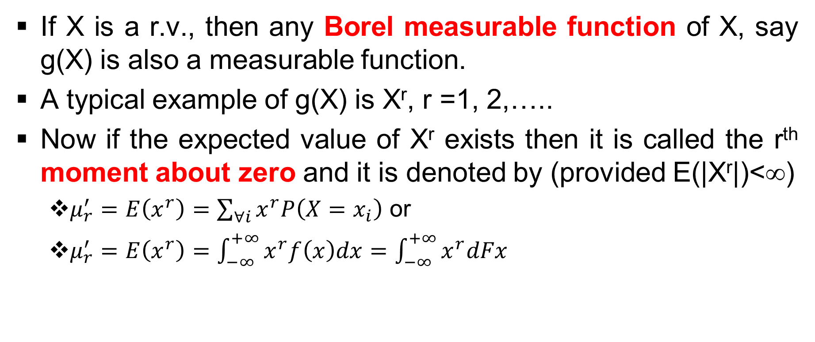
Moments
If X is a r.v., then any Borel measurable function of X, say g(X) is also a measurable function.
A typical example of g(X) is X^{r}, r =1, 2,…..
Now if the expected value of X^{r} exists then it is called the r^{th} moment about zero and it is denoted by (provided E(|X^{r}|)<∞)
  $μ_{r}^{′}=E\left(x^{r}\right)=\sum_{∀i}{x^{r}P\left(X=x_{i}\right)}$ or
  $μ_{r}^{′}=E\left(x^{r}\right)=\int_{−∞}^{+∞}{x^{r}f\left(x\right)dx}=\int_{−∞}^{+∞}{x^{r}dFx}$

Slide 4
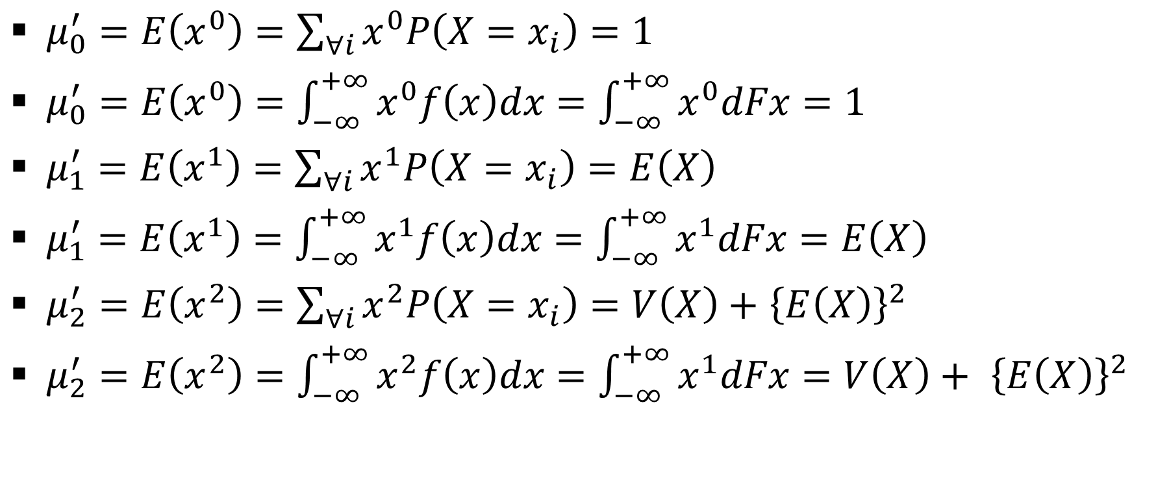
Moments: (contd…)
$μ_{0}^{′}=E\left(x^{0}\right)=\sum_{∀i}{x^{0}P\left(X=x_{i}\right)}=1$
$μ_{0}^{′}=E\left(x^{0}\right)=\int_{−∞}^{+∞}{x^{0}f\left(x\right)dx}=\int_{−∞}^{+∞}{x^{0}dFx}=1$
$μ_{1}^{′}=E\left(x^{1}\right)=\sum_{∀i}{x^{1}P\left(X=x_{i}\right)}=E\left(X\right)$
$μ_{1}^{′}=E\left(x^{1}\right)=\int_{−∞}^{+∞}{x^{1}f\left(x\right)dx}=\int_{−∞}^{+∞}{x^{1}dFx}=E\left(X\right)$
$μ_{2}^{′}=E\left(x^{2}\right)=\sum_{∀i}{x^{2}P\left(X=x_{i}\right)}=V\left(X\right)+$ ${\left\{E\left(X\right)\right\}}^{2}$
$μ_{2}^{′}=E\left(x^{2}\right)=\int_{−∞}^{+∞}{x^{2}f\left(x\right)dx}=\int_{−∞}^{+∞}{x^{1}dFx}=V\left(X\right)+ {\left\{E\left(X\right)\right\}}^{2}$

Slide 5
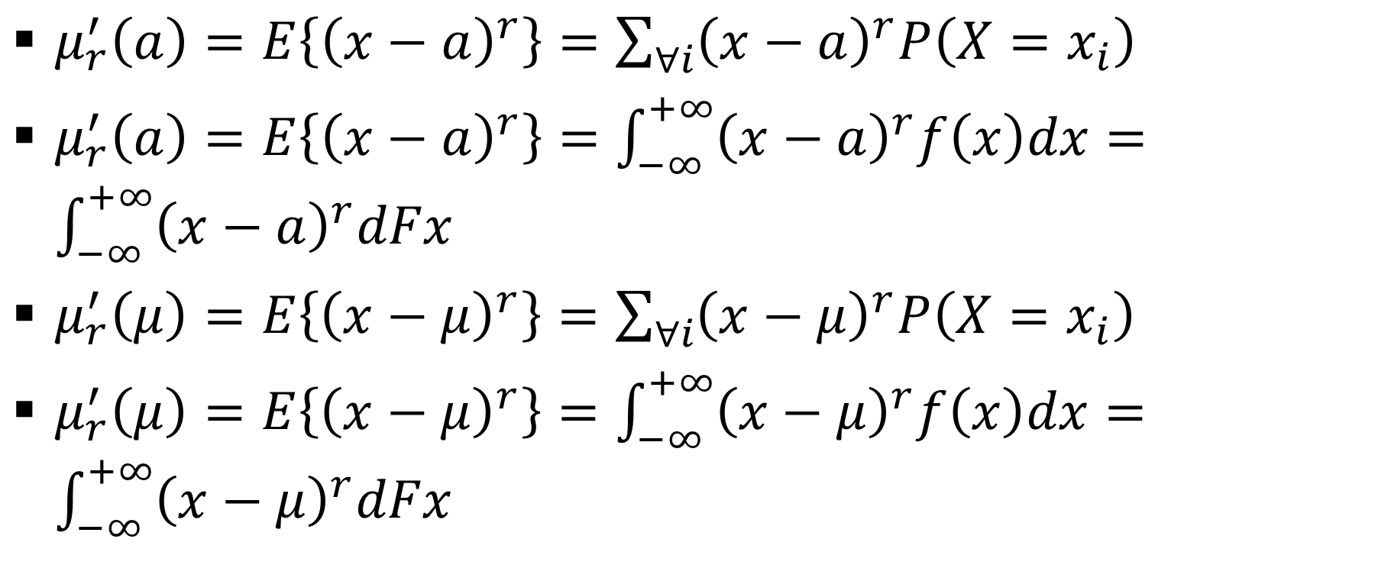
r^{th} Central Moments
$μ_{r}^{′}\left(a\right)=E\left\{{\left(x−a\right)}^{r}\right\}=\sum_{∀i}{{\left(x−a\right)}^{r}P\left(X=x_{i}\right)}$
$μ_{r}^{′}\left(a\right)=E\left\{{\left(x−a\right)}^{r}\right\}=\int_{−∞}^{+∞}{{\left(x−a\right)}^{r}f\left(x\right)dx}=\int_{−∞}^{+∞}{{\left(x−a\right)}^{r}dFx}$
$μ_{r}^{′}\left(μ\right)=E\left\{{\left(x−μ\right)}^{r}\right\}=\sum_{∀i}{{\left(x−μ\right)}^{r}P\left(X=x_{i}\right)}$
$μ_{r}^{′}\left(μ\right)=E\left\{{\left(x−μ\right)}^{r}\right\}=\int_{−∞}^{+∞}{{\left(x−μ\right)}^{r}f\left(x\right)dx}=\int_{−∞}^{+∞}{{\left(x−μ\right)}^{r}dFx}$

Slide 6
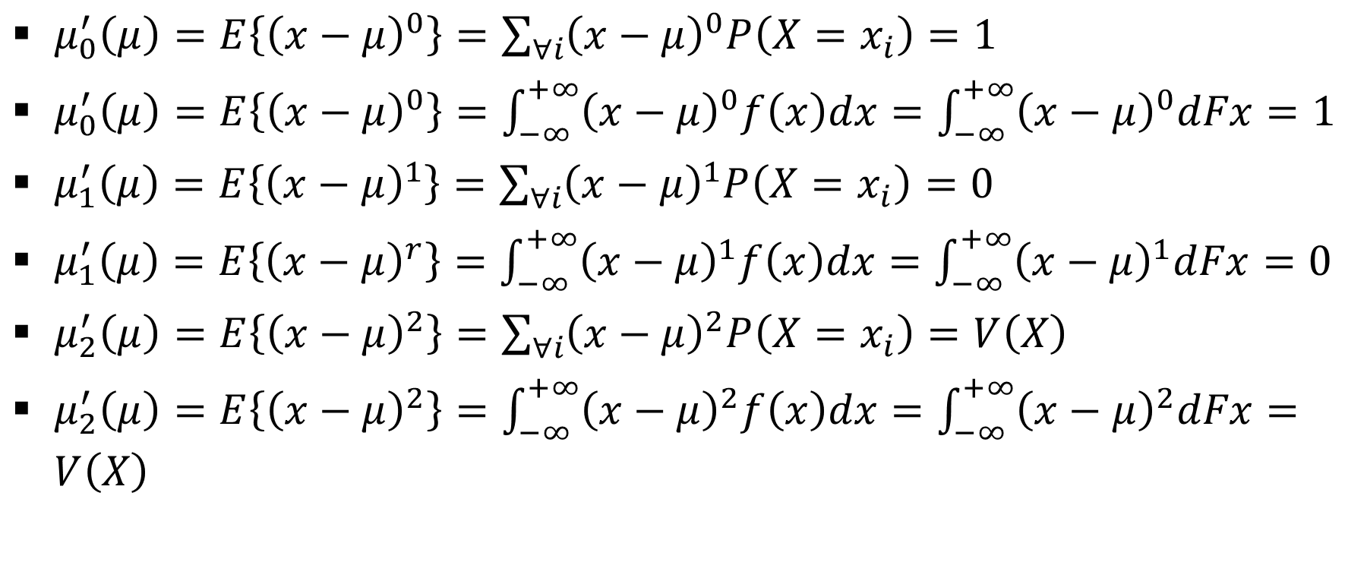
r^{th} Central Moments: (contd…)
$μ_{0}^{′}\left(μ\right)=E\left\{{\left(x−μ\right)}^{0}\right\}=\sum_{∀i}{{\left(x−μ\right)}^{0}P\left(X=x_{i}\right)}=1$
$μ_{0}^{′}\left(μ\right)=E\left\{{\left(x−μ\right)}^{0}\right\}=\int_{−∞}^{+∞}{{\left(x−μ\right)}^{0}f\left(x\right)dx}=\int_{−∞}^{+∞}{{\left(x−μ\right)}^{0}dFx}=1$
$μ_{1}^{′}\left(μ\right)=E\left\{{\left(x−μ\right)}^{1}\right\}=\sum_{∀i}{{\left(x−μ\right)}^{1}P\left(X=x_{i}\right)}=0$
$μ_{1}^{′}\left(μ\right)=E\left\{{\left(x−μ\right)}^{r}\right\}=\int_{−∞}^{+∞}{{\left(x−μ\right)}^{1}f\left(x\right)dx}=\int_{−∞}^{+∞}{{\left(x−μ\right)}^{1}dFx}=0$
$μ_{2}^{′}\left(μ\right)=E\left\{{\left(x−μ\right)}^{2}\right\}=\sum_{∀i}{{\left(x−μ\right)}^{2}P\left(X=x_{i}\right)}=V\left(X\right)$
$μ_{2}^{′}\left(μ\right)=E\left\{{\left(x−μ\right)}^{2}\right\}=\int_{−∞}^{+∞}{{\left(x−μ\right)}^{2}f\left(x\right)dx}=\int_{−∞}^{+∞}{{\left(x−μ\right)}^{2}dFx}=V\left(X\right)$

Slide 7
r^{th} Central Moments: (contd…)
(x − a)^{r} = ^{r}C₀×a⁰×x^{r} − ^{r}C₁×a¹×x^{r−1} + ^{r}C₂×a²×x^{r−2} + ….. + (−1)^{r−1}×^{r}C_{r−1}×a^{r−1}×x¹ + (−1)^{r}×^{r}C_{r}×a^{r}×x⁰
E[(x − a)^{r}] = E[^{r}C₀×a⁰×x^{r}] − E[^{r}C₁×a¹×x^{r−1}] + E[^{r}C₂×a²×x^{r−2}] + ….. + E[(−1)^{r−1}×^{r}C_{r−1}×a^{r−1}×x¹] + E[(−1)^{r}×^{r}C_{r}×a^{r}×x⁰]
μ/_{r}(a) = ^{r}C₀×a⁰×μ/_{r} − ^{r}C₁×a¹×μ/_{r−1} + ^{r}C₂×a²×μ/_{r−2} + ….. + (−1)^{r−1}×^{r}C_{r−1}×a^{r−1}×μ/₁ + (−1)^{r}×^{r}C_{r}×a^{r}×μ/₀

Slide 8
Generating Functions
Generating functions are useful for the study of distribution functions
In general the generating function is obtained as an integral transform using appropriate kernel h(t, x), where t is the parameter and x is the r.v.

Slide 9
Generating Functions: (contd…)
The integral transform of the generating function is given by the following ∫h(t,x)f(x)dx = ∫h(t,x)dF(x) = E[h(t,x)] or ∑h(t,x)P(X=x) = E[h(t,x)]
Expands the generating functions (depending on h(t,x)), one can generate probabilities, moments, etc.

Slide 10
Probability Generating Functions
Meant for discrete distributions which have jumps at non-negative integer values of the variable X and in that case, t^{x} is used as the kernel function.
P_{X}(t) = ∑t^{x}P(X=x) = t⁰P(X=0) + t¹P(X=1) + ….
Coefficients of the expansion t^{X}, when one expands P_{X}(t), are the corresponding probabilities of X

Slide 11
Probability Generating Functions : (contd…)
For every integral r.v. values, X=0,1,2,.. the p.g.f. exits and is unique.
P_{X}(t) can be expressed as a power series in an unique way hence it also means that every p.g.f determines a unique probability distribution.

Slide 12
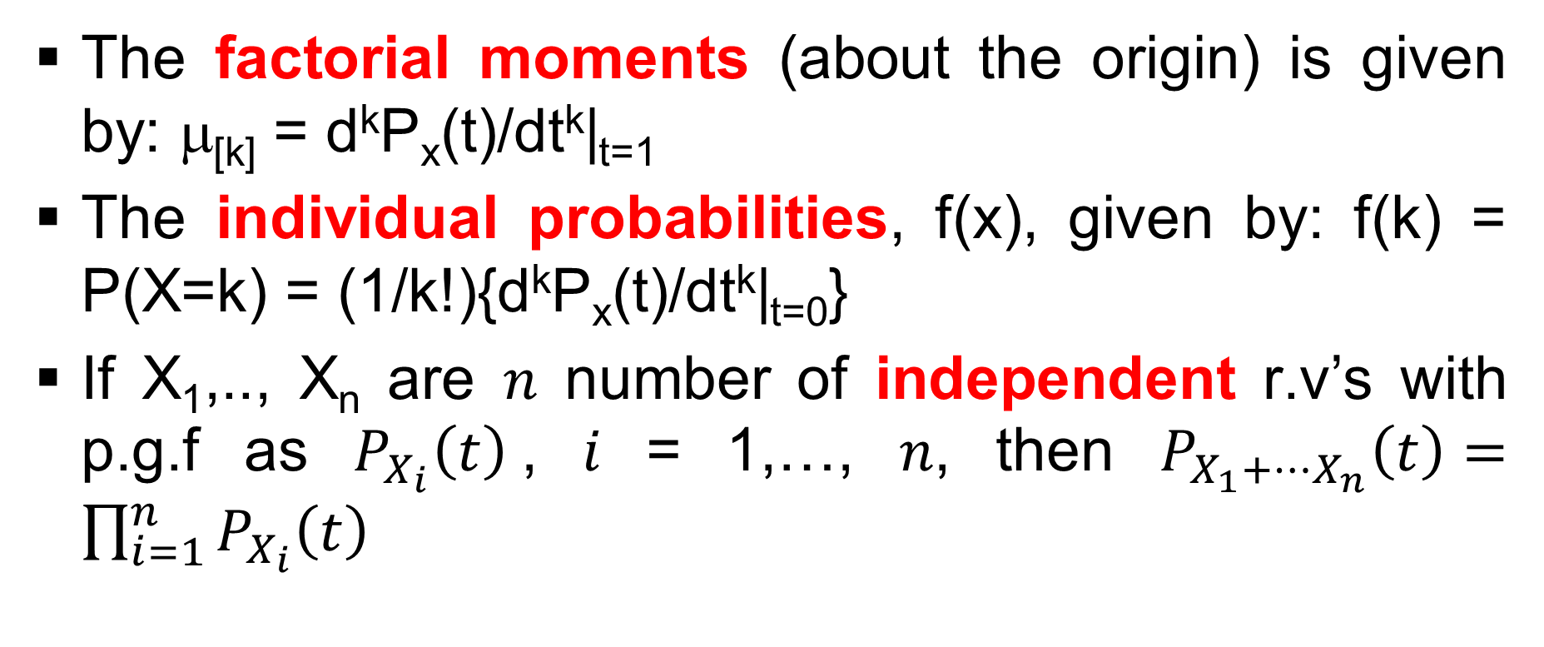
Probability Generating Functions : (contd…)
The factorial moments (about the origin) is given by: μ_{[k]} = d^{k}P_{x}(t)/dt^{k}|_{t=1}
The individual probabilities, f(x), given by: f(k) = P(X=k) = (1/k!){d^{k}P_{x}(t)/dt^{k}|_{t=0}}
If X₁,.., X_{n} are 𝑛 number of independent r.v’s with p.g.f as $P_{X_{i}}\left(t\right)$, 𝑖 = 1,…, 𝑛, then $P_{X_{1}+⋯X_{n}}\left(t\right)=\prod_{i=1}^{n}{P_{X_{i}}\left(t\right)}$

Slide 13
Probability Generating Functions : (contd…)
X~UD(𝑎,𝑏), then P_{X}(t) = ∑t^{𝑥}(1/n) = (1/n){t⁰ + … t^{n}}
P(X = 1) = (1/1!){d¹P_{x}(t)/dt¹|_{t=0}} = (1/1!){(1/n)(1 + … +nt^{n−1})}|_{t=0} = 1/n
P(X = 2) = (1/2!){d²P_{x}(t)/dt²|_{t=0}} = (1/2!){(1/n)(2 + … +n(n−1)t^{n−2})}|_{t=0} = 1/n
P(X = 3) = (1/3!){d³P_{x}(t)/dt³|_{t=0}} = (1/3!){(1/n)(3×2 + … +n(n−1)(n−2)t^{n−3})}|_{t=0} = 1/n
Similar calculations can be done for higher values of X

Slide 14
Probability Generating Functions : (contd…)
X~B(𝑛,𝑝), then P_{X}(t) = ∑t^{𝑥}{^{n}C_{𝑥}p^{𝑥}q^{(n−𝑥)}} = ∑{^{n}C_{𝑥}(tp)^{𝑥}q^{(n−𝑥)}} = (tp+q)^{n} = ^{n}C₀(tp)⁰q^{n} + ^{n}C₁(tp)¹q^{(n−1)} + …..+ ^{n}C_{n−1}(tp)^{(n−1)}q¹ + ^{n}C_{n} (tp)^{n}q⁰
P(X = 1) = (1/1!){d¹P_{x}(t)/dt¹|_{t=0}} = (1/1!){^{n}C₁p¹q^{(n−1)} + 2×^{n}C₂tp²q^{(n−2)} + ….. + n×^{n}C_{n}t^{(n−1)}p^{n}q⁰}|_{t=0} = ^{n}C₁p¹q^{(n−1)}
P(X = 2) = (1/2!){d²P_{x}(t)/dt²|_{t=0}} = (1/2!){2×^{n}C₂p²q^{(n−2)} + 3×2×^{n}C₃tp³q^{(n−3)} + …. + n×(n−1)×^{n}C_{n}t^{(n−2)}p^{n}q⁰}|_{t=0} = ^{n}C₂p²q^{(n−2)}
Similar calculations can be done for higher values of X

Slide 15
Probability Generating Functions : (contd…)
X~NB(𝑝,𝑟), then P_{X}(t) = ∑t^{𝑥}{^{r+x−1}C_{r−1}p^{r}q^{x}} = ∑{^{r+x−1}C_{r−1}p^{r}(tq)^{𝑥}} = ^{r−1}C_{r−1}p^{r}(tq)⁰ + ^{r}C_{r−1}p^{r}(tq)¹ + ….. + ^{r+x−1}C_{r−1}p^{r}(tq)^{𝑥} + …..
P(X = 1) = (1/1!){d¹P_{x}(t)/dt¹|_{t=0}} = (1/1!){^{r+1−1}C_{r−1}p^{r}q + 2×t×^{r+2−1}C_{r−1}p^{r}q² + …..} = ^{r+1−1}C_{r−1}p^{r}q
P(X = 2) = (1/2!){d²P_{x}(t)/dt²|_{t=0}} = (1/2!){2×^{r+2−1}C_{r−1}p^{r}q² + …..} = ^{r+2−1}C_{r−1}p^{r}q²
Similar calculations can be done for higher values of X

Slide 16
Probability Generating Functions : (contd…)
X~G(𝑝), then P_{X}(t) = ∑t^{𝑥}{pq^{𝑥}} = ∑p(tq)^{𝑥} = p(tq)⁰ + p(tq)¹ + + p(tq)² +….. + p(tq)^{𝑥} +……
P(X = 1) = (1/1!){d¹P_{x}(t)/dt¹|_{t=0}} = (1/1!){pq + 2tpq² +….. } = pq
P(X = 2) = (1/2!){d²P_{x}(t)/dt²|_{t=0}} = (1/2!){2pq² + 6ptq³ + .... } = pq²
P(X = 3) = (1/3!){d³P_{x}(t)/dt³|_{t=0}} = (1/3!){6pq³ + 24ptq⁴ + .... } = pq³
Similar calculations can be done for higher values of X

Slide 17
Probability Generating Functions : (contd…)
X~HG(N,𝑛,𝑝), then P_{X}(t) = ∑t^{𝑥}{^{Np}C_{x}^{Nq}C_{n−x}/^{N}C_{n}} = t⁰{^{Np}C₀^{Nq}C_{n−0}/^{N}C_{n}} + t¹{^{Np}C₁^{Nq}C_{n−1}/^{N}C_{n}} + ….. + t^{n}{^{Np}C_{n}^{Nq}C_{n−n}/^{N}C_{n}}
P(X=1) = (1/1!){d¹P_{x}(t)/dt¹|_{t=0}} = (1/1!)[{^{Np}C₁^{Nq}C_{n−1}/^{N}C_{n}} + 2t× {^{Np}C₂^{Nq}C_{n−2}/^{N}C_{n}} + ….. + nt^{n−1}×{^{Np}C_{n}^{Nq}C_{n−n}/^{N}C_{n}}] = ^{Np}C₁^{Nq}C_{n−1}/^{N}C_{n}
P(X=2) = (1/2!){d²P_{x}(t)/dt²|_{t=0}} = (1/2!)[2×{^{Np}C₂^{Nq}C_{n−2}/^{N}C_{n}} + …. + n(n−1)t^{n−2}×{^{Np}C_{n}^{Nq}C_{n−n}/^{N}C_{n}}] = ^{Np}C₂^{Nq}C_{n−2}/^{N}C_{n}
Similar calculations can be done for higher values of X

Slide 18
Probability Generating Functions : (contd…)
X~P(λ), then P_{X}(t) = ∑t^{𝑥}{e^{−λ}λ^{𝑥}/𝑥!} = ∑{e^{−λ}(tλ)^{𝑥}/𝑥!} = e^{−λ}(tλ)⁰/0! + e^{−λ}(tλ)¹/1! + e^{−λ}(tλ)²/2! + …. + e^{−λ}(tλ)^{𝑥}/𝑥! + ….
P(X=1) = (1/1!){d¹P_{x}(t)/dt¹|_{t=0}} = (1/1!){e^{−λ}λ¹/1! + 2te^{−λ}(λ)²/2! + …. + 𝑥t^{𝑥−1}e^{−λ}(λ)^{𝑥}/𝑥! + ….. = e^{−λ}λ¹/1!
P(X=2) = (1/2!){d²P_{x}(t)/dt²|_{t=0}} = (1/2!){2e^{−λ}(λ)²/2! + …. + 𝑥(𝑥−1)t^{𝑥−2}e^{−λ}(λ)^{𝑥}/𝑥! + ….. = e^{−λ}(λ)²/2!
Similar calculations can be done for higher values of X

Slide 19
Probability Generating Functions : (contd…)
X~L(𝑝), then P_{X}(t) = ∑t^{𝑥}{–(ℓ𝑜𝑔_{𝑒} p)^{–1}x^{–1}(1 – p)^{x}} = t⁰{–(ℓ𝑜𝑔_{𝑒} p)^{–1}0^{–1}(1 – p)⁰} + t¹{–(ℓ𝑜𝑔_{𝑒} p)^{–1}1^{–1}(1 – p)¹} + t²{–(ℓ𝑜𝑔_{𝑒} p)^{–1}2^{–1}(1 – p)²} +…… + t^{𝑥}{–(ℓ𝑜𝑔_{𝑒} p)^{–1}x^{–1}(1 – p)^{x}} + …..
P(X=1) = (1/1!){d¹P_{x}(t)/dt¹|_{t=0}} = (1/1!)[{–(ℓ𝑜𝑔_{𝑒} p)^{–1}1^{–1}(1 – p)¹} + 2t¹{–(ℓ𝑜𝑔_{𝑒} p)^{–1}2^{–1}(1 – p)²} + ….. + 𝑥t^{𝑥–1}{–(ℓ𝑜𝑔_{𝑒} p)^{–1}x^{–1}(1 – p)^{x}} + …. = –1×(1 – p)¹/{(ℓ𝑜𝑔_{𝑒} p)×1¹×(1!)}
P(X=2) = (1/2!){d²P_{x}(t)/dt²|_{t=0}} = (1/2!)[2{–(ℓ𝑜𝑔_{𝑒} p)^{–1}2^{–1}(1 – p)²} +….. + 𝑥(𝑥–1)t^{𝑥–2}{–(ℓ𝑜𝑔_{𝑒} p)^{–1}x^{–1}(1 – p)^{x}} + …. = –2×(1 – p)²/{(ℓ𝑜𝑔_{𝑒} p)×2¹×(2!)}
Similar calculations can be done for higher values of X

Slide 20
Moment Generating Functions
The moment generating function (m.g.f) of the r.v., X is obtained by using the kernel function, e^{tx}
M_{X}(t) = E(e^{tx}) = ∫e^{tx}dF(x) = ∫e^{tx}f(x)dx
One must remember that the expected value of this function may not at all exist but for t=0 the value will definitely exist
The moments (about the origin) are specified by the following: μ/_{𝑘} = d^{𝑘}M(x,t)/dt^{𝑘}|_{t=0}

Slide 21
Moment Generating Functions : (contd…)
For continuous r.v. values, the m.g.f. exits and is unique
M_{X}(t) can be expressed in an unique way hence it also means that every m.g.f determines uniquely the moments

Slide 22
Moment Generating Functions : (contd…)
The m.g.f. of a r.v., X about point, 𝑎, is specified by M_{X−𝑎}(t) = E{e^{t(X−𝑎)}} = ∫e^{t(X−𝑎)}dF(x) = ∫e^{t(X−𝑎)}f(x)dx = e^{−𝑎t}M_{X}(t)
The m.g.f. of a r.v., Y = 𝑎 +bX, is specified by M_{𝑎+bX}(t) = E{e^{t(𝑎+bX)}} = ∫e^{t(𝑎+bX)}dF(x) = ∫e^{t(𝑎+bX)}f(x)dx = e^{𝑎t}M_{X}(𝑏t)

Slide 23
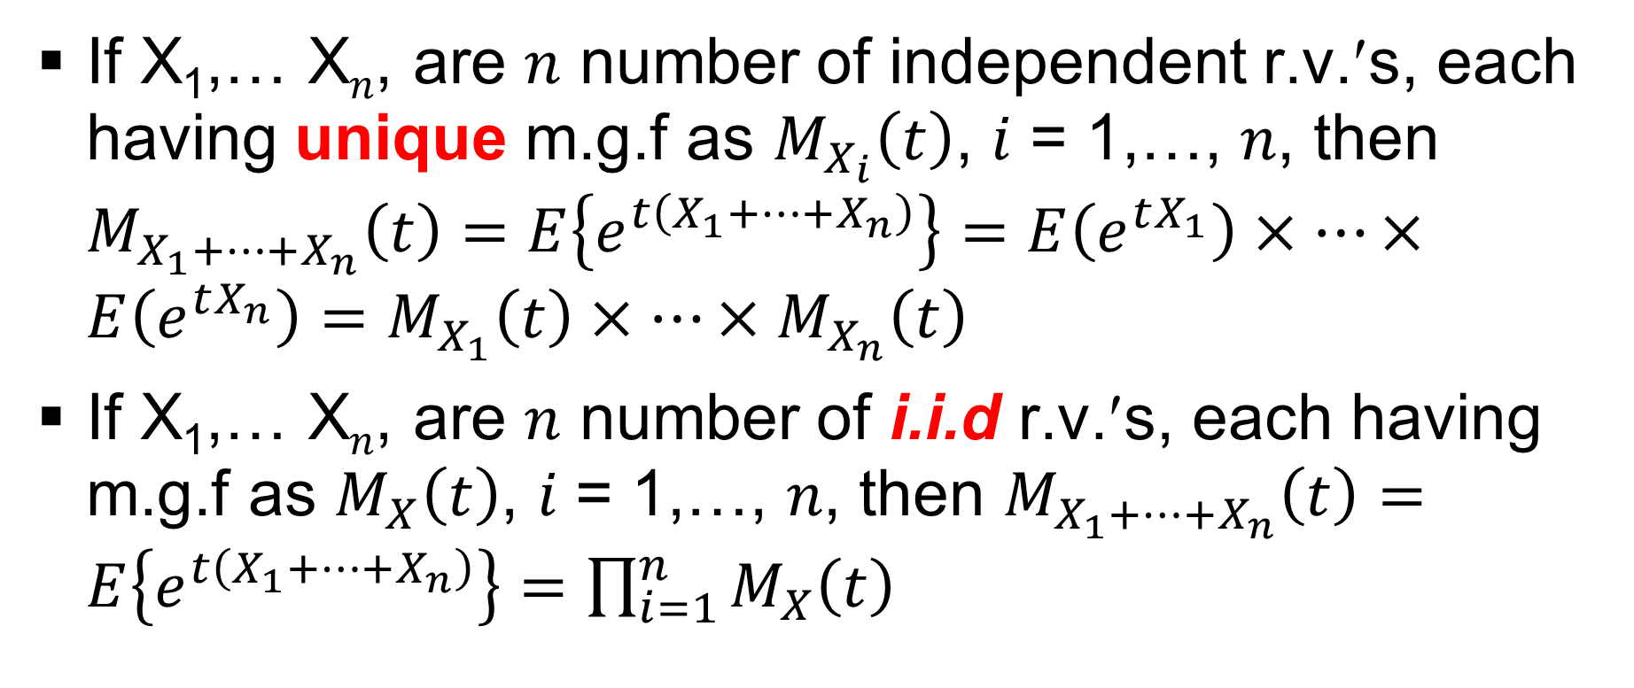
Moment Generating Functions : (contd…)
If X₁,… X$n$, are 𝑛 number of independent r.v.′s, each having unique m.g.f as $M_{X_{i}}\left(t\right)$, 𝑖 = 1,…, 𝑛, then $M_{X_{1}+⋯+X_{n}}\left(t\right)=E\left\{e^{t\left(X_{1}+⋯+X_{n}\right)}\right\}=E\left(e^{tX_{1}}\right)×⋯×E\left(e^{tX_{n}}\right)=M_{X_{1}}\left(t\right)×⋯×M_{X_{n}}\left(t\right)$
If X₁,… X$n$, are 𝑛 number of i.i.d r.v.′s, each having m.g.f as $M_{X}\left(t\right)$, 𝑖 = 1,…, 𝑛, then $M_{X_{1}+⋯+X_{n}}\left(t\right)=E\left\{e^{t\left(X_{1}+⋯+X_{n}\right)}\right\}=\prod_{i=1}^{n}{M_{X}\left(t\right)}$

Slide 24
Moment Generating Functions : (contd…)
X~UD(𝑎,𝑏), then
M_{X}(𝑡) = ∑𝑒^{𝑡𝑥}(1/𝑛) = {𝑒^{𝑡𝑎} − 𝑒^{𝑡(𝑏+1)}}/{(𝑏 − 𝑎 + 1) (1 − 𝑒^{𝑡})}
X~B(𝑛,𝑝), then
M_{X}(𝑡) = ∑𝑒^{𝑡𝑥}{^{𝑛}C_{𝑥}𝑝^{𝑥}𝑞^{(𝑛−𝑥)}} = (1 − 𝑝 + 𝑝𝑒^{𝑡})^{𝑛}
X~NB(𝑝,𝑟), then
M_{X}(𝑡) = ∑𝑒^{𝑡𝑥}{^{𝑟+𝑥−1}C_{𝑟−1}𝑝^{𝑟}𝑞^{𝑥}} = {𝑝/(1 − 𝑒^{𝑡} + 𝑝𝑒^{𝑡})}^{r}, 𝑡 < −log_{𝑒}(1 − 𝑝)

Slide 25
Moment Generating Functions : (contd…)
X~G(𝑝), then
M_{X}(𝑡) = ∑𝑒^{𝑡𝑥}{𝑝𝑞^{𝑥}} = 𝑝/(1 − 𝑒^{𝑡} + 𝑝𝑒^{t}), 𝑡 < − ℓ𝑜𝑔_{𝑒}(1 − 𝑝)
X~HG(N,𝑛,𝑝), then
M_{X}(𝑡) = ∑𝑒^{𝑡𝑥}{^{N𝑝}C_{x}^{N𝑞}C_{n−x}/^{N}C_{n}} = ^{N𝑞}C_{𝑛}×₂F₁(−𝑛, −N 𝑝; N𝑞 −𝑛+1; 𝑒^{𝑡})/^{N}C_{𝑛}

Slide 26
Moment Generating Functions : (contd…)
X~P(λ), then
M_{X}(𝑡) = ∑𝑒^{𝑡𝑥}{𝑒^{−λ}λ^{𝑥}/𝑥!} = 𝑒𝑥𝑝{λ×𝑒𝑥𝑝(𝑡−1)}
X~L(𝑝), then
M_{X}(𝑡) = ∑𝑒^{𝑡𝑥}{–(ℓ𝑜𝑔_{𝑒} 𝑝)^{–1}𝑥^{–1}(1 – 𝑝)^{𝑥}} = ℓ𝑜𝑔_{𝑒}{1 – (1 – 𝑝)𝑒^{𝑡}}/ℓ𝑜𝑔_{𝑒} 𝑝

Slide 27
Moment Generating Functions : (contd…)
X~U(𝑎,𝑏), then
M_{X}(𝑡) = ∫𝑒^{𝑡𝑥}{1/(𝑏 − 𝑎)}𝑑𝑥 = {𝑒^{𝑡𝑏} − 𝑒^{𝑡𝑎}}/𝑡(𝑏 − 𝑎)
X~E(𝑎, θ), then
M_{X}(𝑡) = ∫𝑒^{𝑡𝑥}{1/θ}𝑒^{{−(𝑥−𝑎)/θ}}𝑑𝑥 = 𝑒^{𝑡𝑎}/{θ/(θ − 1)}, t<1/θ

Slide 28
Moment Generating Functions : (contd…)
X~E(μ,σ²), then
M_{X}(𝑡) = ∫𝑒^{𝑡𝑥}{1/(√2πσ²)}𝑒𝑥𝑝[(𝑥 − μ)²/2σ²]𝑑𝑥 = 𝑒𝑥𝑝{𝑡μ + σ²𝑡²/2}
X~LN(μ,σ²), then
M_{X}(𝑡) = ∫𝑒^{𝑡𝑥}{1/xσ√(2π)}𝑒𝑥𝑝{−(log_{e}x−μ)²/2σ²}𝑑𝑥 = Does not exist but raw moments E(X^{𝑡}) = 𝑒𝑥𝑝{𝑡μ + σ²𝑡²/2}

Slide 29
Moment Generating Functions : (contd…)
X~χ_{𝑛} ², then
M_{X}(t) = ∫𝑒^{𝑡𝑥}[1/{Γ(𝑛/2)2^{(𝑛/2)}}x^{{(𝑛/2)−1}}{𝑒𝑥𝑝^{(−𝑥/2)}}]𝑑𝑥 = (1 − 2𝑡)^{−(𝑛/2)}, 𝑡 < 1/2
X~t_{𝑛}, then
M_{X}(t) = ∫𝑒^{𝑡𝑥}[Γ{(𝑛+1)/2}/{Γ(𝑛/2)√(𝑛π)}]{1+𝑥²/𝑛}^{−{(𝑛+1)/2}}𝑑𝑥 = Undefined

Slide 30
Moment Generating Functions : (contd…)
X~F(n,m), then
M_{X}(t) = ∫𝑒^{𝑡𝑥}[n^{n/2}m^{m/2}Γ{(n+m)/2}x^{{(n/2)-1}}]/[Γ(n/2)Γ(m/2)(nx+m)^{{(n+m)/2}}]𝑑𝑥 = Does not exist but raw moments μ_{X}(X^{𝑟}) = (𝑚/𝑛)^{𝑟}{Γ(𝑛/2 + 𝑟)Γ(𝑚/2 − 𝑟)}/{Γ(𝑛/2)Γ(𝑚/2)}
X~G(α,β,γ), then
M_{X}(t) = ∫𝑒^{𝑡𝑥}β^{−α}Γ⁻¹(α)(x−γ)^{(α−1)}exp{−(x−γ)/β}𝑑𝑥 = 𝑒^{𝑡γ}(1 − 𝑡/β)^{−α}, 𝑡 < β

Slide 31
Moment Generating Functions : (contd…)
X~W(α,β,γ), then
M_{X}(t) = ∫𝑒^{𝑡𝑥}(α/β){(x−γ)/β}^{(α−1)}exp[−{(x−γ)/β}^{α}]𝑑𝑥 = 𝑒^{𝑡γ}∑{(𝑡β)^{𝑛}/𝑛!}Γ(𝑛/α + 1), 𝑛 = 0, 1, 2, ….
X~Beta(α,β,γ), then
M_{X}(t) = ∫𝑒^{𝑡𝑥}[Γ(α,β)/{Γ(α)Γ(β)}]{(x−δ₁)^{(α−1)}(δ₂−x)^{(β−1)}}/(δ₂−δ₁)^{(α+β−1)}𝑑𝑥 = 𝑒^{𝑡𝑥}

Slide 32
Moment Generating Functions : (contd…)
X~Cauchy(α,β γ), then
M_{X}(t) = ∫e^{tx}(1/πβ)1/{[1+{(x−γ)/β}²}𝑑𝑥
X~DE(α,β,γ), then
M_{X}(t) = ∫e^{tx}(1/2β)exp{−(|x − γ|/β)}𝑑𝑥

Slide 33
Moment Generating Functions : (contd…)
X~Pareto(α,β,γ), then
M_{X}(t) = ∫e^{tx}[(1/β)[1 + α{(x−γ)/β}]^{−{1 + (1/α)}}]𝑑𝑥
X~Logistic(α,β,γ), then
M_{X}(t) = ∫e^{tx}(α/β){(x−γ)/β}^{(α −1)}[1 + {(x−γ)/β}^{α}]⁻²𝑑𝑥

Slide 34
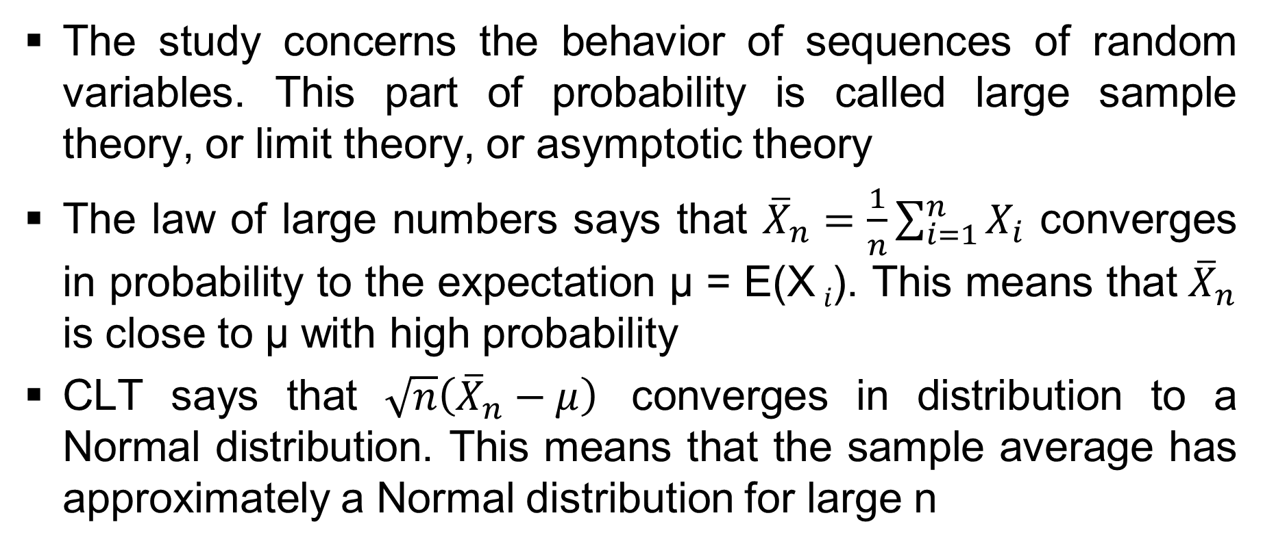
Convergence of Random Variables
The study concerns the behavior of sequences of random variables. This part of probability is called large sample theory, or limit theory, or asymptotic theory
The law of large numbers says that ${\overline{X}}_{n}=\frac{1}{n}\sum_{i=1}^{n}{X_{i}}$ converges in probability to the expectation µ = E(X _{𝑖}). This means that ${\overline{X}}_{n}$ is close to µ with high probability
CLT says that $\sqrt{n}\left({\overline{X}}_{n}−μ\right)$ converges in distribution to a Normal distribution. This means that the sample average has approximately a Normal distribution for large n

