Slide 1

IME602: Probability and Statistics-STATISTICAL INFERENCE
Raghu Nandan Sengupta
Industrial & Management Engineering Department
Indian Institute of Technology Kanpur

Slide 2
Coverage
Sampling
Statistic
Population
Sample
Statistical Inference
Point Estimation
Properties of Estimators (Unbiasedness, Consistency)
Interval Estimation
Hypothesis Testing

Slide 3
Coverage : (contd…)
Different Sampling Methodologies
Simple Random Sampling With Replacement (SRSWR)
Simple Random Sampling Without Replacement (SRSWOR)
Sampling Results
Sampling from a Discrete Distribution

Slide 4
Sampling : (contd…)
Process of using data analysis to infer properties of an underlying probability distribution.
Using statistical analysis we intend ot infers properties of a population
The characteristic of the population which we are interested to find, may be E(X), V(X), etc., for f(𝑥; θ)
In general the parameter(s) is/are denoted by θ or θ = (θ₁, θ₂,…,θ_{k})

Slide 5
Sampling : (contd…)
We are interested to find the statistic, which is the sample counterpart of the population parameter, which we can find using the observations of the sample
Generally as the population is very large or in some case infinite hence we have to take the recourse of studying the sample in order to draw some meaningful conclusions about the population

Slide 6
Sampling : (contd…)
As it is evident and of course very logical we all would immediately conclude that the statistic is also a r.v. and it depends on the sample observations, which are themselves random
As the statistic is random hence it will also have a distribution, which is termed as the sampling distribution and this sampling distribution would be dependent on the population distribution.

Slide 7
Sampling : (contd…)
Consider in a box we have chits marked 1, 2, 3, 4, 4, 5, 6, 6 and if one is asked what is the average of these numbers then the obvious answer is (1 + 2+ +3 +4 + 4+ 5 +6 +6)/8
This average value is akin to the characteristics of the population or the population parameter, denoted by θ, which we want to find out

Slide 8
Sampling : (contd…)
But due to some constraints we take a part of the population, called the sample and use this sample to draw some meaningful conclusion about the population parameter, θ
Generally the population size is denoted by N, which is all practical cases will be considered as infinite, while the size of the sample, i.e., the number of observations is n.
Thus for the above example N = 8, while the n can be 2 or 3 as we may wish

Slide 9
Sampling : (contd…)
Hence if n = 2, we can choose he sample as (1, 2) or ( 1, 1), etc. or if n = 3, then the sample can be chosen as (1, 1, 1) or (1, 4, 6)
For our discussion we will always consider that we do the sampling or the choosing of the observations with replacement
Anther important thing to note is that, that sampling would result in a so called average value and a variance for the samples thus considered, which in other words means that there would be a mean and variance for the sampling distribution which we would denote as the sample mean (the counter part of the population mean or expected value) and the standard error (the counter part of the population standard deviation)

Slide 10
Statistical Inference
Point estimation
Interval estimation
Hypothesis testing

Slide 11
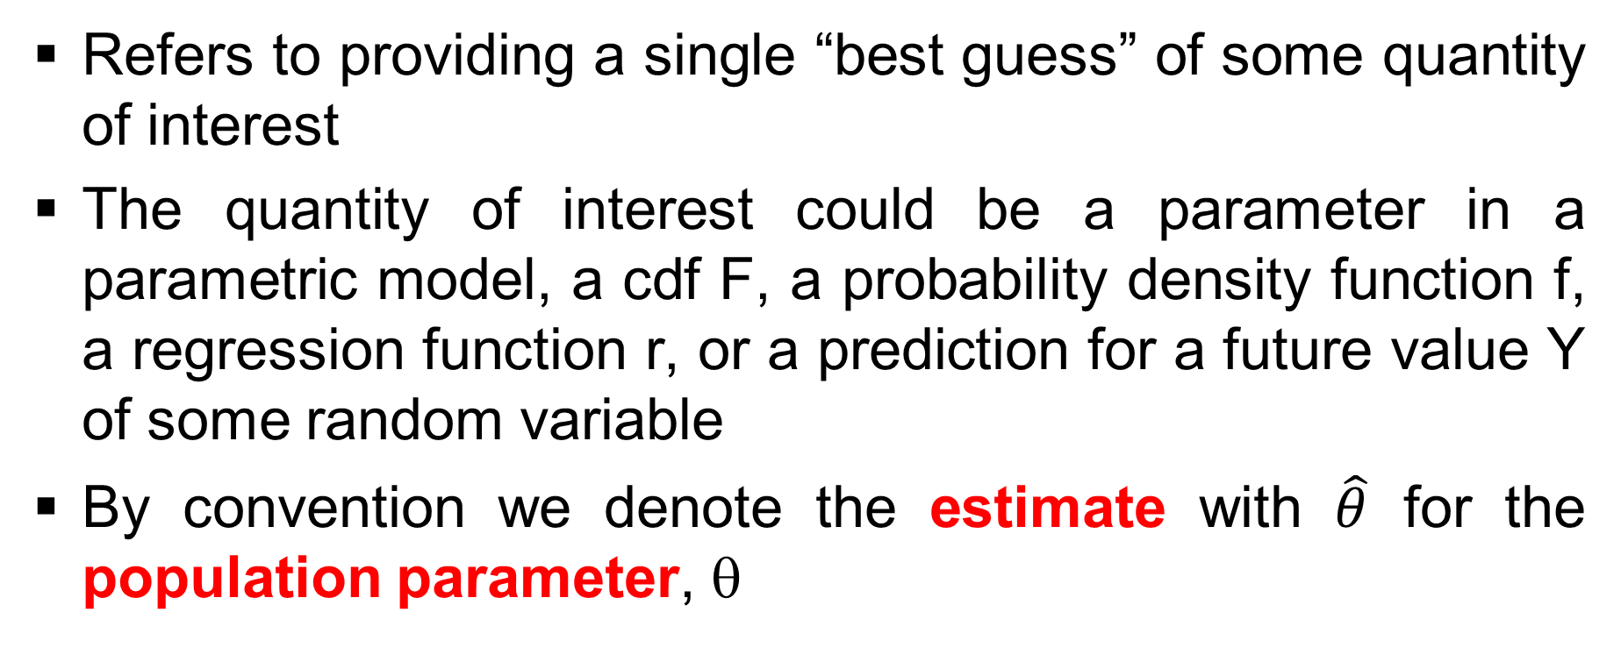
Point Estimation
Refers to providing a single “best guess” of some quantity of interest
The quantity of interest could be a parameter in a parametric model, a cdf F, a probability density function f, a regression function r, or a prediction for a future value Y of some random variable
By convention we denote the estimate with $\hat{θ}$ for the population parameter, θ

Slide 12
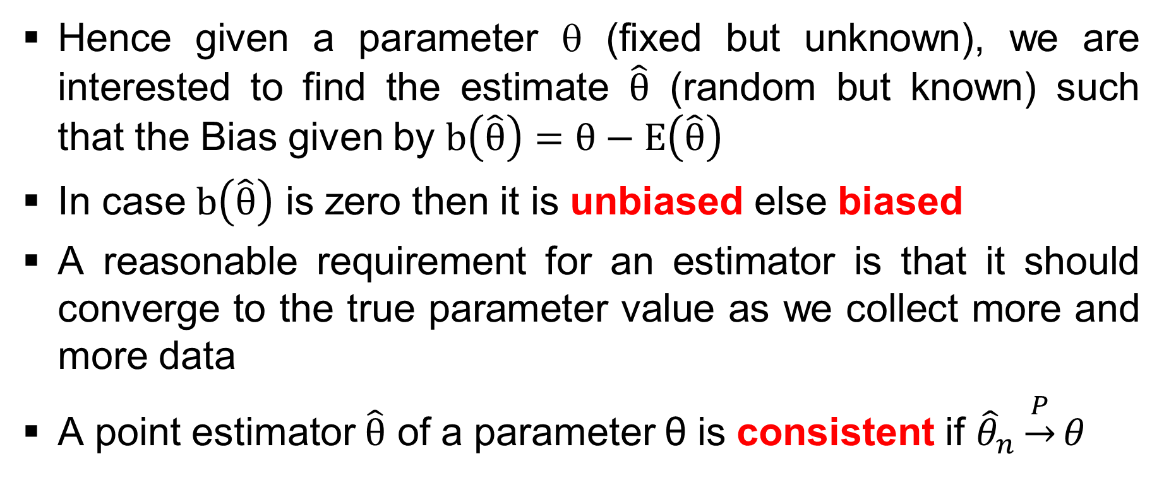
Point Estimation : (contd…)
Hence given a parameter θ (fixed but unknown), we are interested to find the estimate $\hat{θ}$ (random but known) such that the Bias given by $b\left(\hat{θ}\right)=θ−E\left(\hat{θ}\right)$
In case $b\left(\hat{θ}\right)$ is zero then it is unbiased else biased
A reasonable requirement for an estimator is that it should converge to the true parameter value as we collect more and more data
A point estimator $\hat{θ}$ of a parameter θ is consistent if ${\hat{θ}}_{n}\underset{→}{P}θ$

Slide 13
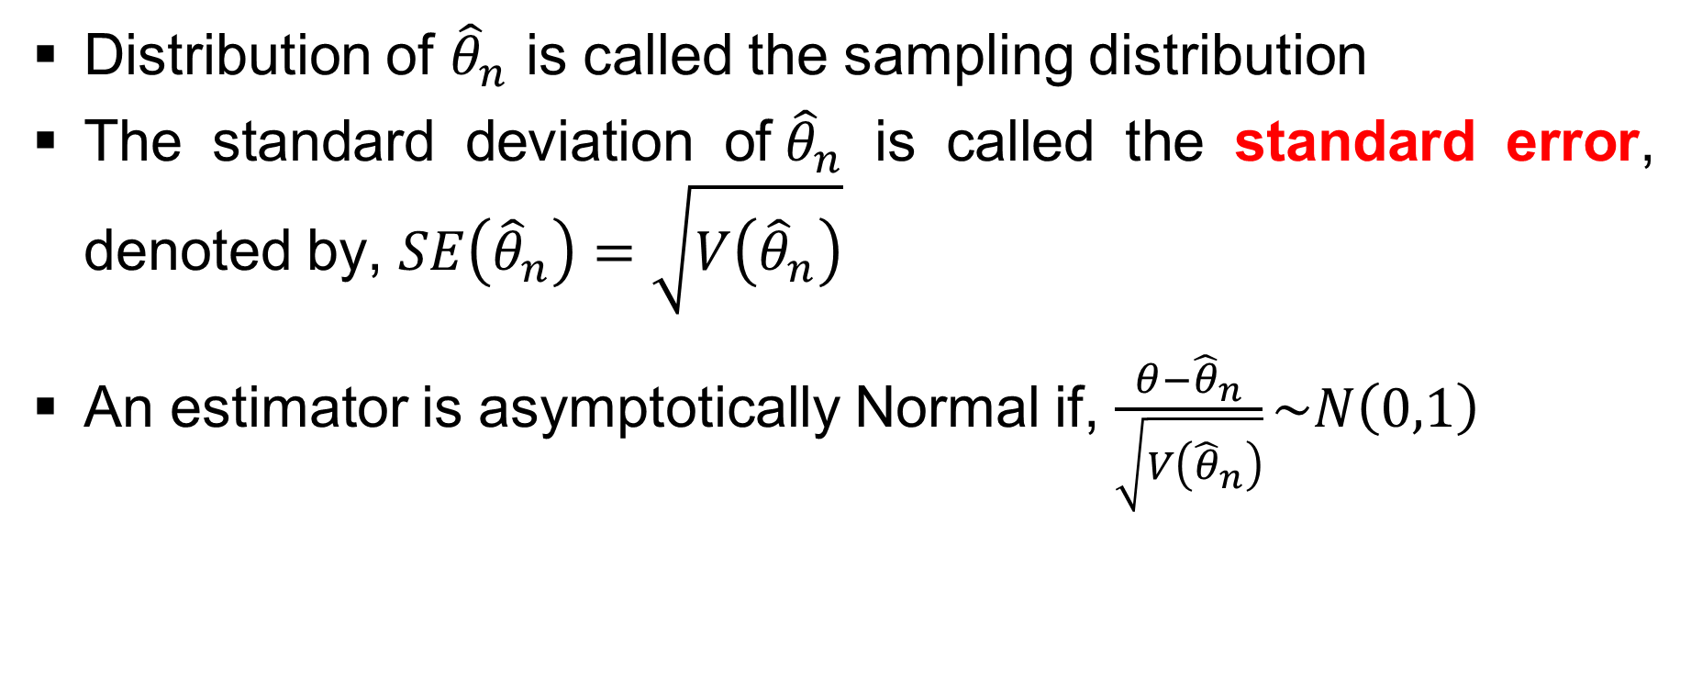
Point Estimation : (contd…)
Distribution of ${\hat{θ}}_{n}$ is called the sampling distribution
The standard deviation of${\hat{θ}}_{n}$ is called the standard error, denoted by, $SE\left({\hat{θ}}_{n}\right)=\sqrt{V\left({\hat{θ}}_{n}\right)}$
An estimator is asymptotically Normal if, $\frac{θ−{\hat{θ}}_{n}}{\sqrt{V\left({\hat{θ}}_{n}\right)}}\sim N\left(0,1\right)$

Slide 14
Estimators and their properties
Estimator: Any statistic (a random function) which is used to estimate the population parameter should adhere to two important properties
  Unbiasedness: E_{θ} (t_{n}) = θ
  Consistency: Lt_{𝑛→∞} P[|t_{𝑛} − θ| < ε] = 1

Slide 15
Interval Estimation
𝑡₁(X₁,..,X_{𝑛}) θ 𝑡₂(X₁,..,X_{𝑛})
We are interested to find 𝑡₁(X₁,..,X_{𝑛}) and 𝑡₂(X₁,..,X_{𝑛}) such that P{𝑡₁(X₁,..,X_{𝑛}) ≤ θ ≤ 𝑡₂(X₁,..,X_{𝑛})} = (1−α)
In case (1−α)=0.99, then 99 out of 100 cases would favour the case
If we refer to the above example of the box, each such picking of the sample will result in different set of observations for the sample, hence the concept of 𝑡₁(X₁,..,X_{𝑛}) and 𝑡₂(X₁,..,X_{𝑛})

Slide 16
Interval Estimation : (contd…)
Very simply stated if n = 2 here 𝑡₁(θ) would be some point depending on the characteristics obtained from the sample (1, 1), while 𝑡₂(θ) would be some point depending on the characteristics obtained from the sample (6, 6) if we consider sampling with replacement
On the other hand if we consider sampling without replacement then 𝑡₁(X₁,..,X_{𝑛}) would be some point depending on the characteristics obtained from the sample (1, 2), while 𝑡₂(X₁,..,X_{𝑛}) would be some point depending on the characteristics obtained from the sample (6, 5)
The percentage or chance which in this example is 99% can vary depending on the level of accuracy one would like to attain in the study

Slide 17
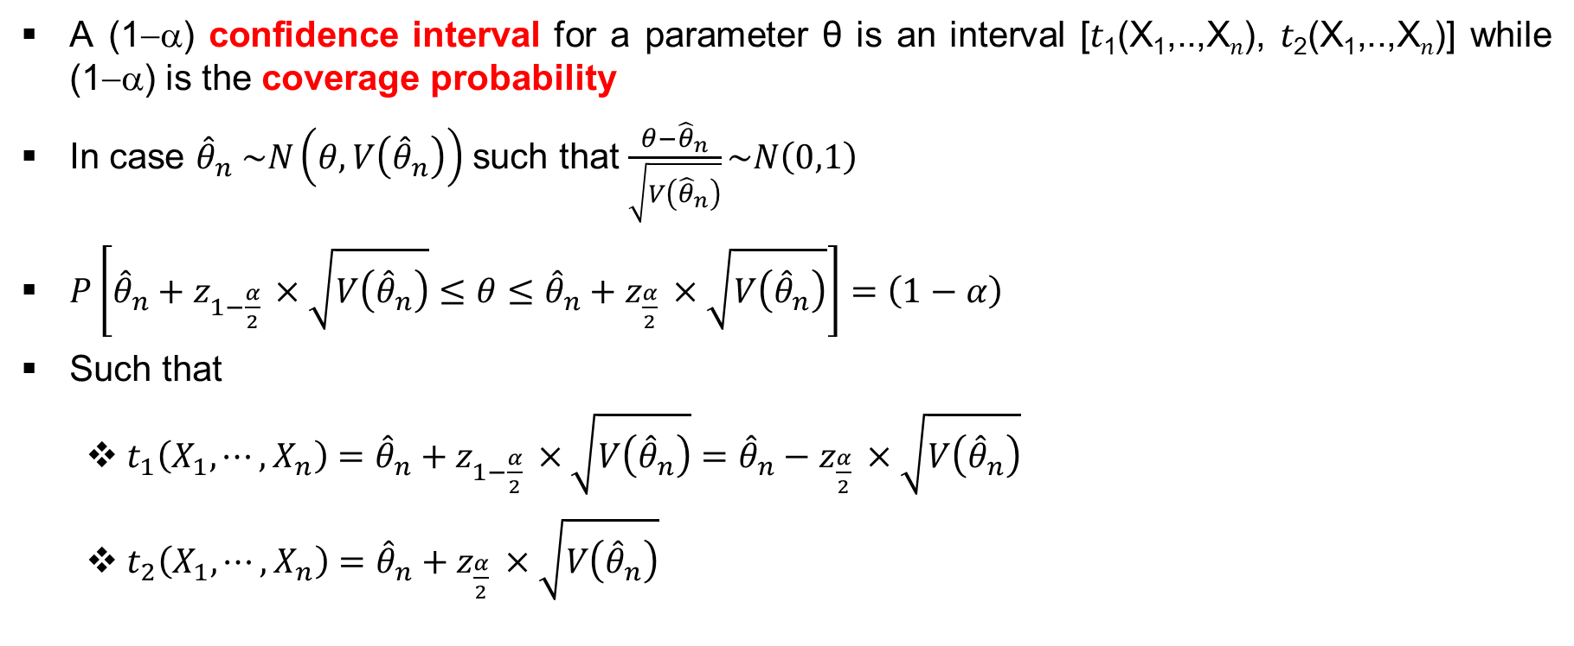
Interval Estimation : (contd…)
A (1−α) confidence interval for a parameter θ is an interval [𝑡₁(X₁,..,X_{𝑛}), 𝑡₂(X₁,..,X_{𝑛})] while (1−α) is the coverage probability
In case ${\hat{θ}}_{n} \sim N\left(θ,V\left({\hat{θ}}_{n}\right)\right)$ such that $\frac{θ−{\hat{θ}}_{n}}{\sqrt{V\left({\hat{θ}}_{n}\right)}}\sim N\left(0,1\right)$
$P\left[{\hat{θ}}_{n}+z_{1−\frac{α}{2} }×\sqrt{V\left({\hat{θ}}_{n}\right)}≤θ≤{\hat{θ}}_{n}+z_{\frac{α}{2} }×\sqrt{V\left({\hat{θ}}_{n}\right)}\right]=\left(1−α\right)$
Such that
  $t_{1}\left(X_{1},⋯,X_{n}\right)={\hat{θ}}_{n}+z_{1−\frac{α}{2} }×\sqrt{V\left({\hat{θ}}_{n}\right)}={\hat{θ}}_{n}−z_{\frac{α}{2} }×\sqrt{V\left({\hat{θ}}_{n}\right)}$
  $t_{2}\left(X_{1},⋯,X_{n}\right)={\hat{θ}}_{n}+z_{\frac{α}{2} }×\sqrt{V\left({\hat{θ}}_{n}\right)}$

Slide 18
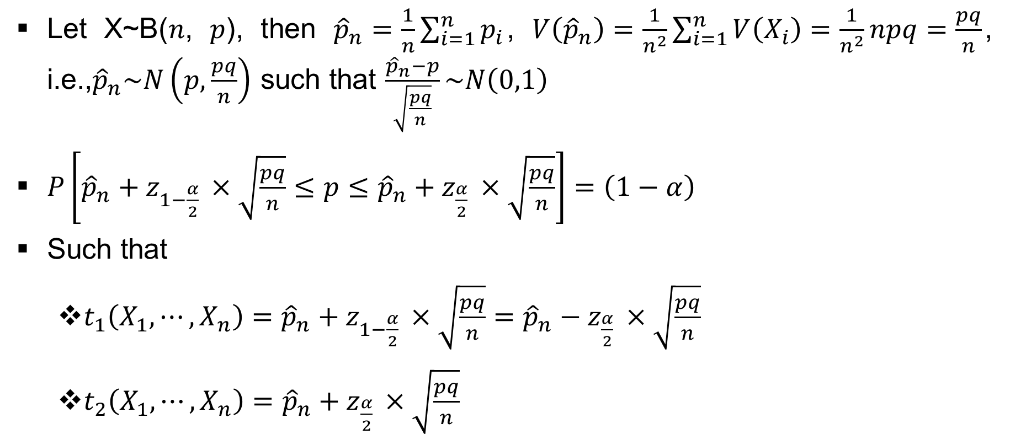
Interval Estimation : (contd…)
Let X~B(𝑛, 𝑝), then ${\hat{p}}_{n}=\frac{1}{n}\sum_{i=1}^{n}{p_{i}}$, $V\left({\hat{p}}_{n}\right)=\frac{1}{n^{2}}\sum_{i=1}^{n}{V\left(X_{i}\right)}=\frac{1}{n^{2}}npq=\frac{pq}{n}$, i.e.,${\hat{p}}_{n}\sim N\left(p,\frac{pq}{n}\right)$ such that $\frac{{\hat{p}}_{n}−p}{\sqrt{\frac{pq}{n}}}\sim N\left(0,1\right)$
$P\left[{\hat{p}}_{n}+z_{1−\frac{α}{2} }×\sqrt{\frac{pq}{n}}≤p≤{\hat{p}}_{n}+z_{\frac{α}{2} }×\sqrt{\frac{pq}{n}}\right]=\left(1−α\right)$
Such that
  $t_{1}\left(X_{1},⋯,X_{n}\right)={\hat{p}}_{n}+z_{1−\frac{α}{2} }×\sqrt{\frac{pq}{n}}={\hat{p}}_{n}−z_{\frac{α}{2} }×\sqrt{\frac{pq}{n}}$
  $t_{2}\left(X_{1},⋯,X_{n}\right)={\hat{p}}_{n}+z_{\frac{α}{2} }×\sqrt{\frac{pq}{n}}$

Slide 19
Hypothesis Testing
Where the experimenter would like to draw some meaningful conclusion from the sample about the population and say with some level of confidence that how far he/she is true or false

Slide 20
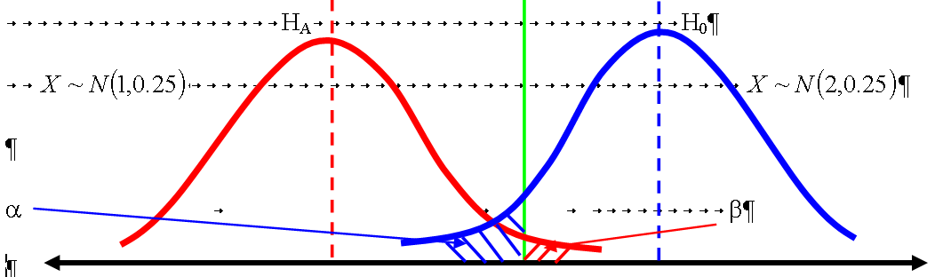
Hypothesis Testing : (contd…)

Slide 21
Sampling
Sampling frame: It is basically the list of all units in the total population, e.g., the list of households, individuals, industries, etc.
Population: Collection of the entire set of measurements relating to the variable under study.
Sample: It is part of the population which one chooses or picks up and draws meaningful conclusion about the population. In the above example N is the statistical population, while n is the sample.
Intangible population: This cannot be observed even if all the resources are provided. Example the requirement in a blood bank or life of an equipment.

Slide 22
Sampling : (contd…)
Population: N
  Population distribution
  Parameter (θ)
Sample: n
  Sampling distribution
  Statistic (t_{n})
Example: Consider a population having the following elements {1, 3, 6, 7}, hence N = 4 and μ = 17/4. If we take n = 2 and chose samples, then the possible values of the sample average are 1, 2,…..,6.5 ,7

Slide 23
Sampling : (contd…)
Probability Sampling (Simple Random Sampling)
It is the method of choosing from a larger set (a population, N) in which the subset of individuals are chosen randomly, all with the same probability
Sampling can be with replacement and without replacement

Slide 24
Sampling : (contd…)
Probability Sampling (Stratified Random Sampling)
It is the method of sampling from a population which can be partitioned into subpopulations, such that the strata should be collectively exhaustive and mutually exclusive
If the population density varies greatly, stratified sampling will ensure that estimates can be made with equal accuracy in different strata
The division into strata is for the population which is homogeneous

Slide 25
Sampling : (contd…)
Probability Sampling (Cluster Sampling)
We divide the population into clusters (primary, secondary and tertiary so that we have our desired sample which is able to mimic the population to the maximum possible extent
The clusters made from the population, which is heterogenous

Slide 26
Sampling : (contd…)
Probability Sampling (Multistage Sampling)
Here the sample size, 𝑛, is not fixed but is decided on a stopping criteria/rule
There are different methodologies such as purely sequential, two stage, three stage, batch sequential etc.
One is important here is to find the distribution of N which is the random size of observations needed to conduct the experiment

Slide 27
Sampling : (contd…)
Probability Sampling (Systematic Sampling)
The most common form of systematic sampling is an equiprobability method and applies in particular when the sampled for single units
Consider the population (N) is very large, say N = 500,000 and consider n = 1000 (which is decided by the experimenter). Now the choice of n is done in such a way, such that N = n*k, where k is an integer
The sampling starts by selecting an element from the list at random and then every k^{th} element in the frame is selected, where k, is the sampling interval

Slide 28
Sampling : (contd…)
Judgement Sampling (Quota Sampling)
Population is first segmented into mutually exclusive sub-groups, just as in stratified sampling.
Then judgment is used to select the subjects or units from each segment based on a specified proportion, but one should remember that this step makes the technique non-probability sampling and can be unreliable

Slide 29
Sampling : (contd…)
Judgement Sampling (Purposive Sampling)
The experimenter selects participants based on specific, relevant characteristics for a study
The sampling methodology allows for in-depth insights into complex phenomena by focusing on individuals who have particular traits or experiences

Slide 30
Sampling : (contd…)
Simple random sampling with replacement (SRSWR)
Simple random sampling without replacement (SRSWOR)
If X has a distribution such that E[X] = μ_{X} and V[X] = σ²_{X}
Then E[X_{i}] = μ_{X} and V[X_{i}] = σ²_{X}

Slide 31
Sampling : (contd…)
Now let us do a thought experiment which is described as follows in a simple step wise manner
Step # 1: Pick up a unit at random and observe the corresponding measurement. The first observation is denoted by X₁, and its realized or actual values (once we observe it) can be u₀ or u₁ or… u_{k}.
Step # 2: Replace the first unit back into the populations and pick up another unit again. This time denote the second unit as X₂. Then the realized or actual values (once we observe it) can be u₀ or u₁ or… u_{k}.

Slide 32
Sampling : (contd…)
Step # 3: Replace the second unit back into the populations and pick up another unit again. This time denote the third unit as X₃. Then the realized or actual values (once we observe it) can be u₀ or u₁ or… u_{k}.
..
Step # n: Replace the (n-1) unit back into the populations and pick up another unit again. This time denote the n^{th} unit as X₂. Then the realized or actual values (once we observe it) can be u₀ or u₁ or… u_{k}.

Slide 33
Simple random sampling with replacement (SRSWR)
P(X₁ = 𝑢_{𝑖}) = (N𝑝_{𝑖}/N)×(N/N)×…. ×(N/N) = 𝑝_{𝑖}
P(X₂ = 𝑢_{𝑗}) = (N/N)×(N𝑝_{𝑗}/N)×…. ×(N/N) = 𝑝_{𝑗}
..
P(X_{𝑛} = 𝑢_{𝑘}) = (N/N)×(N/N)× …. × (N𝑝_{𝑘}/N) = 𝑝_{𝑘}

Slide 34
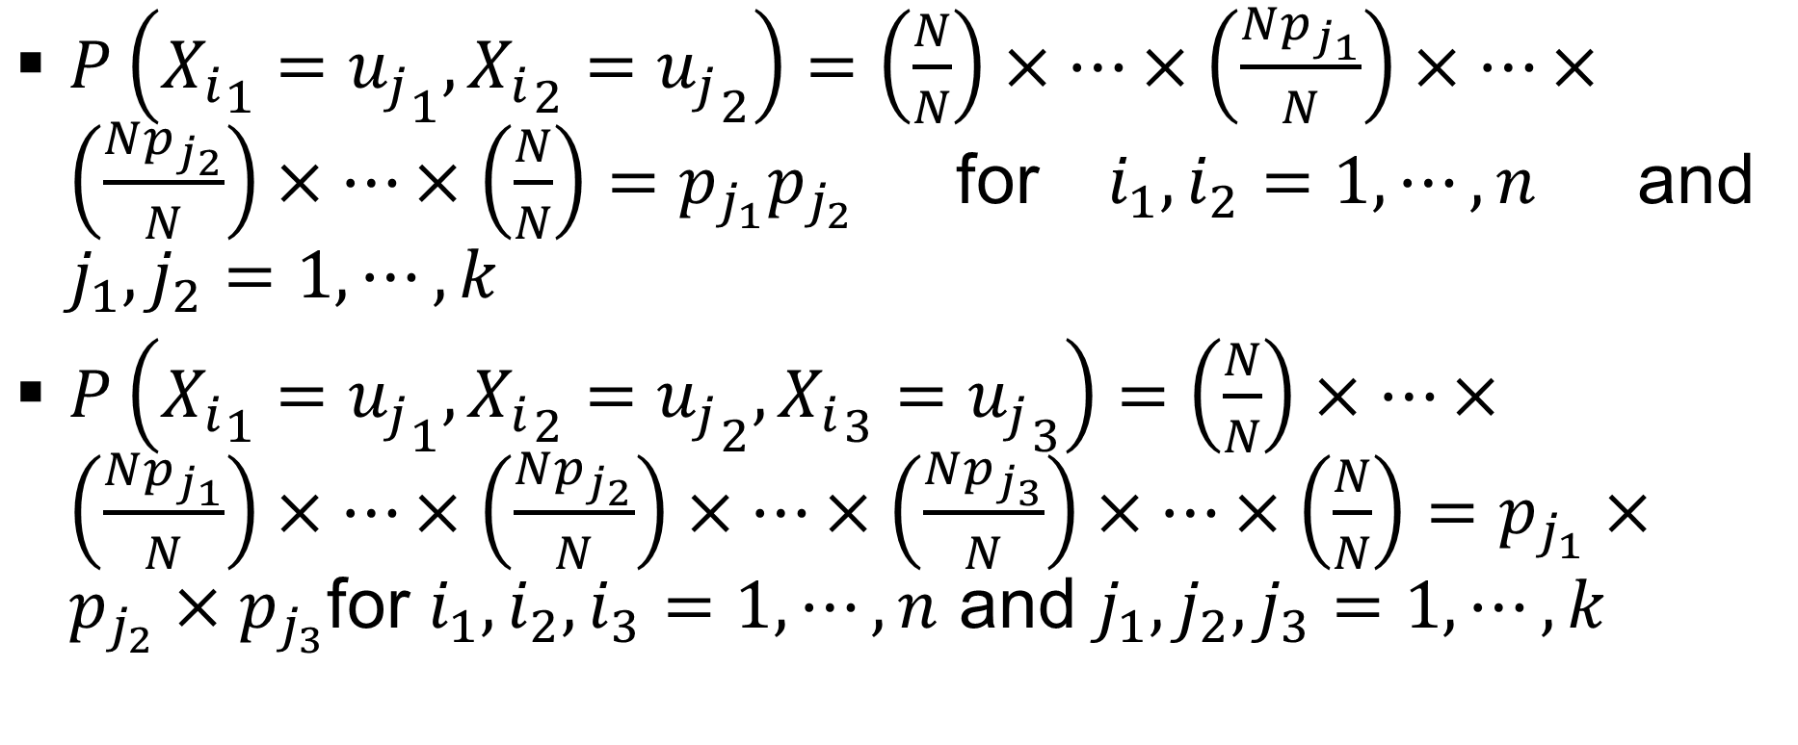
Simple random sampling with replacement (SRSWR): (contd…)
$P\left({X_{i}}_{1}={u_{j}}_{1},{X_{i}}_{2}={u_{j}}_{2}\right)=\left(\frac{N}{N}\right)×⋯×\left(\frac{Np_{j_{1}}}{N}\right)×⋯×\left(\frac{Np_{j_{2}}}{N}\right)×⋯×\left(\frac{N}{N}\right)=p_{j_{1}}p_{j_{2}}$ for $i_{1},i_{2}=1,⋯,n$ and $j_{1},j_{2}=1,⋯,k$
$P\left({X_{i}}_{1}={u_{j}}_{1},{X_{i}}_{2}={u_{j}}_{2},{X_{i}}_{3}={u_{j}}_{3}\right)=\left(\frac{N}{N}\right)×⋯×\left(\frac{Np_{j_{1}}}{N}\right)×⋯×\left(\frac{Np_{j_{2}}}{N}\right)×⋯×\left(\frac{Np_{j_{3}}}{N}\right)×⋯×\left(\frac{N}{N}\right)=p_{j_{1}}×p_{j_{2}}×p_{j_{3}}$for $i_{1},i_{2},i_{3}=1,⋯,n$ and $j_{1},j_{2},j_{3}=1,⋯,k$

Slide 35
Simple random sampling with replacement (SRSWR): (contd…)
X₁,.., X_{n} all have same probability distribution
The common probability distribution is same as population
X₁,.., X_{n} are independent variables
Thus for SRSWR [unit 𝑟 is included in the sample] = 1 − P[unit 𝑟 is not included in the sample]
Thus for SRSWR [unit 𝑟 is included in the sample] = {1 − (N − 1)^{𝑟}/N^{𝑛}}

Slide 36
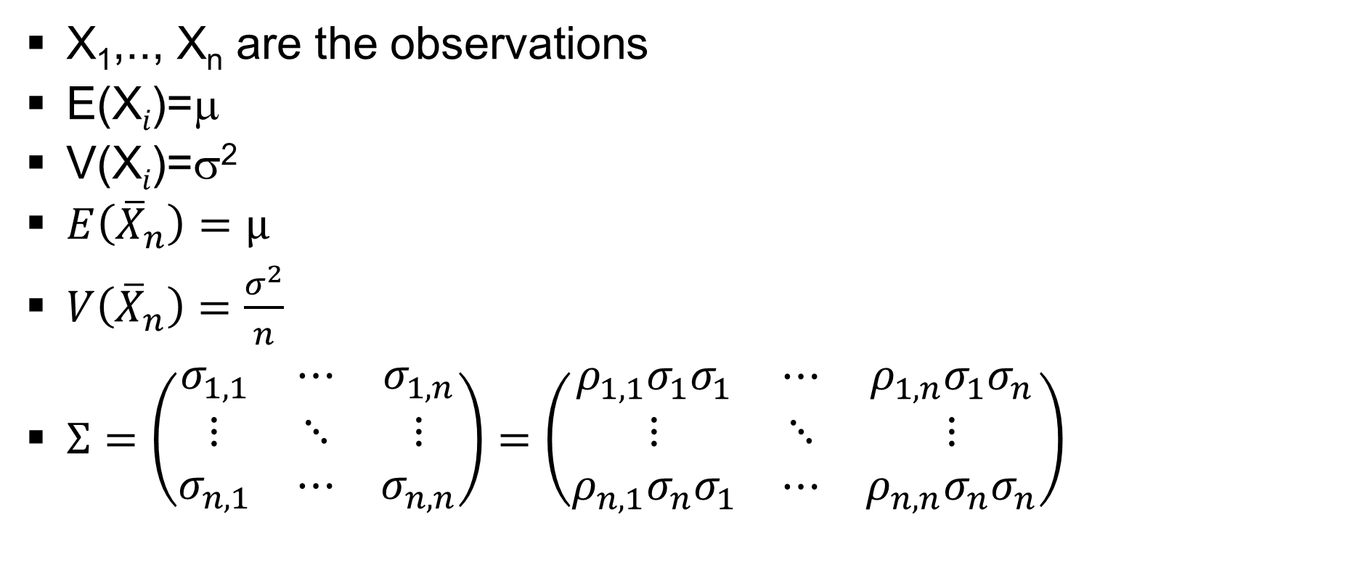
Simple random sampling with replacement (SRSWR): (contd…)
X₁,.., X_{n} are the observations
E(X_{𝑖})=μ
V(X_{𝑖})=σ²
$E\left({\overline{X}}_{n}\right)=μ$
$V\left({\overline{X}}_{n}\right)=\frac{σ^{2}}{n}$
$Σ=\left(\begin{matrix}σ_{1,1} & ⋯ & σ_{1,n} \\ ⋮ & ⋱ & ⋮ \\ σ_{n,1} & ⋯ & σ_{n,n}\end{matrix}\right)=\left(\begin{matrix}ρ_{1,1}σ_{1}σ_{1} & ⋯ & ρ_{1,n}σ_{1}σ_{n} \\ ⋮ & ⋱ & ⋮ \\ ρ_{n,1}σ_{n}σ_{1} & ⋯ & ρ_{n,n}σ_{n}σ_{n}\end{matrix}\right)$

Slide 37
Simple random sampling without replacement (SRSWOR)
P(X₁ = 𝑢_{𝑖}) = (N𝑝_{𝑖}/N)×{(N−1)/(N−1)}×…. ×{(N−𝑛+1)/(N−𝑛+1)} = 𝑝_{𝑖}
P(X₂=𝑢_{𝑗}) = P(X₁=𝑢_{𝑗},X₂=𝑢_{𝑗}) + P(X₁≠𝑢_{𝑗},X₂=𝑢_{𝑗})
Thus P(X₂=𝑢_{𝑗}) =
(N𝑝_{𝑗}/N)×{(N𝑝_{𝑗}−1)/(N−1)}×…. ×{(N−𝑛+1)/(N−𝑛+1)} + {(N−N𝑝_{𝑗})/N}×{(N𝑝_{𝑗}/N−1)} ×…. ×{(N−𝑛+1)/(N−𝑛+1)} = 𝑝_{𝑗}
Thus: P(X_{𝑖}=𝑢_{𝑗}) = 𝑝_{𝑗} for 𝑖=1,…,n and 𝑗=1,.., 𝑘

Slide 38
Simple random sampling without replacement (SRSWOR) : (contd…)
P(X₁=𝑢_{𝑖},X₂=𝑢_{𝑖})=(N𝑝_{𝑖}/N)×{(N𝑝_{𝑖}−1)/(N−1)}×{(N−2)/(N−2)}×…. ×{(N−𝑛+1)/(N−𝑛+1)}
P(X₁=𝑢_{𝑖},X₂=𝑢_{𝑖})=𝑝_{𝑖}×(𝑝_{𝑖} −1/N )/(1−1/N)
P(X₁=𝑢_{𝑖},X₂=𝑢_{𝑖},X₃=𝑢_{𝑖})=(N𝑝_{𝑖}/N)×{(N𝑝_{𝑖}−1)/(N−1)} ×{(N𝑝_{𝑖}−2)/(N−2)}×{(N−3)/(N−3)}×…. ×{(N−𝑛+1)/(N−𝑛+1)}
P(X₁=𝑢_{𝑖},X₂=𝑢_{𝑖},X₃=𝑢_{𝑖})=𝑝_{𝑖}×{(𝑝_{𝑖}−1/N)/(1−1/N)}×{(𝑝_{𝑖}−2/N)/(1−2/N)}

Slide 39
Simple random sampling without replacement (SRSWOR) : (contd…)
P(X₁=𝑢_{𝑖},X₂=𝑢_{𝑗})=(N𝑝_{𝑖}/N)×{N𝑝_{𝑗}/(N−1)}×{(N−2)/(N−2)}×…. ×{(N−𝑛+1)/(N−𝑛+1)}
P(X₁=𝑢_{𝑖},X₂=𝑢_{𝑗})=𝑝_{𝑖}×{𝑝_{𝑗}/(1−1/N)}
P(X₁=𝑢_{𝑖},X₂=𝑢_{𝑗},X₃=𝑢_{𝑘})=(N𝑝_{𝑖}/N)×{N𝑝_{𝑗}/(N−1)}×{N𝑝_{𝑘}/(N−2)}×{(N−3)/(N−3)}×…. ×{(N−𝑛+1)/(N−𝑛+1)}
P(X₁=𝑢_{𝑖},X₂=𝑢_{𝑗},X₃=𝑢_{𝑘})=𝑝_{𝑖}×{𝑝_{𝑗}/(1−1/N)}×{𝑝_{𝑘}/(1−2/N)}
When N is large then we can have independence and for a sample size of 𝑛, there would be a factor 1/{1−(𝑛−1)/N}

Slide 40
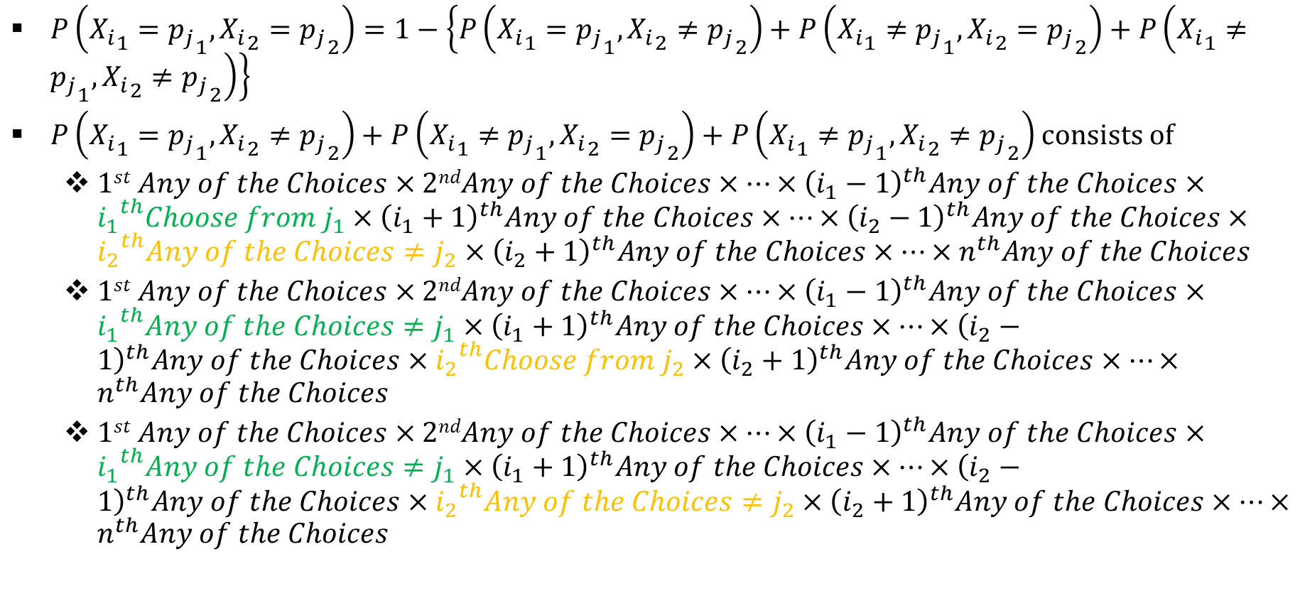
Simple random sampling without replacement (SRSWOR) : (contd…)
$P\left({X_{i}}_{1}={p_{j}}_{1},{X_{i}}_{2}={p_{j}}_{2}\right)=1−\left\{P\left({X_{i}}_{1}={p_{j}}_{1},{X_{i}}_{2}≠{p_{j}}_{2}\right)+P\left({X_{i}}_{1}≠{p_{j}}_{1},{X_{i}}_{2}={p_{j}}_{2}\right)+P\left({X_{i}}_{1}≠{p_{j}}_{1},{X_{i}}_{2}≠{p_{j}}_{2}\right)\right\}$
$P\left({X_{i}}_{1}={p_{j}}_{1},{X_{i}}_{2}≠{p_{j}}_{2}\right)+P\left({X_{i}}_{1}≠{p_{j}}_{1},{X_{i}}_{2}={p_{j}}_{2}\right)+P\left({X_{i}}_{1}≠{p_{j}}_{1},{X_{i}}_{2}≠{p_{j}}_{2}\right)$ consists of
  $1st Any of the Choices×2ndAny of the Choices×⋯×{\left(i_{1}−1\right)}^{th}Any of the Choices×{i_{1}}^{th}{Choose from j}_{1}×{\left(i_{1}+1\right)}^{th}Any of the Choices×⋯×{\left(i_{2}−1\right)}^{th}Any of the Choices×{i_{2}}^{th}Any of the Choices≠j_{2}×{\left(i_{2}+1\right)}^{th}Any of the Choices×⋯×n^{th}Any of the Choices$
  $1st Any of the Choices×2ndAny of the Choices×⋯×{\left(i_{1}−1\right)}^{th}Any of the Choices×{i_{1}}^{th}{Any of the Choices≠j}_{1}×{\left(i_{1}+1\right)}^{th}Any of the Choices×⋯×{\left(i_{2}−1\right)}^{th}Any of the Choices×{i_{2}}^{th}Choose from j_{2}×{\left(i_{2}+1\right)}^{th}Any of the Choices×⋯×n^{th}Any of the Choices$
  $1st Any of the Choices×2ndAny of the Choices×⋯×{\left(i_{1}−1\right)}^{th}Any of the Choices×{i_{1}}^{th}{Any of the Choices≠j}_{1}×{\left(i_{1}+1\right)}^{th}Any of the Choices×⋯×{\left(i_{2}−1\right)}^{th}Any of the Choices×{i_{2}}^{th}Any of the Choices≠j_{2}×{\left(i_{2}+1\right)}^{th}Any of the Choices×⋯×n^{th}Any of the Choices$

Slide 41
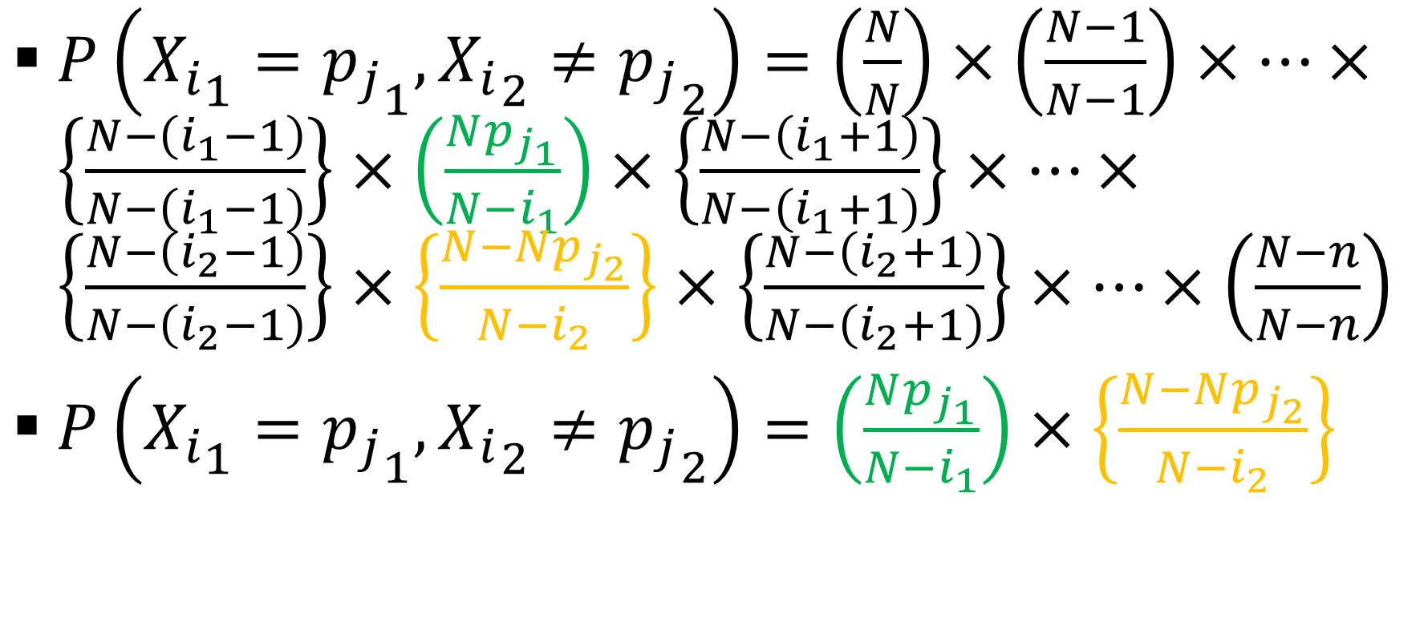
Simple random sampling without replacement (SRSWOR) : (contd…)
$P\left({X_{i}}_{1}={p_{j}}_{1},{X_{i}}_{2}≠{p_{j}}_{2}\right)=\left(\frac{N}{N}\right)×\left(\frac{N−1}{N−1}\right)×⋯×\left\{\frac{N−\left(i_{1}−1\right)}{N−\left(i_{1}−1\right)}\right\}×\left(\frac{Np_{j_{1}}}{N−i_{1}}\right)×\left\{\frac{N−\left(i_{1}+1\right)}{N−\left(i_{1}+1\right)}\right\}×⋯×\left\{\frac{N−\left(i_{2}−1\right)}{N−\left(i_{2}−1\right)}\right\}×\left\{\frac{N−Np_{j_{2}}}{N−i_{2}}\right\}×\left\{\frac{N−\left(i_{2}+1\right)}{N−\left(i_{2}+1\right)}\right\}×⋯×\left(\frac{N−n}{N−n}\right)$
$P\left({X_{i}}_{1}={p_{j}}_{1},{X_{i}}_{2}≠{p_{j}}_{2}\right)=\left(\frac{Np_{j_{1}}}{N−i_{1}}\right)×\left\{\frac{N−Np_{j_{2}}}{N−i_{2}}\right\}$

Slide 42
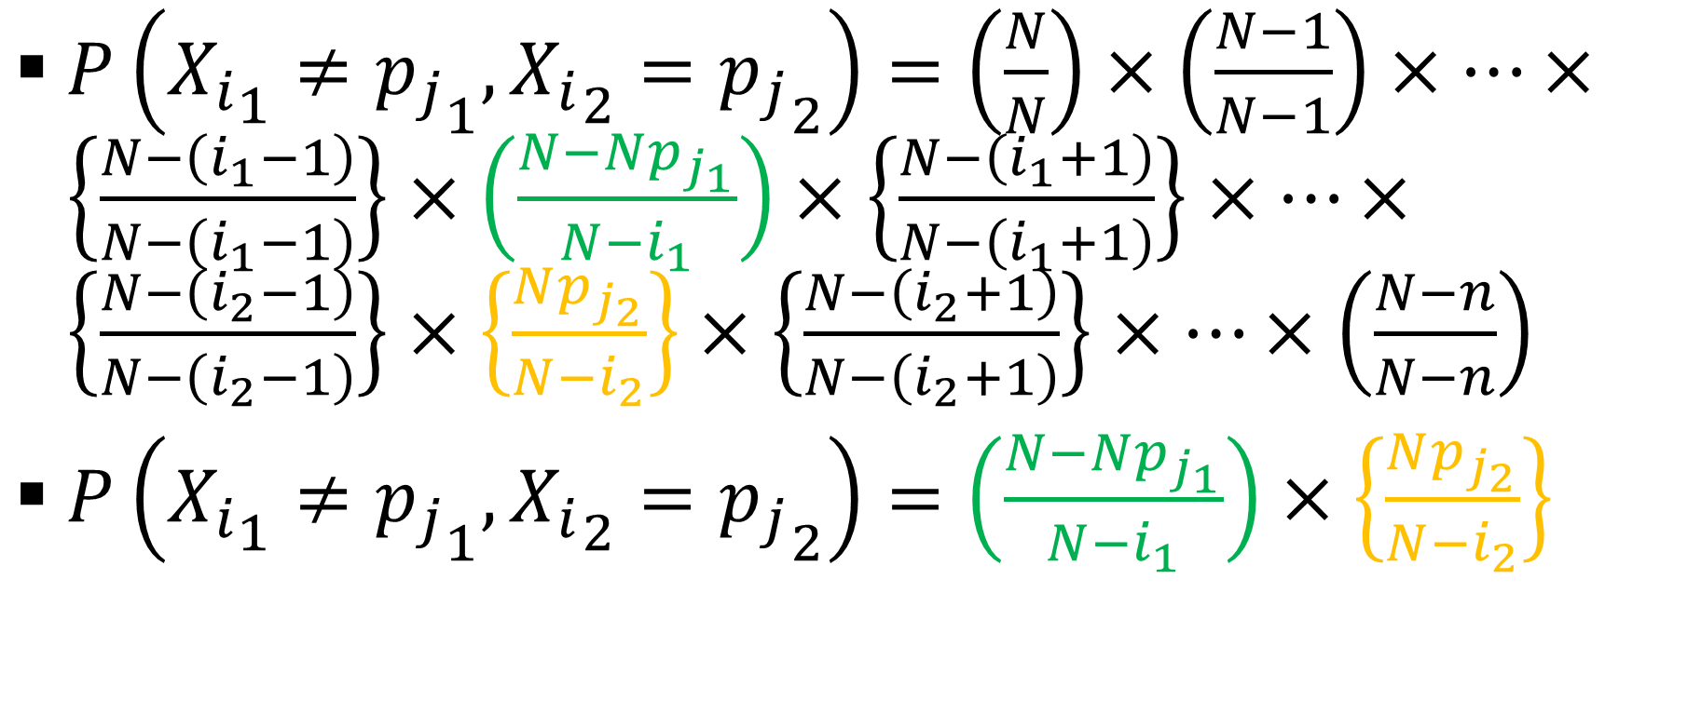
Simple random sampling without replacement (SRSWOR) : (contd…)
$P\left({X_{i}}_{1}≠{p_{j}}_{1},{X_{i}}_{2}={p_{j}}_{2}\right)=\left(\frac{N}{N}\right)×\left(\frac{N−1}{N−1}\right)×⋯×\left\{\frac{N−\left(i_{1}−1\right)}{N−\left(i_{1}−1\right)}\right\}×\left(\frac{N−Np_{j_{1}}}{N−i_{1}}\right)×\left\{\frac{N−\left(i_{1}+1\right)}{N−\left(i_{1}+1\right)}\right\}×⋯×\left\{\frac{N−\left(i_{2}−1\right)}{N−\left(i_{2}−1\right)}\right\}×\left\{\frac{Np_{j_{2}}}{N−i_{2}}\right\}×\left\{\frac{N−\left(i_{2}+1\right)}{N−\left(i_{2}+1\right)}\right\}×⋯×\left(\frac{N−n}{N−n}\right)$
$P\left({X_{i}}_{1}≠{p_{j}}_{1},{X_{i}}_{2}={p_{j}}_{2}\right)=\left(\frac{N−Np_{j_{1}}}{N−i_{1}}\right)×\left\{\frac{Np_{j_{2}}}{N−i_{2}}\right\}$

Slide 43
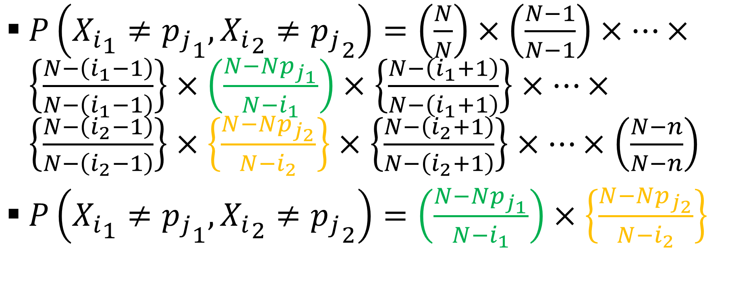
Simple random sampling without replacement (SRSWOR) : (contd…)
$P\left({X_{i}}_{1}≠{p_{j}}_{1},{X_{i}}_{2}≠{p_{j}}_{2}\right)=\left(\frac{N}{N}\right)×\left(\frac{N−1}{N−1}\right)×⋯×\left\{\frac{N−\left(i_{1}−1\right)}{N−\left(i_{1}−1\right)}\right\}×\left(\frac{N−Np_{j_{1}}}{N−i_{1}}\right)×\left\{\frac{N−\left(i_{1}+1\right)}{N−\left(i_{1}+1\right)}\right\}×⋯×\left\{\frac{N−\left(i_{2}−1\right)}{N−\left(i_{2}−1\right)}\right\}×\left\{\frac{N−Np_{j_{2}}}{N−i_{2}}\right\}×\left\{\frac{N−\left(i_{2}+1\right)}{N−\left(i_{2}+1\right)}\right\}×⋯×\left(\frac{N−n}{N−n}\right)$
$P\left({X_{i}}_{1}≠{p_{j}}_{1},{X_{i}}_{2}≠{p_{j}}_{2}\right)=\left(\frac{N−Np_{j_{1}}}{N−i_{1}}\right)×\left\{\frac{N−Np_{j_{2}}}{N−i_{2}}\right\}$

Slide 44
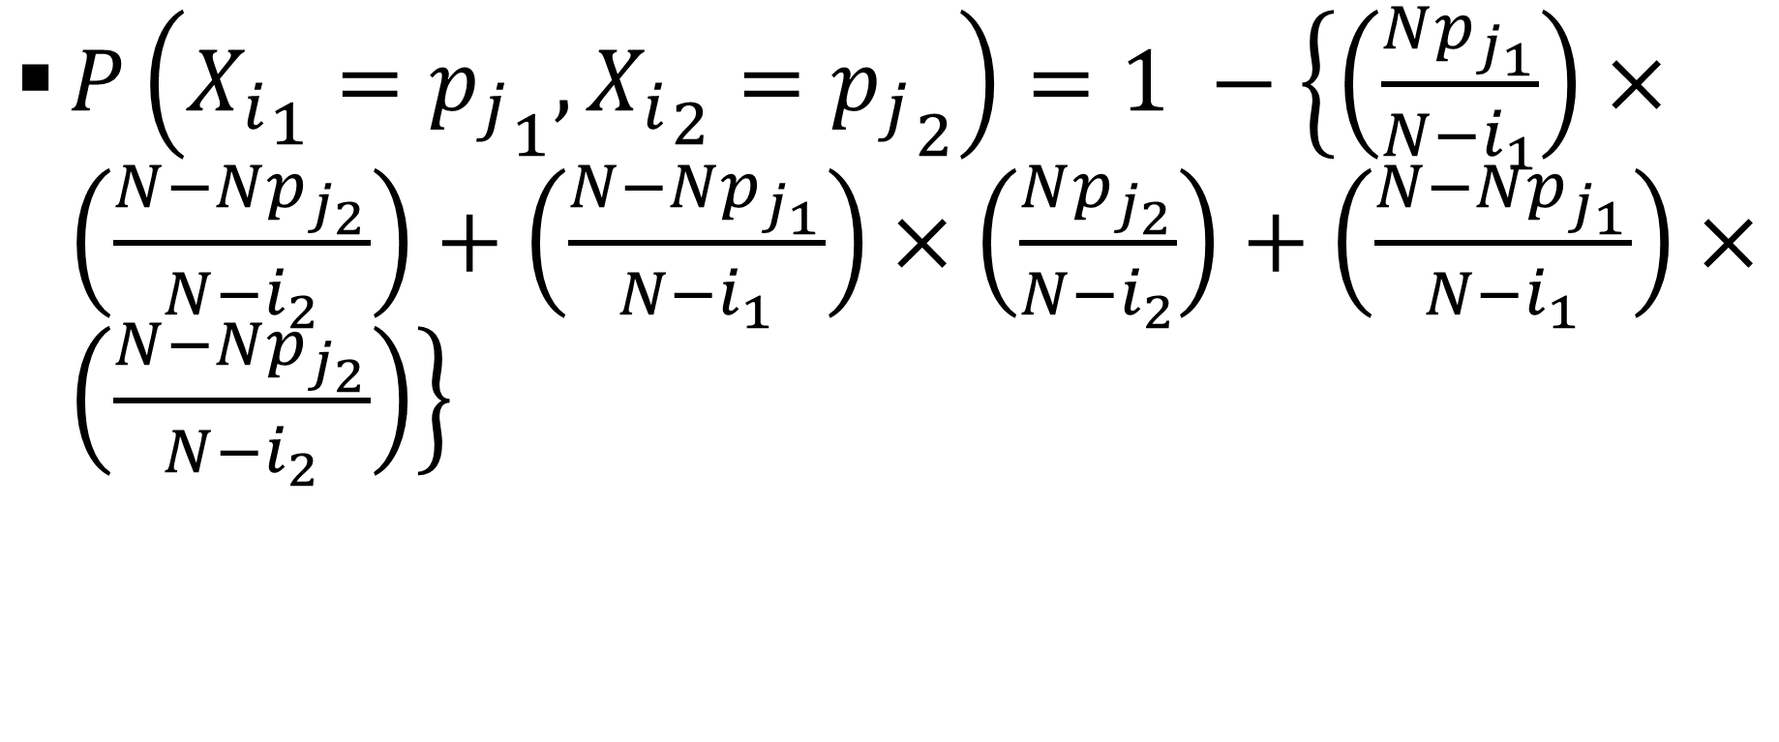
Simple random sampling without replacement (SRSWOR) : (contd…)
$P\left({X_{i}}_{1}={p_{j}}_{1},{X_{i}}_{2}={p_{j}}_{2}\right)=1 −\left\{\left(\frac{Np_{j_{1}}}{N−i_{1}}\right)×\left(\frac{N−Np_{j_{2}}}{N−i_{2}}\right)+\left(\frac{N−Np_{j_{1}}}{N−i_{1}}\right)×\left(\frac{Np_{j_{2}}}{N−i_{2}}\right)+\left(\frac{N−Np_{j_{1}}}{N−i_{1}}\right)×\left(\frac{N−Np_{j_{2}}}{N−i_{2}}\right)\right\}$

Slide 45
Simple random sampling without replacement (SRSWOR) : (contd…)
Thus for SRSWOR [unit 𝑟 is included in the sample] = 1 − p[unit 𝑟 is not included in the sample]
Thus for SRSWOR [unit 𝑟 is included in the sample] = [1 − {(N − 1)/N}×{(N − 2)/(N − 1)}×… ×{(N − 𝑛)/(N − 𝑛 +1)}] = 𝑛/N

Slide 46
Simple random sampling without replacement (SRSWOR) : (contd…)
P(X₁=𝑢_{𝑖},X₂=𝑢_{𝑖})=𝑝_{𝑖}×(𝑝_{𝑖} −1/N )/(1−1/N)
P(X₁=𝑢_{𝑖},X₂=𝑢_{𝑗})=𝑝_{𝑖}×{𝑝_{𝑗}/(1−1/N)}
Cov(X₁,X₂)=E(X₁X₂)−E(X₁)E(X₂)=∑∑𝑢_{𝑖}𝑢_{𝑗}P(X₁=𝑢_{𝑖},X₂=𝑢_{𝑗})−μ²
Cov(X₁,X₂)=∑𝑢²_{𝑖}(N𝑝_{𝑖}/N)×{(N𝑝_{𝑖}−1)/(N−1)}+∑∑𝑢_{𝑖}𝑢_{𝑗}(N𝑝_{𝑖}/N)×{N𝑝_{j}/(N−1)}−μ²
Cov(X₁,X₂)={N²/N(N−1)}×{∑𝑢_{𝑖}𝑝²_{𝑖}}²−{(σ²+μ²)/(N−1)}−μ²=−σ²/(N−1)
Cov(X_{𝑖},X_{𝑗})=−σ²/(N−1), for 𝑖,𝑗=1,…, 𝑛

Slide 47
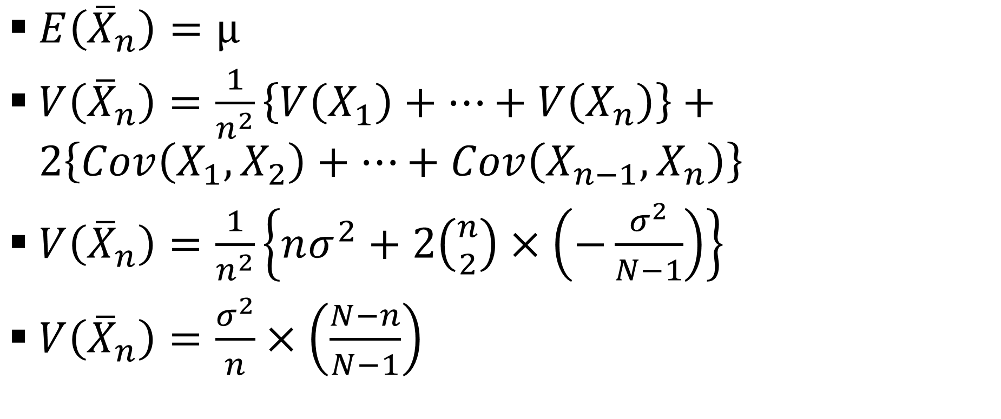
Simple random sampling without replacement (SRSWOR) : (contd…)
$E\left({\overline{X}}_{n}\right)=μ$
$V\left({\overline{X}}_{n}\right)=\frac{1}{n^{2}}\left\{V\left(X_{1}\right)+⋯+V\left(X_{n}\right)\right\}+2\left\{Cov\left(X_{1},X_{2}\right)+⋯+Cov\left(X_{n−1},X_{n}\right)\right\}$
$V\left({\overline{X}}_{n}\right)=\frac{1}{n^{2}}\left\{nσ^{2}+2\left({n \atop 2}\right)×\left(−\frac{σ^{2}}{N−1}\right)\right\}$
$V\left({\overline{X}}_{n}\right)=\frac{σ^{2}}{n}×\left(\frac{N−n}{N−1}\right)$

Slide 48
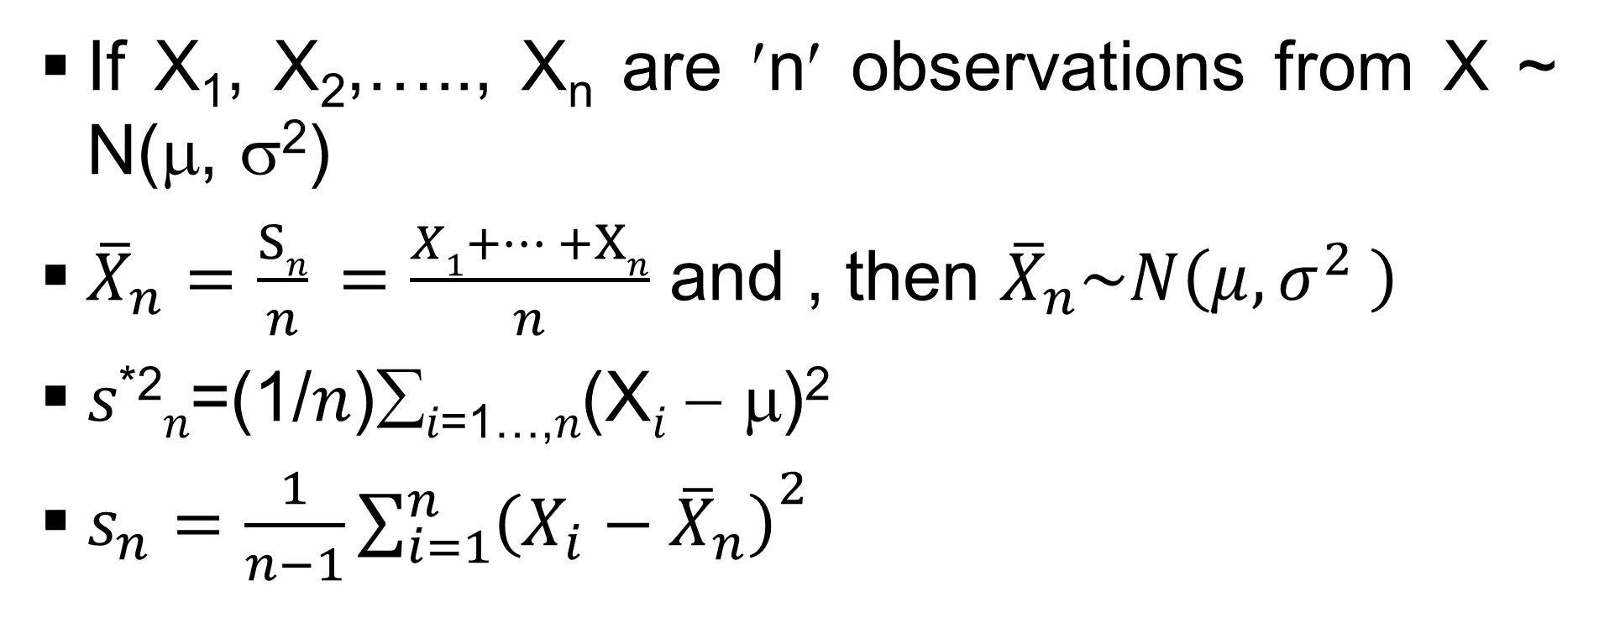
Some Sampling Results
If X₁, X₂,….., X_{n} are ′n′ observations from X ~ N(μ, σ²)
${\overline{X}}_{n}=\frac{Sn}{n} =\frac{X1+… +Xn}{n}$ and , then ${\overline{X}}_{n}\sim N\left(μ,σ^{2} \right)$
𝑠^{*2}_{𝑛}=(1/𝑛)∑_{𝑖=1…,𝑛}(X_{𝑖} − μ)²
$s_{n}=\frac{1}{n−1}{\sum_{i=1}^{n}{\left(X_{i}−{\overline{X}}_{n}\right)}}^{2}$

Slide 49

Some Sampling Results : (contd…)
𝑛𝑠^{*2}_{𝑛}/σ²_{𝑛} ~ χ²_{𝑛}
(𝑛−1)𝑠²_{𝑛}/σ²_{𝑛} ~ χ²_{𝑛−1}
$\frac{{\overline{X}}_{n}−μ}{\frac{s_{n}}{\sqrt{n}}}\sim t_{n−1}$

Slide 50
Some Sampling Results : (contd…)
If X₁, X₂,….., X_{n} are 𝑚 observations from X ~ N(μ_{X}, σ²_{X}) and Y₁, Y₂,….., Y_{𝑛} are 𝑛 observations from Y ~ N(μ_{Y}, σ²_{Y}) and more over these samples are independent and population means are known, then
{(𝑚𝑠^{*2}_{𝑚}/σ²_{X})/𝑚}/{(𝑛𝑠^{*2}_{𝑛}/σ²_{Y})/𝑛}~F_{𝑚,𝑛}

Slide 51
Some Sampling Results : (contd…)
If X₁, X₂,….., X_{n} are 𝑚 observations from X ~ N(μ_{X}, σ²_{X}) and Y₁, Y₂,….., Y_{𝑛} are 𝑛 observations from Y ~ N(μ_{Y}, σ²_{Y}) and more over these samples are independent and population means are unknown, then
[{(𝑚−1)𝑠²_{𝑚}/σ²_{X}}/(𝑚−1)]/[{(𝑛−1)𝑠²_{𝑛} /σ²_{Y})}/(𝑛−1)]~F_{𝑚−1,𝑛−1}

Slide 52
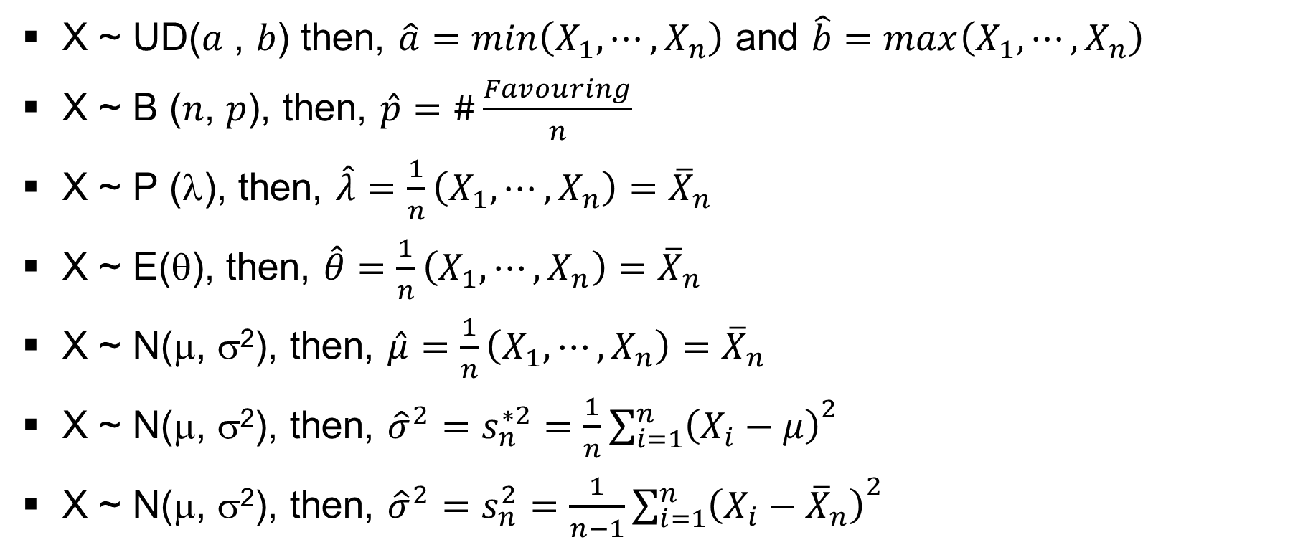
Some Sampling Results : (contd…)
X ~ UD(𝑎 , 𝑏) then, $\hat{a}=min\left(X_{1},⋯,X_{n}\right)$ and $\hat{b}=max\left(X_{1},⋯,X_{n}\right)$
X ~ B (𝑛, 𝑝), then, $\hat{p}=\#\frac{Favouring}{n}$
X ~ P (λ), then, $\hat{λ}=\frac{1}{n}\left(X_{1},⋯,X_{n}\right)={\overline{X}}_{n}$
X ~ E(θ), then, $\hat{θ}=\frac{1}{n}\left(X_{1},⋯,X_{n}\right)={\overline{X}}_{n}$
X ~ N(μ, σ²), then, $\hat{μ}=\frac{1}{n}\left(X_{1},⋯,X_{n}\right)={\overline{X}}_{n}$
X ~ N(μ, σ²), then, ${\hat{σ}}^{2}=s_{n}^{∗2}=\frac{1}{n}{\sum_{i=1}^{n}{\left(X_{i}−μ\right)}}^{2}$
X ~ N(μ, σ²), then, ${\hat{σ}}^{2}=s_{n}^{2}=\frac{1}{n−1}{\sum_{i=1}^{n}{\left(X_{i}−{\overline{X}}_{n}\right)}}^{2}$

Slide 53
Some Sampling Results : (contd…)
It was found that the respective number of members in 10 different families are 4, 5, 6, 7, 8, 3, 4, 5, 6 and 6
If we consider that the number of members in a family to be uniformly distributed
Then the estimated value of a = 3 and that of b = 8.

Slide 54
Some Sampling Results : (contd…)
You are testing the components coming out of the shop floor and find that 9 out of 30 components fail
Then the estimated value of p (proportion of bad items in the population) = 9/30

Slide 55
Some Sampling Results : (contd…)
At a particular teller machine in one of the bank branches it was found that the number of customers arriving in an unit time span were 4, 6, 7, 4, 3, 5, 6, and 5
Then for this Poisson process the estimated value of λ is 5

Slide 56
Some Sampling Results : (contd…)
Suppose it is known that the survival time of a particular type of bulb has the exponential distribution
You test 10 such bulbs and find their respective survival times as 150, 225, 275, 300, 95, 155, 325, 75, 20 and 400 hours respectively.
Then the estimated value of θ = 202

Slide 57
Sampling from Discrete Distribution
For the case of continuous distribution let us simply consider the uniform continuous distribution and then we will prove it is general for any type of continuous distribution
X~U(0,1), f_{X}(𝑥)=1 for 0≤𝑥≤1, such that F_{X}(𝑥) = P_{X}(X≤𝑥) = 𝑥
Let us consider all points between 0 to 1 both inclusive

Slide 58
Sampling from Discrete Distribution : (contd…)
Now sub-divide the interval in 10,000 intervals each of equal length and mark the end points of the intervals thus formed as 0000, 0001,…., 9999.
We now pick up one number at random from 0000, 0001,…., 9999, thus if Y (=124) is the r.v., which denotes the number picked from 0000, 0001,…., 9999

Slide 59
Sampling from Discrete Distribution : (contd…)
Then F_{Y}(𝑦=0.0124) = P_{Y}(Y≤0.0124)=125/10000=0.0125 or F_{Y}(𝑦=0.01247)=P_{Y}(Y≤0.01247)=0.0125=(10000×0.01247+1)/10000
Thus for any 0≤𝑥≤1, G_{X}(𝑥) = F_{Y}(𝑦) = P_{Y}(Y ≤ 𝑥) = {(10000×𝑥+1)/10000} ≈ 𝑥
Now if F_{X}(𝑥) = P_{X}(X ≤ 𝑥) = 𝑥 and G_{X}(𝑥) = P(Y ≤ 𝑥) = {(10000×𝑥+1)/10000} ≈ 𝑥, for 0≤𝑥≤1, then |F_{X}(𝑥) − G_{X}(𝑥)| = |P_{X}(X ≤ 𝑥) − P_{Y}(Y ≤ 𝑥)| = {(10000×𝑥)/10000} − {(10000×𝑥+1)/10000} ≤ |1/10000|

Slide 60
Sampling from Discrete Distribution : (contd…)
If 𝑥=0.13578, then {(10000× 0.13578)/10000} − {(10000× 0.13578 +1)/10000} = |(0.8+1)/10000|, which means the accuracy is determined depending on the value of 𝑥
Hence F_{X}(𝑥) is a continuous distribution while G_{X}(𝑥) is a discrete distribution hence instead of sampling from F_{X}(𝑥) we can sample from G_{X}(𝑥)

Slide 61
Sampling from Discrete Distribution : (contd…)
Consider F_{X}(𝑢) = P_{X}(X ≤ 𝑢) and let Z = F_{X}(𝑥)
If we have the exponential distribution, then F_{X}(𝑢) = P_{X}(X ≤ 𝑢) = ∫_{𝑥=0 to 𝑢}(1/θ)exp{−(𝑥/θ)}d𝑥 = 1 − exp{−(𝑢/θ)}
Hence Z = F_{X}(𝑥) = 1 − exp{−(𝑢/θ)} such that 𝑥 = −θℓ𝑜𝑔_{𝑒}(1 − 𝑧)
Now we are interested in finding out P_{Z}(Z ≤ 𝑣) so that if one considers the illustration below we can have a better understanding of the same

Slide 62
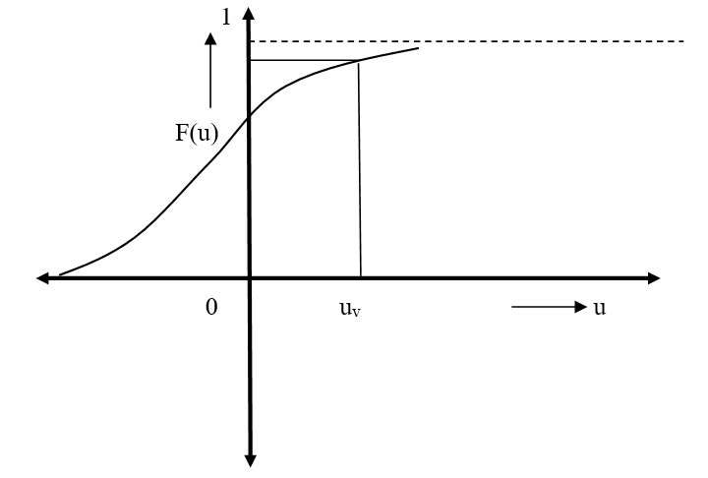
Sampling from Discrete Distribution : (contd…)

Slide 63
Sampling from Discrete Distribution : (contd…)
Thus P_{Z}(Z ≤ 𝑣) = P_{Z}[F_{X}(𝑥) ≤ 𝑣] = P_{X}[X ≤ 𝑢_{𝑣}] = F_{X}(𝑢_{𝑣}) = 𝑣
Here P_{X}[X ≤ 𝑢_{𝑣}] is the monotonically increasing function, where its domain is (−∞, +∞)
Thus if we summarize then for Z = F_{X}(𝑥), then P_{Z}(Z ≤ 𝑣) = 𝑣; 𝑣 = [0,1], hence Z~U(0,1)

Slide 64
Sampling from Discrete Distribution : (contd…)
Steps for sampling
Transform from X to Z
Realize Z has an uniform distribution from 0 to 1, i.e., Z ~ U(0,1)
Sample from Z
Transform observations back from Z to observations in X

Slide 65
Pollen Problem
URL: http://lib.stat.cmu.edu/datasets/
Synthetic dataset about the geometric features of pollen grains. There are 3848 observations on 5 variables. From the 1986. ASA Data Exposition dataset, made up by David Coleman of RCA Labs, Princeton, N.J. The first three variables are the lengths of geometric features observed sampled pollen grains in the x, y, and z dimensions: a "ridge" along x, a "nub" in the y direction, and a "crack" in along the z dimension. The fourth variable is pollen grain weight, and the fifth is density.
For our benefit we will call the variables:
RIDGE
NUB
CRACK
WEIGHT
DENSITY
OBSERVATION NUMBER (for convenience)

Slide 66
Pollen Problem : (contd…)
 | DENSITY | RIDGE | NUB | CRACK | WEIGHT
Expected Value | 0.00017 | -0.00364 | 0.00016 | 0.00310 | 0.00424
SD(S) | 3.14439 | 6.39824 | 5.18631 | 7.87520 | 10.04309
SD(P) | 3.14399 | 6.39741 | 5.18564 | 7.87418 | 10.04179
Median | -0.03045 | -0.16385 | -0.23170 | -0.05615 | -0.14935
Maximum | 10.86730 | 21.40660 | 17.25830 | 30.31780 | 35.80280
Minimum | -12.03910 | -23.28390 | -16.39350 | -31.41300 | -34.03520

Slide 67
Pollen Problem : (contd…)

Slide 68
Pollen Problem : (contd…)

Slide 69
Pollen Problem : (contd…)

Slide 70
Pollen Problem : (contd…)

Slide 71
Pollen Problem : (contd…)

Slide 72
Pollen Problem : (contd…)
Expected values, SD(S), SD(P), % Error for density
For n = 500
Expected Value SD(S) SD(P) % Error
-0.0550528 3.162053622 3.158889986 -0.10015025
For n = 1000
Expected Value SD(S) SD(P) % Error
-0.1031154 3.164329725 3.162747164 -0.050037531

Slide 73
Pollen Problem : (contd…)
Expected values, SD(S), SD(P), % Error for density
For n = 1500
Expected Value SD(S) SD(P) % Error
-0.073460533 3.140692676 3.139645604 -0.033350009
For n = 2000
Expected Value SD(S) SD(P) % Error
-0.0250194 3.120122829 3.1193427 -0.025009379

Slide 74
Pollen Problem : (contd…)
Expected values, SD(S), SD(P), % Error for density
For n = 2500
Expected Value SD(S) SD(P) % Error
-0.03709728 3.127875617 3.127249979 -0.020006002
For n = 3000
Expected Value SD(S) SD(P) % Error
0.001982233 3.122482427 3.12196197 -0.016670834

Slide 75
Pollen Problem : (contd…)
Expected values, SD(S), SD(P), % Error for density
For n = 3500
Expected Value SD(S) SD(P) % Error
0.000891371 3.128506056 3.128059095 -0.014288776
For n = 3848
Expected Value SD(S) SD(P) % Error
0.000166294 3.14439459 3.143985989 -0.012996296

Slide 76
Pollen Problem : (contd…)

Slide 77
Pollen Problem : (contd…)

Slide 78
Pollen Problem : (contd…)

Slide 79
Pollen Problem : (contd…)

Slide 80
Pollen Problem : (contd…)

Slide 81
Pollen Problem : (contd…)

