Slide 1

IME602: Probability and Statistics-POINT ESTIMATION
Raghu Nandan Sengupta
Industrial & Management Engineering Department
Indian Institute of Technology Kanpur

Slide 2
Coverage

Slide 3
Point Estimation
Method of maximum likelihood (MLE)
Method of moments

Slide 4
Maximum Likelihood Estimation (MLE)
The likelihood function is defined by the concept that signifies the chance or the likeliness of the function taking a value based on the realized values
The main focus of this method is to find the estimator such that, the likelihood function is maximized

Slide 5
Maximum Likelihood Estimation (MLE): (contd…)
Consider X₁,…,X_{n} have the same distribution function, f(x; θ), and x₁,…,x_{n} are the corresponding realized values
As all X_{i} are iid, hence the likelihood function, L(x; θ)=Pr(X₁=x₁) ×…×Pr(X_{n}=x_{n})
We maximize the log likelihood function by considering ∂lnL(x; θ)/∂θ=0 and finding the estimates of θ

Slide 6
Method of moments
We derive the equations that relate the population moments to the parameters of interest, i.e., μ_{i}=g_{i}(θ₁,…, θ_{k}), i=1,…,k
After that a sample, X₁,…,X_{n}, is drawn and the population moments are estimated from the sample, μ_{i,e}=f(X₁,…,X_{n})=g_{i}(θ_{1,e},…, θ_{k,e}), i=1,…,k, where θ_{1,e},…, θ_{k,e} are the estimated values of θ₁,…, θ_{k}

Slide 7
Maximum Likelihood Estimation (MLE): (contd…)
Consider you have X₁,.. X_{𝑛} have the same distribution function or say the pmf/pdf as their population distribution or pmf/pdf and these observations are what constitutes a sample of size, 𝑛
Assume 𝑥₁,…, 𝑥_{𝑛} are the corresponding realized values for these observations. Let us assume the pmf/pdf is denoted by f(𝑥; θ)
Let us first consider the discrete case to show how the method of maximum likelihood is used to find the estimator

Slide 8
Maximum Likelihood Estimation (MLE): (contd…)
The likelihood function is defined by the concept that signifies the chance or the likeliness of the function taking a value based on the realized values hence the main focus of this method is to find the estimator such that, the likelihood function is maximized
So if we denote the likelihood function as L(X₁,.. X_{𝑛}; θ), then the realized value of the likelihood function is L(𝑥₁,…, 𝑥_{𝑛}; θ) which is P(X₁=x₁,…, X_{𝑛}=x_{𝑛}) = ∏_{𝑖=1,.., 𝑛}P(X_{𝑖}= 𝑥_{𝑖})

Slide 9
Maximum Likelihood Estimation (MLE): (contd…)
Here L(𝑥₁,…, 𝑥_{𝑛}; θ) is the joint distribution of X_{𝑖}’s, i.e., the joint probability of observing the sample that we have observed, 𝑥₁,…, 𝑥_{𝑛}
Rather then consider L(𝑥₁,…, 𝑥_{𝑛}; θ) we consider ℓ𝑜𝑔_{𝑒}{L(𝑥₁,…, 𝑥_{𝑛}; θ)}

Slide 10
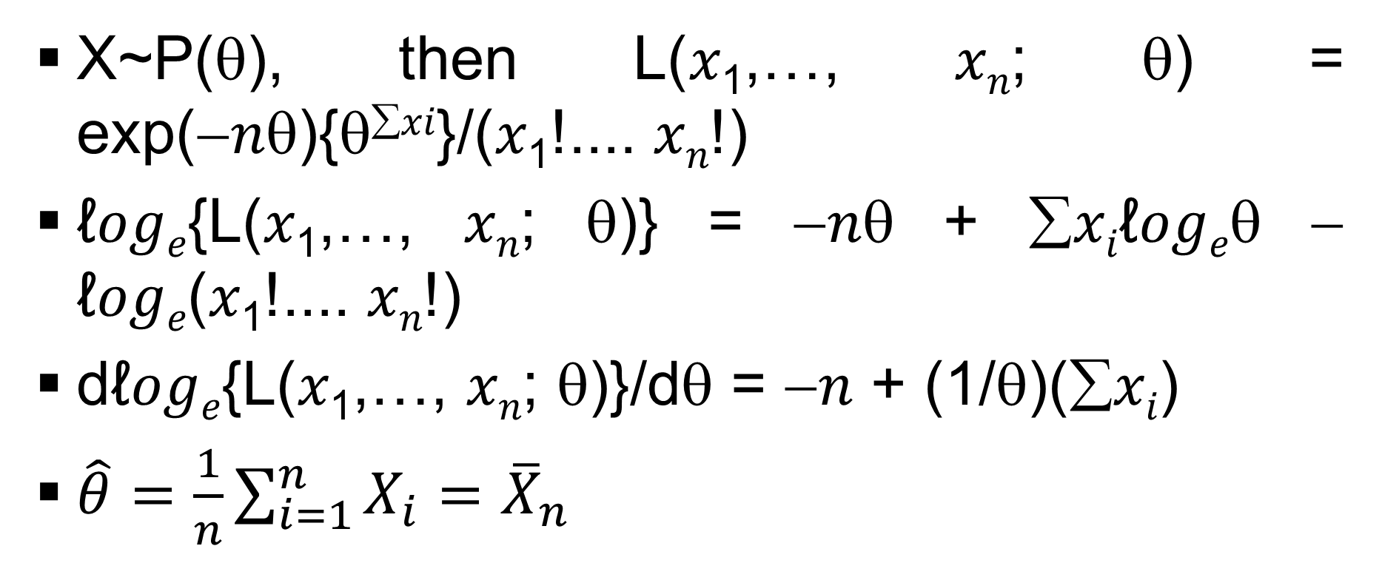
Maximum Likelihood Estimation (MLE): (contd…)
X~P(θ), then L(𝑥₁,…, 𝑥_{𝑛}; θ) = exp(−𝑛θ){θ^{∑𝑥𝑖}}/(𝑥₁!.... 𝑥_{𝑛}!)
ℓ𝑜𝑔_{𝑒}{L(𝑥₁,…, 𝑥_{𝑛}; θ)} = −𝑛θ + ∑𝑥_{𝑖}ℓ𝑜𝑔_{𝑒}θ − ℓ𝑜𝑔_{𝑒}(𝑥₁!.... 𝑥_{𝑛}!)
dℓ𝑜𝑔_{𝑒}{L(𝑥₁,…, 𝑥_{𝑛}; θ)}/dθ = −𝑛 + (1/θ)(∑𝑥_{𝑖})
$\hat{θ}=\frac{1}{n}\sum_{i=1}^{n}{X_{i}}={\overline{X}}_{n}$

Slide 11
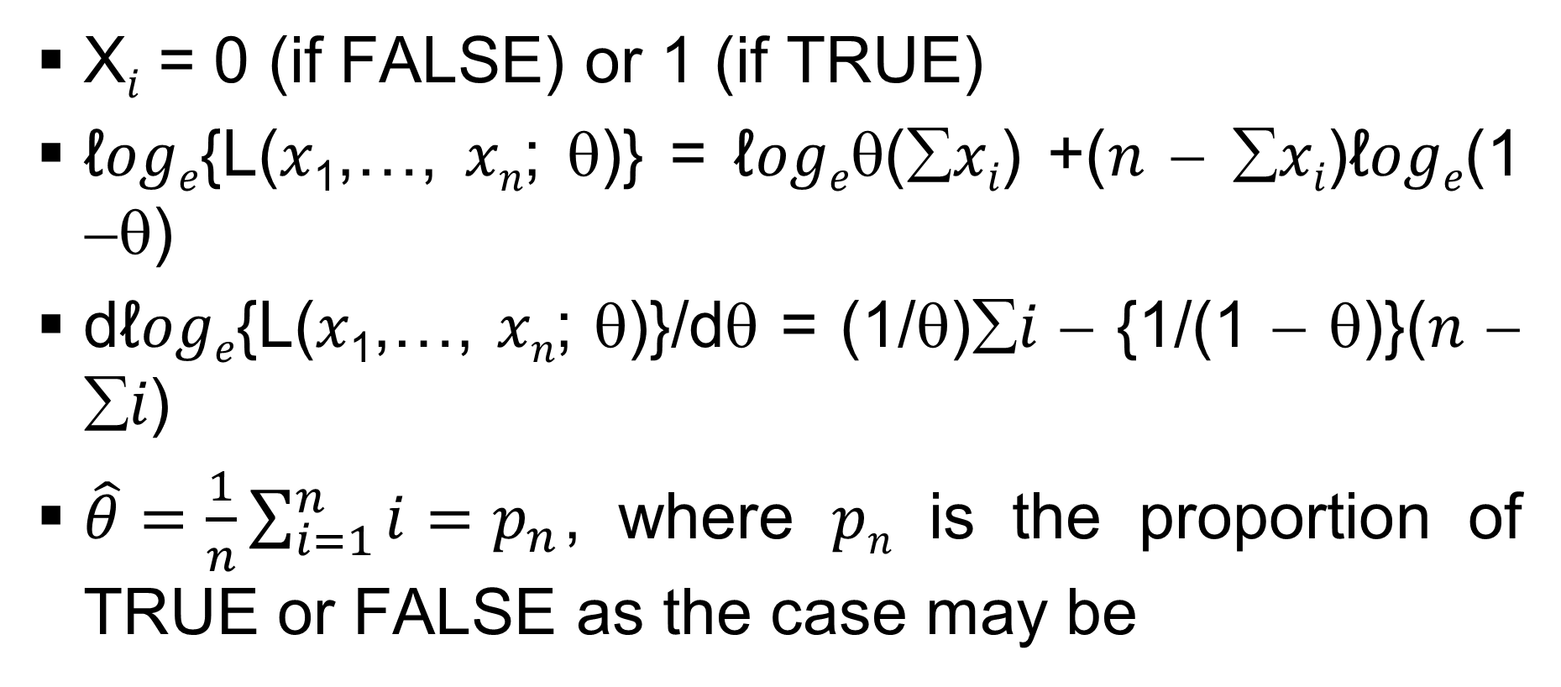
Maximum Likelihood Estimation (MLE): (contd…)
X_{𝑖} = 0 (if FALSE) or 1 (if TRUE)
ℓ𝑜𝑔_{𝑒}{L(𝑥₁,…, 𝑥_{𝑛}; θ)} = ℓ𝑜𝑔_{𝑒}θ(∑𝑥_{𝑖}) +(𝑛 − ∑𝑥_{𝑖})ℓ𝑜𝑔_{𝑒}(1 −θ)
dℓ𝑜𝑔_{𝑒}{L(𝑥₁,…, 𝑥_{𝑛}; θ)}/dθ = (1/θ)∑𝑖 − {1/(1 − θ)}(𝑛 − ∑𝑖)
$\hat{θ}=\frac{1}{n}\sum_{i=1}^{n}{i}=p_{n}$, where 𝑝_{𝑛} is the proportion of TRUE or FALSE as the case may be

Slide 12
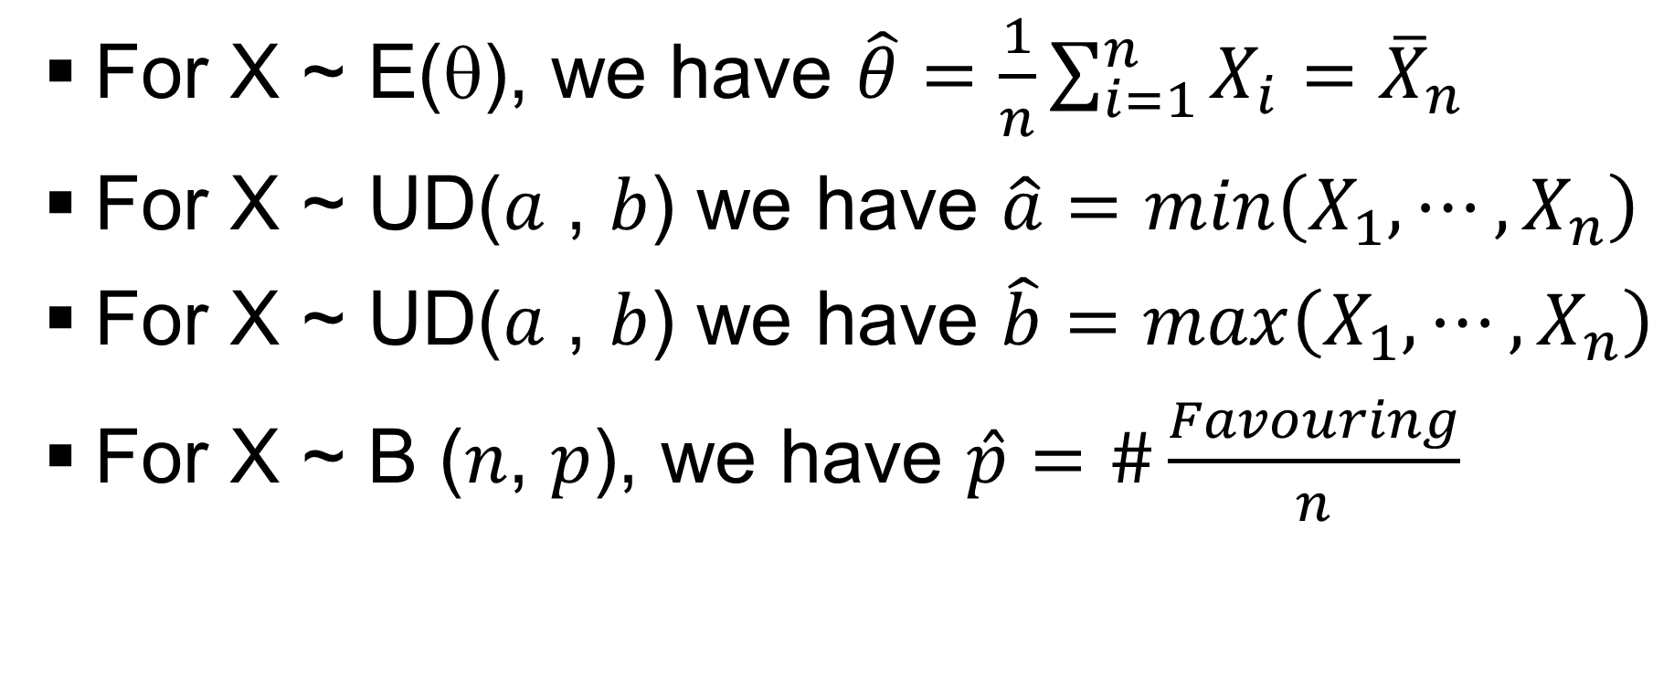
Maximum Likelihood Estimation (MLE): (contd…)
For X ~ E(θ), we have $\hat{θ}=\frac{1}{n}\sum_{i=1}^{n}{X_{i}}={\overline{X}}_{n}$
For X ~ UD(𝑎 , 𝑏) we have $\hat{a}=min\left(X_{1},⋯,X_{n}\right)$
For X ~ UD(𝑎 , 𝑏) we have $\hat{b}=max\left(X_{1},⋯,X_{n}\right)$
For X ~ B (𝑛, 𝑝), we have $\hat{p}=\#\frac{Favouring}{n}$

Slide 13
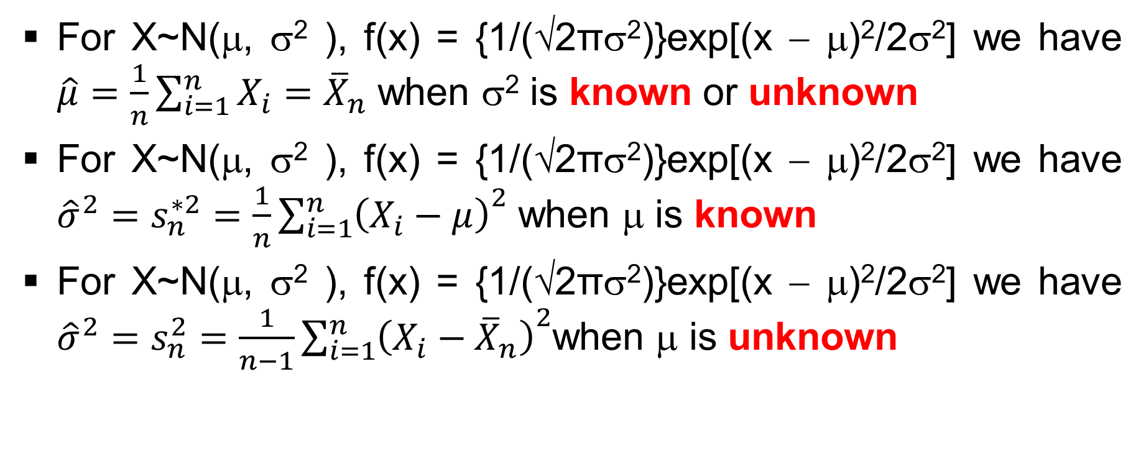
Maximum Likelihood Estimation (MLE): (contd…)
For X~N(μ, σ² ), f(x) = {1/(√2πσ²)}exp[(x − μ)²/2σ²] we have $\hat{μ}=\frac{1}{n}\sum_{i=1}^{n}{X_{i}}={\overline{X}}_{n}$ when σ² is known or unknown
For X~N(μ, σ² ), f(x) = {1/(√2πσ²)}exp[(x − μ)²/2σ²] we have ${\hat{σ}}^{2}=s_{n}^{∗2}=\frac{1}{n}{\sum_{i=1}^{n}{\left(X_{i}−μ\right)}}^{2}$ when μ is known
For X~N(μ, σ² ), f(x) = {1/(√2πσ²)}exp[(x − μ)²/2σ²] we have ${\hat{σ}}^{2}=s_{n}^{2}=\frac{1}{n−1}{\sum_{i=1}^{n}{\left(X_{i}−{\overline{X}}_{n}\right)}}^{2}$when μ is unknown

Slide 14
Maximum Likelihood Estimation (MLE): (contd…)
Desirable properties: We have been deriving many of the estimators using MLE method, but have not thought about whether the estimators found out really fit our bill in the sense whether they do have some desirable properties which is wanted of them
More over if you have more than one estimator for the same case, then which is the so called best is of concern to us

Slide 15
Maximum Likelihood Estimation (MLE): (contd…)
In other words given an estimator we do not know how close that estimator is to the population parameter
The two most important property which is wanted of the estimators are
  Unbiasedness: E_{θ} (t_{n}) = θ
  Consistency: Lt_{𝑛→∞} P[|t_{𝑛} − θ| < ε] = 1

Slide 16
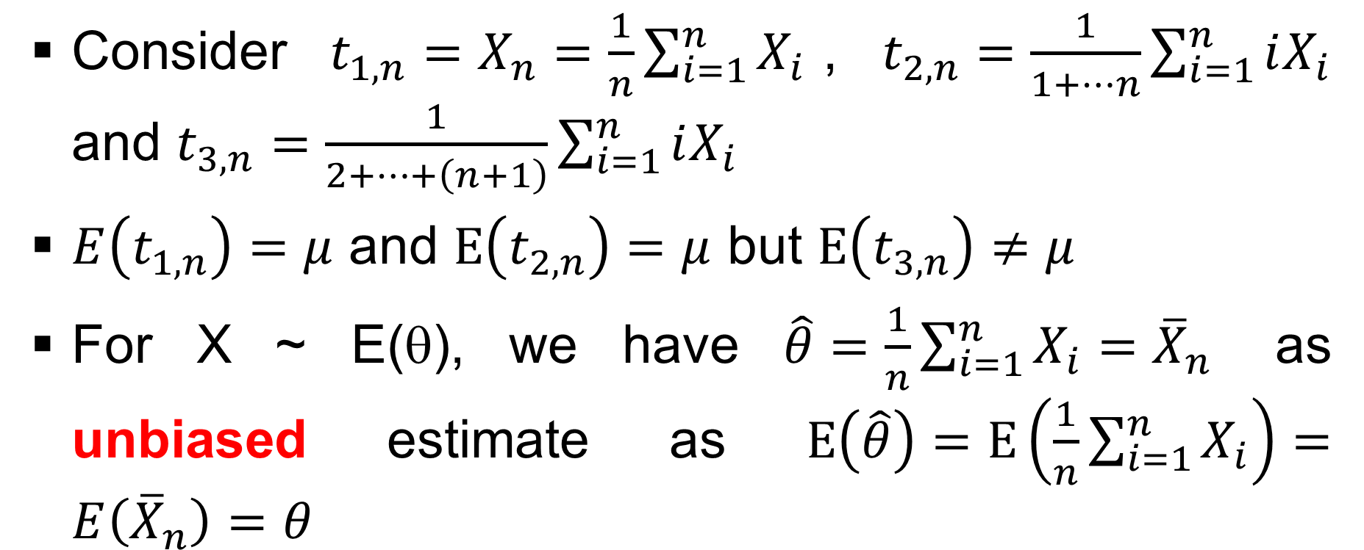
Unbiased Estimates
Consider $t_{1,n}=X_{n}=\frac{1}{n}\sum_{i=1}^{n}{X_{i}}$, $t_{2,n}=\frac{1}{1+⋯n}\sum_{i=1}^{n}{iX_{i}}$ and $t_{3,n}=\frac{1}{2+⋯+\left(n+1\right)}\sum_{i=1}^{n}{iX_{i}}$
$E\left(t_{1,n}\right)=μ$ and $E\left(t_{2,n}\right)=μ$ but $E\left(t_{3,n}\right)≠μ$
For X ~ E(θ), we have $\hat{θ}=\frac{1}{n}\sum_{i=1}^{n}{X_{i}}={\overline{X}}_{n}$ as unbiased estimate as $E\left(\hat{θ}\right)=E\left(\frac{1}{n}\sum_{i=1}^{n}{X_{i}}\right)=E\left({\overline{X}}_{n}\right)=θ$

Slide 17
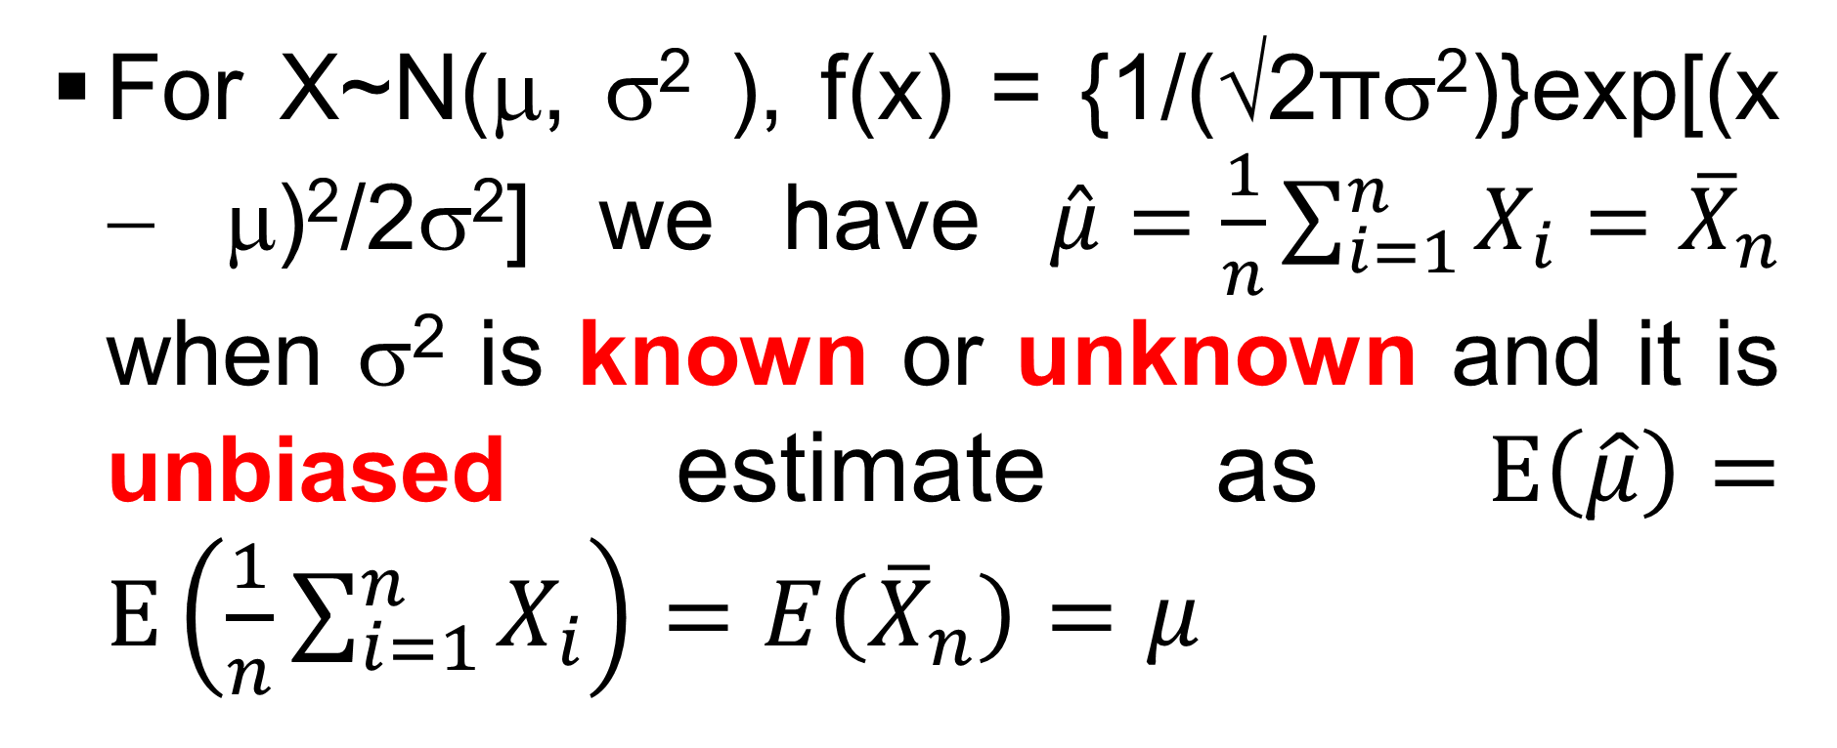
Unbiased Estimates: (contd…)
For X~N(μ, σ² ), f(x) = {1/(√2πσ²)}exp[(x − μ)²/2σ²] we have $\hat{μ}=\frac{1}{n}\sum_{i=1}^{n}{X_{i}}={\overline{X}}_{n}$ when σ² is known or unknown and it is unbiased estimate as $E\left(\hat{μ}\right)=E\left(\frac{1}{n}\sum_{i=1}^{n}{X_{i}}\right)=E\left({\overline{X}}_{n}\right)=μ$

Slide 18
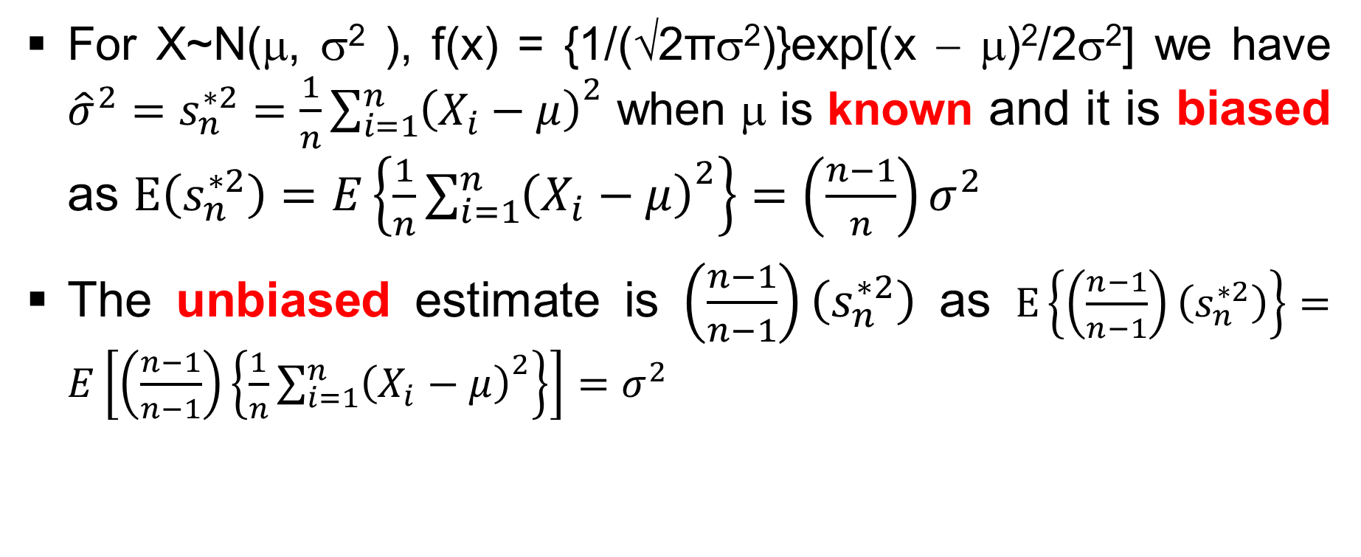
Unbiased Estimates: (contd…)
For X~N(μ, σ² ), f(x) = {1/(√2πσ²)}exp[(x − μ)²/2σ²] we have ${\hat{σ}}^{2}=s_{n}^{∗2}=\frac{1}{n}{\sum_{i=1}^{n}{\left(X_{i}−μ\right)}}^{2}$ when μ is known and it is biased as $E\left(s_{n}^{∗2}\right)=E\left\{\frac{1}{n}{\sum_{i=1}^{n}{\left(X_{i}−μ\right)}}^{2}\right\}=\left(\frac{n−1}{n}\right)σ^{2}$
The unbiased estimate is $\left(\frac{n−1}{n−1}\right)\left(s_{n}^{∗2}\right)$ as $E\left\{\left(\frac{n−1}{n−1}\right)\left(s_{n}^{∗2}\right)\right\}=E\left[\left(\frac{n−1}{n−1}\right)\left\{\frac{1}{n}{\sum_{i=1}^{n}{\left(X_{i}−μ\right)}}^{2}\right\}\right]=σ^{2}$

Slide 19
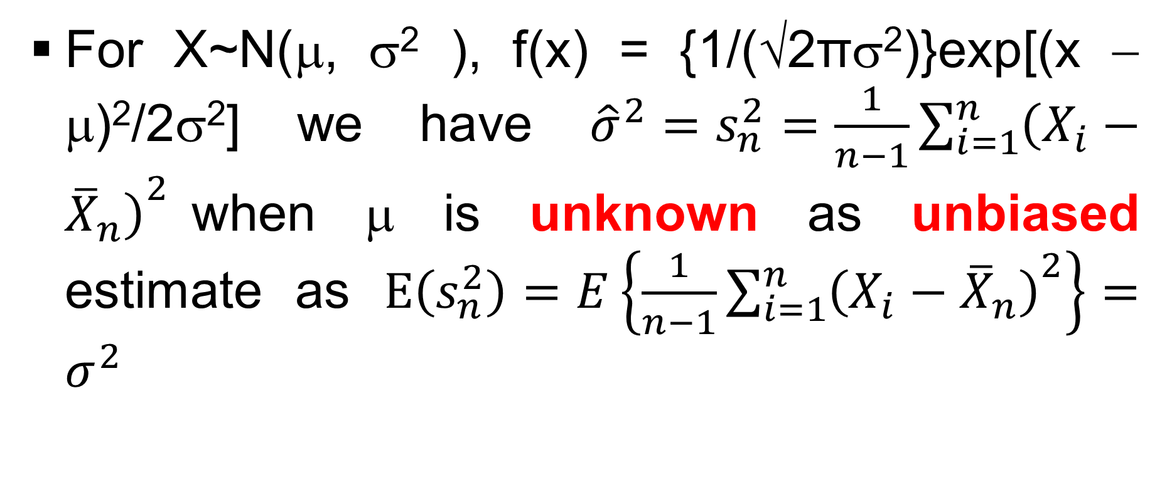
Unbiased Estimates: (contd…)
For X~N(μ, σ² ), f(x) = {1/(√2πσ²)}exp[(x − μ)²/2σ²] we have ${\hat{σ}}^{2}=s_{n}^{2}=\frac{1}{n−1}{\sum_{i=1}^{n}{\left(X_{i}−{\overline{X}}_{n}\right)}}^{2}$when μ is unknown as unbiased estimate as $E\left(s_{n}^{2}\right)=E\left\{\frac{1}{n−1}{\sum_{i=1}^{n}{\left(X_{i}−{\overline{X}}_{n}\right)}}^{2}\right\}=σ^{2}$

Slide 20
Consistency
Suppose

Slide 21
Consistency: (contd…)

Slide 22
Maximum Likelihood Estimation (MLE): (contd…)

Slide 23
Maximum Likelihood Estimation (MLE): (contd…)

Slide 24
Statistical Inference: Interval Estimation (Example for mean with SD/variance known)
The height, X, of boy studying in class II of any school in the city of Bhopal, is normally distributed with mean μ=125 cms and variance σ²=100 cms². We also know the heights (in cms) of 5 such boys who have been selected as the sample are, 120, 100, 110, 140 and 130, then what is the probability that the height of any boy selected at random ((i) from the whole population and (ii) from this sample) will be between 120 cms and 130 cms.

Slide 25
Statistical Inference: Interval Estimation (Example for mean with SD/variance known contd…)
X~N(μ=125,σ²=100)
X_{mean,5}~N(μ=125,σ²/5=20), where n=5, x_{mean,5}=125
Thus from the given information we know that
Pr{a≤X≤b}
i.e., Pr{(a-μ)/σ≤X ≤(b-μ)/σ}=Pr{z₁≤Z≤z₂}
i.e., Pr{120≤X≤130}
i.e., Pr{(120-125)/10≤X ≤(130-125)/10}
i.e., Pr{{-0.5≤Z≤+0.5}=0.3830

Slide 26
Statistical Inference: Interval Estimation (Example for mean with SD/variance known contd…)
X~N(μ=125,σ²=100)
X_{mean,5}~N(μ=125,σ²/5=20), where n=5, x_{mean,5}=125
Thus from the given information we know that
Pr{a≤ X_{mean,5} ≤b}
i.e., Pr{(a-μ)/(σ/√n)≤X_{mean,5}≤(b-μ)/(σ/√n)}=Pr{z₁≤Z≤z₂}
i.e., Pr{120≤X_{mean,5}≤130}
i.e., Pr{(120-125)/(10/√5)≤X_{mean,5}≤(130-125)/(10/√5)}
i.e., Pr{-1.12≤Z≤+1.12}=0.7372

Slide 27
Statistical Inference: Interval Estimation (Example for mean with SD/variance known contd…)
Standard Normal Probabilities
S
z .00 .01 .02 .03 .04 .05 .06 .07 .08 .09
0.0 0.0000 0.0040 0.0080 0.0120 0.0160 0.0199 0.0239 0.0279 0.0319 0.0359
0.1 0.0398 0.0438 0.0478 0.0517 0.0557 0.0596 0.0636 0.0675 0.0714 0.0753
0.2 0.0793 0.0832 0.0871 0.0910 0.0948 0.0987 0.1026 0.1064 0.1103 0.1141
0.3 0.1179 0.1217 0.1255 0.1293 0.1331 0.1368 0.1406 0.1443 0.1480 0.1517
0.4 0.1554 0.1591 0.1628 0.1664 0.1700 0.1736 0.1772 0.1808 0.1844 0.1879
0.5 0.1915 0.1950 0.1985 0.2019 0.2054 0.2088 0.2123 0.2157 0.2190 0.2224
0.6 0.2257 0.2291 0.2324 0.2357 0.2389 0.2422 0.2454 0.2486 0.2517 0.2549
0.7 0.2580 0.2611 0.2642 0.2673 0.2704 0.2734 0.2764 0.2794 0.2823 0.2852
0.8 0.2881 0.2910 0.2939 0.2967 0.2995 0.3023 0.3051 0.3078 0.3106 0.3133
0.9 0.3159 0.3186 0.3212 0.3238 0.3264 0.3289 0.3315 0.3340 0.3365 0.3389
1.0 0.3413 0.3438 0.3461 0.3485 0.3508 0.3531 0.3554 0.3577 0.3599 0.3621
1.1 0.3643 0.3665 0.3686 0.3708 0.3729 0.3749 0.3770 0.3790 0.3810 0.3830
1.2 0.3849 0.3869 0.3888 0.3907 0.3925 0.3944 0.3962 0.3980 0.3997 0.4015
1.3 0.4032 0.4049 0.4066 0.4082 0.4099 0.4115 0.4131 0.4147 0.4162 0.4177
1.4 0.4192 0.4207 0.4222 0.4236 0.4251 0.4265 0.4279 0.4292 0.4306 0.4319
1.5 0.4332 0.4345 0.4357 0.4370 0.4382 0.4394 0.4406 0.4418 0.4429 0.4441
1.6 0.4452 0.4463 0.4474 0.4484 0.4495 0.4505 0.4515 0.4525 0.4535 0.4545
1.7 0.4554 0.4564 0.4573 0.4582 0.4591 0.4599 0.4608 0.4616 0.4625 0.4633
1.8 0.4641 0.4649 0.4656 0.4664 0.4671 0.4678 0.4686 0.4693 0.4699 0.4706
1.9 0.4713 0.4719 0.4726 0.4732 0.4738 0.4744 0.4750 0.4756 0.4761 0.4767
2.0 0.4772 0.4778 0.4783 0.4788 0.4793 0.4798 0.4803 0.4808 0.4812 0.4817
2.1 0.4821 0.4826 0.4830 0.4834 0.4838 0.4842 0.4846 0.4850 0.4854 0.4857
2.2 0.4861 0.4864 0.4868 0.4871 0.4875 0.4878 0.4881 0.4884 0.4887 0.4890
2.3 0.4893 0.4896 0.4898 0.4901 0.4904 0.4906 0.4909 0.4911 0.4913 0.4916
2.4 0.4918 0.4920 0.4922 0.4925 0.4927 0.4929 0.4931 0.4932 0.4934 0.4936
2.5 0.4938 0.4940 0.4941 0.4943 0.4945 0.4946 0.4948 0.4949 0.4951 0.4952
2.6 0.4953 0.4955 0.4956 0.4957 0.4959 0.4960 0.4961 0.4962 0.4963 0.4964
2.7 0.4965 0.4966 0.4967 0.4968 0.4969 0.4970 0.4971 0.4972 0.4973 0.4974
2.8 0.4974 0.4975 0.4976 0.4977 0.4977 0.4978 0.4979 0.4979 0.4980 0.4981
2.9 0.4981 0.4982 0.4982 0.4983 0.4984 0.4984 0.4985 0.4985 0.4986 0.4986
3.0 0.4987 0.4987 0.4987 0.4988 0.4988 0.4989 0.4989 0.4989 0.4990 0.4990
t
a
n
d
a
r
d
N
o
r
m
a
l
D
i
s
t
r
i
b
u
t
i
o
n
0
.
4
0
.
3
)
z
(
0
.
f
2
0
.
1
1.56
{
0
.
0
-
5
-
4
-
3
-
2
-
1
0
1
2
3
4
5
Z
Look in row labeled 1.5 and column labeled .06 to find
P(0 ≤ z ≤ 1.56) = .4406

Slide 28

Statistical Inference: Interval Estimation (for mean)
With σ unknown

Slide 29
Statistical Inference: Interval Estimation (Example for mean with SD/variance unknown)
A food inspector examines 10 jars of certain brand of butter and obtained the following percentages of impurities, the values of which are, 2.3, 1.9, 2.1, 2.8, 2.3, 3.5, 1.8, 1.4, 2.0 and 2.1. Form a 90% level of confidence (loc) for the estimate of the mean of the impurity level, where you can assume the population distribution of the level of impurity as normal, i.e., X~N(μ,σ²)

Slide 30
Statistical Inference: Interval Estimation (Example for mean with SD/variance unknown contd…)
n=10, x_{mean,10}=2.22, s₁₀=0.5789, t_{9,0.05}=1.833
Thus from the given information we know that
Pr{X_{mean,n}-(s_{n}/√n)t_{n-1,α/2}≤μ≤X_{mean,n}+(s_{n}/√n)t_{n-1,α/2}}=(1-α)
Pr{X_{mean,10}-(s₁₀/√10)t_{10-1,α/2}≤μ≤X_{mean,10}+(s₁₀/√10)t_{10-1,α/2}}=(1-α)
Pr{2.22-(0.5789/√10)1.833≤μ≤2.22+(0.5789/√10)1.833}=0.90
LCL=1.8445 and UCL=2.5556

Slide 31
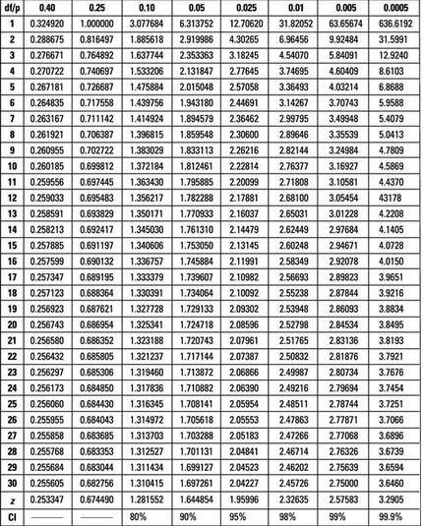
Statistical Inference: Interval Estimation (Example for mean with SD/variance unknown contd…)

Slide 32
Statistical Inference: Interval Estimation (Example for SD/Variance with mean known)
Suppose a sample of 30 school students are given an IQ test. If the sample has a standard error of 12.25 points, find a 90% confidence interval for the population standard deviation. Assume population mean is known

Slide 33
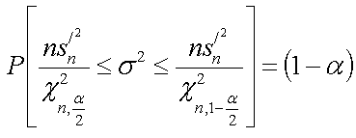
Statistical Inference: Interval Estimation (for SD/Variance)
With μ known

Slide 34
Statistical Inference: Interval Estimation (Example for SD/Variance with mean known)
n=30, s^{*2}_{n}=s^{*2}₃₀=12.25², χ²_{n,1-α/2}= χ²_{30,0.95}=18.493, χ²_{n, α/2}= χ²_{30,0.05}=43.733
Thus from the given information we know that the confidence interval is
(ns^{*2}_{n}/χ²_{n, α/2})≤σ²≤ (ns^{*2}_{n}/χ²_{n, 1-α/2})
i.e., (30*s^{*2}₃₀/χ²_{30, 0.05})≤σ²≤ (30*s^{*2}₃₀/χ²_{30, 0.95})
i.e., (30*12.25²/43.733)≤σ²≤ (30*12.25²/18.493)
i.e., 102.939≤σ²≤243.437
i.e., 10.145≤σ≤15.605

Slide 35
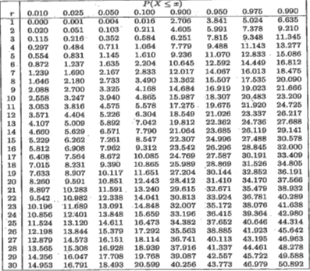
Statistical Inference: Interval Estimation (Example for SD/Variance with mean unknown contd…)

Slide 36
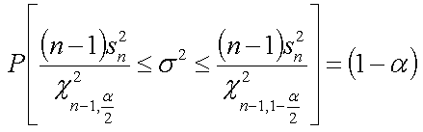
Statistical Inference: Interval Estimation (for SD/Variance)
With μ unknown

Slide 37
Statistical Inference: Interval Estimation (for SD/Variance) (Example)
Suppose a sample of 30 school students are given an IQ test. If the sample has a standard error of 12.23 points, find a 90% confidence interval for the population standard deviation.
Note: As no information is given we implicitly assume the population mean is unknown

Slide 38
Statistical Inference: Interval Estimation (for SD/Variance) (Example contd…``)
n=30, s²_{n}=s²₃₀=12.23², χ²_{n-1,1-α/2}= χ²_{29,0.95}=17.708, χ²_{n-1,α/2}= χ²_{29,0.05}=42.557
Thus from the given information we know that the confidence interval is
{(n-1)s²_{n}/χ²_{n-1, α/2}}≤σ²≤ {(n-1)s²_{n}/χ²_{n-1, 1-α/2}}
i.e., {(30-1)×s²₃₀/χ²_{30-1,0.05}}≤σ²≤{(30-1)×s^{*2}₃₀/χ²_{30-1,0.95}}
i.e., (29×12.23²/42.557)≤σ²≤(29×12.23²/17.708)
i.e., 101.893≤σ²≤244.952
i.e., 10.096≤σ≤15.651

Slide 39
Statistical Inference: Interval Estimation (Example for SD/Variance with mean unknown contd…)

Slide 40
Statistical Inference: Interval Estimation
Confidence interval (CI) can be formulated for
Difference of μ₁ and μ₂, provided σ₁ and σ₂ are known
Difference of μ₁ and μ₂, provided σ₁ and σ₂ are unknown, but equal
Difference of μ₁ and μ₂, provided σ₁ and σ₂ are unknown, but unequal

Slide 41
Statistical Inference: Interval Estimation
Confidence interval (CI) can be formulated for
Ratio of (σ²₁ /σ²₂) provided μ₁ and μ₂, are known
Ratio of (σ²₁ /σ²₂) provided μ₁ and μ₂, are unknown

Slide 42
Statistical Inference: Interval Estimation (Example considering other distribution)
Hemanta Medhi is measuring the surface finish of crank shaft his production unit is manufacturing. Depending on the quality of surface finish, the crank shafts can be either good or bad. Hemanta checks a sample of size 85 and finds 10 of them to be bad. Help Hemanta to formulate a 95% confidence interval and find for him the lower and upper limits of the confidence interval

Slide 43
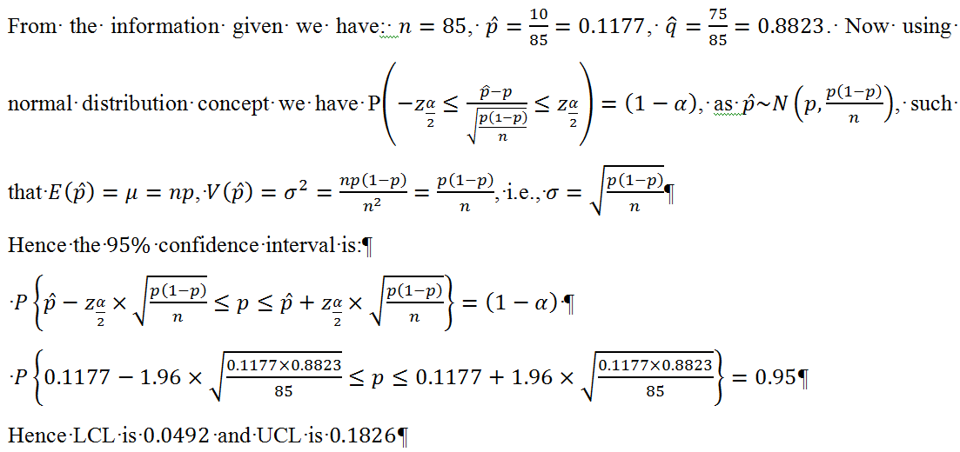
Statistical Inference: Interval Estimation (Example considering other distribution)

