Slide 1

IME602: PROBABILITY AND STATISTICS:REGRESSION ANALYSIS
Raghu Nandan SENGUPTA
Department of Management Sciences (DoMS)
Indian Institute of Technology Kanpur, INDIA

Slide 2
Multiple Linear Regression (MLR)
Multiple linear regression (MLR) is a statistical technique which is used to forecast or predict a dependent variable Y based on independent variable X
In order that our prediction or forecasting is accurate we ensure through proper assumptions and subsequent calculations, that the error of prediction or forecasting is minimized

Slide 3
Multiple Linear Regression (MLR) (contd..)
A model (or theory) is not confirmed unless it is made to include every possibility
One should remember that a deterministic theory will be invalidated by a single contradictory observation
The introduction of stochastic elements into the model changes it from an exact statement to a probabilistic description about expected outcomes and carries with it an important implication

Slide 4
Multiple Linear Regression (MLR) (contd..)
Only a preponderance of contradictory evidence can convincingly invalidate the probabilistic model
What constitutes a preponderance of contradictory evidence is a matter of interpretation
Probabilistic model is less precise but at the same time, more robust

Slide 5
Multiple Linear Regression (MLR) (contd..)
Few relevant examples
What are the likely effects on labor supply behavior of proposed negative income taxes
Does a monetary policy regime that is strongly oriented toward controlling inflation impose a real cost
Does attending a good college bring an expected payoff in lifetime expected income sufficient to justify the higher tuition

Slide 6
Multiple Linear Regression (MLR) (contd..)
Few relevant examples (contd..)
Does a voluntary training program produce tangible benefits? Can these benefits be accurately measured?
Do smaller class sizes bring real benefits in student performance?
Does the humidity predict higher temperature?
Does obesity lead to health problems?

Slide 7
Multiple Linear Regression (MLR) (contd..)
Assumptions (Linearity)
Linear relationship between independent (Y_{nX1}: column vector) and dependent (X_{nXk}: matrix) variables

Slide 8
Multiple Linear Regression (MLR) (contd..)
Assumptions (Full rank)
In general we mean that all the different independent variables are themselves independent, i.e., in the matrix notion (for multiple linear regression) the rows and/or columns are independent

Slide 9
Multiple Linear Regression (MLR) (contd..)
Assumptions (Exogeneity of the independent variables)
The expected value of the disturbance at any observation in the sample is not a function of the independent variables observed at any other observation, including this one.
Thus the independent variables will not carry useful information for prediction of error term

Slide 10
Multiple Linear Regression (MLR) (contd..)
Assumptions (Homoscedasticity and nonautocorrelation)
Each disturbance/error has the same finite variance, and is uncorrelated with every other disturbance/error.
Of course this assumption limits the generality of the model, and we will want to examine how to relax it later.

Slide 11
Multiple Linear Regression (MLR) (contd..)
Assumptions (Data generation)
The data in may be any mixture of constants and random variables. The crucial elements for present purposes are the strict mean independence assumption # 3 and the implicit variance independence assumption in # 4.
Analysis will be done conditionally on the observed independent variable, so whether the elements in the independent variables are fixed constants or random draws from a stochastic process will not influence the results.

Slide 12
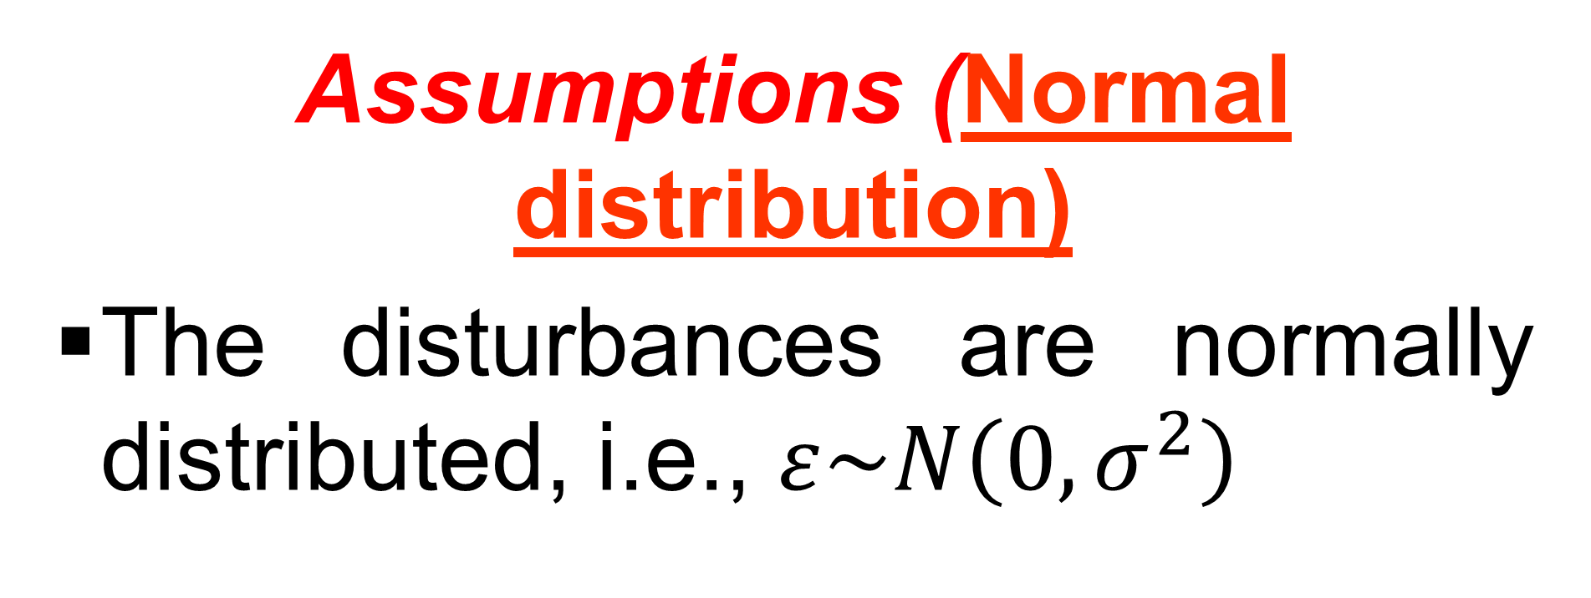
Multiple Linear Regression (MLR) (contd..)

Slide 13
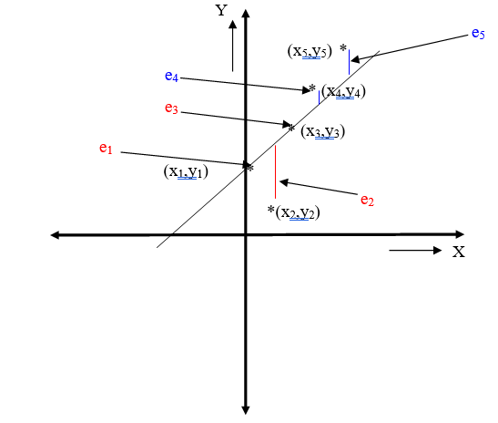
Simple Linear Regression

Slide 14
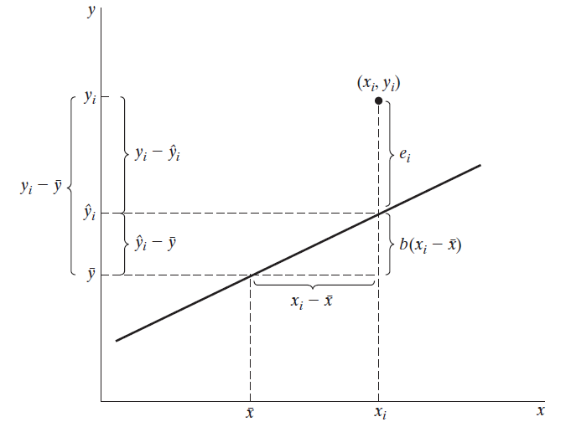
Simple Linear Regression
(Ref: Econometric Analysis by W.H.Green)

Slide 15
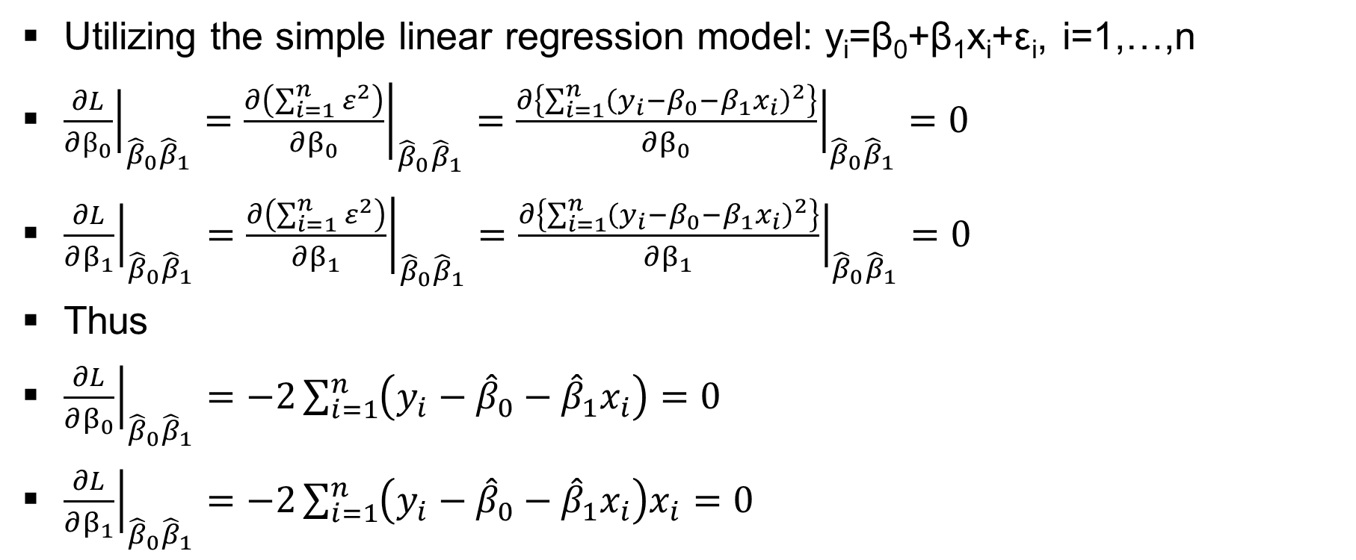
Simple Linear Regression

Slide 16
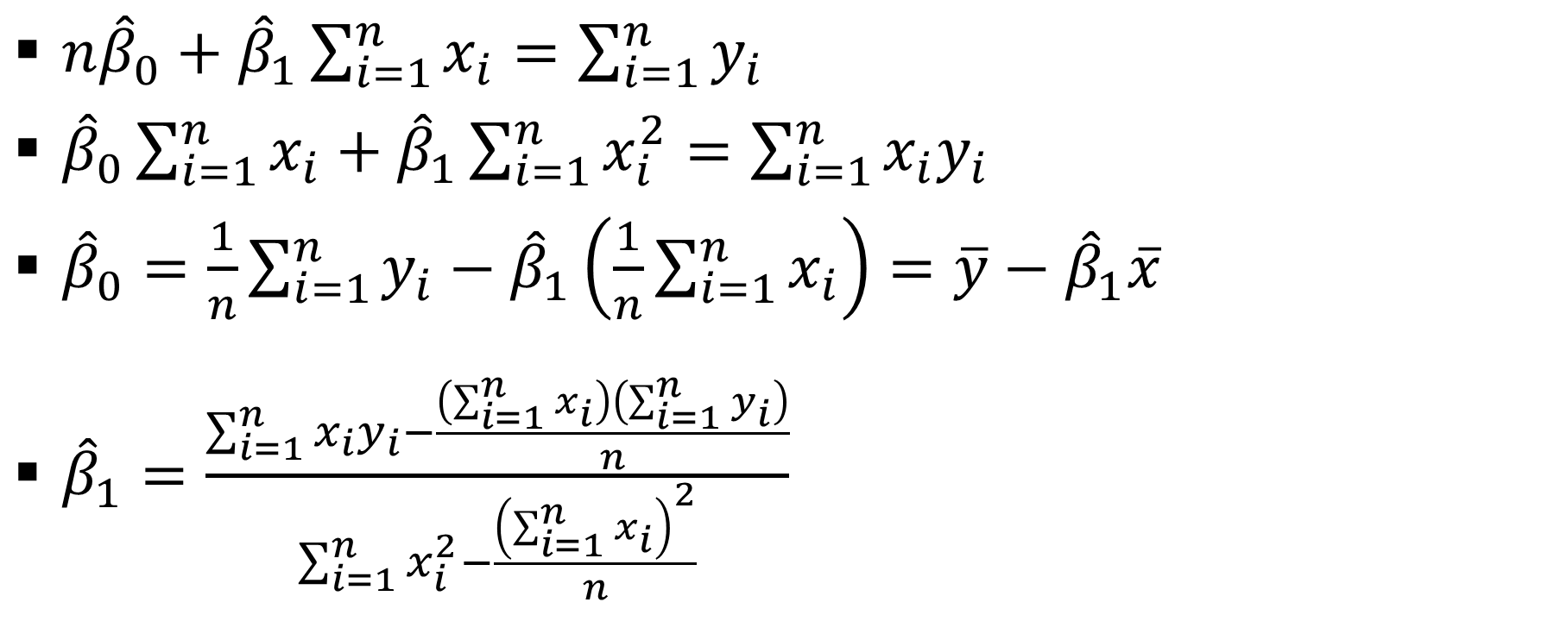
Simple Linear Regression

Slide 17
Simple Linear Regression
Example # 19
Consider the example below where the we have 20 data points regarding Hydro-carbon % (x) versus Purity of Oxygen % (y)
Purity of Oxygen % | 90.10 | 89.05 | 91.43 | 93.74 | 96.73 | 94.45 | 87.59 | 91.77 | 99.42 | 93.65
Hydro-carbon % | 0.99 | 1.02 | 1.15 | 1.29 | 1.46 | 1.36 | 0.87 | 1.23 | 1.55 | 1.40
Purity of Oxygen % | 93.54 | 92.52 | 90.56 | 89.54 | 89.85 | 90.39 | 93.25 | 93.41 | 94.98 | 87.33
Hydro-carbon % | 1.19 | 1.15 | 0.98 | 1.01 | 1.11 | 1.20 | 1.26 | 1.32 | 1.43 | 0.95

Slide 18
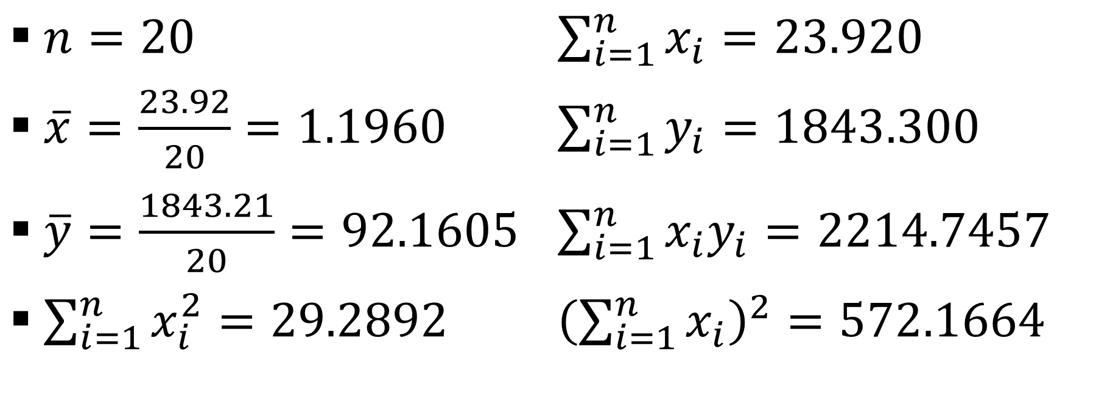
Simple Linear Regression
Example # 19 (contd…)

Slide 19
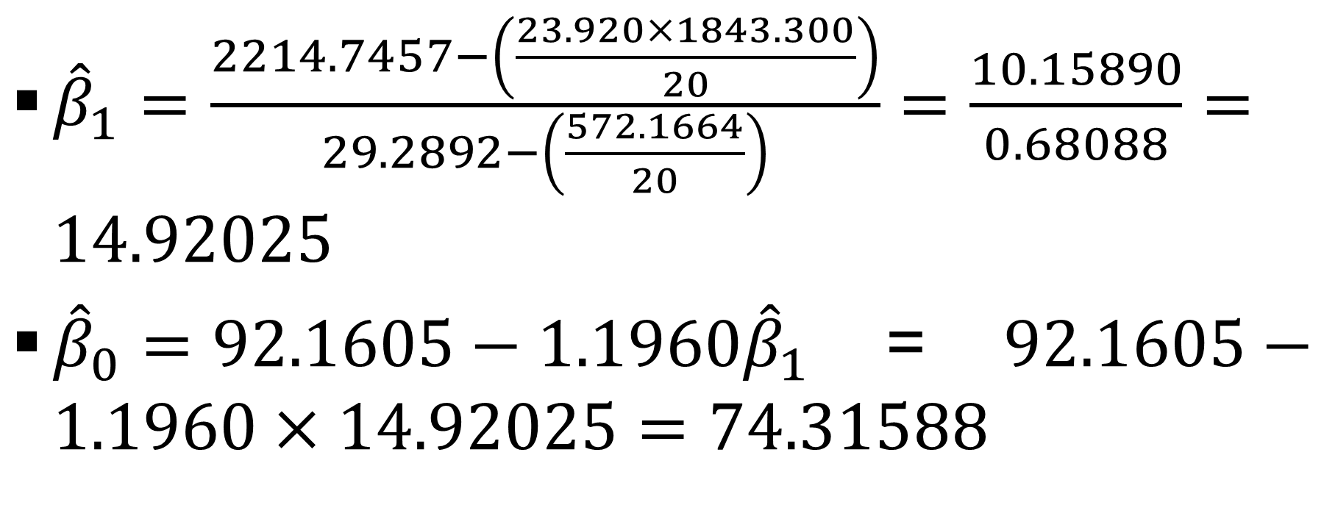
Simple Linear Regression
Example # 19 (contd…)

Slide 20
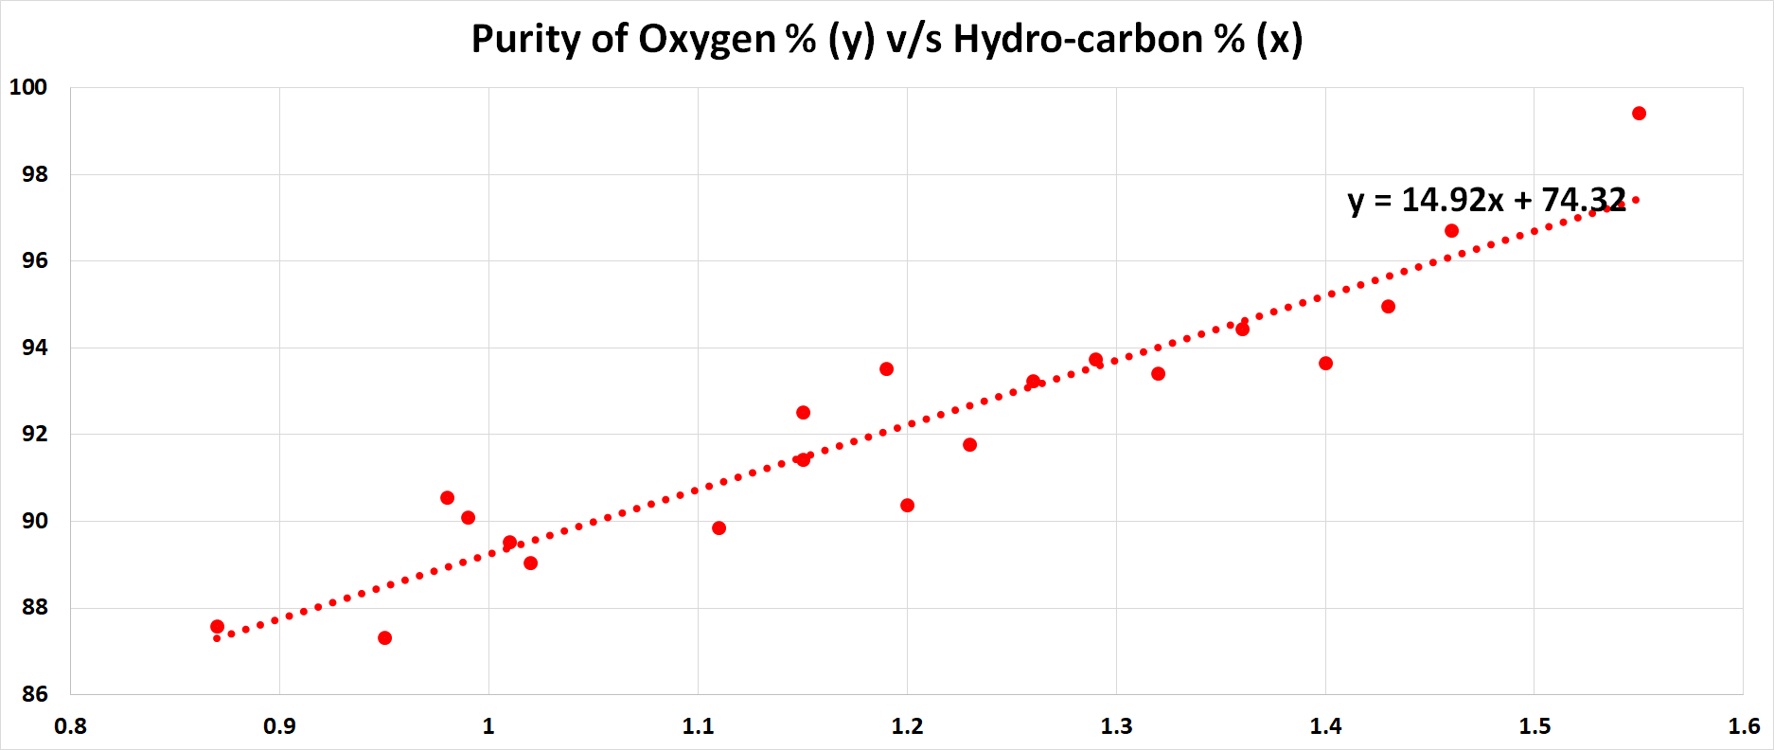
Simple Linear Regression
Example # 19 (contd…)

Slide 21
Simple Linear Regression

Slide 22
Simple Linear Regression

Slide 23
Simple Linear Regression
Example # 20
Consider the example below where the mass, y (grams), of a chemical is related to the time, x (seconds), for which the chemical reaction has been taking place according to the table:
Time, x (seconds) | Mass, y (grams)
7 | 44
9 | 124
14 | 184
18 | 214
22 | 244

Slide 24
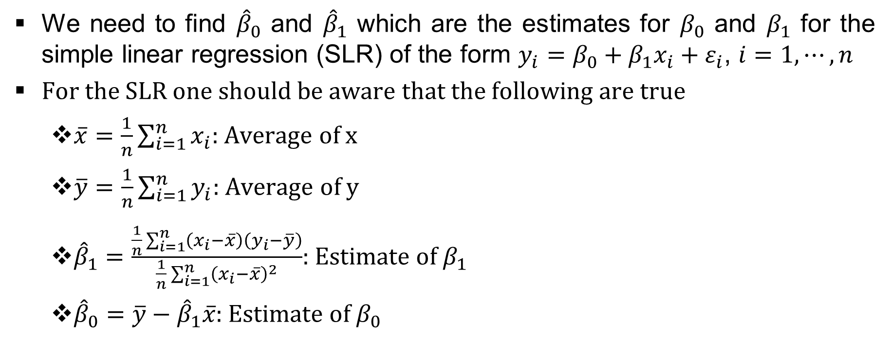
Simple Linear Regression (contd..)
Example # 20 (contd..)

Slide 25
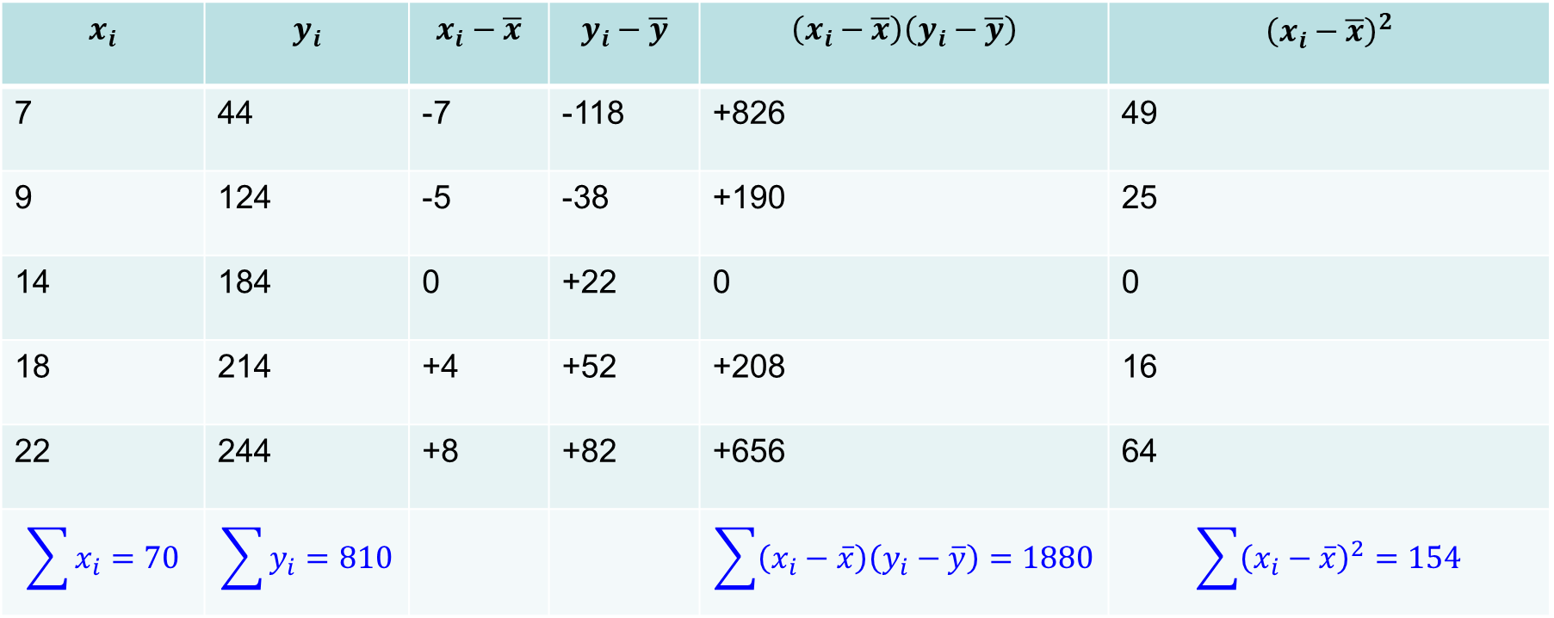
Simple Linear Regression (contd..)
Example # 20 (contd..)
7 | 44 | -7 | -118 | +826 | 49
9 | 124 | -5 | -38 | +190 | 25
14 | 184 | 0 | +22 | 0 | 0
18 | 214 | +4 | +52 | +208 | 16
22 | 244 | +8 | +82 | +656 | 64

Slide 26
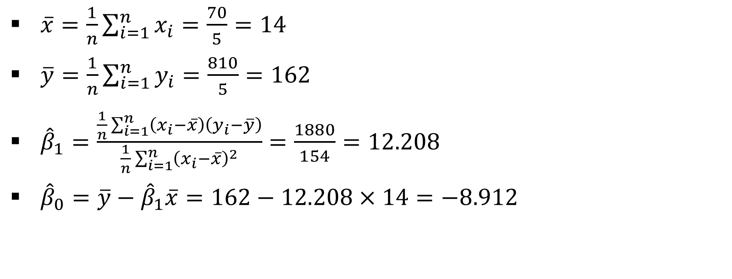
Simple Linear Regression (contd..)
Example # 20 (contd..)

Slide 27
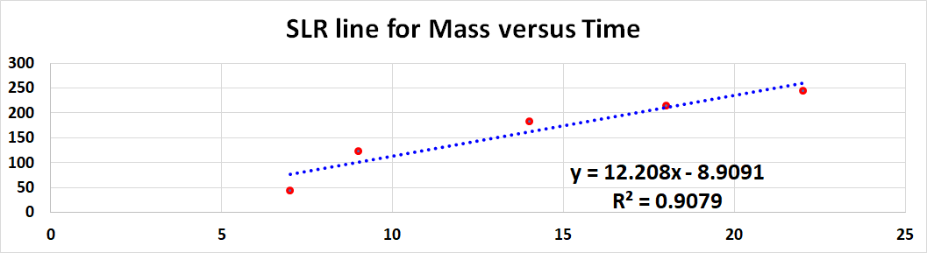
Simple Linear Regression (contd..)
Example # 20 (contd..)

Slide 28
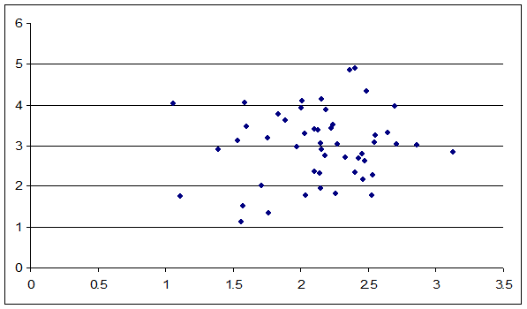
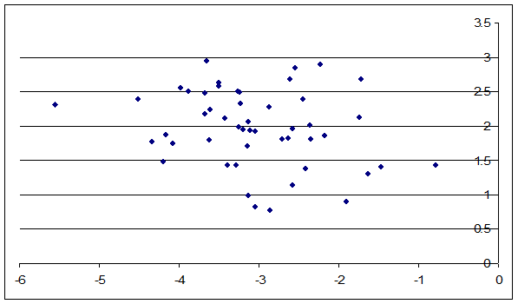
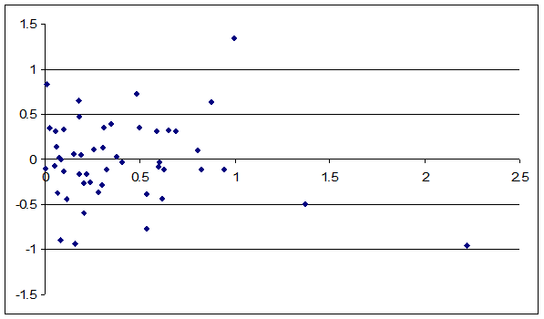
Simple Linear Regression (contd..)
Positive, Negative and Zero Correlation

Slide 29
Simple Linear Regression

Slide 30
Simple Linear Regression

Slide 31
Simple Linear Regression
Example # 21
Suppose two regression lines are given by (i) x-3y+6=0 and (ii) y-4x+12=0
  Which one of these is the regression line of y on x and x on y
  Find mean of x
  Find mean of y
  Find r
  Given s_{x}=3 find s_{y}

Slide 32
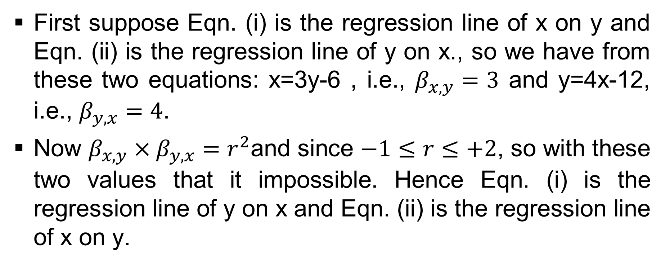
Simple Linear Regression (contd..)
Example # 21 (contd..)

Slide 33
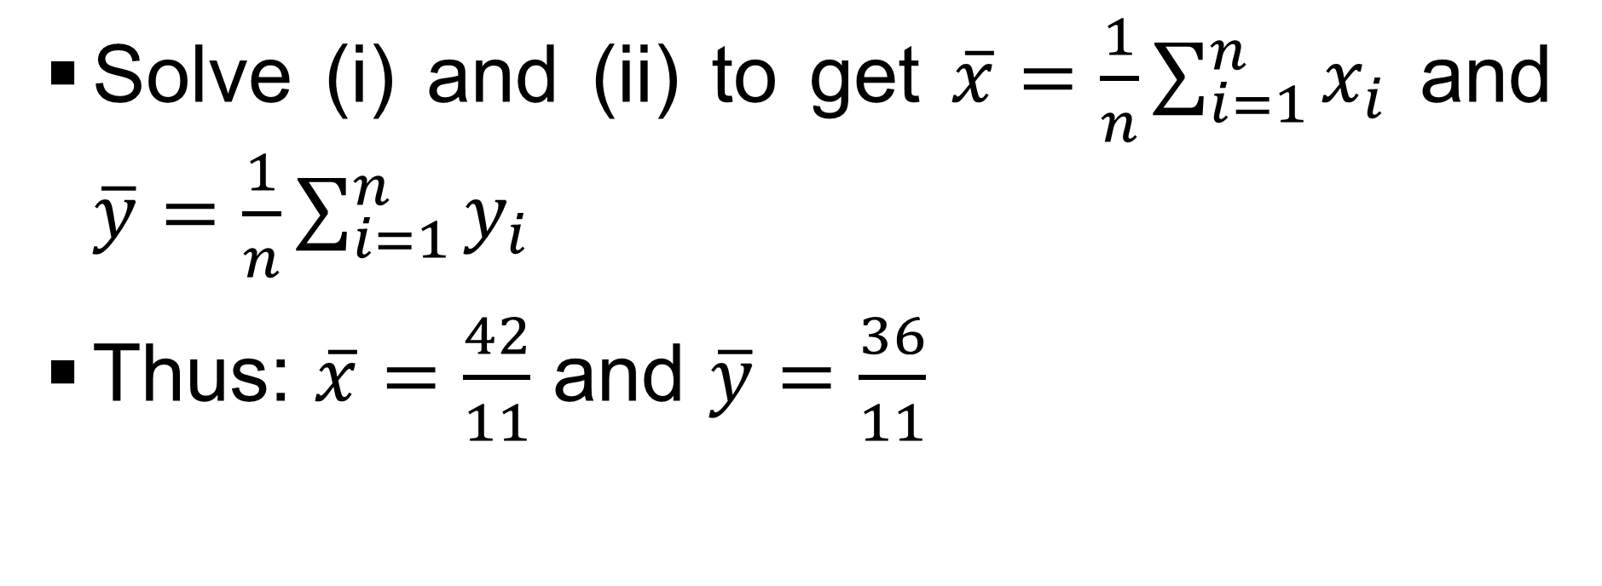
Simple Linear Regression (contd..)
Example # 21 (contd..)

Slide 34
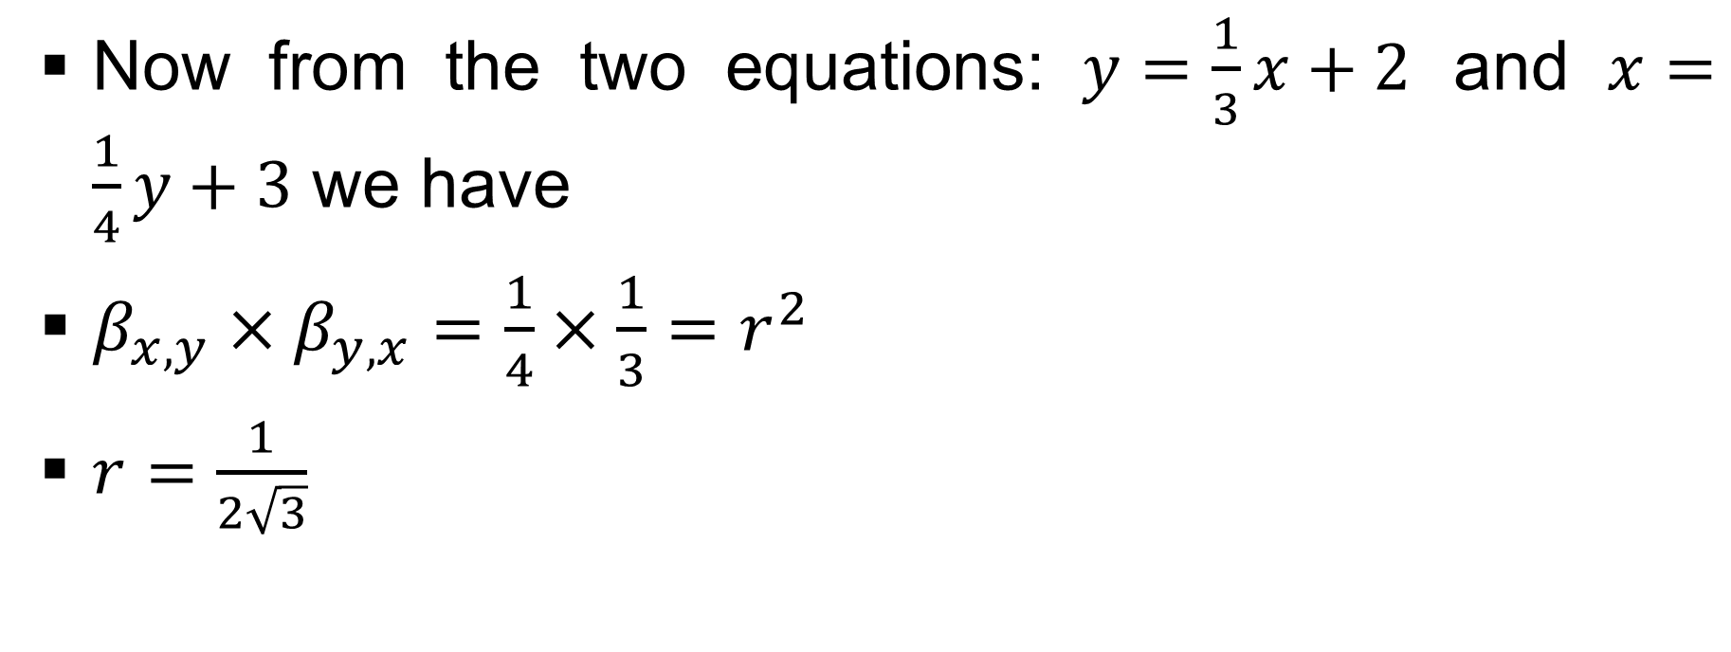
Simple Linear Regression (contd..)
Example # 21 (contd..)

Slide 35
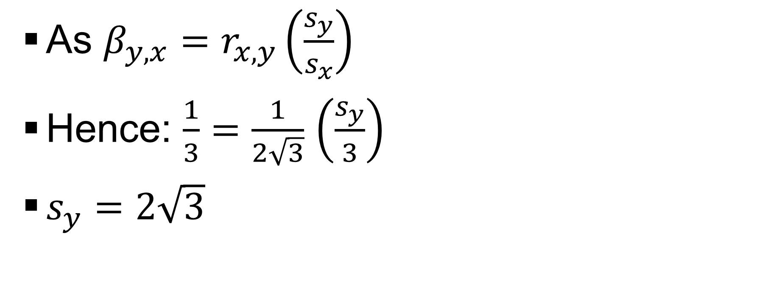
Simple Linear Regression (contd..)
Example # 21 (contd..)

Slide 36
Simple Linear Regression

Slide 37
Simple Linear Regression

Slide 38
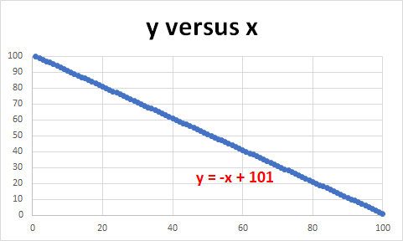
Simple Linear Regression (contd..)
Example # 22
Consider 100 pairs of observations as (100,1),…., (1,100), then what is the correlation coefficient between x and y
It is -1 and the SLR is y_{i} = -x_{i} + 101

Slide 39
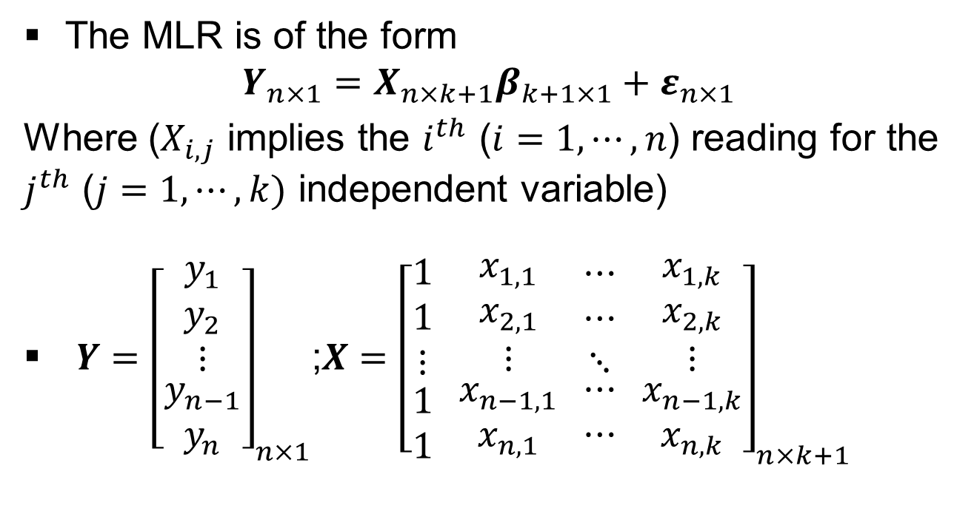
Multiple Linear Regression (MLR) (contd..)

Slide 40
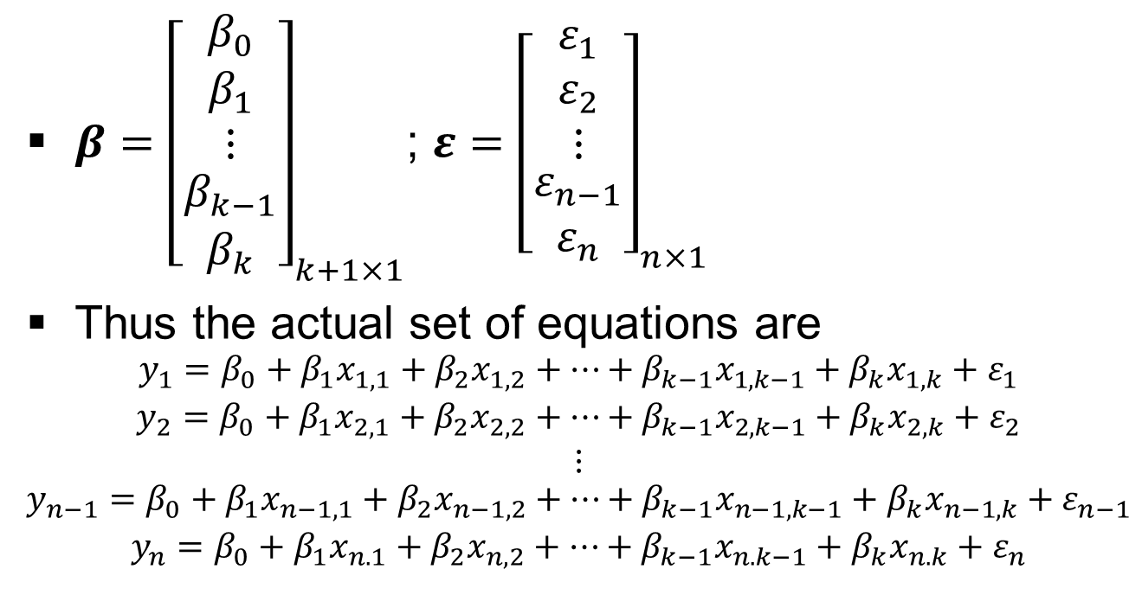
Multiple Linear Regression (MLR) (contd..)

Slide 41
Multiple Linear Regression (MLR) (contd..)
y is a n X 1 vector of observations of dependent variables
X is a n X (k+1) matrix of observations of independent variables, where the first column is 1 signifying the constant

Slide 42
Multiple Linear Regression (MLR) (contd..)
β is a (k+1) X 1 vector of regression coefficients with β₀ signifying the constant
ε is a n X 1 vector of error terms
Note
  (k+1) denotes the number of independent variable including constant, with j=1,2,…,k,k+1
  n is the number of observations, with i=1,2,…,n-1,n

Slide 43
Multiple Linear Regression (MLR)
Linearity (Assumption 1)
Remember the regression equation has to be linear either in the original variables of after some suitable transformation
The equation y = Ax^{β}e^{ε} is not linear but after taking log on both sides can be considered as linear equation, e.g., log_{e}y = log_{e}A + βlog_{e}x + εlog_{e}e

Slide 44
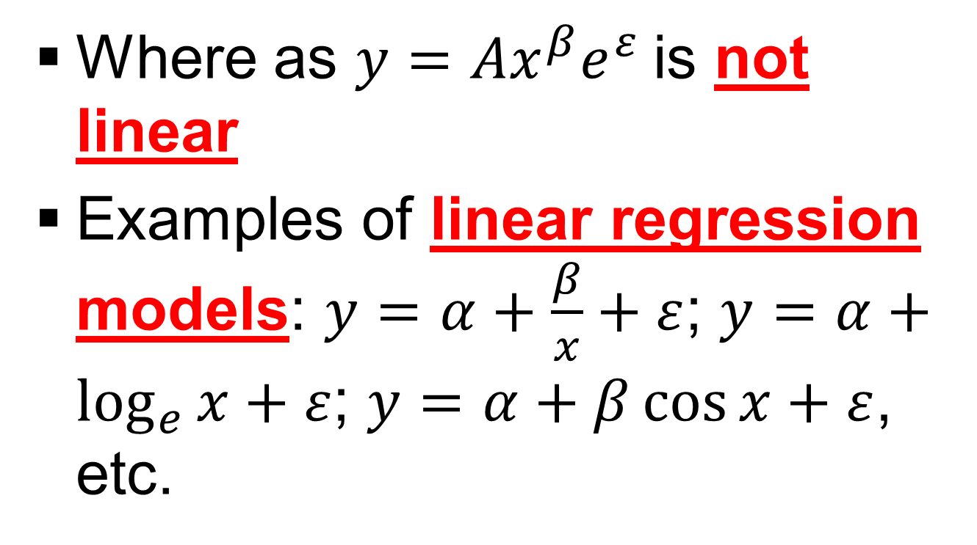
Multiple Linear Regression (MLR)
Linearity (Assumption 1) (contd..)

Slide 45
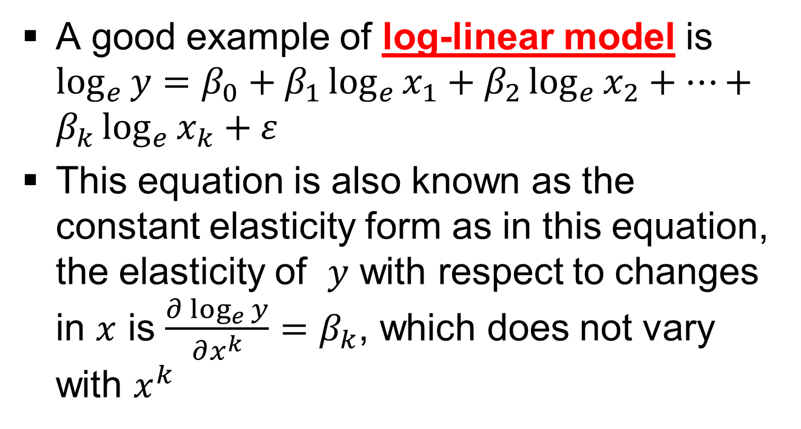
Multiple Linear Regression (MLR)
Linearity (Assumption 1) (contd..)

Slide 46
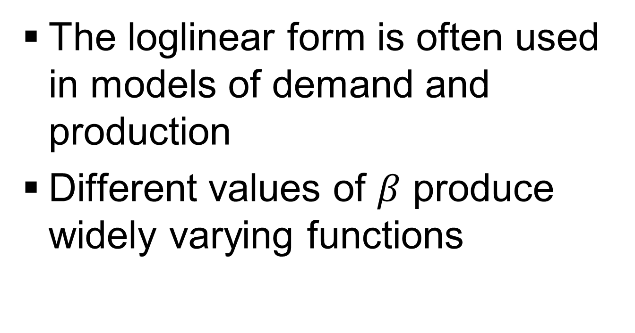
Multiple Linear Regression (MLR)
Linearity (Assumption 1) (contd..)

Slide 47
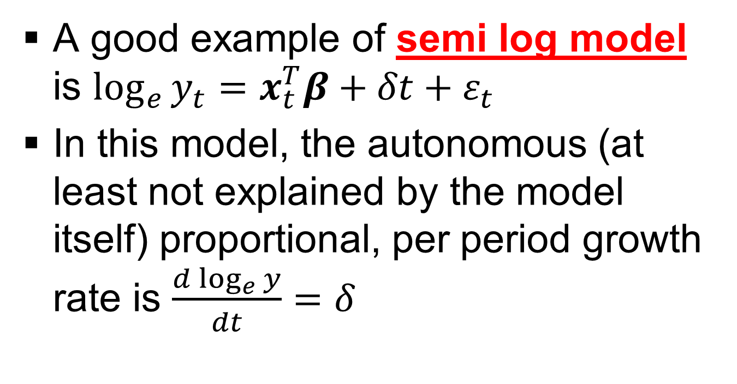
Multiple Linear Regression (MLR)
Linearity (Assumption 1) (contd..)

Slide 48
Multiple Linear Regression (MLR)
Linearity (Assumption 1) (contd..)
Modern studies of demand and production are usually done with a flexible functional form
Flexible functional forms are used in econometrics because they allow analysts to model second-order effects such as elasticities of substitution, which are functions of the second derivatives of production, cost, or utility functions
Modern studies of demand and production are usually done with a flexible functional form which are used in econometrics because they allow analysts to model second-order effects such as elasticities of substitution, which are functions of the second derivatives of production, cost, or utility functions

Slide 49
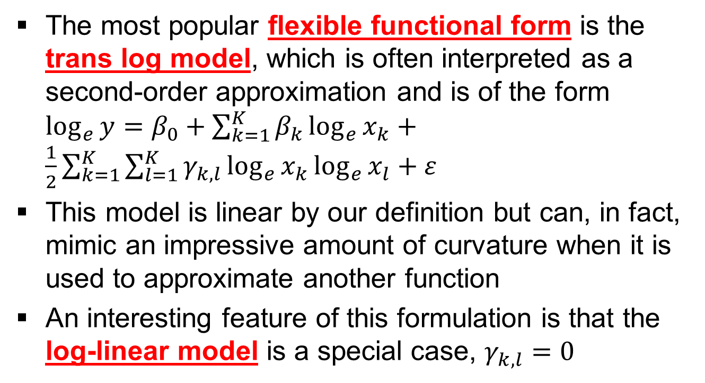
Multiple Linear Regression (MLR)
Linearity (Assumption 1) (contd..)

Slide 50
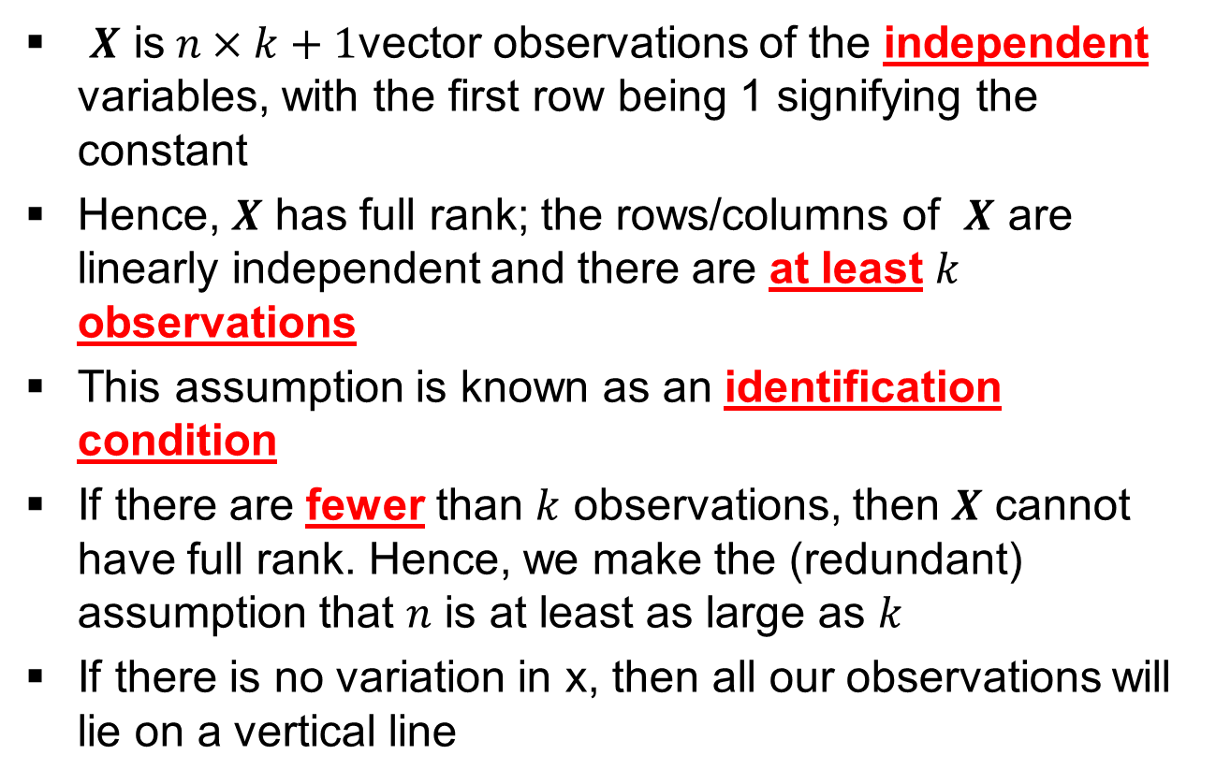
Multiple Linear Regression (MLR)
Full Rank (Assumption 2)

Slide 51
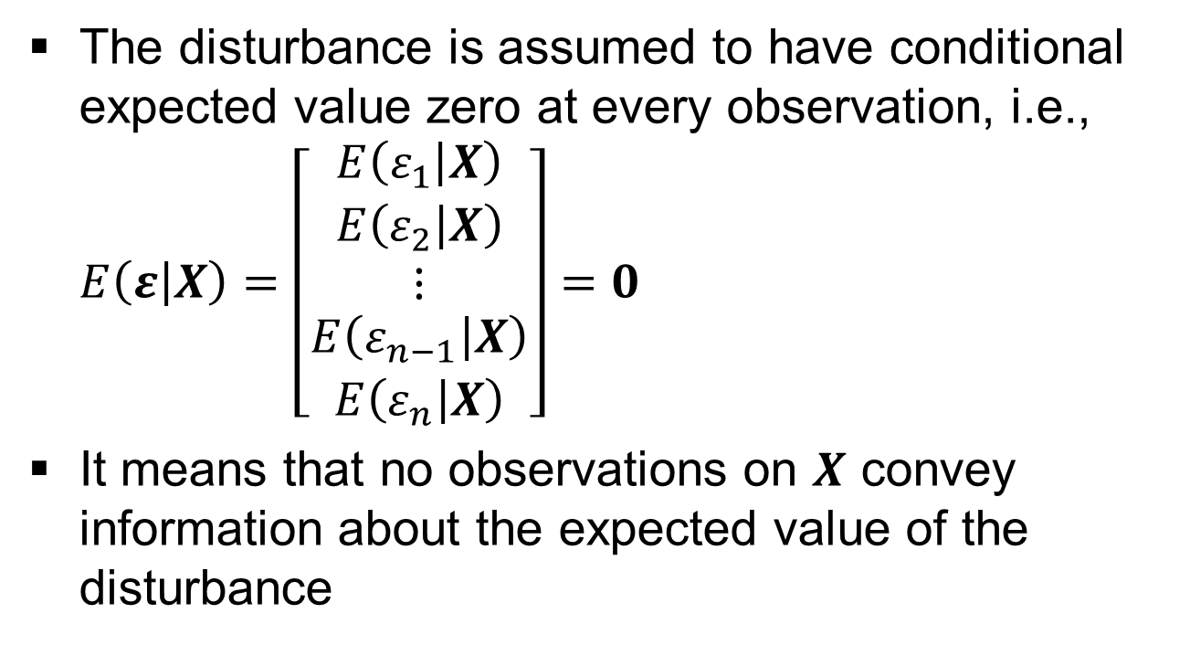
Multiple Linear Regression (MLR)
Exogeneity of the independent variables (Assumption 3)

Slide 52
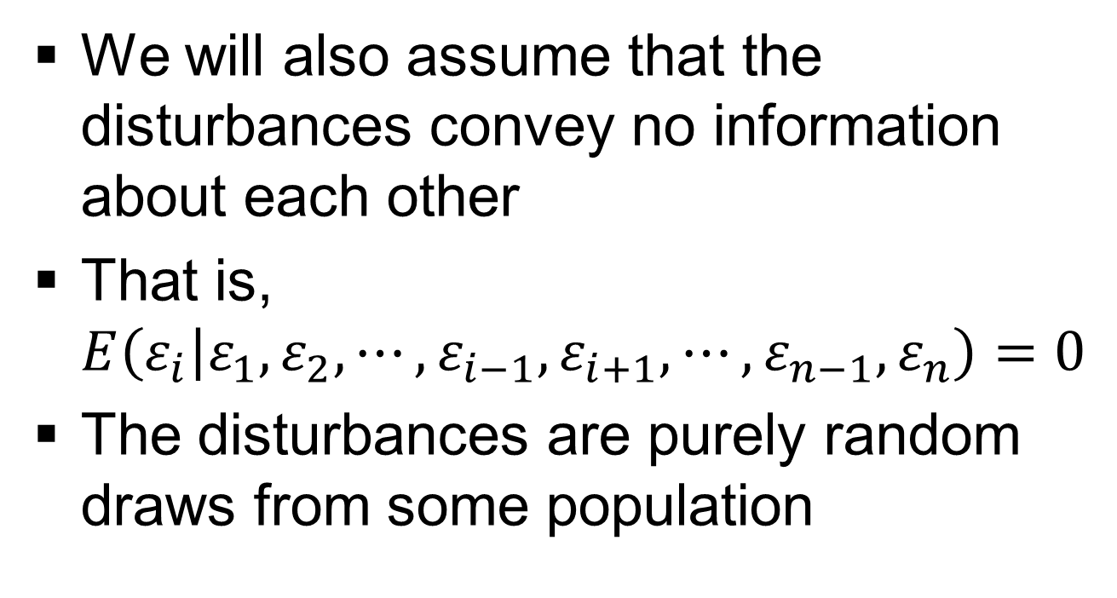
Multiple Linear Regression (MLR)
Exogeneity of the independent variables (Assumption 3) (contd..)

Slide 53
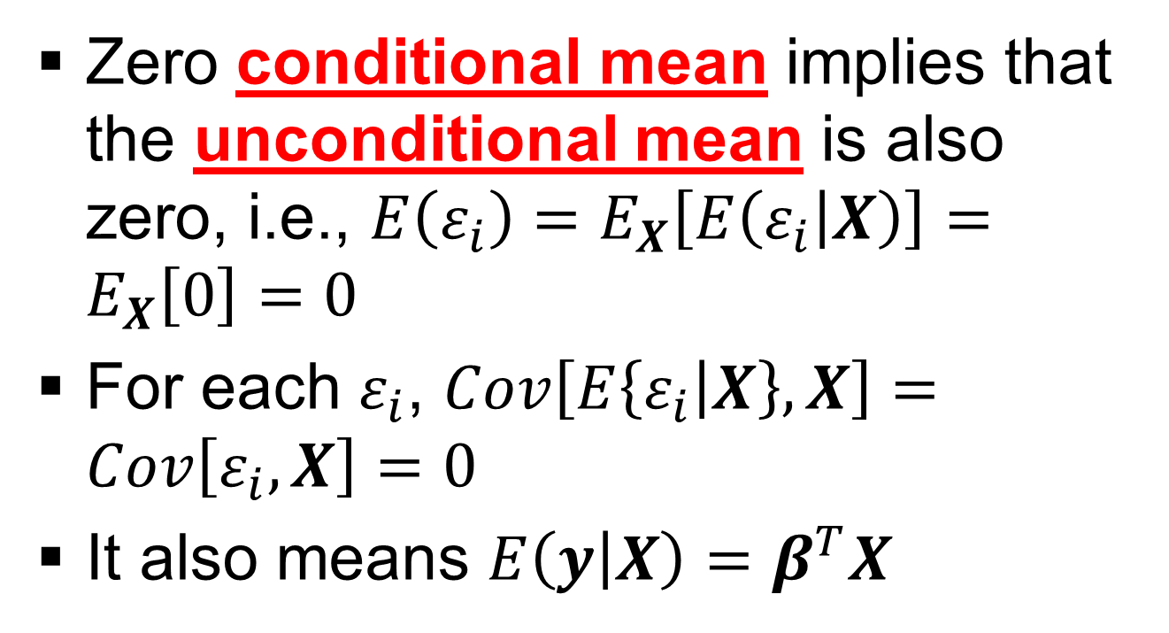
Multiple Linear Regression (MLR)
Exogeneity of the independent variables (Assumption 3) (contd..)

Slide 54
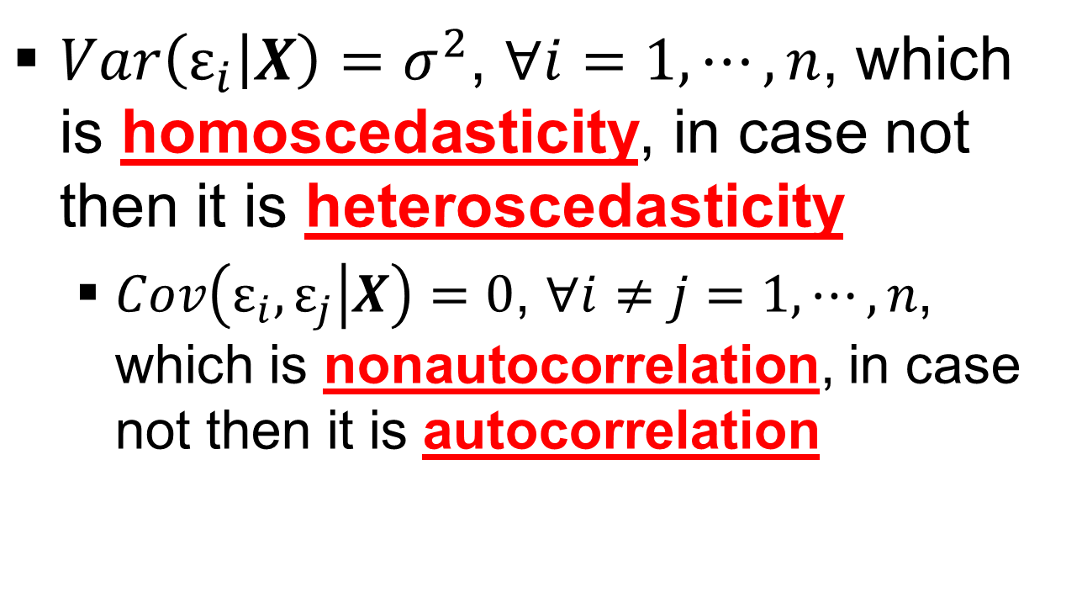
Multiple Linear Regression (MLR)
Homoscedasticity and nonautocorrelation (Assumption 4)

Slide 55
Multiple Linear Regression (MLR)
Homoscedasticity and Heteroscedasticity (Assumption 4)
A sequence of random variables is homoscedastic (homogeneity of variance) if all its random variables have the same finite variance
A sequence of random variables is heteroscedastic (non-homogeneity of variance) if its random variables have different finite variance

Slide 56
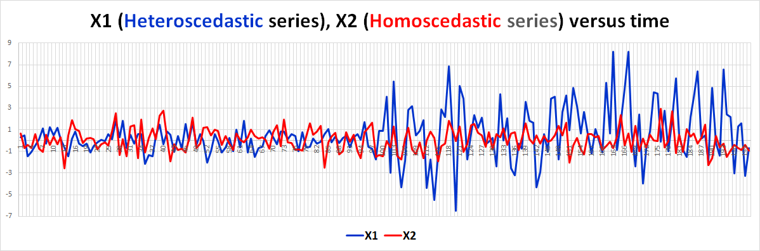
Multiple Linear Regression (MLR)
Homoscedasticity and Heteroscedasticity (Assumption 4)

Slide 57
Multiple Linear Regression (MLR)
Non-autocorrelation and Autocorrelation (Assumption 4)
A sequence of discrete time series is autocorrelated if there is correlation of a random value with its past value
A sequence of discrete time series is non-autocorrelated if there is no correlation of a random value with its past value

Slide 58
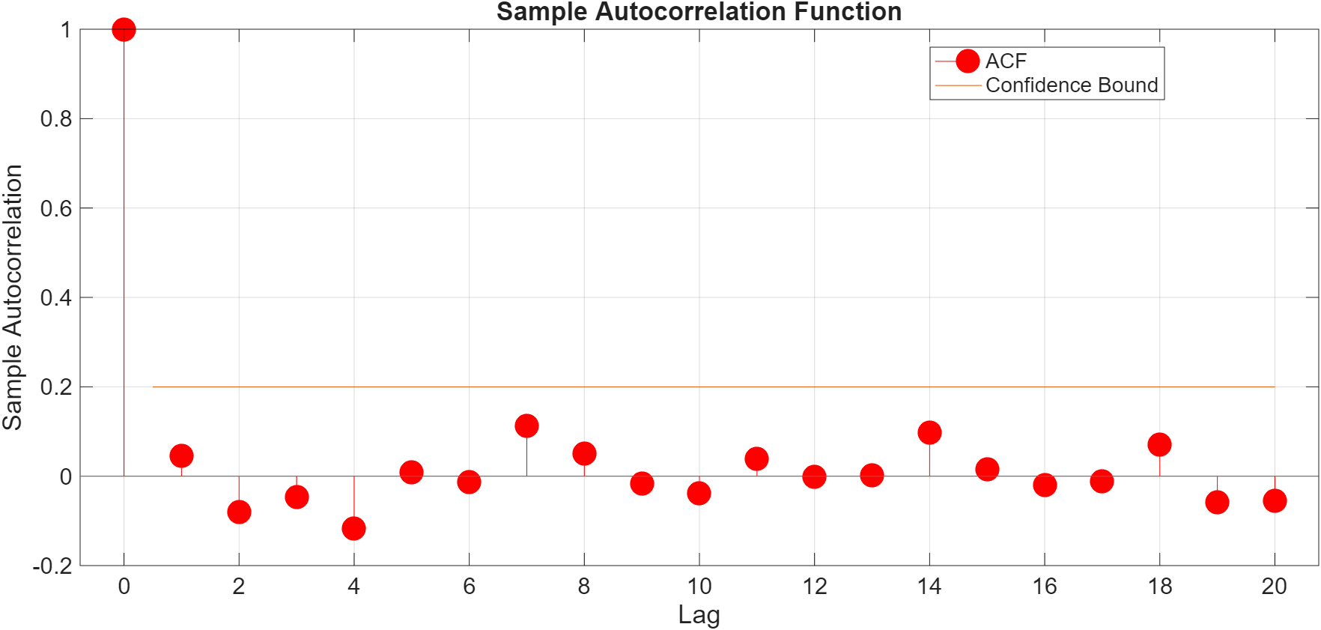
Multiple Linear Regression (MLR)
Non-autocorrelation (Assumption 4)

Slide 59
Multiple Linear Regression (MLR)
Autocorrelation (Assumption 4)

Slide 60
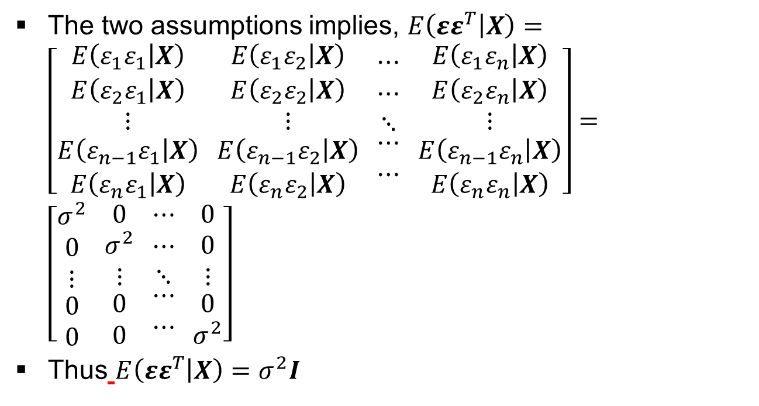
Multiple Linear Regression (MLR)
Homoscedasticity and nonautocorrelation (Assumption 4) (contd..)

Slide 61
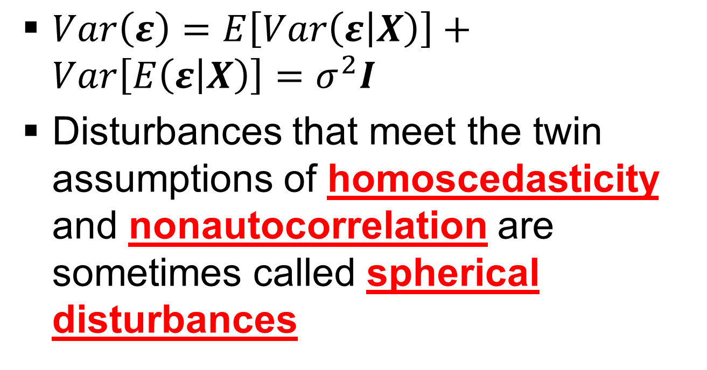
Multiple Linear Regression (MLR)
Homoscedasticity and nonautocorrelation (Assumption 4) (contd..)

Slide 62
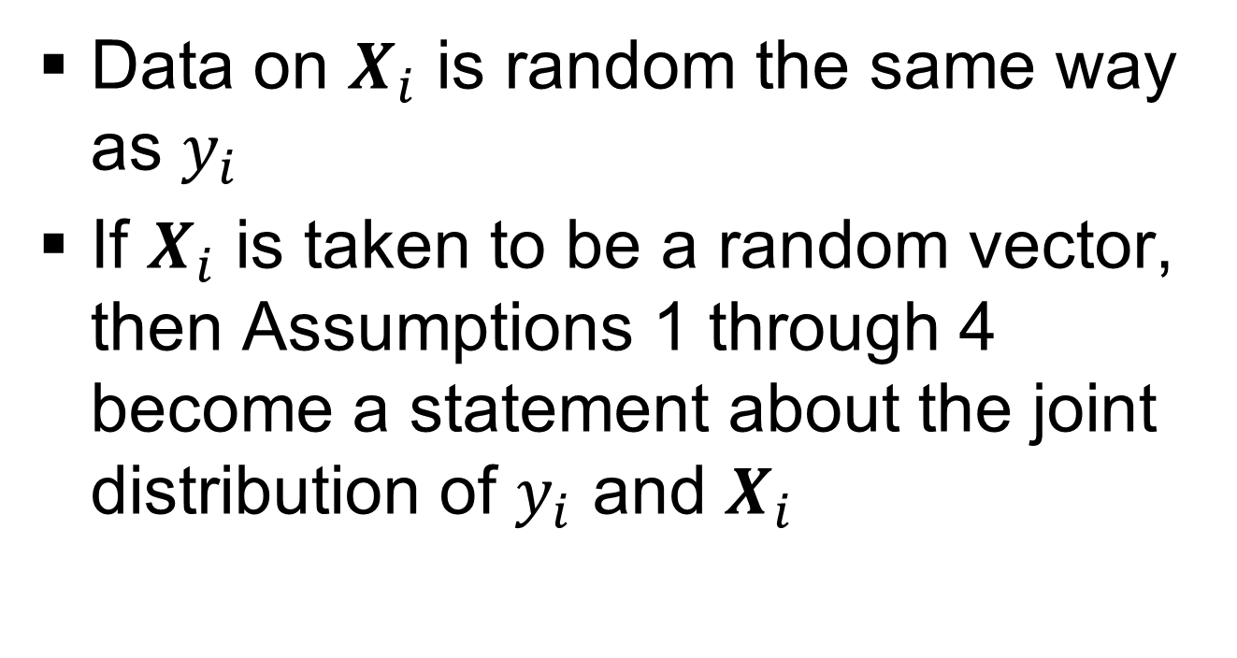
Multiple Linear Regression (MLR)
Data generation (Assumption 5)

Slide 63
Multiple Linear Regression (MLR)
Data generation (Assumption 5) (contd..)
The crucial assumption is Assumption 3, the uncorrelatedness of X and ε
We will assume that X can be a mixture of constant and random variable and the mean and variance of ε_{i}, i=1,2,…,n-1,n, both are independent of all elements of X

Slide 64
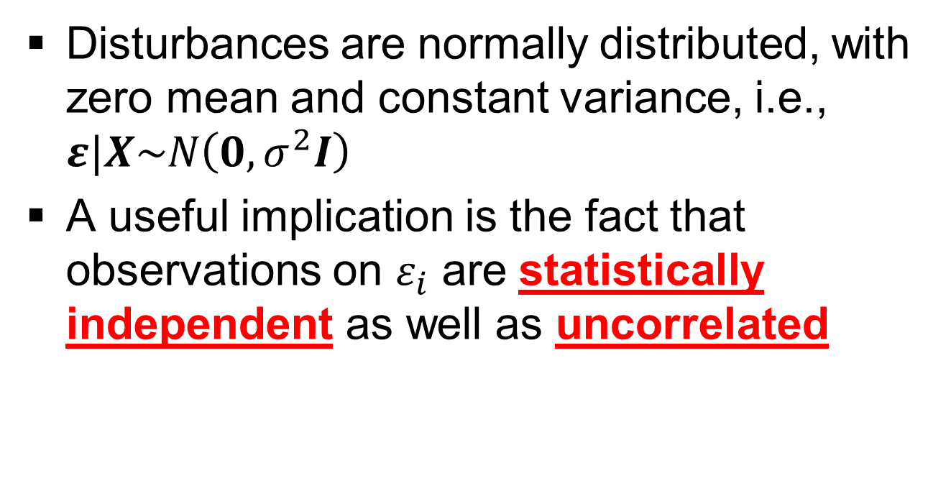
Multiple Linear Regression (MLR)
Normality (Assumption 6)

Slide 65
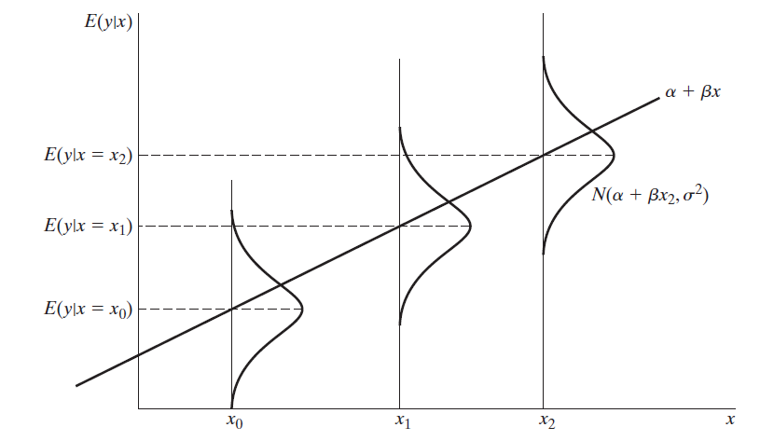
Multiple Linear Regression (MLR) (contd..)
(Ref: Econometric Analysis by W.H.Green)

Slide 66
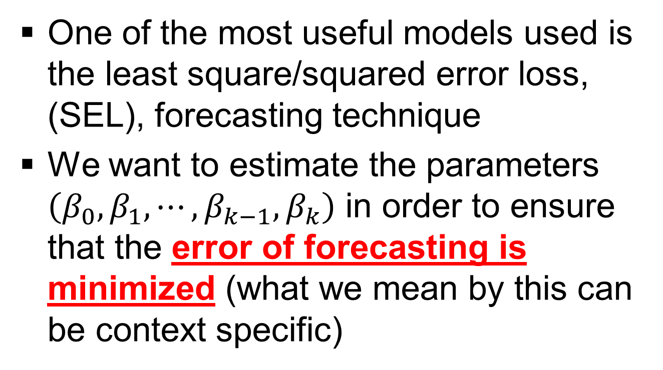
Multiple Linear Regression (MLR) (contd..)

Slide 67
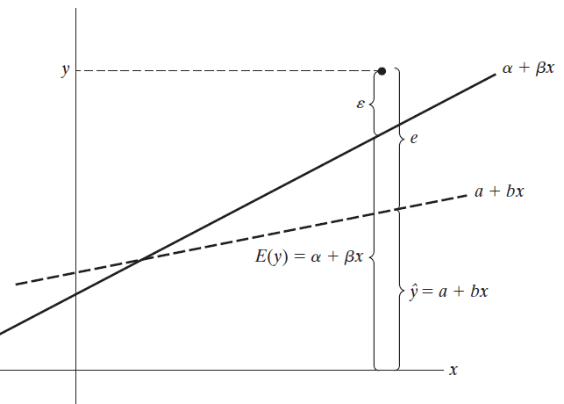
Multiple Linear Regression (MLR) (contd..)
(Ref: Econometric Analysis by W.H.Green)

Slide 68
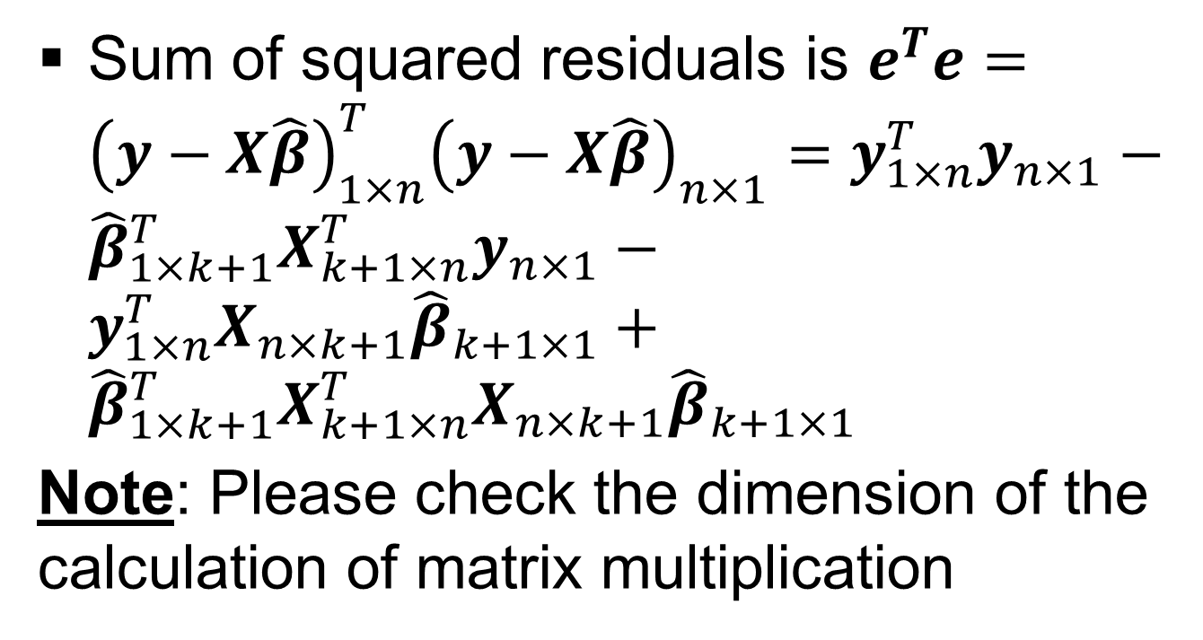
Multiple Linear Regression (MLR) (contd..)

Slide 69
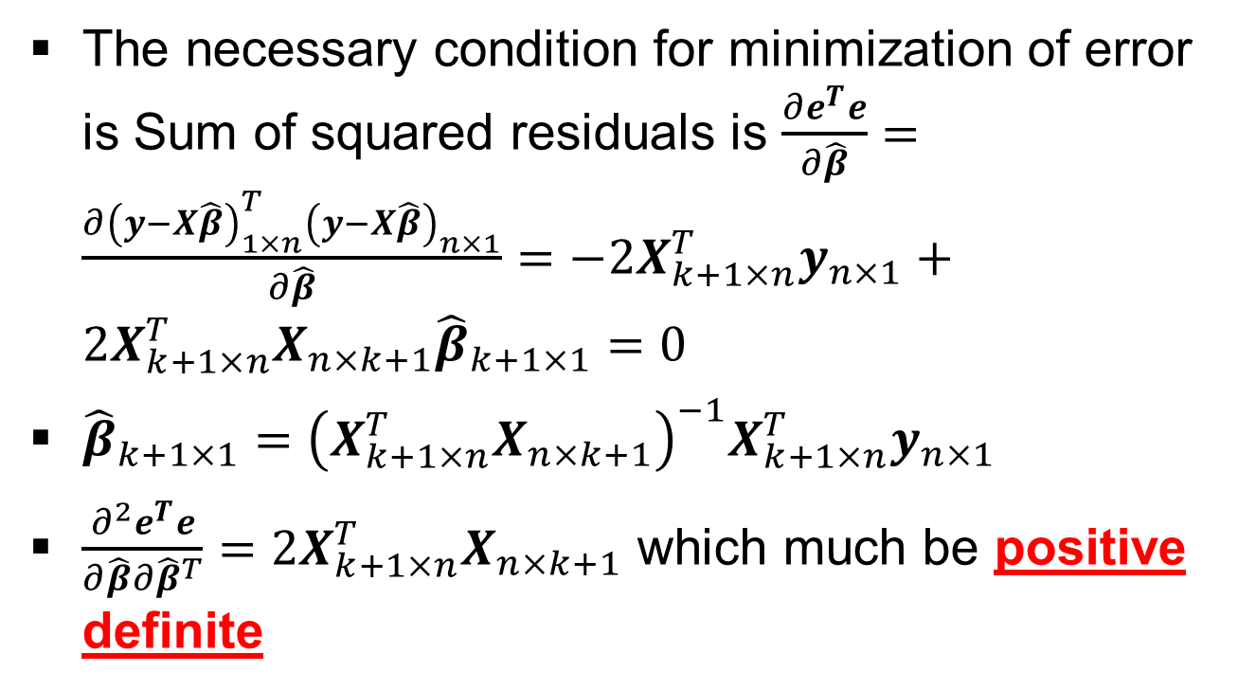
Multiple Linear Regression (MLR) (contd..)

Slide 70
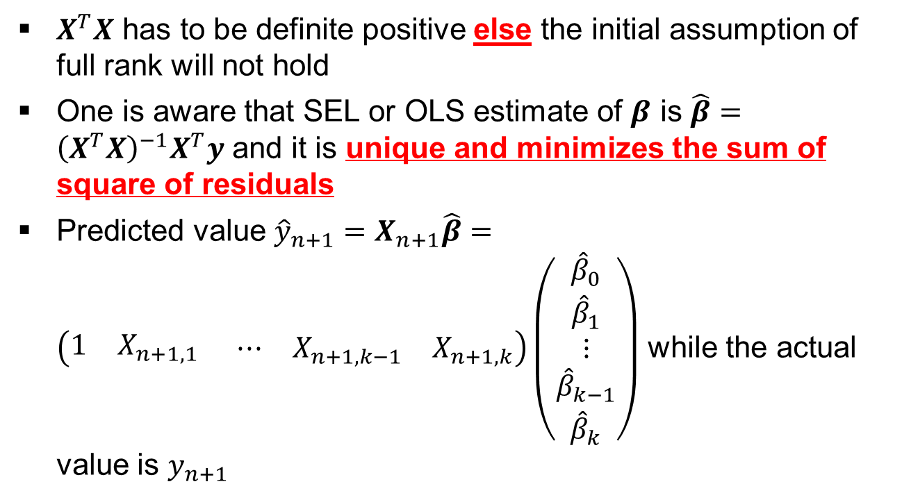
Multiple Linear Regression (MLR) (contd..)

Slide 71
Multiple Linear Regression (MLR) (contd..)
If the variables of MLR are not correlated (i.e., they are orthogonal), then the MLR slopes are the same as the slopes in the individual SLR
Note: Does it mean conditional coefficients and unconditional coefficients are same?

Slide 72
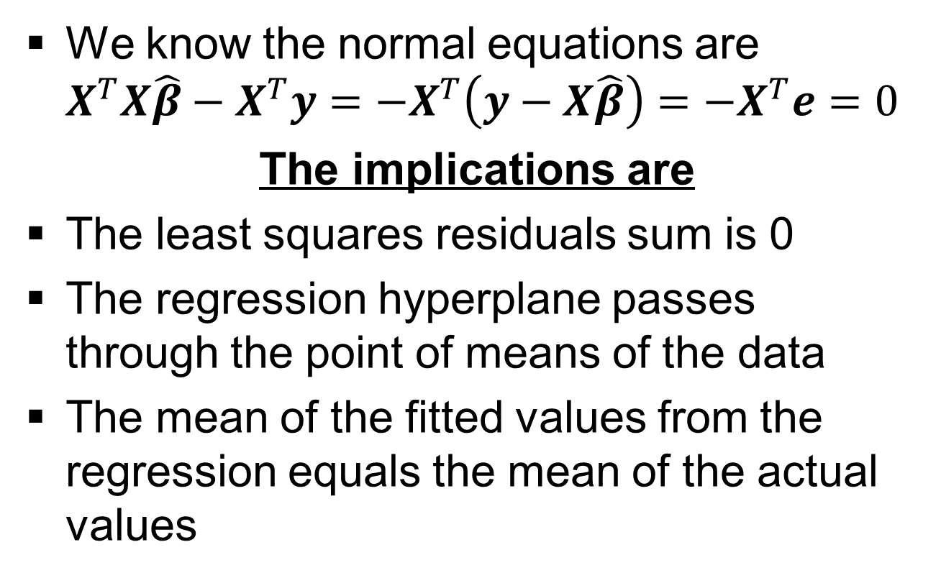
Multiple Linear Regression (MLR) (contd..)

Slide 73
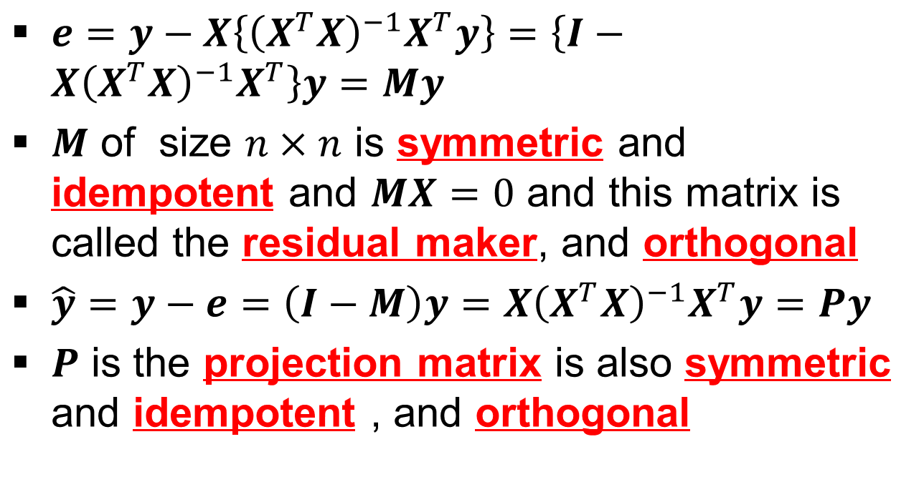
Multiple Linear Regression (MLR) (contd..)

Slide 74
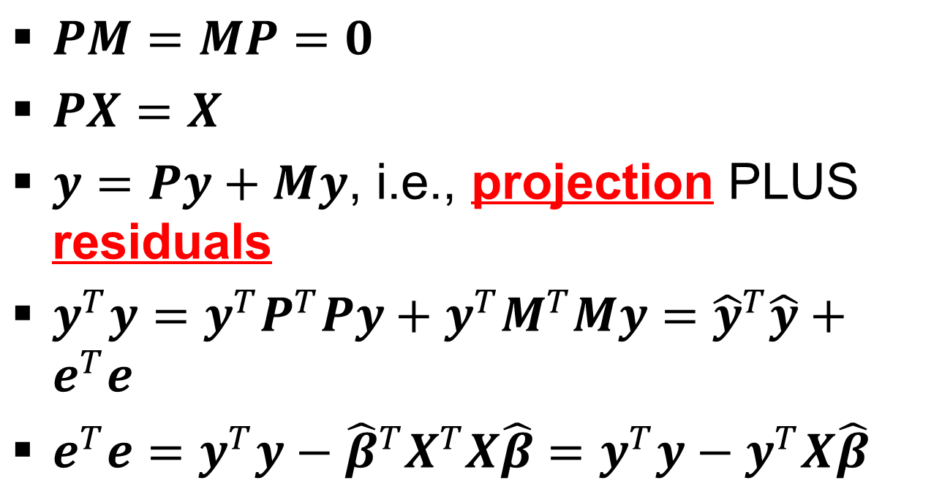
Multiple Linear Regression (MLR) (contd..)

Slide 75
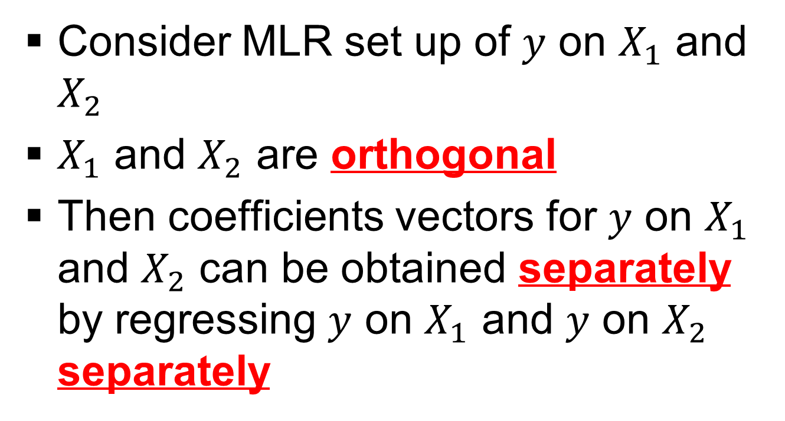
Multiple Linear Regression (MLR) (contd..)

Slide 76
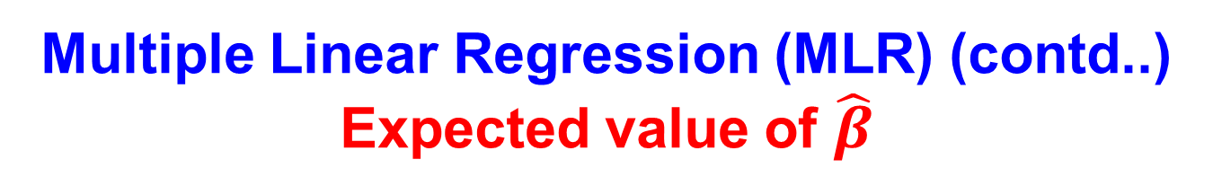
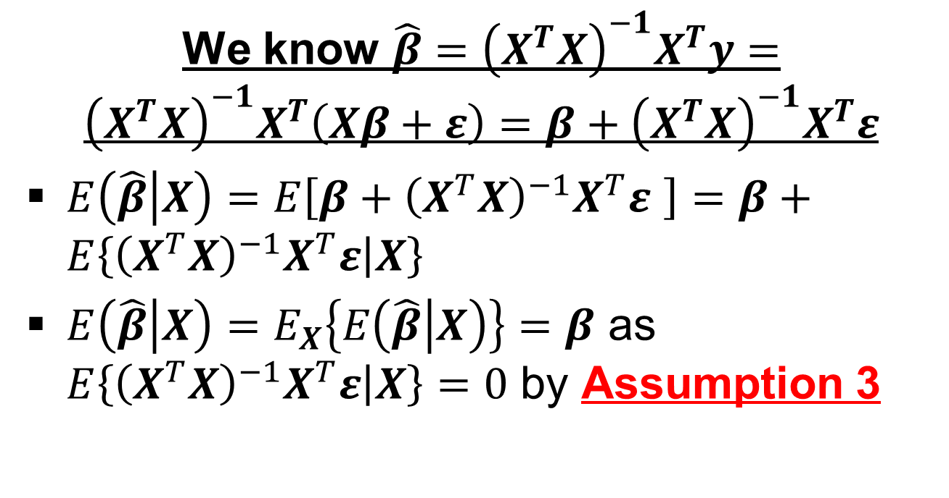

Slide 77



Slide 78



Slide 79

Multiple Linear Regression (MLR) (contd..)
Gauss Markov Theorem

Slide 80



Slide 81



Slide 82


Slide 83

Multiple Linear Regression (MLR) (contd..)

Slide 84
Capital Asset Pricing Model (Simple Linear Regression)
The formulae for the CAPM is given as

Slide 85
Capital Asset Pricing Model (Simple Linear Regression)
Market index portfolio, i.e., it is the fund that contains share of every stock in proportion to the stock′s representation in the entire market.
An asset′s weight is defined as the proportion of the portfolio capital that is allocated to the asset.

Slide 86
Capital Asset Pricing Model (Simple Linear Regression)
The weight of the asset in the market portfolio is equal to the proportion of that asset′s total capital value to the total market capital value.
This weight is called the market capitalization weights and is denoted by w_{i}

Slide 87
Capital Asset Pricing Model (Simple Linear Regression)
Capital market/Pricing line
The capital market/pricing line shows the relation between the expected rate of return and the risk.
Thus as risk increases so does the expected return. Mathematically we can define this as a linear regression, given by
The slope of the capital market/pricing line is the price of risk

Slide 88
Capital Asset Pricing Model (Simple Linear Regression)
Capital market/Pricing line

Slide 89
Capital Asset Pricing Model (Simple Linear Regression)
The capital market/pricing line relates the expected rate of return of an efficient portfolio to its standard deviation.
Remember it does not show how the expected rate of return of an individual asset is related to its corresponding risk.

Slide 90
Capital Asset Pricing Model (Simple Linear Regression)
If the market portfolio M is efficient, then the expected return for any efficient portfolio is given by

Slide 91
Single index models (Simple Linear Regression)
Assumptions
∀ i=1,2,…..,n
∀ i=1,2,…..,n
∀ i≠j, i,j=1,2,…..,n
∀ i=1,2,…..,n

Slide 92
Single index models (Simple Linear Regression)
Results
∀ i=1,2,…..,n
∀ i=1,2,…..,n
∀ i≠j, i,j=1,2,…..,n

Slide 93
Single index models (Simple Linear Regression): Example # 23
Assume α = 3 and β = 2.0
Month Return(i) Return(m) β* Return(m)
1 14 5 2*5
2 10 4 2*4
3 25 10 2*10
4 16 7 2*7
5 4 1 2*1
Hence the errors are: +1, -1, +2, -1, -1 which adds up to 0 as the case should be

Slide 94
Single index models (Simple Linear Regression)
Results

Slide 95

Single index models (Simple Linear Regression)

Slide 96
Single index models (Simple Linear Regression)
Risk of the portfolio

Slide 97
Single index models (Simple Linear Regression)
For the stock prices/indices (assuming they are log-normally distributed) we have r=ln(SP₂/SP₁).
In place of R we can use r and do all the calculation we have done so far.

Slide 98
Single index models (Simple Linear Regression)
In case β=0, then there is no systematic risk
In case β=1, then we have the same systematic risk as market portfolio, in that case
We can easily show that

Slide 99

Single index model (Simple Linear Regression) : Example # 24

Slide 100

Single index model (Simple Linear Regression) : Example # 24 (contd…)

Slide 101
Multiple index models (Multiple Linear Regression)
Using this methodology we try to capture some of the non-market influences that cause securities to move together.
Searching for the non-market influences is akin to searching for corresponding economic factors/influences or structural groups (industries) that account for common movement in stock prices, beyond that accounted for by the market index itself.
This model introduces extra indices with the hope of capturing additional information.

Slide 102
Multiple index models (Multiple Linear Regression)
Uses of Multi Index Model
To predict the correlation coefficients.
To form expectations about returns and study the change in return due to impact of events.
Method of tailoring the return distribution of a portfolio to the specific needs of the investor.
Method of attributing the cause of good or bad performance of a portfolio.

Slide 103
Multiple index models (Multiple Linear Regression)
Assumptions
∀ i=1,...,n
∀ i=1,...,n
∀ j=1,…,L
∀ j≠k, j,k=1,...,L
∀ i=1,...,n & j=1,…,L

Slide 104
Multiple index models (Multiple Linear Regression)

Slide 105
Multiple index models (Multiple Linear Regression)
Some variables which are used in multi index model are (this is not an exhaustive list)
Economic growth
Business cycle
Long-term interest rates
Short term interest rates
Inflation, i.e., CPI
Foreign currency rates, like Rs. vs US$, Rs. vs Yen, Rs. vs UK Pound, etc.

Slide 106

Multiple Linear Regression (MLR) (contd..)

Slide 107

Multiple Linear Regression (MLR) (contd..)

Slide 108
Multiple Linear Regression (MLR) (contd..)

Slide 109
Multiple Linear Regression (MLR) (contd..)

Slide 110
SS_{T} = SS_{R} + SS_{E} explained for Simple Linear Regression
(Ref: Econometric Analysis by W.H.Green)
SS_{E}
SS_{R}
SS_{T}

Slide 111
Multiple Linear Regression (MLR) (contd..)
R² = (SS_{R}/SS_{T}) = 1- (SS_{E}/SS_{T})
R²_{Adj} = 1- {SS_{E}/(n-k)}/{SS_{T}/(n-1)}

Slide 112

Multiple index model (Multiple Linear Regression) : Example # 25

Slide 113
Multiple index model (Multiple Linear Regression) : Example # 25 (contd…)
Here
  Y=TATA_MOTORS stock closing price returns given by ln(P_{TATA,t}/P_{TATA,t-1})
  X₁= NSE50 closing price returns given by ln(P_{NSE,t}/P_{NSE,t-1})
  X₂= INR/USD rate given in INR
  X₃= BRENT_CRUDE price given in EUROS

Slide 114

Multiple index model (Multiple Linear Regression) : Example # 25 (contd…)

Slide 115

Multiple index model (Multiple Linear Regression) : Example # 25

Slide 116

Multiple index model (Multiple Linear Regression) : Example # 25 (contd…)

Slide 117
Multiple Linear Regression (MLR) (contd..)

Slide 118
Multiple Linear Regression (MLR) (contd..)
R² = (SS_{R}/SS_{T}) = 1- (SS_{E}/SS_{T})
R²_{Adj} = 1- {SS_{E}/(n-k)}/{SS_{T}/(n-1)}

Slide 119

Multiple index model (Multiple Linear Regression) : Example # 25

Slide 120
Multiple index model (Multiple Linear Regression) : Example # 25 (contd…)
Here
  Y=TATA_MOTORS stock closing price returns given by ln(P_{TATA,t}/P_{TATA,t-1})
  X₁= NSE50 closing price returns given by ln(P_{NSE,t}/P_{NSE,t-1})
  X₂= INR/USD rate given in INR
  X₃= BRENT_CRUDE price given in EUROS

Slide 121

Multiple index model (Multiple Linear Regression) : Example # 25 (contd…)

Slide 122

Multiple index model (Multiple Linear Regression) : Example # 25

Slide 123

Multiple index model (Multiple Linear Regression) : Example # 25 (contd…)

Slide 124

Multiple Linear Regression (MLR) (contd..)
Example # 26

Slide 125

Multiple Linear Regression (MLR) (contd..)
Example # 26 (contd..)

Slide 126
Multiple Linear Regression (MLR) (contd..)
Example # 26 (contd..)
On running the regression analysis the following results are obtained from ANOVA (Analysis of Variance)
Source | DoF | Adj SS | Adj MS | F-Value | P-Value
Regression | 2 | 1061819 | 530909 | 21.44 | 0.000
O₂ | 1 | 17045 | 17045 | 0.69 | 0.408
CO₂ | 1 | 1044773 | 1044773 | 42.19 | 0.000
Error | 117 | 2897566 | 24766
Lack of Fit | 17 | 91284 | 5370 | 0.19 | 1.000
Pure Error | 100 | 2806283 | 28063
Total | 119 | 3959385

Slide 127

Multiple Linear Regression (MLR) (contd..)
Example # 26 (contd..)

Slide 128

Multiple Linear Regression (MLR) (contd..)
Example # 26 (contd..)

Slide 129
Multiple Linear Regression (MLR) (contd..)
Example # 27
Data are a subsample of 500 observations from a data set that originate in a study where air pollution at a road is related to traffic volume and meteorological variables, collected by the Norwegian Public Roads Administration
The response variable (column 1) consist of hourly values of the logarithm of the concentration of NO₂ (particles), measured at Alnabru in Oslo, Norway, between October 2001 and August 2003.

Slide 130
Multiple Linear Regression (MLR) (contd..)
Example # 27 (contd..)
The predictor variables (columns 2 to 8) seven (07) in number are the logarithm of the number of cars per hour, temperature 2 meter above ground (degree C), wind speed (meters/second), the temperature difference between 25 and 2 meters above ground (degree C), wind direction (degrees between 0 and 360), hour of day and day number from October 1. 2001
URL (data): http://lib.stat.cmu.edu/datasets/NO2.dat
URL (write-up): https://georglsm.r-forge.r-project.org/site-projects/pdf/5713.pdf

Slide 131
Multiple Linear Regression (MLR) (contd..)
Example # 27
Data are a subsample of 500 observations from a data set that originate in a study where air pollution at a road is related to traffic volume and meteorological variables, collected by the Norwegian Public Roads Administration
The response variable (column 1) consist of hourly values of the logarithm of the concentration of NO₂ (particles), measured at Alnabru in Oslo, Norway, between October 2001 and August 2003.

Slide 132
Multiple Linear Regression (MLR) (contd..)
Example # 27 (contd..)
The predictor variables (columns 2 to 8) seven (07) in number are the logarithm of the number of cars per hour, temperature 2 meter above ground (degree C), wind speed (meters/second), the temperature difference between 25 and 2 meters above ground (degree C), wind direction (degrees between 0 and 360), hour of day and day number from October 1. 2001
URL (data): http://lib.stat.cmu.edu/datasets/NO2.dat
URL (write-up): https://georglsm.r-forge.r-project.org/site-projects/pdf/5713.pdf

Slide 133

Multiple Linear Regression (MLR) (contd..)
Example # 27 (contd..)

Slide 134

Multiple Linear Regression (MLR) (contd..)
Example # 27 (contd..)
 | 1 | 0.07848 | 0.05951 | 0.00434 | -0.04960 | -0.04477 | 0.01040
 |  | 1 | -0.10547 | -0.04630 | -0.01578 | -0.02564 | 0.02230
 |  |  | 1 | -0.04205 | 0.00242 | 0.00492 | -0.10630
 |  |  |  | 1 | -0.01460 | -0.01250 | -0.01640
 |  |  |  |  | 1 | 0.05492 | -0.06042
 |  |  |  |  |  | 1 | 0.02780
 |  |  |  |  |  |  | 1

Slide 135

Multiple Linear Regression (MLR) (contd..)
Example # 27 (contd..)

Slide 136
Multiple Linear Regression (MLR) (contd..)
Example # 27 (contd..)
ANOVA Table for our model
 | DoF | SS | MSE | F value
Regression with X₂, X₃ and X₆ | 3 | 157.16884 | 52.38961 | 46.04000
Residual Error | 496 | 564.38594 | 1.13788 | N/A
Total | 499 | 721.55478 | N/A | N/A
R² | R² = (SS_{R}/SS_{T}) = 1- (SS_{E}/SS_{T}) = 1 – (564.38594/721.55478) = 0.22
Adjusted R² | R²_{Adj} = 1- {SS_{E}/(n-k)}/{SS_{T}/(n-1)} = 1 – {(564.38594/497)/(721.55478/499)} = 0.22

Slide 137
Multiple Linear Regression (MLR) (contd..)
Example # 28
The secondary source data is obtained from Statistics and Probability Letters (Sparse Spatial Autoregressions; Pace, R. Kelley and Ronald Barry, 1997, 33, pp: 291-297) and it contains information on the variables using all the block groups in California from the 1990 census
In this sample, a block group on average includes 1425.5 individuals living in a geographically compact area
Naturally, the geographical area included, varies inversely with the population density. The data contains 20,640 observations on 9 variables

Slide 138
Multiple Linear Regression (MLR) (contd..)
Example # 28 (contd..)
The authors have computed distances among centroids of each block groups as measured in latitude and longitude
They have excluded all block groups reporting zero entities for the independent and dependent variables
The data file contains all the variables and specifically, it contains the following which are, median house value, median income, housing median age, total rooms, total bedrooms, population, households, latitude and longitude in that order. The manuscript describing the data can be found at www.spatial-statistics.com

Slide 139

Multiple Linear Regression (MLR) (contd..)
Example # 28 (contd..)

Slide 140

Multiple Linear Regression (MLR) (contd..)
Example # 28 (contd..)

Slide 141

Multiple Linear Regression (MLR) (contd..)
Example # 28 (contd..)

Slide 142
Multiple Linear Regression (MLR) (contd..)
Linear Exponential Loss Function
It is seen that the penalties for over estimation vis-à-vis under estimation are unequal, in the sense that the losses for over estimation when compared to that of under estimation are unequal
To capture this phenomenon an asymmetric loss function which mimics this reality should be used
One form of an asymmetric loss is the Linear Exponential (LINEX) loss function

Slide 143

Multiple Linear Regression (MLR) (contd..)
Linear Exponential Loss Function (contd..)

Slide 144

Multiple Linear Regression (MLR) (contd..)
Linear Exponential Loss Function (contd..)

Slide 145

Multiple Linear Regression (MLR) (contd..)
Linear Exponential Loss Function (contd..)

Slide 146

Multiple Linear Regression (MLR) (contd..)
Linear Exponential Loss Function (contd..)

Slide 147


Multiple Linear Regression (MLR) (contd..)
Linear Exponential Loss Function (contd..)
a |  |  | Difference
-1.00 | +1.0456 | +1.8257 | -0.7801
-0.75 | +1.0456 | +1.6307 | -0.5851
0.00 | +1.0456 | +1.0456 | 0.0000
+0.75 | +1.0456 | +0.4605 | +0.5851
+1.00 | +1.0456 | +0.2655 | +0.7801

Slide 148

Multiple Linear Regression (MLR) (contd..)
Linear Exponential Loss Function (contd..)

Slide 149


Multiple Linear Regression (MLR) (contd..)
Linear Exponential Loss Function (contd..)
a |  |  | Difference
-1.00 | −0.19940 | +0.25999 | -0.4594
-0.75 | −0.19940 | +0.14514 | -0.3445
0.00 | −0.19940 | −0.19940 | 0.0000
+0.75 | −0.19940 | -0.54394 | +0.3445
+1.00 | −0.19940 | -0.65879 | +0.4594

Slide 150


Multiple Linear Regression (MLR) (contd..)
Linear Exponential Loss Function (contd..)
a |  |  | Difference
-1.00 | +1.24100 | +1.54106 | -0.3001
-0.75 | +1.24100 | +1.46604 | -0.2250
0.00 | +1.24100 | +1.2410 | 0.0000
+0.75 | +1.24100 | +1.01596 | +0.2250
+1.00 | +1.24100 | +0.94094 | +0.3001

Slide 151


Multiple Linear Regression (MLR) (contd..)
Linear Exponential Loss Function (contd..)
a |  |  | Difference
-1.00 | +0.00310 | +0.00318 | -0.0001
-0.75 | +0.00310 | +0.00316 | -0.0001
0.00 | +0.00310 | +0.00310 | 0.0000
+0.75 | +0.00310 | +0.00304 | +0.0001
+1.00 | +0.00310 | +0.00302 | +0.0001

Slide 152


Multiple Linear Regression (MLR) (contd..)
Linear Exponential Loss Function (contd..)
a |  |  | Difference
-1.00 | +0.00090 | +0.00090 | 0.0000
-0.75 | +0.00090 | +0.00090 | 0.0000
0.00 | +0.00090 | +0.00090 | 0.0000
+0.75 | +0.00090 | +0.00090 | 0.0000
+1.00 | +0.00090 | +0.00090 | 0.0000

Slide 153

Multiple Linear Regression (MLR) (contd..)
Linear Exponential Loss Function (contd..)

Slide 154

Multiple Linear Regression (MLR) (contd..)
Linear Exponential Loss Function (contd..)

Slide 155

Multiple Linear Regression (MLR) (contd..)
Linear Exponential Loss Function (contd..)

Slide 156

Multiple Linear Regression (MLR) (contd..)
Linear Exponential Loss Function (contd..)

Slide 157

Multiple Linear Regression (MLR) (contd..)
Linear Exponential Loss Function (contd..)
a |  |  | Difference
-1.00 | +1.1816 | +0.7864 | +0.3925
-0.75 | +0.5508 | +0.4408 | +0.1100
0.00 | 0.0000 | 0.0000 | 0.0000
+0.75 | +0.5508 | +0.4289 | +0.1100
+1.00 | +1.1816 | +0.7864 | +0.3925

Slide 158

Multiple Linear Regression (MLR) (contd..)
Linear Exponential Loss Function (contd..)

Slide 159

Multiple Linear Regression (LINEX loss) : Example # 29

Slide 160
Multiple Linear Regression (LINEX loss) : Example # 29
a | Y | Y_SEL | Y_LINEX
-1.00 | -0.057153622 | +0.0836 | +0.0866
-1.00 | +0.019931007 | +0.1246 | +0.1273
-1.00 | +0.001260987 | +0.1374 | +0.1401
-1.00 | -0.018341431 | +0.1046 | +0.1074
-1.00 | +0.011957712 | +0.1158 | +0.1186

Slide 161
Multiple Linear Regression (LINEX loss) : Example # 29 (contd..)
a | Y | Y_SEL | Y_LINEX
-0.75 | -0.057153622 | +0.0836 | +0.0859
-0.75 | +0.019931007 | +0.1246 | +0.1266
-0.75 | +0.001260987 | +0.1374 | +0.1394
-0.75 | -0.018341431 | +0.1046 | +0.1067
-0.75 | +0.011957712 | +0.1158 | +0.1179

Slide 162
Multiple Linear Regression (LINEX loss) : Example # 29 (contd..)
a | Y | Y_SEL | Y_LINEX
0.00 | -0.057153622 | +0.0836 | +0.0836
0.00 | +0.019931007 | +0.1246 | +0.1246
0.00 | +0.001260987 | +0.1374 | +0.1374
0.00 | -0.018341431 | +0.1046 | +0.1046
0.00 | +0.011957712 | +0.1158 | +0.1158

Slide 163
Multiple Linear Regression (LINEX loss) : Example # 29
a | Y | Y_SEL | Y_LINEX
+0.75 | -0.057153622 | +0.0836 | +0.0814
+0.75 | +0.019931007 | +0.1246 | +0.1226
+0.75 | +0.001260987 | +0.1374 | +0.1354
+0.75 | -0.018341431 | +0.1046 | +0.1026
+0.75 | +0.011957712 | +0.1158 | +0.1137

Slide 164
Multiple Linear Regression (LINEX loss) : Example # 29 (contd..)
a | Y | Y_SEL | Y_LINEX
+1.00 | -0.057153622 | +0.0836 | +0.0806
+1.00 | +0.019931007 | +0.1246 | +0.1219
+1.00 | +0.001260987 | +0.1374 | +0.1348
+1.00 | -0.018341431 | +0.1046 | +0.1019
+1.00 | +0.011957712 | +0.1158 | +0.1130

Slide 165

Multiple Linear Regression (MLR) (contd..)
Balanced Loss Function

Slide 166
Multiple Linear Regression (MLR) (contd..)
Balanced Loss Function

Slide 167
Multiple Linear Regression (MLR) (contd..)
Balanced Loss Function (contd..)
MODEL - I (Use SEL Estimate)
Consider the MLR set up with BLF
L(β, β_{HAT}) = λ{(Y − Y_{HAT})^{T}(Y − Y_{HAT})} + (1 − λ)[exp{a(θ – θ_{HAT})} − a(θ – θ_{HAT}) − 1]
L(β, β_{HAT}) = λ{(Xβ − Xβ_{HAT})^{T}(Xβ − Xβ_{HAT})} + (1 − λ)[exp{a(θ – θ_{HAT})} − a(θ – θ_{HAT}) − 1]
SEL portrays precision of estimation
LINEX loss portrays goodness of fit

Slide 168
Multiple Linear Regression (MLR) (contd..)
Balanced Loss Function (contd..)
MODEL - I (Use SEL Estimate)
Estimate is β_{SEL} = (X^{T}X)⁻¹X^{T}Y and θ_{SEL} = ℓ^{T}β_{SEL} = ℓ^{T}(X^{T}X)⁻¹X^{T}Y
Risk is R_{Model-I} = λ(n−p)σ² + (1− λ)[exp{(a²σ²/2)ℓ^{T}(X^{T}X)⁻¹ℓ} − 1]

Slide 169
Multiple Linear Regression (MLR) (contd..)
Balanced Loss Function (contd..)
MODEL - II (Use SEL Estimate)
Consider the MLR set up with BLF
L(β, β_{HAT}) = λ{(β − β_{HAT})^{T}(β − β_{HAT})} + (1 − λ)[exp{a(θ – θ_{HAT})} − a(θ – θ_{HAT}) − 1]
SEL portrays precision of estimation
LINEX loss portrays goodness of fit

Slide 170
Multiple Linear Regression (MLR) (contd..)
Balanced Loss Function (contd..)
MODEL - II (Use SEL Estimate)
Estimate is β_{SEL} = (X^{T}X)⁻¹X^{T}Y and θ_{SEL} = ℓ^{T}β_{SEL} = ℓ^{T}(X^{T}X)⁻¹X^{T}Y
Risk is R_{Model-II} = λσ²(X^{T}X)⁻¹ + (1− λ)[exp{(a²σ²/2)ℓ^{T}(X^{T}X)⁻¹ℓ} − 1]

Slide 171
Multiple Linear Regression (MLR) (contd..)
Balanced Loss Function (contd..)
MODEL - III (Use LINEX Estimate)
Consider the MLR set up with BLF
L(β, β_{HAT}) = λ{(Y − Y_{HAT})^{T}(Y − Y_{HAT})} + (1 − λ)[exp{a(θ – θ_{HAT})} − a(θ – θ_{HAT}) − 1]
L(β, β_{HAT}) = λ{(Xβ − Xβ_{HAT})^{T}(Xβ − Xβ_{HAT})} + (1 − λ)[exp{a(θ – θ_{HAT})} − a(θ – θ_{HAT}) − 1]
SEL portrays precision of estimation
LINEX loss portrays goodness of fit

Slide 172
Multiple Linear Regression (MLR) (contd..)
Balanced Loss Function (contd..)
MODEL - III (Use LINEX Estimate)
Estimate is θ_{LINEX} = ℓ^{T}β_{LINEX} = ℓ^{T}(X^{T}X)⁻¹X^{T}Y – (aσ²/2){ℓ^{T}(X^{T}X)⁻¹ℓ}
Risk is R_{Model-III} = λ[(n–p)σ² + (a²/4){(n– p)σ²}²] + (1–λ)[(a²σ²/2){ℓ^{T}(X^{T}X)⁻¹ℓ}]

Slide 173
Multiple Linear Regression (MLR) (contd..)
Balanced Loss Function (contd..)
MODEL - IV (Use LINEX Estimate)
Consider the MLR set up with BLF
L(β, β_{HAT}) = λ{(β − β_{HAT})^{T}(β − β_{HAT})} + (1 − λ)[exp{a(θ – θ_{HAT})} − a(θ – θ_{HAT}) − 1]
SEL portrays precision of estimation
LINEX loss portrays goodness of fit

Slide 174
Multiple Linear Regression (MLR) (contd..)
Balanced Loss Function (contd..)
MODEL – IV (Use LINEX Estimate)
Estimate is θ_{LINEX} = ℓ^{T}β_{LINEX} = ℓ^{T}(X^{T}X)⁻¹X^{T}Y – (aσ²/2){ℓ^{T}(X^{T}X)⁻¹ℓ}
Risk is
R_{Model-IV} = λ[σ²(X^{T}X)⁻¹ + (a²/4){σ²(X^{T}X)⁻¹}²] + (1 − λ)(a²σ²/2){ℓ^{T}(X^{T}X)⁻¹ℓ}

Slide 175
Multiple Linear Regression (BLF) : Example # 30
ℓ^{T}=(1,1,1,1)
β_{SEL} = (X^{T}X)⁻¹X^{T}Y
θ_{SEL} = ℓ^{T}β_{SEL} = ℓ^{T}(X^{T}X)⁻¹X^{T}Y
θ_{LINEX} = ℓ^{T}β_{SEL} – (aσ²/2){ℓ^{T}(X^{T}X)⁻¹ℓ} = ℓ^{T}(X^{T}X)⁻¹X^{T}Y – (aσ²/2){ℓ^{T}(X^{T}X)⁻¹ℓ}
σ² = 0.0052
{ℓ^{T}(X^{T}X)⁻¹ℓ} = 0.0036
n = 75
p = 4

Slide 176
Multiple Linear Regression (BLF) : Example # 30 (contd..)
λ | a | Risk_{MODEL-I} | Risk_{MODEL-III}
0.00 | -1.25 | 0.0000 | 0.0008
0.00 | -0.75 | 0.0000 | 0.0003
0.00 | 0.00 | 0.0000 | 0.0000
0.00 | +0.75 | 0.0000 | 0.0003
0.00 | +1.25 | 0.0000 | 0.0008

Slide 177
Multiple Linear Regression (BLF) : Example # 30 (contd..)
λ | a | Risk_{MODEL-I} | Risk_{MODEL-III}
0.25 | -1.25 | 0.0923 | 0.0931
0.25 | -0.75 | 0.0923 | 0.0926
0.25 | 0.00 | 0.0923 | 0.0920
0.25 | +0.75 | 0.0923 | 0.0926
0.25 | +1.25 | 0.0923 | 0.0931

Slide 178
Multiple Linear Regression (BLF) : Example # 30 (contd..)
λ | a | Risk_{MODEL-I} | Risk_{MODEL-III}
0.50 | -1.25 | 0.1846 | 0.1854
0.50 | -0.75 | 0.1846 | 0.1849
0.50 | 0.00 | 0.1846 | 0.1838
0.50 | +0.75 | 0.1846 | 0.1849
0.50 | +1.25 | 0.1846 | 0.1854

Slide 179
Multiple Linear Regression (BLF) : Example # 30 (contd..)
λ | a | Risk_{MODEL-I} | Risk_{MODEL-III}
0.75 | -1.25 | 0.2769 | 0.2777
0.75 | -0.75 | 0.2769 | 0.2772
0.75 | 0.00 | 0.2769 | 0.2767
0.75 | +0.75 | 0.2769 | 0.2772
0.75 | +1.25 | 0.2769 | 0.2777

Slide 180
Multiple Linear Regression (BLF) : Example # 30 (contd..)
λ | a | Risk_{MODEL-I} | Risk_{MODEL-III}
1.00 | -1.25 | 0.3692 | 0.3699
1.00 | -0.75 | 0.3692 | 0.3695
1.00 | 0.00 | 0.3692 | 0.3688
1.00 | +0.75 | 0.3692 | 0.3695
1.00 | +1.25 | 0.3692 | 0.3699

Slide 181

Multiple Linear Regression (BLF) : Example # 30 (contd…)

Slide 182

Multiple Linear Regression: Other loss functions (Linear Loss)

Slide 183

Multiple Linear Regression: Other loss functions (Weighted Linear Loss)

Slide 184

Multiple Linear Regression: Other loss functions (Squared Error Loss)

Slide 185
Logistic Regression
Logistic regression are used whenever dependent variable is binary (0 or 1).
Logistic regression estimate the probability of your dependent variable to be 1 (Y=1, when something happens) or 0 (Y=0, when something does not happens).
Logistic regression is one of the most important analytic tools in the social and natural sciences.

Slide 186
Logistic Regression (contd..)
In natural language processing, logistic regression is the baseline supervised machine learning algorithm for classification, and also has a very close relationship with neural networks.
A neural network can be viewed as a series of logistic regression classifiers stacked on top of each other.
The goal of binary logistic regression is to train a classifier that can make a binary decision about the class of a new input observation.

Slide 187

Logistic Regression (contd..)
Sigmoid classifier help us make this decision, σ(z)=1/{1+exp(−z)}.

Slide 188

Logistic Regression (contd..)

Slide 189
Logistic Regression (contd..)
Consider X=(x₁,…, x_{n}) and Y= 0 or 1.
Logistic regression solves this task by learning, from a training set, a vector of weights w=(w₁,...., w_{n}) and a bias term (intercept).
z = (w^{T}x+b) is called logit and is inverse of Sigmoid function.

Slide 190
Logistic Regression (contd..)
P(Y=1) = σ(w^{T}x+b)
P(Y=1) = 1/[1+exp{−(w^{T}x+b)}], a probability is assigned.
P(Y=0) = 1 − σ(w^{T}x+b)
P(Y=0) = exp{−(w^{T}x+b)}/[1+exp{−(w^{T}x+b)}], a probability is assigned.

Slide 191
Logistic Regression (contd..)
Hence P(Y=1) = α and P(Y=0) = (1−α)
Logit(p) = σ⁻¹(p) = ln_{e}{p/(1−p)}.
To create a probability, we pass z through the sigmoid function, σ(z).

Slide 192
Logistic Regression (contd..)
The sigmoid function (named because it looks like an s) is also called the logistic function, and gives logistic regression its name.
Using the term logit for z is a way of reminding us that by using the sigmoid to turn z (which ranges from −∞ to +∞) into a probability, we are implicitly interpreting z as not just any real-valued number, but as specifically a log odds.

Slide 193
Logistic Regression : Example # 31
Consider a binary sentiment classification on restaurant review, whether to assign the + or − to the feedback.
Consider six features, x=(x₁, x₂, x₃, x₄, x₅, x₆).
The restaurant has average food and the menu is not great, plus the food was not warm. So why was it so enjoyable? For one thing, the ambience was good. Another nice touch was, it is spacious, less crowd plus there was good music. I enjoyed the music and I am sure you will also like it.

Slide 194
Logistic Regression : Example # 31 (contd..)
Variable | Definition | Value
X₁ | Count (positive lexicon words in review) | 3
X₂ | Count (negative lexicon words in review) | 2
X₃ | 1 if No and 0 other wise | 1
X₄ | 1st and 2nd pronouns | 3
X₅ | 1 if ! And 0 other wise | 0
X₆ | Ln of word count in document | Ln(57) = 4.0431

Slide 195
Logistic Regression : Example # 31 (contd..)
w=[2.5,−5.0,−1.2,0.5,2.0,0.7].
x=[3,2,1,3,0,4.04]
b = 0.1.
P(Y=1|x) = σ(w^{T}x+b)
P(Y=1|x) = σ([2.5,−5.0,−1.2,0.5,2.0,0.7]. [3,2,1,3,0,4.04] + 0.1).
P(Y=1|x) = 0.73.

Slide 196
Logistic Regression : Example # 31 (contd..)
w=[2.5,−5.0,−1.2,0.5,2.0,0.7].
x=[3,2,1,3,0,4.04]
b = 0.1.
P(Y=0|x) = 1 − σ(w^{T}x+b).
P(Y=0|x) = 1 − σ([2.5,−5.0,−1.2,0.5,2.0,0.7]. [3,2,1,3,0,4.04] + 0.1).
P(Y=0|x) = 0.27.

Slide 197
Non-Linear Regression
Nonlinear regression models are expressed as Y_{i} = f(X, γ) + ε_{i}, i=1,.., n.
Example of nonlinear regression model is exponential regression model of the form Y_{i} = γ₀exp{γ₁X_{i}) + ε_{i}, i=1,.., n and error terms are normal.
  γ₀, γ₁: Parameters
  X_{i}: Independent variable
  ε ~ N(0, σ²)

Slide 198
Non-Linear Regression
Y = f(x, γ) = (γ₀ + γ₁x₁)/(1 + γ₂x₂) + ε
Y = f(x, γ) = γ₀x^{γ1} + ε
Y = f(x, γ) = γ₀ + γ₁exp(−γ₂x) + ε
Y = f(x, γ) = (γ₀ + γ₁x + γ₂x²)/(γ₃x + γ₄x² + γ₅x³) + ε
Y = f(x, γ) = [{γ₀ + γ₁ln(x) + γ₂{ln(x)}²]/[γ₃{ln(x)}² + γ₄{ln(x)}³ + γ₅{ln(x)}⁴] + ε
Y = f(x, γ) = [{γ₀ + γ₁ln(1/x) + γ₂{ln(1/x)}²]/[γ₃{ln(1/x)}² + γ₄{ln(1/x)}³ + γ₅{ln(1/x)}⁴] + ε

Slide 199
Non-Linear Regression Example # 32
Xi | Yi | Xi | Yi
 |  | 31 | 16
2 | 54 | 34 | 18
5 | 50 | 38 | 13
7 | 45 | 45 | 8
10 | 37 | 52 | 11
14 | 35 | 53 | 8
19 | 25 | 60 | 4
26 | 20 | 65 | 6

Slide 200

Non-Linear Regression Example # 32 (contd..)

Slide 201

Non-Linear Regression Example # 32 (contd..)

Slide 202
Non-Linear Regression Example # 33
Year | USA Population | Year | USA Population
in Millions |  | 1890 | 62.948
1790 | 3.929 | 1900 | 75.995
1800 | 5.308 | 1910 | 91.972
1810 | 7.24 | 1920 | 105.711
1820 | 9.638 | 1930 | 122.775
1830 | 12.866 | 1940 | 131.669
1840 | 17.069 | 1950 | 150.697
1850 | 23.192 | 1960 | 179.323
1860 | 31.443 | 1970 | 203.302
1870 | 39.818 | 1980 | 226.542
1880 | 50.156 | 1990 | 248.71

Slide 203

Non-Linear Regression Example # 33 (contd..)

Slide 204
Non-Linear Regression Example # 34
The data is from NIST <https://www.itl.nist.gov/> and involves the thermal expansion of copper.
The response variable is the coefficient of thermal expansion, and the predictor variable is temperature in degrees Kelvin.

Slide 205
Non-Linear Regression Example # 34 (contd..)
There is 1 Response Variable (y) and 1 Predictor Variable (x) with 236 Observations.
Y = (β₁ + β₂x + β₃x² + β₄x³)/(1 + β₅x + β₆x² + β₇x³) + ε

Slide 206

Non-Linear Regression Example # 34 (contd..)

Slide 207
Non-Linear Regression Example # 35
Rectangular hyperbola model which is the Michaelis-Menten equation is a rectangular hyperbola, which is given as
Y = θ₁x/(θ₂ + x) + ε where
θ₁ = Asymptote as x →∞
θ₂ = x value giving a response equal to (θ₁/2)
ε = Error term where ε ~ U(− a, +a) or ε ~ N(0, σ²) or ε ~ t_{n}

Slide 208

Non-Linear Regression Example # 35 (contd..)

Slide 209

Non-Linear Regression Example # 35 (contd..)

Slide 210

Non-Linear Regression Example # 35 (contd..)

Slide 211

Non-Linear Regression Example # 35 (contd..)

Slide 212
Non-Linear Regression Example # 36
Logarithmic model which is given as
Y = θ₁ + θ₂ℓog_{e}(x) + ε where
θ₁ = Constant (log_{e}(1) = 0)
θ₂ = Shape, such that
  θ₂ > 0 we have x increases hence y increases, thus curve is convex
  θ₂ < 0 we have x increases hence y decreases, thus curve is concave
ε = Error term where ε ~ U(− a, +a) or ε ~ N(0, σ²) or ε ~ t_{n}

Slide 213

Non-Linear Regression Example # 36 (contd..)

Slide 214

Non-Linear Regression Example # 36 (contd..)

Slide 215

Non-Linear Regression Example # 36 (contd..)

Slide 216

Non-Linear Regression Example # 36 (contd..)

Slide 217

Non-Linear Regression Example # 37

Slide 218

Non-Linear Regression Example # 37 (contd..)

Slide 219

Non-Linear Regression Example # 37 (contd..)

Slide 220

Non-Linear Regression Example # 37 (contd..)

Slide 221

Non-Linear Regression Example # 37 (contd..)

Slide 222
Non-Linear Regression Example # 38
Negative Exponential model which is given as
Y = θ₁{1 − exp(θ₂x)} + ε where
θ₁ = Multiplying factor
θ₂ = Power of x in the exponential
ε = Error term where ε ~ U(− a, +a) or ε ~ N(0, σ²) or ε ~ t_{n}

Slide 223

Non-Linear Regression Example # 38 (contd..)

Slide 224

Non-Linear Regression Example # 38 (contd..)

Slide 225

Non-Linear Regression Example # 38 (contd..)

Slide 226

Non-Linear Regression Example # 38 (contd..)

Slide 227
Non-Linear Regression Example # 39
Asymptotic model (describes limited growth, where y approaches a horizontal asymptote as x → ∞) which is given as
Y = θ₁ − (θ₁ − θ₂)exp(−θ₃x) + ε where
θ₁ = Maximum attainable value of y
θ₂ = Value of Y for x =0
θ₃ = Proportionality factor (relative rate of Y increase while x increases)
ε = Error term where ε ~ U(− a, +a) or ε ~ N(0, σ²) or ε ~ t_{n}

Slide 228

Non-Linear Regression Example # 39 (contd..)

Slide 229

Non-Linear Regression Example # 39 (contd..)

Slide 230

Non-Linear Regression Example # 39 (contd..)

Slide 231

Non-Linear Regression Example # 39 (contd..)

Slide 232
Non-Linear Regression Example # 40
Exponential model (describes an increasing or decreasing trend with constant relative rate) which is given as
Y = θ₁exp(θ₂x) + ε where
θ₁ = Constant
θ₂ = Growth factor
ε = Error term where ε ~ U(− a, +a) or ε ~ N(0, σ²) or ε ~ t_{n}

Slide 233

Non-Linear Regression Example # 40 (contd..)

Slide 234

Non-Linear Regression Example # 40 (contd..)

Slide 235

Non-Linear Regression Example # 40 (contd..)

Slide 236

Non-Linear Regression Example # 40 (contd..)

Slide 237
Non-Linear Regression Example # 41
Michaelis-Menten model (Enzyme Kinematics equation) which is given as
Y = θ₁x^{α}/(θ₂ + x^{α}) + ε where
θ₁ = Unknown parameter
θ₂ = Unknown parameter
α = Power of X
ε = Error term where ε ~ U(− a, +a) or ε ~ N(0, σ²) or ε ~ t_{n}

Slide 238

Non-Linear Regression Example # 41 (contd..)

Slide 239

Non-Linear Regression Example # 41 (contd..)

Slide 240

Non-Linear Regression Example # 41 (contd..)

Slide 241

Non-Linear Regression Example # 41 (contd..)

Slide 242
Non-Linear Regression Example # 42
Logistic Response model which is given as
Y = θ₁/{1 + θ₂exp(θ₃x)} + ε where
θ₁ = Unknown parameter
θ₂ = Unknown parameter
θ₃ = Exponential factor for x
ε = Error term where ε ~ U(− a, +a) or ε ~ N(0, σ²) or ε ~ t_{n}

Slide 243

Non-Linear Regression Example # 42 (contd..)

Slide 244

Non-Linear Regression Example # 42 (contd..)

Slide 245

Non-Linear Regression Example # 42 (contd..)

Slide 246

Non-Linear Regression Example # 42 (contd..)

Slide 247
Non-Linear Regression Example # 43
Polynomial model which is given as
Y = θ₁ + θ₂x + θ₃x² + θ₄x³ + ε where
θ₁ = Unknown parameter
θ₂ = Unknown parameter
θ₃ = Unknown parameter
θ₄ = Unknown parameter
ε = Error term where ε ~ U(− a, +a) or ε ~ N(0, σ²) or ε ~ t_{n}

Slide 248

Non-Linear Regression Example # 43 (contd..)

Slide 249

Non-Linear Regression Example # 43 (contd..)

Slide 250

Non-Linear Regression Example # 43 (contd..)

Slide 251

Non-Linear Regression Example # 43 (contd..)

Slide 252

Non-Linear Regression Error PLot

Slide 253
Probit Regression Models
For a binary outcome model we can have the answer as
  yes v/s no
  0 v/s 1
  Success v/s Failure, etc.
In general Y_{𝒾} = β₀ + β₁x_{1,𝒾} + …… + β_{k}x_{k,𝒾} + ε_{𝒾} where
  y_{𝒾} = 1 if y_{𝒾}* > τ (threshold)
  y_{𝒾} = 0 if y_{𝒾}* ≤ τ (threshold)

Slide 254
Probit Regression Models (contd…)
E(Y|X = x) = P(Y = 1|X = x), is the probability that Y = 1 given X = x
In case we have one regressor model then its form is Y = β₀ + β₁x₁ + ε

Slide 255

Probit Regression Models (contd…)

Slide 256
Probit Regression Models (contd…)
For models Pr(Y=1|X) is a linear function of X = x
Of course there are some advantages like
  Simple to estimate and to interpret
  Inference is the same as for multiple regression (need heteroskedasticity-robust standard errors)
The obvious disadvantages are
  Linearity need not be true in the practical cases
  Predicted probabilities can be < 0 or > 1

Slide 257
Probit Regression Models (contd…)
Thus for these linear models P(Y=1|X) = β₀ + β₁x₁
Two important notions should be met which are
  0 ≤ P(Y=1|X) ≤ 1 for all X
  P(Y=1|X) should be increasing in X
For which we consider the “S” curve

Slide 258

Probit Regression Models (contd…)

Slide 259
Probit Regression Models (contd…)
For logit model, distribution of error, ε is ℓn{p_{𝒾}/(1 − p_{𝒾})} = Σ_{k=0 to n}β_{k}x_{𝒾k}, i.e., Standard Logistic distribution of errors
For probit model, distribution of error, ε is Φ⁻¹(p_{𝒾}) = Σ_{k=0 to n}β_{k}x_{𝒾k}, i.e., Standard Normal distribution of errors

Slide 260

Probit Regression Models (contd…)

Slide 261

Probit Regression Models (contd…)

Slide 262
Probit Regression Models (contd…)
Probit regression models the probability that Y=1 using the cumulative standard normal distribution function, evaluated at z = β₀ + β₁X, i.e.,
P(Y = 1|X) = Φ(β₀ + β₁X), where Φ is the cumulative normal distribution function
Thus if β₀ = −3; β₁ = 2; X = 1, we have P(Y = 1|X) = Φ(− 1)

Slide 263
Finding Probabilities using Standard Normal Distribution: P(0 < Z < 1.56)
Standard Normal Probabilities
S
t
a
n
d
a
r
d
N
o
r
m
a
l
D
i
s
t
r
i
b
u
t
i
o
n
z .00 .01 .02 .03 .04 .05 .06 .07 .08 .09
0.0 0.0000 0.0040 0.0080 0.0120 0.0160 0.0199 0.0239 0.0279 0.0319 0.0359
0.1 0.0398 0.0438 0.0478 0.0517 0.0557 0.0596 0.0636 0.0675 0.0714 0.0753
0.2 0.0793 0.0832 0.0871 0.0910 0.0948 0.0987 0.1026 0.1064 0.1103 0.1141
0.3 0.1179 0.1217 0.1255 0.1293 0.1331 0.1368 0.1406 0.1443 0.1480 0.1517
0.4 0.1554 0.1591 0.1628 0.1664 0.1700 0.1736 0.1772 0.1808 0.1844 0.1879
0.5 0.1915 0.1950 0.1985 0.2019 0.2054 0.2088 0.2123 0.2157 0.2190 0.2224
0.6 0.2257 0.2291 0.2324 0.2357 0.2389 0.2422 0.2454 0.2486 0.2517 0.2549
0.7 0.2580 0.2611 0.2642 0.2673 0.2704 0.2734 0.2764 0.2794 0.2823 0.2852
0.8 0.2881 0.2910 0.2939 0.2967 0.2995 0.3023 0.3051 0.3078 0.3106 0.3133
0.9 0.3159 0.3186 0.3212 0.3238 0.3264 0.3289 0.3315 0.3340 0.3365 0.3389
1.0 0.3413 0.3438 0.3461 0.3485 0.3508 0.3531 0.3554 0.3577 0.3599 0.3621
1.1 0.3643 0.3665 0.3686 0.3708 0.3729 0.3749 0.3770 0.3790 0.3810 0.3830
1.2 0.3849 0.3869 0.3888 0.3907 0.3925 0.3944 0.3962 0.3980 0.3997 0.4015
1.3 0.4032 0.4049 0.4066 0.4082 0.4099 0.4115 0.4131 0.4147 0.4162 0.4177
1.4 0.4192 0.4207 0.4222 0.4236 0.4251 0.4265 0.4279 0.4292 0.4306 0.4319
1.5 0.4332 0.4345 0.4357 0.4370 0.4382 0.4394 0.4406 0.4418 0.4429 0.4441
1.6 0.4452 0.4463 0.4474 0.4484 0.4495 0.4505 0.4515 0.4525 0.4535 0.4545
1.7 0.4554 0.4564 0.4573 0.4582 0.4591 0.4599 0.4608 0.4616 0.4625 0.4633
1.8 0.4641 0.4649 0.4656 0.4664 0.4671 0.4678 0.4686 0.4693 0.4699 0.4706
1.9 0.4713 0.4719 0.4726 0.4732 0.4738 0.4744 0.4750 0.4756 0.4761 0.4767
2.0 0.4772 0.4778 0.4783 0.4788 0.4793 0.4798 0.4803 0.4808 0.4812 0.4817
2.1 0.4821 0.4826 0.4830 0.4834 0.4838 0.4842 0.4846 0.4850 0.4854 0.4857
2.2 0.4861 0.4864 0.4868 0.4871 0.4875 0.4878 0.4881 0.4884 0.4887 0.4890
0
.
4
0
.
3
)
z
(
0
.
f
2
0
.
1
1.56
{
0
.
0
-
5
-
4
-
3
-
2
-
1
0
1
2
3
4
5
Z
Look in row labeled 1.5 and column labeled .06 to find
P(0 ≤ z ≤ 1.56) = .4406

Slide 264

Probit Regression Models: Example # 44

