Slide 1

IME602: PROBABILITY AND STATISTICS:FORECASTING
Raghu Nandan SENGUPTA
Department of Management Sciences (DoMS)
Indian Institute of Technology Kanpur, INDIA

Slide 2
Forecasting: Example # 01

Slide 3
Forecasting: Example # 02
Average Monthly Temp in °F at NY Central Park (Data: https://www.weather.gov/)
Year | Jan | Feb | Mar | Apr | May | Jun | July | Aug | Sep | Oct | Nov | Dec
2010 | 32.5 | 33.1 | 48.2 | 57.9 | 65.3 | 74.7 | 81.3 | 77.4 | 71.1 | 58.1 | 47.9 | 32.8
2011 | 29.7 | 36.0 | 42.3 | 54.3 | 64.5 | 72.3 | 80.2 | 75.3 | 70.0 | 57.1 | 51.9 | 43.3
2012 | 37.3 | 40.9 | 50.9 | 54.8 | 65.1 | 71.0 | 78.8 | 76.7 | 68.8 | 58.0 | 43.9 | 41.5
2013 | 35.1 | 33.9 | 40.1 | 53.0 | 62.8 | 72.7 | 79.8 | 74.6 | 67.9 | 60.2 | 45.3 | 38.5
2014 | 28.6 | 31.6 | 37.7 | 52.3 | 64.0 | 72.5 | 76.1 | 74.5 | 69.7 | 59.6 | 45.3 | 40.5
2015 | 29.9 | 23.9 | 38.1 | 54.3 | 68.5 | 71.2 | 78.8 | 79.0 | 74.5 | 58.0 | 52.8 | 50.8
2016 | 34.5 | 37.7 | 48.9 | 53.3 | 62.8 | 72.3 | 78.7 | 79.2 | 71.8 | 58.8 | 49.8 | 38.3
2017 | 38.0 | 41.6 | 39.2 | 57.2 | 61.1 | 72.0 | 76.8 | 74.0 | 70.5 | 64.1 | 46.6 | 33.4
2018 | 31.7 | 42.0 | 40.1 | 49.5 | 66.9 | 71.7 | 77.6 | 78.1 | 70.7 | 57.7 | 44.4 | 40.1
2019 | 32.5 | 36.2 | 41.7 | 55.5 | 62.2 | 71.7 | 79.6 | 75.5 | 70.4 | 59.9 | 43.9 | 38.3

Slide 4
Forecasting: Example # 02 (contd…)

Slide 5
Forecasting: Types
Quantitative
  Time Series
  Exploratory
Qualitative
  Delphi Method
  Brain Storming
  Expert Opinion

Slide 6
Forecasting: When it can be applied
Quantitative forecasting can be applied when three conditions exist
  Information about the past is available.
  This information can be quantified in the form of numerical data.
  It can be assumed that some aspects of the past pattern (trend, seasonality, cyclicity, variability, etc.) will continue into the future.

Slide 7
Forecasting: Steps to be followed
Define the problem
Gather data
Preliminary (Exploratory) Analysis
Clean the data to remove inconsistencies
Choose appropriate model
Evaluate model for future forecasting

Slide 8
Forecasting: Methods of depiction of data/information
Graphical plots/Time series/Time plots: (i) Horizontal (stationary in its mean), (ii) Seasonal (periodic), (iii) Cyclic, (iv) Trend (non-stationary mean)
Seasonal plots
Scatter plots
Numerical summaries

Slide 9
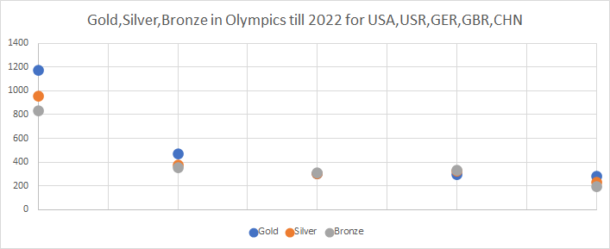
Forecasting: Example # 03

Slide 10
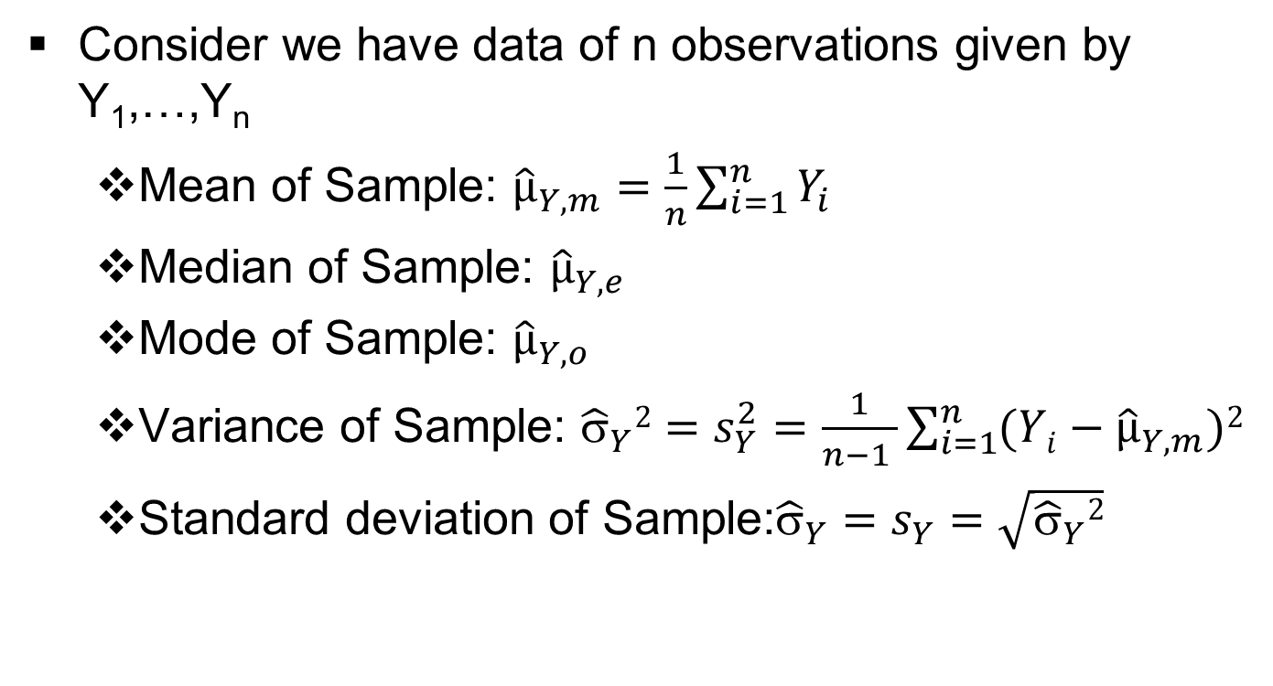
Forecasting: Some numerical characteristics used

Slide 11
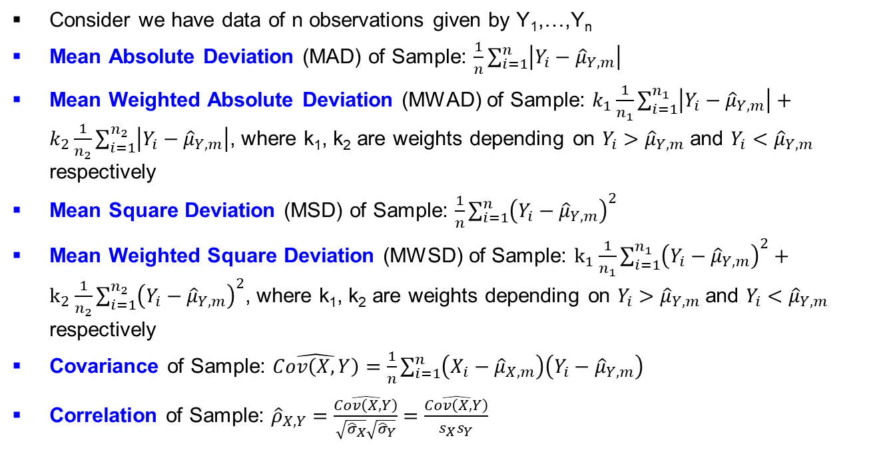
Forecasting: Some numerical characteristics used

Slide 12
Forecasting: Example # 04
Consider the numbers are X = 2, 3, 4, 5, 6, 6, 7, 7, 7, 21, 21, 102 and n = 12
Mean(X) = 15.9167
Median(X) = 6.5000
Mode(X) = 7
Variance(X) = 774.4470
SD(X) = 27.8289

Slide 13
Forecasting: Example # 04 (contd…)
Mean Absolute Deviation (MAD) of X= 16.0417
Median Weighted Absolute Deviation (MWAD) of X = 16.0417 provided all weights are 1
Mean Square Deviation (MSD) of X= 709.9097
Mean Weighted Square Deviation (MWSD) of X = 709.9097 provided all weights are 1

Slide 14
Forecasting: Example # 04 (contd…)
Consider a second set of numbers as Y = 2, 7, 8, 9, 10, 11, 12, 13, 14, 15, 150, 186 and n = 12
Covariance (X,Y) = 1452.9
Correlation (X,Y) = 0.8416

Slide 15
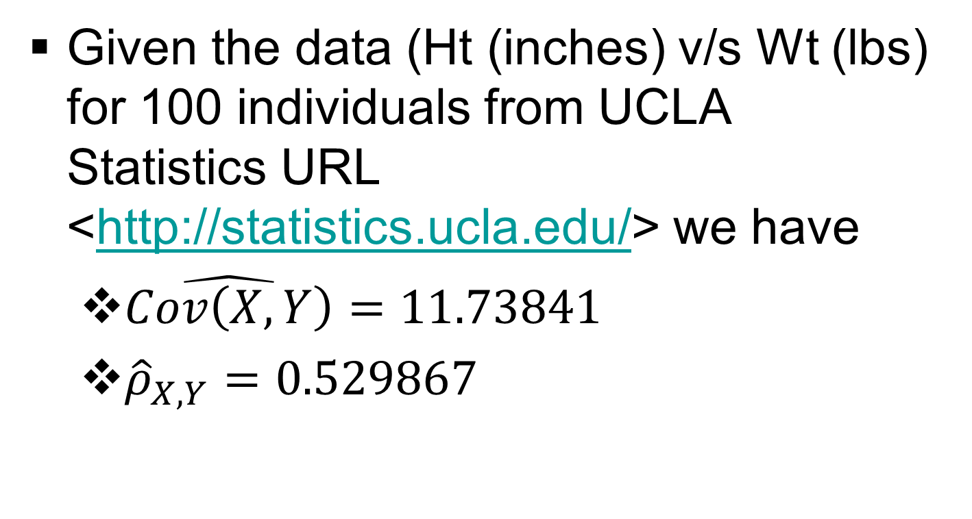
Forecasting: Example # 05

Slide 16
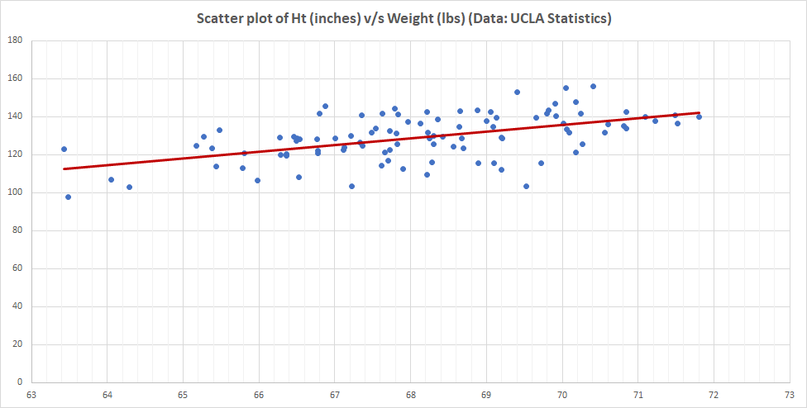
Forecasting: Example # 05 (contd…)

Slide 17
Forecasting: Other concepts
The covariance and correlation coefficient are statistics (summary measures) that measure the extent of the linear relationship between two variables. They can be used to identify explanatory relationships.
Autocovariance and autocorrelation are comparable measures that serve the same purpose for a single time series.

Slide 18
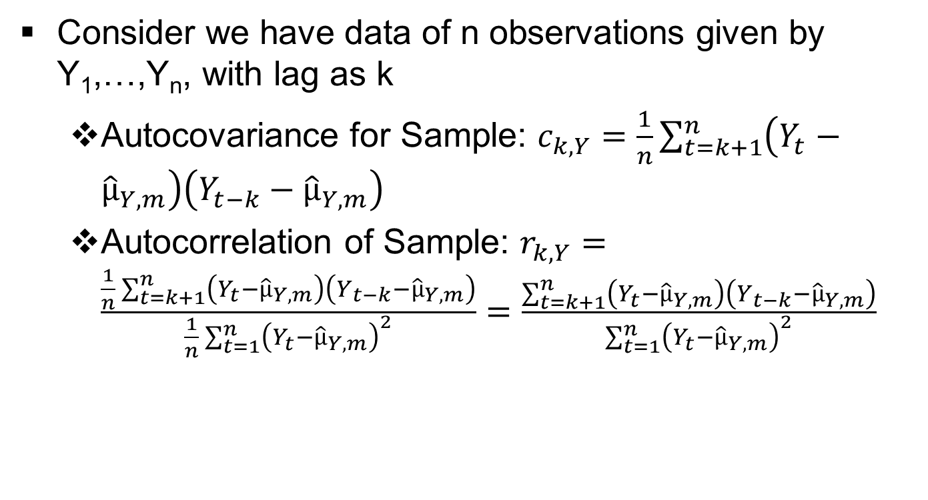
Forecasting: Some numerical characteristics used (contd…)

Slide 19
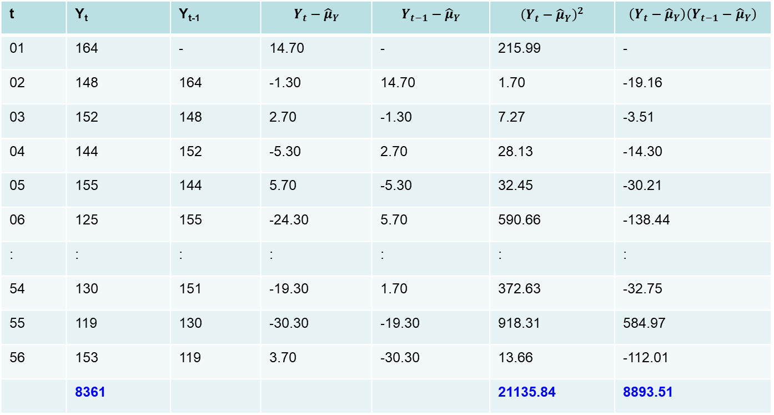
Forecasting: Example # 06
t | Y_{t} | Y_{t-1}
01 | 164 | - | 14.70 | - | 215.99 | -
02 | 148 | 164 | -1.30 | 14.70 | 1.70 | -19.16
03 | 152 | 148 | 2.70 | -1.30 | 7.27 | -3.51
04 | 144 | 152 | -5.30 | 2.70 | 28.13 | -14.30
05 | 155 | 144 | 5.70 | -5.30 | 32.45 | -30.21
06 | 125 | 155 | -24.30 | 5.70 | 590.66 | -138.44
: | : | : | : | : | : | :
54 | 130 | 151 | -19.30 | 1.70 | 372.63 | -32.75
55 | 119 | 130 | -30.30 | -19.30 | 918.31 | 584.97
56 | 153 | 119 | 3.70 | -30.30 | 13.66 | -112.01
 | 8361 |  |  |  | 21135.84 | 8893.51

Slide 20
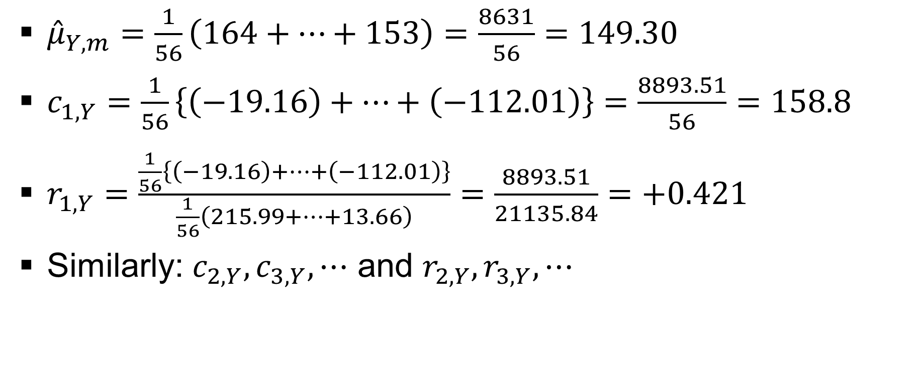
Forecasting: Example # 06 (contd…)

Slide 21
Forecasting: Other concepts (contd…)
Together, the autocorrelations at lags 1, 2, . . . , make up the autocorrelation function or ACF.
Rather than scanning a list of numbers, it is much easier to plot the autocorrelations against the lag.
Such a plot is known as a correlogram and helps us visualize the ACF.

Slide 22
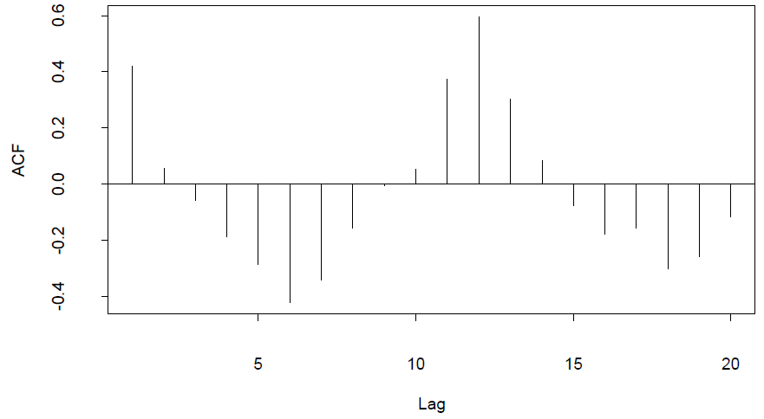
Forecasting: Example # 06
(contd…)

Slide 23
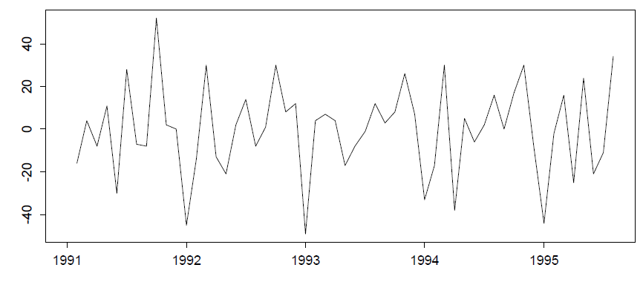
Forecasting: Example # 06 (contd…)

Slide 24
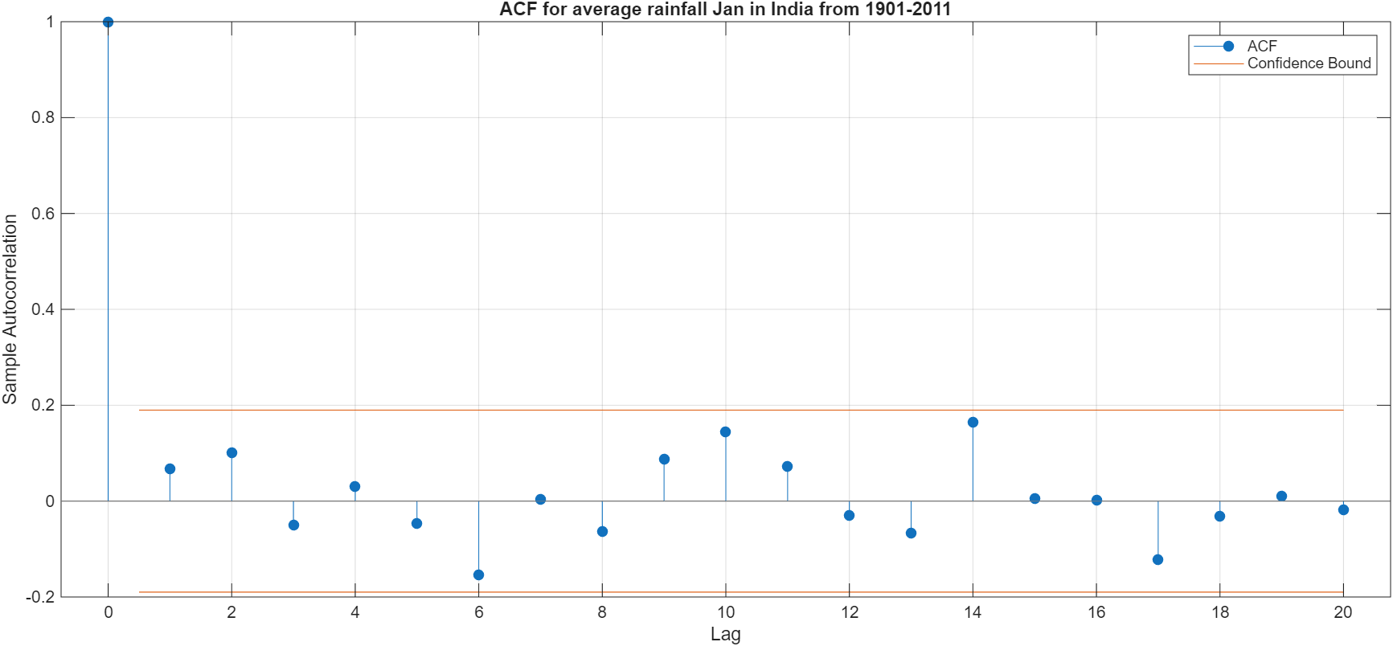
Forecasting: ACF Plots

Slide 25
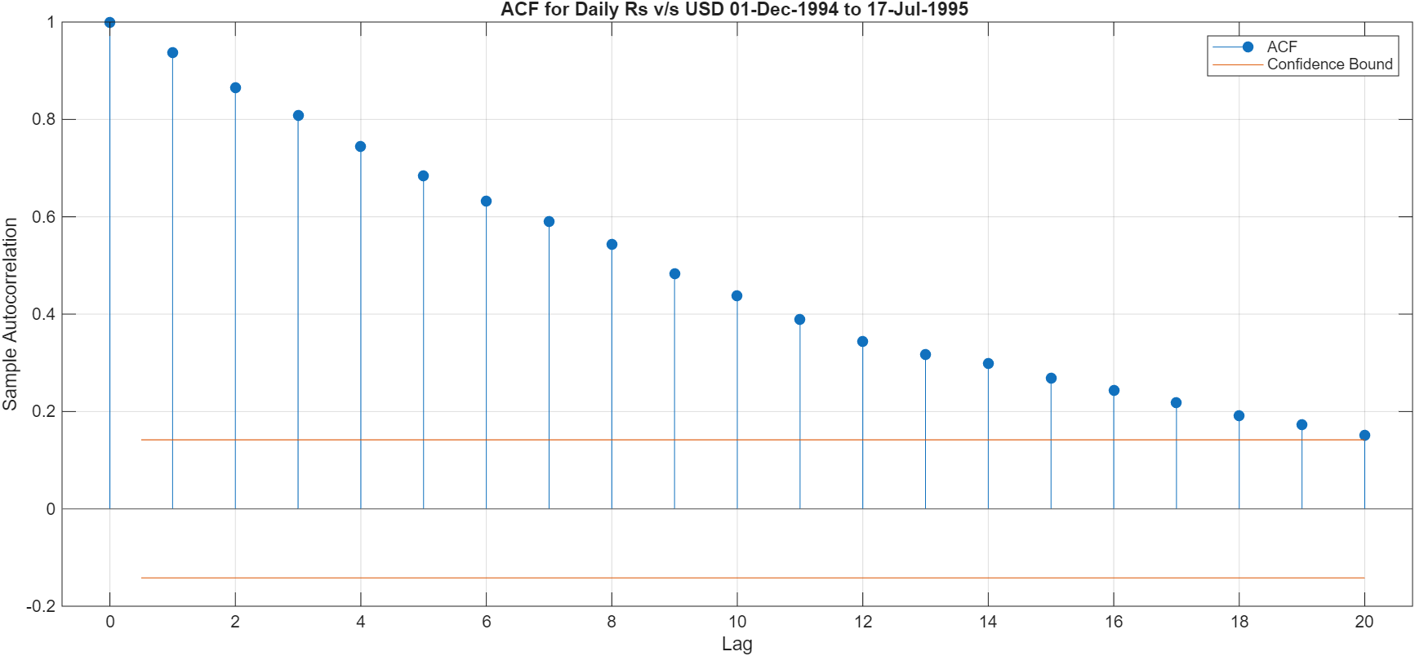
Forecasting: ACF Plots
`

Slide 26
Forecasting: Other concepts (contd…)
Use value of Akaike information criterion (AIC) appropriately
Given a collection of models for the data, AIC estimates the quality of each model, relative to each of the other models and provides a means for model selection.
AIC used extensively in information theory and statistics.

Slide 27
Forecasting: Other concepts (contd…)
AIC: AIC_{M(k)} = -2log{L(_{M(k)})} + 2k, where M(K) is the model with dimension k
AIC estimates the relative amount of information lost by a given model: the less information a model loses, the higher the quality of that model.
In estimating the amount of information lost by a model, AIC deals with the trade-off between the goodness of fit of the model and the simplicity of the model.
In other words, AIC deals with both the risk of overfitting and underfitting.

Slide 28
Forecasting: Some numerical characteristics used (contd…)
Consider we have data of n observations given by Y₁,…,Y_{n}
Y_{t}: Actual value
F_{t}: Forecasted value
E_{t} = (Y_{t} – F_{t}): Error
Mean Error (ME) of Sample: (1/n){E₁ + … + E_{n}}
Mean Absolute Error (MAE) of Sample: (1/n){|E₁| + …. + |E_{n}|}
Mean Squared Error (MSE) of Sample: (1/n){E₁² + …. + E_{n}²}

Slide 29
Forecasting: Some numerical characteristics used (contd…)
Consider we have data of n observations given by Y₁,…,Y_{n}
Y_{t}: Actual value
F_{t}: Forecasted value
E_{t} = (Y_{t} – F_{t}): Error
Mean Percentage Error (MPE) of Sample: (1/n){(Y₁-F₁)/Y₁*100 +…. + (Y_{n}-F_{n})/Y_{n}*100}
Mean Absolute Percentage Error (MAPE) of Sample: (1/n){|(Y₁-F₁)/Y₁|*100 +…. + |(Y_{n}-F_{n})/Y_{n}|*100}

Slide 30
Forecasting: Discussion
ME will only tell you if there is systematic under/over-forecasting, called the forecast bias, and it does not give much indication as to the size of the typical errors.
MAE has the advantage of being more interpretable and is easier to explain to non-specialists.
MSE has the advantage of being easier to handle mathematically.
MAPE is only meaningful if the scale has a meaningful origin, e.g., should be avoided when comparing Temp as °F, °C and K has different origin (e.g., 0 for each scale).

Slide 31
Forecasting: Discussion (contd…)
An MSE or MAPE of zero can always be obtained in the fitting phase by using a polynomial of sufficiently high order.
Different methods use different procedures in the fitting phase.
The relative measures all give equal weight to all errors in contrast to the MSE, which squares the errors and thereby emphasizes large errors.
It would be helpful to have a measure that considers both the disproportionate cost of large errors and provides a relative basis for comparison with naive methods and one measure is the U statistics.

Slide 32
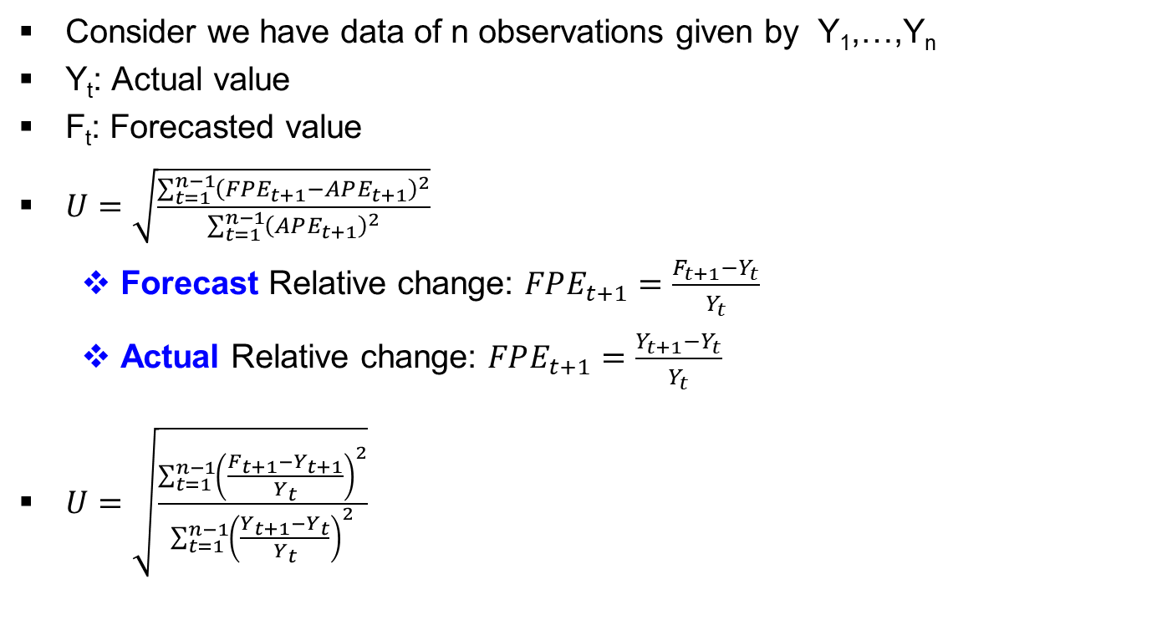
Forecasting: Some numerical characteristics used (contd…)

Slide 33
Forecasting: Discussion (contd…)
U statistics incorporates both MAPE and naïve concept.
U value is 1 if only if FPE_{t+1} is 0 and that would occur if the errors in the forecasting method were the same as those that would be obtained by forecasting no change at all in the actual values, which is comparable to naïve approach.
  U=1: Naïve method is as good as the forecasting technique being evaluated.
  U<1: Forecasting technique being used is better than the naïve method and hence smaller the U-statistic, the better the forecasting technique is relative to the naive method.
  U>1: There is no point in using a formal forecasting method, since using a naïve method will produce better results.

Slide 34
Forecasting: Example # 07
t | Y_{t} | F_{t} | {(F_{t+1} – Y_{t+1})/Y_{t}}² | {(Y_{t+1} – Y_{t})/Y_{t}}²
1 | 138 | 150.25 | =((139.5-136)/138)²=0.0006 | =((136-138)/138)²=0.0002
2 | 136 | 139.50 | 0.0015 | 0.0138
3 | 152 | 157.25 | 0.0118 | 0.0271
4 | 127 | 143.50 | 0.0105 | 0.0357
5 | 151 | 138.00 | 0.0003 | 0.0193
6 | 130 | 127.50 | 0.0219 | 0.0072
7 | 119 | 138.25 | 0.0093 | 0.0816
8 | 153 | 141.50 | - | -
 |  |  | 0.0559 | 0.1849
U=√(0.0559/0.1849)=0.549841

Slide 35
Forecasting: Discussion (contd…)
Autocorrelation function of the one-step forecast errors is very useful in determining if there is any remaining pattern in the errors (or residuals) after a forecasting model has been applied.
This is not a measure of accuracy per se, but rather can be used to indicate if the forecasting method could be improved.
It is good to have a benchmark to determine if an autocorrelation is significantly large, and a simple rule is to only consider autocorrelations that are larger than the critical values of (2/√n) in magnitude.

Slide 36
Forecasting: Predicting Intervals
In statistics, interval estimation is the use of sample data to estimate an interval of possible values of a parameter of interest.
This is in contrast to point estimation, which gives a single value.
The most prevalent forms of interval estimation are confidence intervals (a frequentist method) and credible intervals (a Bayesian method).
Other forms of statistical intervals include tolerance intervals (covering a proportion of a sampled population) and prediction intervals (an estimate of a future observation, used mainly in regression analysis).

Slide 37
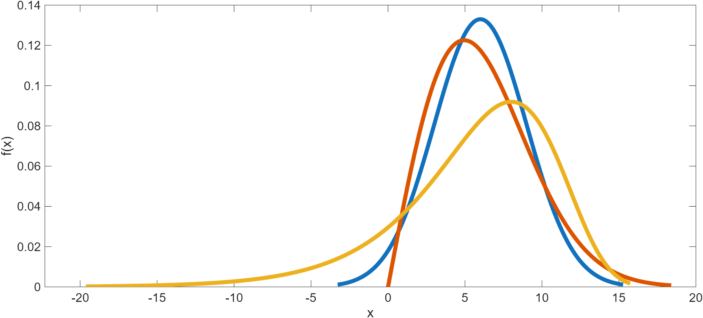
Forecasting: Predicting Intervals (contd…)

Slide 38
Forecasting: Predicting Intervals (contd…)
Prediction intervals are usually based on the MSE because it provides an estimate of the variance of the one-step forecast error.
Thus prediction of interval can be written as F_{n+1} ± k√MSE.
One important thing is to remember is the assumptions (i) E(e_{t}) = 0, (ii) V(e_{t}) is fixed and (iii) e_{t}~N(0,σ²_{e})

Slide 39
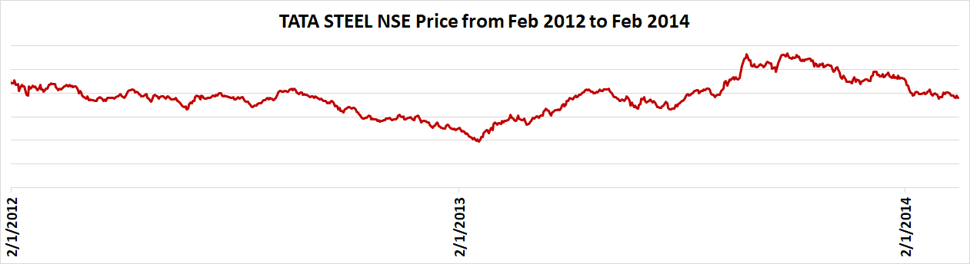
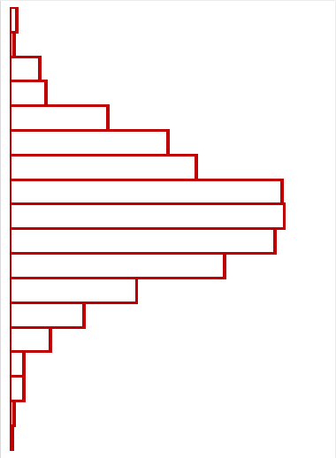
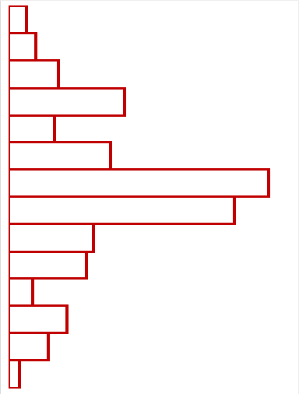
Forecasting: Predicting Intervals (contd…)

Slide 40
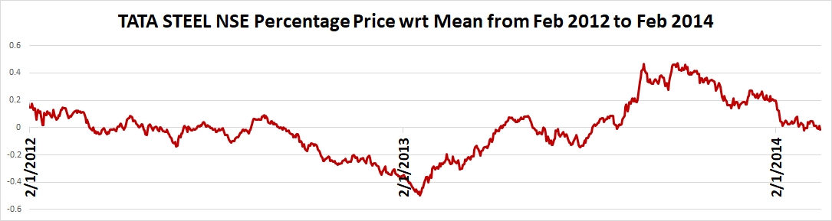
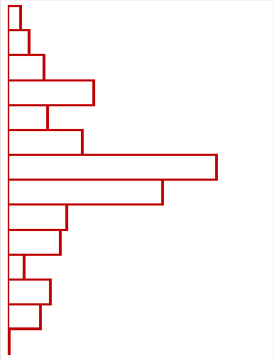
Forecasting: Predicting Intervals (contd…)

Slide 41
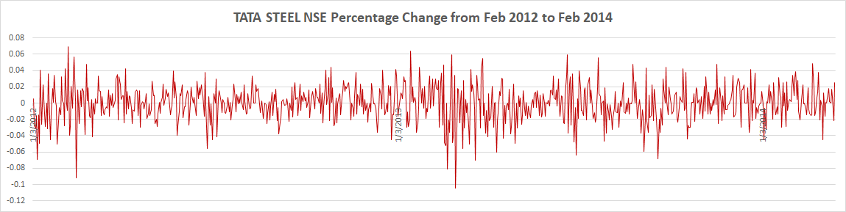
Forecasting: Predicting Intervals (contd…)

Slide 42
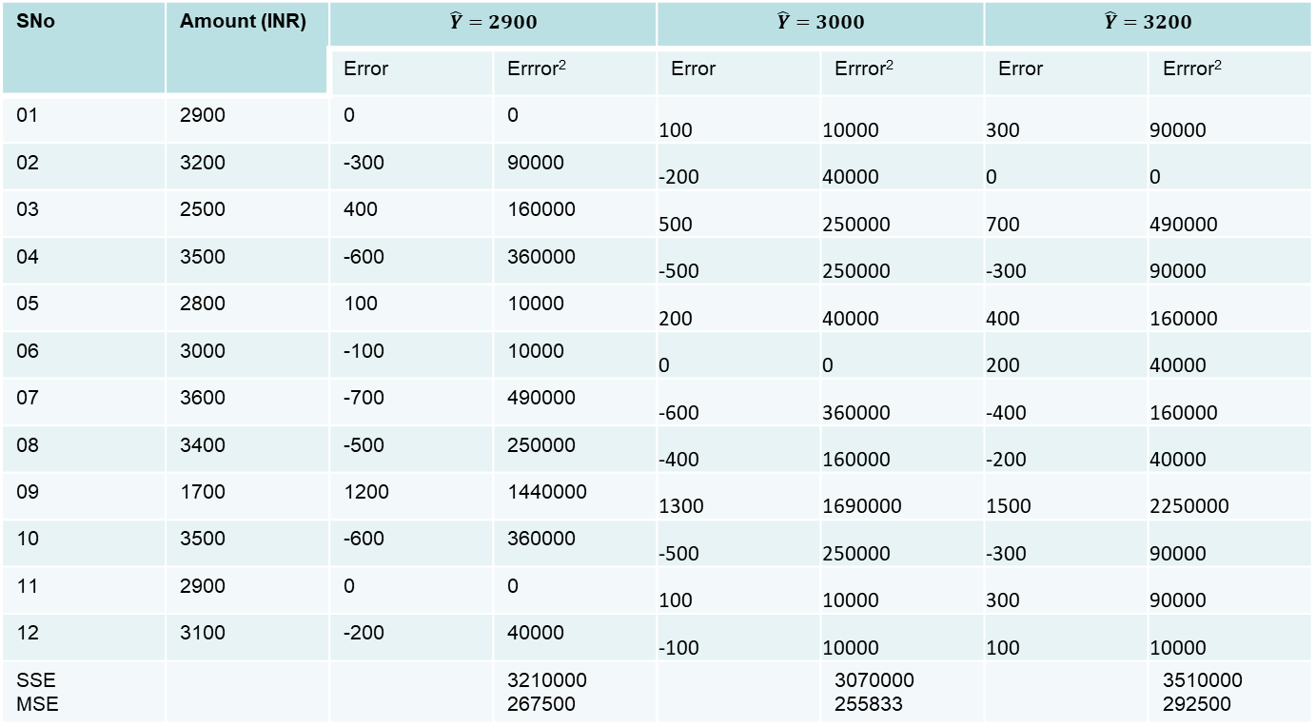
Forecasting: Example # 08
SNo | Amount (INR)
SNo | Amount | Error | Errror² | Error | Errror² | Error | Errror²
01 | 2900 | 0 | 0 | 100 | 10000 | 300 | 90000
02 | 3200 | -300 | 90000 | -200 | 40000 | 0 | 0
03 | 2500 | 400 | 160000 | 500 | 250000 | 700 | 490000
04 | 3500 | -600 | 360000 | -500 | 250000 | -300 | 90000
05 | 2800 | 100 | 10000 | 200 | 40000 | 400 | 160000
06 | 3000 | -100 | 10000 | 0 | 0 | 200 | 40000
07 | 3600 | -700 | 490000 | -600 | 360000 | -400 | 160000
08 | 3400 | -500 | 250000 | -400 | 160000 | -200 | 40000
09 | 1700 | 1200 | 1440000 | 1300 | 1690000 | 1500 | 2250000
10 | 3500 | -600 | 360000 | -500 | 250000 | -300 | 90000
11 | 2900 | 0 | 0 | 100 | 10000 | 300 | 90000
12 | 3100 | -200 | 40000 | -100 | 10000 | 100 | 10000
SSE MSE |  |  | 3210000 267500 |  | 3070000 255833 |  | 3510000 292500

Slide 43
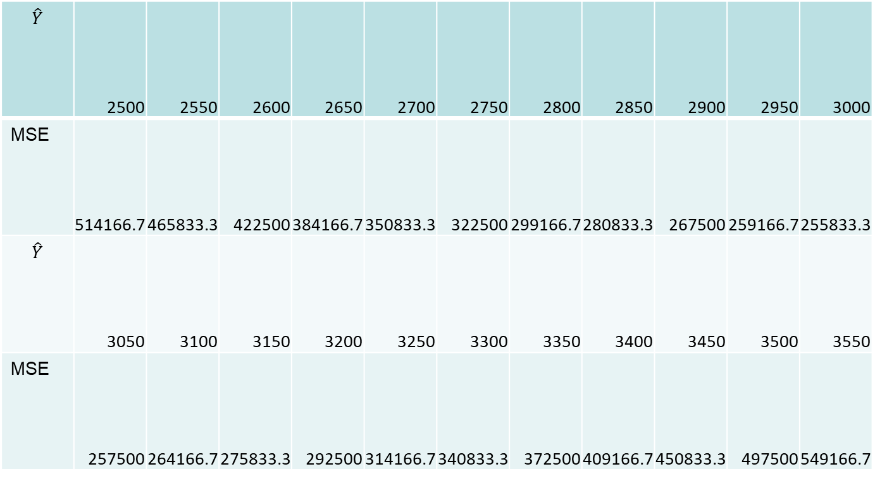
Forecasting: Example # 08 (contd…)
 | 2500 | 2550 | 2600 | 2650 | 2700 | 2750 | 2800 | 2850 | 2900 | 2950 | 3000
MSE | 514166.7 | 465833.3 | 422500 | 384166.7 | 350833.3 | 322500 | 299166.7 | 280833.3 | 267500 | 259166.7 | 255833.3
 | 3050 | 3100 | 3150 | 3200 | 3250 | 3300 | 3350 | 3400 | 3450 | 3500 | 3550
MSE | 257500 | 264166.7 | 275833.3 | 292500 | 314166.7 | 340833.3 | 372500 | 409166.7 | 450833.3 | 497500 | 549166.7

Slide 44
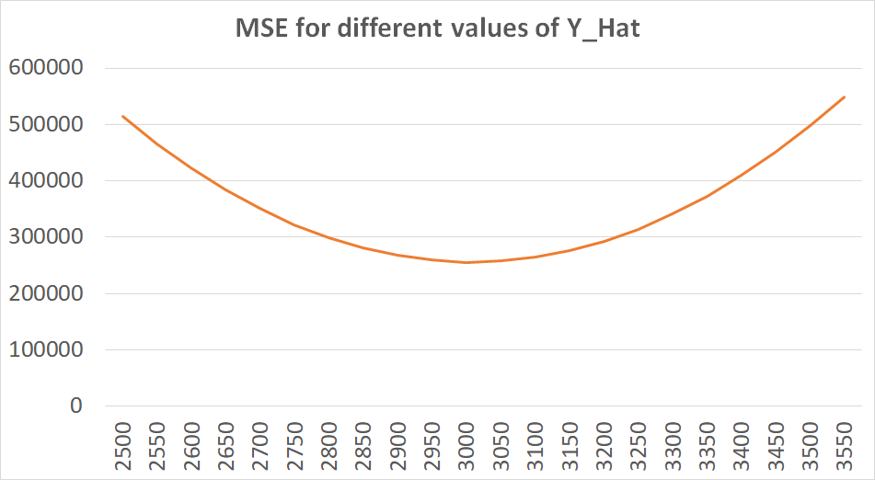
Forecasting: Example # 08 (contd…)

Slide 45
Weighted Moving Averages
In general a weighted k-point moving average can be written as
  T_{t} = {a_{-m}Y_{t-m} + a_{-m+1}Y_{t-m+1} + ….. + a₀Y₀ + ….. + a_{m-1}Y_{t+m-1} + a_{m}Y_{t+m}}
  {a_{-m} + a_{-m+1} + ….. + a₀ + ….. + a_{m-1} + a_{m}}= 1
  Weights are symmetric, i.e., a_{j} = a_{-j}

Slide 46
Weighted Moving Averages (contd…)
Calculate 4X4MA
4MA(1)=(Y₁+Y₂+Y₃+Y₄)/4 = Y₁/4 + Y₂/4 + Y₃/4 + Y₄/4
4MA(2)=(Y₂+Y₃+Y₄+Y₅)/4 = Y₂/4 + Y₃/4 + Y₄/4 + Y₅/4
4MA(3)=(Y₃+Y₄+Y₅+Y₆)/4 = Y₃/4 + Y₄/4 + Y₅/4 + Y₆/4
4MA(4)=(Y₄+Y₅+Y₆+Y₇)/4 = Y₄/4 + Y₅/4 + Y₆/4 + Y₇/4
4X4MA={(Y₁+Y₂+Y₃+Y₄)/4+(Y₂+Y₃+Y₄+Y₅)/4+(Y₃+Y₄+Y₅+Y₆)/4+(Y₄+Y₅+Y₆+Y₇)/4}/4=(1*Y₁+2*Y₂+3*Y₃+4*Y₄+3*Y₅+2*Y₆+1*Y₇)/16
5X4X4MA = a₋₂*4X4MA(1) + a₋₁*4X4MA(2) + a₀*4X4MA(3) + a₁*4X4MA(4) + a₂*4X4MA(5), where a₋₂, a₋₁, a₀, a₂ are weights

Slide 47
Moving Averages: Example # 09
Data given is the number (in X10⁵) of world wide international airline passengers for the years 1949-1956
Using this data to find out
3MA
5MA
7MA
2X4MA
2X6MA
3X3MA
5X4X4MA

Slide 48
Moving Averages: Example # 09 (contd…)
Mth Pass Mth Pass
Jan 112 Jan 145
Feb 118 Feb 150
Mar 132 Mar 178
Apr 129 Apr 163
May 121 May 172
Jun 135 Jun 178
Jul 148 Jul 199
Aug 148 Aug 199
Sep 136 Sep 184
Oct 119 Oct 162
Nov 104 Nov 146
Dec 118 Dec 166
Jan 115 Jan 171
Feb 126 Feb 180
Mar 141 Mar 193
Apr 135 Apr 181
May 125 May 183
Jun 149 Jun 218
Jul 170 Jul 230
Aug 170 Aug 242
Sep 158 Sep 209
Oct 133 Oct 191
Nov 114 Nov 172
Dec 140 Dec 194
Mth Pass Mth Pass
Jan 196 Jan 242
Feb 196 Feb 233
Mar 236 Mar 267
Apr 235 Apr 269
May 229 May 270
Jun 243 Jun 315
Jul 264 Jul 364
Aug 272 Aug 347
Sep 237 Sep 312
Oct 211 Oct 274
Nov 180 Nov 237
Dec 201 Dec 278
Jan 204 Jan 284
Feb 188 Feb 277
Mar 235 Mar 317
Apr 227 Apr 313
May 234 May 318
Jun 264 Jun 374
Jul 302 Jul 413
Aug 293 Aug 405
Sep 259 Sep 355
Oct 229 Oct 306
Nov 203 Nov 271
Dec 229 Dec 306

Slide 49
Moving Averages: Example # 09 (contd…)
3MA for Y₀
=(Y₋₁ + Y₀ + Y₊₁)/3

Slide 50
Moving Averages: Example # 09 (contd…)
5MA for Y₀
=(Y₋₂ + Y₋₁ + Y₀ + Y₊₁ + Y₊₂)/5

Slide 51
Moving Averages: Example # 09 (contd…)
7MA for Y₀
=(Y₋₃ + Y₋₂ + Y₋₁ + Y₀ + Y₊₁ + Y₊₂ + Y₊₃)/7

Slide 52
Moving Averages: Example # 09 (contd…)
2X4MA for Y₀
={(Y₋₂ + Y₋₁ + Y₀ + Y₊₁)/4 + (Y₋₁ + Y₀ + Y₊₁ + Y₊₂)/4]/2
=(1/8)*Y₋₂ + (2/8)*Y₋₁ + (2/8)*Y₀ + (2/8)*Y₊₁ + (1/8)*Y₊₂
Note: Sum of weights is 1 {(1/8)+(2/8)+(2/8)+(2/8)+(1/8)}

Slide 53
Moving Averages: Example # 09 (contd…)
2X6MA for Y₀
= {(Y₋₃ + Y₋₂ + Y₋₁ + Y₀ + Y₊₁ + Y₊₂)/6 + (Y₋₂ + Y₋₁ + Y₀ + Y₊₁ + Y₊₂ + Y₊₃)/6}/2}
=(1/12) *Y₋₃ + (2/12)*Y₋₂ + (2/12)*Y₋₁ + (2/12)*Y₀ + (2/12)*Y₊₁+ (2/12)*Y₊₂ + (1/12)*Y₊₃
Note: Sum of weights is 1 {(1/12)+(2/12)+(2/12)+(2/12)+(2/12) +(2/12)+(1/12)}

Slide 54
Moving Averages: Example # 09 (contd…)
4X6MA for Y₀
={(Y₋₄ + Y₋₃ + Y₋₂ + Y₋₁ + Y₀ + Y₊₁)/6 + (Y₋₃ + Y₋₂ + Y₋₁ + Y₀ + Y₊₁ + Y₊₂)/6 + (Y₋₂ + Y₋₁ + Y₀ + Y₊₁ + Y₊₂ + Y₊₃)/6 +
(Y₋₁ + Y₀ + Y₊₁ + Y₊₂ + Y₊₃ + Y₊₄)/6}/4

Slide 55
Moving Averages: Example # 09 (contd…)
4X6MA for Y₀
(1/24)*Y₋₄ + (2/24)*Y₋₃ + (3/24)*Y₋₂ (4/24)*Y₋₁ + (4/24)*Y₀ + (4/24)*Y₊₁ + (3/24)*Y₊₂ + (2/24)*Y₊₃ + (1/24)*Y₊₄
Note: Sum of weights is 1 {(1/24)+(2/24)+(3/24)+(4/24)+(4/24)+(4/24)+(3/24)+(2/24)+(1/24)}

Slide 56
Moving Averages: Example # 09 (contd…)
3X3MA for Y₀
={(Y₋₂ + Y₋₁ + Y₀)/3 + (Y₋₁ + Y₀ + Y₊₁)/3 + (Y₀ + Y₊₁ + Y₊₂)/3}/3
= (1/9)*Y₋₂ + (2/9)*Y₋₁ + (3/9)*Y₀ + (2/9)*Y₊₁ + (1/9)*Y₊₂
Note: Sum of weights is 1 {(1/9)+(2/9)+(3/9)+(2/9)+(1/9)}

Slide 57
Moving Averages: Example # 09 (contd…)
5X4X4MA for Y₀
= [{(Y₋₅ + Y₋₄ + Y₋₃ + Y₋₂) + (Y₋₄ + Y₋₃ + Y₋₂ + Y₋₁) + (Y₋₃ + Y₋₂ + Y₋₁ + Y₀) + (Y₋₂ + Y₋₁ + Y₀ + Y₊₁)}/4 + {(Y₋₄ + Y₋₃ + Y₋₂ + Y₋₁) + (Y₋₃ + Y₋₂ + Y₋₁ + Y₀) + (Y₋₂ + Y₋₁ + Y₀ + Y₊₁) + (Y₋₁ + Y₀ + Y₊₁ + Y₊₂)}/4 + {(Y₋₃ + Y₋₂ + Y₋₁ + Y₀) + (Y₋₂ + Y₋₁ + Y₀ + Y₊₁) + (Y₋₁ + Y₀ + Y₊₁ + Y₊₂) + (Y₀ + Y₊₁ + Y₊₂ + Y₊₃)}/4 + {(Y₋₂ + Y₋₁ + Y₀ + Y₊₁) + (Y₋₁ + Y₀ + Y₊₁ + Y₊₂) + (Y₀ + Y₊₁ + Y₊₂ + Y₊₃) + (Y₊₁ + Y₊₂ + Y₊₃ + Y₊₄)}/4 + {(Y₋₁ + Y₀ + Y₊₁ + Y₊₂) + (Y₀ + Y₊₁ + Y₊₂ + Y₊₃) + (Y₊₁ + Y₊₂ + Y₊₃ + Y₊₄) + (Y₊₂ + Y₊₃ + Y₊₄ + Y₊₅)}/4]/5

Slide 58
Moving Averages: Example # 09 (contd…)
5X4X4MA for Y₀
= (1/80)*Y₋₅ + (3/80)*Y₋₄ + (6/80)*Y₋₃ + (10/80)*Y₋₂ + (13/80)*Y₋₁ + (14/80)*Y₀ + (13/80)*Y₊₁ + (10/80)*Y₊₂ + (6/80)*Y₊₃ + (3/80)*Y₊₄ + (1/80)*Y₊₅
Note: Sum of weights is 1 {(1/80)+(3/80)+(6/80)+(10/80)+(13/80)+(14/80)+(13/80)+(10/80)+(6/80)+(3/80)+(1/80)}

Slide 59
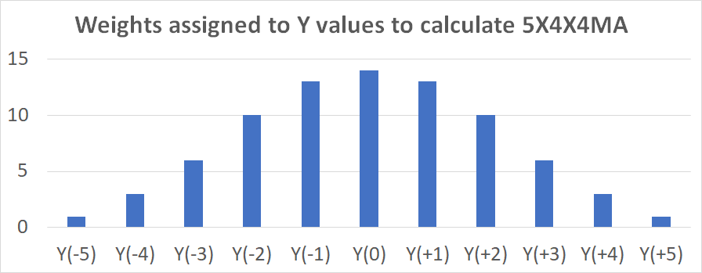
Moving Averages: Example # 09 (contd…)

Slide 60
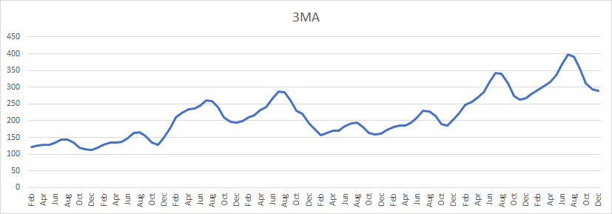
Moving Averages: Example # 09 (contd…)

Slide 61
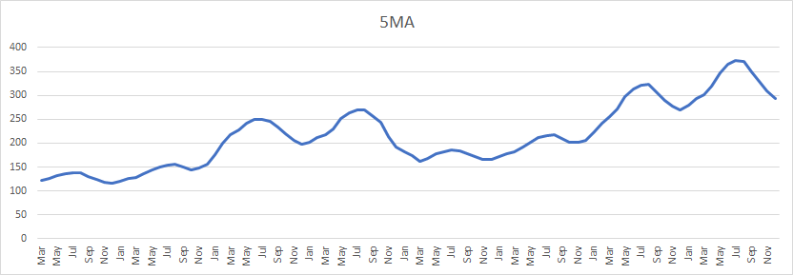
Moving Averages: Example # 09 (contd…)

Slide 62
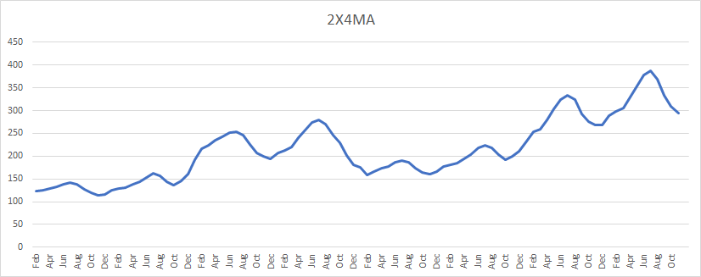
Moving Averages: Example # 09 (contd…)

Slide 63
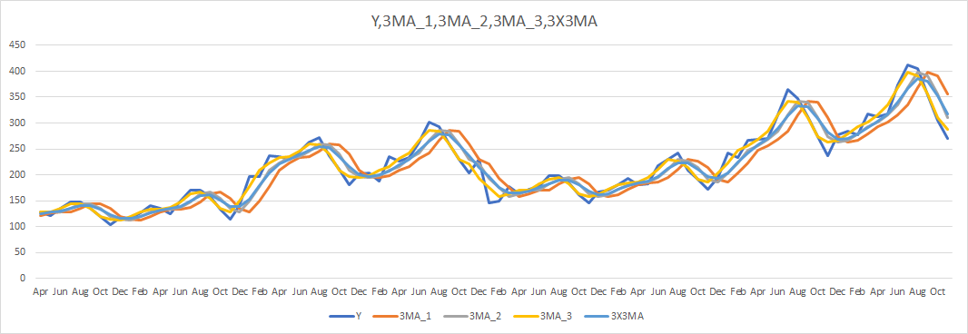
Moving Averages: Example # 09 (contd…)

Slide 64
Moving Averages: Example # 09 (contd…)

Slide 65
Exponential Smoothing Methods
Exponential Smoothing: single non-adaptive parameter
Exponential Smoothing: multiple non-adaptive parameter
Exponential Smoothing: single adaptive parameter

Slide 66
Other Forecasting Methods
Holt′s linear method: trend analysis
Holt-Winter′s method: trends and multiplicative seasonality
Holt-Winter′s method: trends and additive seasonality

Slide 67
Exponential Smoothing (single non-adaptive parameter)
F_{t+1} = F_{t} + α(Y_{t} – F_{t})
F_{t+1} = αY_{t} + (1 - α)F_{t}
Y_{t}: Actual value
F_{t}: Forecasted value
E_{t} = Y_{t} - F_{t} : Error term
α ∈ (0,1): Weight such that MSE is minimized

Slide 68
Exponential Smoothing (single non-adaptive parameter): Example # 10
Month Y(t) F(t, 0.1) F(t,0.5) F(t,0.9)
Jan 200.0
Feb 135.0 200.0 200.0 200.0
Mar 195.0 193.5 167.5 141.5
Apr 197.5 193.7 181.3 189.7
May 310.0 194.0 189.4 196.7
Jun 175.0 205.6 249.7 298.7
Jul 155.0 202.6 212.3 187.4
Aug 130.0 197.8 183.7 158.2
Sep 220.0 191.0 156.8 132.8
Oct 277.5 193.9 188.4 211.3
Nov 235.0 202.3 233.0 270.9
Dec ------- 205.6 234.0 238.6

Slide 69
Exponential Smoothing (single non-adaptive parameter): Example # 10 (contd…)

Slide 70
Exponential Smoothing (multiple non-adaptive parameter)
F_{t+1} = α₁Y_{t} + α₂F_{t} + α₃Y_{t-1} + α₄F_{t-1}
Y_{t}: Actual value
F_{t}: Forecasted value
E_{t} = Y_{t} - F_{t} : Error term
α_{i} ∈ (0,1) where i=1,2,3,4: Weights (which add up to 1) such that MSE, U, MAPE, MPE, MAE is considered
Some other constraints/assumptions can be related to (i) α₁ ≥ α₂ ≥ α₃ ≥ α₄ and/or (ii) 0 ≤ |Y_{t} – F_{t}| ≤ ε₁, etc.

Slide 71
Exponential Smoothing (multiple non-adaptive parameter): Example # 11
Month | Jan | Feb | Mar | Apr | May | Jun | Jul | Aug | Sep | Oct | Nov | Dec
Y | 200.00 | 135.00 | 195.00 | 197.50 | 310.00 | 175.00 | 155.00 | 130.00 | 220.00 | 277.50 | 235.00 | 175.00
Month | Jan | Feb | Mar | Apr | May | Jun | Jul | Aug | Sep | Oct | Nov | Dec
Y | 185.00 | 135.00 | 190.00 | 195.00 | 270.00 | 155.00 | 180.00 | 200.00 | 280.00 | 245.00 | 240.00 | 190.00
Month | Jan | Feb | Mar | Apr | May | Jun | Jul | Aug | Sep | Oct | Nov | Dec
Y | 200.00 | 150.00 | 195.00 | 205.00 | 265.00 | 150.00 | 105.00 | 230.00 | 270.00 | 260.00 | 200.00 | 210.00

Slide 72
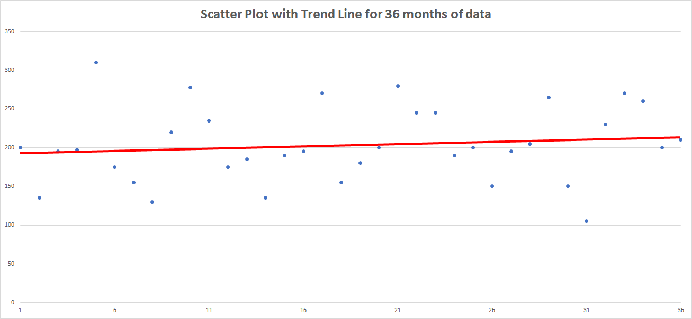
Exponential Smoothing (multiple non-adaptive parameter): Example # 11 (contd…)

Slide 73
Exponential Smoothing (multiple non-adaptive parameter): Example # 11 (contd…)
Starting Values
F₁ = Y₁ (This may not be a good logic to start, and in case we have the AVERAGE value from some past data we can use it here)
F₂ = Y₁ (This means we are expecting the forecasted value of next time will be BEST estimated by actual of previous time)

Slide 74
Exponential Smoothing (multiple non-adaptive parameter): Example # 11 (contd…)
α₁, α₂, α₃, α₄ | 0.40,0.30,0.20,0.10 | 0.50,0.40,0.10,0.00 | 0.30,0.25,0.25,0.20 | 0.30,0.30,0.20,0.20
MSE | 3248.749 | 3332.312 | 3145.955 | 3056.595
MAE | 47.78404 | 48.23577 | 46.73105 | 45.8378
U Statistics | 0.886142 | 0.904781 | 0.865582 | 0.851017
MAPE | 25.26225 | 25.50796 | 24.70266 | 24.2339

Slide 75
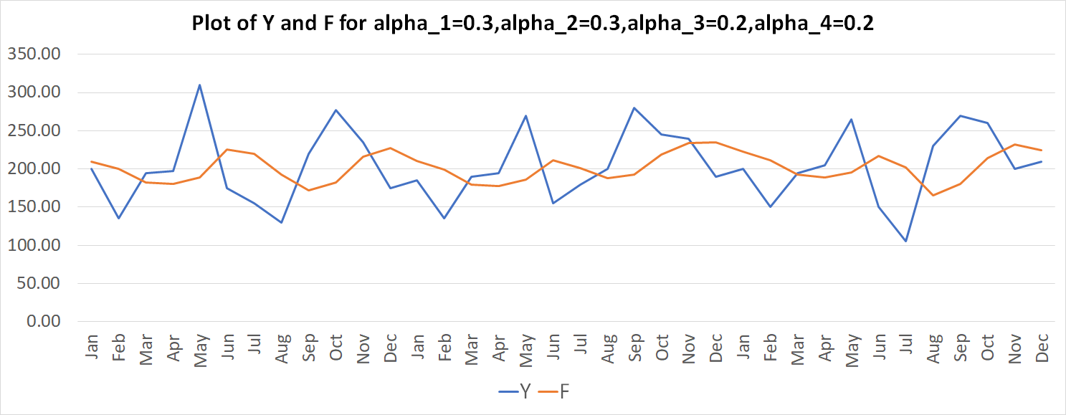
Exponential Smoothing (multiple non-adaptive parameter): Example # 11 (contd…)

Slide 76
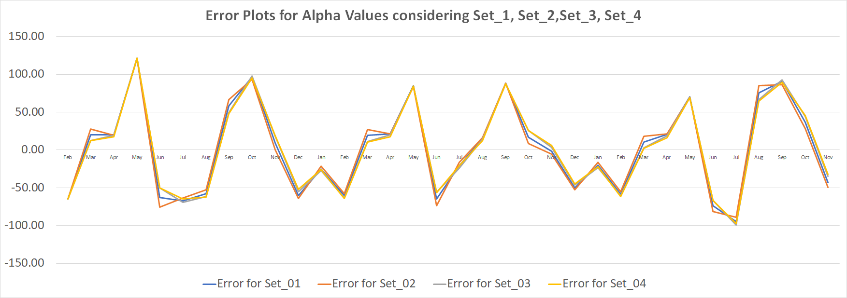
Exponential Smoothing (multiple non-adaptive parameter): Example # 11 (contd…)

Slide 77
Exponential Smoothing (single adaptive parameter)
F_{t+1} = α_{t}Y_{t} + (1 - α_{t})F_{t}
Y_{t}: Actual value
F_{t}: Forecasted value
E_{t} = Y_{t} - F_{t} : Error term
A_{t} = βE_{t} + (1 - β)A_{t-1}: Smoothed Error
M_{t} = β|E_{t}| + (1 - β)M_{t-1}:Absolute Smoothed Error
α_{t+1} = |A_{t}/M_{t}|: Weight
α and β (0≤β≤1) are such that SSE/MSE/U/MAPE, etc., are/is minimized

Slide 78
Exponential Smoothing (single adaptive parameter): Example # 12 (contd…)
Starting values
F₂ = Y₁
A₁ = M₁ = 0
α₂ = 0.2 (which adapts and changes)
β = 0.2 (is fixed and needs to be changed to find the best combination)

Slide 79
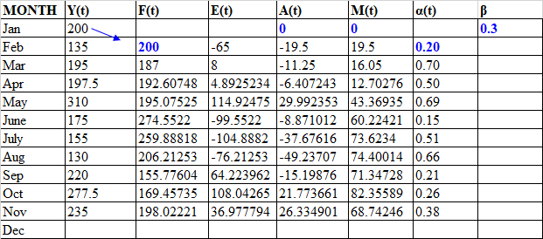
Exponential Smoothing (single adaptive parameter): Example # 12

Slide 80
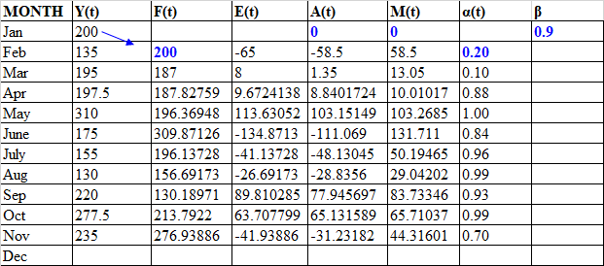
Exponential Smoothing (single adaptive parameter): Example # 12 (contd…)

Slide 81
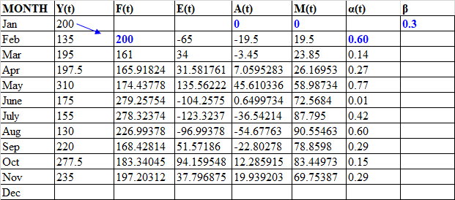
Exponential Smoothing (single adaptive parameter): Example # 12 (contd…)

Slide 82
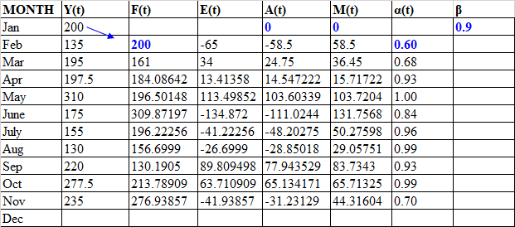
Exponential Smoothing (single adaptive parameter): Example # 12 (contd…)

Slide 83
Exponential Smoothing (single adaptive parameter): Example # 12

Slide 84
Exponential Smoothing (single adaptive parameter): Example # 12 (contd…)

Slide 85
Exponential Smoothing (single adaptive parameter): Example # 12 (contd…)

Slide 86
Exponential Smoothing (single adaptive parameter): Example # 12 (contd…)

Slide 87
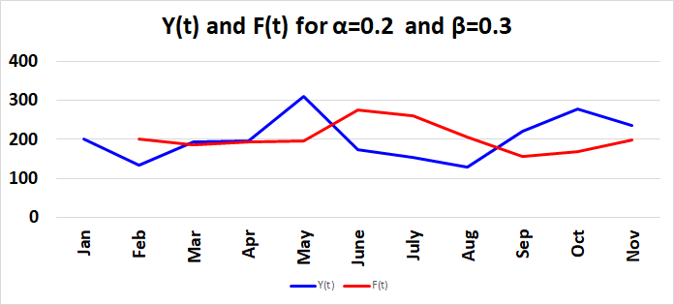
Exponential Smoothing (single adaptive parameter): Example # 12 (contd…)

Slide 88
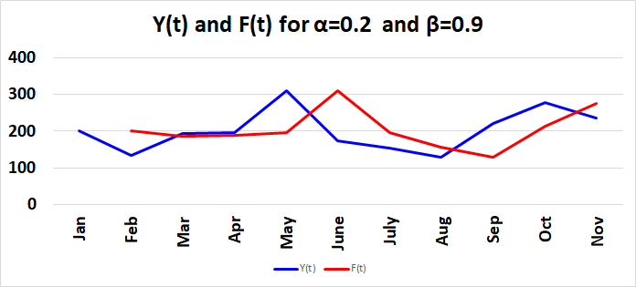
Exponential Smoothing (single adaptive parameter): Example # 12 (contd…)

Slide 89
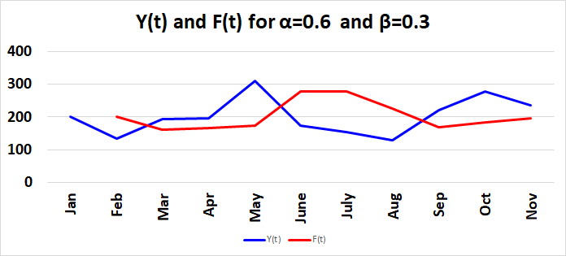
Exponential Smoothing (single adaptive parameter): Example # 12 (contd…)

Slide 90
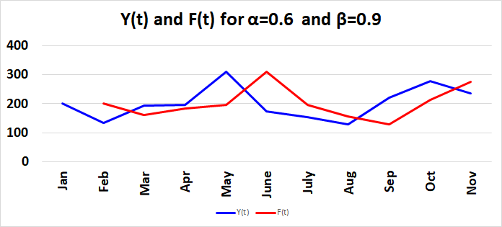
Exponential Smoothing (single adaptive parameter): Example # 12 (contd…)

Slide 91
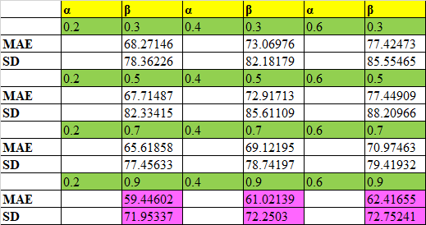
Exponential Smoothing (single adaptive parameter): Example # 12 (contd…)

Slide 92
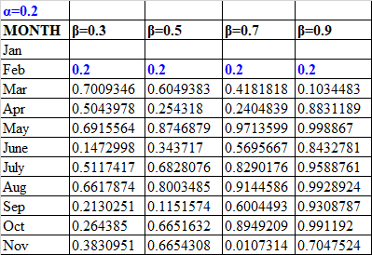
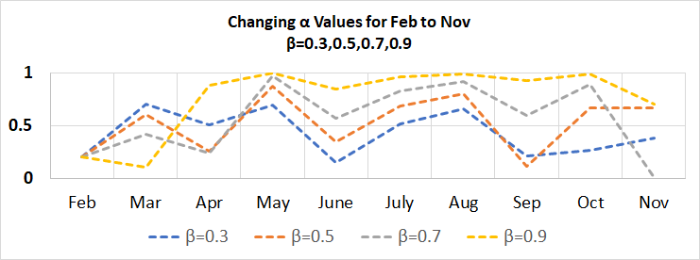
Exponential Smoothing (single adaptive parameter): Example # 12 (contd…)

Slide 93
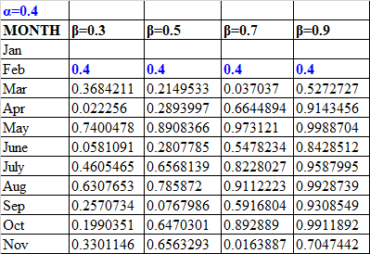
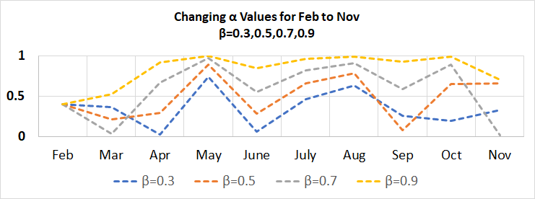
Exponential Smoothing (single adaptive parameter): Example # 12 (contd…)

Slide 94
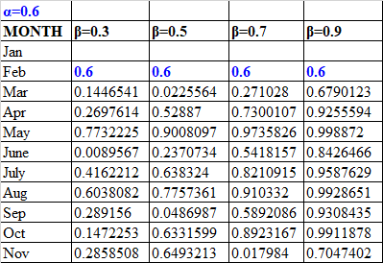
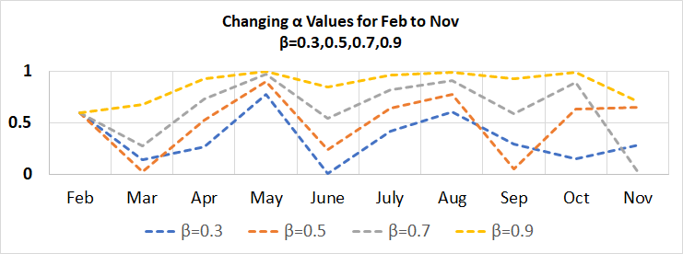
Exponential Smoothing (single adaptive parameter): Example # 12 (contd…)

Slide 95
Forecasting: Example # 13
The IIT Home Tutor Solutions Pvt. Ltd. helps customers to find private tuitions and coaching centers in Kanpur city as well as online tutors. This supply business is competitive, and the ability to deliver talented as well as well-educated tutors promptly is a big factor in getting new customers and maintaining old ones. The manager of the company wants to be certain that enough tutors are available at hand to meet demand promptly. Therefore, the manager wants to be able to forecast the demand for requirement of tutors during the next month. From the records of previous orders, management has accumulated the following data for the past 10 months:

Slide 96
Forecasting: Example # 13 (contd…)
Jan Feb Mar Apr May
120 90 100 75 110
Jun Jul Aug Sep Oct
50 75 130 110 90

Slide 97
Forecasting: Example # 13 (contd…)
Compute the monthly demand forecast for
February through November using the naïve method
April through November using a 3-month moving average
June through November using a 5-month moving average
April through November using a 3-month weighted moving average. Use weights of 0.50, 0.33, and 0.17, with the heavier weights on the more recent months

Slide 98
Forecasting: Example # 13 (contd…)
The naïve method uses demand for the current month as forecast for the next month, i.e.,, Y_{t}=D_{t}=F_{t+1}, where D_{t}=Y_{t} denotes demand for time period t.
So for Feb we would have F_{Feb}=D_{Jan}=120 and in the same way we can write F_{Nov}=D_{Oct}=90.
The other values may be calculated accordingly

Slide 99
Forecasting: Example # 13 (contd…)
For the simple 3 month moving average we use the following formulae which is F_{t+1}=(D_{t}+D_{t-1}+D_{t-2})/3.
Thus we can start to forecast from April ONLY and the value is given as F_{Apr}=(D_{Mar}+D_{Feb}+D_{Jan})/3=(100+90+120)/3=103.3.
The other values may be calculated accordingly

Slide 100
Forecasting: Example # 13 (contd…)
For the simple 5 month moving average we use the following formulae which is F_{t+1}=(D_{t}+D_{t-1}+D_{t-2}+D_{t-3}+D_{t-4})/5.
Thus we can start to forecast from June ONLY and the value is given as F_{Jun}=(D_{May}+D_{Apr}+D_{Mar}+D_{Feb}+D_{Jan})/5=(110+75+100+90+120)/5=99.0.
The other values may be calculated accordingly

Slide 101
Forecasting: Example # 13 (contd…)
For the weighted 3 month moving average we use the following formulae which is F_{t+1}=(α_{t}*D_{t}+α_{t-1}*D_{t-1}+α_{t-2}*D_{t-2})/3.
Thus we can start to forecast from April ONLY and the value is given as F_{Apr}=(α_{t}*D_{t}+α_{t-1}*D_{t-1}+α_{t-2}*D_{t-2})=(0.50*100+0.33*90+0.17*120)=101.0.
The other values may be calculated accordingly

Slide 102
Forecasting: Example # 14
IIT Kanpur Furniture Ltd. makes customized furniture. Orders are received via online request and subsequently demand is fulfilled. Formed and operated by IIT Kanpur students, the company has had steady growth since it started. Due to volatility of demand, they need a good forecast of demand for their furniture so that they will know how much raw material to purchase and stock. They have compiled demand data for the last 12 months as reported below

Slide 103
Forecasting: Example # 14 (contd…)
Jan Feb Mar
37 40 41
Apr May Jun
37 45 50
Jul Aug Sep
43 47 56
Oct Nov Dec
52 55 54

Slide 104
Forecasting: Example # 14 (contd…)
Use exponential smoothing with smoothing parameter α = 0.3 to compute the demand forecast for January (Period 13).
Use exponential smoothing with smoothing parameter α = 0.5 to compute the demand forecast for January (Period 13).
Suresh M. Rao believes that there is an upward trend in the demand. Use trend-adjusted exponential smoothing with smoothing parameter α = 0.5 and trend parameter β = 0.3 to compute the demand forecast for January (Period 13).
Compute the mean squared error for each of the methods used

Slide 105
Forecasting: Example # 14 (contd…)
Part # 01
The formulae to be used is F_{t+1}=F_{t}+α*(D_{t}-F_{t}), here we consider D_{t}=Y_{t} for our convenience.
To determine the forecast of Jan we need to know for Dec and to know about Dec we need to know about Nov and so on.
Thus
F₂=F₁+α*(D₁-F₁)=37+0.3*(37-37)=37.0
F₃=F₂+α*(D₂-F₂)=37+0.3*(40-37)=37.9
……
F₁₃=F₁₂+α*(D₁₂-F₁₂)=50.85+0.3*(54-50.85)=51.79

Slide 106
Forecasting: Example # 14 (contd…)
Part # 02
The formulae to be used is F_{t+1}=F_{t}+α*(D_{t}-F_{t}), here we consider D_{t}=Y_{t} for our convenience.
To determine the forecast of Jan we need to know for Dec and to know about Dec we need to know about Nov and so on.
Thus
F₂=F₁+α*(D₁-F₁)=37+0.5*(37-37)=37.0
F₃=F₂+α*(D₂-F₂)=37+0.5*(40-37)=38.5
……
F₁₃=F₁₂+α*(D₁₂-F₁₂)=53.21+0.5*(54-53.21)=53.61

Slide 107
Forecasting: Example # 14 (contd…)
Part # 03
The formulae to be used when using trend is
  A_{t}={α*D_{t}+(1-α)*(A_{t-1}+T_{t-1})}
  T_{t}={β*(A_{t}-A_{t-1})+(1-β)*T_{t-1}}
Using the above two we find F_{t+1}=(A_{t}+T_{t})

Slide 108
Forecasting: Example # 14 (contd…)
For period t=2 we first consider A₀=37 and T₀=0. Using which we have the following
A₁={α*D₁+(1-α)*(A₀+T₀)}=0.5*37+{(1-0.5)*(37+0)}=37
T₁={β*(A₁-A₀)+(1-β)*T₀}=0.3*((37-37)+(1-0.3)*0=0
F₂=A₁+T₁=37+0=37

Slide 109
Forecasting: Example # 14 (contd…)
For period t=3 we first consider
A₂={α*D₂+(1-α)*(A₁ + T₁)}={0.5*40+(1-0.5)*(37+ 0)}=38.5
T₂={β*(A₂-A₁)+(1-β)*T₁}={0.3*(38.5-37)+(1-0.3)*0}=0.45
F₃=A₂+T₂= 38.5 +0.45=38.95

Slide 110
Forecasting: Example # 14 (contd…)
Part # 04
To compute the mean square error we need to first compute E_{t}=D_{t}-F_{t}
E_{t} is the error of time period t
Find MSE=(E²₁+E²₂+…+E²_{n-1}+E²_{n})/n

Slide 111
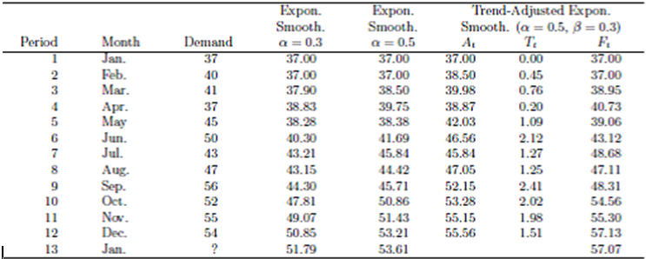
Forecasting: Example # 14 (contd…)

Slide 112
Forecasting: Example # 15
Month | t | Y | F(alpha=0.1) | F(alpha=0.5) | F(alpha=0.9)
Jan | 01 | 200.0
Feb | 02 | 135.0 | 200 | 200 | 200
Mar | 03 | 195.0 | 193.5 | 167.5 | 141.5
Apr | 04 | 197.5 | 193.7 | 181.3 | 189.7
May | 05 | 310.0 | 194.0 | 189.4 | 196.7
Jun | 06 | 175.0 | 205.6 | 249.7 | 298.7
Jul | 07 | 155.0 | 202.6 | 212.3 | 187.4
Aug | 08 | 130.0 | 197.8 | 183.7 | 158.2
Sep | 09 | 220.0 | 191.0 | 156.8 | 132.8
Oct | 10 | 277.5 | 193.9 | 188.4 | 211.3
Nov | 11 | 235.0 | 202.3 | 233.0 | 270.9
Dec | 12 | - | 205.6 | 234.0 | 238.6

Slide 113
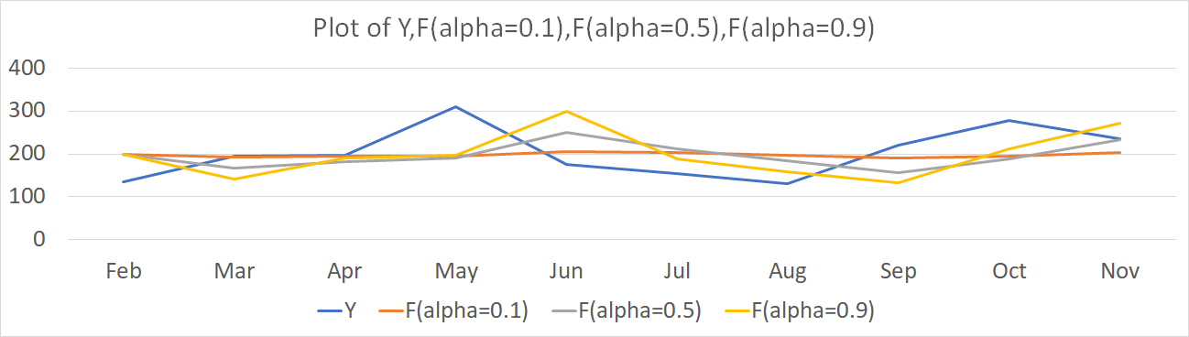
Forecasting: Example # 15 (contd…)

Slide 114
Forecasting: Example # 15 (contd…)
 | α=0.1 | α=0.5 | α=0.9
Mean Error | 5.56 | 6.80 | 4.29
MAE | 47.76 | 56.94 | 61.32
MSE | 3438.33 | 4347.24 | 5039.37
MAPE | 24.58 | 29.20 | 30.81
U Statistics | 0.81 | 0.92 | 0.98

Slide 115
Exponential Smoothing (multiple adaptive parameter)
For multiple adaptive exponential method considerig there are FOUR adaptive parameters, viz, α_{1,t} for Y_{t}; α_{2,t} for F_{t}; α_{3,t} for Y_{t-1} and α_{4.t} for F_{t-1}
Define
α_{j}: Weights for forecasting, i = 1, 2, 3, 4
β_{j}: Weights for error, j = 1, 2, 3, 4
A_{j}: Smoothed error, j = 1, 2, 3, 4
M_{j}: Absolute smoothed error, j = 1, 2, 3, 4

Slide 116
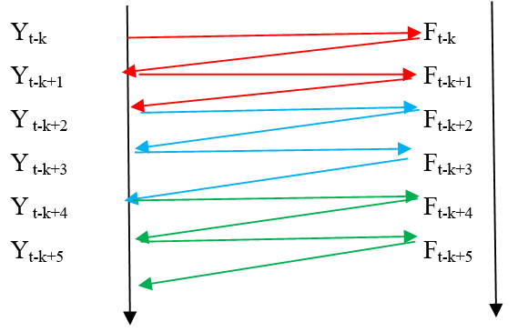
Exponential Smoothing (multiple adaptive parameter) (contd…)

Slide 117
Exponential Smoothing (multiple adaptive parameter) (contd…)
Y | F | E | A | M | α
Y_{t-3} | F_{t-3} | E_{t-3} = Y_{t-3} - F_{t-3} | A_{t-3} = β₄E_{t-3} + (1-β₄)A_{t-4} | M_{t-3} = β₄|E_{t-3}| + (1-β₄)M_{t-4} | α₄ = |A_{t-3}/M_{t-3}||A_{t-2}/M_{t-2}|
Y_{t-2} | F_{t-2} | E_{t-2} = Y_{t-2} - F_{t-2} | A_{t-2} = β₃E_{t-2} + (1-β₃)A_{t-3} | M_{t-2} = β₃|E_{t-2}| + (1-β₃)M_{t-3} | α₃ = |A_{t-2}/M_{t-2}||A_{t-1}/M_{t-1}|
Y_{t-1} | F_{t-1} | E_{t-1} = Y_{t-1} - F_{t-1} | A_{t-1} = β₂E_{t-1} + (1-β₂)A_{t-2} | M_{t-1} = β₂|E_{t-1}| + (1-β₂)A_{t-2} | α₂ = |A_{t-1}/M_{t-1}||A_{t}/M_{t}|
Y_{t} | F_{t} | E_{t} = Y_{t} - F_{t} | A_{t} = β₁E_{t} + (1-β₁)A_{t-1} | M_{t} = β₁|E_{t}| + (1-β₁)M_{t-1} | α₁ = |A_{t}/M_{t}|

Slide 118
Exponential Smoothing (multiple adaptive parameter) (contd…)
F_{t+1} = α_{1,t}Y_{t} + α_{2,t}F_{t} + α_{3,t}Y_{t-1} + α_{4,t}F_{t-1}
A_{t} = M_{t} = 0
A_{t-1} = M_{t-1} = 0
A_{t-2} = M_{t-2} = 0
A_{t-3} = M_{t-3} = 0
Y_{t} = F_{t+1}
Y_{t-1} = F_{t}
Y_{t-2} = F_{t-1}
Y_{t-3} = F_{t-2}
α₁ > α₂ > α₃ > α₄, s.t: α₁ + α₂ + α₃ + α₄ = 1
β₁ > β₂ > β₃ > β₄, s.t: β₁ + β₂ + β₃ + β₄ = 1

Slide 119
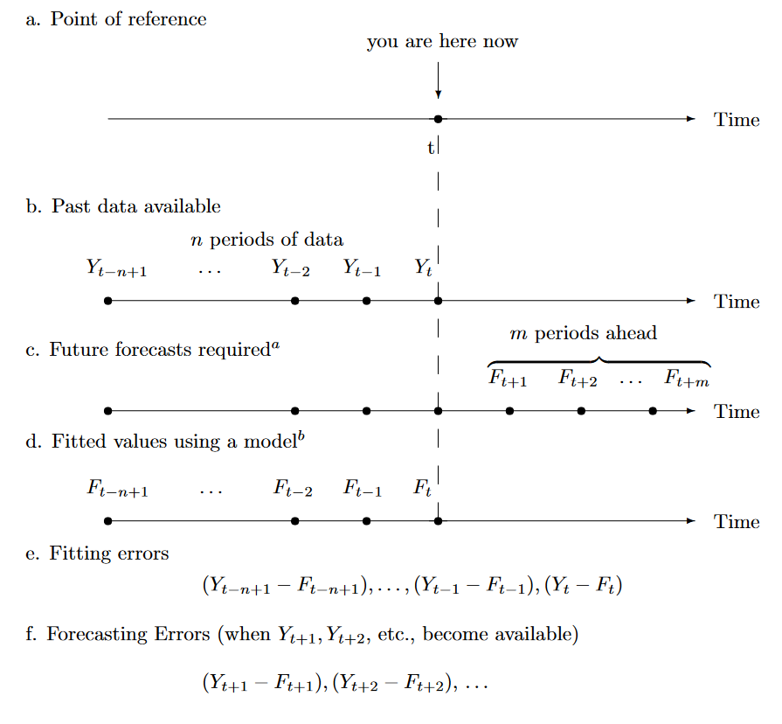
Forecasting: Discussion

Slide 120
Forecasting: Scenarios
The time series of interest is divided into two parts (an “initialization set” and a “test set”) so that an evaluation of a forecasting method can be conducted.
A forecasting method is chosen from a list of possible methods.
The initialization data set is used to get the forecasting method started. Estimates of any trend components, seasonal components, and parameter values are made at this stage.
The method is applied to the test set to see how well it does on data that were not used in estimating the components of the model. After each forecast, the forecasting error is determined, and over the complete test set certain accuracy measures are determined. This stage is iterative in process, hence modification/initialization and subsequent search of the optimal parameters are done.
Finally, the forecasting method is appraised as to its suitability for various kinds of data patterns.

Slide 121
Holt′s Linear Method
Based on level (local mean at that point, which you concentrate on)
Based on trend (the overall average)

Slide 122
Holt′s Linear Method (contd…)
Level: L_{t} = αY_{t} + (1-α)(L_{t-1} + b_{t-1})
Trend: b_{t} = β(L_{t} – L_{t-1}) + (1 - β)b_{t-1}
Forecast: F_{t+m} = L_{t} + b_{t}m

Slide 123
Holt′s Linear Method (contd…)
Y_{t} : Actual value
F_{t} : Forecast value
E_{t} = Y_{t} - F_{t}: Error
L_{t} : Estimate of the level of the series/Smoothing value
b_{t} :Trend/Estimate of the slope of the time series
α ∈ (0,1): Weight for the level
β ∈ (0, 1): Smoothing constant for the trend
m : Number of periods ahead to be forecasted
α and β are such that sum of square of errors is minimized

Slide 124
Holt′s Linear Method: Example # 16
Month Y Month Y
Jan 143.0 Feb 152.0
Mar 161.0 Apr 139.0
May 137.0 Jun 174.0
Jul 142.0 Aug 141.0
Sep 162.0 Oct 180.0
Nov 164.0 Dec 171.0
Jan 206.0 Feb 193.0
Mar 207.0 Apr 218.0
May 229.0 Jun 225.0
Jul 204.0 Aug 227.0
Sep 223.0 Oct 242.0
Nov 239.0 Dec 266.0

Slide 125
Holt′s Linear Method: Example # 16 (contd…)
Starting values
L₁ = Y₁, i.e., L_{Jan} = Y_{Jan} = 14
b₁ = (Y₂ - Y₁), i.e., (152 – 143) = 9
α = Assumed
β = Assumed
m = Assumed

Slide 126
Holt′s Linear Method: Example # 16
Month Y Month Y
Jan 143.0 Feb 152.0
Mar 161.0 Apr 139.0
May 137.0 Jun 174.0
Jul 142.0 Aug 141.0
Sep 162.0 Oct 180.0
Nov 164.0 Dec 171.0
Jan 206.0 Feb 193.0
Mar 207.0 Apr 218.0
May 229.0 Jun 225.0
Jul 204.0 Aug 227.0
Sep 223.0 Oct 242.0
Nov 239.0 Dec 266.0

Slide 127

Holt′s Linear Method: Example # 16 (contd…)

Slide 128

Holt′s Linear Method: Example # 16 (contd…)

Slide 129

Holt′s Linear Method: Example # 16 (contd…)

Slide 130

Holt′s Linear Method: Example # 16 (contd…)

Slide 131
Holt′s Linear Method: Example # 16 (contd…)
m, α, β | 1,0.6,0.10 | 1,0.7,0.10 | 1,0.4,0.90 | 1,0.1,0.01 | 1,0.2,0.90
MAE | 5.783979261 | 10.89961969 | 9.972827291 | 24.37147011 | 17.07240040
MSE | 44.76155225 | 339.8848438 | 127.0317486 | 812.7247694 | 383.8810225
U Statistics | 0.157529937 | 0.483388906 | 0.269637253 | 0.611194049 | 0.443083536

Slide 132
Holt-Winter′s Method
Based on level (local mean at that point, which you concentrate on)
Based on trend (the overall average)
Based on seasonality

Slide 133
Holt-Winter′s Method: Additive Seasonality
Level: L_{t} = α(Y_{t}- S_{t-s}) + (1-α)(L_{t-1} + b_{t-1})
Trend: b_{t} = β(L_{t} – L_{t-1}) + (1 - β)b_{t-1}
Seasonal: S_{t} = γ(Y_{t}- L_{t}) + (1 - γ )S_{t-s} for t > s
Forecast: F_{t+m} = L_{t} + b_{t}m + S_{t-s+m}
S_{i} = Y_{i}/L_{s} where L_{s} = (Y₁+…+Y_{s})/s for i ≤ s
Here one consider seasonality is additive in its characteristics
The level equation for Hold-Winter’s method differs from the level equation of Holt method as we need to subtract here with S_{t-s}, which is done to de-seasonalize Y_{t}
In additive model we add and subtract to incorporate seasonality concept

Slide 134
Holt-Winter′s Method: Additive Seasonality (contd…)
Y_{t} : Actual value
F_{t+m} : Forecast value, m time periods away
L_{t}: Level of series (smoothened/average value of the series that DOES NOT consider seasonality)
b_{t} : Trend
S_{t} : Seasonal component
s : Length of seasonality
m: Time period which is how many period ahead forecasting is needed
α: Weight corresponding to level
β: Weight corresponding to trend
γ : Weight corresponding to seasonality
α, β and γ are chosen such that sum of square of errors is minimized

Slide 135
Holt-Winter′s Method: Additive Seasonality: Example # 17
Year | Quarter | Period | Y_{t} | Year | Quarter | Period | Y_{t}
1 | 1 | 01 | 362 | 4 | 1 | 13 | 544
 | 2 | 02 | 385 |  | 2 | 14 | 582
 | 3 | 03 | 432 |  | 3 | 15 | 681
 | 4 | 04 | 341 |  | 4 | 16 | 557
2 | 1 | 05 | 382 | 5 | 1 | 17 | 628
 | 2 | 06 | 409 |  | 2 | 18 | 707
 | 3 | 07 | 498 |  | 3 | 19 | 773
 | 4 | 08 | 387 |  | 4 | 20 | 592
3 | 1 | 09 | 473 | 6 | 1 | 21 | 627
 | 2 | 10 | 513 |  | 2 | 22 | 725
 | 3 | 11 | 582 |  | 3 | 23 | 854
 | 4 | 12 | 474 |  | 4 | 24 | 661

Slide 136
Holt-Winter′s Method: Additive Seasonality: Example # 17 (contd…)
Starting values
α = Assumed as 0.882
β = Assumed as 0.055
γ = Assumed as 0.000
s = 4 (after 4 months)
To initialize the Holt-Winters’ forecasting method, we need initial values of the level L_{t}, the trend b_{t}, and the seasonal indices S_{t}.
To determine initial estimates of the seasonal indices we need to use at least one complete season’s data (i.e., s periods).

Slide 137
Holt-Winter′s Method: Additive Seasonality: Example # 17 (contd…)
Starting values
L_{s} = (1/s)(Y₁+ …. +Y_{s}), i.e., average of ALL Y values in the seasonal time frame
b_{s} = (1/s){(Y_{s+1}-Y₁)/s + (Y_{s+2}-Y₂)/s + ….. +(Y_{s+s}-Y_{s})/s)}
S₁=Y₁/L_{s}
S₂=Y₂/L_{s}
.
.
.
S_{s}=Y_{s}/L_{s}

Slide 138
Holt-Winter′s Method: Additive Seasonality
Level: L_{t} = α(Y_{t}- S_{t-s}) + (1-α)(L_{t-1} + b_{t-1})
Trend: b_{t} = β(L_{t} – L_{t-1}) + (1 - β)b_{t-1}
Seasonal: S_{t} = γ(Y_{t}- L_{t}) + (1 - γ )S_{t-s} for t > s
Forecast: F_{t+m} = L_{t} + b_{t}m + S_{t-s+m}
S_{i} = Y_{i}/L_{s} where L_{s} = (Y₁+…+Y_{s})/s for i ≤ s
Here one consider seasonality is additive in its characteristics
The level equation for Hold-Winter’s method differs from the level equation of Holt method as we need to subtract here with S_{t-s}, which is done to de-seasonalize Y_{t}
In additive model we add and subtract to incorporate seasonality concept

Slide 139
Holt-Winter′s Method: Additive Seasonality (contd…)
Y_{t} : Actual value
F_{t+m} : Forecast value, m time periods away
L_{t}: Level of series (smoothened/average value of the series that DOES NOT consider seasonality)
b_{t} : Trend
S_{t} : Seasonal component
s : Length of seasonality
m: Time period which is how many period ahead forecasting is needed
α: Weight corresponding to level
β: Weight corresponding to trend
γ : Weight corresponding to seasonality
α, β and γ are chosen such that sum of square of errors is minimized

Slide 140
Holt-Winter′s Method: Additive Seasonality: Example # 17 (contd…)
Starting values
α = Assumed as 0.882
β = Assumed as 0.055
γ = Assumed as 0.000
s = 4 (after 4 months)
To initialize the Holt-Winters’ forecasting method, we need initial values of the level L_{t}, the trend b_{t}, and the seasonal indices S_{t}.
To determine initial estimates of the seasonal indices we need to use at least one complete season’s data (i.e., s periods).

Slide 141
Holt-Winter′s Method: Additive Seasonality: Example # 17 (contd…)
Starting values
L_{s} = (1/s)(Y₁+ …. +Y_{s}), i.e., average of ALL Y values in the seasonal time frame
b_{s} = (1/s){(Y_{s+1}-Y₁)/s + (Y_{s+2}-Y₂)/s + ….. +(Y_{s+s}-Y_{s})/s)}
S₁=Y₁/L_{s}
S₂=Y₂/L_{s}
.
.
.
S_{s}=Y_{s}/L_{s}

Slide 142

Holt-Winter′s Method: Additive Seasonality: Example # 17 (contd…)

Slide 143

Holt-Winter′s Method: Additive Seasonality: Example # 17 (contd…)

Slide 144

Holt-Winter′s Method: Additive Seasonality: Example # 17 (contd…)

Slide 145
Holt-Winter′s Method: Multiplicative Seasonality
Level: L_{t} = α(Y_{t}/S_{t-s}) + (1-α)(L_{t-1} + b_{t-1})
Trend: b_{t} = β(L_{t} – L_{t-1}) + (1 - β)b_{t-1}
Seasonal: S_{t} = γ(Y_{t}/L_{t}) + (1 - γ )S_{t-s} for t > s
Forecast: F_{t+m} = (L_{t} + b_{t}m)S_{t-s+m}
S_{i} = Y_{i}/L_{s} where L_{s} = (Y₁+…+Y_{s})/s for i ≤ s
Here one consider seasonality is multiplicative in its characteristics
The level equation for Hold-Winter’s method differs from the level equation of Holt method as we need to divide here with S_{t-s}, which is done to de-seasonalize Y_{t}
In multiplicative model we multiply and divide to incorporate seasonality concept

Slide 146
Holt-Winter′s Method: Multiplicative Seasonality (contd…)
Y_{t} : Actual value
F_{t+m} : Forecast value, m time periods away
L_{t}: Level of series (smoothened/average value of the series that DOES NOT consider seasonality)
b_{t} : Trend
S_{t} : Seasonal component
s : Length of seasonality
m: Time period which is how many period ahead forecasting is needed
α: Weight corresponding to level
β: Weight corresponding to trend
γ : Weight corresponding to seasonality
α, β and γ are chosen such that sum of square of errors is minimized

Slide 147
Holt-Winter′s Method: Multiplicative Seasonality: Example # 18
Year | Quarter | Period | Y_{t} | Year | Quarter | Period | Y_{t}
1 | 1 | 01 | 362 | 4 | 1 | 13 | 544
 | 2 | 02 | 385 |  | 2 | 14 | 582
 | 3 | 03 | 432 |  | 3 | 15 | 681
 | 4 | 04 | 341 |  | 4 | 16 | 557
2 | 1 | 05 | 382 | 5 | 1 | 17 | 628
 | 2 | 06 | 409 |  | 2 | 18 | 707
 | 3 | 07 | 498 |  | 3 | 19 | 773
 | 4 | 08 | 387 |  | 4 | 20 | 592
3 | 1 | 09 | 473 | 6 | 1 | 21 | 627
 | 2 | 10 | 513 |  | 2 | 22 | 725
 | 3 | 11 | 582 |  | 3 | 23 | 854
 | 4 | 12 | 474 |  | 4 | 24 | 661

Slide 148
Holt-Winter′s Method: Multiplicative Seasonality: Example # 18 (contd…)
Starting values
α = Assumed as 0.950
β = Assumed as 0.40
γ = Assumed as 0.000
s = 4 (after 4 months)
To initialize the Holt-Winters’ forecasting method, we need initial values of the level L_{t}, the trend b_{t}, and the seasonal indices S_{t}.
To determine initial estimates of the seasonal indices we need to use at least one complete season’s data (i.e., s periods).

Slide 149
Holt-Winter′s Method: Multiplicative Seasonality: Example # 18 (contd…)
Starting values
L_{s} = (1/s)(Y₁+ …. +Y_{s}), i.e., average of ALL Y values in the seasonal time frame
b_{s} = (1/s){(Y_{s+1}-Y₁)/s + (Y_{s+2}-Y₂)/s + ….. +(Y_{s+s}-Y_{s})/s)}
S₁=Y₁/L_{s}
S₂=Y₂/L_{s}
.
.
.
S_{s}=Y_{s}/L_{s}

Slide 150
Holt-Winter′s Method: Multiplicative Seasonality
Level: L_{t} = α(Y_{t}/S_{t-s}) + (1-α)(L_{t-1} + b_{t-1})
Trend: b_{t} = β(L_{t} – L_{t-1}) + (1 - β)b_{t-1}
Seasonal: S_{t} = γ(Y_{t}/L_{t}) + (1 - γ )S_{t-s} for t > s
Forecast: F_{t+m} = (L_{t} + b_{t}m)S_{t-s+m}
S_{i} = Y_{i}/L_{s} where L_{s} = (Y₁+…+Y_{s})/s for i ≤ s
Here one consider seasonality is multiplicative in its characteristics
The level equation for Hold-Winter’s method differs from the level equation of Holt method as we need to divide here with S_{t-s}, which is done to de-seasonalize Y_{t}
In multiplicative mode we multiply and divide to incorporate seasonality concept

Slide 151
Holt-Winter′s Method: Multiplicative Seasonality (contd…)
Y_{t} : Actual value
F_{t+m} : Forecast value, m time periods away
L_{t}: Level of series (smoothened/average value of the series that DOES NOT consider seasonality)
b_{t} : Trend
S_{t} : Seasonal component
s : Length of seasonality
m: Time period which is how many period ahead forecasting is needed
α: Weight corresponding to level
β: Weight corresponding to trend
γ : Weight corresponding to seasonality
α, β and γ are chosen such that sum of square of errors is minimized

Slide 152
Holt-Winter′s Method: Multiplicative Seasonality: Example # 18
Year | Quarter | Period | Y_{t} | Year | Quarter | Period | Y_{t}
1 | 1 | 01 | 362 | 4 | 1 | 13 | 544
 | 2 | 02 | 385 |  | 2 | 14 | 582
 | 3 | 03 | 432 |  | 3 | 15 | 681
 | 4 | 04 | 341 |  | 4 | 16 | 557
2 | 1 | 05 | 382 | 5 | 1 | 17 | 628
 | 2 | 06 | 409 |  | 2 | 18 | 707
 | 3 | 07 | 498 |  | 3 | 19 | 773
 | 4 | 08 | 387 |  | 4 | 20 | 592
3 | 1 | 09 | 473 | 6 | 1 | 21 | 627
 | 2 | 10 | 513 |  | 2 | 22 | 725
 | 3 | 11 | 582 |  | 3 | 23 | 854
 | 4 | 12 | 474 |  | 4 | 24 | 661

Slide 153
Holt-Winter′s Method: Multiplicative Seasonality: Example # 18 (contd…)
Starting values
α = Assumed as 0.950
β = Assumed as 0.40
γ = Assumed as 0.000
s = 4 (after 4 months)
To initialize the Holt-Winters’ forecasting method, we need initial values of the level L_{t}, the trend b_{t}, and the seasonal indices S_{t}.
To determine initial estimates of the seasonal indices we need to use at least one complete season’s data (i.e., s periods).

Slide 154
Holt-Winter′s Method: Multiplicative Seasonality: Example # 18 (contd…)
Starting values
L_{s} = (1/s)(Y₁+ …. +Y_{s}), i.e., average of ALL Y values in the seasonal time frame
b_{s} = (1/s){(Y_{s+1}-Y₁)/s + (Y_{s+2}-Y₂)/s + ….. +(Y_{s+s}-Y_{s})/s)}
S₁=Y₁/L_{s}
S₂=Y₂/L_{s}
.
.
.
S_{s}=Y_{s}/L_{s}

Slide 155

Holt-Winter′s Method: Multiplicative Seasonality: Example # 18 (contd…)

Slide 156

Holt-Winter′s Method: Multiplicative Seasonality: Example # 18 (contd…)

Slide 157

Holt-Winter′s Method: Multiplicative Seasonality: Example # 18 (contd…)

