Slide 1

TIME SERIES MODELS
Raghu Nandan SENGUPTA
Department of Management Sciences (DoMS)
Indian Institute of Technology Kanpur, INDIA

Slide 2
Time Series Analysis
A time series is a set of observations x_{t}, each one being recorded at a specific time t.
  Discrete-time time series
  Continuous-time time series
Application of time series analysis
  Economic Planning
  Sales Forecasting
  Inventory control
  Production Planning
  Budgeting
  Prediction of Financial data

Slide 3
Time Series Analysis
Main objectives of time series are:
  Description: Using summary statistics and/or graphical methods and a time plot of the data is particularly valuable
  Modelling: Use of suitable statistical model to describe the data generating process (univariate time series and multivariate time series)
  Forecasting: Use of estimates to predict/forecast the future values of the time series
  Control: To take action so as to control a given process and check the validity of the model

Slide 4
Time Series Analysis: Example # 45

Slide 5
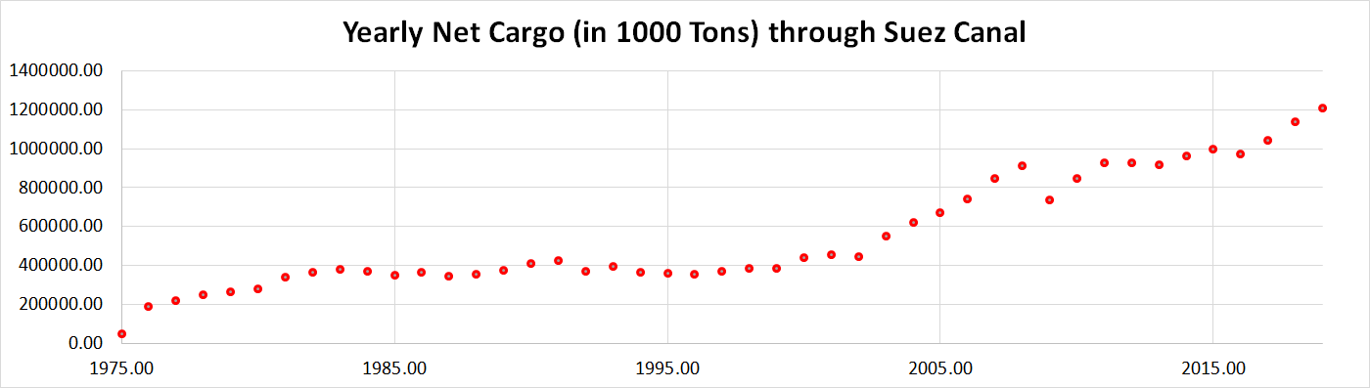
Time Series Analysis: Example # 46

Slide 6
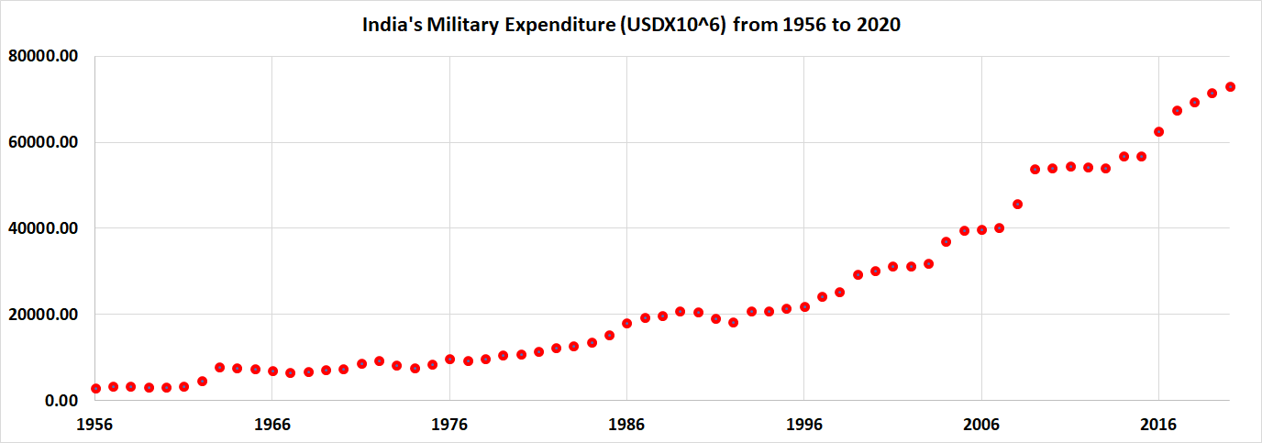
Time Series Analysis: Example # 47

Slide 7
Time Series Analysis
A time series model for the observed data {x_{t}} is a specification of the joint distributions (or possibly the mean and covariance) of a sequence of random variable {X_{t}} of which {x_{t}} is postulated to be a realization.
A Complete Probabilistic time series model is given by P[X₁≤x₁,……,X_{n} ≤ x_{n}], where −∞< x₁,……, x_{n} <∞ n= 1,2 ….
For all joint distribution the Second-Order properties (First and Second order moments) completely determine the joint distribution and hence gives the complete probabilistic characterization of the sequence.

Slide 8
Introduction: Time Series Model
Zero Mean Models (no trend and seasonal component)
  Examples:
  iid noise (knowledge of X₁,.., X_{n} is of no value for predicting the behaviour of X_{n+h}), P[X₁≤x₁,……,X_{n} ≤ x_{n}] = P[X₁≤x₁]…P[X_{n} ≤ x_{n}] =F(x₁)…. F(x_{n}), where F(.) is the cumulative distribution function
  Random Walk (a man/women walking either to right or left on a straight road/line)
Models With Trend and Seasonality (sale of fridge, winter garments, etc.)

Slide 9
Stationary Model
A time series {X_{t}, t = 0 , ±1, …} is said to be stationary if it has statistical properties similar to those of “time-shifted” series {X_{t+h}, t = 0 , ±1, …} for each integer h.
Definition:
  Let {X_{t}} be a time series with E(.)<∞.
  The mean function of {X_{t}} is µ_{x}(t) = E(X_{t})
  Covariance function of {X_{t}} is γ_{x}(r,s)= Cov(X_{r} , X_{s})= E[(X_{r}- µ_{x}(r))( X_{s}- µ_{x}(s))] for all integers r and s.
Then {X_{t}} is (weakly) Stationary if: (i) µ_{x}(t) is independent of t, and (ii) γ_{x}(t+h,t) is independent of t for each h

Slide 10
Auto-covariance Function
Let {X_{t}} be a stationary time series.
The auto covariance function (ACVF) of {X_{t}} at lag h is γ_{x}(h) = Cov(X_{t+h}, X_{t})
The auto correlation function (ACF) of {X_{t}} at lag h is ρ_{x}(h) = Cor (X_{t+h}, X_{t}) = γ_{x}(h)/γ_{x}(0)
Where: γ_{x}(h, 0)/γ_{x}(t+h, t)

Slide 11
Classical Decomposition of the Model
X_{t} = μ_{t} + s_{t} + ε_{t}
  X_{t} = Random Variable
  μ_{t} = Trend component (Average)
  s_{t} = Seasonal Component
  ε_{t} = Random noise component
Our aim is to
  Estimate deterministic component μ_{t} and s_{t}
  Calculate properties of ε_{t} using stationary probabilistic model
  Use above two for purpose of prediction and simulation of {X_{t} }

Slide 12
Basic Properties of ACVF and ACF
The ACVF (auto covariance function) and ACF (auto correlation function) provides a useful measure of the degree of dependence among the values of the time series at different times
Plays an important role in predicting future values of the series in terms of past and present values

Slide 13
Basic Properties of ACVF
|γ(ℎ)| ≤ γ(0) for all ℎ, i.e., absolute value of ACVF (auto covariance function) at any lag ℎ is bounded by the variance of the process
γ(0) ≥ 0, i.e., ACVF (auto covariance function) is maximum when ℎ = 0

Slide 14
Basic Properties of ACVF
γ(ℎ) = γ(−ℎ) for all ℎ, i.e., ACVF (auto covariance function) is symmetric, meaning the covariance for a positive lag is the same as for a negative lag
Σ_{𝑖=1 to k}Σ_{𝑗=1 to k}{γ(t_{𝑖} − t_{𝑗})}ℎ(t_{𝑖})ℎ(t_{𝑗}) ≥ 0, ACVF (auto covariance function) is positive semi-definite where (t₁,…. t_{k}) are time points and h(t) is any real valued function

Slide 15
Basic Properties of ACF
ρ(ℎ) i.e., ACF (auto correlation function) with lag ℎ, such that ρ(ℎ) = γ(ℎ)/γ(0)
−1 ≤ ρ(ℎ) ≤ +1
We have a stationary process if and only if ρ(.) is an ACVF (auto covariance function) with ρ(0) =1

Slide 16
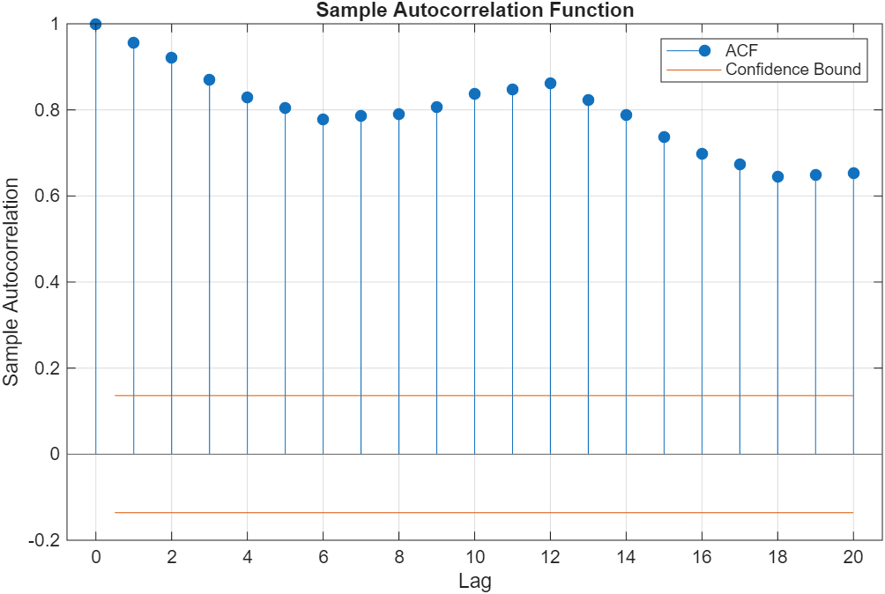
Basic Properties of ACF : Example # 48

Slide 17
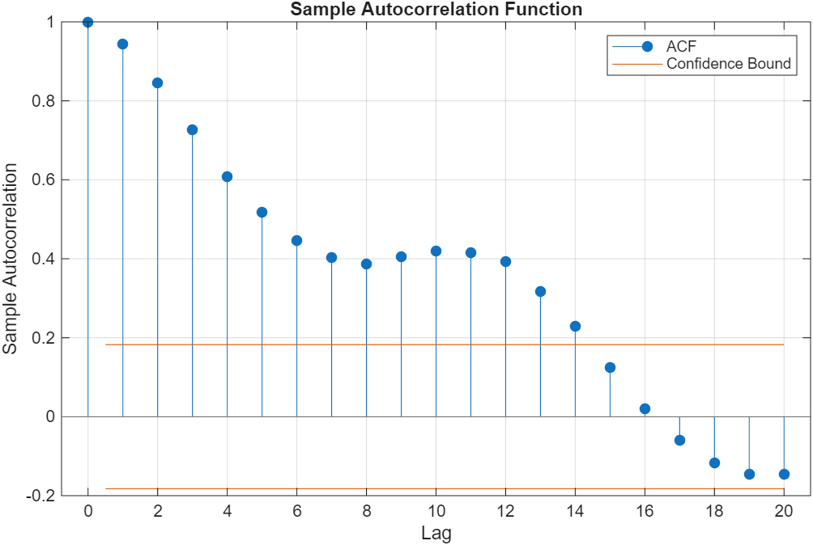
Basic Properties of ACF : Example # 48

Slide 18
Basic Properties of ACF
Slow decay indicates non-stationarity and if the ACF values decay slowly toward zero, it suggests that the time series is non-stationary and has a trend.
Rapid decay indicates stationarity and if the ACF values decays to or near zero relatively quickly (within a few lags), it is a sign that the time series is stationary and does not have a significant trend.

Slide 19
Strictly stationary Time Series {X_{t}}
{X_{t}} is a Strictly stationary time series if (X₁,…,X_{n})/ is distributed similarly as (X_{1+h},…,X_{n+h})/, where lag is denoted by h and for all integers h and n ≥ 1. Thus the two random vectors have the same joint distribution function
Properties:
  The random variable X_{t} are identically distributed, i.e., two vectors have the same distribution function
  (X_{t}, X_{t+h})^{T} = (X₁,X_{1+h})^{T} in distribution for all integers t and h
  {X_{t}} is weakly stationary if E(X_{t}²) < ∞ for all t.
  Weak stationarity does not imply strict stationarity
  An iid sequence is strictly stationary

Slide 20
Stationary Processes
Every second order stationary process is either a linear process or can be transformed into a linear process by subtracting the deterministic component.
The time series {X_{t}} is a linear process if it has the representation X_{t} = μ + Σ_{𝑗=−∞ to +∞}(φ_{𝑗}ε_{t−𝑗}) for all t, where {ε_{t}} ~ WN(0, σ²) (White Noise with zero mean and fixed variance which is σ²)and {φ_{𝑗}} is a sequence of constants with Σ_{𝑗=−∞ to +∞}|φ_{𝑗}| < ∞
A linear process is called a moving average or MA(∞) if X_{t} = μ + Σ_{𝑗=−∞ to +∞}(φ_{𝑗}Z_{t−𝑗}) for all j < 0, which implies that the current value of a series is a linear combination of the past and present white noise (error) terms, with the coefficients satisfying Σ_{𝑗=−∞ to +∞}(φ_{𝑗}²) < ∞ for the process to be stationary.

Slide 21
Conditions for Stationarity
Conditions for Stationarity of an MA(∞) Process
A linear process, represented as a moving average, is stationary if its statistical properties do not change over time, thus, for an MA(∞) process:
Constant Mean implies that expected value of the process is constant

Slide 22
Conditions for Stationarity
MA(∞) processes with WN error terms, this implies constant mean is zero
Constant Variance implies the variance of the process must be constant and finite, thus for a standard MA process, the variance is a function of the white noise variance (σ²) and the squared weights, which remains constant if the sum of squared weights is finite, i.e., Σ_{𝑗=−∞ to +∞}(φ_{𝑗}²) < ∞.
Thus, constant variance, Var(X_{t}) = σ²Σ_{𝑗=0 to +∞}(φ_{𝑗}²)
Covariance Depends Only on Lag thus autocovariance between observations at different times must depend only on the time lag, h and not on the specific time point, t itself
Thus, constant covariance, Cov(X_{t}, X_{t+h}) = σ²Σ_{𝑗=0 to +∞}(φ_{𝑗}φ_{𝑗+𝒉})

Slide 23
Introduction to ARIMA (p, d, q) Process : Example # 49
Autoregressive Integrated Moving Average (ARIMA) is a statistical technique for analyzing and forecasting time series data by combining three components
  Autoregression (AR) with parameter, p
  Integration (I) with parameter, d
  Moving average (MA) with parameter, q
For UK population data: ARIMA(1,0,1) with
Value StandardError t-statistic p-Value
Constant 1.1429e+06 5.4232e-09 2.1074e+14 0
AR{1} 0.98178 0.0050056 196.14 0
MA{1} 0.12028 0.15468 0.77763 0.43679
Variance 1.7982e+12 4.2731e-14 4.2081e+25 0

Slide 24
Introduction to ARIMA (p, d, q) Process : Example # 50 & 51
For International Airline Passenger data: ARIMA(1,0,1) with
Value StandardError t-statistic p-Value
Constant 18.943 11.618 1.6305 0.103
AR{1} 0.93882 0.029897 31.402 1.9113e-216
MA{1} 0.42316 0.075427 5.6102 2.0206e-08
Variance 957.71 115 8.3281 8.2155e-17
For Australian Monthly Electricity Production data: ARIMA(1,0,1) with
Value StandardError t-statistic p-Value
Constant 331.3 193.31 1.7138 0.086564
AR{1} 0.93882 0.029897 31.402 1.9113e-216
MA{1} 0.42316 0.075427 5.6102 2.0206e-08
Variance 957.71 115 8.3281 8.2155e-17

Slide 25
Introduction to ARIMA (p, d, q) Process
x_{t} = μ + {φ₁X_{t − 1} + ….+ φ_{p}X_{t − p}} − {θ₁e_{t − 1} − …. − θ_{q}e_{t − q}}
Here the moving average parameters (θ’s) are defined so that their signs are negative in the equation, following the convention.
Often the parameters are denoted there by AR(1), AR(2), …, and MA(1), MA(2), ….
Thus
  If d = 0, then x_{t} = X_{t}
  If d = 1, then x_{t} = X_{t} − X_{t −1}
  If d = 2, then x_{t} = X_{t} − 2X_{t −1} + X_{t −2}

Slide 26
Introduction to ARIMA (p,d,q) Process
ARIMA(1,0,0) = first-order autoregressive model
ARIMA(0,1,0) = random walk
ARIMA(1,1,0) = differenced first-order autoregressive model
ARIMA(0,1,1) without constant = simple exponential smoothing
ARIMA(0,1,1) with constant = simple exponential smoothing with growth
ARIMA(0,2,1) or (0,2,2) without constant = linear exponential smoothing
ARIMA(1,1,2) without constant = damped-trend linear exponential smoothing

Slide 27
Introduction to ARMA (1,1) Process
The time series {X_{t}} is an Auto Regressive Moving Average ARMA(1,1) process if it is stationary and satisfies (for every t), X_{t} = φX_{t − 1} = ε_{t} + θε_{t − 1}
Using Backward shift operator B, it can be written as φ(B)Xt = θ(B) ε_{t}, where φ(B) and θ(B) are linear filters
Where
  {ε_{t}} ~ WN(0, σ²) and φ + θ ≠ 0
  θ(B) = 1 + θB
  φ(B) = 1 − φB

Slide 28





Introduction to ARMA (1,1) Process
Properties:
  A stationary solution of ARMA (1,1) equations exist if and only if
  If , then the unique stationary solution is given below.
  Here, {X_{t}} is casual or casual function of {ε_{t}}, as X_{t} can be represented in terms of current and past values of ε _{s} , s≤t.
  If , then the unique solution is given as below. Here the solution is non causal, since X_{t} is function of ε _{s} , s≥t

Slide 29




Introduction to ARMA (1,1) Process
Properties contd… :
  If , the ARMA(1,1) is invertible, as Z_{t} can be represented in terms of X_{s} , s≤t.
  If , the ARMA(1,1) is noninvertible, as Z_{t} can be represented in terms of X_{s} , s≥t.

Slide 30


ARMA (p , q) PROCESS
{X_{t}} is an ARMA (p , q) process if {X_{t}} is stationary and if for every t,
(A1)
where {Z_{t}} ~ WN (0, σ²) and the polynomials θ(z) and ϕ(z) have no common factors.
&
The process {X_{t}} is an ARMA (p , q) process with mean µ if {X_{t} - µ} is an ARMA (p , q) process.

Slide 31
Auto Regressive (AR(p)) Process & Properties
Autoregressive (AR) model is the foundation of ARIMA models
AR(p) is of the form: x_{𝑡} = Σ_{𝑗=1 to 𝑝}(φ_{𝑗}x_{𝑡 −𝑗}) + ε_{𝑡}
ε_{𝑡}, 𝑡 = 0, ±1, ±2,….. is White Noise
φ₁,…, φ_{𝑝} are fixed/non-random
E(x_{𝑡}) = 0 if mean is zero for all 𝑡
E(x_{𝑡}) exits if a constant term is added

Slide 32
Auto Regressive (AR(p)) Process & Properties: Example # 52
Using backshift operator B (i.e., B^{k}x_{𝑡} = x_{𝑡−𝑘} , φ(B)x_{𝑡} = ε_{𝑡}) we can write (1 − φ₁B − φ₂B² − …. − φ_{p}B^{p})x_{𝑡} = ε_{𝑡}
(1 − φ₁B − φ₂B² − …. − φ_{p}B^{p}) is the autoregressive operator of order p
Considering the Australian Electricity Production (Jan 1977 to Dec 1994) we have
  φ₁ = 0.964331, 𝑝 = 1, c = 400.53, E(x_{𝑡}) = 11229, V(x_{𝑡}) = 362169

Slide 33
Auto Regressive (AR(p)) Process & Properties
x_{𝑡} = φx_{𝑡 −1} + ε_{𝑡}, is a random walk for φ = 1, and it is non-stationary
We can express AR process as x_{𝑡} = φ^{𝑘}x_{𝑡 −} _{𝑘} + Σ_{𝑗 = 0 to 𝑘}(φ^{𝑗}ε _{𝑡 −} _{𝑗})
If |φ|<1 and with 𝑘 → ∞, x_{𝑡} = Σ_{𝑗 = 0 to ∞}(φ^{𝑗}ε _{𝑡 −} _{𝑗}) is stationary AR(1), as Cov(x_{𝑡}, x_{𝑡+𝘩}) = σ²{φ^{𝘩}/(1 − φ²)} and only depends on 𝘩
Here σ² is variance of WN

Slide 34
Auto Regressive (AR(p)) Process & Properties
AR(𝑝) x_{𝑡} = c +Σ_{𝑗=1 to 𝑝}(φ_{𝑗}x_{𝑡 −𝑗}) + ε_{𝑡}
Is stationary then E(x_{𝑡}) = c/(1 − φ₁ − …. φ_{p}) which is constant
Is stationary then V(x_{𝑡}) can be found using Yule-Walker equations

Slide 35
Auto Regressive (AR(p)) Process & Properties
Series x_{𝑡} = Σ_{𝑗=1 to 𝑝}(φ_{𝑗}x_{𝑡 −𝑗}) + ε_{𝑡}, 𝑡 = 0, ±1, ±2,….. is causal if it can be expressed as x_{𝑡} = Σ_{𝑗 = 0 to ∞}(φ^{𝑗}ε _{𝑡 −} _{𝑗}) and Σ_{𝑗 = 0 to ∞}|φ^{𝑗}| < ∞
Causality implies stationarity, hence Cov(x_{𝑡}, x_{𝑡+𝘩}) = σ²Σ_{𝑗 = 0 to ∞}(φ_{𝑗}φ_{𝑗 + 𝘩})

Slide 36
Moving average (MA(q)) Process & Properties
Moving Average (MA) model MA(q) is of the form: x_{𝑡} = ε_{𝑡} + Σ_{𝑗=1 to 𝑞}(θ_{𝑗}ε_{𝑡 −𝑗})
ε_{𝑡}, 𝑡 = 0, ±1, ±2,….. is White Noise
θ₁,…, θ_{𝑞} are fixed/non-random
E(x_{𝑡}) = 0 if mean is zero for all 𝑡
E(x_{𝑡}) exits if a constant term is added

Slide 37
Moving average (MA(q)) Process & Properties: Example # 53
Using backshift operator B (i.e., B^{k}x_{𝑡} = x_{𝑡−𝑘}, x_{𝑡} = θ(B)ε_{𝑡}) we can write x_{𝑡} = (1 + θ₁B + θ₂B² + …. + θ_{𝑞}B^{𝑞}) ε_{𝑡}
(1 + θ₁B + θ₂B² + …. + θ_{𝑞}B^{𝑞}) is the moving average operator of order 𝑞
Considering the Australian Electricity Production (Jan 1977 to Dec 1994) we have
  θ₁ = 0.78903, 𝑞 = 1, c = 10440, V(x_{𝑡}) = 5373330

Slide 38
ACVF, ACF and PACF for ARMA(p,q)
Auto covariance Function (ACVF): One of the method to calculate ACVF is
Autocorrelation function (ACF): ACF is calculated from ACVF using the equation ρ(h) = γ(h)/γ(0)
Partial Autocorrelation Function (PACF): It is the function α(.) defined by the equations α(0) =1 and α (h) = φ_{hh}, h ≥ 1

Slide 39
Forecasting Stationary Time Series
For a stationary time series with known mean µ and auto covariance γ in terms of values {X_{n},….,X₁}, the value for X_{n+h} is predicted by linear combination of {1,X_{n},….,X₁} which has minimum mean squared error and is denoted by P_{n}X_{n+h} and has the formP_{n}X_{n+h} = a₀ + a₁X_{n} + …+ a_{n}X₁
The coefficients (a₀ ,a₁,…., a_{n} ) is determined by finding the values that minimize S(a₀ ,a₁,…., a_{n} ) = E(X_{n+h} - a₀ - a₁X_{n} - …- a_{n}X₁)²

Slide 40
Modeling with ARMA
We assume that the data have been “mean-corrected” by subtracting the sample mean, so that it is appropriate to fit a Zero-mean ARMA model to the adjusted data.
The parameters to be estimated are the white noise variance σ²,the coefficients {ϕ_{i}, i = 1,..,p} and {θ_{i}, i= 1,..,q}
We assume that the values of p and q are known.
There are two ways of estimation
  Preliminary Estimation
  Maximum Likelihood Estimation

Slide 41
Preliminary Estimation
Four Techniques of preliminary estimation of the parameters ϕ= (ϕ₁,…, ϕ_{p})’,θ=(θ₁,…,θ_{q})’ and σ² from the observations x₁,…,x_{n} of the causal ARMA (p,q) process defined by ϕ(B)X_{t} = θ(B)Z_{t}, {Z_{t}} ~ WN(0, σ² )
  Yule-Walker Estimation
  Burg’s Algorithm
  The Innovations Algorithms
  The Hannan-Rissanen Algorithm

Slide 42
Maximum Likelihood Estimation
The Gaussian Likelihood for an ARMA process:
Maximum Likelihood Estimators ,
  where are the values of ϕ,θ that minimize
Order Selection (AICC Criterion): Choose p, q, ϕ_{p}, and θ_{q} to minimize

Slide 43
Introduction to Financial Time Series
Moving Average Models :
Constant Volatility / Unconditional Volatility
Volatility Estimates do change over time, but this is attributed to ‘Noise’.
Financial Market Returns show signs of Autocorrelation.
Financial Market Volatility comes in clusters.
Auto Regressive Conditional Heteroscedasticity (ARCH)
Variants of GARCH

Slide 44
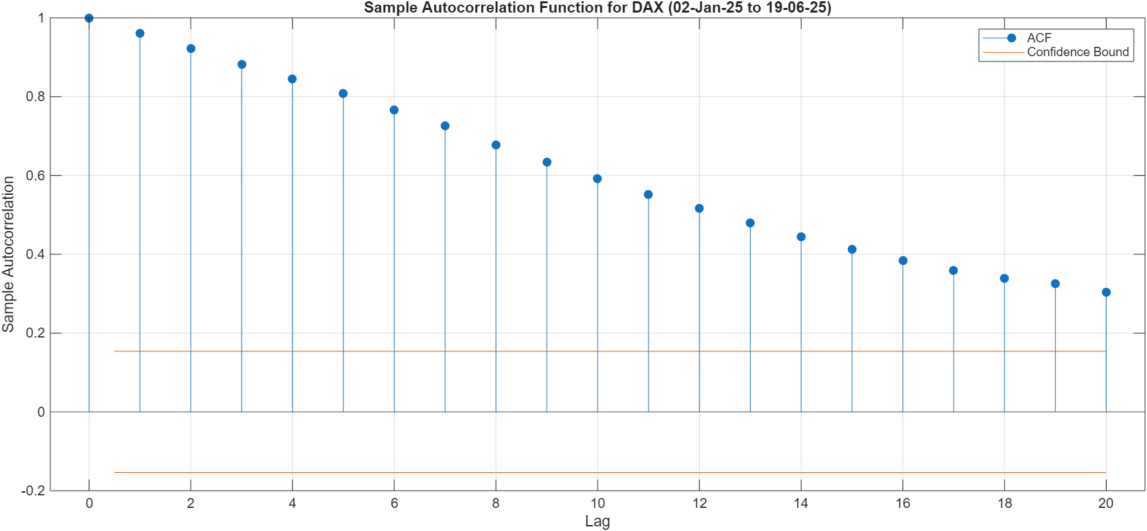
ARMA (p,q) for Financial Time Series: Example # 54

Slide 45
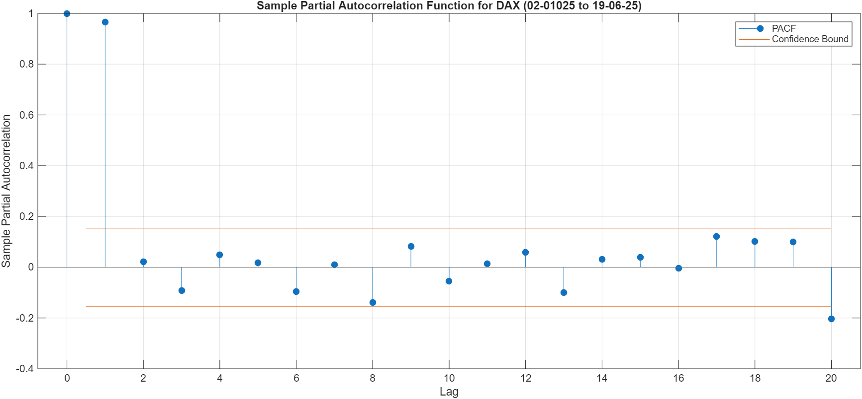
ARMA (p,q) for Financial Time Series: Example # 54

Slide 46
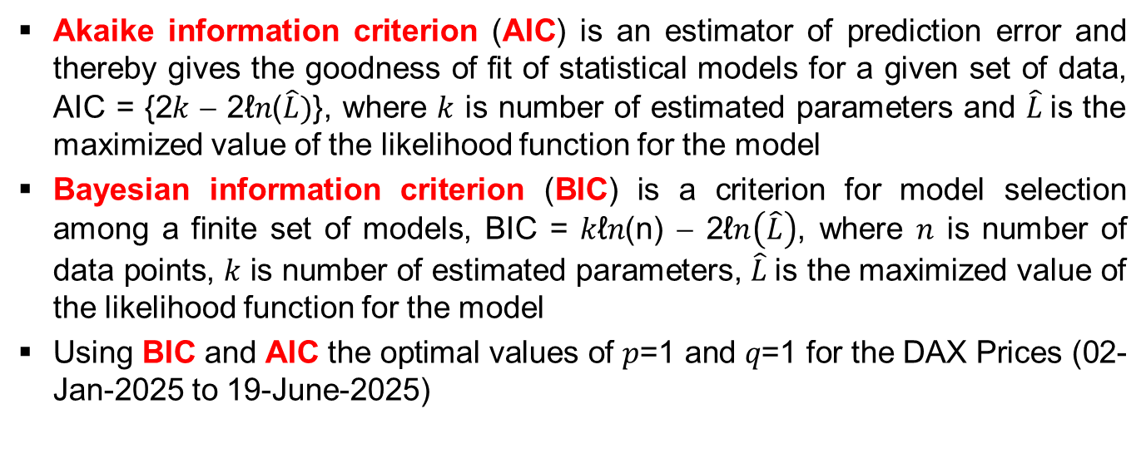
AIC and BIC Calculations and Use

Slide 47
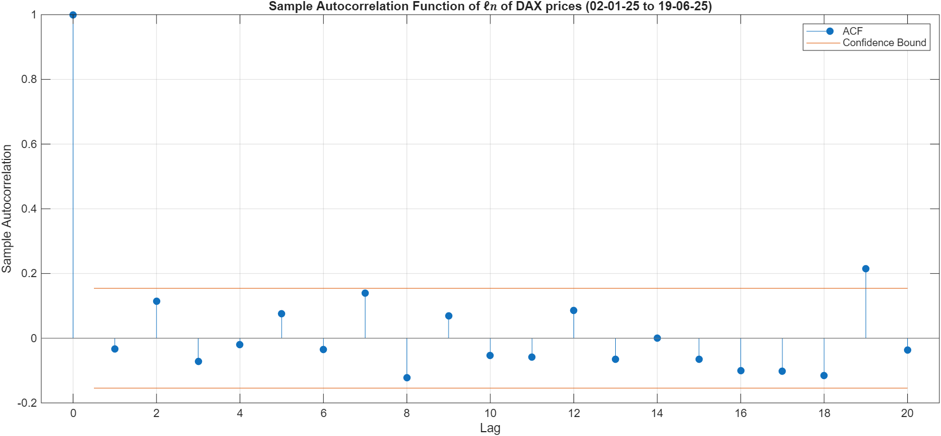
ARMA (p,q) for Financial Time Series : Example # 55

Slide 48
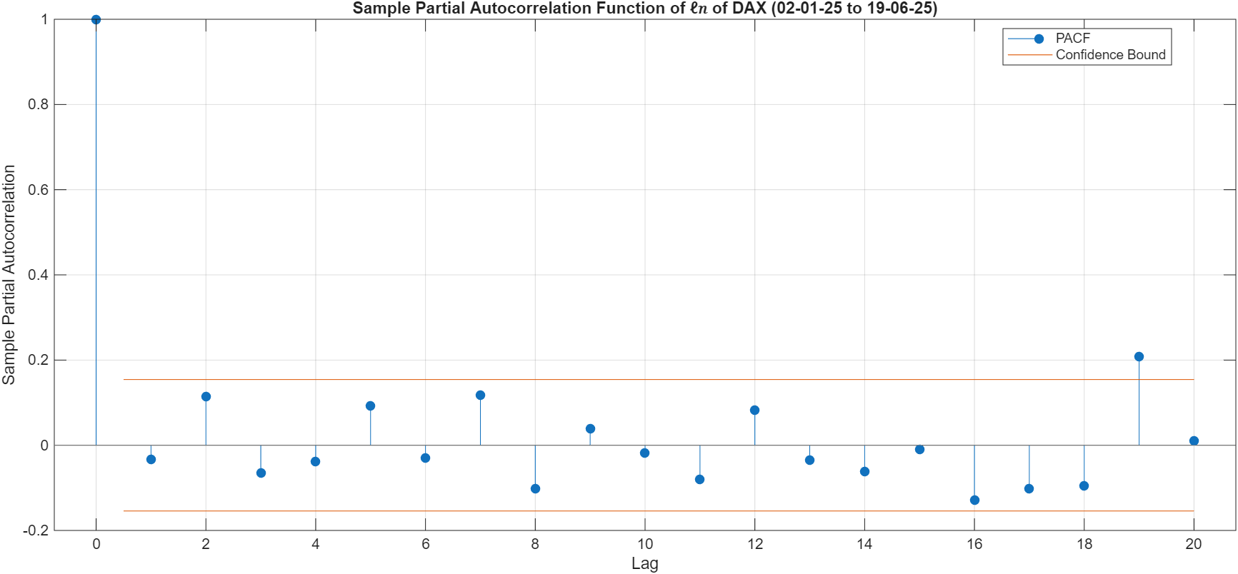
ARMA (p,q) for Financial Time Series : Example # 55

Slide 49
ARMA (p,q) for Financial Time Series: Example # 55
Using BIC and AIC the optimal values of 𝑝=2 and 𝑞=2 for the ℓ𝑛 DAX Prices (02-Jan-2025 to 19-June-2025)

Slide 50
Introduction to GARCH
Generalized Autoregressive Conditional Heteroscedasticity.
Returns are assumed to be generated by a stochastic process with time varying volatility.
Conditional Distribution of Returns.
In fact Conditional Variance is an Autoregressive process.

Slide 51
Introduction to GARCH
Two major effects prevailing in financial markets :
  Volatility Clustering: Implies strong autocorrelation in squared returns, and the practicality is large changes tend to be followed by large changes, of either sign, and small changes tend to be followed by small changes

Slide 52
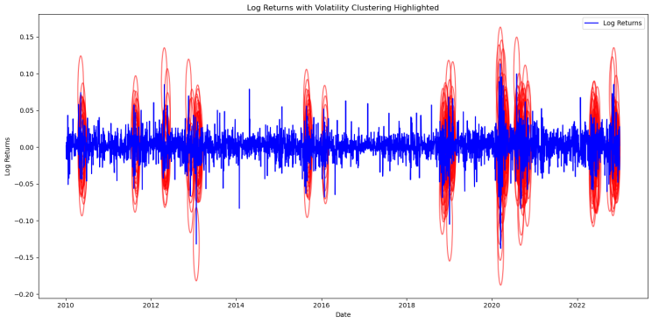
Introduction to GARCH : Example # 56

Slide 53
Introduction to GARCH
  Leverage Effect: Company's use of borrowed funds to finance its assets and when return on capital employed exceeds the cost of the debt extra profit goes to the shareholders, increasing their return on equity (Source of Asymmetry)

Slide 54
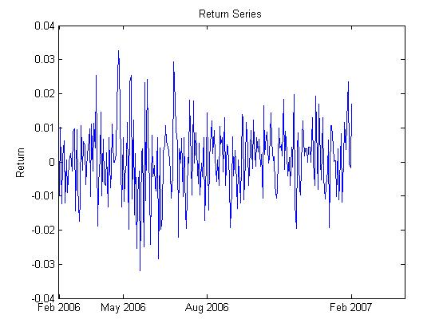
Volatility Clustering
Strong Autocorrelation of squared returns.
Very pronounced in Intra-day data.
A basic test is Box-Pierce LM test.
However, Volatility Clustering may still be present even though the data does not show strong autocorrelation
Cause maybe negative skewness & extreme excess kurtosis on particular stocks.

Slide 55
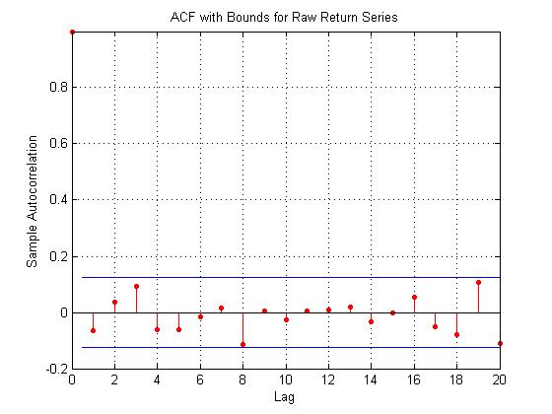
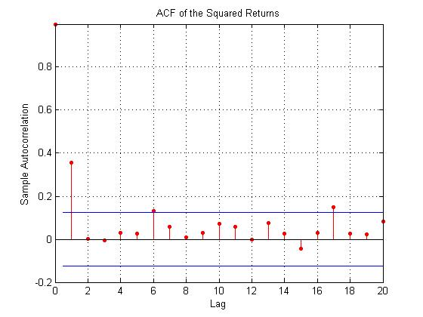
Presence of Autocorrelation : Example # 57
Autocorrelation for Return Series
Autocorrelation for Squared Return Series
High Autocorrelation

Slide 56
Leverage Effect
In Equity markets it is observed that the volatility is higher in a falling market than in a rising market
Leverage Effect :
  Cause of implied volatility skew in equity markets
  Implies Asymmetry in volatility clustering
EGARCH / AGARCH capture this effect

Slide 57
General Equations
Conditional Mean Equation
  Simple Linear regression provides a model for conditional mean of a return process
Conditional Variance Equation
  Describes the evolution of conditional variance of the unexpected return process.
  V_{t}(ε_{t}) = σ²_{t} : Error process has time varying variance.
  ε_{t} : Unexpected return

Slide 58
Autoregressive Conditional Heteroscedasticity (ARCH)
The ARCH(p) process captures the conditional heteroscedasticity of financial returns by assuming that present conditional variance is the weighted average of past squared unexpected return
σ²_{t} = α₀ + α₁ε²_{t-1} + … + α_{p}ε²_{t-p}
α₀ > 0, α₁,…,α_{p}>=0

Slide 59
Symmetric GARCH
The GARCH(p,q) model adds q autoregressive terms to the ARCH(p) specification
The conditional variance takes the form of:
σ²_{t} = α₀ + α₁ε²_{t-1} + … + α_{p}ε²_{t-p} + β₁σ²_{t-1} +…+ β_{q}σ²_{t-q}
where α₀ > 0, α₁,…,α_{p} , β₁,…, β_{q} >=0
α : Error Coefficient: High value means volatility reacts quite intensely to market movements
β : Lag Coefficient: High value corresponds to persistence of volatility

Slide 60
Asymmetric GARCH
AGARCH / EGARCH captures the Leverage effect as well.
High Presence of asymmetry in volatility clustering in financial markets
EGARCH
The conditional variance takes the form of :
ln σ²_{t} = α₀ + g( z_{t-1} )+ β ln σ²_{t-1}
Defined in terms of standard normal variate z_{t} which is the standardized unexpected return ε_{t} / σ_{t}

Slide 61
AGARCH(1,1)
AGARCH(1,1) : σ²_{t} = w+ α(ε_{t-1} –λ)² + βσ²_{t-1}
  _{Where :}
  λ : Leverage Coefficient
  Easier to estimate as compared to EGARCH model
  Volatility forecasts made from AGARCH model differ from that made by GARCH(1,1) model

Slide 62
Analysis and Estimation of GARCH Models
Choice of Data, Stability of GARCH parameters and Long-Term Volatility
In choosing time span of data, a view has to be taken on whether or not current forecasts should be influenced by events that occurred many years ago, e.g., Including Gulf War period in a crude oil GARCH model would make current volatility estimates very spiky
All parameter estimates (in particular GARCH constant) are sensitive to the historic data used for the model
Long term level of volatility to which a current volatility term structure will converge depends on estimates of the GARCH model parameters

Slide 63
Choosing the best GARCH Model
Model should capture Volatility clustering adequately
Returns should have no significant Autoregressive conditional heteroscedasticity once they have been standardized by their conditional volatility.

Slide 64
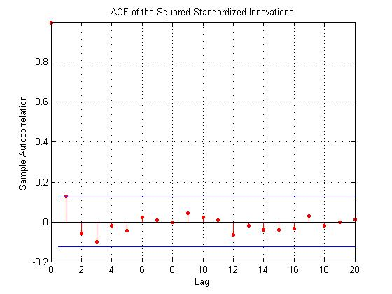
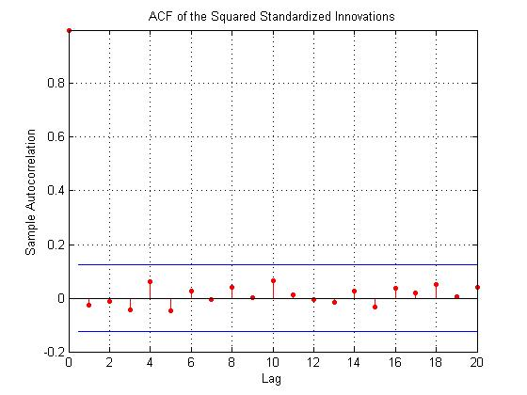
GARCH (2,1) v/s EGARCH(1,1) : Example # 58
GARCH(2,1)
EGARCH(1,1) (Better )

Slide 65
Analysis and Estimation Using GARCH(1,1)
Pre-estimation Analysis
  The pre-estimation analysis loads the data in the form of a price series, then converts the price series to a return series. It checks the return series for correlation, and quantifies the correlation
Parameter Estimation
Post-estimation Analysis
  This part of the example starts by comparing the residuals, conditional standard deviations, and returns.
  It then uses plots and quantitative techniques to compare correlation of the standardized innovations.

Slide 66
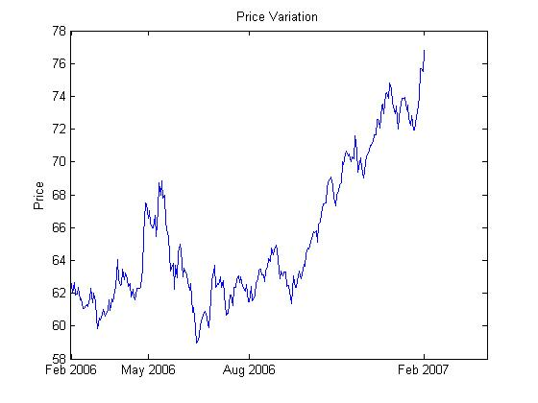
Pre-estimation Analysis: Example # 59
Price Variation
Return Series

Slide 67
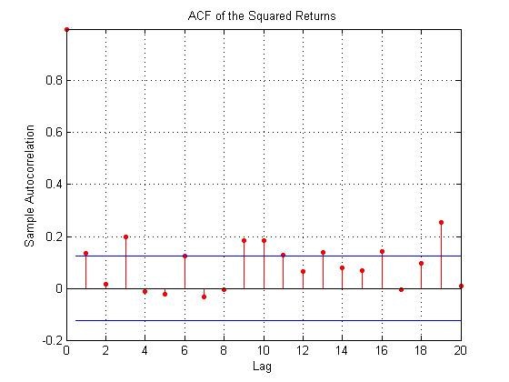
Autocorrelation of Returns and Squared of Return Series: Example # 60
Autocorrelation for Return Series
Autocorrelation for Squared Return Series

Slide 68
Ljung-Box-Pierce Q-Test
Ljung-Box-Pierce Q-Test, it can be verified, at least approximately, that no significant correlation is present in the raw returns when tested for up to 10, 15, and 20 lags of the ACF at the 0.05 level of significance.
However, there is significant serial correlation in the squared returns when tested with the same inputs

Slide 69
Ljung-Box-Pierce Q-Test: Example # 61
For DAX Prices (02-Jan-2025 to 19-June-2025) we have the following results
H: 1
P-value: 0.0000
Q-statistic: 1426.8502
Critical Value: 31.4104
Null hypothesis rejected: Significant autocorrelation detected

Slide 70
Ljung-Box-Pierce Q-Test: Example # 62
For ℓ𝑛DAX Prices (02-Jan-2025 to 19-June-2025) we have the following results
H: 0
P-value: 0.0535
Q-statistic: 31.1327
Critical Value: 31.4104
Null hypothesis not rejected: No significant autocorrelation detected

Slide 71
Parameter Estimation: Example # 63
Mean: ARMAX(0,0,0); Variance: GARCH(1,1)
Conditional Probability Distribution: Gaussian
Number of Model Parameters Estimated: 4
Standard T
Parameter Value Error Statistic
----------- ----------- ------------ -----------
C 0.0010764 0.0006622 1.6254
K 2.8386e-006 3.1143e-006 0.9115
GARCH(1) 0.92801 0.047386 19.5842
ARCH(1) 0.047358 0.029413 1.6101

Slide 72
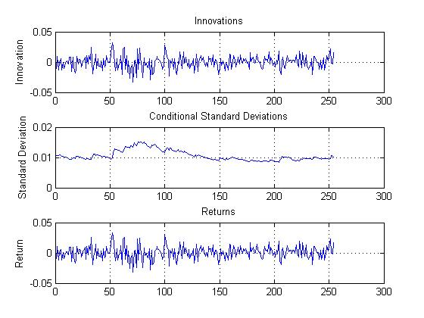
Post-estimation Analysis : Example # 63
Comparing the Residuals, Conditional Standard Deviations, and Returns

Slide 73
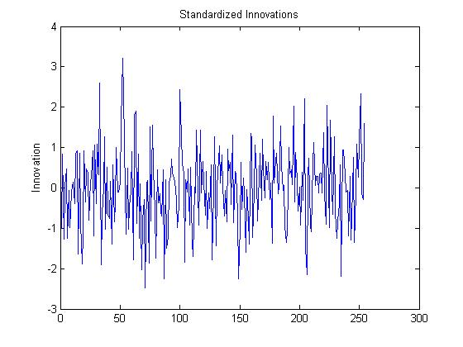
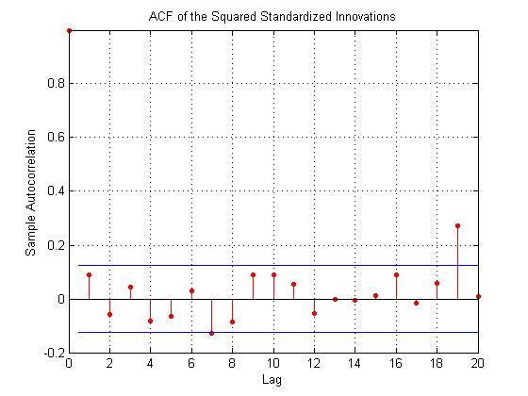
Correlation and Standardized Innovations: Example # 63
Compare the ACF of the squared standardized innovations in this figure to the ACF of the squared returns prior to fitting the default model. The comparison shows that the default model sufficiently explains the heteroscedasticity in the raw returns.

Slide 74
EGARCH(1,1) Model Application : Example # 63

Slide 75
Applications of GARCH Models
Generates Volatility term structures that converge to long-term average volatility level as maturity increases.
Term structure forecasts mean-revert to long term level of volatility.
Major difference between forecasts made by GARCH and AGARCH are in short term volatility forecasts following a larger fall in market price.

Slide 76
Applications of GARCH Models
In Option Pricing and Hedging
Smile Fitting :
  GARCH option prices are put in the Black Scholes formula, and the GARCH ‘implied volatility’ is then backed out of the formula

