Slide 1

IME634: Management Decision Analysis
Raghu Nandan Sengupta
Industrial & Management Department
Indian Institute of Technology Kanpur

Slide 2
Multiple Linear Regression (MLR)
Multiple linear regression (MLR) is a statistical technique which is used to forecast or predict a dependent variable Y based on independent variable X
In order that our prediction or forecasting is accurate we ensure through proper assumptions and subsequent calculations, that the error of prediction or forecasting is minimized

Slide 3
Multiple Linear Regression (MLR) (contd..)
A model (or theory) is not confirmed unless it is made to include every possibility
One should remember that a deterministic theory will be invalidated by a single contradictory observation
The introduction of stochastic elements into the model changes it from an exact statement to a probabilistic description about expected outcomes and carries with it an important implication

Slide 4
Multiple Linear Regression (MLR) (contd..)
Only a preponderance of contradictory evidence can convincingly invalidate the probabilistic model
What constitutes a preponderance of contradictory evidence is a matter of interpretation
Probabilistic model is less precise but at the same time, more robust

Slide 5
Multiple Linear Regression (MLR) (contd..)
Few relevant examples
What are the likely effects on labor supply behavior of proposed negative income taxes
Does a monetary policy regime that is strongly oriented toward controlling inflation impose a real cost
Does attending a good college bring an expected payoff in lifetime expected income sufficient to justify the higher tuition

Slide 6
Multiple Linear Regression (MLR) (contd..)
Few relevant examples (contd..)
Does a voluntary training program produce tangible benefits? Can these benefits be accurately measured?
Do smaller class sizes bring real benefits in student performance?
Does the humidity predict higher temperature?
Does obesity lead to health problems?

Slide 7
Multiple Linear Regression (MLR) (contd..)
Assumptions
Linearity: Linear relationship between independent and dependent variables
Full rank: In general we mean that all the different independent variables are themselves independent, i.e., in the matrix notion (for multiple linear regression) the rows and/or columns are independent

Slide 8
Multiple Linear Regression (MLR) (contd..)
Assumptions (contd..)
Exogeneity of the independent variables: The expected value of the disturbance at any observation in the sample is not a function of the independent variables observed at any other observation, including this one. Thus the independent variables will not carry useful information for prediction of error term
Homoscedasticity and nonautocorrelation: Each disturbance/error has the same finite variance, and is uncorrelated with every other disturbance/error. Of course this assumption limits the generality of the model, and we will want to examine how to relax it in later

Slide 9
Multiple Linear Regression (MLR) (contd..)
Assumptions (contd..)
Data generation: The data in may be any mixture of constants and random variables. The crucial elements for present purposes are the strict mean independence assumption # 3 and the implicit variance independence assumption in # 4. Analysis will be done conditionally on the observed independent variable, so whether the elements in the independent variables are fixed constants or random draws from a stochastic process will not influence the results
Normal distribution: The disturbances are normally distributed

Slide 10
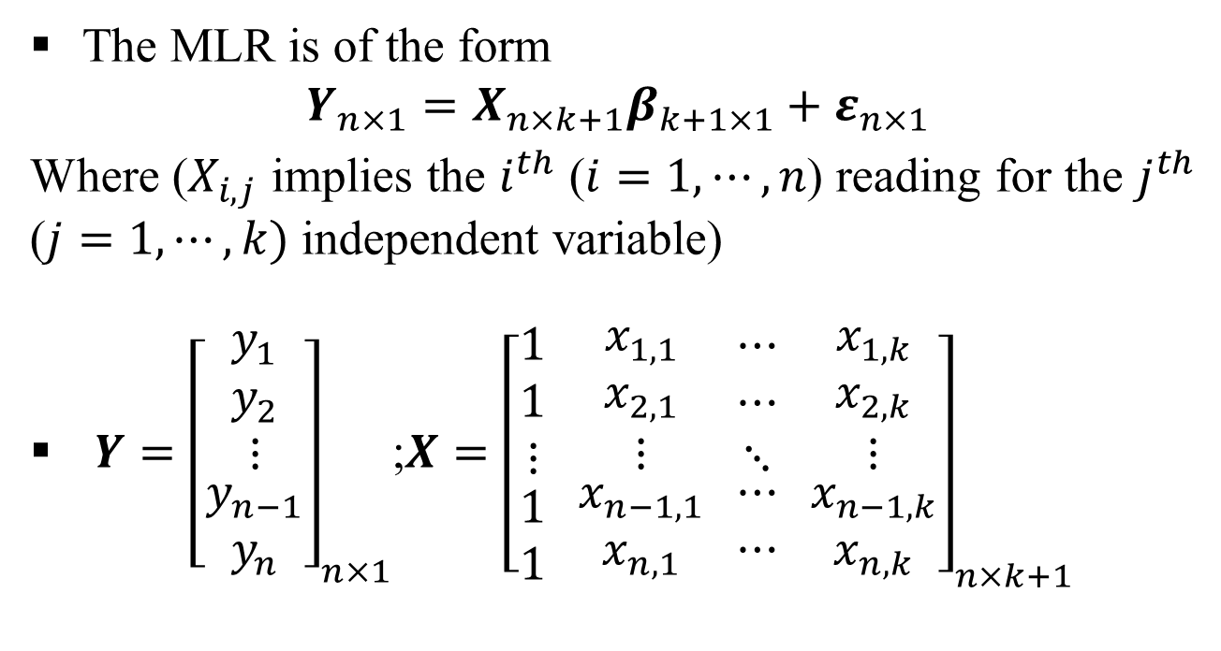
Multiple Linear Regression (MLR) (contd..)
The MLR is of the form
$$Y_{n×1}=X_{n×k+1}β_{k+1×1}+ε_{n×1}$$
Where ($X_{i,j}$ implies the $i^{th}$ ($i=1,⋯,n$) reading for the $j^{th}$ ($j=1,⋯,k)$ independent variable)
$Y={\left[\begin{aligned}\begin{matrix}y_{1} \\ y_{2} \\ ⋮\end{matrix} \\ y_{n−1} \\ y_{n}\end{aligned}\right]}_{n×1}$;$X={\left[\begin{aligned}\begin{matrix}1 \\ 1 \\ ⋮\end{matrix} \\ 1 \\ 1\end{aligned} \begin{aligned}\begin{matrix}x_{1,1} \\ x_{2,1} \\ ⋮\end{matrix} \\ x_{n−1,1} \\ x_{n,1}\end{aligned} \begin{aligned}\begin{matrix}⋯ \\ ⋯ \\ ⋱\end{matrix} \\ ⋯ \\ ⋯\end{aligned} \begin{aligned}\begin{matrix}x_{1,k} \\ x_{2,k} \\ ⋮\end{matrix} \\ x_{n−1,k} \\ x_{n,k}\end{aligned}\right]}_{n×k+1}$

Slide 11
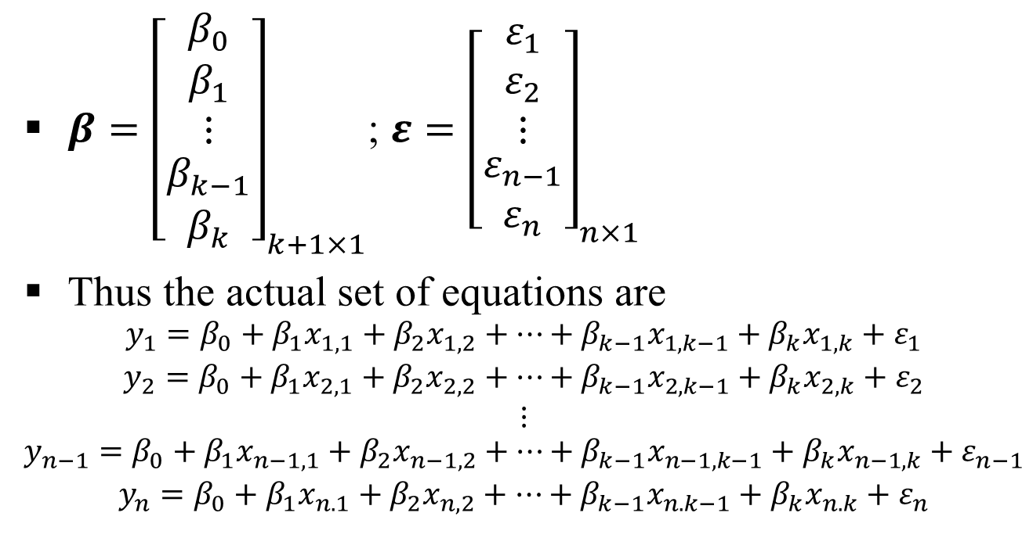
Multiple Linear Regression (MLR) (contd..)
$β={\left[\begin{aligned}\begin{matrix}β_{0} \\ β_{1} \\ ⋮\end{matrix} \\ β_{k−1} \\ β_{k}\end{aligned}\right]}_{k+1×1}$; $ε={\left[\begin{aligned}\begin{matrix}ε_{1} \\ ε_{2} \\ ⋮\end{matrix} \\ ε_{n−1} \\ ε_{n}\end{aligned}\right]}_{n×1}$
Thus the actual set of equations are
$$\begin{aligned}\begin{matrix}y_{1}=β_{0}+β_{1}x_{1,1}+β_{2}x_{1,2}+⋯+β_{k−1}x_{1,k−1}+β_{k}x_{1,k}+ε_{1} \\ y_{2}=β_{0}+β_{1}x_{2,1}+β_{2}x_{2,2}+⋯+β_{k−1}x_{2,k−1}+β_{k}x_{2,k}+ε_{2} \\ ⋮\end{matrix} \\ y_{n−1}=β_{0}+β_{1}x_{n−1, 1}+β_{2}x_{n−1,2}+⋯+β_{k−1}x_{n−1,k−1}+β_{k}x_{n−1,k}+ε_{n−1} \\ y_{n}=β_{0}+β_{1}x_{n.1}+β_{2}x_{n,2}+⋯+β_{k−1}x_{n.k−1}+β_{k}x_{n.k}+ε_{n}\end{aligned}$$

Slide 12
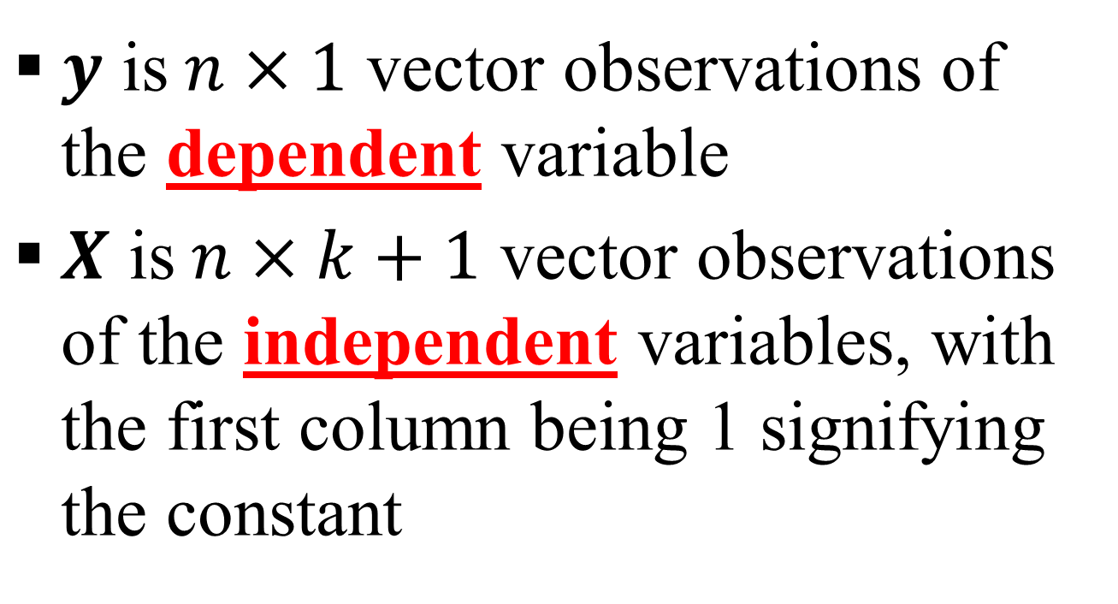
Multiple Linear Regression (MLR) (contd..)
$y$ is$n×1$ vector observations of the dependent variable
$X$ is$n×k+1$ vector observations of the independent variables, with the first column being 1 signifying the constant

Slide 13
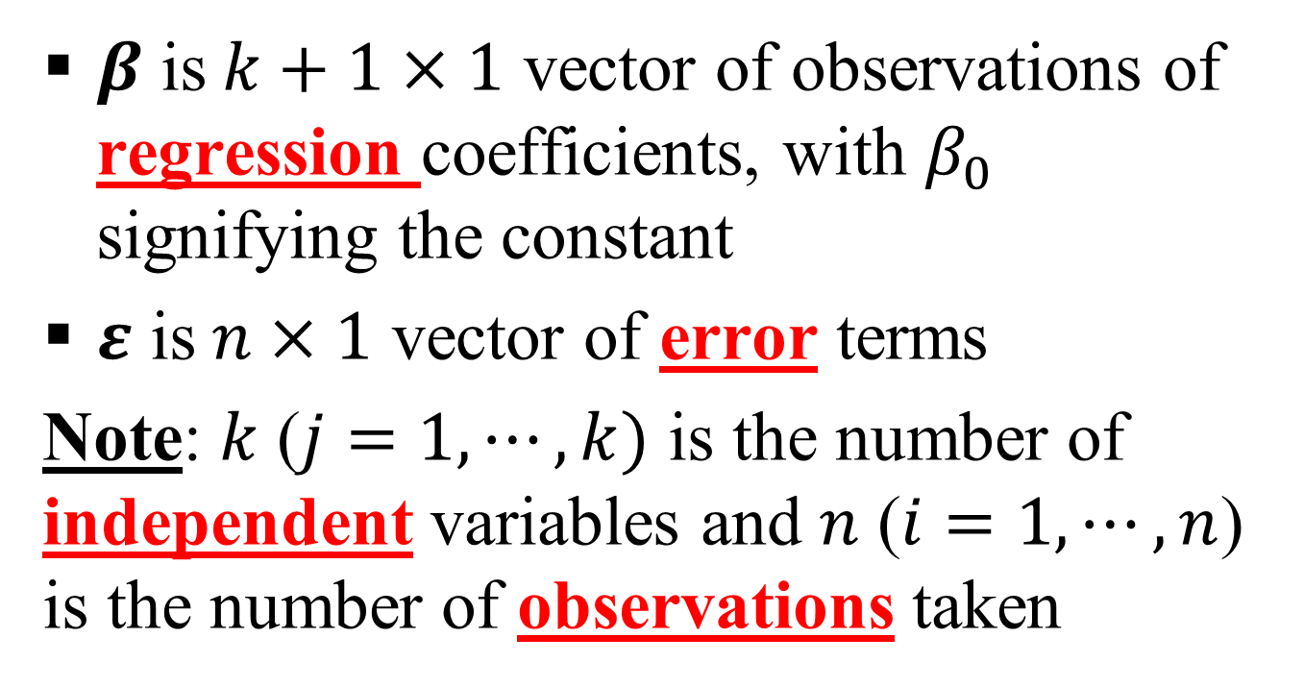
Multiple Linear Regression (MLR) (contd..)
$β$ is$k+1×1$ vector of observations of regression coefficients, with $β_{0}$ signifying the constant
$ε$ is$n×1$ vector of error terms
Note: $k$ ($j=1,⋯,k)$ is the number of independent variables and $n$ ($i=1,⋯,n$) is the number of observations taken

Slide 14
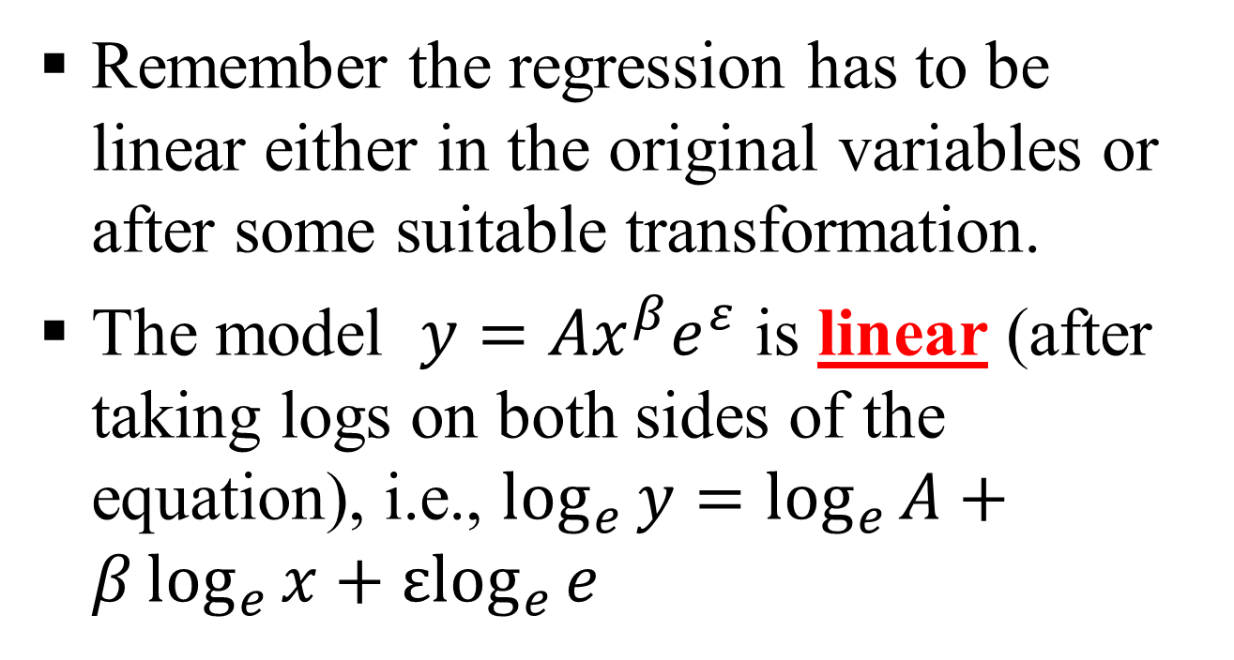
Multiple Linear Regression (MLR)
Linearity (Assumption 1)
Remember the regression has to be linear either in the original variables or after some suitable transformation.
The model $y=Ax^{β}e^{ε}$ is linear (after taking logs on both sides of the equation), i.e., $\log_{e}{y}=\log_{e}{A}+β\log_{e}{x}+{εlog}_{e}{e}$

Slide 15
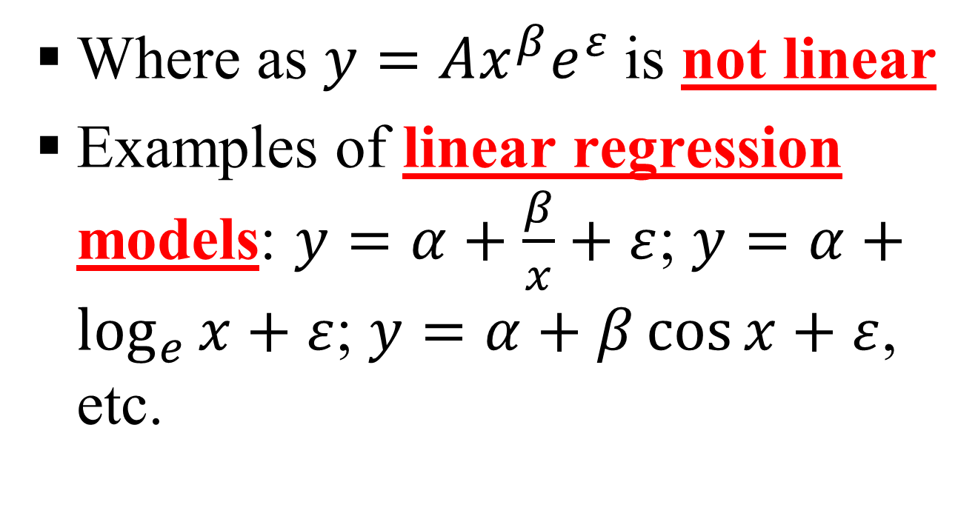
Multiple Linear Regression (MLR)
Linearity (Assumption 1) (contd..)
Where as $y=Ax^{β}e^{ε}$is not linear
Examples of linear regression models: $y=α+\frac{β}{x}+ε$; $y=α+\log_{e}{x}+ε$; $y=α+β\cos{x}+ε$, etc.

Slide 16
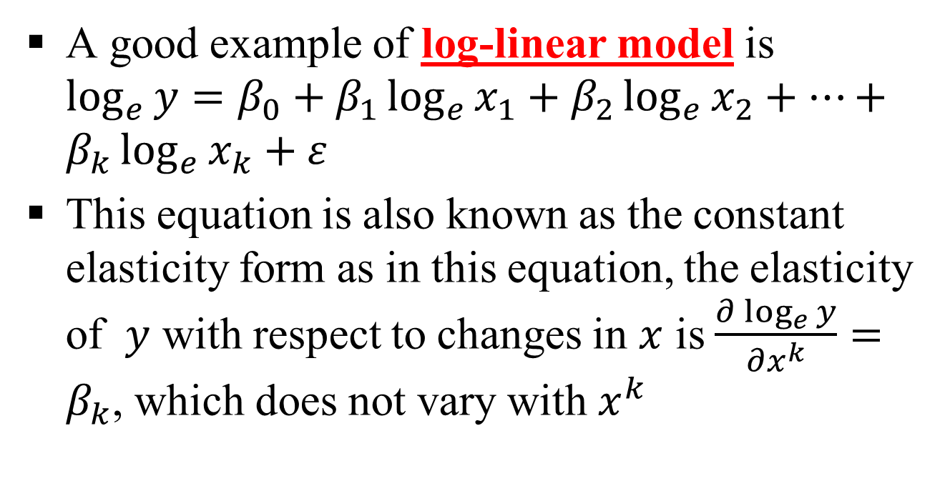
Multiple Linear Regression (MLR)
Linearity (Assumption 1) (contd..)
A good example of log-linear model is $\log_{e}{y}=β_{0}+β_{1}\log_{e}{x_{1}}+β_{2}\log_{e}{x_{2}}+⋯+β_{k}\log_{e}{x_{k}}+ε$
This equation is also known as the constant elasticity form as in this equation, the elasticity of $y$ with respect to changes in $x$ is $\frac{∂\log_{e}{y}}{∂x^{k}}=β_{k}$, which does not vary with $x^{k}$

Slide 17
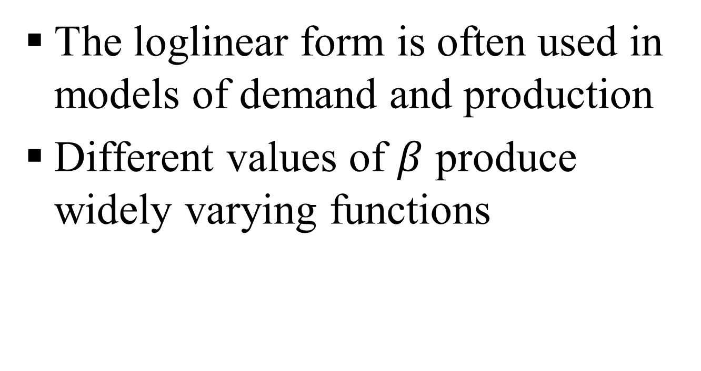
Multiple Linear Regression (MLR)
Linearity (Assumption 1) (contd..)
The loglinear form is often used in models of demand and production
Different values of $β$ produce widely varying functions

Slide 18
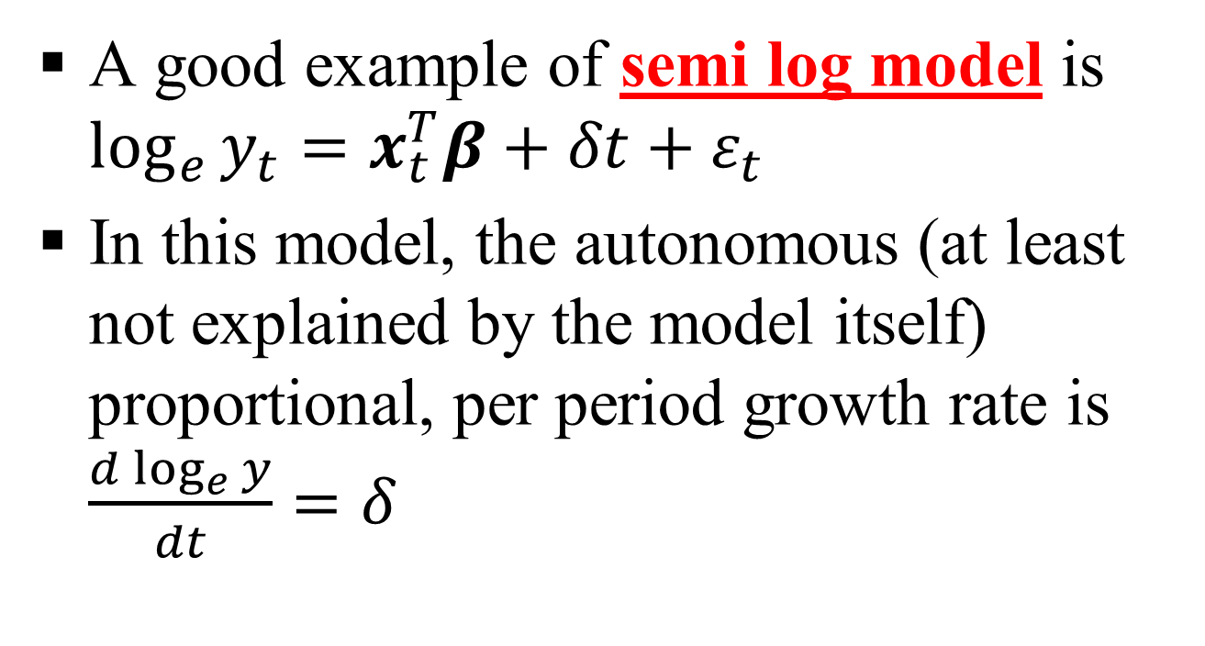
Multiple Linear Regression (MLR)
Linearity (Assumption 1) (contd..)
A good example of semi log model is $\log_{e}{y_{t}}=x_{t}^{T}β+δt+ε_{t}$
In this model, the autonomous (at least not explained by the model itself) proportional, per period growth rate is $\frac{d\log_{e}{y}}{dt}=δ$

Slide 19
Multiple Linear Regression (MLR)
Linearity (Assumption 1) (contd..)
Modern studies of demand and production are usually done with a flexible functional form
Flexible functional forms are used in econometrics because they allow analysts to model second-order effects such as elasticities of substitution, which are functions of the second derivatives of production, cost, or utility functions
Modern studies of demand and production are usually done with a flexible functional form which are used in econometrics because they allow analysts to model second-order effects such as elasticities of substitution, which are functions of the second derivatives of production, cost, or utility functions

Slide 20
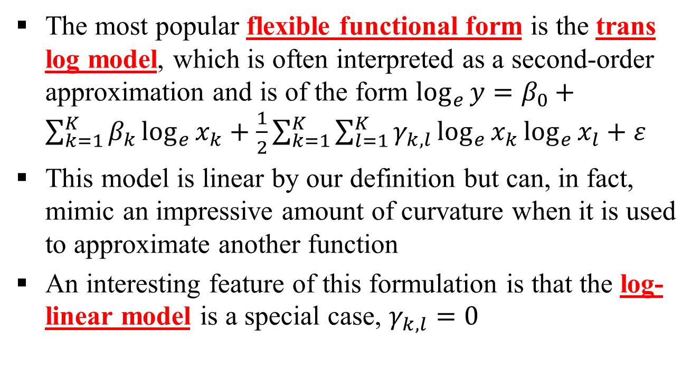
Multiple Linear Regression (MLR)
Linearity (Assumption 1) (contd..)
The most popular flexible functional form is the trans log model, which is often interpreted as a second-order approximation and is of the form $\log_{e}{y}=β_{0}+\sum_{k=1}^{K}{β_{k}\log_{e}{x_{k}}}+\frac{1}{2}\sum_{k=1}^{K}{\sum_{l=1}^{K}{γ_{k,l}\log_{e}{x_{k}}\log_{e}{x_{l}}}}+ε$
This model is linear by our definition but can, in fact, mimic an impressive amount of curvature when it is used to approximate another function
An interesting feature of this formulation is that the log-linear model is a special case, $γ_{k,l}=0$

Slide 21
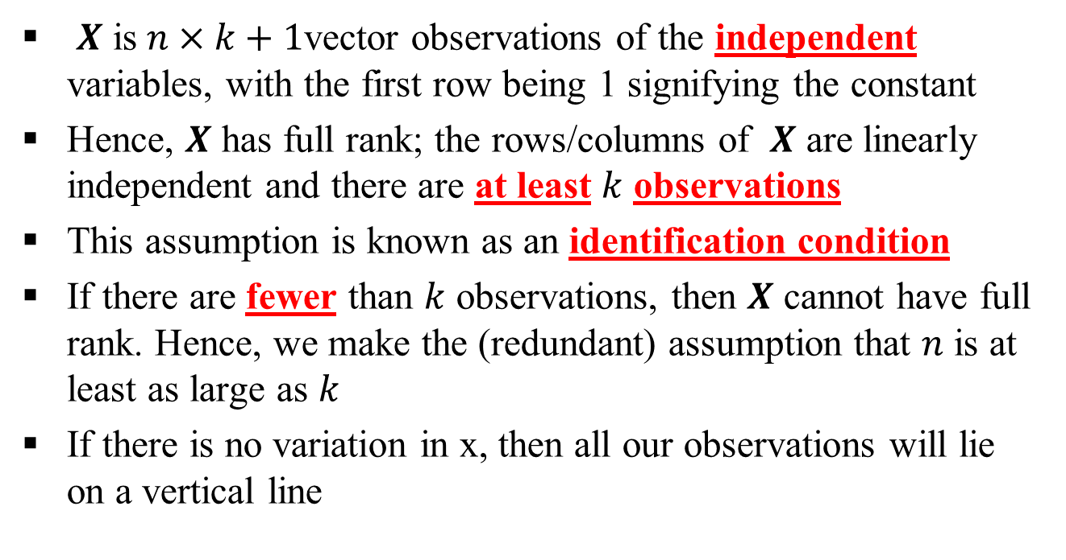
Multiple Linear Regression (MLR)
Full Rank (Assumption 2)
$X$ is$n×k+1$vector observations of the independent variables, with the first row being 1 signifying the constant
Hence, $X$ has full rank; the rows/columns of $X$ are linearly independent and there are at least $k$ observations
This assumption is known as an identification condition
If there are fewer than $k$ observations, then $X$ cannot have full rank. Hence, we make the (redundant) assumption that $n$ is at least as large as $k$
If there is no variation in x, then all our observations will lie on a vertical line

Slide 22
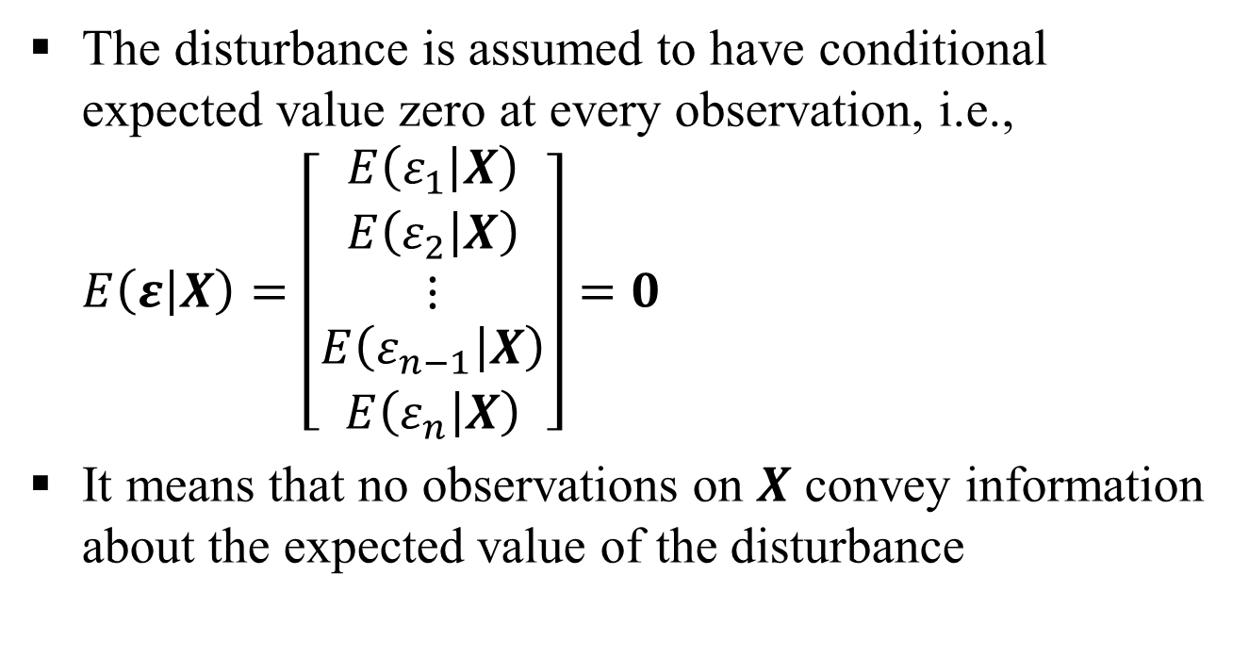
Multiple Linear Regression (MLR)
Exogeneity of the independent variables (Assumption 3)
The disturbance is assumed to have conditional expected value zero at every observation, i.e., $E\left(ε | X\right)=\left[\begin{aligned}\begin{matrix}E\left(ε_{1} | X\right) \\ E\left(ε_{2} | X\right) \\ ⋮\end{matrix} \\ E\left(ε_{n−1} | X\right) \\ E\left(ε_{n} | X\right)\end{aligned}\right]=0$
It means that no observations on $X$ convey information about the expected value of the disturbance

Slide 23
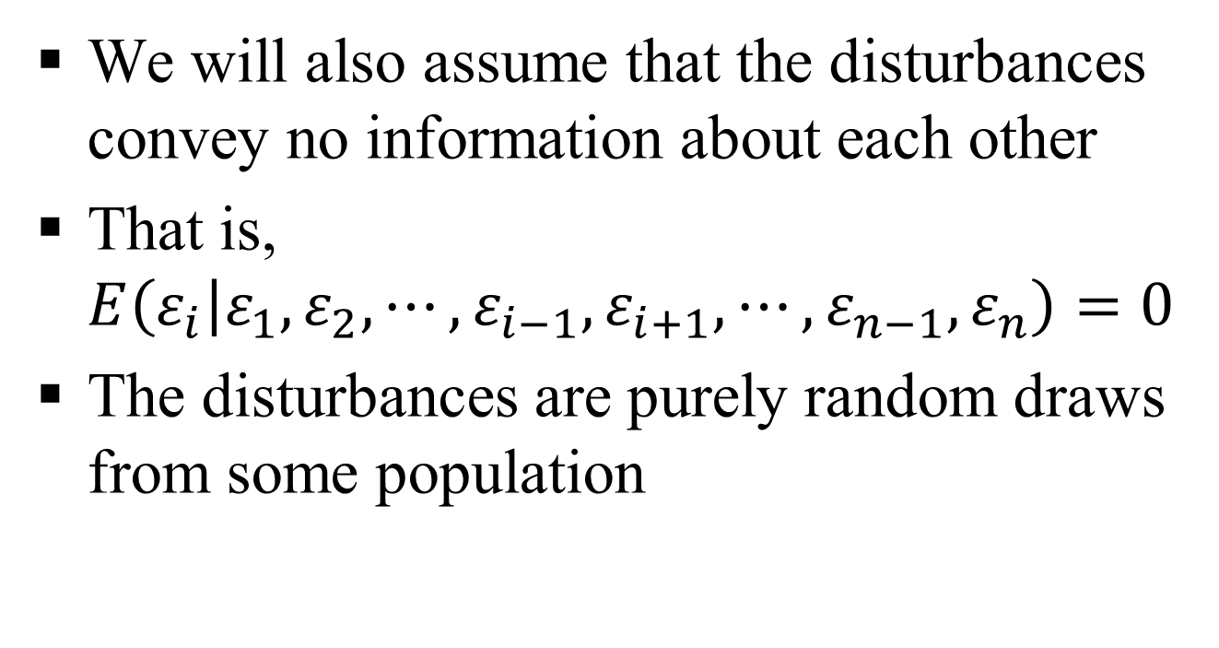
Multiple Linear Regression (MLR)
Exogeneity of the independent variables (Assumption 3) (contd..)
We will also assume that the disturbances convey no information about each other
That is, $E\left(ε_{i} | ε_{1},ε_{2},⋯,ε_{i−1},ε_{i+1},⋯,ε_{n−1},ε_{n}\right)=0$
The disturbances are purely random draws from some population

Slide 24
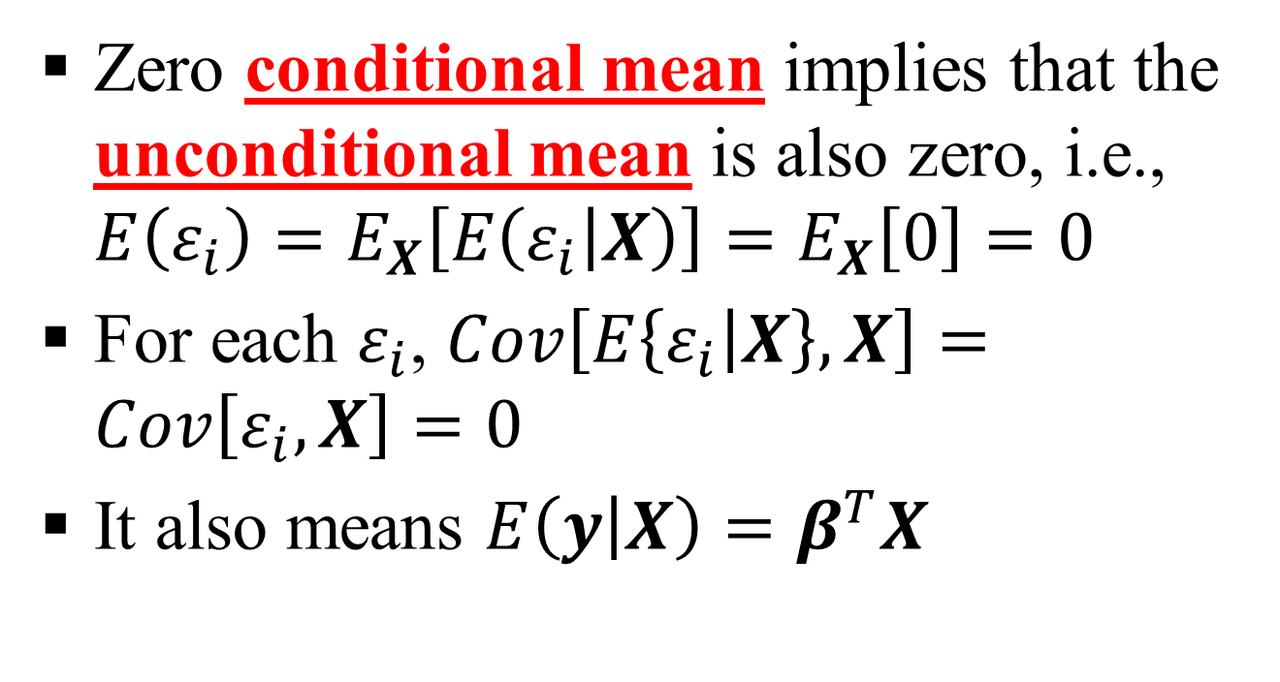
Multiple Linear Regression (MLR)
Exogeneity of the independent variables (Assumption 3) (contd..)
Zero conditional mean implies that the unconditional mean is also zero, i.e., $E\left(ε_{i}\right)=E_{X}\left[E\left(ε_{i} | X\right)\right]=E_{X}\left[0\right]=0$
For each $ε_{i}$, $Cov\left[E\left\{ε_{i} | X\right\},X\right]=Cov\left[ε_{i},X\right]=0$
It also means $E\left(y | X\right)=β^{T}X$

Slide 25
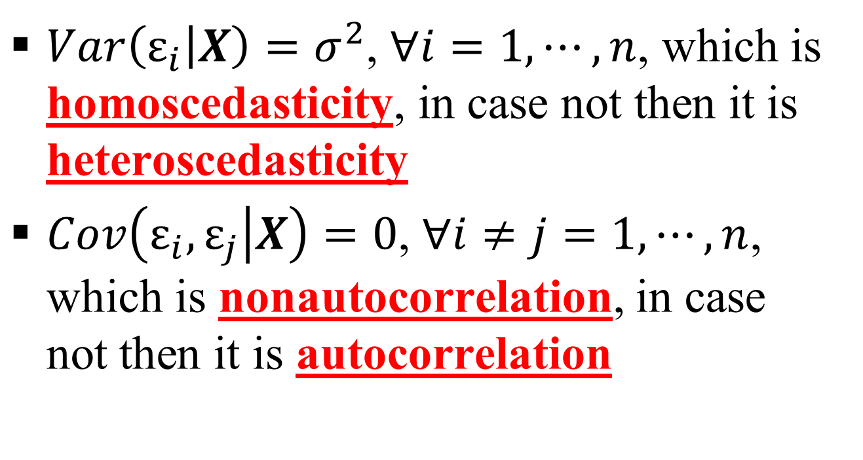
Multiple Linear Regression (MLR)
Homoscedasticity and nonautocorrelation (Assumption 4)
$Var\left(ε_{i} | X\right)=σ^{2}$, $∀i=1,⋯,n$, which is homoscedasticity, in case not then it is heteroscedasticity
$Cov\left(ε_{i},ε_{j} | X\right)=0$, $∀i≠j=1,⋯,n$, which is nonautocorrelation, in case not then it is autocorrelation

Slide 26
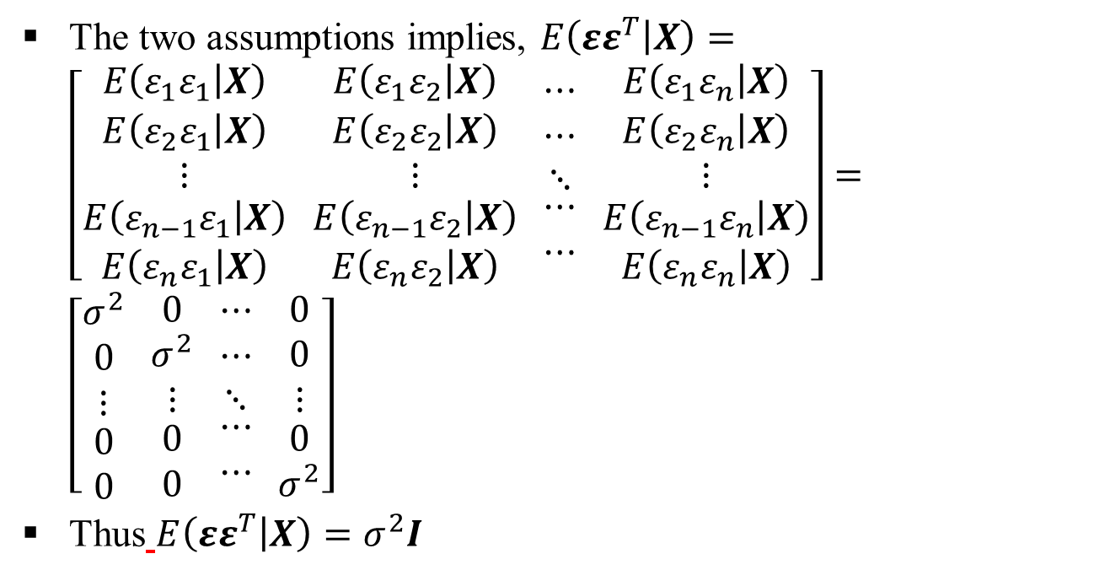
Multiple Linear Regression (MLR)
Homoscedasticity and nonautocorrelation (Assumption 4) (contd..)
The two assumptions implies, $E\left(εε^{T} | X\right)=\left[\begin{aligned}\begin{matrix}E\left(ε_{1}ε_{1} | X\right) \\ E\left(ε_{2}ε_{1} | X\right) \\ ⋮\end{matrix} \\ E\left(ε_{n−1}ε_{1} | X\right) \\ E\left(ε_{n}ε_{1} | X\right)\end{aligned} \begin{aligned}\begin{matrix}E\left(ε_{1}ε_{2} | X\right) \\ E\left(ε_{2}ε_{2} | X\right) \\ ⋮\end{matrix} \\ E\left(ε_{n−1}ε_{2} | X\right) \\ E\left(ε_{n}ε_{2} | X\right)\end{aligned} \begin{aligned}\begin{matrix}⋯ \\ ⋯ \\ ⋱\end{matrix} \\ ⋯ \\ ⋯\end{aligned} \begin{aligned}\begin{matrix}E\left(ε_{1}ε_{n} | X\right) \\ E\left(ε_{2}ε_{n} | X\right) \\ ⋮\end{matrix} \\ E\left(ε_{n−1}ε_{n} | X\right) \\ E\left(ε_{n}ε_{n} | X\right)\end{aligned}\right]=\left[\begin{aligned}\begin{matrix}σ^{2} \\ 0 \\ ⋮\end{matrix} \\ 0 \\ 0\end{aligned} \begin{aligned}\begin{matrix}0 \\ σ^{2} \\ ⋮\end{matrix} \\ 0 \\ 0\end{aligned} \begin{aligned}\begin{matrix}⋯ \\ ⋯ \\ ⋱\end{matrix} \\ ⋯ \\ ⋯\end{aligned} \begin{aligned}\begin{matrix}0 \\ 0 \\ ⋮\end{matrix} \\ 0 \\ σ^{2}\end{aligned}\right]$
Thus $E\left(εε^{T} | X\right)=σ^{2}I$

Slide 27
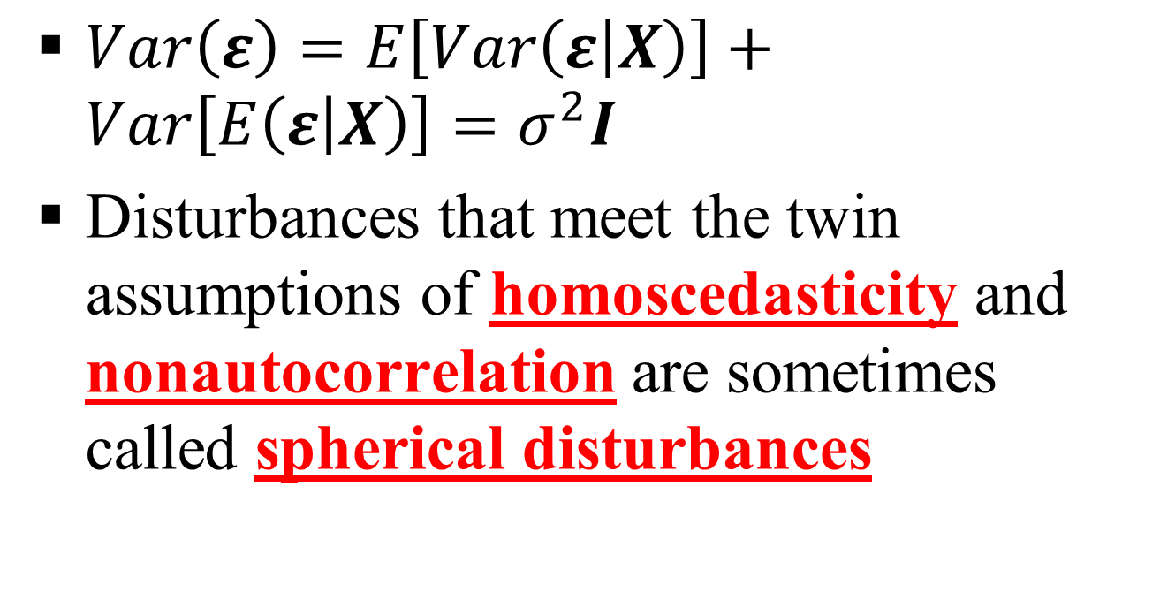
Multiple Linear Regression (MLR)
Homoscedasticity and nonautocorrelation (Assumption 4) (contd..)
$Var\left(ε\right)=E\left[Var\left(ε | X\right)\right]+Var\left[E\left(ε | X\right)\right]=σ^{2}I$
Disturbances that meet the twin assumptions of homoscedasticity and nonautocorrelation are sometimes called spherical disturbances

Slide 28
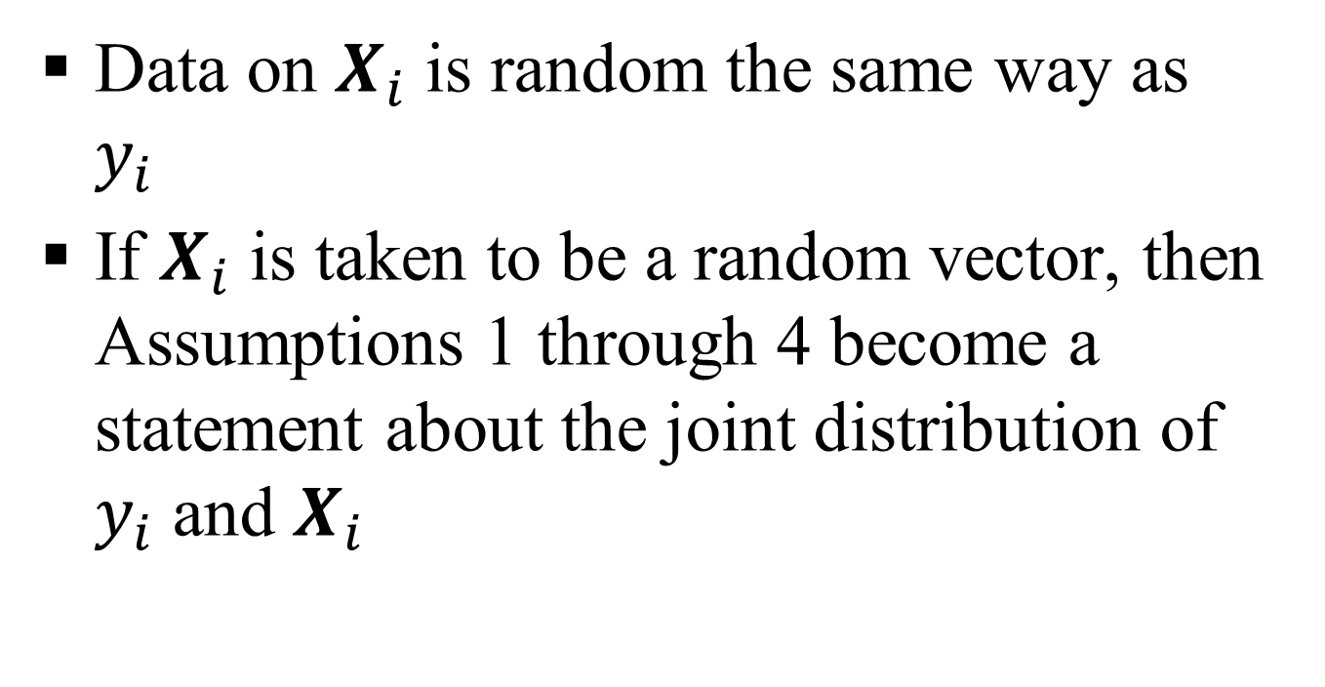
Multiple Linear Regression (MLR)
Data generation (Assumption 5)
Data on $X_{i}$ is random the same way as $y_{i}$
If $X_{i}$ is taken to be a random vector, then Assumptions 1 through 4 become a statement about the joint distribution of $y_{i}$ and $X_{i}$

Slide 29
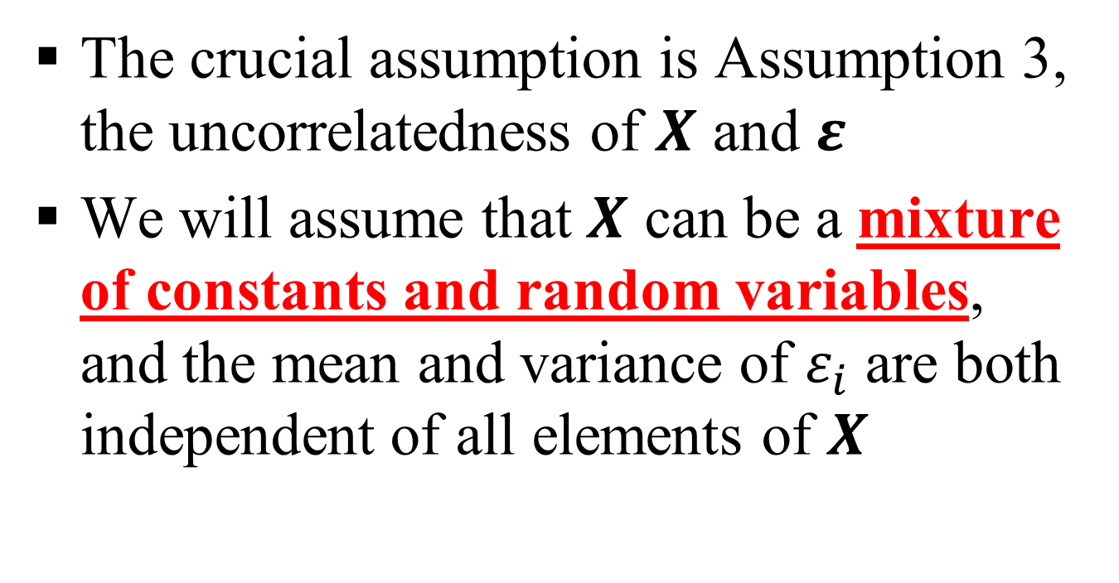
Multiple Linear Regression (MLR)
Data generation (Assumption 5) (contd..)
The crucial assumption is Assumption 3, the uncorrelatedness of $X$ and $ε$
We will assume that $X$ can be a mixture of constants and random variables, and the mean and variance of $ε_{i}$ are both independent of all elements of $X$

Slide 30
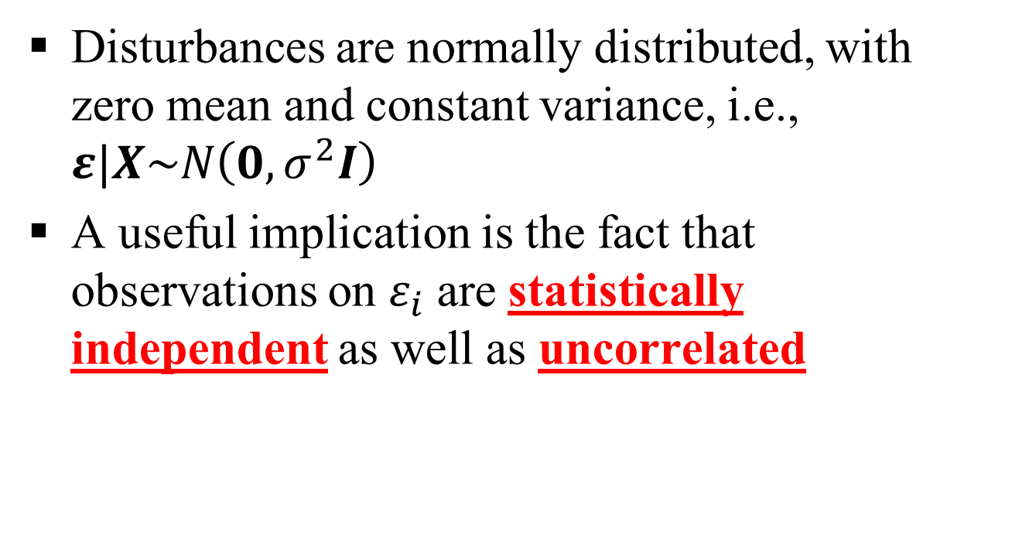
Multiple Linear Regression (MLR)
Normality (Assumption 6)
Disturbances are normally distributed, with zero mean and constant variance, i.e., $ε|X\sim N\left(0,σ^{2}I\right)$
A useful implication is the fact that observations on $ε_{i}$ are statistically independent as well as uncorrelated

Slide 31
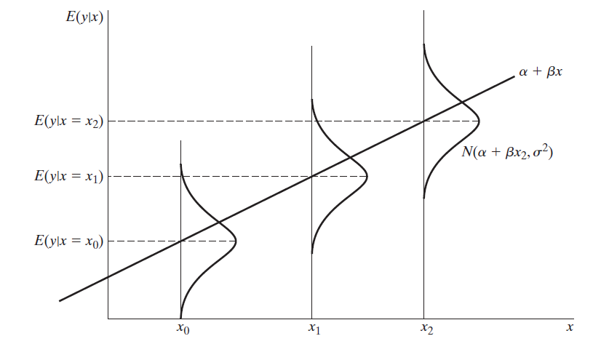
Multiple Linear Regression (MLR) (contd..)
(Ref: Econometric Analysis by W.H.Green)

Slide 32
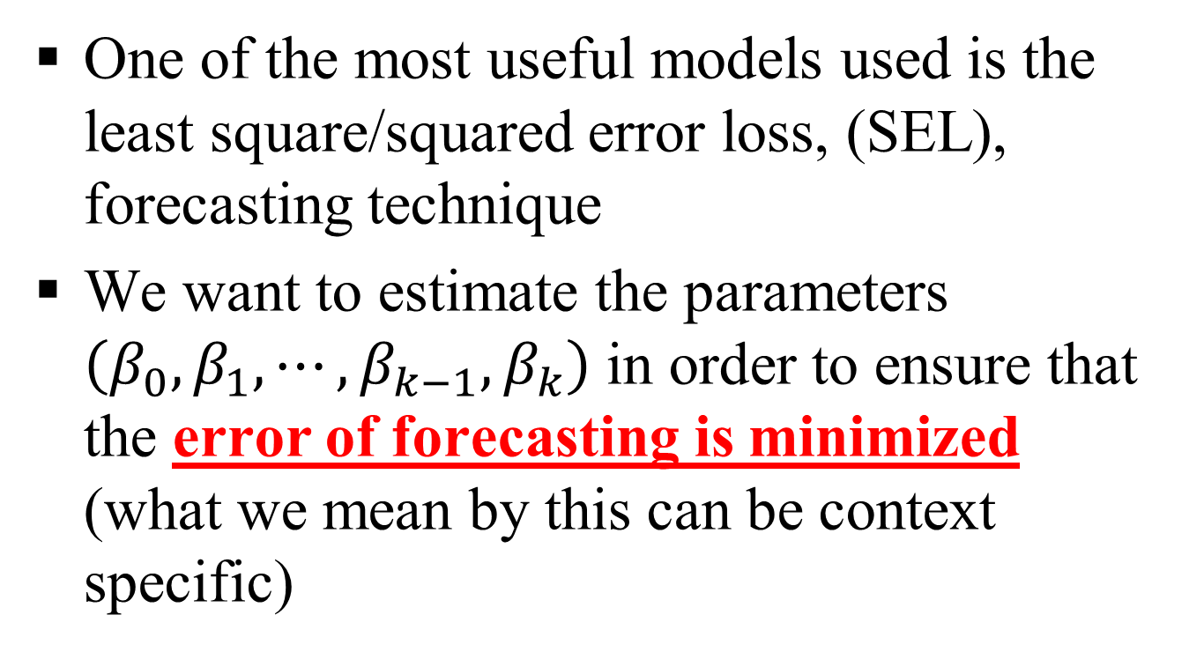
Multiple Linear Regression (MLR) (contd..)
One of the most useful models used is the least square/squared error loss, (SEL), forecasting technique
We want to estimate the parameters $\left(β_{0},β_{1},⋯,β_{k−1},β_{k}\right)$ in order to ensure that the error of forecasting is minimized (what we mean by this can be context specific)

Slide 33
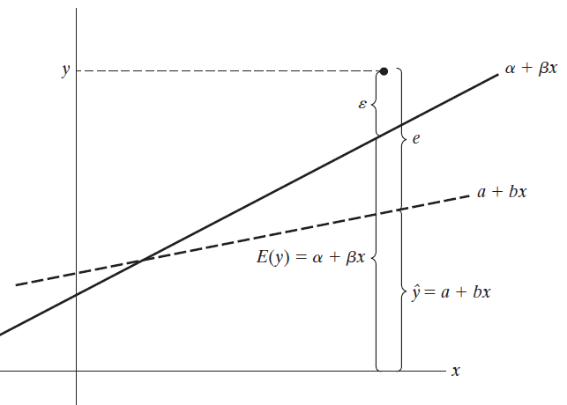
Multiple Linear Regression (MLR) (contd..)
(Ref: Econometric Analysis by W.H.Green)

Slide 34
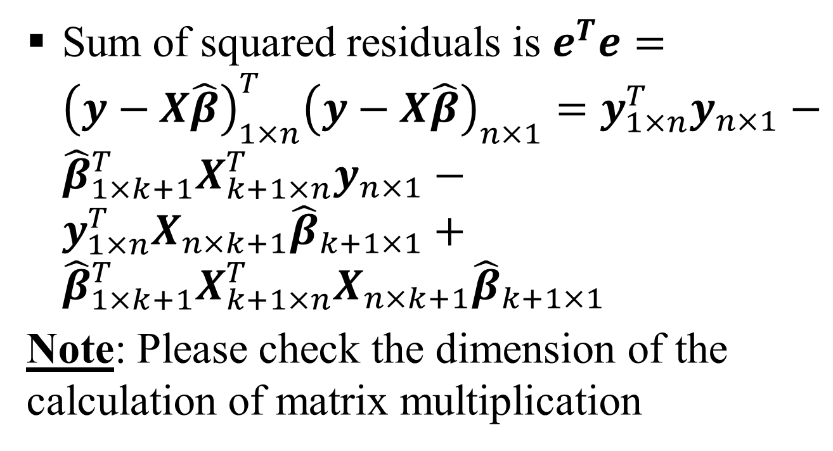
Multiple Linear Regression (MLR) (contd..)
Sum of squared residuals is $e^{T}e={\left(y−X\hat{β}\right)}_{1×n}^{T}{\left(y−X\hat{β}\right)}_{n×1}=y_{1×n}^{T}y_{n×1}−{\hat{β}}_{1×k+1}^{T}X_{k+1×n}^{T}y_{n×1}−y_{1×n}^{T}X_{n×k+1}{\hat{β}}_{k+1×1}+{\hat{β}}_{1×k+1}^{T}X_{k+1×n}^{T}X_{n×k+1}{\hat{β}}_{k+1×1}$
Note: Please check the dimension of the calculation of matrix multiplication

Slide 35
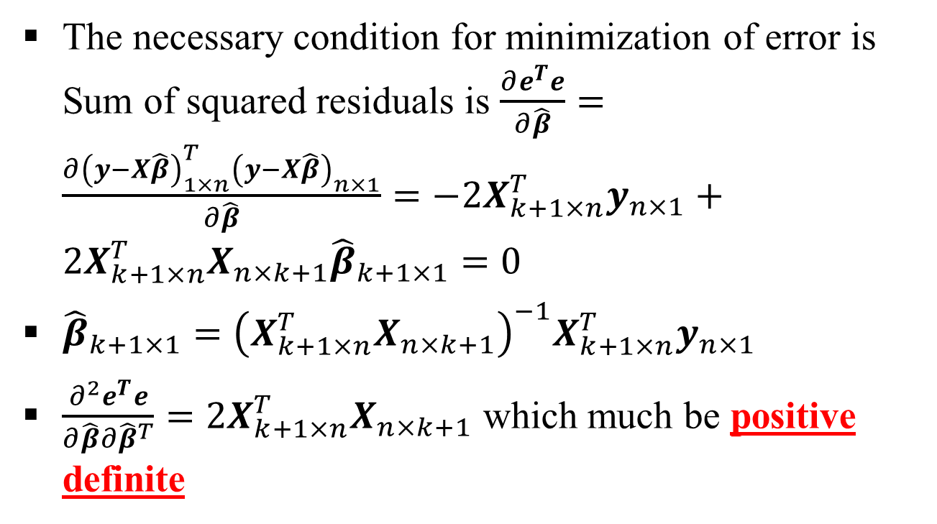
Multiple Linear Regression (MLR) (contd..)
The necessary condition for minimization of error is Sum of squared residuals is $\frac{∂e^{T}e}{∂\hat{β}}=\frac{∂{\left(y−X\hat{β}\right)}_{1×n}^{T}{\left(y−X\hat{β}\right)}_{n×1}}{∂\hat{β}}=−2X_{k+1×n}^{T}y_{n×1}+2X_{k+1×n}^{T}X_{n×k+1}{\hat{β}}_{k+1×1}=0$
${\hat{β}}_{k+1×1}={\left(X_{k+1×n}^{T}X_{n×k+1}\right)}^{−1}X_{k+1×n}^{T}y_{n×1}$
$\frac{∂^{2}e^{T}e}{∂\hat{β}∂{\hat{β}}^{T}}=2X_{k+1×n}^{T}X_{n×k+1}$ which much be positive definite

Slide 36
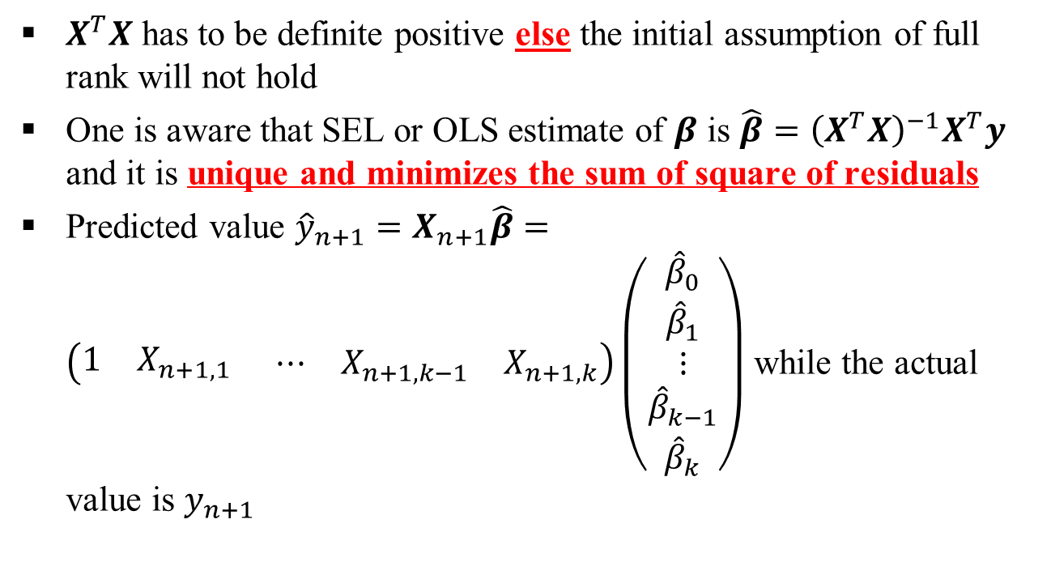
Multiple Linear Regression (MLR) (contd..)
$X^{T}X$ has to be definite positive else the initial assumption of full rank will not hold
One is aware that SEL or OLS estimate of $β$ is $\hat{β}={\left(X^{T}X\right)}^{−1}X^{T}y$ and it is unique and minimizes the sum of square of residuals
Predicted value ${\hat{y}}_{n+1}=X_{n+1}\hat{β}=\left(\begin{matrix}1 & X_{n+1,1} \end{matrix} ⋯{ X}_{n+1,k−1} X_{n+1,k}\right)\left(\begin{aligned}\begin{matrix}{\hat{β}}_{0} \\ {\hat{β}}_{1} \\ ⋮\end{matrix} \\ {\hat{β}}_{k−1} \\ {\hat{β}}_{k}\end{aligned}\right)$ while the actual value is $y_{n+1}$

Slide 37
Multiple Linear Regression (MLR) (contd..)
If the variables of MLR are not correlated (i.e., they are orthogonal), then the MLR slopes are the same as the slopes in the individual SLR
Note: Does it mean conditional coefficients and unconditional coefficients are same?

Slide 38
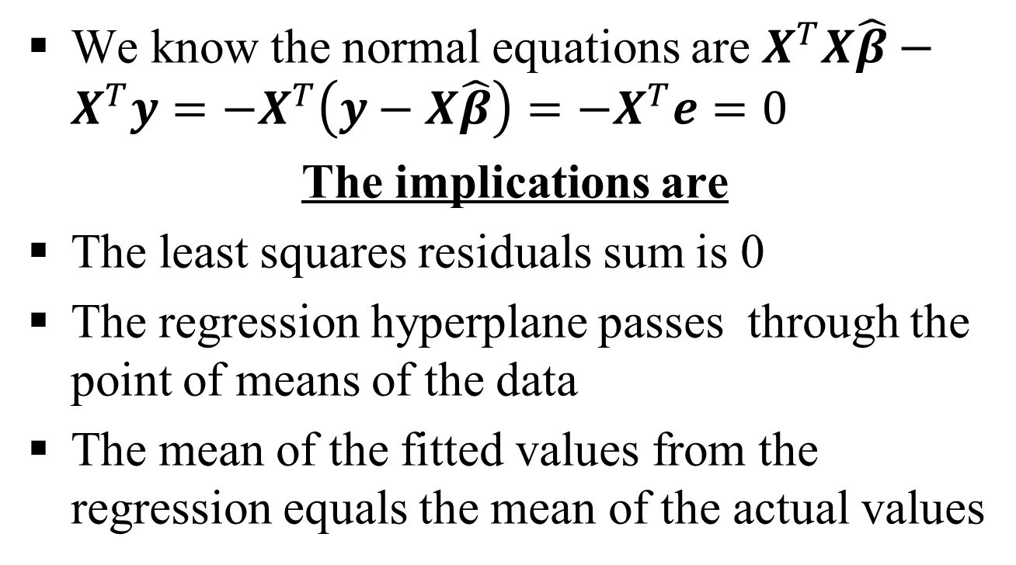
Multiple Linear Regression (MLR) (contd..)
We know the normal equations are $X^{T}X\hat{β}−X^{T}y=−X^{T}\left(y−X\hat{β}\right)=−X^{T}e=0$
The implications are
The least squares residuals sum is 0
The regression hyperplane passes through the point of means of the data
The mean of the fitted values from the regression equals the mean of the actual values

Slide 39
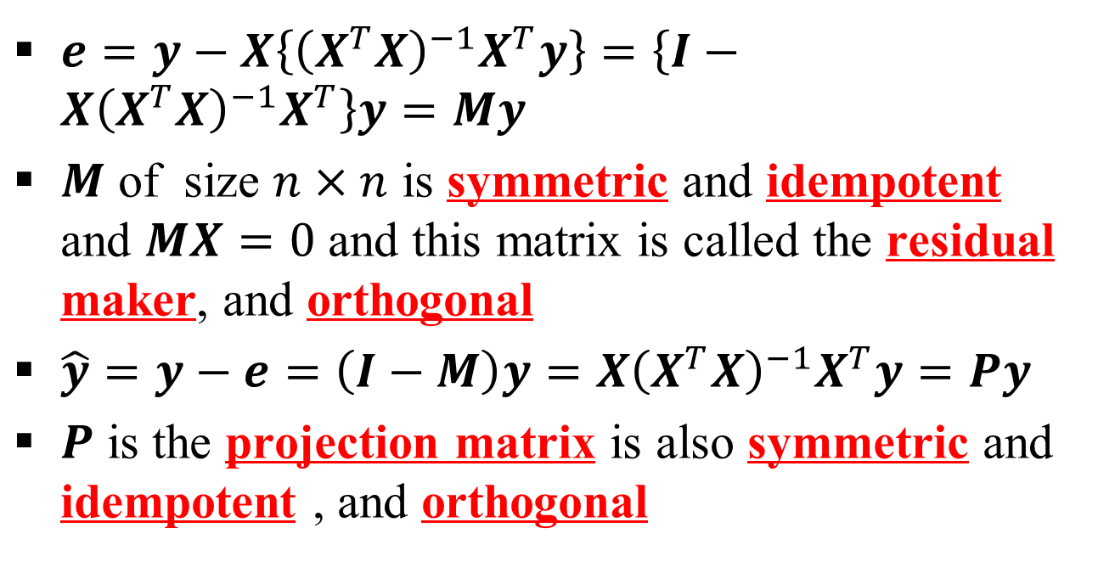
Multiple Linear Regression (MLR) (contd..)
$e=y−X\left\{{\left(X^{T}X\right)}^{−1}X^{T}y\right\}=\left\{I−X{\left(X^{T}X\right)}^{−1}X^{T}\right\}y=My$
$M$ of size $n×n$ is symmetric and idempotent and $MX=0$ and this matrix is called the residual maker, and orthogonal
$\hat{y}=y−e=\left(I−M\right)y={X\left(X^{T}X\right)}^{−1}X^{T}y=Py$
$P$ is the projection matrix is also symmetric and idempotent , and orthogonal

Slide 40
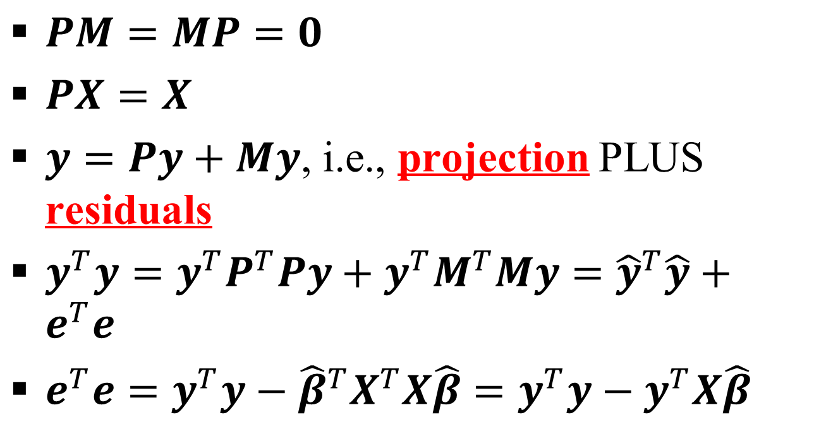
Multiple Linear Regression (MLR) (contd..)
$PM=MP=0$
$PX=X$
$y=Py+My$, i.e., projection PLUS residuals
$y^{T}y=y^{T}P^{T}Py+y^{T}M^{T}My={\hat{y}}^{T}\hat{y}+e^{T}e$
$e^{T}e=y^{T}y−{\hat{β}}^{T}X^{T}X\hat{β}=y^{T}y−y^{T}X\hat{β}$

Slide 41
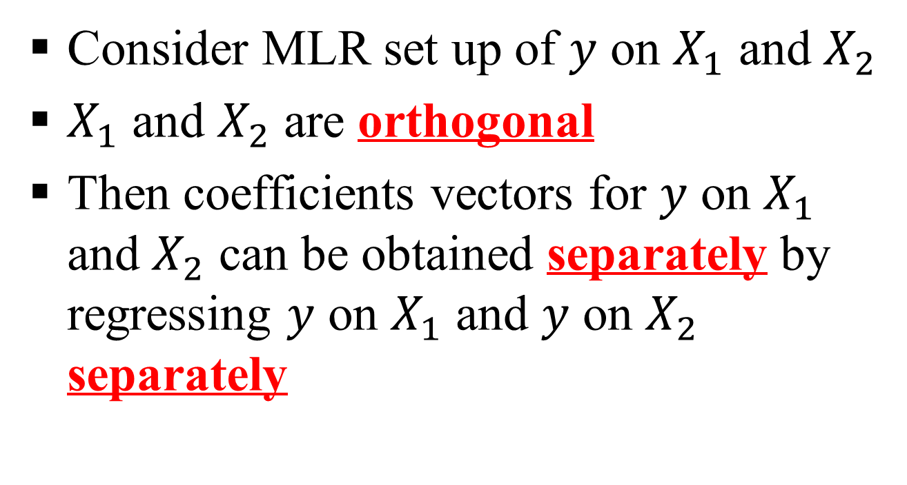
Multiple Linear Regression (MLR) (contd..)
Consider MLR set up of $y$ on $X_{1}$ and $X_{2}$
$X_{1}$ and $X_{2}$ are orthogonal
Then coefficients vectors for $y$ on $X_{1}$ and $X_{2}$ can be obtained separately by regressing $y$ on $X_{1}$ and $y$ on $X_{2}$ separately

Slide 42
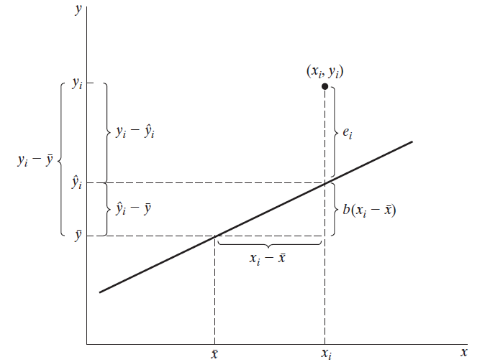
Multiple Linear Regression (MLR) (contd..)
(Ref: Econometric Analysis by W.H.Green)

Slide 43
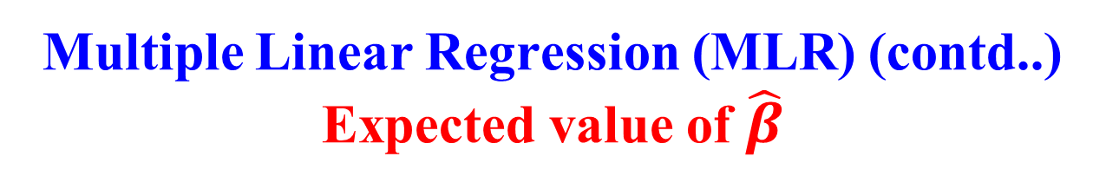
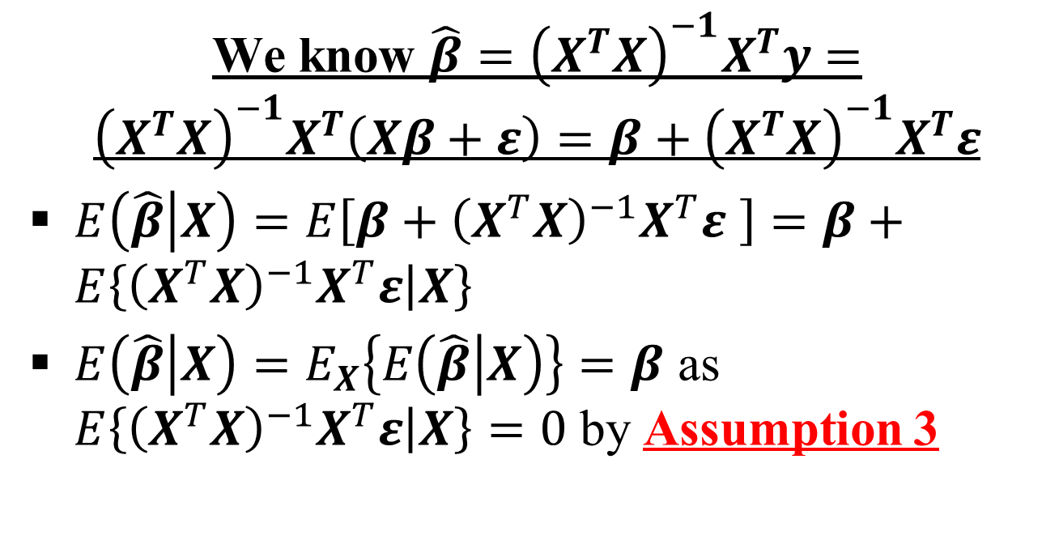
Multiple Linear Regression (MLR) (contd..)
Expected value of $\hat{β}$
We know $\hat{β}={\left(X^{T}X\right)}^{−1}X^{T}y={\left(X^{T}X\right)}^{−1}X^{T}\left(Xβ+ε\right)=β+{\left(X^{T}X\right)}^{−1}X^{T}ε$
$E\left(\hat{β} | X\right)=E\left[β+{\left(X^{T}X\right)}^{−1}X^{T}ε \right]=β+E\left\{{\left(X^{T}X\right)}^{−1}X^{T}ε | X\right\}$
$E\left(\hat{β} | X\right)=E_{X}\left\{E\left(\hat{β} | X\right)\right\}=β$ as $E\left\{{\left(X^{T}X\right)}^{−1}X^{T}ε | X\right\}=0$ by Assumption 3

Slide 44
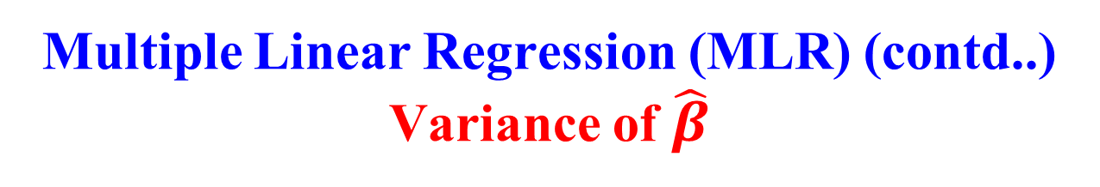
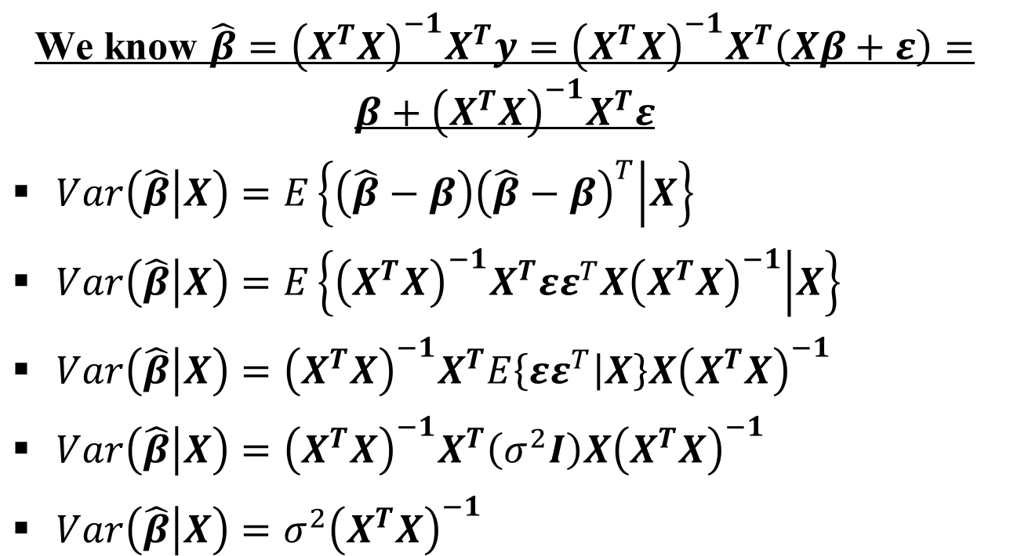
Multiple Linear Regression (MLR) (contd..)
Variance of $\hat{β}$
We know $\hat{β}={\left(X^{T}X\right)}^{−1}X^{T}y={\left(X^{T}X\right)}^{−1}X^{T}\left(Xβ+ε\right)=β+{\left(X^{T}X\right)}^{−1}X^{T}ε$
$Var\left(\hat{β} | X\right)=E\left\{\left(\hat{β}−β\right){\left(\hat{β}−β\right)}^{T} | X\right\}$
$Var\left(\hat{β} | X\right)=E\left\{{\left(X^{T}X\right)}^{−1}X^{T}εε^{T}X{\left(X^{T}X\right)}^{−1} | X\right\}$
$Var\left(\hat{β} | X\right)={\left(X^{T}X\right)}^{−1}X^{T}E\left\{εε^{T} | X\right\}X{\left(X^{T}X\right)}^{−1}$
$Var\left(\hat{β} | X\right)={\left(X^{T}X\right)}^{−1}X^{T}\left(σ^{2}I\right)X{\left(X^{T}X\right)}^{−1}$
$Var\left(\hat{β} | X\right)=σ^{2}{\left(X^{T}X\right)}^{−1}$

Slide 45
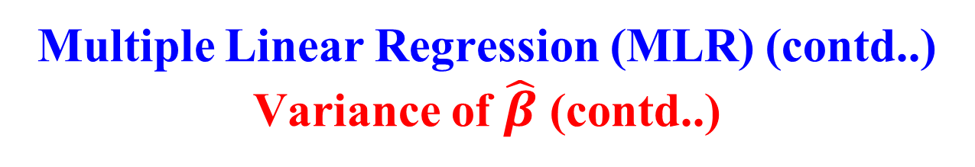
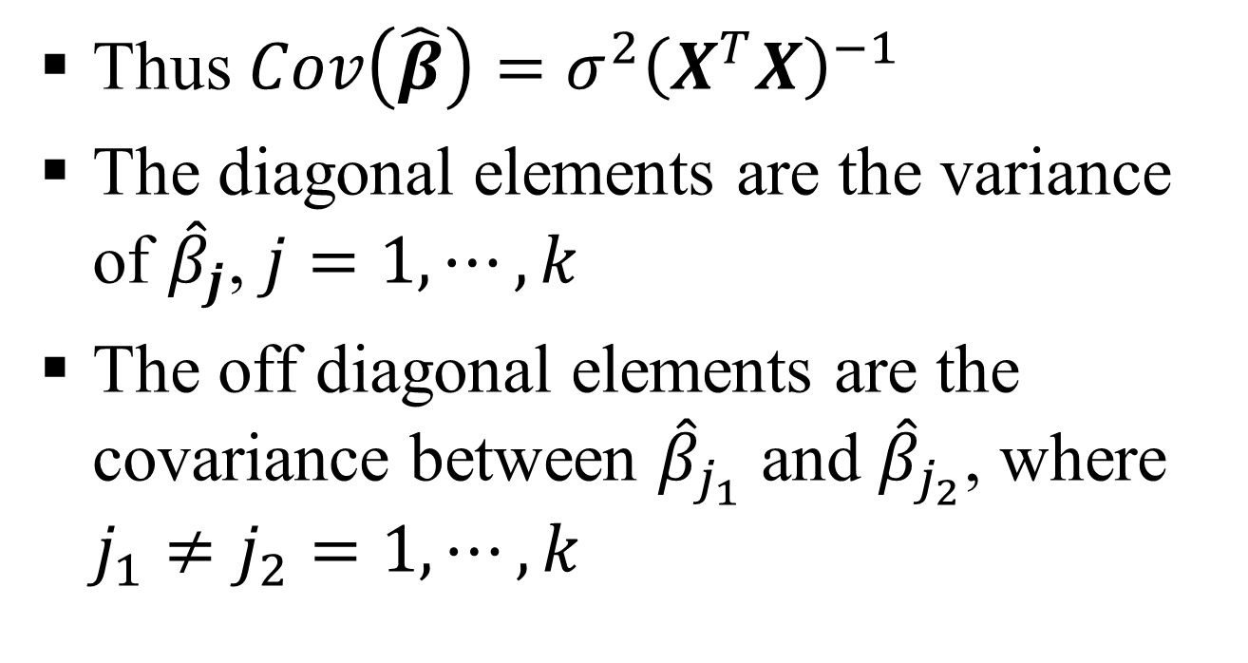
Multiple Linear Regression (MLR) (contd..)
Variance of $\hat{β}$ (contd..)
Thus $Cov\left(\hat{β}\right)=σ^{2}{\left(X^{T}X\right)}^{−1}$
The diagonal elements are the variance of ${\hat{β}}_{j}$, $j=1,⋯,k$
The off diagonal elements are the covariance between ${\hat{β}}_{j_{1}}$ and ${\hat{β}}_{j_{2}}$, where $j_{1}≠j_{2}=1,⋯,k$

Slide 46
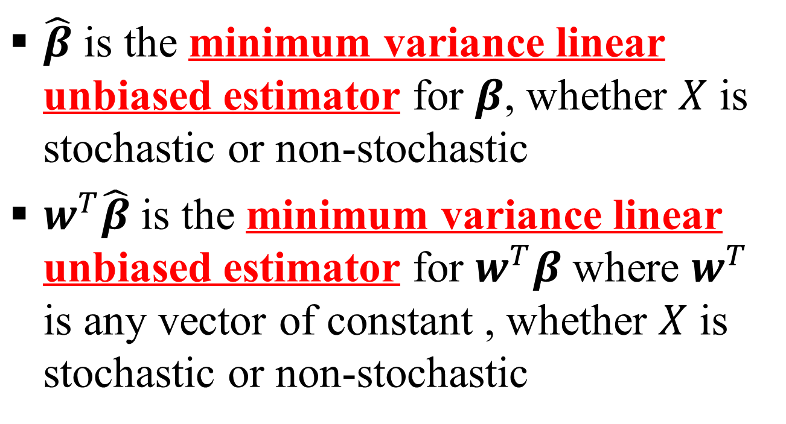
Multiple Linear Regression (MLR) (contd..)
Gauss Markov Theorem
$\hat{β}$ is the minimum variance linear unbiased estimator for $β$, whether $X$ is stochastic or non-stochastic
$w^{T}\hat{β}$ is the minimum variance linear unbiased estimator for $w^{T}β$ where $w^{T}$ is any vector of constant , whether $X$ is stochastic or non-stochastic

Slide 47
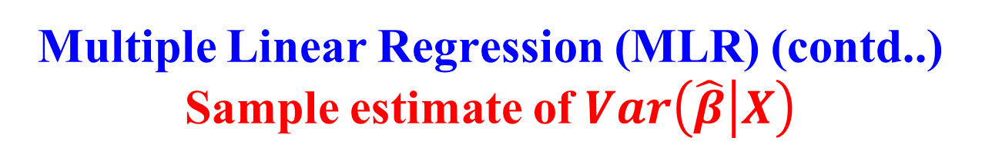
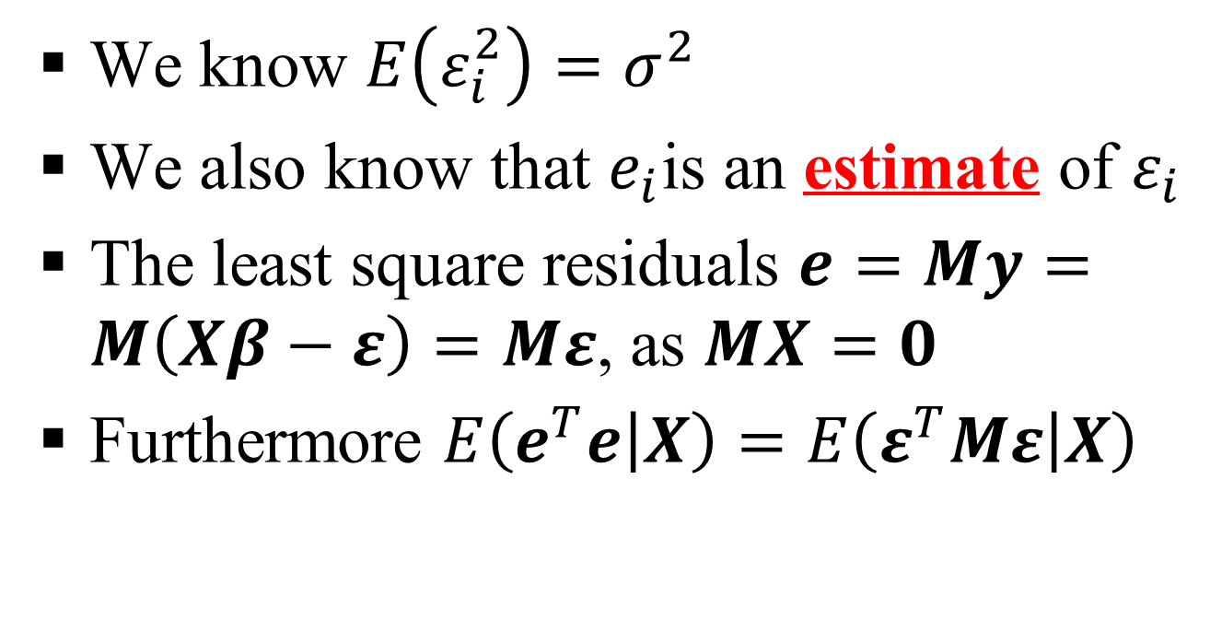
Multiple Linear Regression (MLR) (contd..)
Sample estimate of $Var\left(\hat{β} | X\right)$
We know $E\left(ε_{i}^{2}\right)=σ^{2}$
We also know that $e_{i}$is an estimate of $ε_{i}$
The least square residuals $e=My=M\left(Xβ−ε\right)=Mε$, as $MX=0$
Furthermore $E\left(e^{T}e | X\right)=E\left(ε^{T}Mε | X\right)$

Slide 48
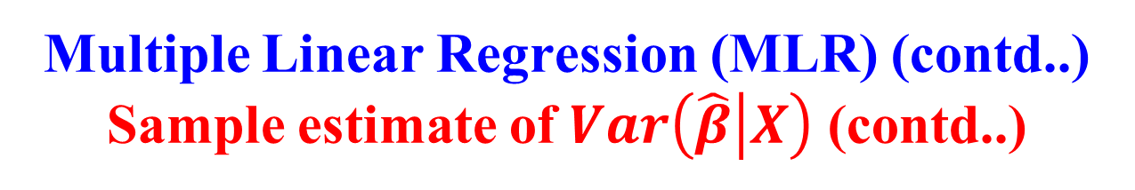
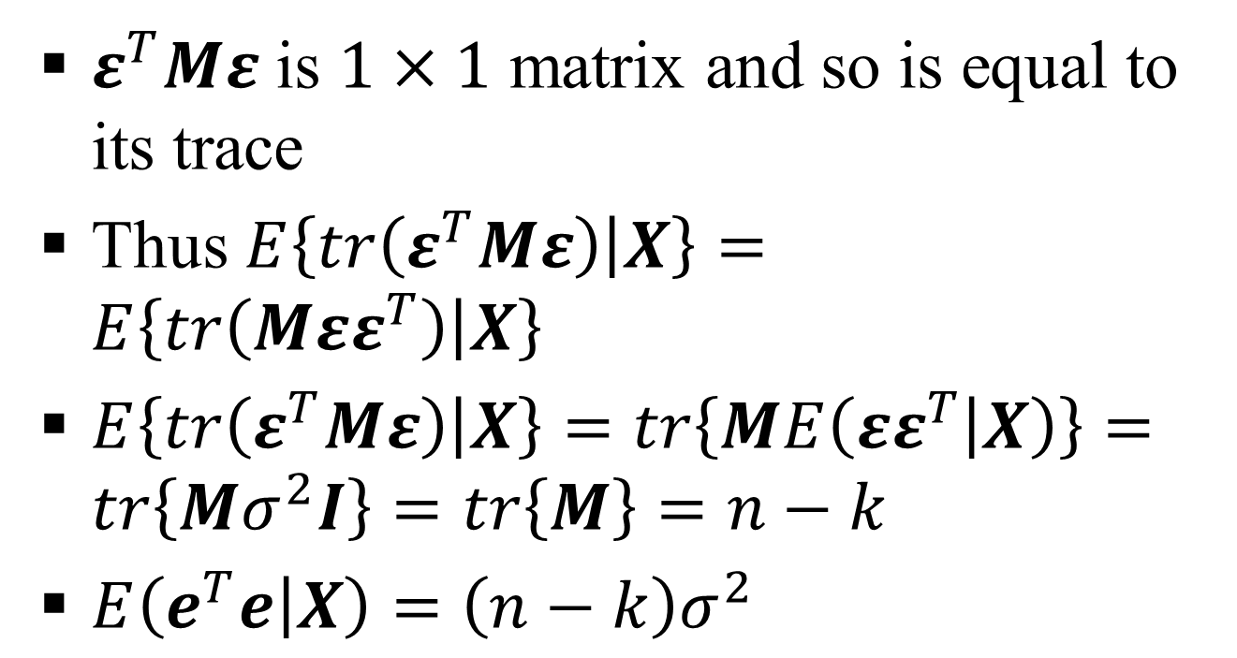
Multiple Linear Regression (MLR) (contd..)
Sample estimate of $Var\left(\hat{β} | X\right)$ (contd..)
$ε^{T}Mε$ is $1×1$ matrix and so is equal to its trace
Thus $E\left\{tr\left(ε^{T}Mε\right) | X\right\}=E\left\{tr\left(Mεε^{T}\right) | X\right\}$
$E\left\{tr\left(ε^{T}Mε\right) | X\right\}=tr\left\{ME\left(εε^{T} | X\right)\right\}=tr\left\{Mσ^{2}I\right\}=tr\left\{M\right\}=n−k$
$E\left(e^{T}e | X\right)=\left(n−k\right)σ^{2}$

Slide 49
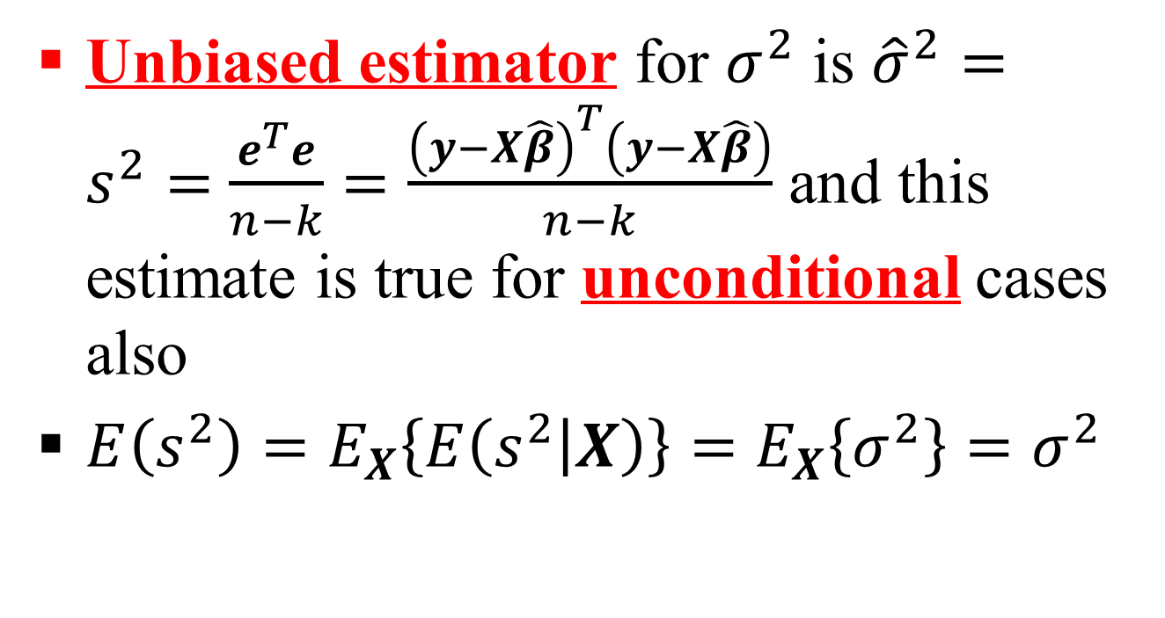
Multiple Linear Regression (MLR) (contd..)
Sample estimate of $Var\left(\hat{β} | X\right)$ (contd..)
Unbiased estimator for $σ^{2}$ is ${\hat{σ}}^{2}=s^{2}=$ $\frac{e^{T}e}{n−k}=\frac{{\left(y−X\hat{β}\right)}^{T}\left(y−X\hat{β}\right)}{n−k}$ and this estimate is true for unconditional cases also
$E\left(s^{2}\right)=E_{X}\left\{E\left(s^{2} | X\right)\right\}=E_{X}\left\{σ^{2}\right\}=σ^{2}$

Slide 50
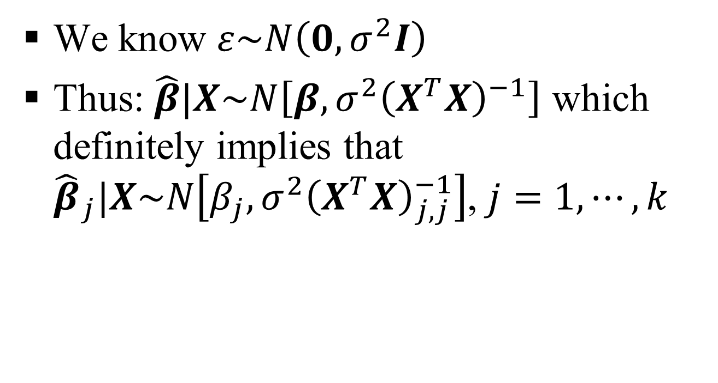
Multiple Linear Regression (MLR) (contd..)
We know $ε\sim N\left(0,σ^{2}I\right)$
Thus: $\hat{β}|X\sim N\left[β,σ^{2}{\left(X^{T}X\right)}^{−1}\right]$ which definitely implies that ${\hat{β}}_{j}|X\sim N\left[β_{j},σ^{2}{\left(X^{T}X\right)}_{j,j}^{−1}\right]$, $j=1,⋯,k$

Slide 51
Multiple Linear Regression (MLR) (contd..)
Hypothesis Testing
We know $ε\sim N\left(0,σ^{2}I\right)$
Thus: $\hat{β}|X\sim N\left[β,σ^{2}{\left(X^{T}X\right)}^{−1}\right]$ which definitely implies that ${\hat{β}}_{j}|X\sim N\left[β_{j},σ^{2}{\left(X^{T}X\right)}_{j,j}^{−1}\right]$, $j=1,⋯,k$

Slide 52
Multiple Linear Regression (MLR) (contd..)
Example # 01
Data are a subsample of 500 observations from a data set that originate in a study where air pollution at a road is related to traffic volume and meteorological variables, collected by the Norwegian Public Roads Administration
The response variable (column 1) consist of hourly values of the logarithm of the concentration of NO₂ (particles), measured at Alnabru in Oslo, Norway, between October 2001 and August 2003

Slide 53
Multiple Linear Regression (MLR) (contd..)
Example # 01 (contd..)
The predictor variables (columns 2 to 8) seven (07) in number are the logarithm of the number of cars per hour, temperature 2 meter above ground (degree C), wind speed (meters/second), the temperature difference between 25 and 2 meters above ground (degree C), wind direction (degrees between 0 and 360), hour of day and day number from October 1. 2001
URL (data): http://lib.stat.cmu.edu/datasets/NO2.dat
URL (write-up): https://georglsm.r-forge.r-project.org/site-projects/pdf/5713.pdf

Slide 54
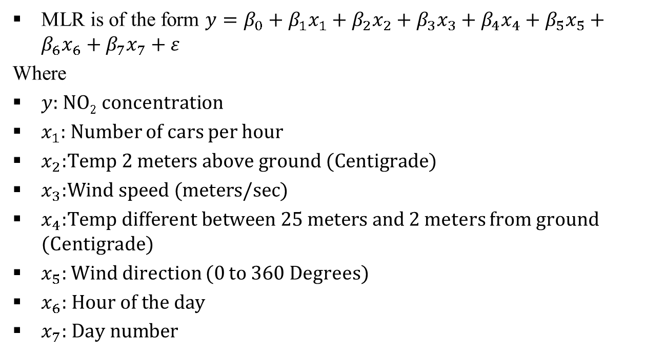
Multiple Linear Regression (MLR) (contd..)
Example # 01 (contd..)
MLR is of the form $y=β_{0}+β_{1}x_{1}+β_{2}x_{2}+β_{3}x_{3}+β_{4}x_{4}+β_{5}x_{5}+β_{6}x_{6}+β_{7}x_{7}+ε$
Where
$y$: NO₂ concentration
$x_{1}$: Number of cars per hour
$x_{2}\text{:}\text{Temp}\text{ 2 }\text{meters} \text{above} \text{ground}\text{ (}\text{Centigrade}\text{)}$
$x_{3}\text{:}\text{Wind} \text{speed}\text{ (}\text{meters}\text{/}\text{sec}\text{)}$
$x_{4}\text{:}\text{Temp} \text{different} \text{between}\text{ 25 }\text{meters} \text{and}$ 2 meters from ground (Centigrade)
$x_{5}\text{:}$ Wind direction (0 to 360 Degrees)
$x_{6}\text{:} \text{Hour} \text{of} \text{the} \text{day}$
$x_{7}\text{:} \text{Day} \text{number}$

Slide 55
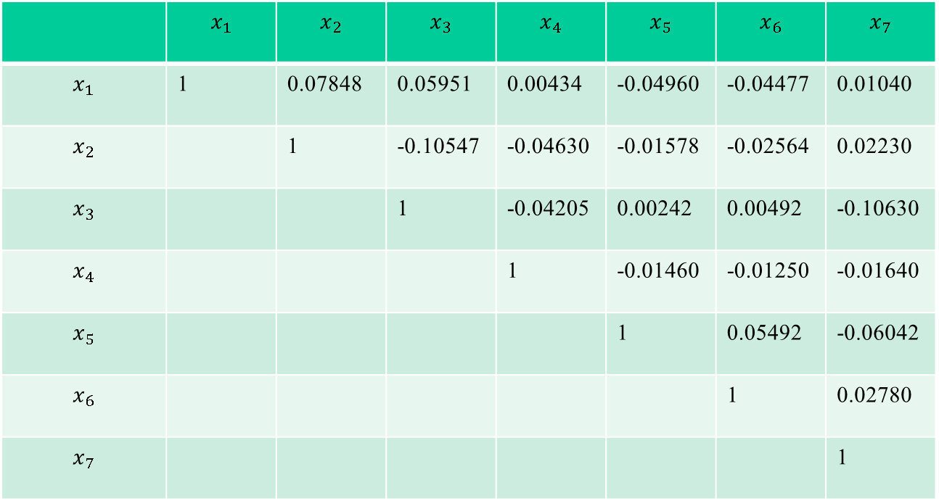
Multiple Linear Regression (MLR) (contd..)
Example # 01 (contd..)
 | $$x_{1}$$ | $$x_{2}$$ | $$x_{3}$$ | $$x_{4}$$ | $$x_{5}$$ | $$x_{6}$$ | $$x_{7}$$
$$x_{1}$$ | 1 | 0.07848 | 0.05951 | 0.00434 | -0.04960 | -0.04477 | 0.01040
$$x_{2}$$ |  | 1 | -0.10547 | -0.04630 | -0.01578 | -0.02564 | 0.02230
$$x_{3}$$ |  |  | 1 | -0.04205 | 0.00242 | 0.00492 | -0.10630
$$x_{4}$$ |  |  |  | 1 | -0.01460 | -0.01250 | -0.01640
$$x_{5}$$ |  |  |  |  | 1 | 0.05492 | -0.06042
$$x_{6}$$ |  |  |  |  |  | 1 | 0.02780
$$x_{7}$$ |  |  |  |  |  |  | 1

Slide 56
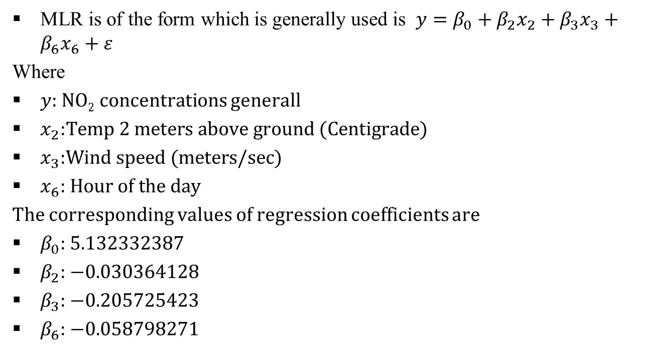
Multiple Linear Regression (MLR) (contd..)
Example # 01 (contd..)
MLR is of the form which is generally used is $y=β_{0}+β_{2}x_{2}+β_{3}x_{3}+β_{6}x_{6}+ε$
Where
$y$: NO₂ concentrations generall
$x_{2}\text{:}\text{Temp}\text{ 2 }\text{meters} \text{above} \text{ground}\text{ (}\text{Centigrade}\text{)}$
$x_{3}\text{:}\text{Wind} \text{speed}\text{ (}\text{meters}\text{/}\text{sec}\text{)}$
$x_{6}\text{:} \text{Hour} \text{of} \text{the} \text{day}$
The corresponding values of regression coefficients are
$β_{0}$: 5.132332387
$β_{2}$: −0.030364128
$β_{3}$: −0.205725423
$β_{6}$: −0.058798271

Slide 57
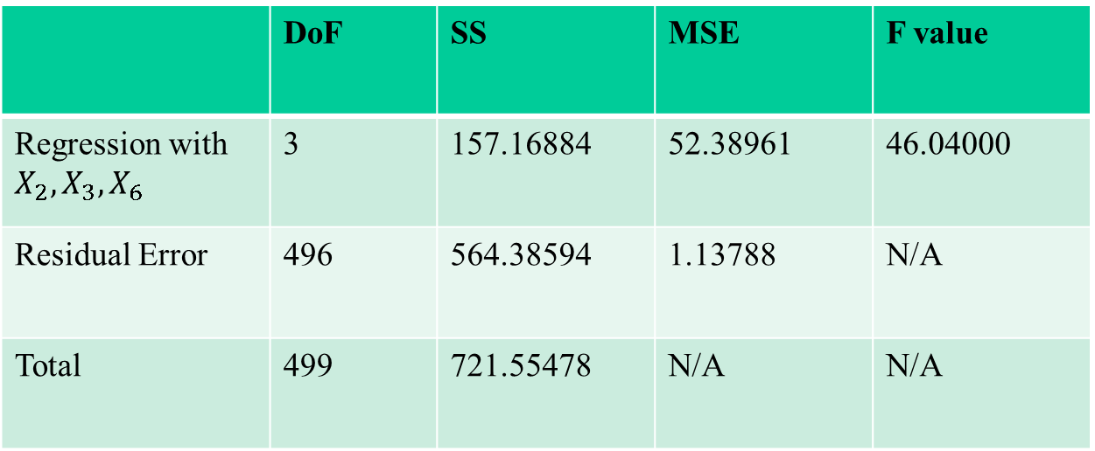
Multiple Linear Regression (MLR) (contd..)
Example # 01 (contd..)
ANOVA Table for our model
 | DoF | SS | MSE | F value
Regression with $X_{2},X_{3},X_{6}$ | 3 | 157.16884 | 52.38961 | 46.04000
Residual Error | 496 | 564.38594 | 1.13788 | N/A
Total | 499 | 721.55478 | N/A | N/A

Slide 58
Multiple Linear Regression (MLR) (contd..)
Example # 02
The secondary source data is obtained from Statistics and Probability Letters (Sparse Spatial Autoregressions; Pace, R. Kelley and Ronald Barry, 1997, 33, pp: 291-297) and it contains information on the variables using all the block groups in California from the 1990 census
In this sample, a block group on average includes 1425.5 individuals living in a geographically compact area
Naturally, the geographical area included, varies inversely with the population density. The data contains 20,640 observations on 9 variables

Slide 59
Multiple Linear Regression (MLR) (contd..)
Example # 02 (contd..)
The authors have computed distances among centroids of each block groups as measured in latitude and longitude
They have excluded all block groups reporting zero entities for the independent and dependent variables
The data file contains all the variables and specifically, it contains the following which are, median house value, median income, housing median age, total rooms, total bedrooms, population, households, latitude and longitude in that order. The manuscript describing the data can be found at www.spatial-statistics.com

Slide 60
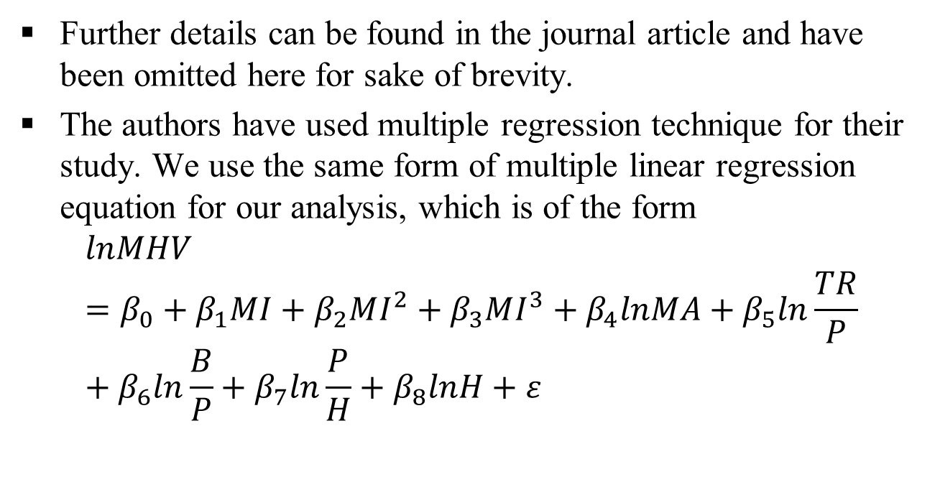
Multiple Linear Regression (MLR) (contd..)
Example # 02 (contd..)
Further details can be found in the journal article and have been omitted here for sake of brevity.
The authors have used multiple regression technique for their study. We use the same form of multiple linear regression equation for our analysis, which is of the form
$$lnMHV=β_{0}+β_{1}MI+β_{2}MI^{2}+β_{3}MI^{3}+β_{4}lnMA+β_{5}ln\frac{TR}{P}+β_{6}ln\frac{B}{P}+β_{7}ln\frac{P}{H}+β_{8}lnH+ε$$

Slide 61

Multiple Linear Regression (MLR) (contd..)
Example # 02 (contd..)
$β_{0}=11.4939$
$β_{1}=0.4790$
$β_{2}=−0.0166$
$β_{3}=−0.0002$
$β_{4}=0.1570$
$β_{5}=−0.8582$
$β_{6}=0.8043$
$β_{7}=−0.4077$
$β_{8}=0.0477$

Slide 62

Multiple Linear Regression (MLR) (contd..)
Example # 02 (contd..)
We want predict $θ=l^{T}β=11.6992$ which we can do taking different samples size $n$
If we take $25$ samples then we will obtain ${\hat{θ}}_{n=1}$,…., ${\hat{θ}}_{n=25}$, the mean of which sould be $11.6992$
Larger the sample size in each sample and larger the number of samples, then in the asymptotic sense we will slowly tend towards $11.6992$

Slide 63
Multiple Linear Regression (MLR) (contd..)
Linear Exponential Loss Function
It is seen that the penalties for over estimation vis-à-vis under estimation are unequal, in the sense that the losses for over estimation when compared to that of under estimation are unequal
To capture this phenomenon an asymmetric loss function which mimics this reality should be used
One form of an asymmetric loss is the Linear Exponential (LINEX) loss function

Slide 64

Multiple Linear Regression (MLR) (contd..)
Linear Exponential Loss Function (contd..)
If $θ$ is the parameter and $\hat{θ}$ the estimator, then the error of estimation is denoted by $Δ=\left(θ−\hat{θ}\right)$
For example OLS/SEL would be denoted by $L\left(Δ\right)=L\left(θ,\hat{θ}\right)={\left(θ−\hat{θ}\right)}^{2}$, or the weighted form would be $L\left(Δ\right)=L\left(θ,\hat{θ}\right)={w\left(θ−\hat{θ}\right)}^{2}$, where $w$ is he weight
LINEX loss can be expressed as $L\left(Δ\right)=L\left(θ,\hat{θ}\right)=b\left\{e^{a\left(θ−\hat{θ}\right)}−a\left(θ−\hat{θ}\right)−1\right\}$, where $a$ is shape and $b$ is scale parameters respectively

Slide 65

Multiple Linear Regression (MLR) (contd..)
Linear Exponential Loss Function (contd..)
Consider we want to estimate $θ=l^{T}β$, then $\hat{θ}=l^{T}\hat{β}$ is the best estimator for OLS/SEL
Under LINEX loss the best estimator is ${\hat{θ}}_{LINEX}=l^{T}\hat{β}−\frac{aσ^{2}}{2}l^{T}{\left(X^{T}X\right)}^{−1}l$

Slide 66

Multiple Linear Regression (MLR) (contd..)
Linear Exponential Loss Function (contd..)
Risk for $\hat{θ}$, i.e., $R_{LINEX}\left(θ,\hat{θ}\right)=E\left\{L_{LINEX}\left(θ,\hat{θ}\right)\right\}=exp\left\{\frac{1}{2}a^{2}σ^{2}l^{T}{\left(X^{T}X\right)}^{−1}l\right\}−1$

Slide 67

Multiple Linear Regression (MLR) (contd..)
Linear Exponential Loss Function (contd..)
Risk for ${\hat{θ}}_{LINEX}$, i.e., $R_{LINEX}\left(θ,{\hat{θ}}_{LINEX}\right)=E\left\{L_{LINEX}\left(θ,{\hat{θ}}_{LINEX}\right)\right\}=exp\left\{\frac{1}{2}a^{2}σ^{2}l^{T}{\left(X^{T}X\right)}^{−1}l\right\}{\left\{1+\frac{\frac{1}{2}a^{2}σ^{2}l^{T}{\left(X^{T}X\right)}^{−1}l}{\left(\frac{n−k}{2}\right) }\right\}}^{−\left(\frac{n−k}{2}\right)}+\left\{\frac{1}{2}a^{2}σ^{2}l^{T}{\left(X^{T}X\right)}^{−1}l\right\}−1$

Slide 68

Multiple Linear Regression (MLR) (contd..)
Linear Exponential Loss Function (contd..)
$R_{LINEX}\left(θ,{\hat{θ}}_{LINEX}\right)=E\left\{L_{LINEX}\left(θ,{\hat{θ}}_{LINEX}\right)\right\}≤R_{LINEX}\left(θ,\hat{θ}\right)=E\left\{L_{LINEX}\left(θ,\hat{θ}\right)\right\}$

Slide 69

Multiple Linear Regression (MLR) (contd..)
Balanced Loss Function
$θ$ is the parameter and $\hat{θ}$ the estimator, then the error of estimation is denoted by $Δ=\left(θ−\hat{θ}\right)$
$L\left(Δ\right)=L\left(θ,\hat{θ}\right)=λ{\left\{g\left(θ\right)−g\left(\hat{θ}\right)\right\}}^{T}\left\{g\left(θ\right)−g\left(\hat{θ}\right)\right\}+\left(1−λ\right){\left\{θ−\hat{θ}\right\}}^{T}\left\{θ−\hat{θ}\right\}$, where $λ$ is the weight
First part is goodness of fit and the second part is precision of estimation

Slide 70

Multiple Linear Regression (MLR) (contd..)
Balanced Loss Function (contd..)
Model I
Assume $L\left(β,\hat{β}\right)=λ{\left(Xβ−X\hat{β}\right)}^{T}\left(Xβ−X\hat{β}\right)+\left(1−λ\right)\left\{e^{a\left(θ−\hat{θ}\right)}−a\left(θ−\hat{θ}\right)−1\right\}$
Let $\hat{β}={\left(X^{T}X\right)}^{−1}X^{T}y$ and $\hat{θ}=l^{T}\hat{β}$

Slide 71

Multiple Linear Regression (MLR) (contd..)
Balanced Loss Function (contd..)
Model I (contd..)
$R\left(β,\hat{β}\right)=E\left\{L\left(β,\hat{β}\right)\right\}=λ\left(n−k\right)σ^{2}+\left(1−λ\right)\left[exp\left\{\frac{1}{2}a^{2}σ^{2}l^{T}{\left(X^{T}X\right)}^{−1}l\right\}−1\right]$

Slide 72

Multiple Linear Regression (MLR) (contd..)
Balanced Loss Function (contd..)
Model II
Assume $L\left(β,\hat{β}\right)=λ{\left(Xβ−X\hat{β}\right)}^{T}\left(Xβ−X\hat{β}\right)+\left(1−λ\right)\left\{e^{a\left(θ−\hat{θ}\right)}−a\left(θ−\hat{θ}\right)−1\right\}$
Let $\hat{β}={\left(X^{T}X\right)}^{−1}X^{T}y−\frac{aσ^{2}}{2}\left\{l^{T}{\left(X^{T}X\right)}^{−1}l\right\}$ and $\hat{θ}=l^{T}\hat{β}$

Slide 73

Multiple Linear Regression (MLR) (contd..)
Balanced Loss Function (contd..)
Model II (contd..)
$R\left(β,\hat{β}\right)=E\left\{L\left(β,\hat{β}\right)\right\}=λ\left(n−k\right)σ^{2}+\left(1−λ\right)\left[\frac{1}{2}a^{2}σ^{2}l^{T}{\left(X^{T}X\right)}^{−1}l−1\right]$

Slide 74

Multiple Linear Regression (MLR) (contd..)
Balanced Loss Function (contd..)
Model III
Assume $L\left(β,\hat{β}\right)=λ{{\left(θ−\hat{θ}\right)}^{T}\left(θ−\hat{θ}\right)}^{T}+\left(1−λ\right)\left\{e^{a\left(X^{∗}β−X^{∗}\hat{β}\right)}−a\left(X^{∗}β−X^{∗}\hat{β}\right)−1\right\}$
Let $\hat{β}={\left(X^{T}X\right)}^{−1}X^{T}y$ and $\hat{θ}=l^{T}\hat{β}$

Slide 75

Multiple Linear Regression (MLR) (contd..)
Balanced Loss Function (contd..)
Model III (contd..)
$R\left(β,\hat{β}\right)=E\left\{L\left(β,\hat{β}\right)\right\}=λσ^{2}l^{T}{\left(X^{T}X\right)}^{−1}l+\left(1−λ\right)\left[exp\left\{\frac{a^{2}σ^{2}}{2}{X^{∗}}^{T}{\left(X^{T}X\right)}^{−1}X^{∗}\right\}−1\right]$

Slide 76

Multiple Linear Regression (MLR) (contd..)
Balanced Loss Function (contd..)
Model IV
Assume $L\left(β,\hat{β}\right)=λ{{\left(θ−\hat{θ}\right)}^{T}\left(θ−\hat{θ}\right)}^{T}+\left(1−λ\right)\left\{e^{a\left(X^{∗}β−X^{∗}\hat{β}\right)}−a\left(X^{∗}β−X^{∗}\hat{β}\right)−1\right\}$
Let $\hat{β}={\left(X^{T}X\right)}^{−1}X^{T}y−\frac{aσ^{2}}{2}\left\{l^{T}{\left(X^{T}X\right)}^{−1}l\right\}$ and $\hat{θ}=l^{T}\hat{β}$

Slide 77

Multiple Linear Regression (MLR) (contd..)
Balanced Loss Function (contd..)
Model IV (contd..)
$R\left(β,\hat{β}\right)=E\left\{L\left(β,\hat{β}\right)\right\}=λσ^{2}l^{T}{\left(X^{T}X\right)}^{−1}l+\left(1−λ\right)\left[\frac{a^{2}σ^{2}}{2}{X^{∗}}^{T}{\left(X^{T}X\right)}^{−1}X^{∗}−1\right]$

