Slide 1

IME634: Management Decision Analysis
Raghu Nandan Sengupta
Industrial & Management Department
Indian Institute of Technology Kanpur

Slide 2
Technique for Order Preference by Similarity to Ideal Solution (TOPSIS)
Technique for Order Preference by Similarity to Ideal Solution (TOPSIS) method was developed for the INTEGRated Human Exploration Mission Simulation FaciliTY (INTEGRITY) project in the Johnson Space Centre to assess the priority of a set of human spaceflight mission simulators

Slide 3
TOPSIS (contd…)
One assumes utility function is monotonic, in the sense the more/less you get more/less you want
The basic premise based on which TOPSIS works is the fact that selected alternatives should have the shortest distance from the positive-ideal solution, and the farthest distance from the negative-ideal solution

Slide 4
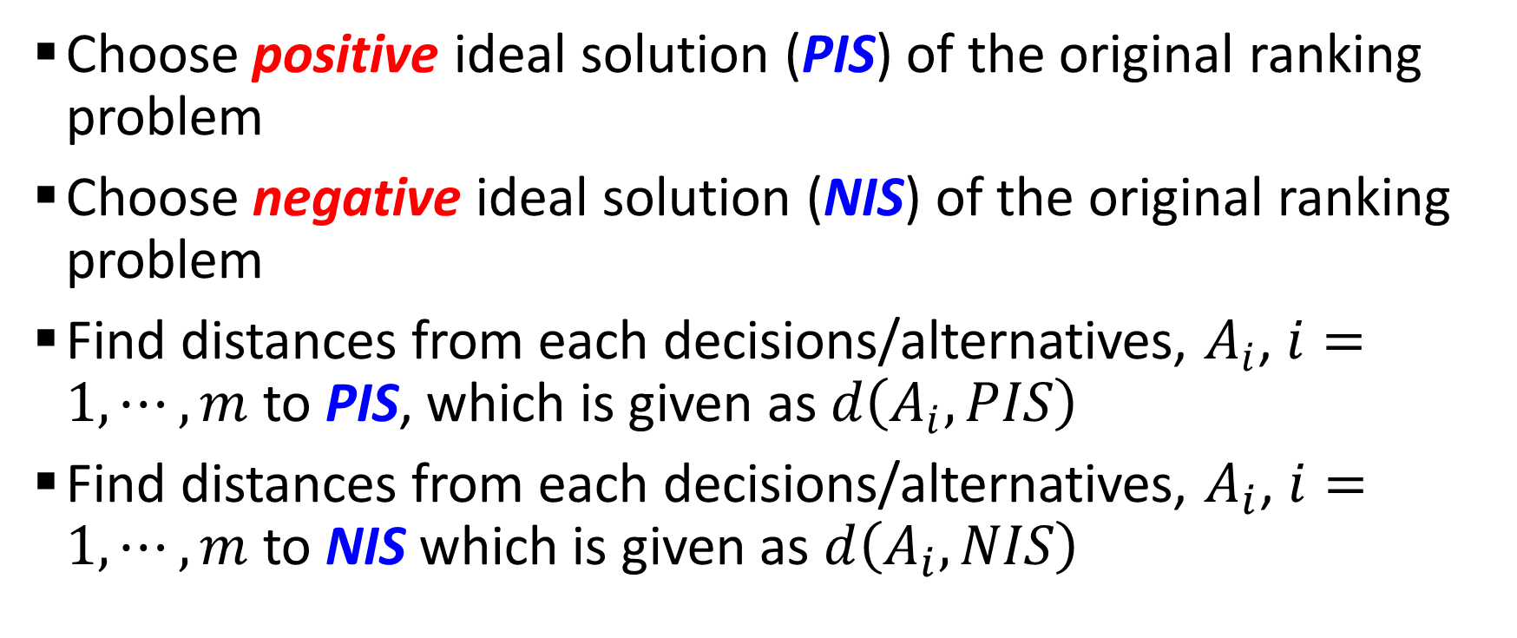
TOPSIS (contd…)
Choose positive ideal solution (PIS) of the original ranking problem
Choose negative ideal solution (NIS) of the original ranking problem
Find distances from each decisions/alternatives, $A_{i}$, $i=1,⋯,m$ to PIS, which is given as $d\left(A_{i},PIS\right)$
Find distances from each decisions/alternatives, $A_{i}$, $i=1,⋯,m$ to NIS which is given as $d\left(A_{i},NIS\right)$

Slide 5
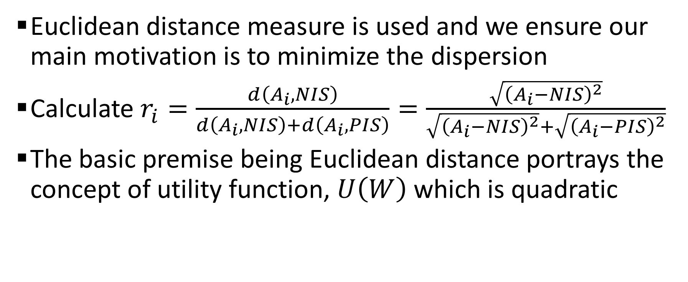
TOPSIS (contd…)
Euclidean distance measure is used and we ensure our main motivation is to minimize the dispersion
Calculate $r_{i}=\frac{d\left(A_{i},NIS\right)}{d\left(A_{i},NIS\right)+d\left(A_{i},PIS\right)}=\frac{\sqrt{{\left(A_{i}−NIS\right)}^{2}}}{\sqrt{{\left(A_{i}−NIS\right)}^{2}}+\sqrt{{\left(A_{i}−PIS\right)}^{2}}}$
The basic premise being Euclidean distance portrays the concept of utility function, $U\left(W\right)$ which is quadratic

Slide 6
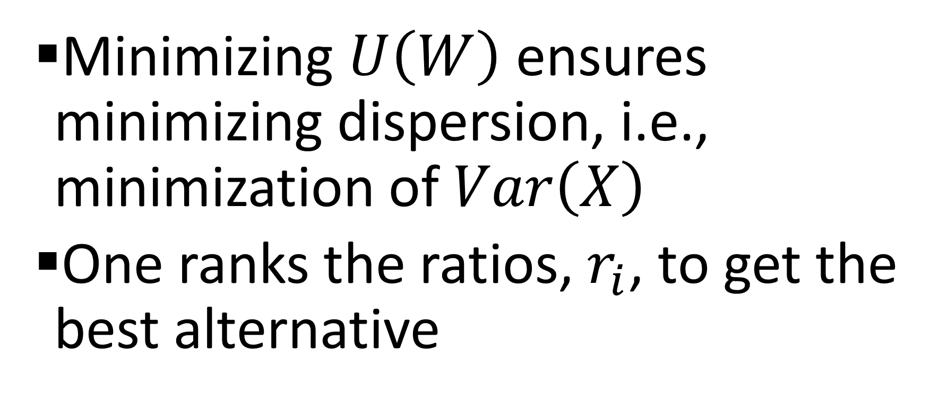
TOPSIS (contd…)
Minimizing $U\left(W\right)$ ensures minimizing dispersion, i.e., minimization of $Var\left(X\right)$
One ranks the ratios, $r_{i}$, to get the best alternative

Slide 7
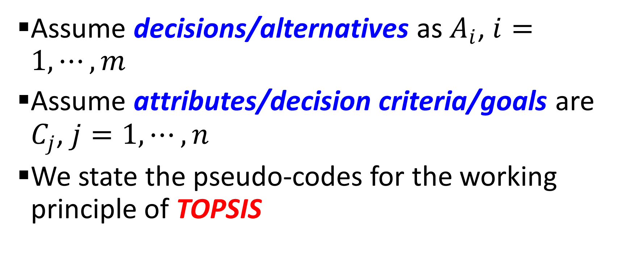
Algorithm for TOPSIS
Assume decisions/alternatives as $A_{i}$, $i=1,⋯,m$
Assume attributes/decision criteria/goals are $C_{j}$, $j=1,⋯,n$
We state the pseudo-codes for the working principle of TOPSIS

Slide 8
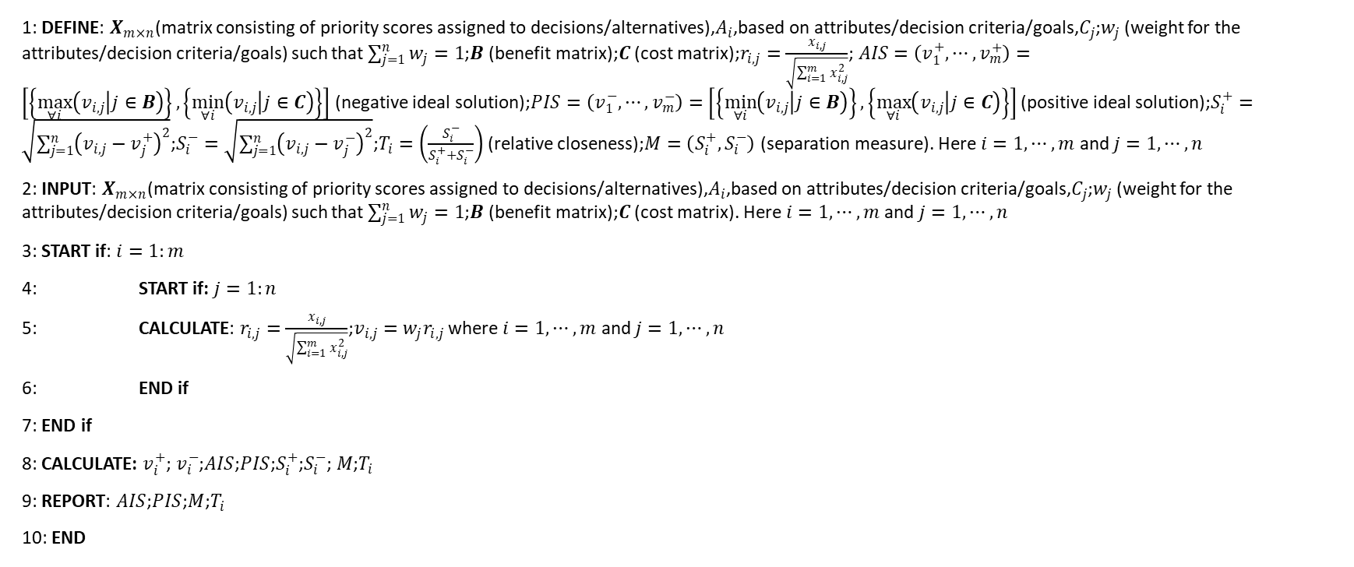
Algorithm for TOPSIS (contd…)
1: DEFINE: $X_{m×n}$(matrix consisting of priority scores assigned to decisions/alternatives),$A_{i}$,based on attributes/decision criteria/goals,$C_{j}$;$w_{j}$ (weight for the attributes/decision criteria/goals) such that $\sum_{j=1}^{n}{w_{j}}=1$;$B$ (benefit matrix);$C$ (cost matrix);$r_{i,j}=\frac{x_{i,j}}{\sqrt{\sum_{i=1}^{m}{x_{i,j}^{2}}}}$;$AIS=\left(v_{1}^{+},⋯,v_{m}^{+}\right)=\left[\left\{\max_{∀i}\left(v_{i,j} | j∈B\right)\right\},\left\{\min_{∀i}\left(v_{i,j} | j∈C\right)\right\}\right]$ (negative ideal solution);$PIS=\left(v_{1}^{−},⋯,v_{m}^{−}\right)=\left[\left\{\min_{∀i}\left(v_{i,j} | j∈B\right)\right\},\left\{\max_{∀i}\left(v_{i,j} | j∈C\right)\right\}\right]$ (positive ideal solution);$S_{i}^{+}=\sqrt{\sum_{j=1}^{n}{{\left(v_{i,j}−v_{j}^{+}\right)}^{2}}}$;$S_{i}^{−}=\sqrt{\sum_{j=1}^{n}{{\left(v_{i,j}−v_{j}^{−}\right)}^{2}}}$;$T_{i}=\left(\frac{S_{i}^{−}}{S_{i}^{+}+S_{i}^{−}}\right)$ (relative closeness);$M=\left(S_{i}^{+},S_{i}^{−}\right)$ (separation measure). Here $i=1,⋯,m$ and $j=1,⋯,n$
2: INPUT: $X_{m×n}$(matrix consisting of priority scores assigned to decisions/alternatives),$A_{i}$,based on attributes/decision criteria/goals,$C_{j}$;$w_{j}$ (weight for the attributes/decision criteria/goals) such that $\sum_{j=1}^{n}{w_{j}}=1$;$B$ (benefit matrix);$C$ (cost matrix). Here $i=1,⋯,m$ and $j=1,⋯,n$
3: START if: $i=1:m$
4: START if: $j=1:n$
5: CALCULATE: $r_{i,j}=\frac{x_{i,j}}{\sqrt{\sum_{i=1}^{m}{x_{i,j}^{2}}}}$;$v_{i,j}=w_{j}r_{i,j}$ where $i=1,⋯,m$ and $j=1,⋯,n$
6: END if
7: END if
8: CALCULATE: $v_{i}^{+}$;$v_{i}^{−}$;$AIS$;$PIS$;$S_{i}^{+}$;$S_{i}^{−}$;$M$;$T_{i}$
9: REPORT: $AIS$;$PIS$;$M$;$T_{i}$
10: END

Slide 9
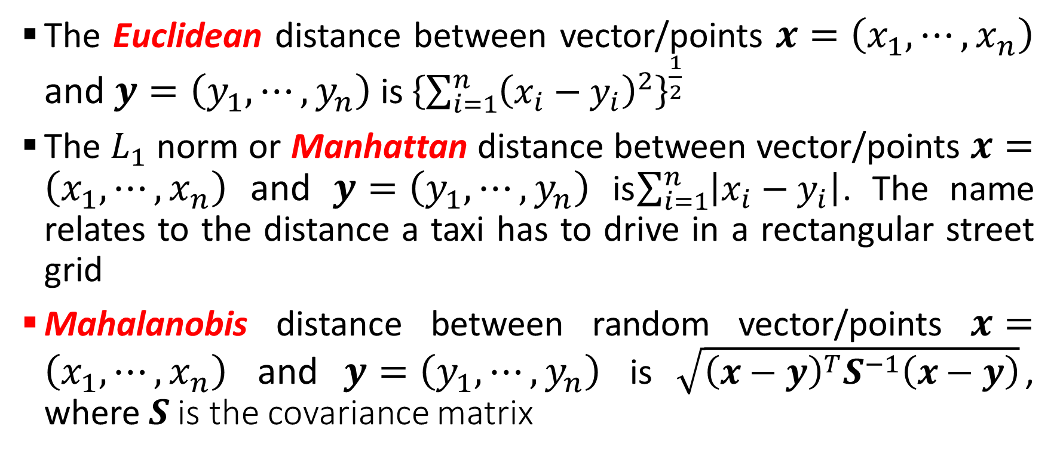
TOPSIS (contd…): Distance measure
The Euclidean distance between vector/points $x=\left(x_{1},⋯,x_{n}\right)$ and $y=\left(y_{1},⋯,y_{n}\right)$ is ${\left\{\sum_{i=1}^{n}{{\left(x_{i}−y_{i}\right)}^{2}}\right\}}^{\frac{1}{2}}$
The $L_{1}$ norm or Manhattan distance between vector/points $x=\left(x_{1},⋯,x_{n}\right)$ and $y=\left(y_{1},⋯,y_{n}\right)$ is$\sum_{i=1}^{n}{\left|x_{i}−y_{i}\right|}$. The name relates to the distance a taxi has to drive in a rectangular street grid
Mahalanobis distance between random vector/points $x=\left(x_{1},⋯,x_{n}\right)$ and $y=\left(y_{1},⋯,y_{n}\right)$ is $\sqrt{{\left(x−y\right)}^{T}S^{−1}\left(x−y\right)}$, where $S$ is the covariance matrix

Slide 10
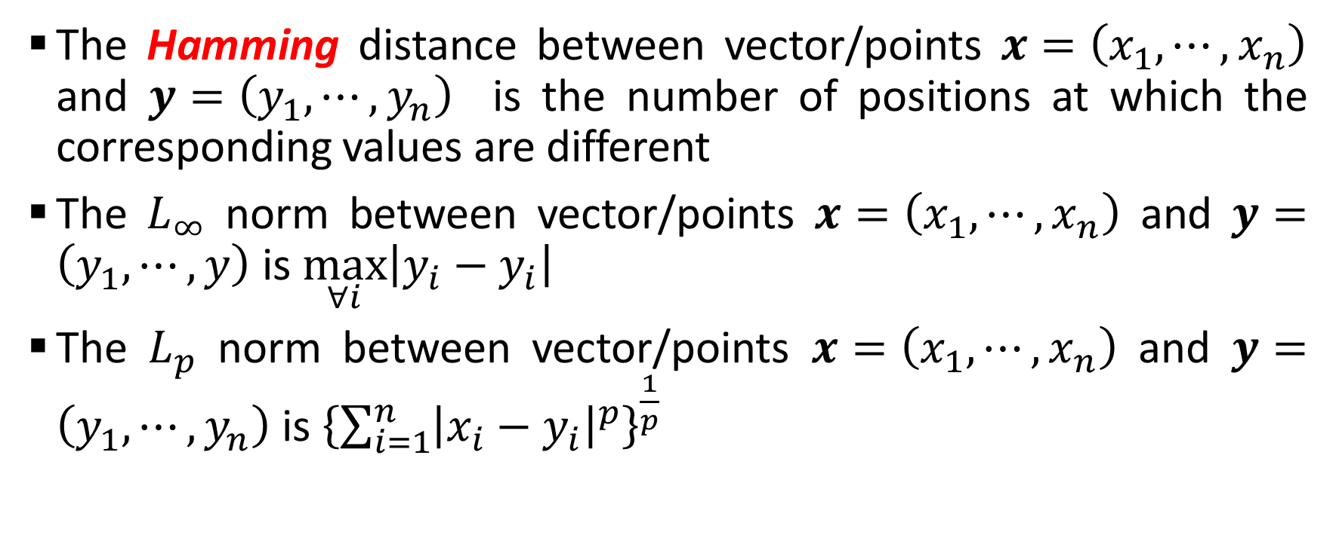
TOPSIS (contd…): Distance measure
The Hamming distance between vector/points $x=\left(x_{1},⋯,x_{n}\right)$ and $y=\left(y_{1},⋯,y_{n}\right)$ is the number of positions at which the corresponding values are different
The $L_{∞}$ norm between vector/points $x=\left(x_{1},⋯,x_{n}\right)$ and $y=\left(y_{1},⋯,y\right)$ is $\max_{∀i}\left|y_{i}−y_{i}\right|$
The $L_{p}$ norm between vector/points $x=\left(x_{1},⋯,x_{n}\right)$ and $y=\left(y_{1},⋯,y_{n}\right)$ is ${\left\{\sum_{i=1}^{n}{{\left|x_{i}−y_{i}\right|}^{p}}\right\}}^{\frac{1}{p}}$

Slide 11
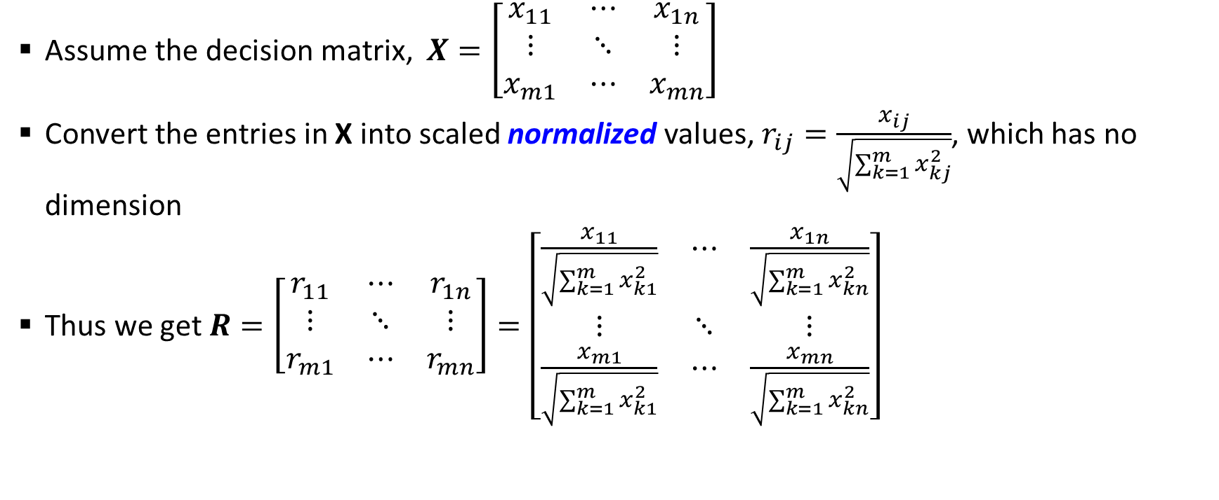
TOPSIS: Step # 01 (Construct the normalized decision matrix)
Assume the decision matrix, $X=\left[\begin{matrix}x_{11} & ⋯ & x_{1n} \\ ⋮ & ⋱ & ⋮ \\ x_{m1} & ⋯ & x_{mn}\end{matrix}\right]$
Convert the entries in X into scaled normalized values, $r_{ij}=\frac{x_{ij}}{\sqrt{\sum_{k=1}^{m}{x_{kj}^{2}}}}$, which has no dimension
Thus we get $R=\left[\begin{matrix}r_{11} & ⋯ & r_{1n} \\ ⋮ & ⋱ & ⋮ \\ r_{m1} & ⋯ & r_{mn}\end{matrix}\right]=\left[\begin{matrix}\frac{x_{11}}{\sqrt{\sum_{k=1}^{m}{x_{k1}^{2}}}} & ⋯ & \frac{x_{1n}}{\sqrt{\sum_{k=1}^{m}{x_{kn}^{2}}}} \\ ⋮ & ⋱ & ⋮ \\ \frac{x_{m1}}{\sqrt{\sum_{k=1}^{m}{x_{k1}^{2}}}} & ⋯ & \frac{x_{mn}}{\sqrt{\sum_{k=1}^{m}{x_{kn}^{2}}}}\end{matrix}\right]$

Slide 12
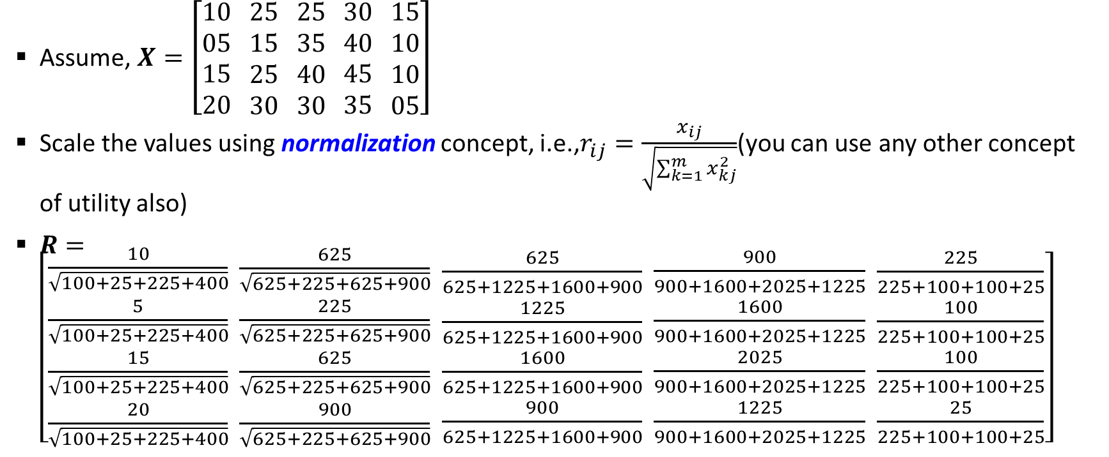
TOPSIS: Step # 01 (Construct the normalized decision matrix) (contd..)
Assume, $X=\left[\begin{aligned}10 \\ 05 \\ 15 \\ 20\end{aligned} \begin{aligned}25 \\ 15 \\ 25 \\ 30\end{aligned} \begin{aligned}25 \\ 35 \\ 40 \\ 30\end{aligned} \begin{aligned}30 \\ 40 \\ 45 \\ 35\end{aligned} \begin{aligned}15 \\ 10 \\ 10 \\ 05\end{aligned}\right]$
Scale the values using normalization concept, i.e.,$r_{ij}=\frac{x_{ij}}{\sqrt{\sum_{k=1}^{m}{x_{kj}^{2}}}}$(you can use any other concept of utility also)
$R=\left[\begin{aligned}\frac{10}{\sqrt{100+25+225+400}} \\ \frac{5}{\sqrt{100+25+225+400}} \\ \frac{15}{\sqrt{100+25+225+400}} \\ \frac{20}{\sqrt{100+25+225+400}}\end{aligned} \begin{aligned}\frac{625}{\sqrt{625+225+625+900}} \\ \frac{225}{\sqrt{625+225+625+900}} \\ \frac{625}{\sqrt{625+225+625+900}} \\ \frac{900}{\sqrt{625+225+625+900}}\end{aligned} \begin{aligned}\frac{625}{625+1225+1600+900} \\ \frac{1225}{625+1225+1600+900} \\ \frac{1600}{625+1225+1600+900} \\ \frac{900}{625+1225+1600+900}\end{aligned} \begin{aligned}\frac{900}{900+1600+2025+1225} \\ \frac{1600}{900+1600+2025+1225} \\ \frac{2025}{900+1600+2025+1225} \\ \frac{1225}{900+1600+2025+1225}\end{aligned} \begin{aligned}\frac{225}{225+100+100+25} \\ \frac{100}{225+100+100+25} \\ \frac{100}{225+100+100+25} \\ \frac{25}{225+100+100+25}\end{aligned}\right]$

Slide 13
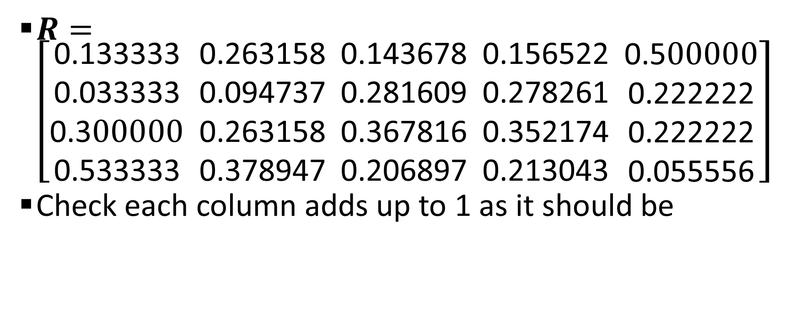
TOPSIS: Step # 01 (Construct the normalized decision matrix) (contd..)
$R=\left[\begin{aligned}\text{0.133333} \\ \text{0.033333} \\ \text{0.3}00000 \\ \text{0.533333}\end{aligned} \begin{aligned}\text{0.263158} \\ \text{0.094737} \\ \text{0.263158} \\ \text{0.378947}\end{aligned} \begin{aligned}\text{0.143678} \\ \text{0.281609} \\ \text{0.367816} \\ \text{0.206897}\end{aligned} \begin{aligned}\text{0.156522} \\ \text{0.278261} \\ \text{0.352174} \\ \text{0.213043}\end{aligned} \begin{aligned}\text{0.5}00000 \\ \text{0.222222} \\ \text{0.222222} \\ \text{0.055556}\end{aligned}\right]$
Check each column adds up to 1 as it should be

Slide 14
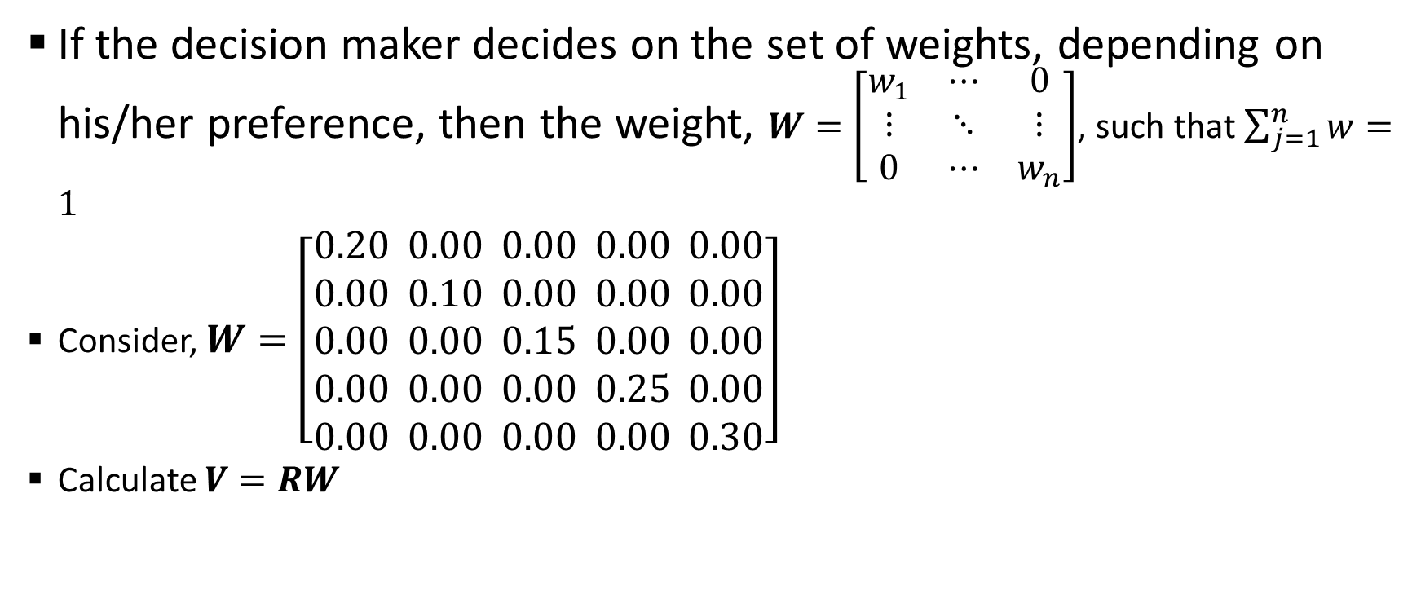
TOPSIS: Step # 02 (Construct the weighted normalized decision matrix)
If the decision maker decides on the set of weights, depending on his/her preference, then the weight, $W=\left[\begin{matrix}w_{1} & ⋯ & 0 \\ ⋮ & ⋱ & ⋮ \\ 0 & ⋯ & w_{n}\end{matrix}\right]$, such that $\sum_{j=1}^{n}{w}=1$
Consider, $W=\left[\begin{aligned}0.20 \\ 0.00 \\ 0.00 \\ 0.00 \\ 0.00\end{aligned} \begin{aligned}0.00 \\ 0.10 \\ 0.00 \\ 0.00 \\ 0.00\end{aligned} \begin{aligned}0.00 \\ 0.00 \\ 0.15 \\ 0.00 \\ 0.00\end{aligned} \begin{aligned}0.00 \\ 0.00 \\ 0.00 \\ 0.25 \\ 0.00\end{aligned} \begin{aligned}0.00 \\ 0.00 \\ 0.00 \\ 0.00 \\ 0.30\end{aligned}\right]$
Calculate $V=RW$

Slide 15
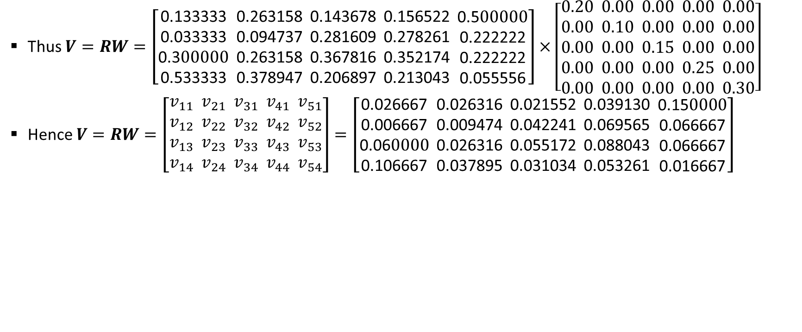
TOPSIS: Step # 02 (Construct the weighted normalized decision matrix) (contd..)
Thus $V=RW=\left[\begin{aligned}\text{0.133333} \\ \text{0.033333} \\ \text{0.3}00000 \\ \text{0.533333}\end{aligned} \begin{aligned}\text{0.263158} \\ \text{0.094737} \\ \text{0.263158} \\ \text{0.378947}\end{aligned} \begin{aligned}\text{0.143678} \\ \text{0.281609} \\ \text{0.367816} \\ \text{0.206897}\end{aligned} \begin{aligned}\text{0.156522} \\ \text{0.278261} \\ \text{0.352174} \\ \text{0.213043}\end{aligned} \begin{aligned}\text{0.5}00000 \\ \text{0.222222} \\ \text{0.222222} \\ \text{0.055556}\end{aligned}\right]×\left[\begin{aligned}0.20 \\ 0.00 \\ 0.00 \\ 0.00 \\ 0.00\end{aligned} \begin{aligned}0.00 \\ 0.10 \\ 0.00 \\ 0.00 \\ 0.00\end{aligned} \begin{aligned}0.00 \\ 0.00 \\ 0.15 \\ 0.00 \\ 0.00\end{aligned} \begin{aligned}0.00 \\ 0.00 \\ 0.00 \\ 0.25 \\ 0.00\end{aligned} \begin{aligned}0.00 \\ 0.00 \\ 0.00 \\ 0.00 \\ 0.30\end{aligned}\right]$
Hence $V=RW=\left[\begin{aligned}v_{11} \\ v_{12} \\ v_{13} \\ v_{14}\end{aligned} \begin{aligned}v_{21} \\ v_{22} \\ v_{23} \\ v_{24}\end{aligned} \begin{aligned}v_{31} \\ v_{32} \\ v_{33} \\ v_{34}\end{aligned} \begin{aligned}v_{41} \\ v_{42} \\ v_{43} \\ v_{44}\end{aligned} \begin{aligned}v_{51} \\ v_{52} \\ v_{53} \\ v_{54}\end{aligned}\right]=\left[\begin{aligned}\text{0.026667} \\ \text{0.006667} \\ \text{0.06}0000 \\ \text{0.106667}\end{aligned} \begin{aligned}\text{0.026316} \\ \text{0.009474} \\ \text{0.026316} \\ \text{0.037895}\end{aligned} \begin{aligned}\text{0.021552} \\ \text{0.042241} \\ \text{0.055172} \\ \text{0.031034}\end{aligned} \begin{aligned}\text{0.03913}\text{0} \\ \text{0.069565} \\ \text{0.088043} \\ \text{0.053261}\end{aligned} \begin{aligned}\text{0.15}0000 \\ \text{0.066667} \\ \text{0.066667} \\ \text{0.016667}\end{aligned}\right]$

Slide 16
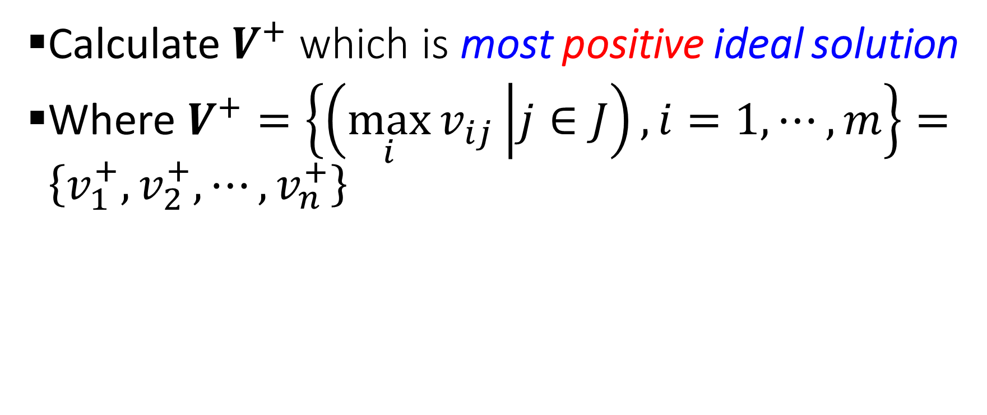
TOPSIS: Step # 03 (Determine the most positive-ideal, most negative-ideal solutions)
Calculate $V^{+}$ which is most positive ideal solution
Where $V^{+}=\left\{\left(\max_{i}{v_{ij}} | j∈J\right),i=1,⋯,m\right\}=\left\{v_{1}^{+},v_{2}^{+},⋯,v_{n}^{+}\right\}$

Slide 17
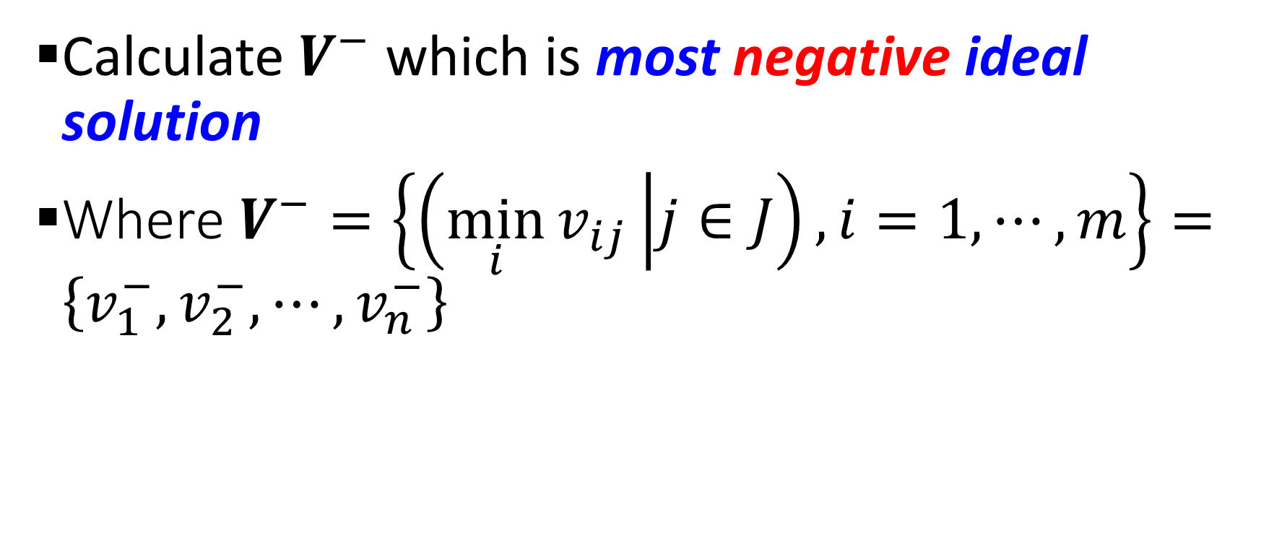
TOPSIS: Step # 03 (Determine the most positive-ideal, most negative-ideal solutions)
Calculate $V^{−}$ which is most negative ideal solution
Where $V^{−}=\left\{\left(\min_{i}{v_{ij}} | j∈J\right),i=1,⋯,m\right\}=\left\{v_{1}^{−},v_{2}^{−},⋯,v_{n}^{−}\right\}$

Slide 18
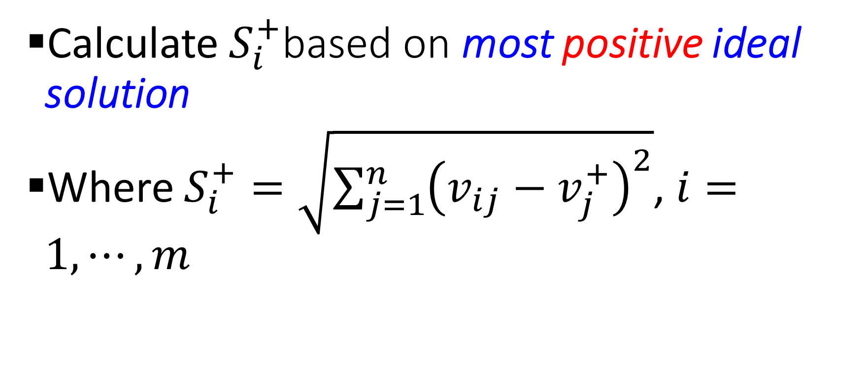
TOPSIS: Step # 04 (Calculate the distance based on most positive-ideal, most negative-ideal solutions)
Calculate $S_{i}^{+}$based on most positive ideal solution
Where $S_{i}^{+}=\sqrt{{\sum_{j=1}^{n}{\left(v_{ij}−v_{j}^{+}\right)}}^{2}}$, $i=1,⋯,m$

Slide 19
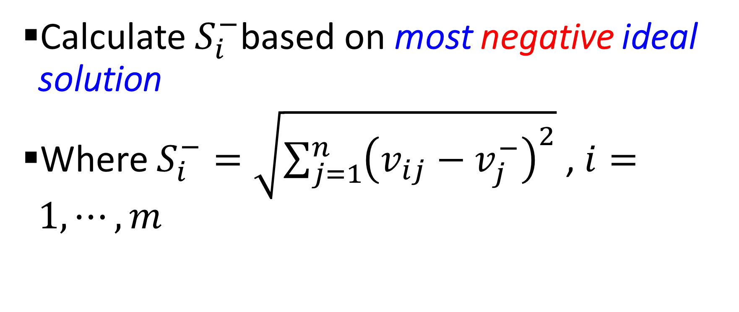
TOPSIS: Step # 04 (Calculate the distance based on most positive-ideal, most negative-ideal solutions)
Calculate $S_{i}^{−}$based on most negative ideal solution
Where $S_{i}^{−}=\sqrt{{\sum_{j=1}^{n}{\left(v_{ij}−v_{j}^{−}\right)}}^{2}}$ , $i=1,⋯,m$

Slide 20

TOPSIS: Step # 05 (Calculate the relative proximity based on ideal solution)
Calculate $c_{i}=\frac{S_{i}^{−}}{\left(S_{i}^{−}+S_{i}^{+}\right)}$ , $i=1,⋯,m$

Slide 21
TOPSIS: Example
Consider the problem related to buying a house/apartment among four (04) choices, where the decision to buy the house/apartment is based on eleven (11) different parameters/criterion which are
  City
  Price
  Loan availability/conditions
  Location
  Number of rooms
  Safety
  Proximity to markets
  Proximity to schools
  Proximity to hospitals
  Facilities available
  Resale condition

Slide 22
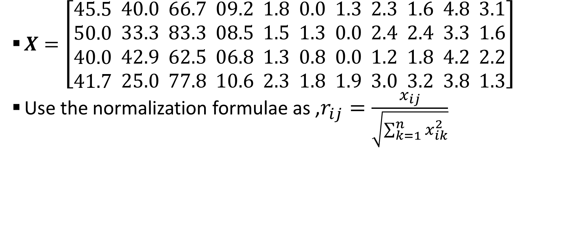
TOPSIS: Example (contd..)
$X=\left[\begin{aligned}45.5 \\ 50.0 \\ 40.0 \\ 41.7\end{aligned} \begin{aligned}40.0 \\ 33.3 \\ 42.9 \\ 25.0\end{aligned} \begin{aligned}66.7 \\ 83.3 \\ 62.5 \\ 77.8\end{aligned} \begin{aligned}09.2 \\ 08.5 \\ 06.8 \\ 10.6\end{aligned} \begin{aligned}1.8 \\ 1.5 \\ 1.3 \\ 2.3\end{aligned} \begin{aligned}0.0 \\ 1.3 \\ 0.8 \\ 1.8\end{aligned} \begin{aligned}1.3 \\ 0.0 \\ 0.0 \\ 1.9\end{aligned} \begin{aligned}2.3 \\ 2.4 \\ 1.2 \\ 3.0\end{aligned} \begin{aligned}1.6 \\ 2.4 \\ 1.8 \\ 3.2\end{aligned} \begin{aligned}4.8 \\ 3.3 \\ 4.2 \\ 3.8\end{aligned} \begin{aligned}3.1 \\ 1.6 \\ 2.2 \\ 1.3\end{aligned}\right]$
Use the normalization formulae as ,$r_{ij}=\frac{x_{ij}}{\sqrt{\sum_{k=1}^{n}{x_{ik}^{2}}}}$

Slide 23
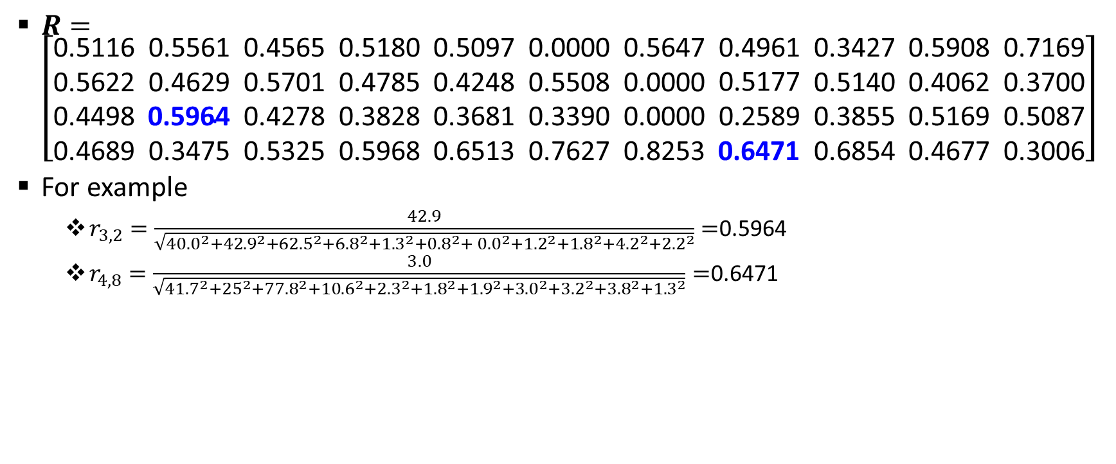
TOPSIS: Example (contd..)
$R=\left[\begin{aligned}\text{0.5116} \\ \text{0.5622} \\ \text{0.4498} \\ \text{0.4689}\end{aligned} \begin{aligned}\text{0.5561} \\ \text{0.4629} \\ \text{0.5964} \\ \text{0.3475}\end{aligned} \begin{aligned}\text{0.4565} \\ \text{0.5701} \\ \text{0.4278} \\ \text{0.5325}\end{aligned} \begin{aligned}\text{0.5180} \\ \text{0.4785} \\ \text{0.3828} \\ \text{0.5968}\end{aligned} \begin{aligned}\text{0.5097} \\ \text{0.4248} \\ \text{0.3681} \\ \text{0.6513}\end{aligned} \begin{aligned}\text{0.0000} \\ \text{0.5508} \\ \text{0.3390} \\ \text{0.7627}\end{aligned} \begin{aligned}\text{0.5647} \\ \text{0.0000} \\ \text{0.0000} \\ \text{0.8253}\end{aligned} \begin{aligned}\text{0.4961} \\ \text{0.5177} \\ \text{0.2589} \\ \text{0.6471}\end{aligned} \begin{aligned}\text{0.3427} \\ \text{0.5140} \\ \text{0.3855} \\ \text{0.6854}\end{aligned} \begin{aligned}\text{0.5908} \\ \text{0.4062} \\ \text{0.5169} \\ \text{0.4677}\end{aligned} \begin{aligned}\text{0.7169} \\ \text{0.3700} \\ \text{0.5087} \\ \text{0.3006}\end{aligned}\right]$
For example
  $r_{3,2}=\frac{42.9}{\sqrt{{40.0}^{2}+{42.9}^{2}+{62.5}^{2}+{6.8}^{2}+{1.3}^{2}+{0.8}^{2}+ {0.0}^{2}+{1.2}^{2}+{1.8}^{2}+{4.2}^{2}+{2.2}^{2}}}=$0.5964
  $r_{4,8}=\frac{3.0}{\sqrt{{41.7}^{2}+{25}^{2}+{77.8}^{2}+{10.6}^{2}+{2.3}^{2}+{1.8}^{2}+{1.9}^{2}+{3.0}^{2}+{3.2}^{2}+{3.8}^{2}+{1.3}^{2}}}=$0.6471

Slide 24

TOPSIS: Example (contd..)
Consider $W=(0.119, 0.106, 0.115, 0.090, 0.113, 0.061, 0.064, 0.113, 0.096, 0.065, 0.058)$, where $\sum_{j=1}^{n=11}{w_{j}}=\left(0.119+0.106+0.115+0.090+0.113+0.061+0.064+0.113+0.096+0.065+0.058\right)=1$

Slide 25
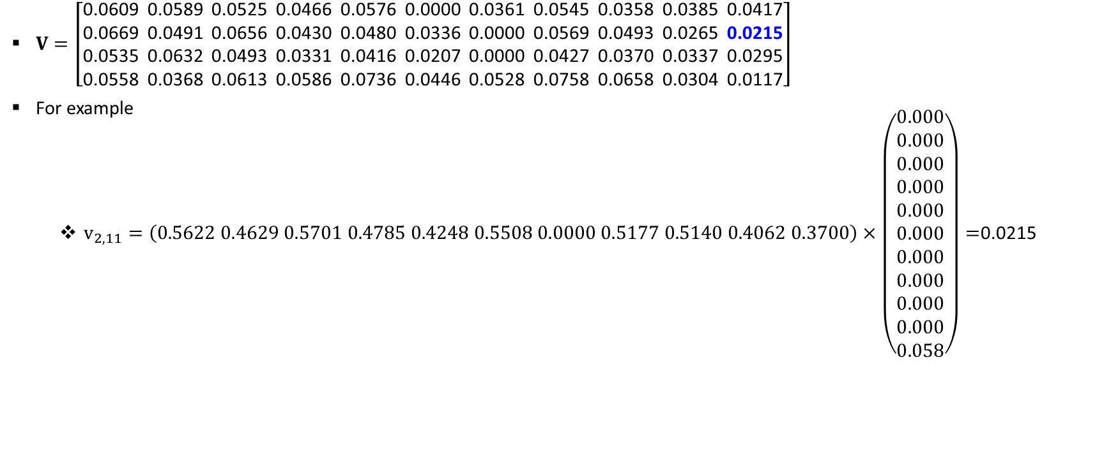
TOPSIS: Example (contd..)
$V=\left[\begin{aligned}\text{0.0609} \\ \text{0.06}\text{69} \\ \text{0.}\text{0535} \\ \text{0.}\text{0558}\end{aligned} \begin{aligned}\text{0.}\text{0589} \\ \text{0.}\text{0491} \\ \text{0.}\text{0632} \\ \text{0.}\text{0368}\end{aligned} \begin{aligned}\text{0.}\text{0525} \\ \text{0.}\text{0656} \\ \text{0.}\text{0493} \\ \text{0.}\text{0613}\end{aligned} \begin{aligned}\text{0.}\text{0466} \\ \text{0.}\text{0430} \\ \text{0.}\text{0331} \\ \text{0.}\text{0586}\end{aligned} \begin{aligned}\text{0.}\text{0576} \\ \text{0.}\text{0480} \\ \text{0.}\text{0416} \\ \text{0.}\text{0736}\end{aligned} \begin{aligned}\text{0.0000} \\ \text{0.}\text{0336} \\ \text{0.}\text{0207} \\ \text{0.}\text{0446}\end{aligned} \begin{aligned}\text{0.}\text{0361} \\ \text{0.0000} \\ \text{0.0000} \\ \text{0.}\text{0528}\end{aligned} \begin{aligned}\text{0.}\text{0545} \\ \text{0.}\text{0569} \\ \text{0.}\text{0427} \\ \text{0.}\text{0758}\end{aligned} \begin{aligned}\text{0.}\text{0358} \\ \text{0.}\text{0493} \\ \text{0.}\text{0370} \\ \text{0.}\text{0658}\end{aligned} \begin{aligned}\text{0.}\text{0385} \\ \text{0.}\text{0265} \\ \text{0.}\text{0337} \\ \text{0.}\text{0304}\end{aligned} \begin{aligned}\text{0.}\text{0417} \\ \text{0.0215} \\ \text{0.}\text{0295} \\ \text{0.}\text{0117}\end{aligned}\right]$
For example
  $v_{2,11}=\left(0.5622 0.4629 0.5701 0.4785 0.4248 0.5508 0.0000 0.5177 0.5140 0.4062 0.3700\right)×\left(\begin{aligned}0.000 \\ 0.000 \\ 0.000 \\ 0.000 \\ 0.000 \\ 0.000 \\ 0.000 \\ 0.000 \\ 0.000 \\ 0.000 \\ 0.058\end{aligned}\right)=$0.0215

Slide 26
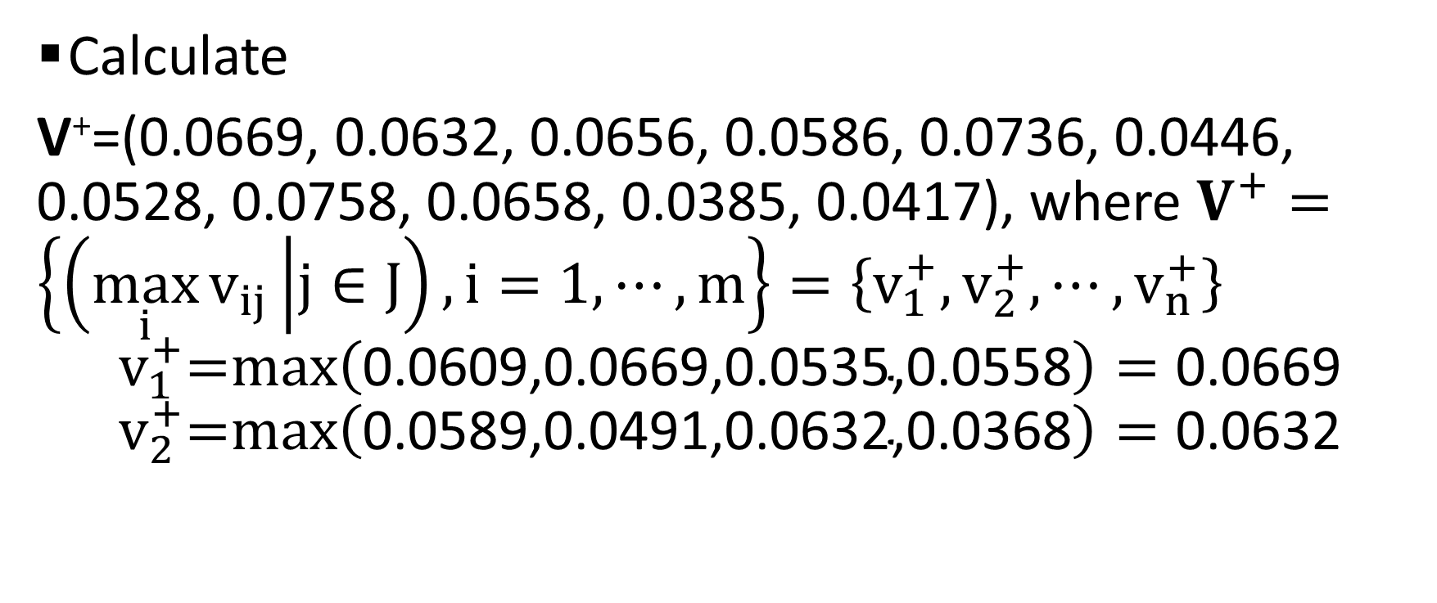
TOPSIS: Example (contd..)
Calculate
V⁺=(0.0669, 0.0632, 0.0656, 0.0586, 0.0736, 0.0446, 0.0528, 0.0758, 0.0658, 0.0385, 0.0417), where $V^{+}=\left\{\left(\max_{i}{v_{ij}} | j∈J\right),i=1,⋯,m\right\}=\left\{v_{1}^{+},v_{2}^{+},⋯,v_{n}^{+}\right\}$
$$v_{1}^{+}\text{=}\text{max}\left(\text{0.0609,0.0669,0.0535,0.0558}\right)=\text{0.0669}$$
$$v_{2}^{+}\text{=}\text{max}\left(\text{0.0589,0.0491,0.0632,0.0368}\right)=\text{0.06}\text{32}$$

Slide 27
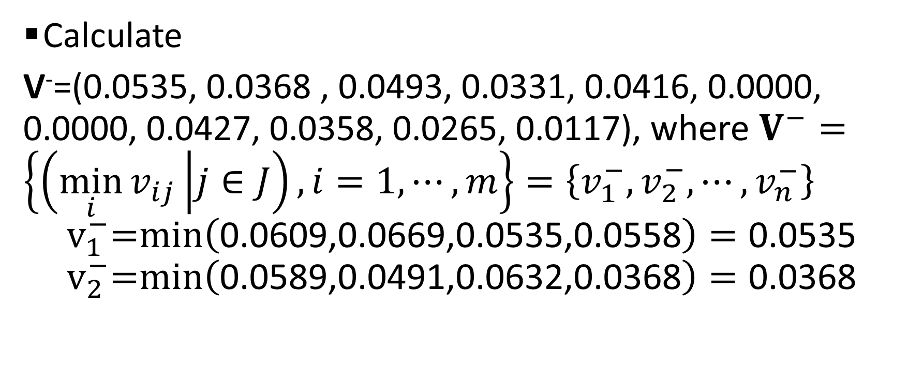
TOPSIS: Example (contd..)
Calculate
V⁻=(0.0535, 0.0368 , 0.0493, 0.0331, 0.0416, 0.0000, 0.0000, 0.0427, 0.0358, 0.0265, 0.0117), where $V^{−}=\left\{\left(\min_{i}{v_{ij}} | j∈J\right),i=1,⋯,m\right\}=\left\{v_{1}^{−},v_{2}^{−},⋯,v_{n}^{−}\right\}$
$$v_{1}^{−}\text{=}\text{min}\left(\text{0.0609,0.0669,0.0535,0.0558}\right)=\text{0.0}\text{535}$$
$$v_{2}^{−}\text{=}\text{min}\left(\text{0.0589,0.0491,0.0632,0.0368}\right)=\text{0.0}\text{368}$$

Slide 28
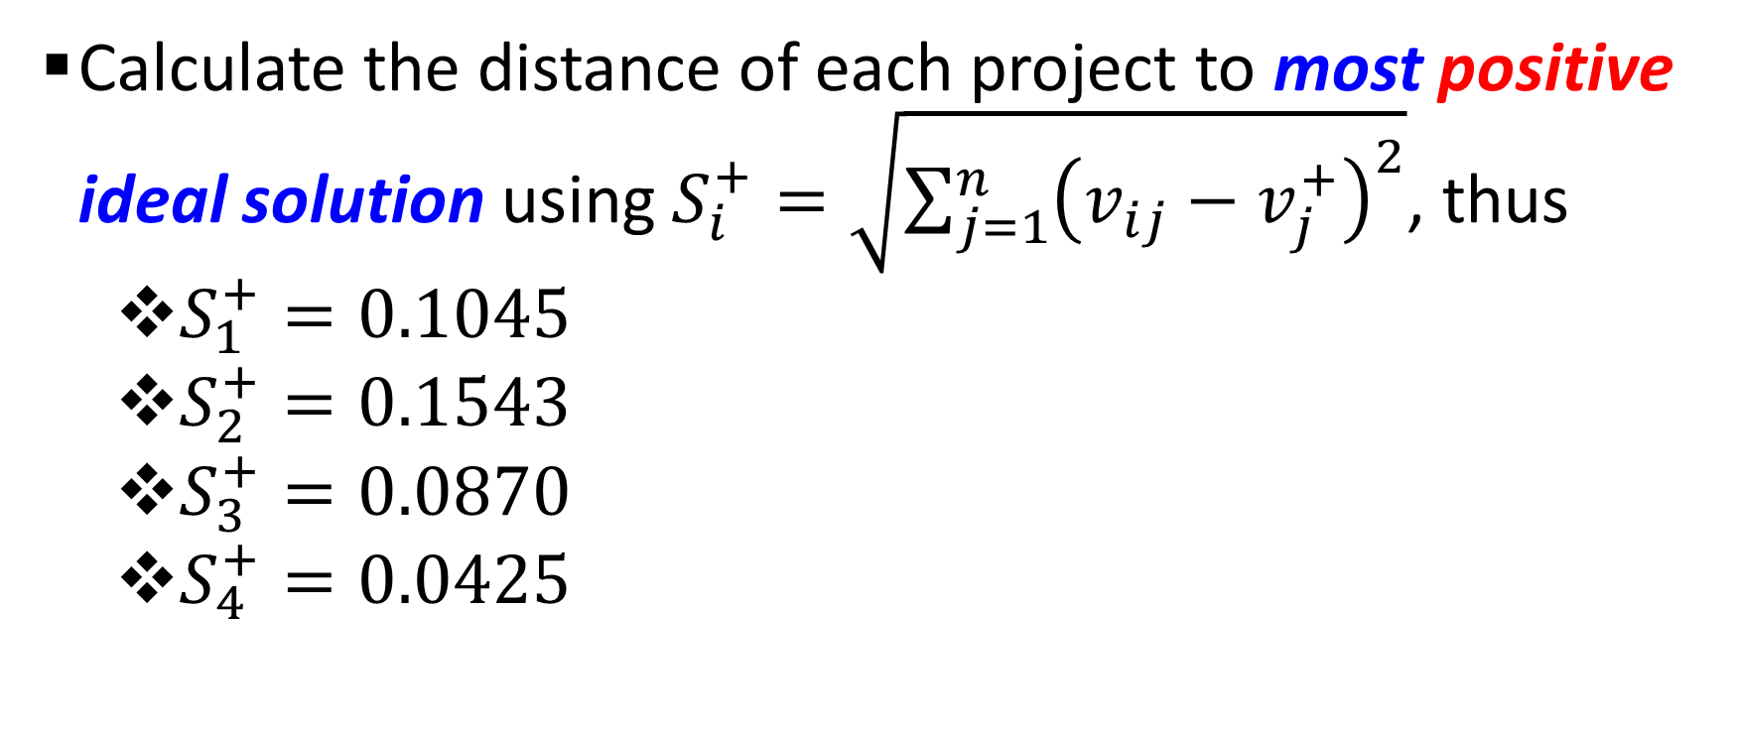
TOPSIS: Example (contd..)
Calculate the distance of each project to most positive ideal solution using $S_{i}^{+}=\sqrt{{\sum_{j=1}^{n}{\left(v_{ij}−v_{j}^{+}\right)}}^{2}}$, thus
  $S_{1}^{+}=0.1045$
  $S_{2}^{+}=0.1543$
  $S_{3}^{+}=0.0870$
  $S_{4}^{+}=0.0425$

Slide 29
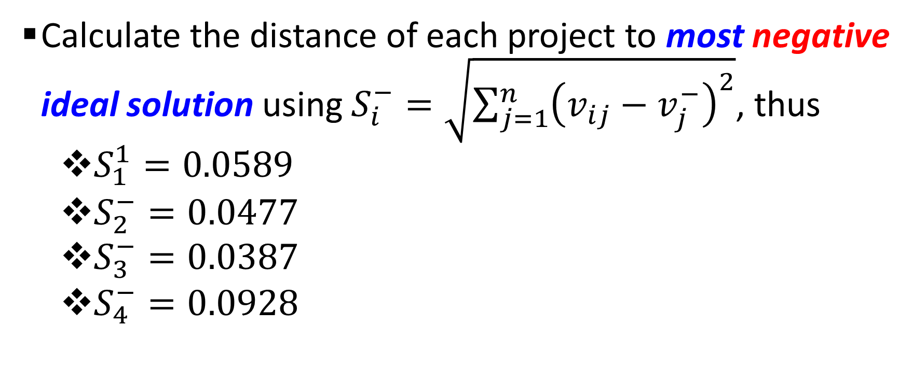
TOPSIS: Example (contd..)
Calculate the distance of each project to most negative ideal solution using $S_{i}^{−}=\sqrt{{\sum_{j=1}^{n}{\left(v_{ij}−v_{j}^{−}\right)}}^{2}}$, thus
  $S_{1}^{1}=0.0589$
  $S_{2}^{−}=0.0477$
  $S_{3}^{−}=0.0387$
  $S_{4}^{−}=0.0928$

Slide 30
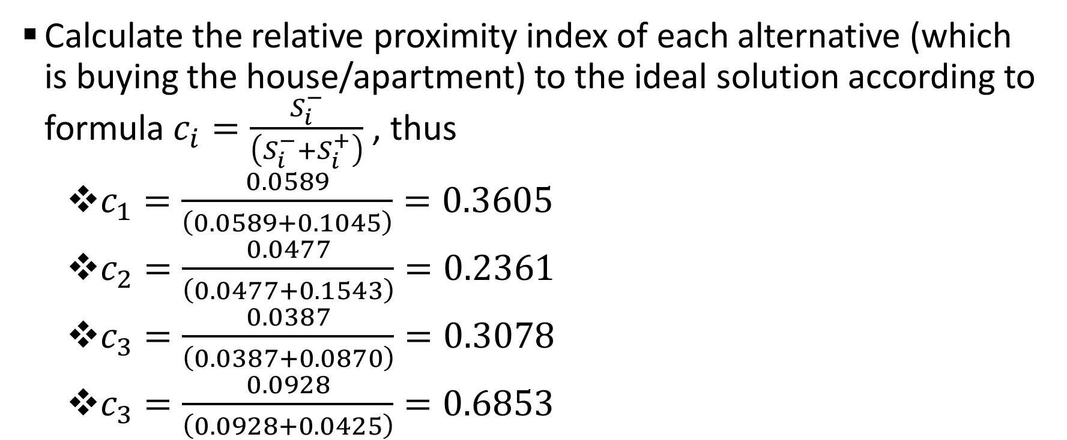
TOPSIS: Example (contd..)
Calculate the relative proximity index of each alternative (which is buying the house/apartment) to the ideal solution according to formula $c_{i}=\frac{S_{i}^{−}}{\left(S_{i}^{−}+S_{i}^{+}\right)}$ , thus
  $c_{1}=\frac{0.0589}{\left(0.0589+0.1045\right)}=0.3605$
  $c_{2}=\frac{0.0477}{\left(0.0477+0.1543\right)}=0.2361$
  $c_{3}=\frac{0.0387}{\left(0.0387+0.0870\right)}=0.3078$
  $c_{3}=\frac{0.0928}{\left(0.0928+0.0425\right)}=0.6853$

Slide 31
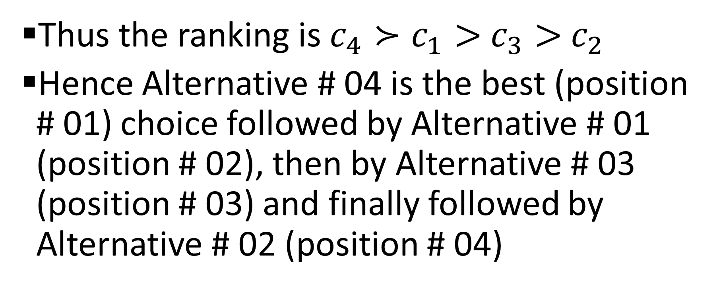
TOPSIS: Example (contd..)
Thus the ranking is $c_{4}≻c_{1}>$ $c_{3}>$ $c_{2}$
Hence Alternative # 04 is the best (position # 01) choice followed by Alternative # 01 (position # 02), then by Alternative # 03 (position # 03) and finally followed by Alternative # 02 (position # 04)

