Slide 1

IME634: Management Decision Analysis
Raghu Nandan Sengupta
Industrial & Management Department
Indian Institute of Technology Kanpur

Slide 2
VIKOR (VIseKriterijumska Optimizacija I Kompromisno Resenje)
The idea of VIKOR (VIseKriterijumska Optimizacija I Kompromisno Resenje) i.e., Multicriteria Optimization and Compromise Solution), a MCDM technique, was developed by Serafim Opricovic during his Ph.D. work
VIKOR method was introduced as one applicable technique to be implemented within MCDM problem and it as developed as a multi attribute decision making method to solve a discrete decision making problem with non-commensurable (different units) and conflicting criteria

Slide 3
VIKOR (contd..)
In this method the decision maker likes a solution that is closest to the ideal, and hence the decisions/alternatives are evaluated/compared/ranked accordingly
While ranking, the decisions/alternatives, rather than the best solution, is the target as finding out the ideal solution is not always feasible, but rather the closest to the ideal is what is practically possible.

Slide 4
VIKOR (contd..)
Two of the MCDM methods, i.e., VIKOR and TOPSIS are based on an aggregating function which represents the concept of closeness of the solution to the ideal solution
In VIKOR we follow linear normalization while in TOPSIS it is vector normalization

Slide 5
VIKOR (contd..)
The use of normalization is used to eliminate the units of criterion functions and thus ensure a level playing field for different criterion
In VIKOR we determine a maximum group utility for the majority and a minimum of an individual regret for the opponent
In TOPSIS a solution with the shortest distance to the ideal solution and the greatest distance from the negative-ideal solution is required to be found. While doing this we do not consider the relative importance of these distances.

Slide 6
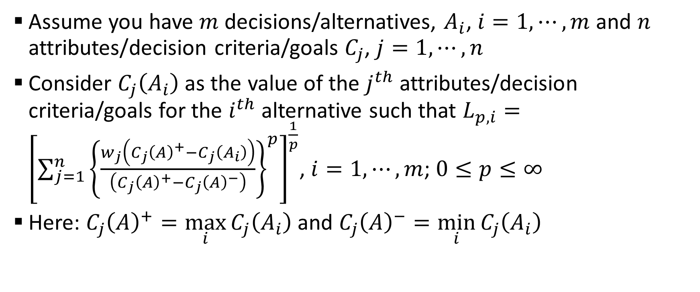
VIKOR (contd..)
Assume you have $m$ decisions/alternatives, $A_{i}$, $i=1,⋯,m$ and $n$ attributes/decision criteria/goals $C_{j}$, $j=1,⋯,n$
Consider $C_{j}\left(A_{i}\right)$ as the value of the $j^{th}$ attributes/decision criteria/goals for the $i^{th}$ alternative such that $L_{p,i}={\left[\sum_{j=1}^{n}{{\left\{\frac{w_{j}\left(C_{j}{\left(A\right)}^{+}−C_{j}\left(A_{i}\right)\right)}{\left(C_{j}{\left(A\right)}^{+}−C_{j}{\left(A\right)}^{−}\right)}\right\}}^{p}}\right]}^{\frac{1}{p}}$, $i=1,⋯,m$; $0≤p≤∞$
Here: $C_{j}{\left(A\right)}^{+}=\max_{i}{C_{j}\left(A_{i}\right)}$ and $C_{j}{\left(A\right)}^{−}=\min_{i}{C_{j}\left(A_{i}\right)}$

Slide 7
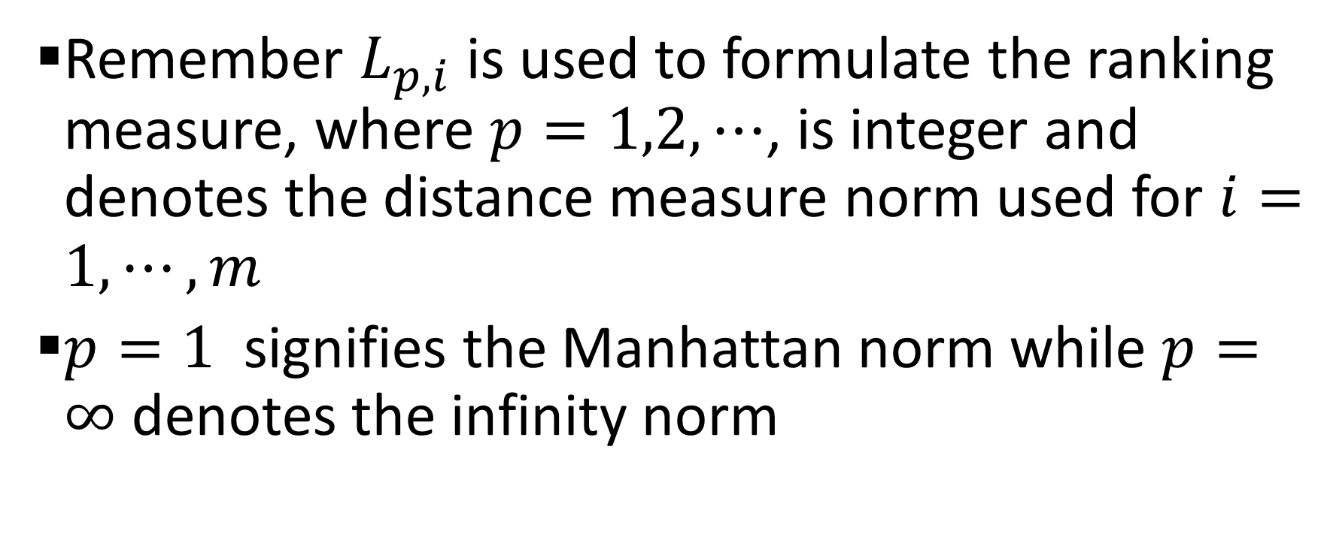
VIKOR (contd..)
Remember $L_{p,i}$ is used to formulate the ranking measure, where $p=1,2,⋯$, is integer and denotes the distance measure norm used for $i=1,⋯,m$
$p=1$ signifies the Manhattan norm while $p=∞$ denotes the infinity norm

Slide 8
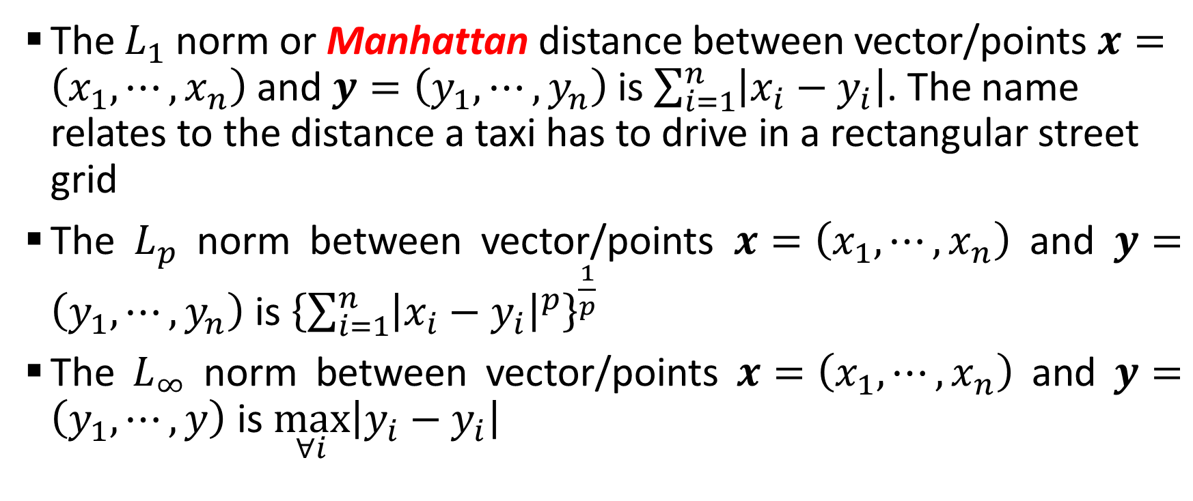
VIKOR (contd..): Distance
The $L_{1}$ norm or Manhattan distance between vector/points $x=\left(x_{1},⋯,x_{n}\right)$ and $y=\left(y_{1},⋯,y_{n}\right)$ is $\sum_{i=1}^{n}{\left|x_{i}−y_{i}\right|}$. The name relates to the distance a taxi has to drive in a rectangular street grid
The $L_{p}$ norm between vector/points $x=\left(x_{1},⋯,x_{n}\right)$ and $y=\left(y_{1},⋯,y_{n}\right)$ is ${\left\{\sum_{i=1}^{n}{{\left|x_{i}−y_{i}\right|}^{p}}\right\}}^{\frac{1}{p}}$
The $L_{∞}$ norm between vector/points $x=\left(x_{1},⋯,x_{n}\right)$ and $y=\left(y_{1},⋯,y\right)$ is $\max_{∀i}\left|y_{i}−y_{i}\right|$

Slide 9
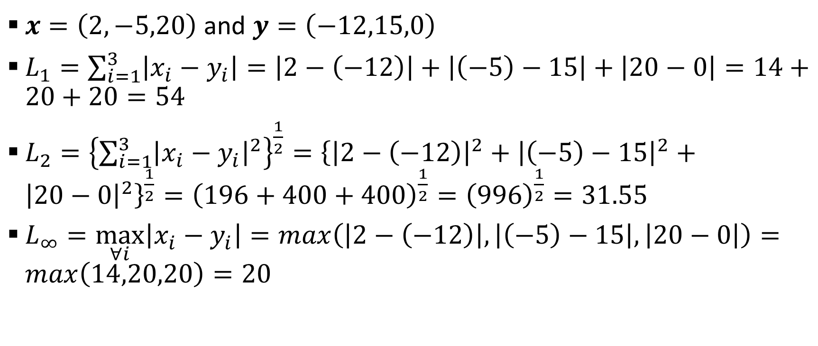
VIKOR (contd..): Distance (Example)
$x=\left(2,−5,20\right)$ and $y=\left(−12,15,0\right)$
$L_{1}=\sum_{i=1}^{3}{\left|x_{i}−y_{i}\right|}=\left|2−\left(−12\right)\right|+\left|\left(−5\right)−15\right|+\left|20−0\right|=14+20+20=54$
$L_{2}={\left\{\sum_{i=1}^{3}{{\left|x_{i}−y_{i}\right|}^{2}}\right\}}^{\frac{1}{2}}={\left\{{\left|2−\left(−12\right)\right|}^{2}+{\left|\left(−5\right)−15\right|}^{2}+{\left|20−0\right|}^{2}\right\}}^{\frac{1}{2}}={\left(196+400+400\right)}^{\frac{1}{2}}={\left(996\right)}^{\frac{1}{2}}=31.55$
$L_{∞}=\max_{∀i}\left|x_{i}−y_{i}\right|=max\left(\left|2−\left(−12\right)\right|,\left|\left(−5\right)−15\right|,\left|20−0\right|\right)=max\left(14,20,20\right)=20$

Slide 10
VIKOR (contd..): Distance (Example)

Slide 11
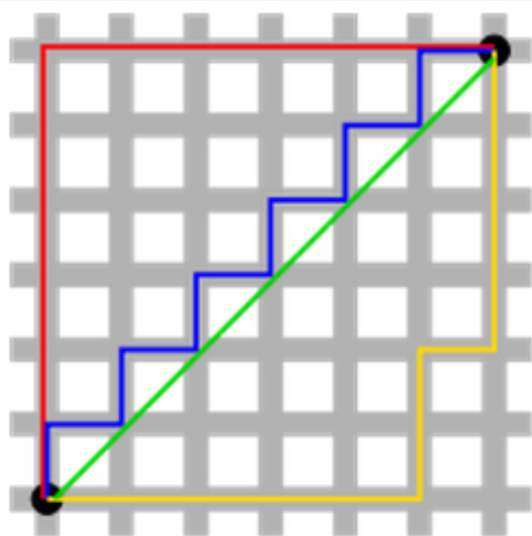
VIKOR (contd..): Distance

Slide 12
VIKOR (contd..): Distance
The green line (L₂-norm) is the unique shortest path, while the red, blue, yellow (L₁-norm) are all same length (=12) for the same route
This is why L₂-norm has unique solution while L₁-norm does not have any unique solution
One can generalize this to n-dimension case

Slide 13
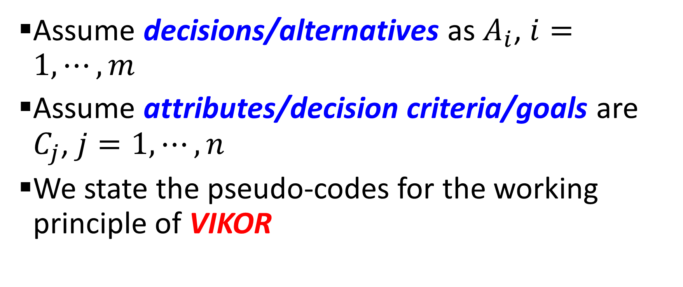
VIKOR Algorithm
Assume decisions/alternatives as $A_{i}$, $i=1,⋯,m$
Assume attributes/decision criteria/goals are $C_{j}$, $j=1,⋯,n$
We state the pseudo-codes for the working principle of VIKOR

Slide 14
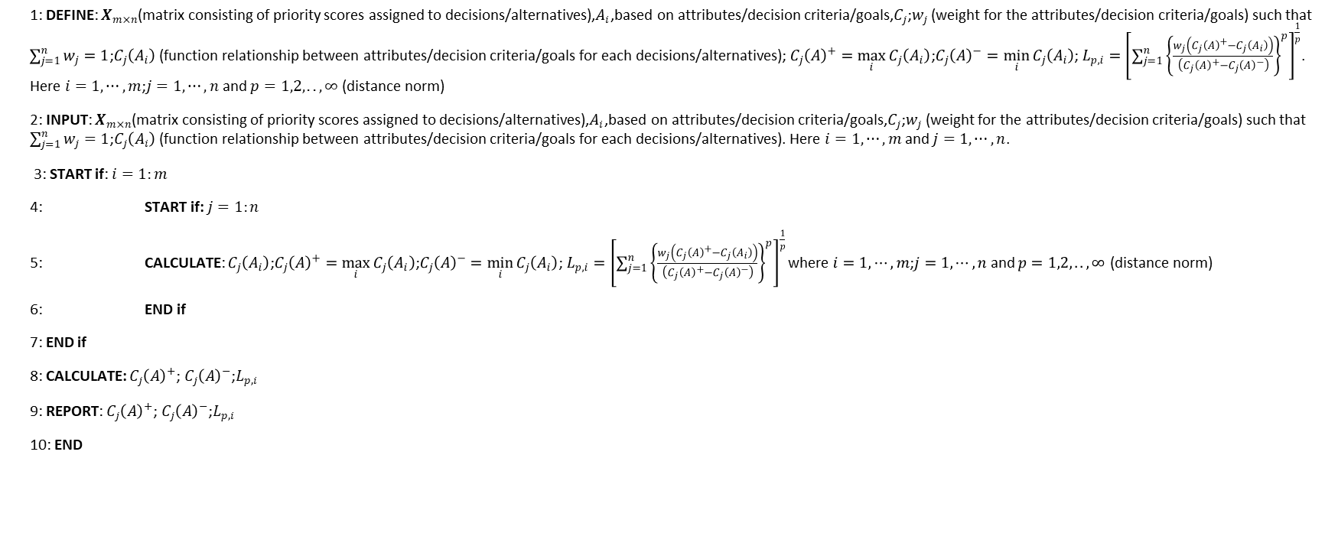
VIKOR Algorithm (contd..)
1: DEFINE: $X_{m×n}$(matrix consisting of priority scores assigned to decisions/alternatives),$A_{i}$,based on attributes/decision criteria/goals,$C_{j}$;$w_{j}$ (weight for the attributes/decision criteria/goals) such that $\sum_{j=1}^{n}{w_{j}}=1$;$C_{j}\left(A_{i}\right)$ (function relationship between attributes/decision criteria/goals for each decisions/alternatives);$C_{j}{\left(A\right)}^{+}=\max_{i}{C_{j}\left(A_{i}\right)}$;$C_{j}{\left(A\right)}^{−}=\min_{i}{C_{j}\left(A_{i}\right)}$;$L_{p,i}={\left[\sum_{j=1}^{n}{{\left\{\frac{w_{j}\left(C_{j}{\left(A\right)}^{+}−C_{j}\left(A_{i}\right)\right)}{\left(C_{j}{\left(A\right)}^{+}−C_{j}{\left(A\right)}^{−}\right)}\right\}}^{p}}\right]}^{\frac{1}{p}}$. Here $i=1,⋯,m$;$j=1,⋯,n$ and $p=1,2,..,∞$ (distance norm)
2: INPUT: $X_{m×n}$(matrix consisting of priority scores assigned to decisions/alternatives),$A_{i}$,based on attributes/decision criteria/goals,$C_{j}$;$w_{j}$ (weight for the attributes/decision criteria/goals) such that $\sum_{j=1}^{n}{w_{j}}=1$;$C_{j}\left(A_{i}\right)$ (function relationship between attributes/decision criteria/goals for each decisions/alternatives). Here $i=1,⋯,m$ and $j=1,⋯,n$.
3: START if: $i=1:m$
4: START if: $j=1:n$
5: CALCULATE: $C_{j}\left(A_{i}\right)$;$C_{j}{\left(A\right)}^{+}=\max_{i}{C_{j}\left(A_{i}\right)}$;$C_{j}{\left(A\right)}^{−}=\min_{i}{C_{j}\left(A_{i}\right)}$;$L_{p,i}={\left[\sum_{j=1}^{n}{{\left\{\frac{w_{j}\left(C_{j}{\left(A\right)}^{+}−C_{j}\left(A_{i}\right)\right)}{\left(C_{j}{\left(A\right)}^{+}−C_{j}{\left(A\right)}^{−}\right)}\right\}}^{p}}\right]}^{\frac{1}{p}}$ where $i=1,⋯,m$;$j=1,⋯,n$ and $p=1,2,..,∞$ (distance norm)
6: END if
7: END if
8: CALCULATE: $C_{j}{\left(A\right)}^{+}$;$C_{j}{\left(A\right)}^{−}$;$L_{p,i}$
9: REPORT: $C_{j}{\left(A\right)}^{+}$;$C_{j}{\left(A\right)}^{−}$;$L_{p,i}$
10: END

Slide 15
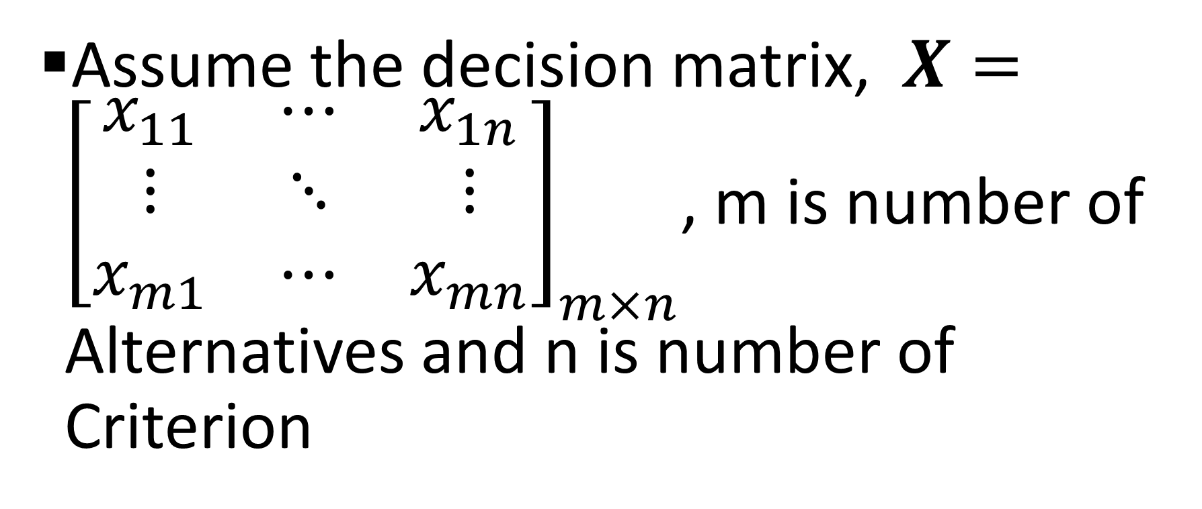
VIKOR: Steps # 01 (Construct the normalized decision matrix)
Assume the decision matrix, $X={\left[\begin{matrix}x_{11} & ⋯ & x_{1n} \\ ⋮ & ⋱ & ⋮ \\ x_{m1} & ⋯ & x_{mn}\end{matrix}\right]}_{m×n}$, m is number of Alternatives and n is number of Criterion

Slide 16
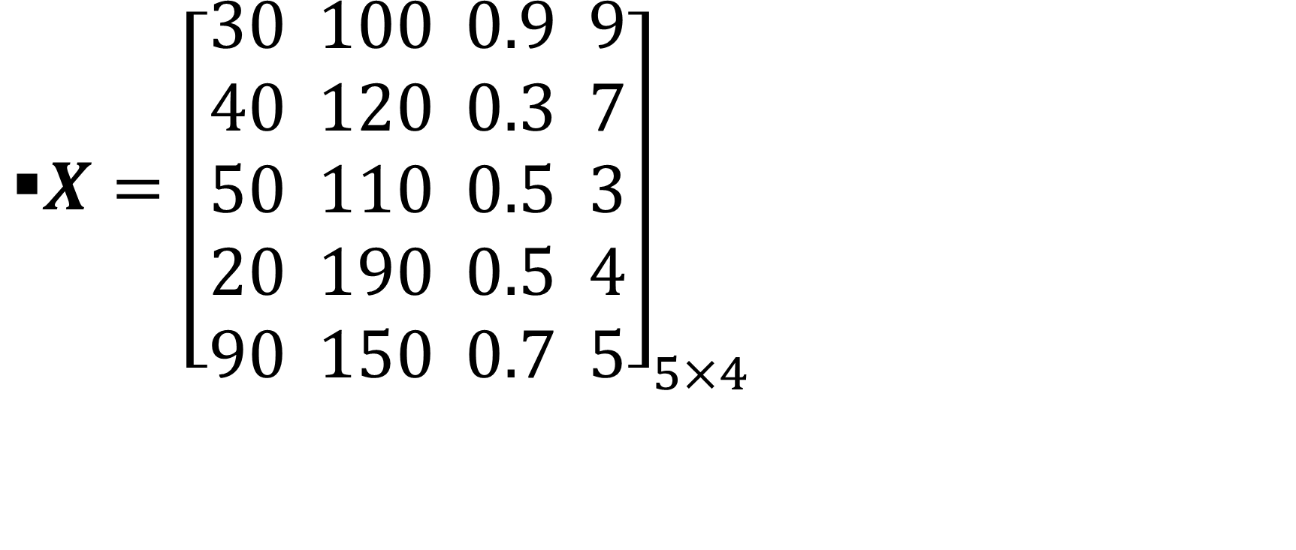
VIKOR: Steps # 01 (Construct the normalized decision matrix)
$X={\left[\begin{aligned}30 \\ 40 \\ 50 \\ 20 \\ 90\end{aligned} \begin{aligned}100 \\ 120 \\ 110 \\ 190 \\ 150\end{aligned} \begin{aligned}0.9 \\ 0.3 \\ 0.5 \\ 0.5 \\ 0.7\end{aligned} \begin{aligned}9 \\ 7 \\ 3 \\ 4 \\ 5\end{aligned}\right]}_{5×4}$

Slide 17
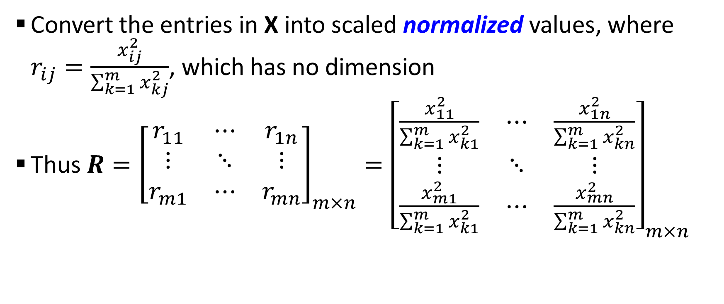
VIKOR: Steps # 01 (Construct the normalized decision matrix)
Convert the entries in X into scaled normalized values, where $r_{ij}=\frac{x_{ij}^{2}}{\sum_{k=1}^{m}{x_{kj}^{2}}}$, which has no dimension
Thus $R={\left[\begin{matrix}r_{11} & ⋯ & r_{1n} \\ ⋮ & ⋱ & ⋮ \\ r_{m1} & ⋯ & r_{mn}\end{matrix}\right]}_{m×n}={\left[\begin{matrix}\frac{x_{11}^{2}}{\sum_{k=1}^{m}{x_{k1}^{2}}} & ⋯ & \frac{x_{1n}^{2}}{\sum_{k=1}^{m}{x_{kn}^{2}}} \\ ⋮ & ⋱ & ⋮ \\ \frac{x_{m1}^{2}}{\sum_{k=1}^{m}{x_{k1}^{2}}} & ⋯ & \frac{x_{mn}^{2}}{\sum_{k=1}^{m}{x_{kn}^{2}}}\end{matrix}\right]}_{m×n}$

Slide 18
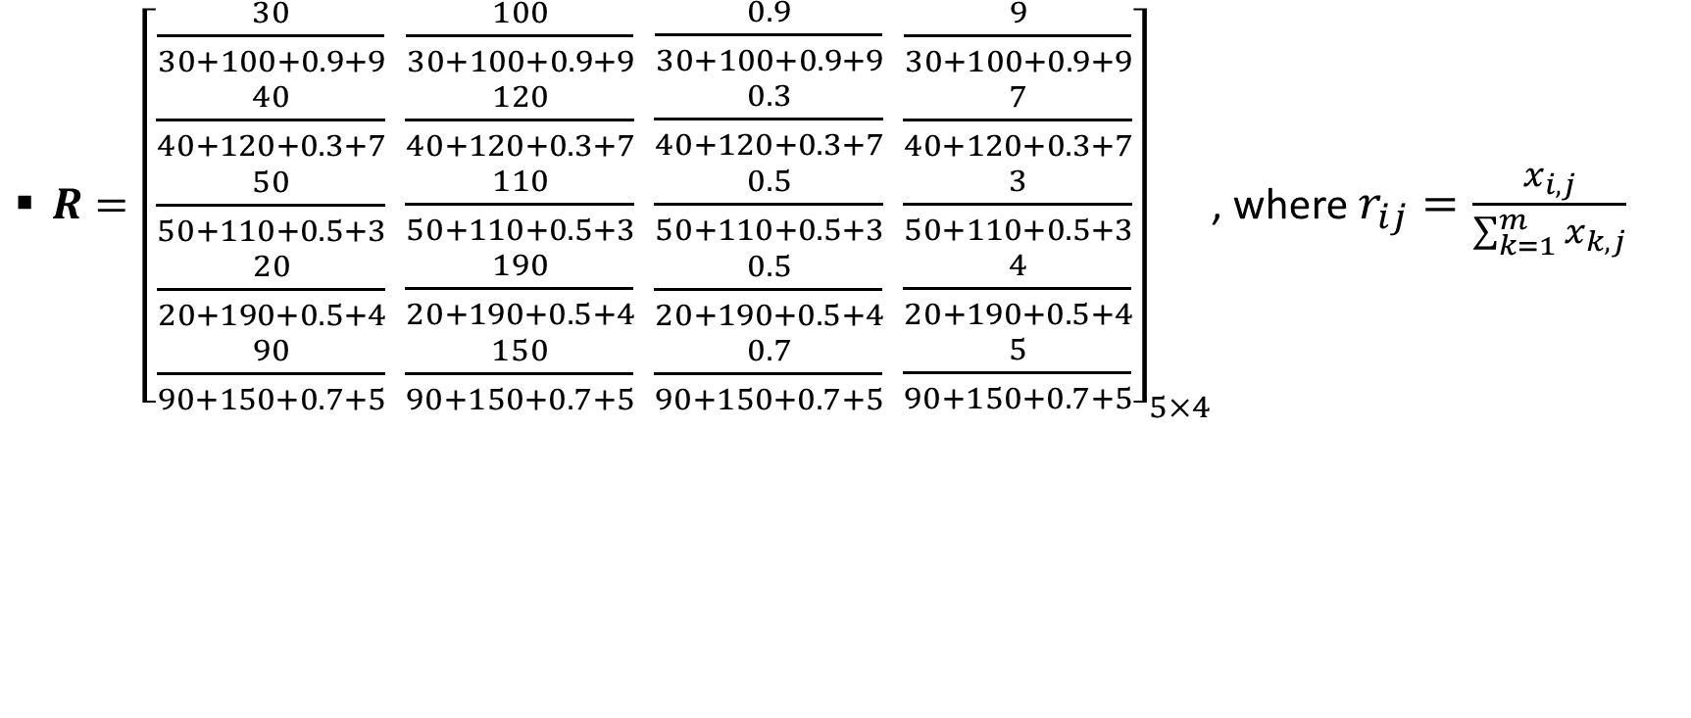
VIKOR: Steps # 01 (Construct the normalized decision matrix)
$R={\left[\begin{aligned}\frac{30}{30+100+0.9+9} \\ \frac{40}{40+120+0.3+7} \\ \frac{50}{50+110+0.5+3} \\ \frac{20}{20+190+0.5+4} \\ \frac{90}{90+150+0.7+5}\end{aligned} \begin{aligned}\frac{100}{30+100+0.9+9} \\ \frac{120}{40+120+0.3+7} \\ \frac{110}{50+110+0.5+3} \\ \frac{190}{20+190+0.5+4} \\ \frac{150}{90+150+0.7+5}\end{aligned} \begin{aligned}\frac{0.9}{30+100+0.9+9} \\ \frac{0.3}{40+120+0.3+7} \\ \frac{0.5}{50+110+0.5+3} \\ \frac{0.5}{20+190+0.5+4} \\ \frac{0.7}{90+150+0.7+5}\end{aligned} \begin{aligned}\frac{9}{30+100+0.9+9} \\ \frac{7}{40+120+0.3+7} \\ \frac{3}{50+110+0.5+3} \\ \frac{4}{20+190+0.5+4} \\ \frac{5}{90+150+0.7+5}\end{aligned}\right]}_{5×4}$, where $r_{ij}=\frac{x_{i,j}}{\sum_{k=1}^{m}{x_{k,j}}}$

Slide 19
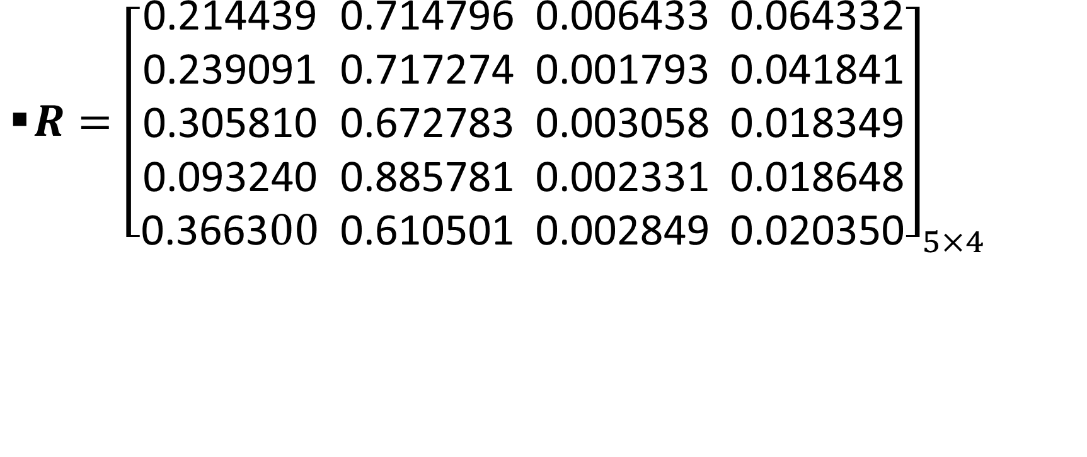
VIKOR: Steps # 01 (Construct the normalized decision matrix)
$R={\left[\begin{aligned}\text{0.214439} \\ \text{0.239091} \\ \text{0.30581}\text{0} \\ \text{0.09324}\text{0} \\ \text{0.3663}00\end{aligned} \begin{aligned}\text{0.714796} \\ \text{0.717274} \\ \text{0.672783} \\ \text{0.885781} \\ \text{0.610501}\end{aligned} \begin{aligned}\text{0.006433} \\ \text{0.001793} \\ \text{0.003058} \\ \text{0.002331} \\ \text{0.002849}\end{aligned} \begin{aligned}\text{0.064332} \\ \text{0.041841} \\ \text{0.018349} \\ \text{0.018648} \\ \text{0.02035}\text{0}\end{aligned}\right]}_{5×4}$

Slide 20
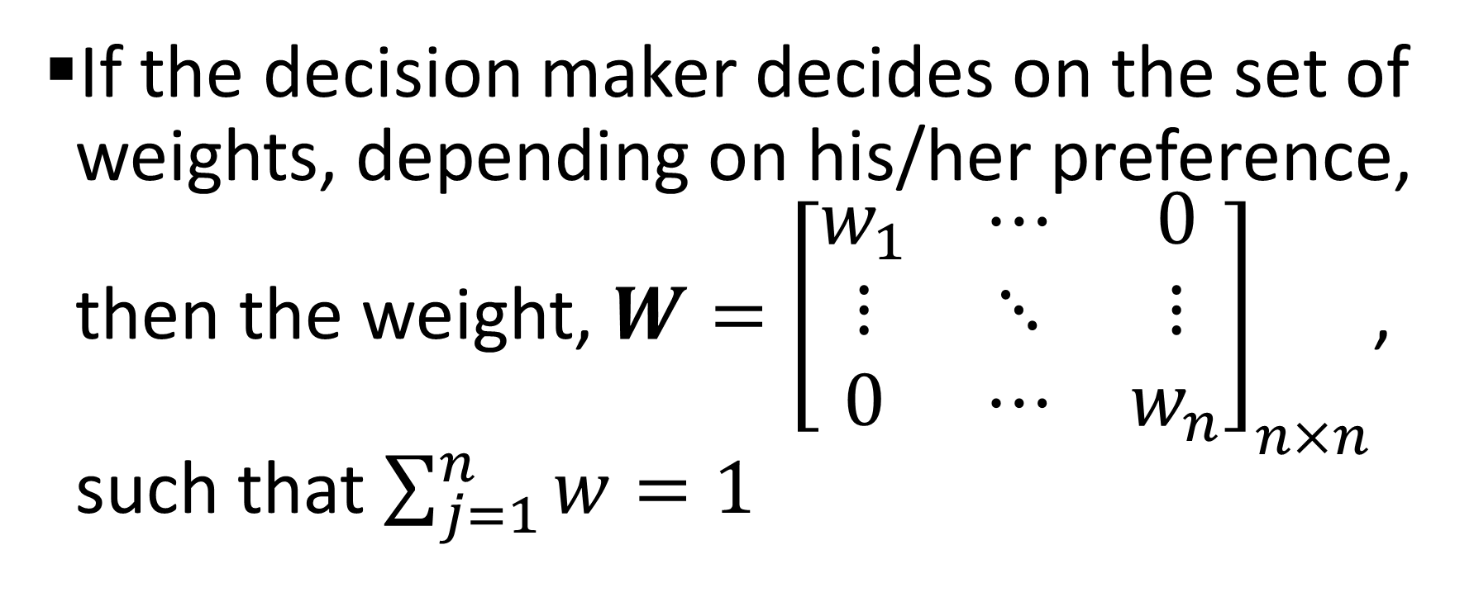
VIKOR: Step # 02 (Construct the weighted normalized decision matrix)
If the decision maker decides on the set of weights, depending on his/her preference, then the weight, $W={\left[\begin{matrix}w_{1} & ⋯ & 0 \\ ⋮ & ⋱ & ⋮ \\ 0 & ⋯ & w_{n}\end{matrix}\right]}_{n×n}$, such that $\sum_{j=1}^{n}{w}=1$

Slide 21
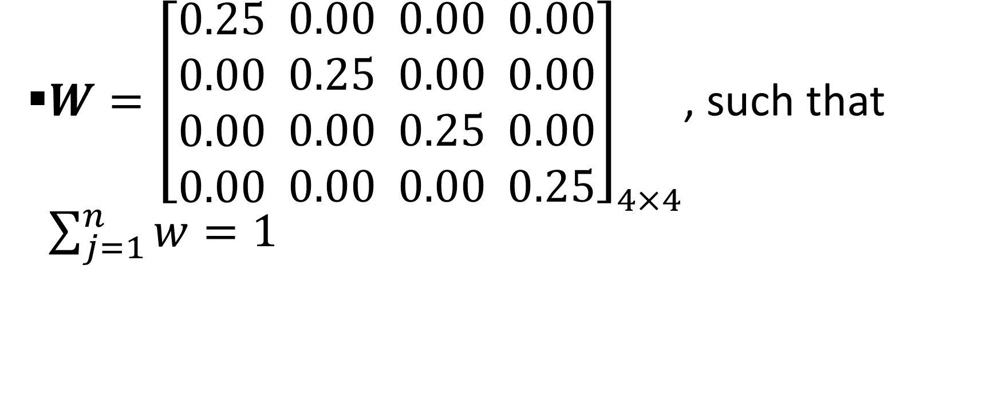
VIKOR: Step # 02 (Construct the weighted normalized decision matrix)
$W={\left[\begin{aligned}0.25 \\ 0.00 \\ 0.00 \\ 0.00\end{aligned} \begin{aligned}0.00 \\ 0.25 \\ 0.00 \\ 0.00\end{aligned} \begin{aligned}0.00 \\ 0.00 \\ 0.25 \\ 0.00\end{aligned} \begin{aligned}0.00 \\ 0.00 \\ 0.00 \\ 0.25\end{aligned}\right]}_{4×4}$, such that $\sum_{j=1}^{n}{w}=1$

Slide 22
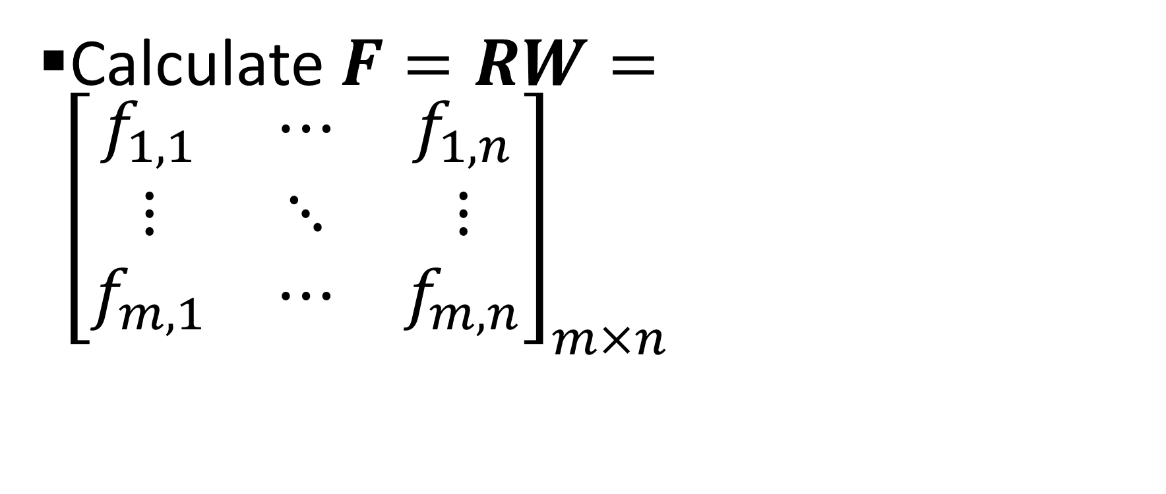
VIKOR: Step # 02 (Construct the weighted normalized decision matrix)
Calculate $F=RW={\left[\begin{matrix}f_{1,1} & ⋯ & f_{1,n} \\ ⋮ & ⋱ & ⋮ \\ f_{m,1} & ⋯ & f_{m,n}\end{matrix}\right]}_{m×n}$

Slide 23
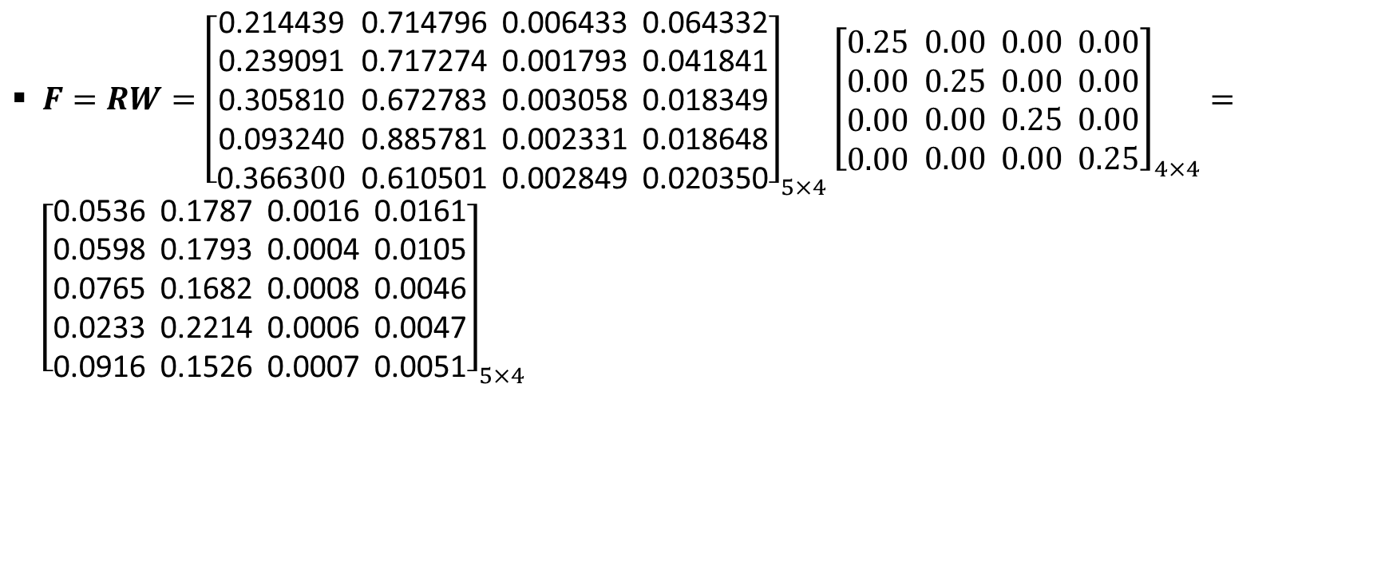
VIKOR: Step # 02 (Construct the weighted normalized decision matrix)
$F=RW={\left[\begin{aligned}\text{0.214439} \\ \text{0.239091} \\ \text{0.305810} \\ \text{0.093240} \\ \text{0.3663}00\end{aligned} \begin{aligned}\text{0.714796} \\ \text{0.717274} \\ \text{0.672783} \\ \text{0.885781} \\ \text{0.610501}\end{aligned} \begin{aligned}\text{0.006433} \\ \text{0.001793} \\ \text{0.003058} \\ \text{0.002331} \\ \text{0.002849}\end{aligned} \begin{aligned}\text{0.064332} \\ \text{0.041841} \\ \text{0.018349} \\ \text{0.018648} \\ \text{0.020350}\end{aligned}\right]}_{5×4}{\left[\begin{aligned}0.25 \\ 0.00 \\ 0.00 \\ 0.00\end{aligned} \begin{aligned}0.00 \\ 0.25 \\ 0.00 \\ 0.00\end{aligned} \begin{aligned}0.00 \\ 0.00 \\ 0.25 \\ 0.00\end{aligned} \begin{aligned}0.00 \\ 0.00 \\ 0.00 \\ 0.25\end{aligned}\right]}_{4×4}={\left[\begin{aligned}\text{0.0536} \\ \text{0.0598} \\ \text{0.0765} \\ \text{0.0233} \\ \text{0.0916}\end{aligned} \begin{aligned}\text{0.1787} \\ \text{0.1793} \\ \text{0.1682} \\ \text{0.2214} \\ \text{0.1526}\end{aligned} \begin{aligned}\text{0.0016} \\ \text{0.0004} \\ \text{0.0008} \\ \text{0.0006} \\ \text{0.0007}\end{aligned} \begin{aligned}\text{0.0161} \\ \text{0.0105} \\ \text{0.0046} \\ \text{0.0047} \\ \text{0.0051}\end{aligned}\right]}_{5×4}$

Slide 24
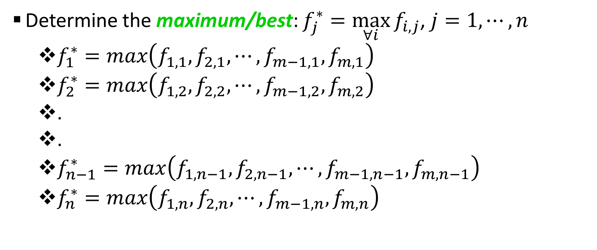
VIKOR: Step # 03 (Determine the maximum/best from the criterion values)
Determine the maximum/best: $f_{j}^{∗}=\max_{∀i}{f_{i,j}}$, $j=1,⋯,n$
  $f_{1}^{∗}=max\left(f_{1,1},f_{2,1},⋯,f_{m−1,1},f_{m,1}\right)$
  $f_{2}^{∗}=max\left(f_{1,2},f_{2,2},⋯,f_{m−1,2},f_{m,2}\right)$
  .
  .
  $f_{n−1}^{∗}=max\left(f_{1,n−1},f_{2,n−1},⋯,f_{m−1,n−1},f_{m,n−1}\right)$
  $f_{n}^{∗}=max\left(f_{1,n},f_{2,n},⋯,f_{m−1,n},f_{m,n}\right)$

Slide 25
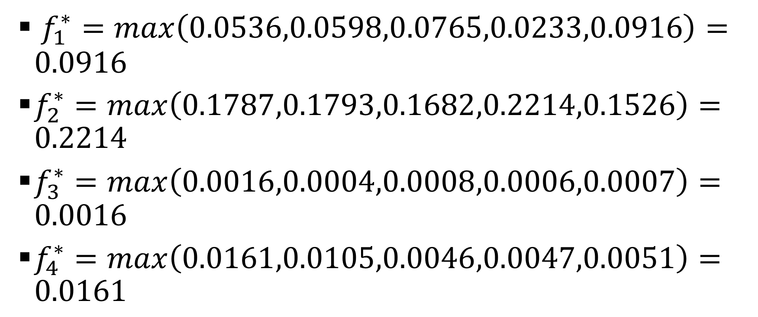
VIKOR: Step # 03 (Determine the maximum/best from the criterion values)
$f_{1}^{∗}=max\left(0.0536,0.0598,0.0765,0.0233,0.0916\right)=0.0916$
$f_{2}^{∗}=max\left(0.1787,0.1793,0.1682,0.2214,0.1526\right)=0.2214$
$f_{3}^{∗}=max\left(0.0016,0.0004,0.0008,0.0006,0.0007\right)=0.0016$
$f_{4}^{∗}=max\left(0.0161,0.0105,0.0046,0.0047,0.0051\right)=0.0161$

Slide 26
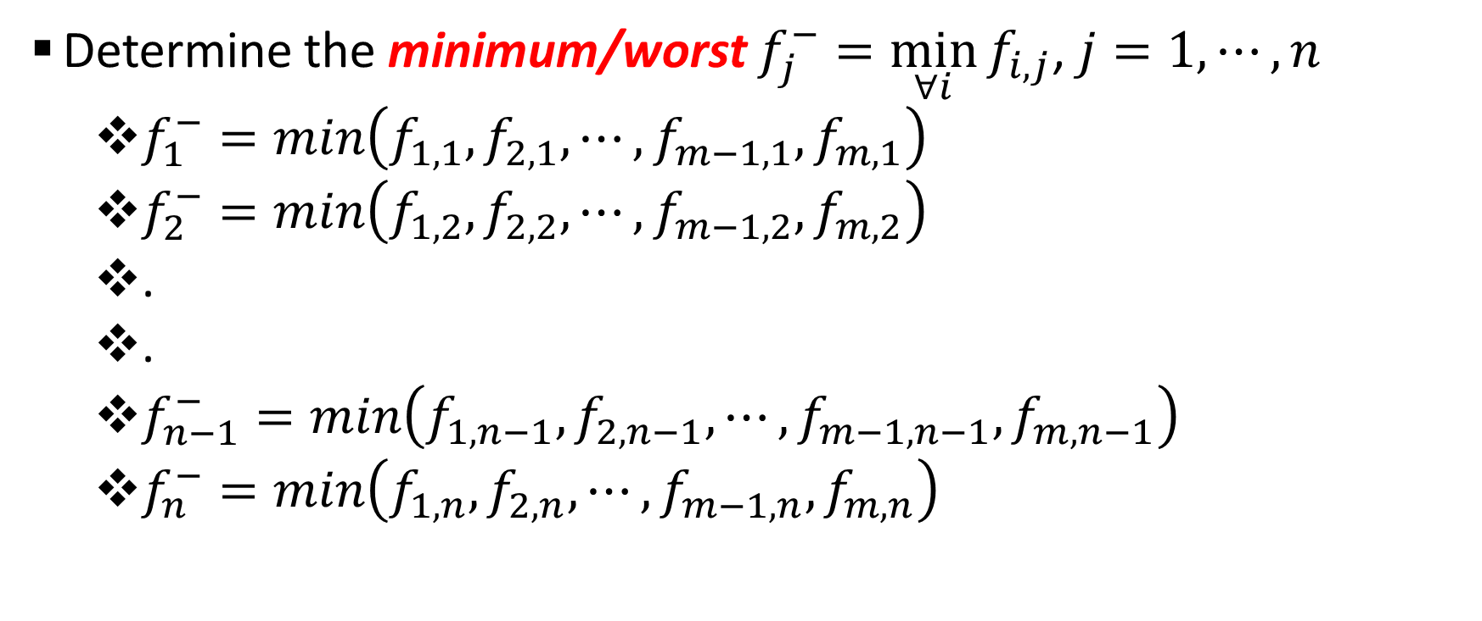
VIKOR: Step # 03 (Determine the minimum/worst from the criterion values)
Determine the minimum/worst $f_{j}^{−}=\min_{∀i}{f_{i,j}}$, $j=1,⋯,n$
  $f_{1}^{−}=min\left(f_{1,1},f_{2,1},⋯,f_{m−1,1},f_{m,1}\right)$
  $f_{2}^{−}=min\left(f_{1,2},f_{2,2},⋯,f_{m−1,2},f_{m,2}\right)$
  .
  .
  $f_{n−1}^{−}=min\left(f_{1,n−1},f_{2,n−1},⋯,f_{m−1,n−1},f_{m,n−1}\right)$
  $f_{n}^{−}=min\left(f_{1,n},f_{2,n},⋯,f_{m−1,n},f_{m,n}\right)$

Slide 27
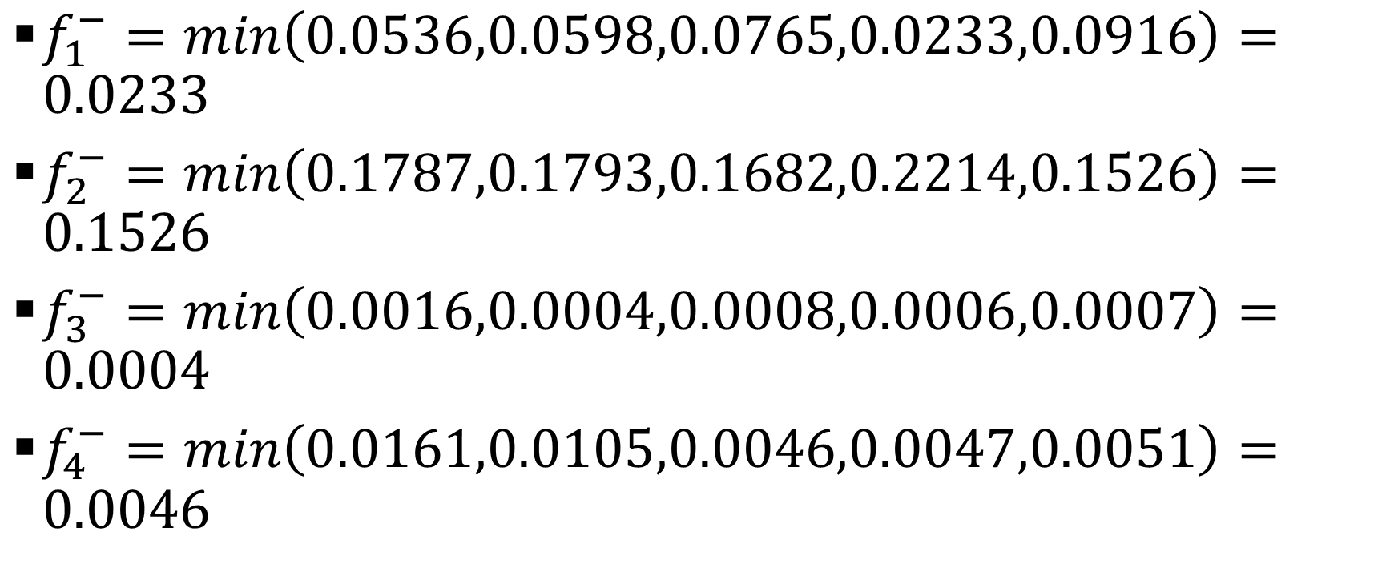
VIKOR: Step # 03 (Determine the minimum/worst from the criterion values)
$f_{1}^{−}=min\left(0.0536,0.0598,0.0765,0.0233,0.0916\right)=0.0233$
$f_{2}^{−}=min\left(0.1787,0.1793,0.1682,0.2214,0.1526\right)=0.1526$
$f_{3}^{−}=min\left(0.0016,0.0004,0.0008,0.0006,0.0007\right)=0.0004$
$f_{4}^{−}=min\left(0.0161,0.0105,0.0046,0.0047,0.0051\right)=$ $0.0046$

Slide 28
VIKOR: Step # 03 (Graphical representation of maximum/best and minimum/worst for each criterion)

Slide 29
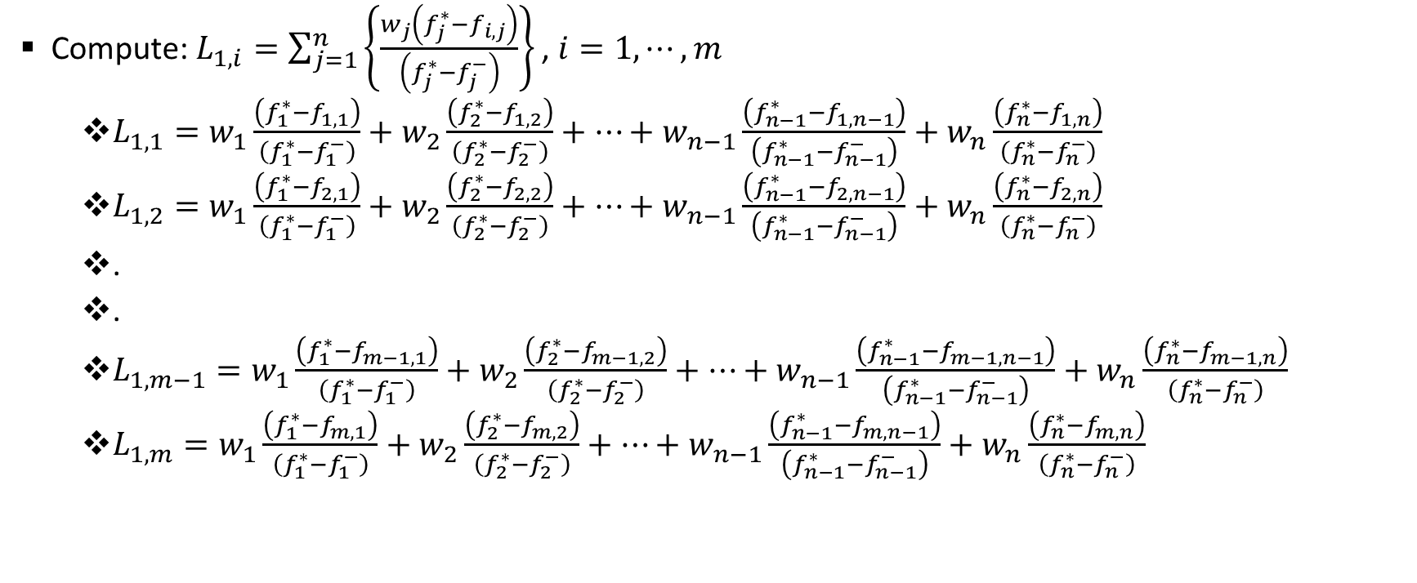

VIKOR: Step # 04 (Determine the relative ratios based on $L_{1}$ norm utilizing maximum/best and minimum/worst ratios)
Compute:$L_{1,i}=\sum_{j=1}^{n}{\left\{\frac{w_{j}\left(f_{j}^{∗}−f_{i,j}\right)}{\left(f_{j}^{∗}−f_{j}^{−}\right)}\right\}}$ , $i=1,⋯,m$
  $L_{1,1}=w_{1}\frac{\left(f_{1}^{∗}−f_{1,1}\right)}{\left(f_{1}^{∗}−f_{1}^{−}\right)}+w_{2}\frac{\left(f_{2}^{∗}−f_{1,2}\right)}{\left(f_{2}^{∗}−f_{2}^{−}\right)}+⋯+w_{n−1}\frac{\left(f_{n−1}^{∗}−f_{1,n−1}\right)}{\left(f_{n−1}^{∗}−f_{n−1}^{−}\right)}+w_{n}\frac{\left(f_{n}^{∗}−f_{1,n}\right)}{\left(f_{n}^{∗}−f_{n}^{−}\right)}$
  $L_{1,2}=w_{1}\frac{\left(f_{1}^{∗}−f_{2,1}\right)}{\left(f_{1}^{∗}−f_{1}^{−}\right)}+w_{2}\frac{\left(f_{2}^{∗}−f_{2,2}\right)}{\left(f_{2}^{∗}−f_{2}^{−}\right)}+⋯+w_{n−1}\frac{\left(f_{n−1}^{∗}−f_{2,n−1}\right)}{\left(f_{n−1}^{∗}−f_{n−1}^{−}\right)}+w_{n}\frac{\left(f_{n}^{∗}−f_{2,n}\right)}{\left(f_{n}^{∗}−f_{n}^{−}\right)}$
  .
  .
  $L_{1,m−1}=w_{1}\frac{\left(f_{1}^{∗}−f_{m−1,1}\right)}{\left(f_{1}^{∗}−f_{1}^{−}\right)}+w_{2}\frac{\left(f_{2}^{∗}−f_{m−1,2}\right)}{\left(f_{2}^{∗}−f_{2}^{−}\right)}+⋯+w_{n−1}\frac{\left(f_{n−1}^{∗}−f_{m−1,n−1}\right)}{\left(f_{n−1}^{∗}−f_{n−1}^{−}\right)}+w_{n}\frac{\left(f_{n}^{∗}−f_{m−1,n}\right)}{\left(f_{n}^{∗}−f_{n}^{−}\right)}$
  $L_{1,m}=w_{1}\frac{\left(f_{1}^{∗}−f_{m,1}\right)}{\left(f_{1}^{∗}−f_{1}^{−}\right)}+w_{2}\frac{\left(f_{2}^{∗}−f_{m,2}\right)}{\left(f_{2}^{∗}−f_{2}^{−}\right)}+⋯+w_{n−1}\frac{\left(f_{n−1}^{∗}−f_{m,n−1}\right)}{\left(f_{n−1}^{∗}−f_{n−1}^{−}\right)}+w_{n}\frac{\left(f_{n}^{∗}−f_{m,n}\right)}{\left(f_{n}^{∗}−f_{n}^{−}\right)}$

Slide 30
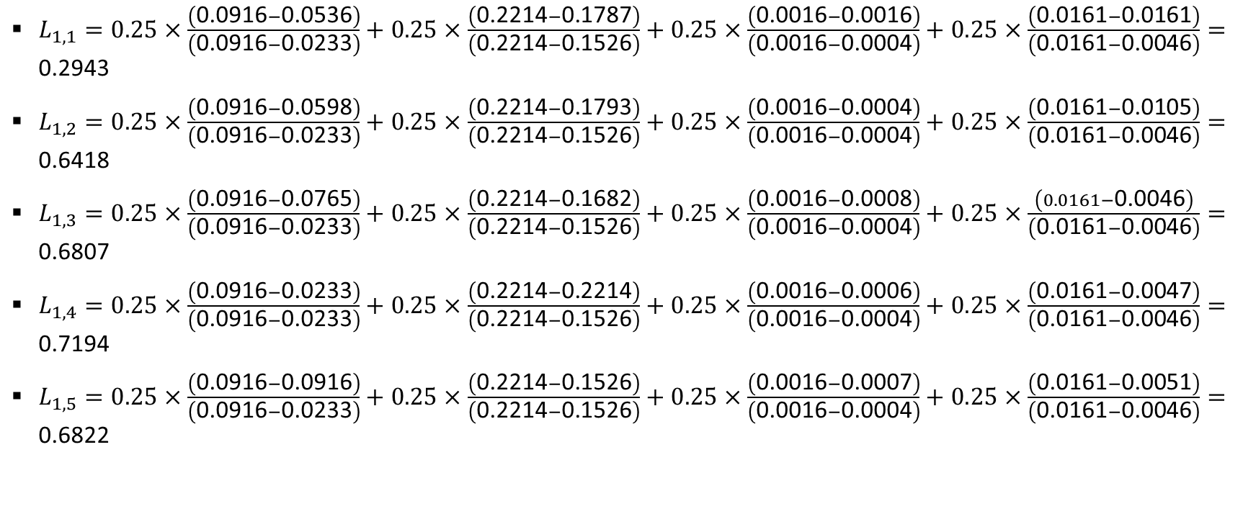
VIKOR: Step # 04 (Determine the relative ratios based on $L_{1}$ norm utilizing maximum/best and minimum/worst ratios)
$L_{1,1}=0.25×\frac{\left(\text{0.0916}−\text{0.0536}\right)}{\left(\text{0.0916}−\text{0.0233}\right)}+0.25×\frac{\left(\text{0.2214}−\text{0.1787}\right)}{\left(\text{0.2214}−\text{0.1526}\right)}+0.25×\frac{\left(\text{0.0016}−\text{0.0016}\right)}{\left(\text{0.0016}−\text{0.0004}\right)}+0.25×\frac{\left(\text{0.0161}−\text{0.0161}\right)}{\left(\text{0.0161}−\text{0.0046}\right)}=\text{0.2943}$
$L_{1,2}=0.25×\frac{\left(\text{0.0916}−\text{0.0598}\right)}{\left(\text{0.0916}−\text{0.0233}\right)}+0.25×\frac{\left(\text{0.2214}−\text{0.1793}\right)}{\left(\text{0.2214}−\text{0.1526}\right)}+0.25×\frac{\left(\text{0.0016}−\text{0.0004}\right)}{\left(\text{0.0016}−\text{0.0004}\right)}+0.25×\frac{\left(\text{0.0161}−\text{0.0105}\right)}{\left(\text{0.0161}−\text{0.0046}\right)}=\text{0.6418}$
$L_{1,3}=0.25×\frac{\left(\text{0.0916}−\text{0.0765}\right)}{\left(\text{0.0916}−\text{0.0233}\right)}+0.25×\frac{\left(\text{0.2214}−\text{0.1682}\right)}{\left(\text{0.2214}−\text{0.1526}\right)}+0.25×\frac{\left(\text{0.0016}−\text{0.0008}\right)}{\left(\text{0.0016}−\text{0.0004}\right)}+0.25×\frac{\left(0.0161−\text{0.0046}\right)}{\left(\text{0.0161}−\text{0.0046}\right)}=\text{0.6807}$
$L_{1,4}=0.25×\frac{\left(\text{0.0916}−\text{0.0233}\right)}{\left(\text{0.0916}−\text{0.0233}\right)}+0.25×\frac{\left(\text{0.2214}−\text{0.2214}\right)}{\left(\text{0.2214}−\text{0.1526}\right)}+0.25×\frac{\left(\text{0.0016}−\text{0.0006}\right)}{\left(\text{0.0016}−\text{0.0004}\right)}+0.25×\frac{\left(\text{0.0161}−\text{0.0047}\right)}{\left(\text{0.0161}−\text{0.0046}\right)}=\text{0.7194}$
$L_{1,5}=0.25×\frac{\left(\text{0.0916}−\text{0.0916}\right)}{\left(\text{0.0916}−\text{0.0233}\right)}+0.25×\frac{\left(\text{0.2214}−\text{0.1526}\right)}{\left(\text{0.2214}−\text{0.1526}\right)}+0.25×\frac{\left(\text{0.0016}−\text{0.0007}\right)}{\left(\text{0.0016}−\text{0.0004}\right)}+0.25×\frac{\left(\text{0.0161}−\text{0.0051}\right)}{\left(\text{0.0161}−\text{0.0046}\right)}=\text{0.6822}$

Slide 31
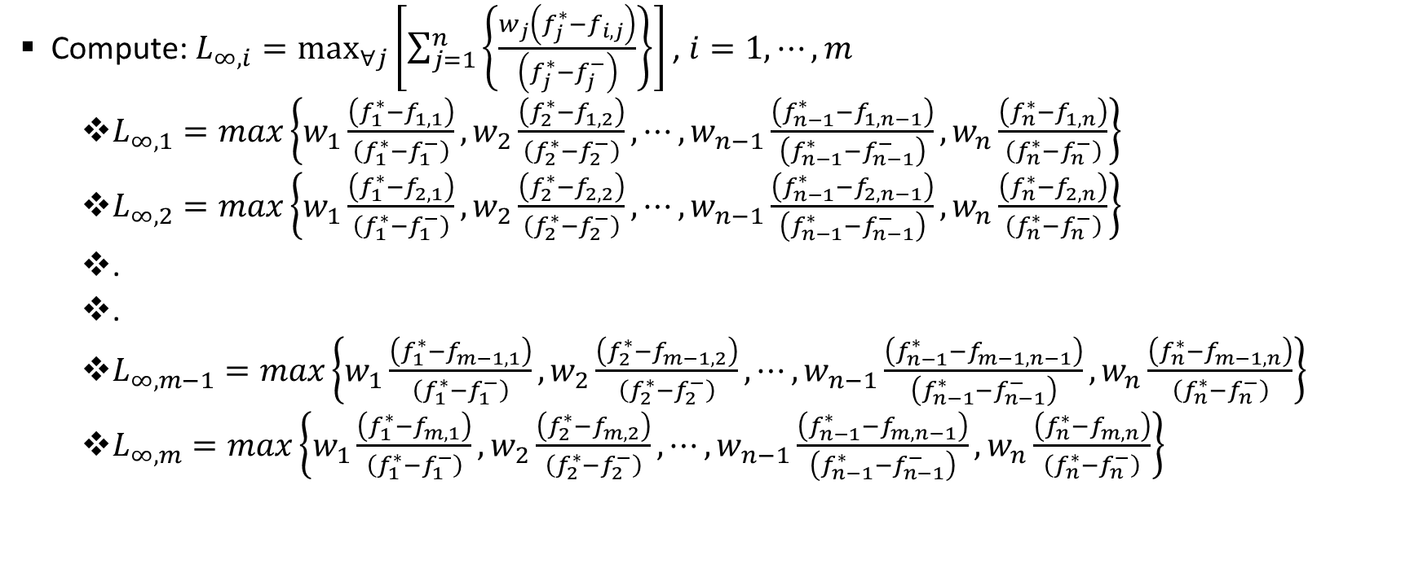

VIKOR: Step # 04 (Determine the relative ratios based on $L_{∞}$ norm utilizing maximum/best and minimum/worst ratios)
Compute:$L_{∞,i}=\max_{∀j}\left[\sum_{j=1}^{n}{\left\{\frac{w_{j}\left(f_{j}^{∗}−f_{i,j}\right)}{\left(f_{j}^{∗}−f_{j}^{−}\right)}\right\}}\right]$ , $i=1,⋯,m$
  $L_{∞,1}=max\left\{w_{1}\frac{\left(f_{1}^{∗}−f_{1,1}\right)}{\left(f_{1}^{∗}−f_{1}^{−}\right)},w_{2}\frac{\left(f_{2}^{∗}−f_{1,2}\right)}{\left(f_{2}^{∗}−f_{2}^{−}\right)},⋯,w_{n−1}\frac{\left(f_{n−1}^{∗}−f_{1,n−1}\right)}{\left(f_{n−1}^{∗}−f_{n−1}^{−}\right)},w_{n}\frac{\left(f_{n}^{∗}−f_{1,n}\right)}{\left(f_{n}^{∗}−f_{n}^{−}\right)}\right\}$
  $L_{∞,2}=max\left\{w_{1}\frac{\left(f_{1}^{∗}−f_{2,1}\right)}{\left(f_{1}^{∗}−f_{1}^{−}\right)},w_{2}\frac{\left(f_{2}^{∗}−f_{2,2}\right)}{\left(f_{2}^{∗}−f_{2}^{−}\right)},⋯,w_{n−1}\frac{\left(f_{n−1}^{∗}−f_{2,n−1}\right)}{\left(f_{n−1}^{∗}−f_{n−1}^{−}\right)},w_{n}\frac{\left(f_{n}^{∗}−f_{2,n}\right)}{\left(f_{n}^{∗}−f_{n}^{−}\right)}\right\}$
  .
  .
  $L_{∞,m−1}=max\left\{w_{1}\frac{\left(f_{1}^{∗}−f_{m−1,1}\right)}{\left(f_{1}^{∗}−f_{1}^{−}\right)},w_{2}\frac{\left(f_{2}^{∗}−f_{m−1,2}\right)}{\left(f_{2}^{∗}−f_{2}^{−}\right)},⋯,w_{n−1}\frac{\left(f_{n−1}^{∗}−f_{m−1,n−1}\right)}{\left(f_{n−1}^{∗}−f_{n−1}^{−}\right)},w_{n}\frac{\left(f_{n}^{∗}−f_{m−1,n}\right)}{\left(f_{n}^{∗}−f_{n}^{−}\right)}\right\}$
  $L_{∞,m}=max\left\{w_{1}\frac{\left(f_{1}^{∗}−f_{m,1}\right)}{\left(f_{1}^{∗}−f_{1}^{−}\right)},w_{2}\frac{\left(f_{2}^{∗}−f_{m,2}\right)}{\left(f_{2}^{∗}−f_{2}^{−}\right)},⋯,w_{n−1}\frac{\left(f_{n−1}^{∗}−f_{m,n−1}\right)}{\left(f_{n−1}^{∗}−f_{n−1}^{−}\right)},w_{n}\frac{\left(f_{n}^{∗}−f_{m,n}\right)}{\left(f_{n}^{∗}−f_{n}^{−}\right)}\right\}$

Slide 32
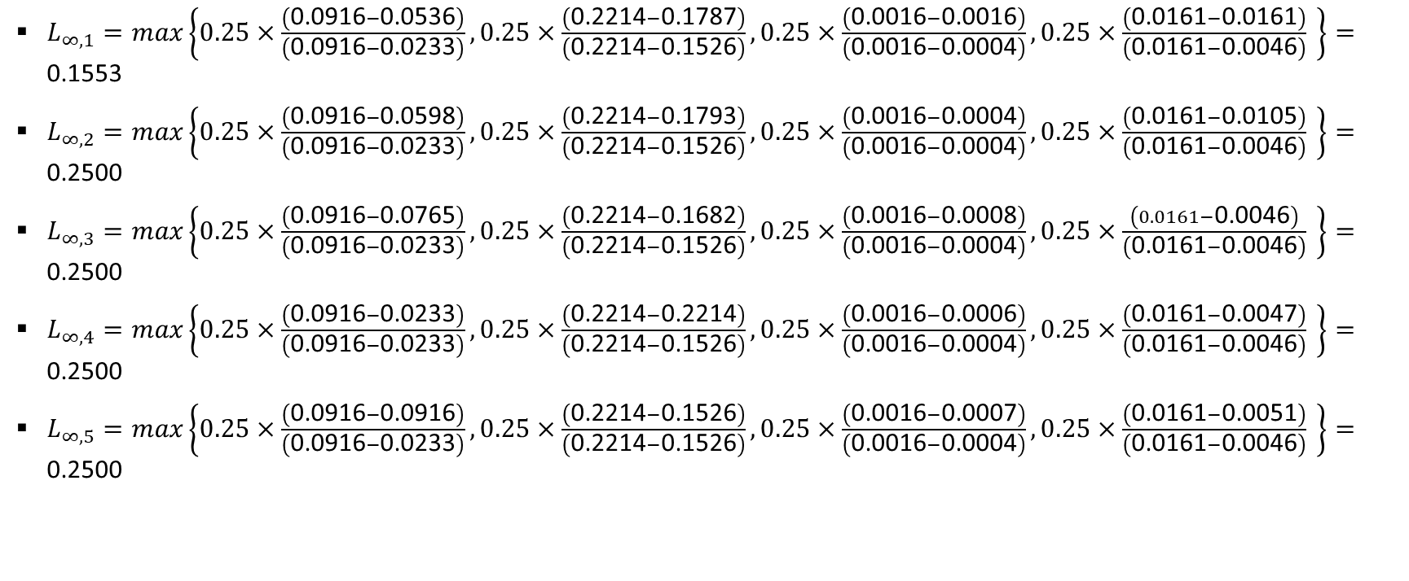
VIKOR: Step # 04 (Determine the relative ratios based on $L_{∞}$ norm utilizing maximum/best and minimum/worst ratios)
$L_{∞,1}=max\left\{0.25×\frac{\left(\text{0.0916}−\text{0.0536}\right)}{\left(\text{0.0916}−\text{0.0233}\right)},0.25×\frac{\left(\text{0.2214}−\text{0.1787}\right)}{\left(\text{0.2214}−\text{0.1526}\right)},0.25×\frac{\left(\text{0.0016}−\text{0.0016}\right)}{\left(\text{0.0016}−\text{0.0004}\right)},0.25×\frac{\left(\text{0.0161}−\text{0.0161}\right)}{\left(\text{0.0161}−\text{0.0046}\right)} \right\}=\text{0.1553}$
$L_{∞,2}=max\left\{0.25×\frac{\left(\text{0.0916}−\text{0.0598}\right)}{\left(\text{0.0916}−\text{0.0233}\right)},0.25×\frac{\left(\text{0.2214}−\text{0.1793}\right)}{\left(\text{0.2214}−\text{0.1526}\right)},0.25×\frac{\left(\text{0.0016}−\text{0.0004}\right)}{\left(\text{0.0016}−\text{0.0004}\right)},0.25×\frac{\left(\text{0.0161}−\text{0.0105}\right)}{\left(\text{0.0161}−\text{0.0046}\right)} \right\}=\text{0.2500}$
$L_{∞,3}=max\left\{0.25×\frac{\left(\text{0.0916}−\text{0.0765}\right)}{\left(\text{0.0916}−\text{0.0233}\right)},0.25×\frac{\left(\text{0.2214}−\text{0.1682}\right)}{\left(\text{0.2214}−\text{0.1526}\right)},0.25×\frac{\left(\text{0.0016}−\text{0.0008}\right)}{\left(\text{0.0016}−\text{0.0004}\right)},0.25×\frac{\left(0.0161−\text{0.0046}\right)}{\left(\text{0.0161}−\text{0.0046}\right)} \right\}=\text{0.2500}$
$L_{∞,4}=max\left\{0.25×\frac{\left(\text{0.0916}−\text{0.0233}\right)}{\left(\text{0.0916}−\text{0.0233}\right)},0.25×\frac{\left(\text{0.2214}−\text{0.2214}\right)}{\left(\text{0.2214}−\text{0.1526}\right)},0.25×\frac{\left(\text{0.0016}−\text{0.0006}\right)}{\left(\text{0.0016}−\text{0.0004}\right)},0.25×\frac{\left(\text{0.0161}−\text{0.0047}\right)}{\left(\text{0.0161}−\text{0.0046}\right)} \right\}=\text{0.2500}$
$L_{∞,5}=max\left\{0.25×\frac{\left(\text{0.0916}−\text{0.0916}\right)}{\left(\text{0.0916}−\text{0.0233}\right)},0.25×\frac{\left(\text{0.2214}−\text{0.1526}\right)}{\left(\text{0.2214}−\text{0.1526}\right)},0.25×\frac{\left(\text{0.0016}−\text{0.0007}\right)}{\left(\text{0.0016}−\text{0.0004}\right)},0.25×\frac{\left(\text{0.0161}−\text{0.0051}\right)}{\left(\text{0.0161}−\text{0.0046}\right)} \right\}=\text{0.2500}$

Slide 33
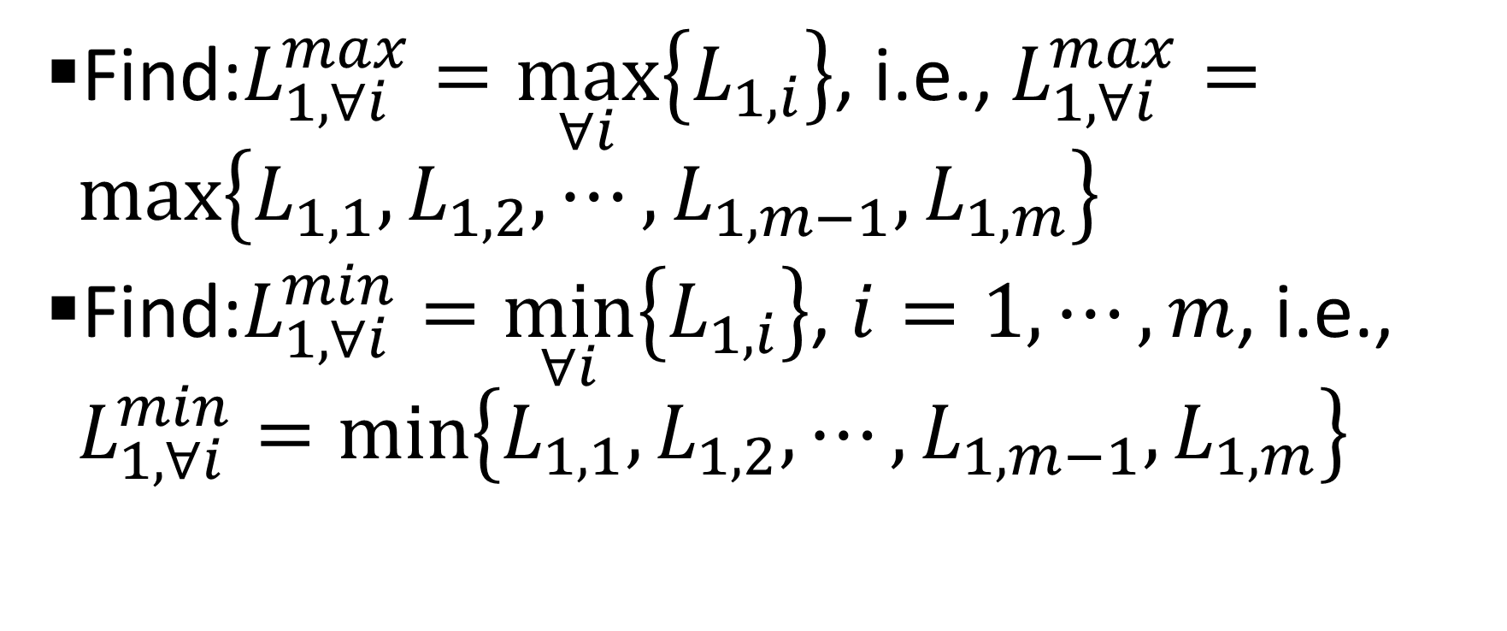

VIKOR: Step # 05 (Determine the maximum/minimum based on $L_{1}$ norm)
Find:$L_{1,∀i}^{max}=\max_{∀i}\left\{L_{1,i}\right\}$, i.e., $L_{1,∀i}^{max}=max\left\{L_{1,1},L_{1,2},⋯,L_{1,m−1},L_{1,m}\right\}$
Find:$L_{1,∀i}^{min}=\min_{∀i}\left\{L_{1,i}\right\}$, $i=1,⋯,m$, i.e., $L_{1,∀i}^{min}=min\left\{L_{1,1},L_{1,2},⋯,L_{1,m−1},L_{1,m}\right\}$

Slide 34
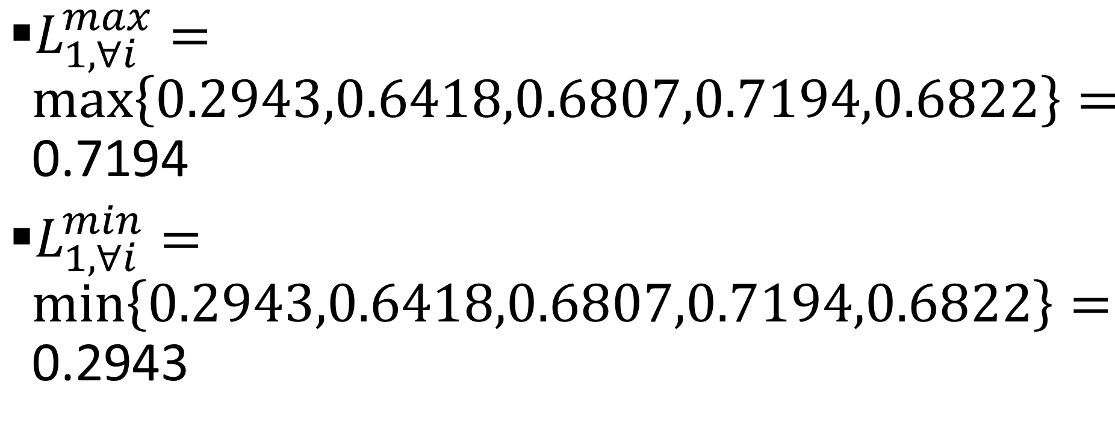
VIKOR: Step # 05 (Determine the maximum/minimum based on $L_{1}$ norm)
$L_{1,∀i}^{max}=max\left\{0.2943,0.6418,0.6807,0.7194,0.6822\right\}=\text{0.7194}$
$L_{1,∀i}^{min}=min\left\{0.2943,0.6418,0.6807,0.7194,0.6822\right\}=\text{0.2943}$

Slide 35
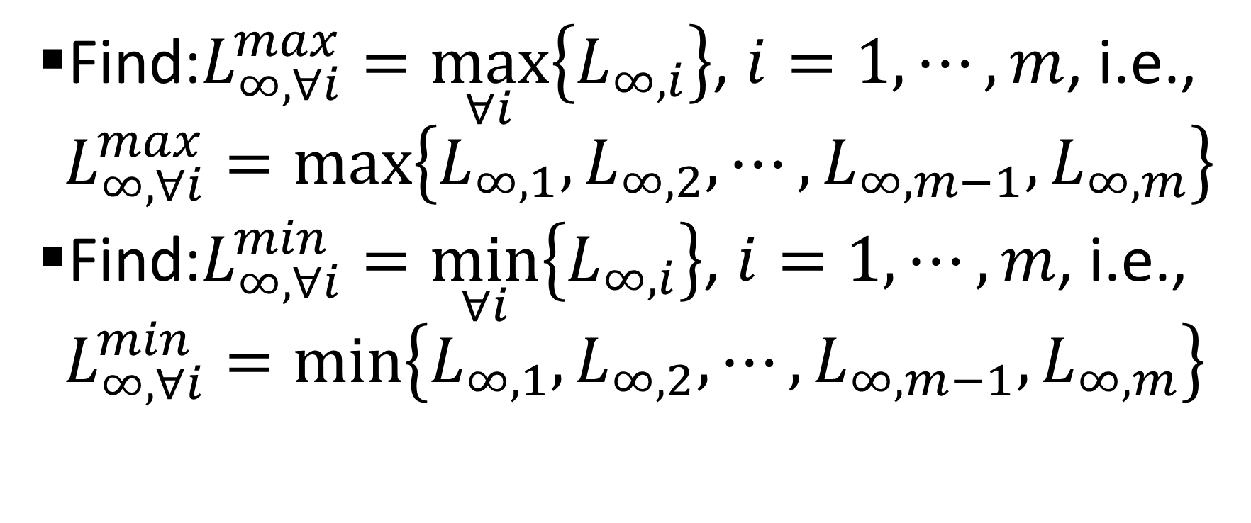

VIKOR: Step # 05 (Determine the maximum/minimum based on $L_{∞}$ norm)
Find:$L_{∞,∀i}^{max}=\max_{∀i}\left\{L_{∞,i}\right\}$, $i=1,⋯,m$, i.e., $L_{∞,∀i}^{max}=max\left\{L_{∞,1},L_{∞,2},⋯,L_{∞,m−1},L_{∞,m}\right\}$
Find:$L_{∞,∀i}^{min}=\min_{∀i}\left\{L_{∞,i}\right\}$, $i=1,⋯,m$, i.e., $L_{∞,∀i}^{min}=min\left\{L_{∞,1},L_{∞,2},⋯,L_{∞,m−1},L_{∞,m}\right\}$

Slide 36
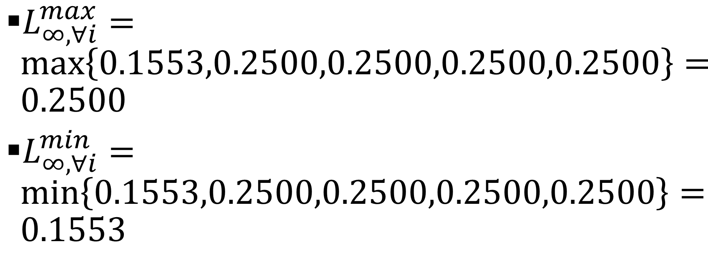
VIKOR: Step # 05 (Determine the maximum/minimum based on $L_{∞}$ norm)
$L_{∞,∀i}^{max}=max\left\{0.1553,0.2500,0.2500,0.2500,0.2500\right\}=0.2500$
$L_{∞,∀i}^{min}=min\left\{0.1553,0.2500,0.2500,0.2500,0.2500\right\}=0.1553$

Slide 37
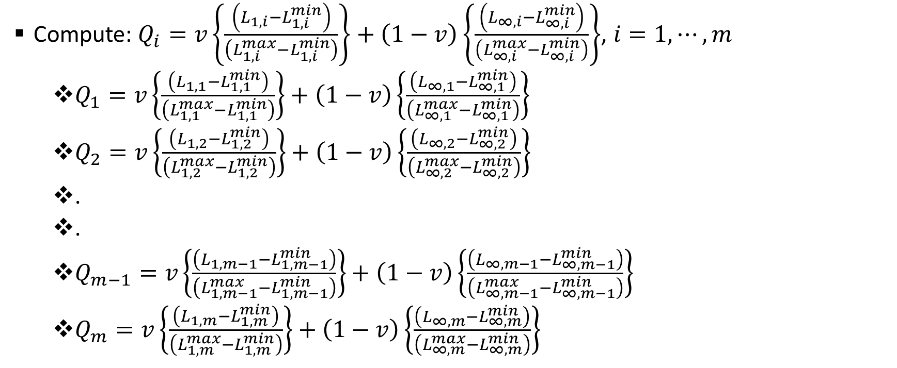
VIKOR: Step # 06 (Calculate relative ranking)
Compute:$Q_{i}=v\left\{\frac{\left(L_{1,i}−L_{1,i}^{min}\right)}{\left(L_{1,i}^{max}−L_{1,i}^{min}\right)}\right\}+\left(1−v\right)\left\{\frac{\left(L_{∞,i}−L_{∞,i}^{min}\right)}{\left(L_{∞,i}^{max}−L_{∞,i}^{min}\right)}\right\}$, $i=1,⋯,m$
  $Q_{1}=v\left\{\frac{\left(L_{1,1}−L_{1,1}^{min}\right)}{\left(L_{1,1}^{max}−L_{1,1}^{min}\right)}\right\}+\left(1−v\right)\left\{\frac{\left(L_{∞,1}−L_{∞,1}^{min}\right)}{\left(L_{∞,1}^{max}−L_{∞,1}^{min}\right)}\right\}$
  $Q_{2}=v\left\{\frac{\left(L_{1,2}−L_{1,2}^{min}\right)}{\left(L_{1,2}^{max}−L_{1,2}^{min}\right)}\right\}+\left(1−v\right)\left\{\frac{\left(L_{∞,2}−L_{∞,2}^{min}\right)}{\left(L_{∞,2}^{max}−L_{∞,2}^{min}\right)}\right\}$
  .
  .
  $Q_{m−1}=v\left\{\frac{\left(L_{1,m−1}−L_{1,m−1}^{min}\right)}{\left(L_{1,m−1}^{max}−L_{1,m−1}^{min}\right)}\right\}+\left(1−v\right)\left\{\frac{\left(L_{∞,m−1}−L_{∞,m−1}^{min}\right)}{\left(L_{∞,m−1}^{max}−L_{∞,m−1}^{min}\right)}\right\}$
  $Q_{m}=v\left\{\frac{\left(L_{1,m}−L_{1,m}^{min}\right)}{\left(L_{1,m}^{max}−L_{1,m}^{min}\right)}\right\}+\left(1−v\right)\left\{\frac{\left(L_{∞,m}−L_{∞,m}^{min}\right)}{\left(L_{∞,m}^{max}−L_{∞,m}^{min}\right)}\right\}$

Slide 38
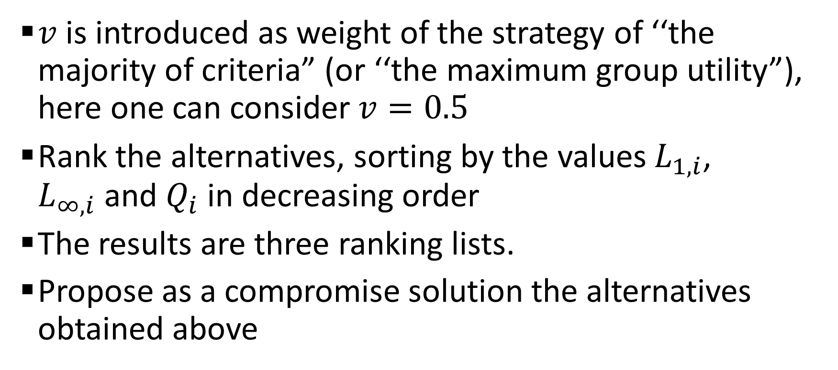
VIKOR: Step # 06 (Calculate relative ranking)
$v$ is introduced as weight of the strategy of ‘‘the majority of criteria” (or ‘‘the maximum group utility”), here one can consider $v=0.5$
Rank the alternatives, sorting by the values $L_{1,i}$, $L_{∞,i}$and $Q_{i}$ in decreasing order
The results are three ranking lists.
Propose as a compromise solution the alternatives obtained above

